Slide 1
Artificial Intelligence in Pediatric Radiology
Joseph Rich, Dr. Amit Sura
September 23, 2026
1 / 61

Slide 2
Objectives
Describe the big players in radiology AI, both general and pediatric, since 2023
Summarize what radiology AI does well and what remains unresolved
2 / 61

Slide 3
Methods
Academic output. PubMed (E-utilities) yearly counts per query and per modality/task term group, plus preprints (OpenAlex type:preprint: arXiv, medRxiv, bioRxiv, …) counted with the same queries, because PubMed does not index arXiv (4,426 radiology-AI preprints in 2025). Most-cited papers from OpenAlex (union of modality/task searches, deduped, articles and preprints): one list for 2008-2022, then one per year from 2023, each showing raw citations and the field-weighted citation impact (FWCI, 1 = world average for that field and year), so recent papers are not buried under 2023 ones. Venues: Semantic Scholar venue search (NeurIPS, ICLR, ICML, CVPR, MICCAI, MIDL) and OpenAlex journal filters (RSNA, SPR), 2023–present; PatentsView for granted patents.
Systematic review. Separately from the counts, every pediatric radiology-AI record from 2005 onward was retrieved from PubMed/MEDLINE and Embase, screened against prespecified criteria, and read into a structured row under a fixed schema (3,496 included primary studies). This is the corpus behind the review section, the paper database, and the manuscript; slides that name individual studies rank them by citation impact normalized to the field and year.
Clinical problems. The pediatric radiology-AI query AND a term group per problem (bone age, fracture, pneumonia, appendicitis, brain tumor, …), counted per era; a paper can name several problems.
Datasets. Public pediatric imaging datasets, sizes verified against the primary papers or hosting pages.
Commercial players. The FDA AI-enabled device list (public spreadsheet: decision date, device, company, lead panel), filtered to the Radiology panel; cross-checked against a curated list of products with pediatric indications.
Trade press. Newsletter archives (The Imaging Wire, RSNA News, ESR/ECR, TLDR, Signify Research, Radiology Business) split into stories; a story is radiology-AI when AI terms co-occur with imaging terms, pediatric when pediatric terms also co-occur; a story's outbound publisher link is resolved to a DOI and cited (OpenAlex).
Pediatric filter. PubMed: the radiology-AI query AND (pediatric* OR paediatric* OR child* OR infant* OR neonat* OR adolescen* OR “children's hospital”). Most-cited lists: the title must also carry a pediatric term (bone age, fetal, newborn, …), otherwise highly cited adult papers float in. Newsletters: pediatric term inside the same story.
Representative PubMed query (radiology ∩ AI):
(radiology OR radiograph* OR “medical imaging” OR MRI OR “computed tomography” OR CT[tiab] OR ultrasound[tiab] … NOT (“optical coherence” OR fundus OR dental OR histopatholog* …)) AND (“artificial intelligence” OR “deep learning” OR “convolutional neural network” OR radiomics …)
3 / 61

Slide 4
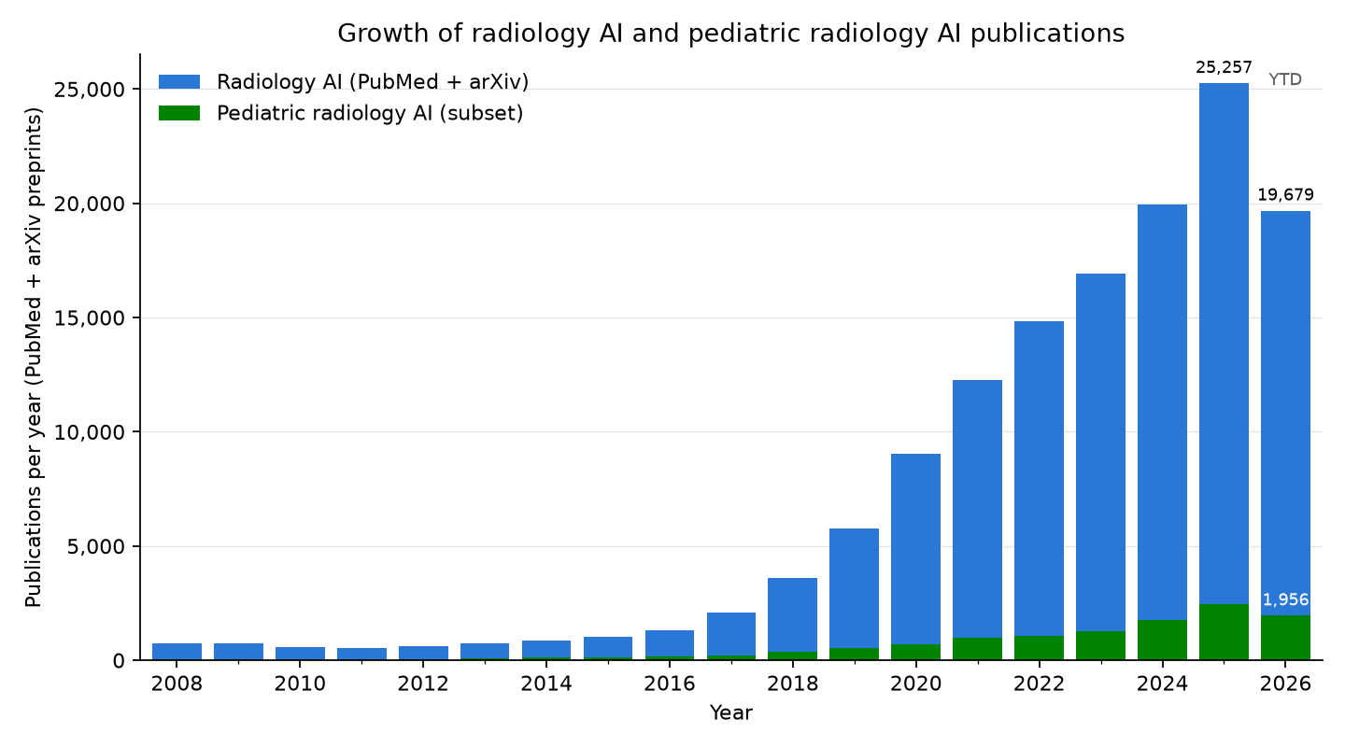
Radiology AI publication counts
4 / 61

Slide 5
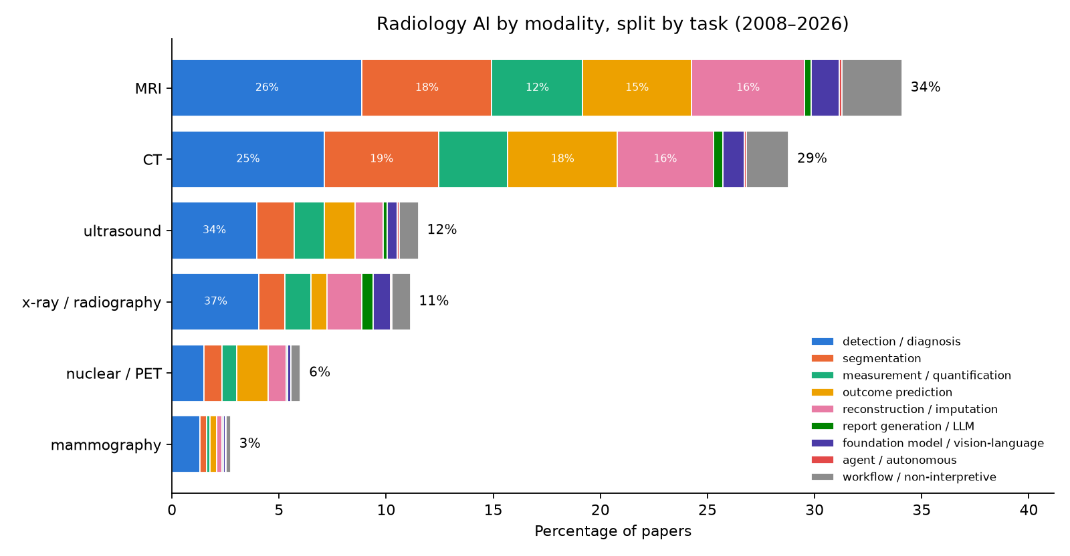
Radiology AI publications, stratified by modality and task
Bar = percentage of radiology-AI papers (123,413 = 98,842 PubMed + 24,571 preprints, 2008–present) whose title/abstract names the modality; segments = which task terms those papers use (overlapping). What each task means, by what the model produces:
detection / diagnosis: is a finding present now, and which one (label or box): fracture, pneumonia, tumor; includes triage and screening
segmentation: outline a structure or lesion (a mask)
measurement / quantification: a number from the image: bone age, Cobb angle, organ volume, fetal biometry
outcome prediction: a future risk, response, or survival estimate from the image (prognosis, radiomics signatures)
reconstruction / imputation: a better or missing image: lower dose, faster scans, denoising, synthetic CT/MR
report generation / LLM: text: draft, summarize, or extract from radiology reports
foundation model / vision-language: a large pretrained model reused across tasks (segment-anything, self-supervised)
agent / autonomous: multi-step actions taken without a human in the loop
workflow / non-interpretive: protocoling, scheduling, ordering, decision support, education
5 / 61

Slide 6
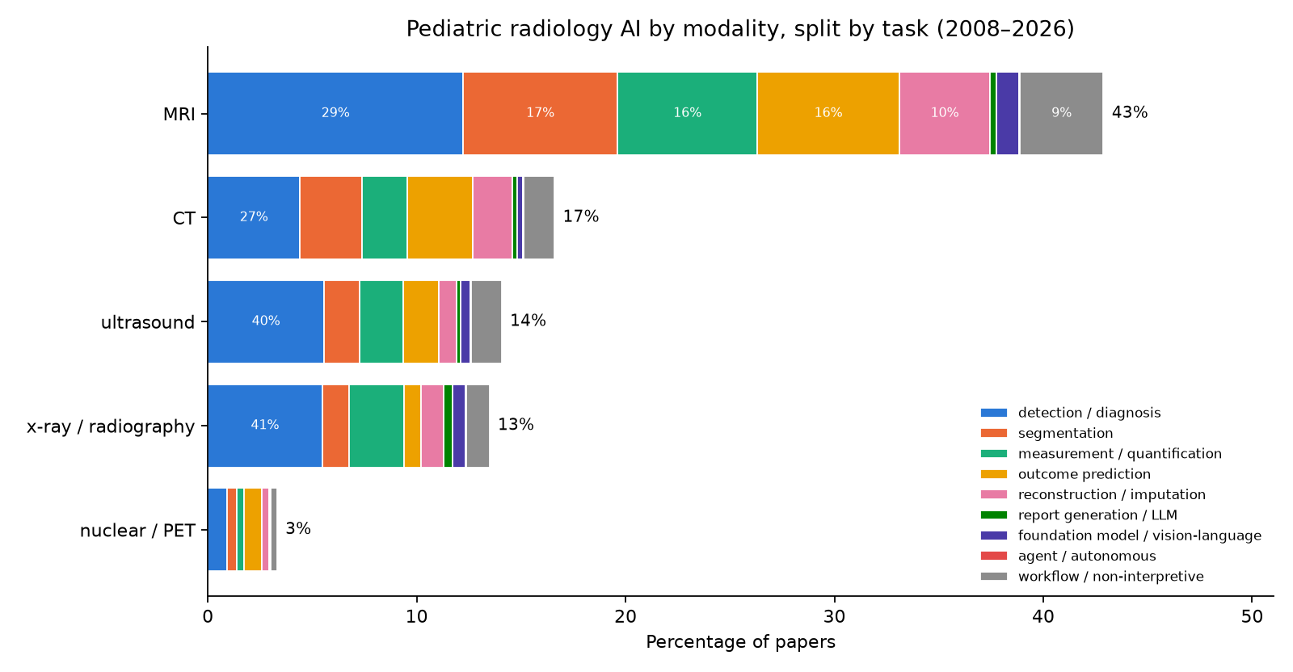
Pediatric radiology AI publications, stratified by modality and task
Same construction, restricted to the pediatric subset (10,620 papers incl. 479 preprints). Top pediatric modalities: MRI 41%, CT 16%, ultrasound 13%, x-ray / radiography 13%. Mammography is omitted: its 79 pediatric-query hits (of 10,620) are adult breast-imaging papers whose abstracts mention children.
detection / diagnosis: is a finding present now, and which one (label or box): fracture, pneumonia, tumor; includes triage and screening
segmentation: outline a structure or lesion (a mask)
measurement / quantification: a number from the image: bone age, Cobb angle, organ volume, fetal biometry
outcome prediction: a future risk, response, or survival estimate from the image (prognosis, radiomics signatures)
reconstruction / imputation: a better or missing image: lower dose, faster scans, denoising, synthetic CT/MR
report generation / LLM: text: draft, summarize, or extract from radiology reports
foundation model / vision-language: a large pretrained model reused across tasks (segment-anything, self-supervised)
agent / autonomous: multi-step actions taken without a human in the loop
workflow / non-interpretive: protocoling, scheduling, ordering, decision support, education
6 / 61

Slide 7
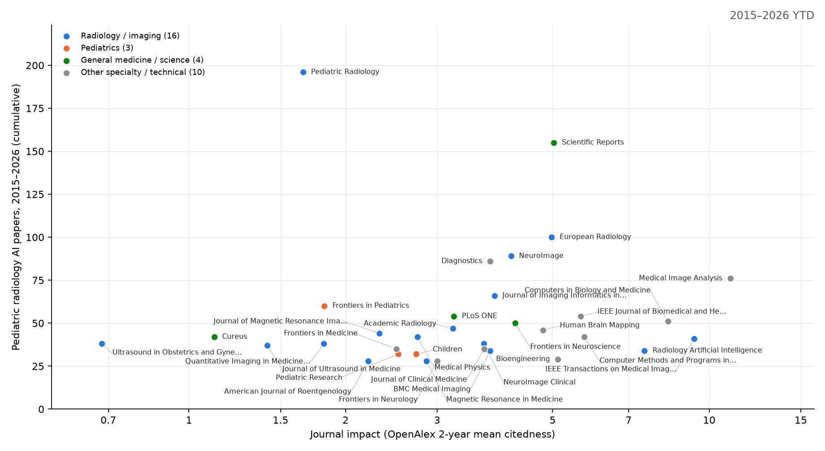
Which journals publish pediatric radiology AI
x = OpenAlex 2-year mean citedness (a free JIF analogue; runs below the published JIF). y = cumulative pediatric radiology-AI papers 2015-2026 (PubMed, strict title/abstract query). The 33 journals with at least 25 of them are shown, carrying 1,807 of 5,099; the rest is a long tail. Largest: Pediatric Radiology (196); median impact 3.7, 1 at 10 or above – this work lands mostly in mid-impact specialty and technical journals. A further 3 conference proceedings and preprint servers clear the threshold (94 papers) but have no impact number of any kind and are not plotted. The same chart animated year by year: figures/journal_impact.gif.
7 / 61

Slide 8
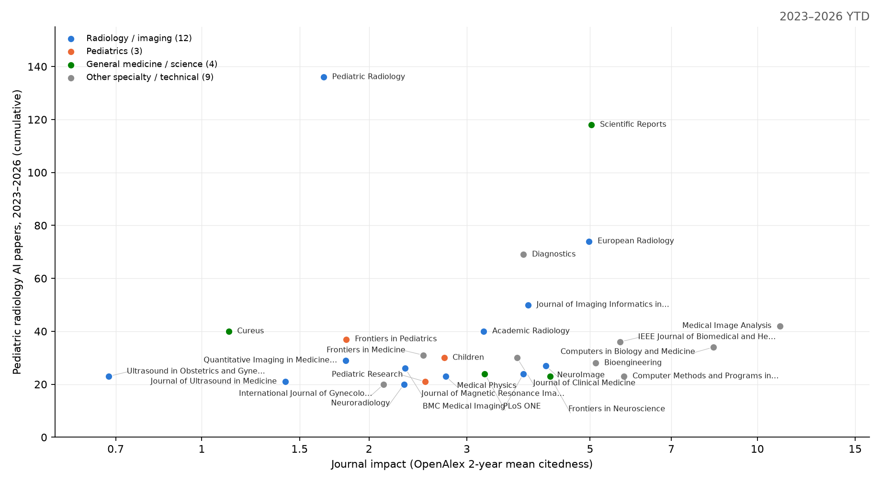
Which journals publish pediatric radiology AI, 2023–present
x = OpenAlex 2-year mean citedness (a free JIF analogue; runs below the published JIF). y = cumulative pediatric radiology-AI papers 2023-2026 (PubMed, strict title/abstract query). The 28 journals with at least 20 of them are shown, carrying 1,099 of 3,340; the rest is a long tail. Largest: Pediatric Radiology (136); median impact 3.2, 1 at 10 or above – this work lands mostly in mid-impact specialty and technical journals. medRxiv clears the threshold (31 papers) but has no impact number of any kind, so it is not plotted.
8 / 61

Slide 9
Cross-check: an independent 2025 scoping review of pediatric radiology AI
Kamran et al., Pediatric Radiology 2025 (doi 10.1007/s00247-025-06462-5): 789 original pediatric-focused articles hand-screened from four databases, 2005 to August 2024. Our PubMed counts are larger because they include any paper that mentions a pediatric term.
Modality: radiography 38%, MRI 33%, ultrasound 14%, CT 11%, nuclear 2%. Our pediatric query ranks MRI first (MRI 41%, CT 16%, ultrasound 13%, x-ray / radiography 13%) because MRI-heavy neurodevelopment papers mention children.
Subspecialty: musculoskeletal 33%, neuro 29%, chest 17%, body 14%, cardiac 6%.
Top applications: bone age (88 articles), pneumonia (65), brain tumors (54), scoliosis (45), hip dysplasia (28), congenital heart disease (25), autism (18), epilepsy (14), ADHD (9), hydrocephalus (9).
Use of AI: 91% image interpretation / diagnosis; 5.6% image quality; under 2% for acquisition, communication, protocoling, education, and policy combined.
Data: 65% used a single local hospital dataset; 7% did not report the dataset; China 28%, USA 25%, Canada 7% of articles.
Growth: 23 articles in 2018, 158 in 2022, 171 in 2023, consistent with our PubMed curve.
Recommendations: multi-institutional, age-diverse pediatric datasets; CLAIM-style reporting with subgroup results and calibration; funding for the neglected non-interpretive areas (policy, education, implementation); children and families as stakeholders across the AI lifecycle.
What it adds to this deck: the same three leading tasks (bone age, pneumonia, brain tumor) and the same gap (small local datasets, adult tools applied to children) reached by a manual review.
9 / 61

Slide 10
Reading the whole pediatric literature, not a sample of it
Counting publications says how much is being published; it does not say what was built, for which children, or how well it was tested. So every pediatric radiology-AI record from 2005 onward was retrieved from PubMed/MEDLINE and Embase, screened against prespecified criteria, and read into a structured row — model, modality, body region, age group, task, dataset size, data source, validation, availability — under one fixed schema.
6,995 records retrieved, 393 conference proceedings set aside, 6,602 screened, 2,650 off-topic and 456 non-primary removed, 3,496 primary studies included (PubMed 3,122, Embase 365, OpenAlex 9).
Embase earns its place: 365 of the included studies are not in PubMed at all. They have no PMID, so no NIH relative citation ratio; ranking them at all is why the impact column below is OpenAlex's field-weighted score.
Conference proceedings are retrieved and reported but not screened: an abstract cannot support a judgement about study design, and it carries no DOI linking it to the later full paper.
Screening and extraction were done by a constrained model under a fixed schema, with a blinded second-model re-screen of 150 records (94.7% agreement, kappa = 0.885). Dual-human validation is outstanding.
The same corpus is the paper database (reports/04_paper_database.md) and the systematic review manuscript, so the three never disagree.
10 / 61

Slide 11
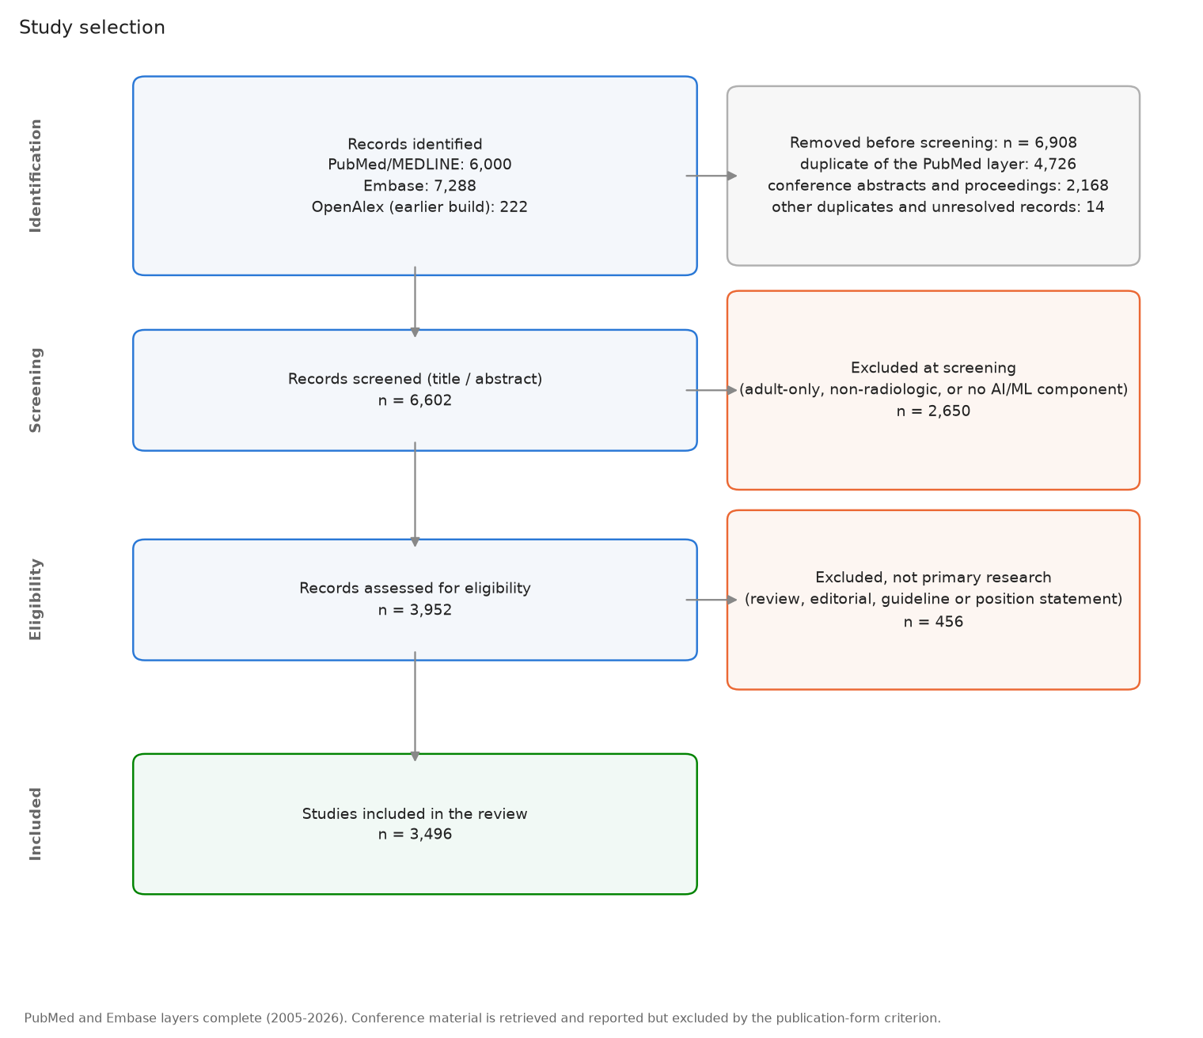
Study selection
11 / 61

Slide 12
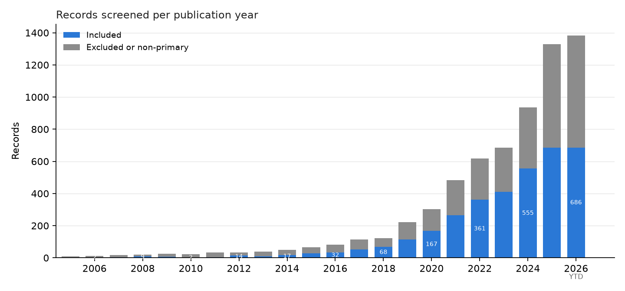
Included studies per publication year
Blue = the 3,496 included primary studies; gray = records read and then excluded as off-topic or non-primary. 2025+ is year to date and still being indexed.
12 / 61

Slide 13
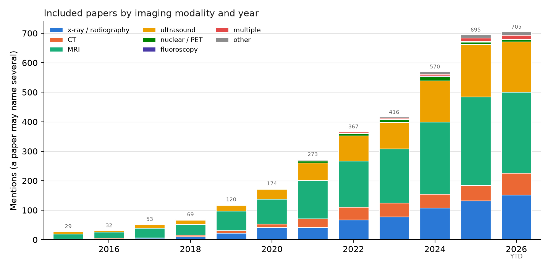
What the pediatric literature is made of
Modality: MRI 46%, ultrasound 24%, x-ray / radiography 19%, CT 9%. Task: detection / diagnosis 38%, measurement / quantification 24%, outcome prediction 20%, segmentation 19%. Age group: child 37%, adolescent 25%, fetal 22%, infant 15%. Categories are multilabel, so an axis can exceed 100%. MRI leads on the strength of the fetal and developmental-neuroscience literature: remove the MRI studies that use cognitive-neuroscience methods or report cognitive and behavioral outcomes and MRI falls level with ultrasound (30% each), which is why reviews built on narrower vocabulary rank radiography or ultrasound first.
13 / 61

Slide 14
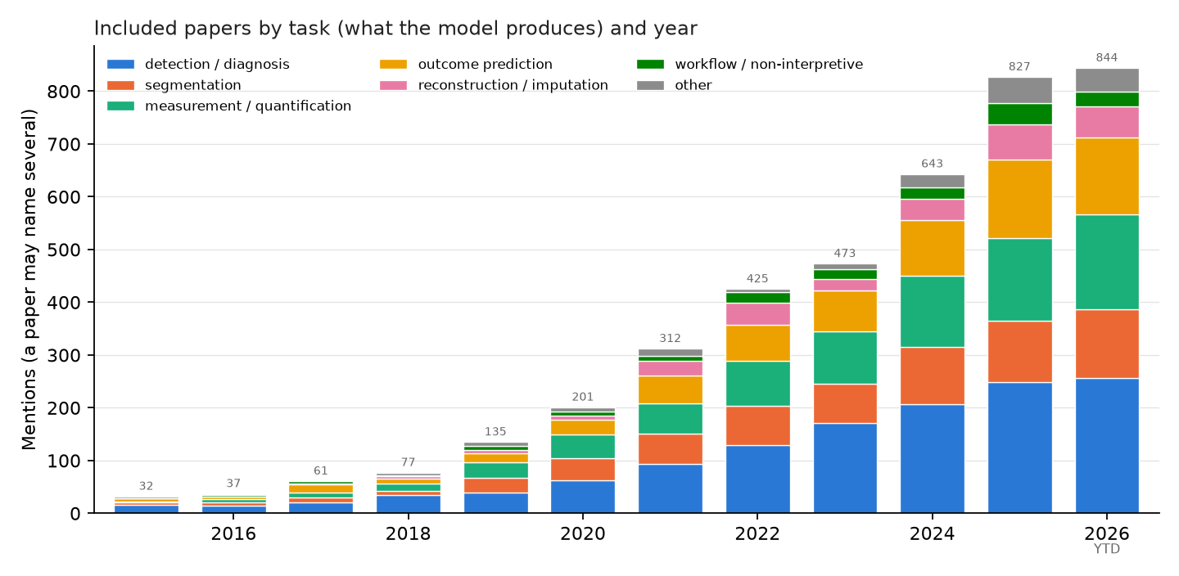
What the models produce
14 / 61

Slide 15
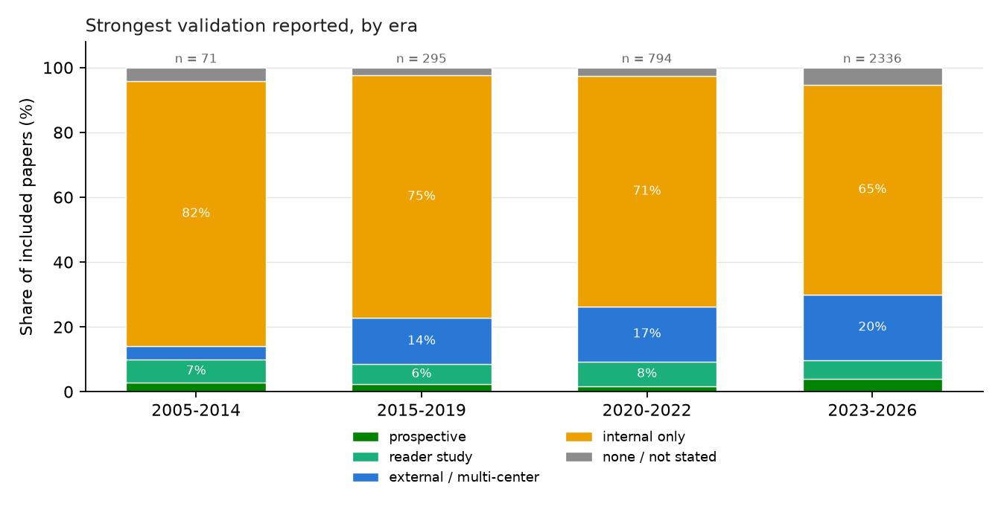
How well is it tested?
Of 3,496 included studies, external or multi-center validation was reported by 18.7%, a reader study by 6.2%, prospective evaluation by 3.3%, and a working code or model URL by 92 studies. External validation rose across eras; reader studies did not.
15 / 61

Slide 16
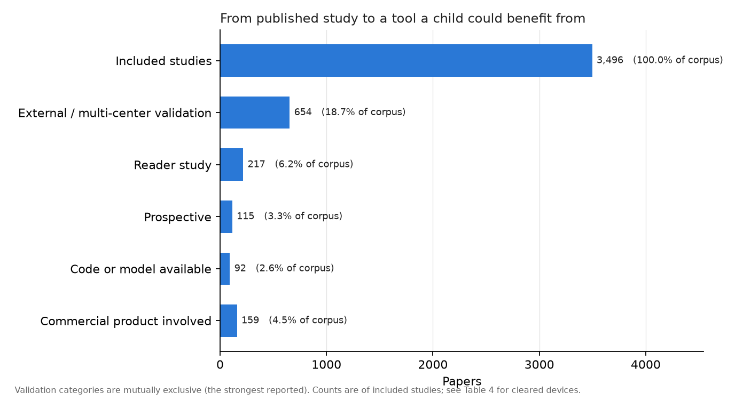
From published study to a tool a child benefits from
16 / 61

Slide 17
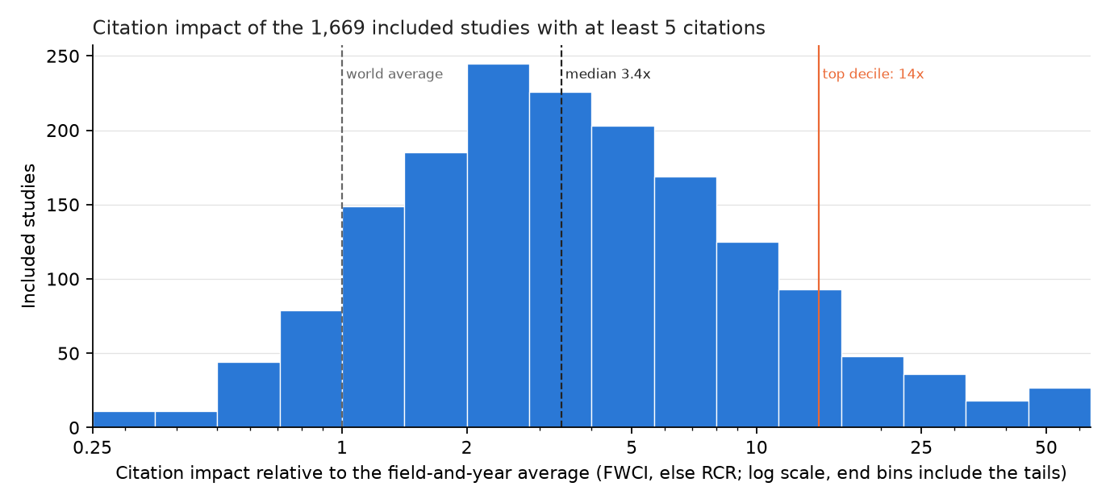
Which of these studies is the field actually reading?
The median included study is cited 3.38 times the world average for its field and year: this is a well-cited literature, not a neglected one.
1,669 of 3,496 studies (47.7%) have enough citations to be ranked; the rest are too recent.
The top decile is the 167 studies at 14x average and up (PubMed 158, Embase 6, OpenAlex 3).
Selecting on citations does not select for rigor: external or multi-center validation is 22.8% in that decile against 18.7% across the corpus, and two thirds of it is still internal validation only.
17 / 61

Slide 18
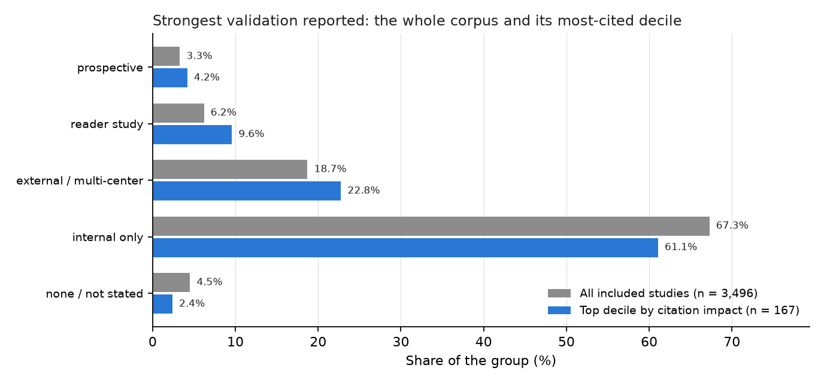
Does citation impact pick out the better-validated work?
The most-cited decile is somewhat more likely to report external validation and a reader study, but the difference is small: citations track topic and audience more than evidence.
18 / 61

Slide 19
Highest-impact pediatric radiology AI studies, 2005–2026
Impact | Cites | Year | Study | Venue | What it does
329x | 273 | 2018 | Performance of a Deep-Learning Neural Network Model in Assessing Skelet... | Radiology | skeletal maturity (bone age) assessment in the workup of endo...
325x | 219 | 2017 | Fully Automated Deep Learning System for Bone Age Assessment. | Journal of digital imaging | skeletal maturity (bone age) assessment in endocrine and meta...
293x | 1,757 | 2018 | Identifying Medical Diagnoses and Treatable Diseases by Image-Based Dee... | Cell | pediatric pneumonia on chest radiographs, and bacterial vs vi...
221x | 167 | 2017 | Deep learning for automated skeletal bone age assessment in X-ray image... | Medical image analysis | skeletal maturity (bone age) assessment in endocrine, genetic...
200x | 321 | 2016 | Automatic Segmentation of MR Brain Images With a Convolutional Neural N... | IEEE transactions on medi... | automatic brain tissue segmentation for quantitative MRI anal...
93x | 269 | 2021 | CA-Net | IEEE transactions on medi... | segmenting the placenta and fetal brain on fetal MRI
83x | 701 | 2019 | Attention Gate (Attention U-Net) | Medical image analysis | identifying the correct standard views during fetal ultrasoun...
73x | 112 | 2017 | Computerized Bone Age Estimation Using Deep Learning Based Program: Eva... | AJR. American journal of... | bone age estimation, and whether software assistance makes ra...
71x | 78 | 2019 | Artificial intelligence-assisted interpretation of bone age radiographs... | Skeletal radiology | whether AI assistance makes pediatric radiologists better at...
Impact = citations relative to the average paper of the same field and year (OpenAlex FWCI; iCite RCR where OpenAlex has none), shown once a study has 5 citations. dagger Embase-only; ast preprint.
19 / 61

Slide 20
Highest-impact pediatric radiology AI studies, 2023
Impact | Cites | Study | Venue | What it does
69x | 106 | iBEAT V2.0 | Nature protocols | measuring cortical development in infants, whose brain MRI de...
37x | 20 | Bone Age Assessment Using Artificial Intelligence in Korean Pediatric P... | Korean journal of radiolo... | whether bone age in a given population should be predicted ag...
34x | 9 | Bone age assessment based on deep neural networks with annotation-free... | Frontiers in artificial i... | automated bone age assessment from hand radiographs without m...
30x | 39 | FeTA | Medical image analysis | segmenting the developing fetal brain into tissues, the step...
28x | 20 | Deep focus approach for accurate bone age estimation from lateral cepha... | Journal of dental sciences | estimating skeletal maturity from the lateral cephalogram a g...
27x | 11 | Bone Age Estimation and Prediction of Final Adult Height Using Deep Lea... | Yonsei medical journal | automatically estimating bone age and predicting final adult...
26x | 21 | Detection of ASD Children through Deep-Learning Application of fMRI. | Children (Basel, Switzerl... | early detection of autism spectrum disorder in children, wher...
26x | 14 | High performance for bone age estimation with an artificial intelligenc... | Diagnostic and interventi... | How does an AI solution for bone age assessment compare in ac...
25x | 49 | Automated classification of common maternal fetal ultrasound planes usi... dagger | Biomedical Signal Process... | automated identification of standard fetal ultrasound planes...
410 studies included from 2023; 289 have enough citations to be ranked. Impact = citations relative to the average paper of the same field and year (OpenAlex FWCI; iCite RCR where OpenAlex has none), shown once a study has 5 citations. dagger Embase-only; ast preprint.
20 / 61

Slide 21
Highest-impact pediatric radiology AI studies, 2024
Impact | Cites | Study | Venue | What it does
29x | 16 | Automated bone age assessment in a German pediatric cohort: agreement b... | European radiology | whether a bone age product can be swapped in for an expert re...
29x | 16 | A Dempster-Shafer Approach to Trustworthy AI With Application to Fetal... | IEEE transactions on patt... | detecting and correcting failures in automated fetal brain MR...
26x | 12 | HFSCCD: A Hybrid Neural Network for Fetal Standard Cardiac Cycle Detect... | IEEE journal of biomedica... | Automatically detecting standard cardiac cycle frames in feta...
24x | 5 | Assessment of Bone Age Based on Hand Radiographs Using Regression-Based... | Life (Basel, Switzerland) | estimating bone age from hand radiographs
24x | 17 | FetalBrainAwareNet | Computerized medical imag... | Synthesizing anatomically accurate fetal head standard-plane...
24x | 16 | On the use of contrastive learning for standard-plane classification in... | Computers in biology and... | automated identification of standard imaging planes in fetal...
22x | 12 | Transformer based multi-modal MRI fusion for prediction of post-menstru... | Medical image analysis | Estimating post-menstrual age and assessing brain maturity fr...
21x | 9 | TW3 AI bone age assessment system | Quantitative imaging in m... | validating an AI system for Tanner-Whitehouse 3 bone age asse...
20x | 11 | Artificial intelligence assisted common maternal fetal planes predictio... | Frontiers in medicine | automatically classifying standard maternal-fetal ultrasound...
555 studies included from 2024; 264 have enough citations to be ranked.
21 / 61

Slide 22
Highest-impact pediatric radiology AI studies, 2025
Impact | Cites | Study | Venue | What it does
54x | 10 | ChatGPT-o4-mini-high, ChatGPT-4.5, Gemini 2.5 Pro | Academic radiology | whether a general-purpose chatbot can substitute for dedicate...
52x | 34 | Prediction of mental health risk in adolescents. | Nature medicine | predicting future risk of general psychiatric illness in adol...
32x | 13 | BoneXpert, PANDA, BoneView | European radiology | which of the bone age products approved for the European mark...
29x | 10 | Whole examination AI estimation of fetal biometrics from 20-week ultras... | NPJ digital medicine | fetal biometry currently rests on a handful of frames a sonog...
29x | 8 | Uncovering ethical biases in publicly available fetal ultrasound datase... | NPJ digital medicine | whether publicly available fetal ultrasound image datasets us...
28x | 13 | Scanner-based real-time three-dimensional brain + body slice-to-volume... | Pediatric radiology | motion-corrected 3D fetal MRI has stayed a research technique...
26x | 21 | Predicting pediatric patient rehabilitation outcomes after spinal defor... | Communications medicine | telling an adolescent before scoliosis surgery how they are l...
24x | 10 | Three-dimensional markerless surface topography approach with convoluti... | Scientific reports | screening adolescents for scoliosis without the unnecessary r...
23x | 5 | Advancing prenatal healthcare by explainable AI enhanced fetal ultrasou... | Scientific reports | automated, explainable segmentation of fetal ultrasound image...
685 studies included from 2025; 118 have enough citations to be ranked.
22 / 61

Slide 23
Highest-impact pediatric radiology AI studies, 2026 (year to date)
Impact | Cites | Study | Venue | What it does
46x | 7 | Infants have rich visual categories in ventrotemporal cortex at 2 month... | Nature neuroscience | characterizing the development of visual category representat...
14x | 6 | Perceived Racism, Brain Development, and Internalizing and Externalizin... | Journal of the American A... | assessing effects of perceived racial discrimination on longi...
6x | 5 | Use of Artificial Intelligence-Based Software to Aid in the Identificat... | Obstetrics and gynecology | evaluating whether AI-based software improves ob-gyn and mate...
5x | 5 | Artificial Intelligence for the Detection of Fetal Ultrasound Findings... | Obstetrics and gynecology | identifying second-trimester fetal ultrasound findings suspic...
4x | 14 | G-YOLOv11 dagger | Biomedical Signal Process... | fracture detection on pediatric wrist radiographs
4x | 8 | Machine Learning Algorithms for Predicting Cobb Angle Beyond 25° in Fem... | Spine | predicting which female adolescents with idiopathic scoliosis...
3x | 5 | Motion-Echo | European heart journal | automating myocardial strain analysis from pediatric echocard...
3x | 8 | Safe for kids? AI medical devices in radiology overlook paediatric suit... | European radiology | whether the AI devices a European radiology department can bu...
3x | 9 | GPT-4.1 | European archives of oto-... | detecting and lateralizing pediatric airway foreign body aspi...
686 studies included from 2026; 12 have enough citations to be ranked. Few studies from this year have enough citations for a normalized value yet, so this table is thin by construction rather than because the year was quiet.
23 / 61

Slide 24
The biggest public pediatric radiology AI datasets
Dataset | Year | Modality | Size | Ages | Access
CBTN clinical MRI (Children's Brain Tumor Network) | 2023 | brain / spine tumor MRI | 23,101 exams (1,526 patients); tumor masks for 370 | pediatric | application (NCI CCDI)
GRAZPEDWRI-DX | 2022 | wrist radiographs (trauma) | 20,327 images (6,091 patients) | 0.2–19 y | open
RSNA Pediatric Bone Age Challenge | 2017 | hand radiographs | 14,236 images (bone age + sex) | mean 10.6 y | open (RSNA terms)
FETAL_PLANES_DB | 2020 | fetal ultrasound (standard planes) | 12,400 images (1,792 pregnancies) | fetal | open
ABCD Study | 2018– | brain MRI, longitudinal | 11,878 participants, up to 7 follow-ups | 9–10 y at baseline | application (NBDC)
PediCXR / VinDr-PCXR | 2023 | chest radiographs | 9,125 studies; 36 findings, 15 diagnoses | 10 y | credentialed (PhysioNet)
Guangzhou pediatric chest X-ray (Kermany) | 2018 | chest radiographs | 5,856 images (normal / bacterial / viral pneumonia) | 1–5 y | open
ABIDE I + II (autism) | 2012 / 2016 | brain MRI (structural, resting fMRI) | 2,156 subjects | 5–64 y (mostly children) | open
Regensburg Pediatric Appendicitis | 2023 | abdominal ultrasound + labs | 1,709 images (579 patients) | 0–18 y | open
dHCP (Developing Human Connectome Project) | 2022–24 | neonatal + fetal brain MRI | 886 neonatal + 297 fetal datasets, with segmentations | 20–45 weeks | open (NDA)
Pediatric-CT-SEG (TCIA) | 2022 | chest / abdomen / pelvis CT | 718 series (359 patients); 29 organ contours | 5 days – 16 y | open
BraTS-PEDs (pediatric brain tumor challenge) | 2023–25 | brain tumor MRI | 464 patients (2024 challenge); 1,649 series on TCIA | pediatric | registration / TCIA
FeTA (fetal brain tissue annotation) | 2021–24 | fetal brain MRI | 280 volumes (120 train + 160 test); 7 tissue labels | 18–35 weeks | registration
Sizes verified against the primary paper or hosting page (2026-09). Only two pediatric radiograph sets exceed 10,000 images; the largest public pediatric-only CT set has 359 patients; no RSNA pediatric challenge has run since bone age in 2017. Adult benchmarks (CheXpert 224k, MIMIC-CXR 377k) exclude children.
24 / 61

Slide 25
Most-cited radiology AI papers, 2008-2022
Cites | FWCI | Paper | Venue | What it answers
14,326 | 1023.0 | A survey on deep learning in medical image analysis (2017) | Medical Image Anal. | survey: What can deep learning do across medical imaging? (the field's reference surv...
5,658 | 446.6 | Swin-Unet: Unet-like Pure Transformer for Medical Image Segmentation (2021) | ECCV Workshops | segmentation
2,990 | 340.4 | Deep Learning in Medical Image Analysis (2017) | Annual Review of Biomedical... | survey: How does deep learning apply to medical image analysis? (review)
2,553 | 290.0 | Swin UNETR: Swin Transformers for Semantic Segmentation of Brain Tumors in MR... (2022) | BrainLes@MICCAI | segmentation
2,769 | 272.4 | COVID-Net: a tailored deep convolutional neural network design for detection... (2020) | Scientific Reports | classification: Can a CNN detect COVID-19 on chest X-ray? (COVID-Net)
3,634 | 236.9 | ChestX-Ray8: Hospital-Scale Chest X-Ray Database and Benchmarks on Weakly-Sup... (2017) | Computer Vision and Pattern... | classification
10,044 | 226.3 | nnU-Net: a self-configuring method for deep learning-based biomedical image s... (2020) | Nature Methods | segmentation: Can one self-configuring method segment any organ or lesion without hand tuni...
4,100 | 170.2 | Convolutional neural networks: an overview and application in radiology (2018) | Insights into Imaging | tutorial: What is a convolutional neural network, explained for radiologists?
5,587 | 158.4 | Computational Radiomics System to Decode the Radiographic Phenotype (2017) | Cancer Research | radiomics: Can standardized image features (radiomics) be extracted reproducibly? (PyRad...
3,322 | 149.0 | Artificial intelligence in radiology (2018) | Nature Reviews. Cancer | review: How will AI change radiology practice? (Hosny et al.)
Rows are the most-cited papers of the period, ordered by FWCI = field-weighted citation impact (OpenAlex): citations relative to the world average for papers of the same field and year (1 = average), so a recent paper can be compared with an older one. Preprints (arXiv, medRxiv) are included; the venue column names the server.
25 / 61

Slide 26
Most-cited radiology AI papers, 2023
Cites | FWCI | Paper | Venue | What it answers
1,608 | 615.8 | Segment anything in medical images | Nature Communications | foundation: Can a prompt-based 'segment anything' model work on medical images? (MedSAM)
2,099 | 243.8 | Foundation models for generalist medical artificial intelligence | Nature | foundation model: What would a single generalist medical AI model that handles images, text and...
702 | 118.5 | Redefining Radiology: A Review of Artificial Intelligence Integration in Medi... | Diagnostics | survey / review: Where does AI fit in radiology workflow, from acquisition to reporting? (revi...
509 | 75.2 | Medical image analysis using deep learning algorithms | Frontiers in Public Health | other
562 | 74.5 | A Study of CNN and Transfer Learning in Medical Imaging: Advantages, Challeng... | Sustainability | other
861 | 69.6 | Segment Anything Model for medical image analysis: an experimental study | Medical Image Anal. | segmentation: How well does the unmodified Segment Anything Model work on medical images? (...
573 | 55.8 | MRI-based brain tumor detection using convolutional deep learning methods and... | BMC Medical Informatics and... | oncology
460 | 44.5 | Brain Tumor Detection Based on Deep Learning Approaches and Magnetic Resonanc... | Cancers | oncology
391 | 42.2 | SAM-Adapter: Adapting Segment Anything in Underperformed Scenes | 2023 IEEE/CVF International... | segmentation
442 | 37.4 | A generalist vision–language foundation model for diverse biomedical tasks | Nature Medicine | other
Rows are the most-cited papers of the period, ordered by FWCI = field-weighted citation impact (OpenAlex): citations relative to the world average for papers of the same field and year (1 = average), so a recent paper can be compared with an older one. Preprints (arXiv, medRxiv) are included; the venue column names the server. 1 of the 10 rows are preprints.
26 / 61

Slide 27
Most-cited radiology AI papers, 2024
Cites | FWCI | Paper | Venue | What it answers
1,074 | 225.2 | VM-UNet: Vision Mamba UNet for Medical Image Segmentation | ACM Transactions on Multime... | segmentation: Does a state-space (Mamba) backbone beat convolutions and transformers for me...
242 | 110.3 | Generalist foundation models from a multimodal dataset for 3D computed tomogr... | Nature Biomedical Engineeri... | other
282 | 74.6 | Artificial intelligence in neuro-oncology: advances and challenges in brain t... | npj Precision Oncology | oncology
279 | 72.6 | METhodological RadiomICs Score (METRICS): a quality scoring tool for radiomic... | Insights into Imaging | radiomics: How should the quality of a radiomics study be scored? (METRICS checklist)
349 | 47.6 | Deep learning for medical image segmentation: State-of-the-art advancements a... | Informatics in Medicine Unl... | segmentation
317 | 43.4 | Advances in Medical Image Segmentation: A Comprehensive Review of Traditional... | Bioengineering | segmentation
238 | 37.0 | Employing deep learning and transfer learning for accurate brain tumor detect... | Scientific Reports | oncology
242 | 36.0 | Deep semi-supervised learning for medical image segmentation: A review | Expert systems with applica... | segmentation
241 | 34.5 | A review of deep learning-based information fusion techniques for multimodal... | Comput. Biol. Medicine | survey / review
298 | 31.8 | Vision-language models for medical report generation and visual question answ... | Frontiers Artif. Intell. | report generation / LLM: What can vision-language models do for report generation and visual question...
27 / 61

Slide 28
Most-cited radiology AI papers, 2025
Cites | FWCI | Paper | Venue | What it answers
258 | 225.8 | Deep Convolutional Neural Networks in Medical Image Analysis: A Review | Inf. | survey / review
145 | 158.8 | Multi-model assurance analysis showing large language models are highly vulne... | Communications Medicine | LLM / reports
122 | 108.2 | Multimodal generative AI for medical image interpretation | Nature | other
313 | 94.9 | Towards generalist foundation model for radiology by leveraging web-scale 2D&... | Nature Communications | foundation model: Can a radiology foundation model trained on web-scale 2D and 3D scans general...
173 | 87.2 | Development and validation of an autonomous artificial intelligence agent for... | Nature Cancer | agent / autonomous: Can an autonomous LLM agent that calls imaging and other tools support oncolo...
208 | 65.9 | A review of deep learning for brain tumor analysis in MRI | npj Precision Oncology | survey / review
150 | 65.8 | Med-R1: Reinforcement Learning for Generalizable Medical Reasoning in Vision-... | IEEE Transactions on Medica... | LLM / reports
233 | 64.6 | Artificial intelligence in healthcare and medicine: clinical applications, th... | European Journal of Medical... | other
151 | 54.0 | Medical Image Segmentation: A Comprehensive Review of Deep Learning-Based Met... | Tomography | segmentation
118 | 39.5 | Advanced Brain Tumor Classification in MR Images Using Transfer Learning and... | Cancers | oncology
1 of the 10 rows are preprints.
28 / 61

Slide 29
Most-cited radiology AI papers, 2026 (year to date)
Cites | FWCI | Paper | Venue | What it answers
48 | 102.6 | A generalizable foundation model for analysis of human brain MRI | Nature Neuroscience | other
16 | 90.5 | Reporting checklist for foundation and large language models in medical resea... | Diagnostic and Intervention... | LLM / reports
15 | 76.1 | Scaling medical AI across clinical contexts | Nature Medicine | foundation model: How can medical AI be scaled across hospitals, populations and tasks without...
27 | 67.3 | Applications and limitations of large language models to integrate medical co... | Iran Journal of Computer Sc... | survey / review
18 | 62.7 | A hybrid deep learning framework based on VGG19 and U-Net for accurate brain... | Magnetic Resonance Letters | segmentation
37 | 58.8 | Explainable artificial intelligence (XAI) in medical imaging: a systematic re... | BMC Medical Imaging | survey / review: Which explainability methods are used in medical imaging AI and do they help?...
12 | 45.3 | Explainable AI-driven MRI-based brain tumor classification: a novel deep lear... | Frontiers Artif. Intell. | oncology
21 | 44.2 | Agentic AI in Radiology: Evolution from Large Language Models to Future Clini... | Radiology: Artificial Intel... | agent / autonomous: What are agentic AI systems in radiology and what stands between them and cli...
17 | 28.4 | Leveraging multi-modal foundation models for analysing spatial multi-omic and... | Nature Biomedical Engineeri... | other
19 | 21.4 | BIBSNet: A deep learning baby image brain segmentation network for MRI scans | Developmental Cognitive Neu... | segmentation: Can one network segment infant brain MRI across the first years of life? (BIB...
Citations for the current year are still accumulating; the FWCI column is the more stable signal here. 1 of the 10 rows are preprints.
29 / 61

Slide 30
Most-cited pediatric radiology AI papers, 2008-2022
Cites | FWCI | Paper | Venue | What it answers
426 | 328.6 | Performance of a Deep-Learning Neural Network Model in Assessing Skeletal Mat... (2017) | Radiology | bone age: Can a CNN assess skeletal maturity as accurately as radiologists?
431 | 321.5 | Fully Automated Deep Learning System for Bone Age Assessment (2017) | Journal of digital imaging | bone age: Fully automated bone age from hand radiographs
403 | 221.2 | Deep learning for automated skeletal bone age assessment in X-ray images (2017) | Medical Image Anal. | bone age: Deep learning for automated bone age (BoNet)
143 | 73.0 | Computerized Bone Age Estimation Using Deep Learning Based Program: Evaluatio... (2017) | AJR. American journal of ro... | bone age: Is a commercial deep-learning bone-age program accurate and faster in practic...
191 | 57.8 | A Review on Deep-Learning Algorithms for Fetal Ultrasound-Image Analysis (2022) | Medical Image Anal. | survey / review
352 | 57.4 | Standard Plane Localization in Fetal Ultrasound via Domain Transferred Deep N... (2015) | IEEE journal of biomedical... | fetal MRI
194 | 57.0 | Automatic Fetal Ultrasound Standard Plane Recognition Based on Deep Learning... (2021) | IEEE Transactions on Indust... | fetal MRI
233 | 30.3 | Evaluation of deep convolutional neural networks for automatic classification... (2020) | Scientific Reports | fetal MRI
458 | 27.0 | The RSNA Pediatric Bone Age Machine Learning Challenge. (2019) | Radiology | bone age: How well can crowdsourced AI estimate bone age? (RSNA challenge, 260 teams)
253 | 25.8 | An ensemble of neural networks provides expert-level prenatal detection of co... (2021) | Nature Medicine | detection
A different corpus from the systematic-review tables earlier in the deck: this is a citation search of Semantic Scholar over radiology AI with a pediatric title filter, so it includes conference papers and is not screened for eligibility. The review tables rank the screened corpus. Both are shown because neither contains the other.
30 / 61

Slide 31
Most-cited pediatric radiology AI papers, 2023
Cites | FWCI | Paper | Venue | What it answers
32 | 36.6 | Bone Age Assessment Using Artificial Intelligence in Korean Pediatric Populat... | Korean Journal of Radiology | bone age
62 | 33.6 | Standard fetal ultrasound plane classification based on stacked ensemble of d... | Expert systems with applica... | fetal ultrasound: Can an ensemble of networks classify the standard fetal ultrasound planes?
27 | 33.5 | Bone age assessment based on deep neural networks with annotation-free cascad... | Frontiers in Artificial Int... | bone age
43 | 23.8 | Review on deep learning fetal brain segmentation from Magnetic Resonance imag... | Artif. Intell. Medicine | segmentation
37 | 20.2 | Transfer learning for accurate fetal organ classification from ultrasound ima... | Scientific Reports | fetal MRI
34 | 16.6 | Deep Learning-Based Multiclass Brain Tissue Segmentation in Fetal MRIs | Italian National Conference... | segmentation
43 | 9.7 | Deeplasia: deep learning for bone age assessment validated on skeletal dyspla... | Pediatric Radiology | bone age
30 | 7.8 | Deep learning for estimation of fetal weight throughout the pregnancy from fe... | American Journal of Obstetr... | fetal MRI
38 | 7.3 | Deep learning model for prenatal congenital heart disease (CHD) screening can... | Ultrasound in Obstetrics an... | fetal ultrasound: Does a prenatal congenital heart disease screening model work on retrospectiv...
31 | 5.8 | MRI-Based End-To-End Pediatric Low-Grade Glioma Segmentation and Classificati... | Canadian Association of Rad... | segmentation
Rows are the most-cited papers of the period, ordered by FWCI = field-weighted citation impact (OpenAlex): citations relative to the world average for papers of the same field and year (1 = average), so a recent paper can be compared with an older one. Preprints (arXiv, medRxiv) are included; the venue column names the server. 1 of the 10 rows are preprints.
31 / 61

Slide 32
Most-cited pediatric radiology AI papers, 2024
Cites | FWCI | Paper | Venue | What it answers
17 | 34.8 | Intrapartum Ultrasound Image Segmentation of Pubic Symphysis and Fetal Head U... | International Conference on... | segmentation
30 | 23.8 | FetalBrainAwareNet: Bridging GANs with anatomical insight for fetal ultrasoun... | Comput. Medical Imaging Gra... | fetal MRI
20 | 19.5 | Artificial intelligence assisted common maternal fetal planes prediction from... | Frontiers in Medicine | fetal MRI
18 | 15.9 | Deep learning denoising reconstruction for improved image quality in fetal ca... | Frontiers in Cardiovascular... | reconstruction: Does deep-learning denoising improve fetal cardiac cine MRI?
30 | 15.1 | RTSeg-net: A lightweight network for real-time segmentation of fetal head and... | Comput. Biol. Medicine | segmentation
16 | 13.4 | FetSAM: Advanced Segmentation Techniques for Fetal Head Biometrics in Ultraso... | IEEE Open Journal of Engine... | segmentation
23 | 7.0 | Deep learning-based automated lesion segmentation on pediatric focal cortical... | Insights into Imaging | epilepsy: Can focal cortical dysplasia lesions be found automatically on preoperative p...
18 | 5.3 | Integration of a Deep Convolutional Neural Network With Adaptive Channel Weig... | IEEE Transactions on Instru... | fetal MRI
18 | 5.2 | Explainable AI in Deep Learning Based Classification of Fetal Ultrasound Imag... | Procedia Computer Science | fetal MRI
19 | 4.8 | A deep learning framework for identifying and segmenting three vessels in fet... | BioMedical Engineering OnLi... | segmentation
32 / 61

Slide 33
Most-cited pediatric radiology AI papers, 2025
Cites | FWCI | Paper | Venue | What it answers
16 | 171.3 | A comprehensive review of artificial intelligence - based algorithm towards f... | Artificial Intelligence Rev... | survey / review
18 | 85.1 | M-CNN-RF: A hybrid deep learning model for accurate pediatric skeletal age es... | Alexandria Engineering Jour... | other
20 | 77.0 | Bone Age Assessment Using Various Medical Imaging Techniques Enhanced by Arti... | Diagnostics | bone age
18 | 24.9 | Advancing prenatal healthcare by explainable AI enhanced fetal ultrasound ima... | Scientific Reports | segmentation
12 | 21.8 | FetalMovNet: A Novel Deep Learning Model Based on Attention Mechanism for Fet... | IEEE Access | fetal MRI
11 | 14.5 | Effectiveness and clinical impact of using deep learning for first-trimester... | BMC Pregnancy and Childbirth | fetal MRI
12 | 12.4 | Association between deep learning radiomics based on placental MRI and preecl... | European Journal of Radiolo... | radiomics
16 | 8.7 | Prenatal detection of congenital heart defects using the deep learning-based... | BMJ Open | fetal ultrasound: Can deep learning on prenatal ultrasound video detect congenital heart defect...
11 | 8.6 | Multi-view deep learning framework for the detection of chest X-rays compatib... | Nature Communications | detection
11 | 7.0 | Evaluation of Image Quality and Scan Time Efficiency in Accelerated 3D T1-Wei... | Korean Journal of Radiology | reconstruction
33 / 61

Slide 34
Most-cited pediatric radiology AI papers, 2026 (year to date)
Cites | FWCI | Paper | Venue | What it answers
11 | 34.3 | Artificial intelligence and radiomics for pediatric brain tumor classificatio... | Neuroradiology | oncology: Can AI and radiomics classify pediatric brain tumors and their molecular subt...
5 | 27.9 | Deep learning assessment of fetal brain maturation on 3D ultrasound volumes i... | Ultrasound in Obstetrics an... | fetal ultrasound: Can deep learning grade fetal brain maturation on 3D ultrasound in growth res...
3 | 17.6 | Foundation models in radiology: a primer for pediatric radiologists | Pediatric Radiology | foundation model: What should a pediatric radiologist know about foundation models? (primer)
2 | 17.6 | Deep Learning-Based Multi-Class Pediatric Wrist Fracture Subtype Classificati... | Journal of Imaging | fracture
3 | 17.3 | Current applications and challenges of artificial intelligence applied to dia... | Pediatric Radiology | classification
4 | 13.6 | Data mining in pediatric radiology in the era of artificial intelligence. | Pediatric Radiology | other
2 | 13.2 | Acquisition time/dose reduction in pediatric PET imaging using patch-based de... | EJNMMI Physics | reconstruction: Can pediatric PET use one fifth of the counts with patch-based deep-learning...
2 | 12.6 | Optimizing pediatric chest CT: superior image quality and lower radiation dos... | European Journal of Radiolo... | reconstruction: Can deep-learning reconstruction lower pediatric chest CT dose while improvin...
2 | 12.2 | Enhancing efficiency in pediatric brain tumor segmentation using a pathologic... | Neuro-Oncology Advances | segmentation
3 | 11.7 | Automated bone age assessment in rare pediatric growth disorders: a comparati... | Frontiers in Endocrinology | bone age: Does an open bone-age model hold up in rare growth disorders against several...
Citations for the current year are still accumulating; the FWCI column is the more stable signal here.
34 / 61

Slide 35
NeurIPS: radiology AI works, 2023–2026
Conference on Neural Information Processing Systems. Radiology-AI works found, 2023–2026: 45 (2023: 13, 2024: 12, 2025: 20); 0 pediatric (marked ★).
Year | Cites | FWCI | Paper
2025 | 24 | – | 3D-RAD: A Comprehensive 3D Radiology Med-VQA Dataset with Multi-Temporal Analysis and Diverse Diagnostic Tasks
2025 | 20 | – | Better Tokens for Better 3D: Advancing Vision-Language Modeling in 3D Medical Imaging
2024 | 47 | 2.0 | Touchstone Benchmark: Are We on the Right Way for Evaluating AI Algorithms for Medical Segmentation?
2024 | 26 | 0.9 | Eye-gaze Guided Multi-modal Alignment for Medical Representation Learning
2024 | 25 | 1.2 | Enhancing vision-language models for medical imaging: bridging the 3D gap with innovative slice selection
2024 | 20 | – | DiffusionBlend: Learning 3D Image Prior through Position-aware Diffusion Score Blending for 3D Computed Tomography Reco...
2023 | 144 | – | SegVol: Universal and Interactive Volumetric Medical Image Segmentation
2023 | 104 | – | LVM-Med: Learning Large-Scale Self-Supervised Vision Models for Medical Imaging via Second-order Graph Matching
2023 | 72 | – | EHRXQA: A Multi-Modal Question Answering Dataset for Electronic Health Records with Chest X-ray Images
2023 | 66 | – | SwiFT: Swin 4D fMRI Transformer
2023 | 64 | – | NeuroGraph: Benchmarks for Graph Machine Learning in Brain Connectomics
2023 | 19 | – | Knowledge-based in silico models and dataset for the comparative evaluation of mammography AI for a range of breast cha...
Source: Semantic Scholar venue search, citations and FWCI from OpenAlex; title-level relevance filter; the 12 most-cited of 45 works, newest year first.
35 / 61

Slide 36
ICLR: radiology AI works, 2023–2026
International Conference on Learning Representations. Radiology-AI works found, 2023–2026: 17 (2023: 4, 2024: 5, 2025: 8); 0 pediatric (marked ★).
Year | Cites | FWCI | Paper
2025 | 70 | – | Large-scale and Fine-grained Vision-language Pre-training for Enhanced CT Image Understanding
2025 | 13 | – | SimXRD-4M: Big Simulated X-ray Diffraction Data and Crystal Symmetry Classification Benchmark
2025 | 9 | – | Self-Supervised Diffusion MRI Denoising via Iterative and Stable Refinement
2025 | 9 | – | Score-based Self-supervised MRI Denoising
2024 | 143 | – | MMed-RAG: Versatile Multimodal RAG System for Medical Vision Language Models
2024 | 31 | – | MediConfusion: Can you trust your AI radiologist? Probing the reliability of multimodal medical foundation models
2024 | 19 | – | The Effect of Intrinsic Dataset Properties on Generalization: Unraveling Learning Differences Between Natural and Medic...
2024 | 16 | – | LeFusion: Controllable Pathology Synthesis via Lesion-Focused Diffusion Models
2023 | 107 | – | Advancing Radiograph Representation Learning with Masked Record Modeling
2023 | 84 | – | DDM2: Self-Supervised Diffusion MRI Denoising with Generative Diffusion Models
2023 | 40 | – | AE-FLOW: Autoencoders with Normalizing Flows for Medical Images Anomaly Detection
2023 | 18 | – | Improved Training of Physics-Informed Neural Networks Using Energy-Based Priors: a Study on Electrical Impedance Tomogr...
Source: Semantic Scholar venue search, citations and FWCI from OpenAlex; title-level relevance filter; the 12 most-cited of 17 works, newest year first.
36 / 61

Slide 37
ICML: radiology AI works, 2023–2026
International Conference on Machine Learning. Radiology-AI works found, 2023–2026: 12 (2023: 4, 2024: 2, 2025: 6); 0 pediatric (marked ★).
Year | Cites | FWCI | Paper
2025 | 21 | – | CLIMB: Data Foundations for Large Scale Multimodal Clinical Foundation Models
2025 | 17 | – | MindLLM: A Subject-Agnostic and Versatile Model for fMRI-to-Text Decoding
2025 | 11 | – | Raptor: Scalable Train-Free Embeddings for 3D Medical Volumes Leveraging Pretrained 2D Foundation Models
2025 | 5 | – | Efficient Noise Calculation in Deep Learning-based MRI Reconstructions
2025 | 2 | – | LangDAug: Langevin Data Augmentation for Multi-Source Domain Generalization in Medical Image Segmentation
2025 | 0 | – | Staged and Physics-Grounded Learning Framework with Hyperintensity Prior for Pre-Contrast MRI Synthesis
2024 | 14 | – | Unsupervised Domain Adaptation for Anatomical Structure Detection in Ultrasound Images
2024 | 10 | – | Adaptive Sampling of k-Space in Magnetic Resonance for Rapid Pathology Prediction
2023 | 17 | – | ACAT: Adversarial Counterfactual Attention for Classification and Detection in Medical Imaging
2023 | 16 | – | Robustness of Deep Learning for Accelerated MRI: Benefits of Diverse Training Data
2023 | 15 | – | Learning High-Order Relationships of Brain Regions
2023 | 8 | – | Contextualized Policy Recovery: Modeling and Interpreting Medical Decisions with Adaptive Imitation Learning
Source: Semantic Scholar venue search, citations and FWCI from OpenAlex; title-level relevance filter; the 12 most-cited of 12 works, newest year first.
37 / 61

Slide 38
CVPR: radiology AI works, 2023–2026
IEEE/CVF Conference on Computer Vision and Pattern Recognition. Radiology-AI works found, 2023–2026: 57 (2023: 15, 2024: 24, 2025: 18); 1 pediatric (marked ★).
Year | Cites | FWCI | Paper
2025 | 68 | 265.4 | Enhanced Contrastive Learning with Multi-view Longitudinal Data for Chest X-ray Report Generation
2024 | 84 | 47.9 | Towards Generalizable Tumor Synthesis
2024 | 81 | 14.6 | Rethinking Diffusion Model for Multi-Contrast MRI Super-Resolution
2024 | 73 | 13.8 | MemSAM: Taming Segment Anything Model for Echocardiography Video Segmentation
2023 | 243 | 20.2 | Dynamic Graph Enhanced Contrastive Learning for Chest X-Ray Report Generation
2023 | 222 | 75.5 | Ambiguous Medical Image Segmentation Using Diffusion Models
2023 | 217 | 18.7 | METransformer: Radiology Report Generation by Transformer with Multiple Learnable Expert Tokens
2023 | 164 | 21.9 | MCF: Mutual Correction Framework for Semi-Supervised Medical Image Segmentation
2023 | 133 | 14.4 | KiUT: Knowledge-injected U-Transformer for Radiology Report Generation
2023 | 117 | 67.2 | Structure-Aware Sparse-View X-Ray 3D Reconstruction
2023 | 103 | 11.0 | Label-Free Liver Tumor Segmentation
2023 | 75 | 14.1 | Learning Federated Visual Prompt in Null Space for MRI Reconstruction
Source: Semantic Scholar venue search, citations and FWCI from OpenAlex; title-level relevance filter; the 12 most-cited of 57 works, newest year first.
38 / 61

Slide 39
MICCAI: radiology AI works, 2023–2026
Medical Image Computing and Computer-Assisted Intervention. Radiology-AI works found, 2023–2026: 521 (2023: 139, 2024: 195, 2025: 187); 25 pediatric (marked ★).
Year | Cites | FWCI | Paper
2025 | 208 | 1.1 | MedVLM-R1: Incentivizing Medical Reasoning Capability of Vision-Language Models (VLMs) via Reinforcement Learning
2024 | 133 | – | CT2Rep: Automated Radiology Report Generation for 3D Medical Imaging
2024 | 102 | – | Anatomically-Controllable Medical Image Generation with Segmentation-Guided Diffusion Models
2024 | 87 | – | MedCLIP-SAM: Bridging Text and Image Towards Universal Medical Image Segmentation
2023 | 462 | – | MedNeXt: Transformer-driven Scaling of ConvNets for Medical Image Segmentation
2023 | 128 | – | CoLa-Diff: Conditional Latent Diffusion Model for Multi-Modal MRI Synthesis
2023 | 105 | – | DiffMIC: Dual-Guidance Diffusion Network for Medical Image Classification
2023 | 97 | 13.9 | Beyond Adapting SAM: Towards End-to-End Ultrasound Image Segmentation via Auto Prompting
2023 | 95 | – | Self-Supervised MRI Reconstruction with Unrolled Diffusion Models
2023 | 83 | – | Make-A-Volume: Leveraging Latent Diffusion Models for Cross-Modality 3D Brain MRI Synthesis
2023 | 72 | 19.0 | BerDiff: Conditional Bernoulli Diffusion Model for Medical Image Segmentation
2023 | 71 | – | Ariadne's Thread: Using Text Prompts to Improve Segmentation of Infected Areas from Chest X-ray images
Source: Semantic Scholar venue search, citations and FWCI from OpenAlex; title-level relevance filter; the 12 most-cited of 521 works, newest year first.
39 / 61

Slide 40
MIDL: radiology AI works, 2023–2026
Medical Imaging with Deep Learning. Radiology-AI works found, 2023–2026: 62 (2023: 33, 2024: 29); 2 pediatric (marked ★).
Year | Cites | FWCI | Paper
2024 | 14 | – | Imbalance-aware loss functions improve medical image classification
2023 | 78 | – | Patched Diffusion Models for Unsupervised Anomaly Detection in Brain MRI
2023 | 39 | – | MMCFormer: Missing Modality Compensation Transformer for Brain Tumor Segmentation
2023 | 29 | – | Medical diffusion on a budget: textual inversion for medical image generation
2023 | 23 | – | MProtoNet: A Case-Based Interpretable Model for Brain Tumor Classification with 3D Multi-parametric Magnetic Resonance...
2023 | 22 | – | Diffusion Models for Contrast Harmonization of Magnetic Resonance Images
2023 | 20 | – | Exploring Image Augmentations for Siamese Representation Learning with Chest X-Rays
2023 | 19 | – | 3D Medical Axial Transformer: A Lightweight Transformer Model for 3D Brain Tumor Segmentation
2023 | 19 | – | Vision-Language Modelling For Radiological Imaging and Reports In The Low Data Regime
2023 | 14 | – | E(3) x SO(3)-Equivariant Networks for Spherical Deconvolution in Diffusion MRI
2023 | 14 | – | Amortized Normalizing Flows for Transcranial Ultrasound with Uncertainty Quantification
2023 | 13 | – | Selective experience replay compression using coresets for lifelong deep reinforcement learning in medical imaging
Source: Semantic Scholar venue search, citations and FWCI from OpenAlex; title-level relevance filter; the 12 most-cited of 62 works, newest year first.
40 / 61

Slide 41
RSNA: radiology AI works, 2023–2026
Radiological Society of North America: Radiology, Radiology: AI, RadioGraphics. Radiology-AI works found, 2023–2026: 616 (2023: 151, 2024: 174, 2025: 185, 2026: 106); 13 pediatric (marked ★). RSNA annual-meeting abstracts are not indexed; the society's journals stand in.
Year | Cites | FWCI | Paper
2024 | 452 | 113.7 | Checklist for Artificial Intelligence in Medical Imaging (CLAIM): 2024 Update.
2024 | 324 | 26.4 | Chatbots and Large Language Models in Radiology: A Practical Primer for Clinical and Research Applications.
2024 | 215 | 58.7 | The Image Biomarker Standardization Initiative: Standardized Convolutional Filters for Reproducible Radiomics and Enhan...
2023 | 919 | 29.4 | ChatGPT and Other Large Language Models Are Double-edged Swords.
2023 | 419 | 13.5 | Performance of ChatGPT on a Radiology Board-style Examination: Insights into Current Strengths and Limitations.
2023 | 392 | 33.2 | Deep Learning Image Reconstruction for CT: Technical Principles and Clinical Prospects.
2023 | 282 | 9.1 | Automation Bias in Mammography: The Impact of Artificial Intelligence BI-RADS Suggestions on Reader Performance.
2023 | 273 | 44.4 | Potential of ChatGPT and GPT-4 for Data Mining of Free-Text CT Reports on Lung Cancer.
2023 | 265 | 37.0 | MRI-based Quantification of Intratumoral Heterogeneity for Predicting Treatment Response to Neoadjuvant Chemotherapy in...
2023 | 259 | 47.2 | How AI Responds to Common Lung Cancer Questions: ChatGPT vs Google Bard.
2023 | 258 | 35.5 | A Guide to Cross-Validation for Artificial Intelligence in Medical Imaging.
2023 | 225 | 36.2 | Predicting Microvascular Invasion in Hepatocellular Carcinoma Using CT-based Radiomics Model.
Source: Semantic Scholar venue search, citations and FWCI from OpenAlex; title-level relevance filter; the 12 most-cited of 616 works, newest year first.
41 / 61

Slide 42
SPR: radiology AI works, 2023–2026
Society for Pediatric Radiology: Pediatric Radiology (journal). Radiology-AI works found, 2023–2026: 120 (2023: 27, 2024: 17, 2025: 37, 2026: 39); 70 pediatric (marked ★). SPR meeting abstracts are not indexed; the society's journal stands in.
Year | Cites | FWCI | Paper
2025 | 18 | 4.6 | AI implementation in pediatric radiology for patient safety: a multi-society statement from the ACR, ESPR, SPR, SLARP,... ★
2025 | 17 | 27.9 | Scanner-based real-time three-dimensional brain + body slice-to-volume reconstruction for T2-weighted 0.55-T low-field... ★
2024 | 24 | 2.0 | Capability of multimodal large language models to interpret pediatric radiological images ★
2024 | 15 | – | Artificial Intelligence vs. Doctors: Diagnosing Necrotizing Enterocolitis on Abdominal Radiographs
2023 | 49 | 1.6 | Detecting pediatric wrist fractures using deep-learning-based object detection ★
2023 | 44 | 1.2 | Artificial intelligence to identify fractures on pediatric and young adult upper extremity radiographs ★
2023 | 43 | 9.7 | Deeplasia: deep learning for bone age assessment validated on skeletal dysplasias ★
2023 | 42 | 1.2 | Comparison of diagnostic performance of a deep learning algorithm, emergency physicians, junior radiologists and senior...
2023 | 35 | 1.0 | Artificial intelligence-based detection of paediatric appendicular skeletal fractures: performance and limitations for... ★
2023 | 31 | 1.0 | The unintended consequences of artificial intelligence in paediatric radiology ★
2023 | 23 | 4.0 | Artificial Intelligence in Paediatric Tuberculosis ★
2023 | 20 | 4.2 | Innovative advances in pediatric radiology: computed tomography reconstruction techniques, photon-counting detector com... ★
Source: Semantic Scholar venue search, citations and FWCI from OpenAlex; title-level relevance filter; the 12 most-cited of 120 works, newest year first.
42 / 61

Slide 43
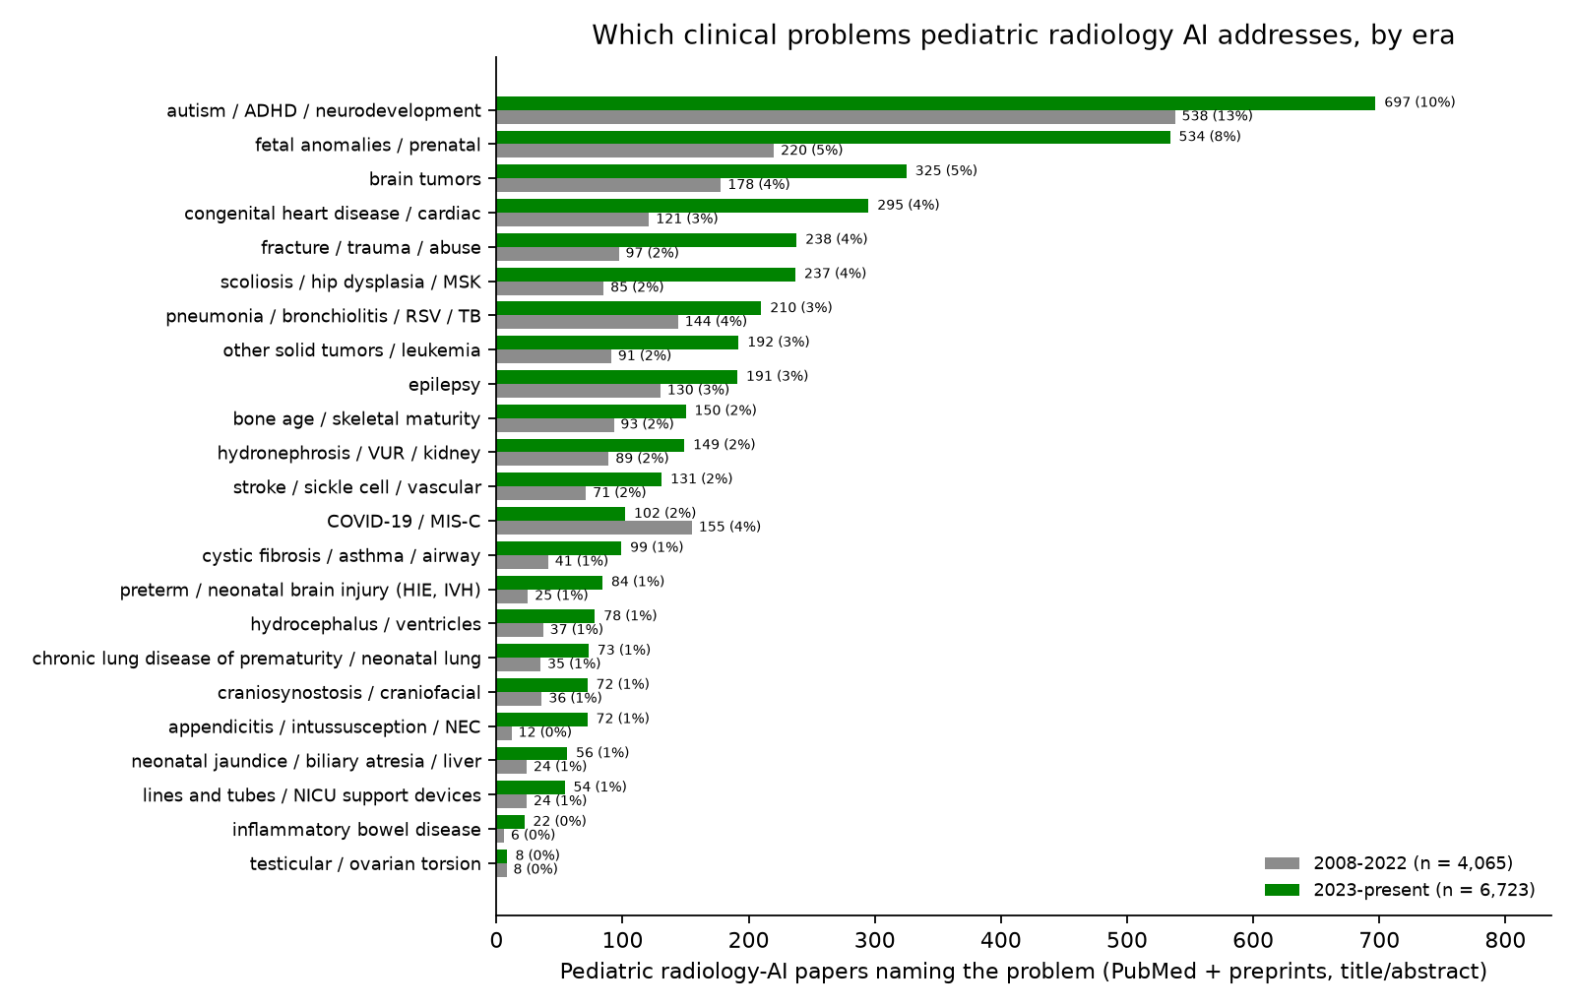
Which medical problems pediatric radiology AI addresses
43 / 61

Slide 44
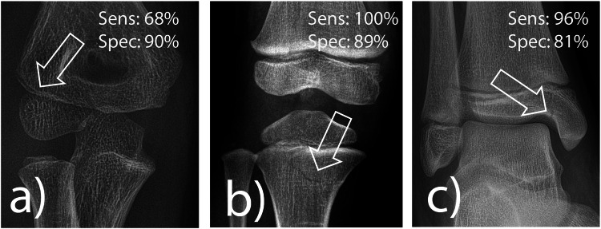
AI fracture detection in a real pediatric emergency department
Ziegner et al., European Radiology 2025 (second most-cited pediatric paper of 2025)
1pt
Problem: fractures in children are missed most often by the least experienced readers, at night, in the emergency department.
Data: 1,672 consecutive radiographs of children under 18 from one tertiary pediatric emergency department, plus a selected medicolegal set (proximal tibia, radial condyle); three pediatric residents read each before and after seeing the AI.
Method: a commercially available, CE-marked deep-learning fracture detector (adult-derived, pediatric extension) run stand-alone and as a second reader.
Result: stand-alone sensitivity 92%, specificity 83%; 100% for proximal tibia but 68% for radial condyle fractures; residents' accuracy rose from 88% to 90%, and in 2% of cases they dropped a correct diagnosis after seeing the AI.
Why it matters: the first real-life pediatric ED evaluation: the gain from a cleared adult tool is real but modest, and the elbow remains the weak spot.
Ziegner et al., Eur Radiol 2025, figure 4: pediatric fractures the software found, with its per-region sensitivity and specificity
source: cdn.ncbi.nlm.nih.gov
44 / 61

Slide 45
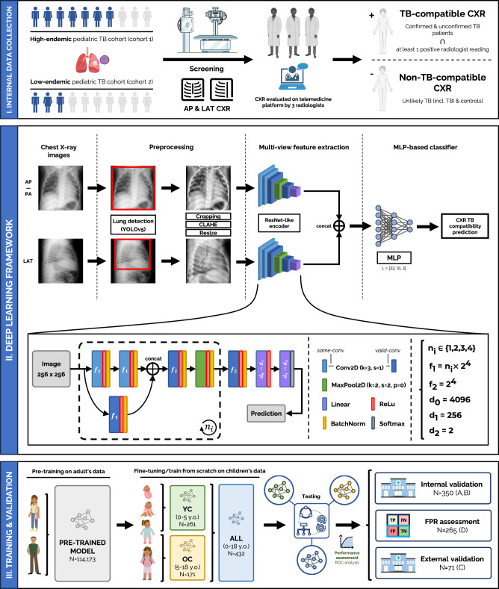
pTBLightNet: pediatric tuberculosis on frontal and lateral chest radiographs
Capellán-Martín et al., Nature Communications 2025 (open access)
1pt
Problem: pediatric pulmonary TB has vaguer symptoms and subtler radiographs than adult TB; most affected children in high-burden settings are never diagnosed.
Data: pre-trained on 114,173 adult chest radiographs, then fine-tuned and tested on 918 radiographs from three pediatric TB cohorts, with lateral views.
Method: a multi-view network that scores frontal and lateral films for TB-compatible findings; separate models for under-5 and 5-18 years.
Result: AUC 0.90 on internal and 0.68 on external testing; lateral views helped most in the youngest children; age-specific models matched larger undifferentiated ones.
Why it matters: shows both the value of adult pre-training for a rare pediatric target and the internal-to-external drop that every pediatric deployment should expect.
Capellan-Martin et al., Nat Commun 2025, figure 1: the multi-view pTBLightNet pipeline
source: cdn.ncbi.nlm.nih.gov
45 / 61

Slide 46
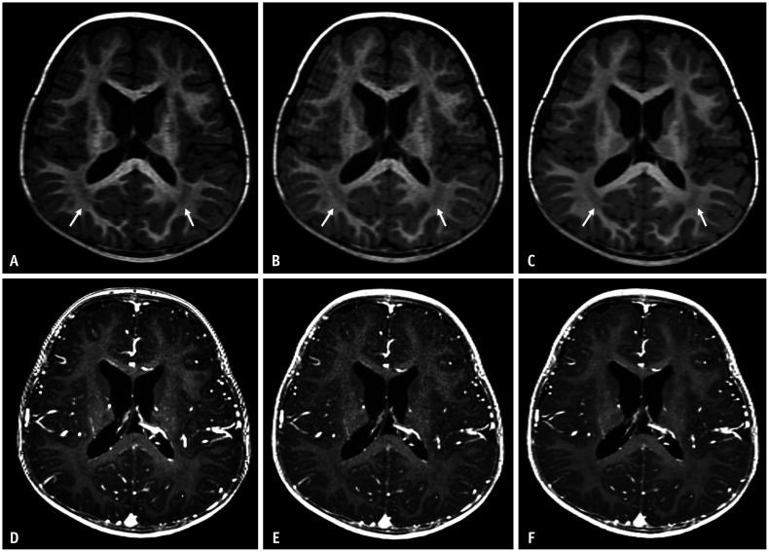
Deep-learning reconstruction shortens pediatric brain MRI
Yoo et al., Korean Journal of Radiology 2025 (open access)
1pt
Problem: long 3D T1 sequences are where children move, sedation is prescribed, and scanner time is lost.
Data: 46 children scanned with both the conventional and an accelerated 3D T1 protocol (pre- and post-contrast) on one 3T scanner.
Method: vendor deep-learning reconstruction applied to the accelerated acquisition; noise, contrast, signal-to-noise and radiologist ratings compared with the conventional scan.
Result: acquisition time cut by 29% (pre-contrast) and 41% (post-contrast); the deep-learning images had lower noise, higher SNR and CNR, better overall quality and fewer artifacts than the conventional scan.
Why it matters: reconstruction AI is on the scanner today and gives children a shorter, better exam without any diagnostic model in the loop.
Yoo et al., Korean J Radiol 2025, figure 2: conventional (A, D) vs accelerated 3D T1 pediatric brain MRI without (B, E) and with (C, F) deep-learning reconstruction
source: cdn.ncbi.nlm.nih.gov
46 / 61

Slide 47
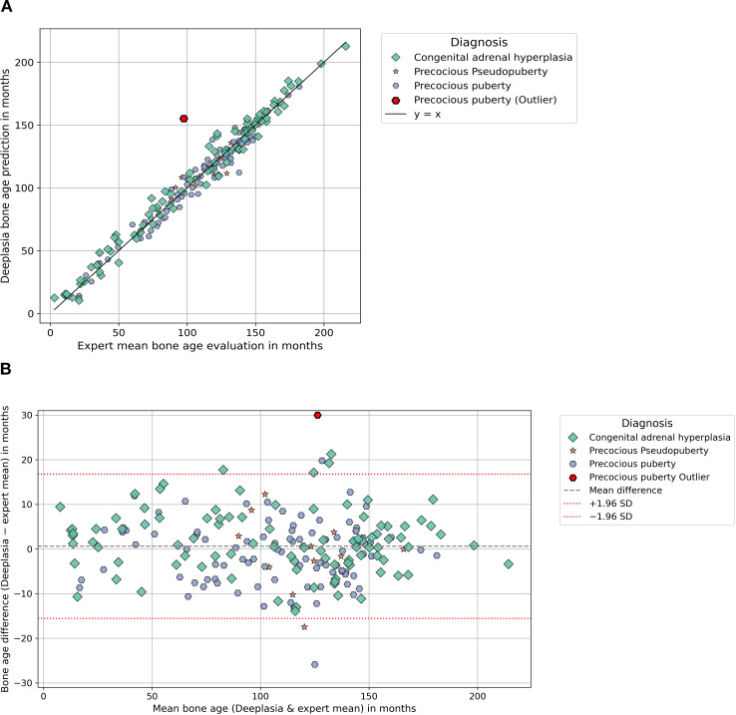
Deeplasia bone age in rare growth disorders, against multiple experts
Skaf et al., Frontiers in Endocrinology 2026 (open access); external validation of Rassmann et al., Pediatr Radiol 2023
1pt
Problem: bone-age models are trained on ordinary hands; the children who need bone age most have syndromes, endocrine disease or lysosomal storage disorders that distort the skeleton.
Data: 1,138 hand radiographs from several centers: SHOX deficiency, Noonan, Silver-Russell, Turner, CAH, precocious puberty (cohort 1) and mucopolysaccharidoses and other storage disorders (cohort 2); two to five expert Greulich-Pyle readings each.
Method: the open-source Deeplasia system run unchanged; each human rater and the model scored against the remaining experts.
Result: mean absolute error 6.0 months (cohort 1) and 7.1 months (storage disorders), 1-year accuracy 90% and 81%; the model beat every individual human rater.
Why it matters: an open pediatric model validated on the hardest cases, by an outside group, on external data: the template for how a children's hospital should test any tool.
Skaf et al., Front Endocrinol 2026, figure 1: Deeplasia bone age vs the expert mean in the endocrine cohort (scatter and Bland-Altman)
source: cdn.ncbi.nlm.nih.gov
47 / 61

Slide 48
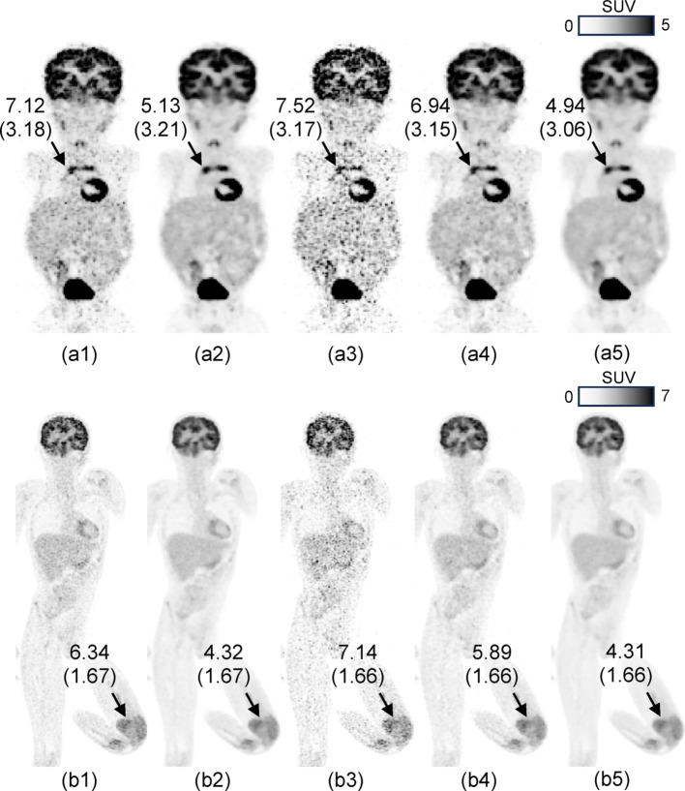
Pediatric PET at one fifth of the counts with patch-based deep learning
Han et al., EJNMMI Physics 2026 (open access; Cincinnati Children's)
1pt
Problem: PET dose and scan time in children are set by noise; conventional denoising networks need large training sets that pediatric PET does not have.
Data: one high-quality pediatric exam for training; a NEMA phantom and 88 clinical whole-body FDG exams (under 12 years) with list-mode data truncated from 90 s to 20 s per bed.
Method: a patch-based network that learns local structure from a single exam and denoises the reduced-count images; blinded observer study and SUV analysis.
Result: 20-second images rated equal or better than the standard 90-second images in more than 85% of cases, with resolution, contrast and SUV preserved.
Why it matters: either a 4.5x shorter scan or about 22% of today's injected activity, from a method trainable on a single local exam.
Han et al., EJNMMI Phys 2026, figure 5: pediatric whole-body FDG PET, standard 90 s vs 20 s per bed, with and without patch-based deep-learning denoising
source: cdn.ncbi.nlm.nih.gov
48 / 61

Slide 49
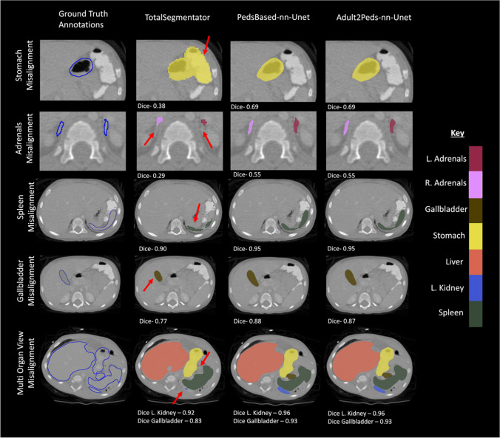
Children are not small adults: an adult CT segmentation model in children
Chatterjee et al., Journal of Imaging Informatics in Medicine 2025
1pt
Problem: the most-used open CT organ segmentation model (TotalSegmentator) was trained on adults; nobody had measured how it behaves in children.
Data: external adult (n = 300) and pediatric (n = 359) abdominal CT sets with expert organ labels.
Method: TotalSegmentator scored on both sets; then a pediatric-only nnU-Net and an adult model fine-tuned on pediatric cases.
Result: mean Dice fell from 0.81 in adults to 0.73 in children, worst for the adrenals (0.69 to 0.41 and 0.35), duodenum and pancreas; pediatric training or fine-tuning recovered the loss.
Why it matters: the clearest quantitative case for local pediatric validation and fine-tuning of adult-derived tools before clinical use.
Chatterjee et al., J Imaging Inform Med 2025, figure 7: pediatric CT organ labels, ground truth vs adult-trained TotalSegmentator vs pediatric-trained models
source: cdn.ncbi.nlm.nih.gov
49 / 61

Slide 50
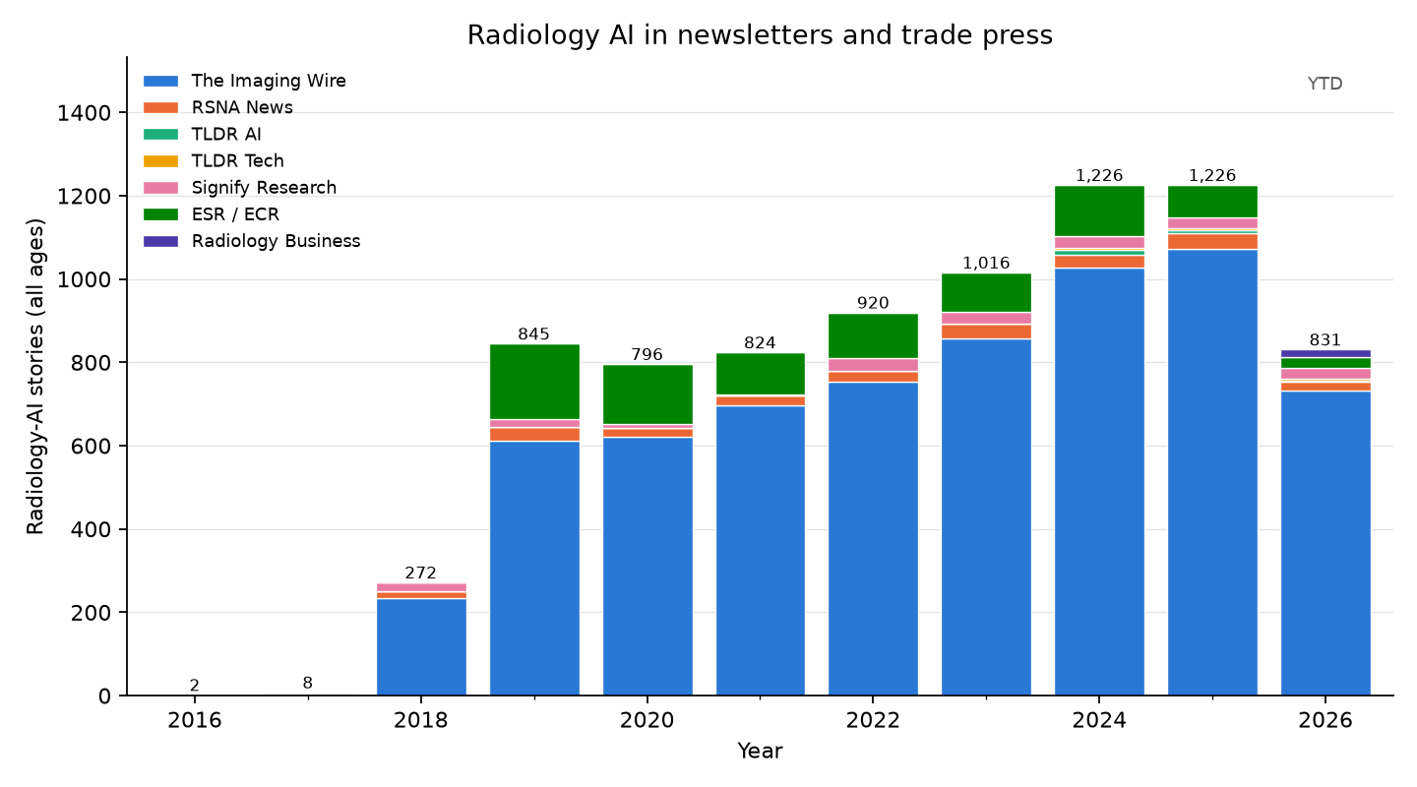
Newsletters — radiology AI stories, all ages
50 / 61

Slide 51
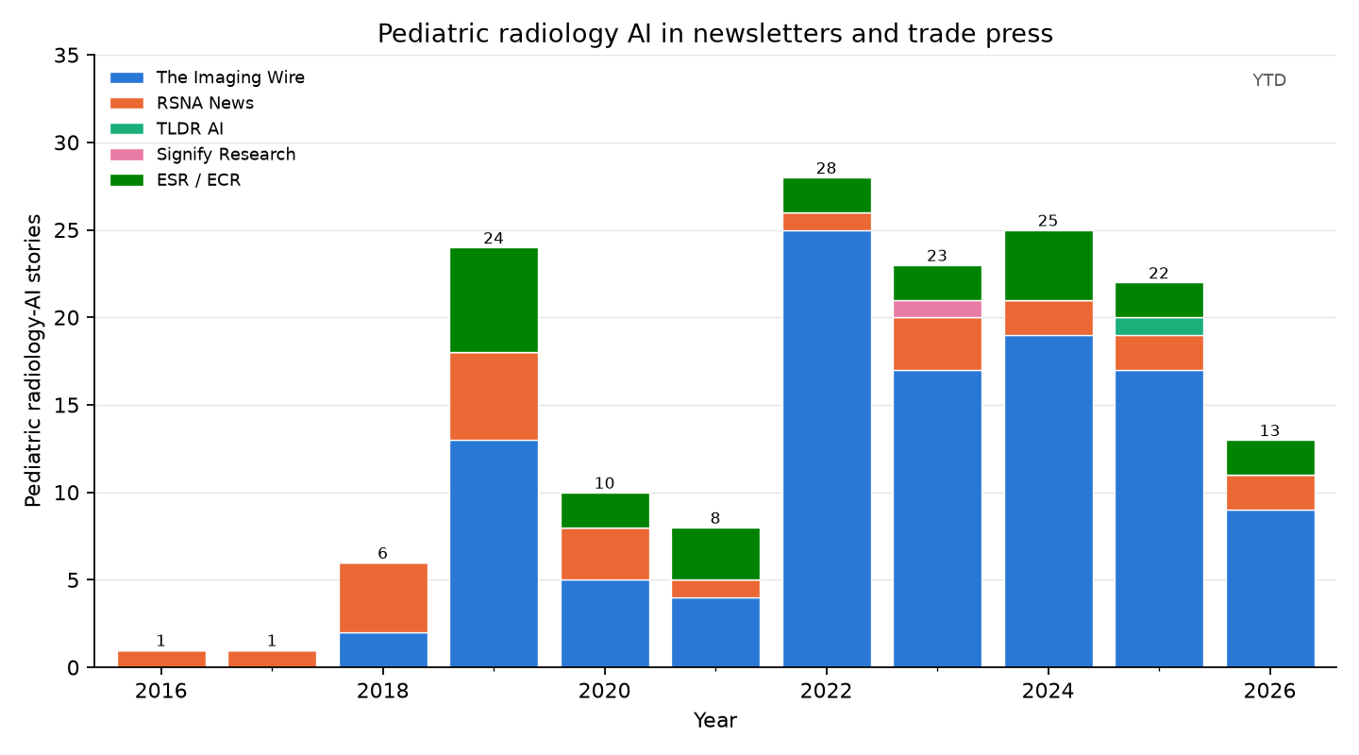
Newsletters — pediatric radiology AI stories
51 / 61

Slide 52
Pediatric radiology AI in the trade press, 2023 (23 stories)
Date | Newsletter | Story | Paper
2023-01-08 | The Imaging Wire | Gestational Age AI
2023-03-01 | The Imaging Wire | Fetal Ultrasound AI Generalizability | Sendra-Balcells et al., 2023 (Scientific Re...
2023-03-08 | ESR / ECR | ECR 2023 – A true celebration of the cycle of life.
2023-03-17 | The Imaging Wire | When Sao Paolo's Diagnosticos da America (DASA, the world's fourth larg...
2023-04-07 | The Imaging Wire | Ultrasound Spots Breech Pregnancies | Knights et al., 2023 (PLOS Medicine)
2023-04-07 | The Imaging Wire | When Sao Paolo's Diagnosticos da America SA (DASA, the world's fourth l...
2023-04-12 | Signify Research | Where do opportunities exist?
2023-04-12 | RSNA News | RSNA Webinar to Examine Impact of Large Language Models
2023-05-07 | The Imaging Wire | New C-Arm Launched
2023-06-07 | The Imaging Wire | BrightHeart's Fetal Heart AI
2023-06-12 | RSNA News | Understanding the Imaging Spectrum of non-Hodgkin Lymphoma in Children,...
2023-06-19 | The Imaging Wire | Better Together at SIIM
2023-06-25 | The Imaging Wire | AI Detects Child Abuse on CT
2023-07-07 | RSNA News | Survivors of Childhood Cancer: Risk of Future Disease, Screening Needs...
2023-08-02 | The Imaging Wire | MRI Radiomics Hones in on Crohn's | Liu et al., 2024 (American Journal of Roent...
2023-08-02 | The Imaging Wire | Sonio Gets FDA Nod for Fetal AI
2023-09-20 | The Imaging Wire | GE Lands $44M AI Ultrasound Grant
2023-10-08 | The Imaging Wire | ChatGPT Reports for Patients | Jeblick et al., 2023 (European Radiology)
2023-11-08 | The Imaging Wire | Philips to Expand AI-Powered POCUS
2023-11-08 | The Imaging Wire | Stories of Success in Cloud and AI
2023-11-12 | The Imaging Wire | Uneven Success Against Breast Cancer | Pediatric Radiation
2023-11-26 | The Imaging Wire | AI of MRI Diagnoses Autism
2023-12-11 | ESR / ECR | Revolutionising paediatric radiology: the future impact of AI
52 / 61

Slide 53
Pediatric radiology AI in the trade press, 2024 (25 stories)
Date | Newsletter | Story | Paper
2024-01-10 | The Imaging Wire | AI Models Go Head-to-Head in Project AIR Study | van Leeuwen et al., 2024 (Radiology)
2024-01-15 | ESR / ECR | Hidden health risks of endocrine disruptors?
2024-01-17 | The Imaging Wire | Echo AI's RHD Impact | Brown et al., 2024 (Journal of the American...
2024-01-20 | The Imaging Wire | Us2.ai
2024-02-07 | The Imaging Wire | Meet Gleamer at ECR 2024
2024-03-20 | The Imaging Wire | AI Helps Residents Detect Fractures
2024-04-22 | The Imaging Wire | GE Launches US Scanners
2024-05-19 | The Imaging Wire | Early Preeclampsia Risk Screening | Guerby et al., 2024 (Hypertension)
2024-06-29 | The Imaging Wire | FDA Clears New Clarius Prenatal App
2024-07-01 | ESR / ECR | AI applications in musculoskeletal imaging
2024-07-10 | RSNA News | Experts Outline Considerations to Deploy AI in Radiology
2024-08-14 | The Imaging Wire | Cardiac Ultrasound Scanner Cleared
2024-08-25 | The Imaging Wire | When Follow-Up Falls Short | Pediatric CT Use
2024-08-25 | The Imaging Wire | MAUI Emerges from Stealth
2024-09-04 | The Imaging Wire | Samsung Finalizes Sonio Acquisition
2024-09-08 | The Imaging Wire | AZmed AI Extended to Kids
2024-10-03 | ESR / ECR | On Artificial Intelligence: An interview with Susan Shelmerdine
2024-10-06 | The Imaging Wire | Fracture AI Improves Over Time
2024-10-10 | The Imaging Wire | Low-Dose CT in Kids | Hinton Nabs Nobel, Cancels MRI
2024-10-10 | The Imaging Wire | Low-Dose CT Confounds CAD in Kids | Hardie et al., 2025 (American Journal of Ro...
2024-10-17 | ESR / ECR | On Artificial Intelligence: An interview with Brendan Kelly
2024-11-19 | RSNA News | Incorrect AI Advice Influences Diagnostic Decisions
2024-11-25 | The Imaging Wire | Fetal Ultrasound AI Cleared
2024-12-02 | The Imaging Wire | Milvue Joins deepc AI Platform
2024-12-15 | The Imaging Wire | Researchers Study AI for Pediatric Fractures
53 / 61

Slide 54
Pediatric radiology AI in the trade press, 2025 (22 stories)
Date | Newsletter | Story | Paper
2025-01-08 | The Imaging Wire | AI for Pediatric Fracture Detection
2025-01-08 | The Imaging Wire | Children's National taps Microsoft to prototype AI tools .
2025-01-29 | The Imaging Wire | Samsung Launches OB/GYN Ultrasound
2025-02-02 | The Imaging Wire | Ultrasound AI Detects Fetal Defects
2025-02-06 | ESR / ECR | Philips at #ECR2025: New AI-enabled systems, intelligent software, and...
2025-02-14 | ESR / ECR | Learn more about FUJIFILM's latest innovations at ECR! | Iwan et al., 2020 (European Radiology)
2025-02-27 | The Imaging Wire | AI Detects Pediatric Epilepsy
2025-03-04 | TLDR AI | AI to diagnose invisible brain abnormalities in children with epilepsy...
2025-04-02 | The Imaging Wire | AZmed Gets New Chest AI Clearances
2025-04-13 | The Imaging Wire | GE's Cincinnati Pediatric Partnership
2025-05-14 | The Imaging Wire | Philips Partners with NVIDIA on AI for MRI
2025-05-18 | The Imaging Wire | New GE Clearances
2025-05-20 | RSNA News | Radiologists Share Tips to Prevent AI Bias
2025-06-01 | The Imaging Wire | BrightHeart's 3rd FDA Clearance
2025-07-03 | The Imaging Wire | DeepEcho Gets FDA Nod for Fetal AI
2025-07-10 | RSNA News | How Is AI Being Used in Daily Neuroradiology Practice?
2025-08-03 | The Imaging Wire | Radiologist Pay Jumps Nearly 8% in New Survey
2025-08-13 | The Imaging Wire | AI-Assisted Fracture Detection
2025-08-27 | The Imaging Wire | Sonio Launches New Maternal-Fetal AI Options
2025-10-01 | The Imaging Wire | Carebot Expands AI Portfolio
2025-10-08 | The Imaging Wire | Reducing CT Radiation Dose System-Wide
2025-11-09 | The Imaging Wire | AI Detects Pediatric Elbow Fractures
54 / 61

Slide 55
Pediatric radiology AI in the trade press, 2026 (year to date) (13 stories)
Date | Newsletter | Story | Paper
2026-01-07 | The Imaging Wire | BrightHeart Raises EUR 11M
2026-01-28 | The Imaging Wire | AHA Publishes New Stroke Guidelines | Prabhakaran et al., 2026 (Stroke)
2026-01-28 | ESR / ECR | Guerbet: Innovation and French Cooperation in the Spotlight at ECR 2026
2026-02-01 | The Imaging Wire | DL-Based CT Reduces Radiation Dose
2026-02-08 | The Imaging Wire | GE Bolsters Ultrasound with Fetal AI
2026-02-26 | ESR / ECR | MRI Unveiling at the
2026-03-29 | The Imaging Wire | Ultrasound AI Gets Breakthrough Nod
2026-05-10 | The Imaging Wire | Pediatric MRI Safety, RTs and Remote Radiology, and PSMA-PET
2026-06-22 | RSNA News | Researchers Use AI to Establish Body Charts for CT Imaging Across the A...
2026-06-28 | The Imaging Wire | BrightHeart's Bright Future | Zelop et al., 2025 (Obstetrics & Gynecology)
2026-07-12 | The Imaging Wire | AI's Rise in Pediatric Imaging | Shah et al., 2026 (European Radiology)
2026-08-16 | The Imaging Wire | CT vs. MRI for Pediatric TBI, Helium Vulnerability, and Ditching the Di...
2026-08-25 | RSNA News | AI Challenges Fuel Innovation Beyond the Leaderboard
55 / 61

Slide 56
Commercial software with a pediatric angle
Vendor | Product | Task | Pediatric status | FDA list
Gleamer | BoneView | fracture detection on radiographs | pediatric indication (age 2+) cleared 2023 | 4 (2022–2025)
AZmed | Rayvolve | fracture (and chest) findings on radiographs | pediatric fracture indication cleared 2024 | 4 (2022–2025)
Visiana | BoneXpert | automated bone age (GP / TW) | pediatric by design; CE-marked since 2009 (not on the FDA AI list) | not listed
16 Bit | Rho | automated bone age | pediatric by design | 1 (2024)
Ever Fortune.AI | EFAI Bonesuite Bone Age Pro | automated bone age | pediatric by design | 11 (2022–2026)
BrightHeart | Fetal EchoScan | fetal echocardiography view / anomaly assist | prenatal (fetal) by design | 5 (2024–2025)
GE HealthCare / Canon / Siemens / Philips | TrueFidelity, AiCE, Deep Resolve, Precise Image | deep-learning CT / MR reconstruction (lower dose, faster scans) | adult-cleared scanner software, widely used for pediatric dose reduction | 307 (2014–2026)
Subtle Medical / AIRS Medical | SubtleMR, SwiftMR | accelerated MRI via deep-learning denoising | adult-cleared; pediatric scan-time studies | 13 (2018–2026)
Qure.ai | qXR / qER | chest radiograph and head CT triage / quantification | adult indications; pediatric TB-screening evidence only | 9 (2020–2026)
Aidoc / Viz.ai | BriefCase, Viz LVO / ICH | worklist triage (hemorrhage, LVO, PE, pneumothorax) | adult-only indications; the largest deployed category | 43 (2018–2026)
“FDA list” = number of radiology AI-enabled devices the company has on the FDA list (years). Pediatric status is the publicly stated indication; confirm the age range in the 510(k) summary before purchase.
56 / 61

Slide 57
Worth knowing as a radiologist — and why
TotalSegmentator (open tool): free, one-command segmentation of 100+ structures on any CT (and MR); the basis for opportunistic measurements (bone density, muscle, organ volumes)
nnU-Net (open tool): if a vendor claims a segmentation result, this is the baseline they had to beat
MONAI (open framework): what your data scientists will build with; knowing the name lets you read a methods section
RSNA Pediatric Bone Age Challenge (2017) (paper / dataset): the one pediatric task with a public benchmark, many models, and cleared products (BoneXpert, Rho)
"Variable generalization performance of a deep learning model to detect pneumonia in chest radiographs" (Zech et al., PLoS Med 2018) (paper): the cleanest demonstration that a model can learn the hospital instead of the disease; the reason to demand local validation
CLAIM checklist (Radiology: AI 2020) (guideline): how to tell a well-reported AI study from a weak one
"Improving Image Quality and Reducing Radiation Dose for Pediatric CT by Using Deep Learning Reconstruction" (Brady et al., Radiology 2021) (paper): the most-cited non-bone-age pediatric paper: deep-learning reconstruction lowers pediatric CT dose with better image quality; the most immediately usable pediatric benefit
FDA AI-enabled device list (registry): the authoritative list of what is cleared; check the indication's age range before buying
Gleamer BoneView / AZmed Rayvolve (products): the first fracture-detection tools with pediatric indications; realistic first pediatric AI purchases
MedSAM / segment-anything models (foundation models): where annotation and segmentation tooling is heading: click, don't draw
57 / 61

Slide 58
What the field does well
Finding what is there. Detection / diagnosis is the bulk of the literature (45% of radiology-AI papers, 46% of pediatric); in adults it has become deployed worklist triage, the largest block of the 1,164 FDA-listed radiology AI devices.
Outlining and measuring. Segmentation (26% of papers) has open, strong defaults (nnU-Net, TotalSegmentator); in children the mature measurement task is bone age (RSNA challenge: 4.2-month error, several cleared products), and measurement / quantification is 22% of pediatric papers.
Better images from less dose. Reconstruction / imputation is 23% of radiology AI and 12% of pediatric work; deep-learning reconstruction is on today's scanners and cut pediatric CT dose by about half at equal or better image quality.
Shared benchmarks where they exist. Fetal and neonatal brain MRI (FeTA, dHCP) and pediatric brain tumors (BraTS-PEDs) now have challenge datasets, and multi-site pediatric neuro-oncology models match radiologists retrospectively.
58 / 61

Slide 59
Bleeding edge
Foundation and vision-language models: 7.2% of radiology-AI papers (3.9% pediatric); segment-anything style tools (MedSAM) and generalist radiology models are replacing task-specific training.
Report generation and LLMs: 3.8% of papers; drafting and extracting from reports, with fluency ahead of reliability.
Agents: 1.0% of radiology-AI papers (42 pediatric papers in total); LLMs that call imaging tools and take multi-step actions.
Pediatric-specific: bone age robust to skeletal dysplasias (Deeplasia); fetal ultrasound AI is the most active commercial pediatric area in the trade press (BrightHeart, Sonio, DeepEcho clearances, 2023–2026); adult fracture tools extended to children (Gleamer 2023, AZmed 2024) and now tested in a real pediatric emergency department.
Generalization studies: adult-trained CT organ segmentation degrades in small children, and the first pediatric prospective-style reader studies show smaller gains than stand-alone accuracy implies.
59 / 61

Slide 60
Open problems — where a children's hospital could contribute
Which diseases? Since 2023 the pediatric corpus (6,723 papers) leans to autism / ADHD / neurodevelopment (697); fetal anomalies / prenatal (534); brain tumors (325); congenital heart disease / cardiac (295). Barely studied: testicular / ovarian torsion (8); inflammatory bowel disease (22); lines and tubes / NICU support devices (54); neonatal jaundice / biliary atresia / liver (56); craniosynostosis / craniofacial (72); appendicitis / intussusception / NEC (72). Which of these deserve a model first is an open question for this group.
Dataset curation. What would a multi-center pediatric dataset look like: age-stratified, consented, protocol-diverse, with rare phenotypes? Which of our own archives (CT, ultrasound, NICU radiographs) could become the pediatric benchmark that does not yet exist?
Validation. Local, age-stratified testing of adult-cleared tools; prospective reader studies rather than retrospective accuracy; monitoring for drift as children grow and protocols change.
Beyond interpretation. Workflow / non-interpretive work is 13% of papers, but communication with families, education, protocoling and policy are almost absent; these are cheaper to build and evaluate than diagnostic models.
Regulation and liability. Few of the 1,164 radiology clearances carry a pediatric indication; which adult clearances are acceptable to use off-label in children, and under what local validation?
60 / 61

Slide 61
Implications for a children's hospital
Buy maturity, build for the gaps: adopt cleared adult-derived tools that transfer (reconstruction, bone age, fracture with a pediatric indication); treat the under-studied pediatric problems as local validation and research.
Demand local pediatric validation before clinical use, by age group, and check the age range in the clearance.
Prioritize dose and throughput: deep-learning reconstruction gives the clearest pediatric benefit today.
Invest in data: a curated, shareable pediatric dataset is the scarcest resource in the field and the contribution a children's hospital is uniquely placed to make.
61 / 61

