Slide 1
Artificial Intelligence in Pediatric Radiology
Joseph Rich, Dr. Amit Sura
October 8, 2026
1 / 49

Slide 2
Objectives
Describe the big players in radiology AI, both general and pediatric
Summarize what radiology AI does well and what remains unresolved
2 / 49

Slide 3
Methods
Journals, Preprints: PubMed, Embase, arXiv, medRxiv
Conferences: NeurIPS, ICLR, ICML, CVPR, MICCAI, MIDL
Datasets: Hand-curated list
Newsletters: The Imaging Wire, RSNA News, TLDR AI, TLDR Tech, Signify Research, ESR / ECR, Radiology Business
Commercial: FDA list of AI-enabled devices
Date range: January 1 2008 – September 30 2026
Search strategy: radiology AND AI [AND pediatric]
radiology: (radiology[tiab] OR radiological[tiab] OR radiograph*[tiab] OR "medical imaging"[tiab] OR "diagnostic imaging"[tiab] OR tomography[tiab] OR "magnetic resonance"[tiab] OR MRI[tiab] OR "MR imaging"[tiab] OR "MR images"[tiab] OR MRIs[tiab] OR "MR image"[tiab] OR "MR scan"[tiab] OR "MR scans"[tiab] OR "computed tomography"[tiab] OR CT[tiab] OR ultrasound[tiab] OR ultrasonograph*[tiab] OR sonograph*[tiab] OR echocardiograph*[tiab] OR mammograph*[tiab] OR "chest x-ray"[tiab] OR "x-ray"[tiab] OR fluoroscop*[tiab] OR scintigraph*[tiab] OR "positron emission"[tiab] OR PET[tiab] OR SPECT[tiab] OR angiograph*[tiab] OR neuroimaging[tiab] OR tractograph*[tiab] OR elastograph*[tiab] OR "fMRI"[tiab] OR "functional MRI"[tiab] OR "functional magnetic resonance"[tiab] OR connectome*[tiab] OR "diffusion tensor"[tiab] OR DTI[tiab] OR "bone age"[tiab] OR "skeletal age"[tiab] OR "skeletal maturity"[tiab] OR "barium enema"[tiab])
AI: ("artificial intelligence"[tiab] OR "machine learning"[tiab] OR "deep learning"[tiab] OR "convolutional neural network"[tiab] OR "convolutional neural networks"[tiab] OR "neural network"[tiab] OR "neural networks"[tiab] OR "computer-aided diagnosis"[tiab] OR "computer aided diagnosis"[tiab] OR "computer-aided detection"[tiab] OR radiomic*[tiab] OR "computer vision"[tiab] OR "large language model"[tiab] OR "large language models"[tiab] OR "foundation model"[tiab] OR "foundation models"[tiab] OR "transfer learning"[tiab] OR "vision transformer"[tiab] OR "self-supervised"[tiab] OR "random forest"[tiab] OR "support vector machine"[tiab] OR "gradient boosting"[tiab] OR "natural language processing"[tiab])
pediatric: (pediatric*[tiab] OR paediatric*[tiab] OR child*[tiab] OR infant*[tiab] OR neonat*[tiab] OR adolescen*[tiab] OR fetal[tiab] OR foetal[tiab] OR fetus*[tiab] OR foetus*[tiab] OR newborn*[tiab] OR preterm[tiab] OR "premature infant"[tiab] OR "premature infants"[tiab] OR "premature birth"[tiab] OR "premature neonate"[tiab] OR "premature neonates"[tiab] OR prenatal[tiab] OR antenatal[tiab] OR perinatal[tiab] OR youth[tiab] OR juvenile[tiab] OR "children's hospital"[tiab] OR schoolchild*[tiab] OR toddler*[tiab])
3 / 49

Slide 4
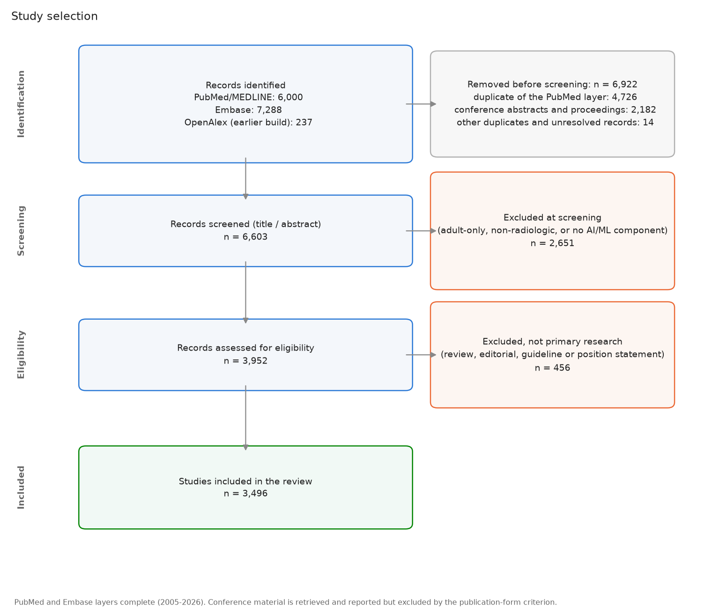
Study selection
JOURNALS
4 / 49

Slide 5
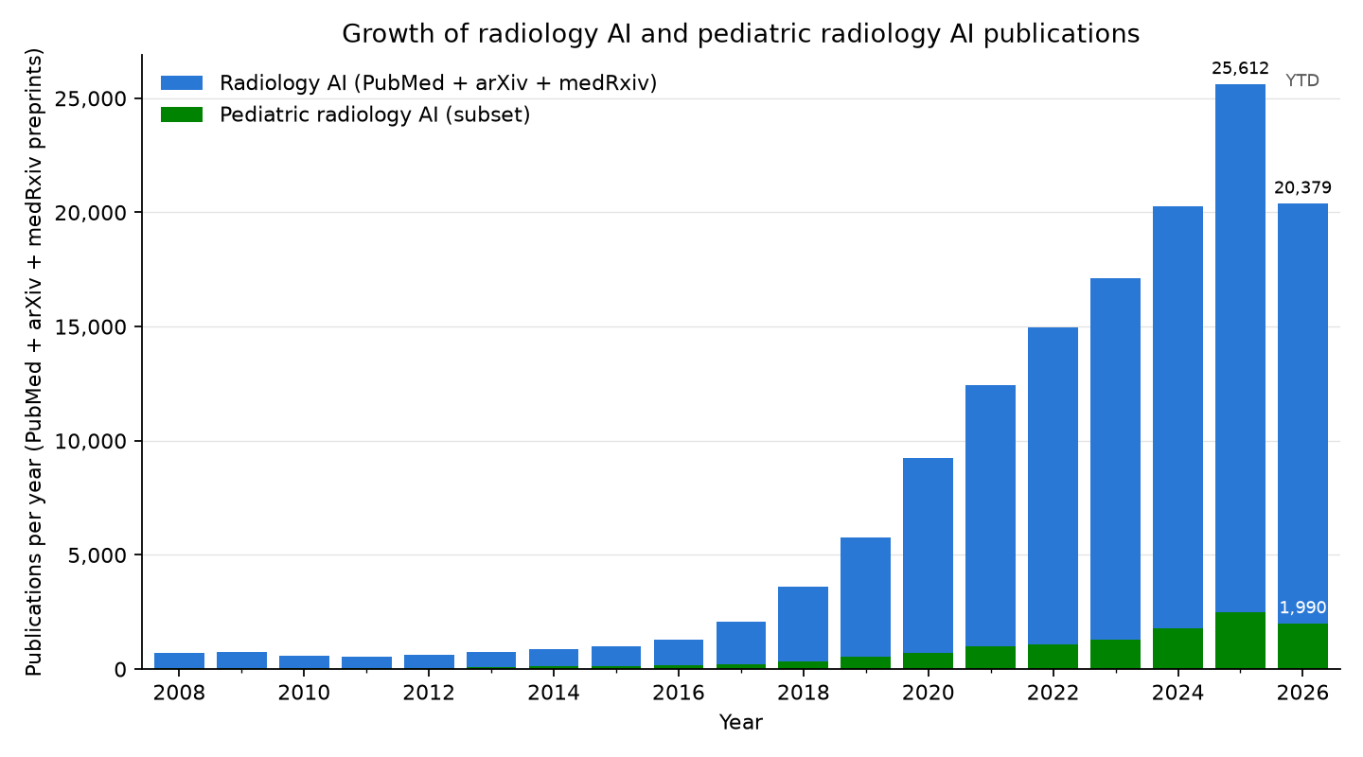
Radiology AI publication counts
JOURNALS
5 / 49

Slide 6
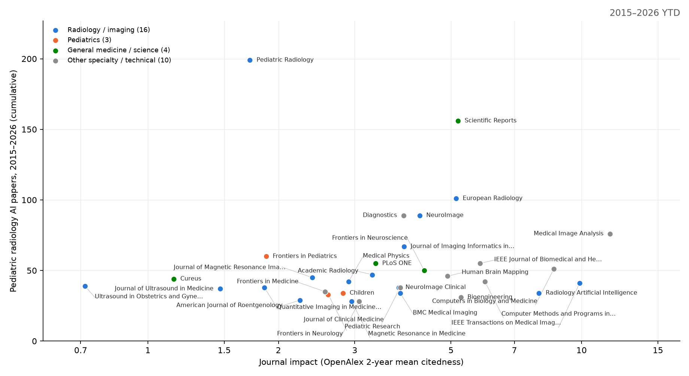
Which journals publish pediatric radiology AI
JOURNALS
x = OpenAlex 2-year mean citedness (a free JIF analogue; runs below the published JIF). y = cumulative pediatric radiology-AI papers 2015-2026 (PubMed, strict title/abstract query). The 33 journals with at least 25 of them are shown, carrying 1,807 of 5,099; the rest is a long tail. Largest: Pediatric Radiology (196); median impact 3.7, 1 at 10 or above – this work lands mostly in mid-impact specialty and technical journals. A further 3 conference proceedings and preprint servers clear the threshold (94 papers) but have no impact number of any kind and are not plotted. The same chart animated year by year: figures/journal_impact.gif.
6 / 49

Slide 7
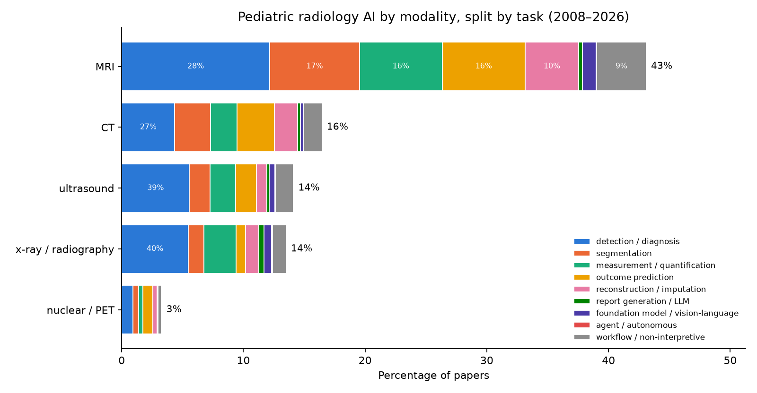
Pediatric radiology AI publications, stratified by modality and task
JOURNALS
Same construction, restricted to the pediatric subset (10,737 papers incl. 596 preprints). Top pediatric modalities: MRI 41%, CT 16%, ultrasound 13%, x-ray / radiography 12%. Mammography is omitted: its 79 pediatric-query hits (of 10,737) are adult breast-imaging papers whose abstracts mention children.
detection / diagnosis: is a finding present now, and which one (label or box): fracture, pneumonia, tumor; includes triage and screening
segmentation: outline a structure or lesion (a mask)
measurement / quantification: a number from the image: bone age, Cobb angle, organ volume, fetal biometry
outcome prediction: a future risk, response, or survival estimate from the image (prognosis, radiomics signatures)
reconstruction / imputation: a better or missing image: lower dose, faster scans, denoising, synthetic CT/MR
report generation / LLM: text: draft, summarize, or extract from radiology reports
foundation model / vision-language: a large pretrained model reused across tasks (segment-anything, self-supervised)
agent / autonomous: multi-step actions taken without a human in the loop
workflow / non-interpretive: protocoling, scheduling, ordering, decision support, education
7 / 49

Slide 8
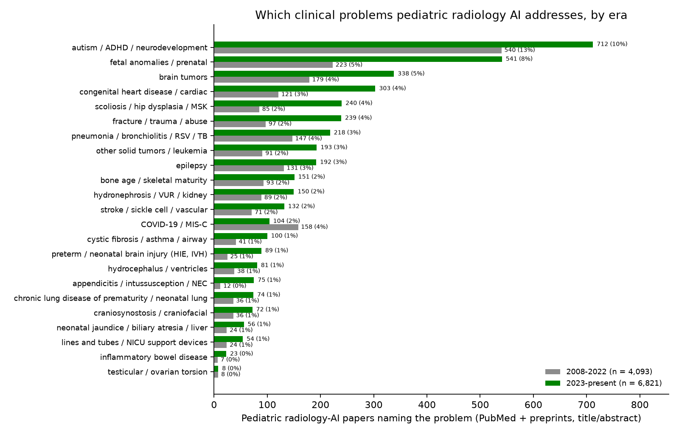
Pediatric radiology AI publications, stratified by medical problem
JOURNALS
8 / 49

Slide 9
Most-cited radiology AI papers, 2008-2022
JOURNALS
Cites | FWCI | Paper | Venue | What it answers
14,326 | 1023.0 | A survey on deep learning in medical image analysis (2017) | Medical Image Anal. | survey: What can deep learning do across medical imaging? (the field's reference survey)
5,658 | 446.6 | Swin-Unet: Unet-like Pure Transformer for Medical Image Segmentation (2021) | ECCV Workshops | segmentation
2,990 | 340.4 | Deep Learning in Medical Image Analysis (2017) | Annual Review of Biomedical Engineering | survey: How does deep learning apply to medical image analysis? (review)
2,553 | 290.0 | Swin UNETR: Swin Transformers for Semantic Segmentation of Brain Tumors in MRI Images (2022) | BrainLes@MICCAI | segmentation
2,769 | 272.4 | COVID-Net: a tailored deep convolutional neural network design for detection of COVID-19 cases from chest X-ray images (2020) | Scientific Reports | classification: Can a CNN detect COVID-19 on chest X-ray? (COVID-Net)
3,634 | 236.9 | ChestX-Ray8: Hospital-Scale Chest X-Ray Database and Benchmarks on Weakly-Supervised Classification and Localization of Common Thorax Diseases (2017) | Computer Vision and Pattern Recognition | classification
10,044 | 226.3 | nnU-Net: a self-configuring method for deep learning-based biomedical image segmentation (2020) | Nature Methods | segmentation: Can one self-configuring method segment any organ or lesion without hand tuning? (nnU-Net)
4,100 | 170.2 | Convolutional neural networks: an overview and application in radiology (2018) | Insights into Imaging | tutorial: What is a convolutional neural network, explained for radiologists?
5,587 | 158.4 | Computational Radiomics System to Decode the Radiographic Phenotype (2017) | Cancer Research | radiomics: Can standardized image features (radiomics) be extracted reproducibly? (PyRadiomics)
3,322 | 149.0 | Artificial intelligence in radiology (2018) | Nature Reviews. Cancer | review: How will AI change radiology practice? (Hosny et al.)
FWCI = field-weighted citation impact (OpenAlex): citations relative to the world average for papers of the same field and year (1 = average)
9 / 49

Slide 10
Most-cited radiology AI papers, 2023
JOURNALS
Cites | FWCI | Paper | Venue | What it answers
1,608 | 615.8 | Segment anything in medical images | Nature Communications | foundation: Can a prompt-based 'segment anything' model work on medical images? (MedSAM)
2,099 | 243.8 | Foundation models for generalist medical artificial intelligence | Nature | foundation model: What would a single generalist medical AI model that handles images, text and records look like? (perspective)
702 | 118.5 | Redefining Radiology: A Review of Artificial Intelligence Integration in Medical Imaging | Diagnostics | survey / review: Where does AI fit in radiology workflow, from acquisition to reporting? (review)
509 | 75.2 | Medical image analysis using deep learning algorithms | Frontiers in Public Health | other
562 | 74.5 | A Study of CNN and Transfer Learning in Medical Imaging: Advantages, Challenges, Future Scope | Sustainability | other
861 | 69.6 | Segment Anything Model for medical image analysis: an experimental study | Medical Image Anal. | segmentation: How well does the unmodified Segment Anything Model work on medical images? (it needs prompts and adaptation)
573 | 55.8 | MRI-based brain tumor detection using convolutional deep learning methods and chosen machine learning techniques | BMC Medical Informatics and Decision Making | oncology
460 | 44.5 | Brain Tumor Detection Based on Deep Learning Approaches and Magnetic Resonance Imaging | Cancers | oncology
391 | 42.2 | SAM-Adapter: Adapting Segment Anything in Underperformed Scenes | 2023 IEEE/CVF International Conference on Computer Vision Workshops (ICCVW) | segmentation
442 | 37.4 | A generalist vision–language foundation model for diverse biomedical tasks | Nature Medicine | other
10 / 49

Slide 11
Most-cited radiology AI papers, 2024
JOURNALS
Cites | FWCI | Paper | Venue | What it answers
1,074 | 225.2 | VM-UNet: Vision Mamba UNet for Medical Image Segmentation | ACM Transactions on Multimedia Computing, Communications, and Applications (TOMCCAP) | segmentation: Does a state-space (Mamba) backbone beat convolutions and transformers for medical segmentation?
242 | 110.3 | Generalist foundation models from a multimodal dataset for 3D computed tomography | Nature Biomedical Engineering | other
282 | 74.6 | Artificial intelligence in neuro-oncology: advances and challenges in brain tumor diagnosis, prognosis, and precision treatment | npj Precision Oncology | oncology
279 | 72.6 | METhodological RadiomICs Score (METRICS): a quality scoring tool for radiomics research endorsed by EuSoMII | Insights into Imaging | radiomics: How should the quality of a radiomics study be scored? (METRICS checklist)
349 | 47.6 | Deep learning for medical image segmentation: State-of-the-art advancements and challenges | Informatics in Medicine Unlocked | segmentation
317 | 43.4 | Advances in Medical Image Segmentation: A Comprehensive Review of Traditional, Deep Learning and Hybrid Approaches | Bioengineering | segmentation
238 | 37.0 | Employing deep learning and transfer learning for accurate brain tumor detection | Scientific Reports | oncology
242 | 36.0 | Deep semi-supervised learning for medical image segmentation: A review | Expert systems with applications | segmentation
241 | 34.5 | A review of deep learning-based information fusion techniques for multimodal medical image classification | Comput. Biol. Medicine | survey / review
298 | 31.8 | Vision-language models for medical report generation and visual question answering: a review | Frontiers Artif. Intell. | report generation / LLM: What can vision-language models do for report generation and visual question answering? (review)
11 / 49

Slide 12
Most-cited radiology AI papers, 2025
JOURNALS
Cites | FWCI | Paper | Venue | What it answers
258 | 225.8 | Deep Convolutional Neural Networks in Medical Image Analysis: A Review | Inf. | survey / review
145 | 158.8 | Multi-model assurance analysis showing large language models are highly vulnerable to adversarial hallucination attacks during clinical decision support | Communications Medicine | LLM / reports
122 | 108.2 | Multimodal generative AI for medical image interpretation | Nature | other
313 | 94.9 | Towards generalist foundation model for radiology by leveraging web-scale 2D&3D medical data | Nature Communications | foundation model: Can a radiology foundation model trained on web-scale 2D and 3D scans generalize across modalities and tasks? (RadFM)
173 | 87.2 | Development and validation of an autonomous artificial intelligence agent for clinical decision-making in oncology | Nature Cancer | agent / autonomous: Can an autonomous LLM agent that calls imaging and other tools support oncology decisions? (validation study)
208 | 65.9 | A review of deep learning for brain tumor analysis in MRI | npj Precision Oncology | survey / review
150 | 65.8 | Med-R1: Reinforcement Learning for Generalizable Medical Reasoning in Vision-Language Models | IEEE Transactions on Medical Imaging | LLM / reports
233 | 64.6 | Artificial intelligence in healthcare and medicine: clinical applications, therapeutic advances, and future perspectives | European Journal of Medical Research | other
151 | 54.0 | Medical Image Segmentation: A Comprehensive Review of Deep Learning-Based Methods | Tomography | segmentation
118 | 39.5 | Advanced Brain Tumor Classification in MR Images Using Transfer Learning and Pre-Trained Deep CNN Models | Cancers | oncology
12 / 49

Slide 13
Most-cited radiology AI papers, 2026 (year to date)
JOURNALS
Cites | FWCI | Paper | Venue | What it answers
48 | 102.6 | A generalizable foundation model for analysis of human brain MRI | Nature Neuroscience | other
16 | 90.5 | Reporting checklist for foundation and large language models in medical research (REFINE): an international consensus guideline. | Diagnostic and Interventional Radiology | LLM / reports
15 | 76.1 | Scaling medical AI across clinical contexts | Nature Medicine | foundation model: How can medical AI be scaled across hospitals, populations and tasks without breaking? (perspective)
27 | 67.3 | Applications and limitations of large language models to integrate medical context: a comprehensive review | Iran Journal of Computer Science | survey / review
18 | 62.7 | A hybrid deep learning framework based on VGG19 and U-Net for accurate brain tumor segmentation in MRI images | Magnetic Resonance Letters | segmentation
37 | 58.8 | Explainable artificial intelligence (XAI) in medical imaging: a systematic review of techniques, applications, and challenges | BMC Medical Imaging | survey / review: Which explainability methods are used in medical imaging AI and do they help? (review)
12 | 45.3 | Explainable AI-driven MRI-based brain tumor classification: a novel deep learning approach | Frontiers Artif. Intell. | oncology
21 | 44.2 | Agentic AI in Radiology: Evolution from Large Language Models to Future Clinical Integration. | Radiology: Artificial Intelligence | agent / autonomous: What are agentic AI systems in radiology and what stands between them and clinical use? (review)
17 | 28.4 | Leveraging multi-modal foundation models for analysing spatial multi-omic and histopathology data | Nature Biomedical Engineering | other
19 | 21.4 | BIBSNet: A deep learning baby image brain segmentation network for MRI scans | Developmental Cognitive Neuroscience | segmentation: Can one network segment infant brain MRI across the first years of life? (BIBSNet)
13 / 49

Slide 14
Most-cited pediatric radiology AI papers, 2008-2022
JOURNALS
Cites | FWCI | Paper | Venue | What it answers
426 | 328.6 | Performance of a Deep-Learning Neural Network Model in Assessing Skeletal Maturity on Pediatric Hand Radiographs. (2017) | Radiology | bone age: Can a CNN assess skeletal maturity as accurately as radiologists?
431 | 321.5 | Fully Automated Deep Learning System for Bone Age Assessment (2017) | Journal of digital imaging | bone age: Fully automated bone age from hand radiographs
403 | 221.2 | Deep learning for automated skeletal bone age assessment in X-ray images (2017) | Medical Image Anal. | bone age: Deep learning for automated bone age (BoNet)
143 | 73.0 | Computerized Bone Age Estimation Using Deep Learning Based Program: Evaluation of the Accuracy and Efficiency. (2017) | AJR. American journal of roentgenology | bone age: Is a commercial deep-learning bone-age program accurate and faster in practice?
191 | 57.8 | A Review on Deep-Learning Algorithms for Fetal Ultrasound-Image Analysis (2022) | Medical Image Anal. | survey / review
352 | 57.4 | Standard Plane Localization in Fetal Ultrasound via Domain Transferred Deep Neural Networks (2015) | IEEE journal of biomedical and health informatics | fetal MRI
194 | 57.0 | Automatic Fetal Ultrasound Standard Plane Recognition Based on Deep Learning and IIoT (2021) | IEEE Transactions on Industrial Informatics | fetal MRI
233 | 30.3 | Evaluation of deep convolutional neural networks for automatic classification of common maternal fetal ultrasound planes (2020) | Scientific Reports | fetal MRI
458 | 27.0 | The RSNA Pediatric Bone Age Machine Learning Challenge. (2019) | Radiology | bone age: How well can crowdsourced AI estimate bone age? (RSNA challenge, 260 teams)
253 | 25.8 | An ensemble of neural networks provides expert-level prenatal detection of complex congenital heart disease (2021) | Nature Medicine | detection
14 / 49

Slide 15
Most-cited pediatric radiology AI papers, 2023
JOURNALS
Cites | FWCI | Paper | Venue | What it answers
32 | 36.6 | Bone Age Assessment Using Artificial Intelligence in Korean Pediatric Population: A Comparison of Deep-Learning Models Trained With Healthy Chronological and Greulich-Pyle Ages as Labels | Korean Journal of Radiology | bone age
62 | 33.6 | Standard fetal ultrasound plane classification based on stacked ensemble of deep learning models | Expert systems with applications | fetal ultrasound: Can an ensemble of networks classify the standard fetal ultrasound planes?
27 | 33.5 | Bone age assessment based on deep neural networks with annotation-free cascaded critical bone region extraction | Frontiers in Artificial Intelligence | bone age
43 | 23.8 | Review on deep learning fetal brain segmentation from Magnetic Resonance images | Artif. Intell. Medicine | segmentation
37 | 20.2 | Transfer learning for accurate fetal organ classification from ultrasound images: a potential tool for maternal healthcare providers | Scientific Reports | fetal MRI
34 | 16.6 | Deep Learning-Based Multiclass Brain Tissue Segmentation in Fetal MRIs | Italian National Conference on Sensors | segmentation
43 | 9.7 | Deeplasia: deep learning for bone age assessment validated on skeletal dysplasias | Pediatric Radiology | bone age
30 | 7.8 | Deep learning for estimation of fetal weight throughout the pregnancy from fetal abdominal ultrasound. | American Journal of Obstetrics & Gynecology MFM | fetal MRI
38 | 7.3 | Deep learning model for prenatal congenital heart disease (CHD) screening can be applied to retrospective imaging from the community setting, outperforming initial clinical detection in a well-annotated cohort | Ultrasound in Obstetrics and Gynecology | fetal ultrasound: Does a prenatal congenital heart disease screening model work on retrospective real-world scans?
31 | 5.8 | MRI-Based End-To-End Pediatric Low-Grade Glioma Segmentation and Classification | Canadian Association of Radiologists journal = Journal l'Association canadienne des radiologistes | segmentation
15 / 49

Slide 16
Most-cited pediatric radiology AI papers, 2024
JOURNALS
Cites | FWCI | Paper | Venue | What it answers
17 | 34.8 | Intrapartum Ultrasound Image Segmentation of Pubic Symphysis and Fetal Head Using Dual Student-Teacher Framework with CNN-ViT Collaborative Learning | International Conference on Medical Image Computing and Computer-Assisted Intervention | segmentation
30 | 23.8 | FetalBrainAwareNet: Bridging GANs with anatomical insight for fetal ultrasound brain plane synthesis | Comput. Medical Imaging Graph. | fetal MRI
20 | 19.5 | Artificial intelligence assisted common maternal fetal planes prediction from ultrasound images based on information fusion of customized convolutional neural networks | Frontiers in Medicine | fetal MRI
18 | 15.9 | Deep learning denoising reconstruction for improved image quality in fetal cardiac cine MRI | Frontiers in Cardiovascular Medicine | reconstruction: Does deep-learning denoising improve fetal cardiac cine MRI?
30 | 15.1 | RTSeg-net: A lightweight network for real-time segmentation of fetal head and pubic symphysis from intrapartum ultrasound images | Comput. Biol. Medicine | segmentation
16 | 13.4 | FetSAM: Advanced Segmentation Techniques for Fetal Head Biometrics in Ultrasound Imagery | IEEE Open Journal of Engineering in Medicine and Biology | segmentation
23 | 7.0 | Deep learning-based automated lesion segmentation on pediatric focal cortical dysplasia II preoperative MRI: a reliable approach | Insights into Imaging | epilepsy: Can focal cortical dysplasia lesions be found automatically on preoperative pediatric MRI?
18 | 5.3 | Integration of a Deep Convolutional Neural Network With Adaptive Channel Weight Technique for Automated Identification of Standard Fetal Biometry Planes | IEEE Transactions on Instrumentation and Measurement | fetal MRI
18 | 5.2 | Explainable AI in Deep Learning Based Classification of Fetal Ultrasound Image Planes | Procedia Computer Science | fetal MRI
19 | 4.8 | A deep learning framework for identifying and segmenting three vessels in fetal heart ultrasound images | BioMedical Engineering OnLine | segmentation
16 / 49

Slide 17
Most-cited pediatric radiology AI papers, 2025
JOURNALS
Cites | FWCI | Paper | Venue | What it answers
16 | 171.3 | A comprehensive review of artificial intelligence - based algorithm towards fetal facial anomalies detection (2013–2024) | Artificial Intelligence Review | survey / review
18 | 85.1 | M-CNN-RF: A hybrid deep learning model for accurate pediatric skeletal age estimation using hand bone radiographs | Alexandria Engineering Journal | other
20 | 77.0 | Bone Age Assessment Using Various Medical Imaging Techniques Enhanced by Artificial Intelligence | Diagnostics | bone age
18 | 24.9 | Advancing prenatal healthcare by explainable AI enhanced fetal ultrasound image segmentation using U-Net++ with attention mechanisms | Scientific Reports | segmentation
12 | 21.8 | FetalMovNet: A Novel Deep Learning Model Based on Attention Mechanism for Fetal Movement Classification in US | IEEE Access | fetal MRI
11 | 14.5 | Effectiveness and clinical impact of using deep learning for first-trimester fetal ultrasound image quality auditing | BMC Pregnancy and Childbirth | fetal MRI
12 | 12.4 | Association between deep learning radiomics based on placental MRI and preeclampsia with fetal growth restriction: A multicenter study. | European Journal of Radiology | radiomics
16 | 8.7 | Prenatal detection of congenital heart defects using the deep learning-based image and video analysis: protocol for Clinical Artificial Intelligence in Fetal Echocardiography (CAIFE), an international multicentre multidisciplinary study | BMJ Open | fetal ultrasound: Can deep learning on prenatal ultrasound video detect congenital heart defects?
11 | 8.6 | Multi-view deep learning framework for the detection of chest X-rays compatible with pediatric pulmonary tuberculosis | Nature Communications | detection
11 | 7.0 | Evaluation of Image Quality and Scan Time Efficiency in Accelerated 3D T1-Weighted Pediatric Brain MRI Using Deep Learning-Based Reconstruction | Korean Journal of Radiology | reconstruction
17 / 49

Slide 18
Most-cited pediatric radiology AI papers, 2026 (year to date)
JOURNALS
Cites | FWCI | Paper | Venue | What it answers
11 | 34.3 | Artificial intelligence and radiomics for pediatric brain tumor classification and molecular characterization: a systematic review | Neuroradiology | oncology: Can AI and radiomics classify pediatric brain tumors and their molecular subtypes? (review)
5 | 27.9 | Deep learning assessment of fetal brain maturation on 3D ultrasound volumes in early-onset fetal growth restriction | Ultrasound in Obstetrics and Gynecology | fetal ultrasound: Can deep learning grade fetal brain maturation on 3D ultrasound in growth restriction?
3 | 17.6 | Foundation models in radiology: a primer for pediatric radiologists | Pediatric Radiology | foundation model: What should a pediatric radiologist know about foundation models? (primer)
2 | 17.6 | Deep Learning-Based Multi-Class Pediatric Wrist Fracture Subtype Classification: A Pilot Study Comparing Convolutional Neural Network Architectures | Journal of Imaging | fracture
3 | 17.3 | Current applications and challenges of artificial intelligence applied to diagnostics in pediatric musculoskeletal imaging | Pediatric Radiology | classification
4 | 13.6 | Data mining in pediatric radiology in the era of artificial intelligence. | Pediatric Radiology | other
2 | 13.2 | Acquisition time/dose reduction in pediatric PET imaging using patch-based deep learning | EJNMMI Physics | reconstruction: Can pediatric PET use one fifth of the counts with patch-based deep-learning denoising?
2 | 12.6 | Optimizing pediatric chest CT: superior image quality and lower radiation dose with deep learning reconstruction. | European Journal of Radiology | reconstruction: Can deep-learning reconstruction lower pediatric chest CT dose while improving image quality?
2 | 12.2 | Enhancing efficiency in pediatric brain tumor segmentation using a pathologically diverse single-center clinical dataset | Neuro-Oncology Advances | segmentation
3 | 11.7 | Automated bone age assessment in rare pediatric growth disorders: a comparative study using Deeplasia | Frontiers in Endocrinology | bone age: Does an open bone-age model hold up in rare growth disorders against several experts? (Deeplasia)
18 / 49

Slide 19
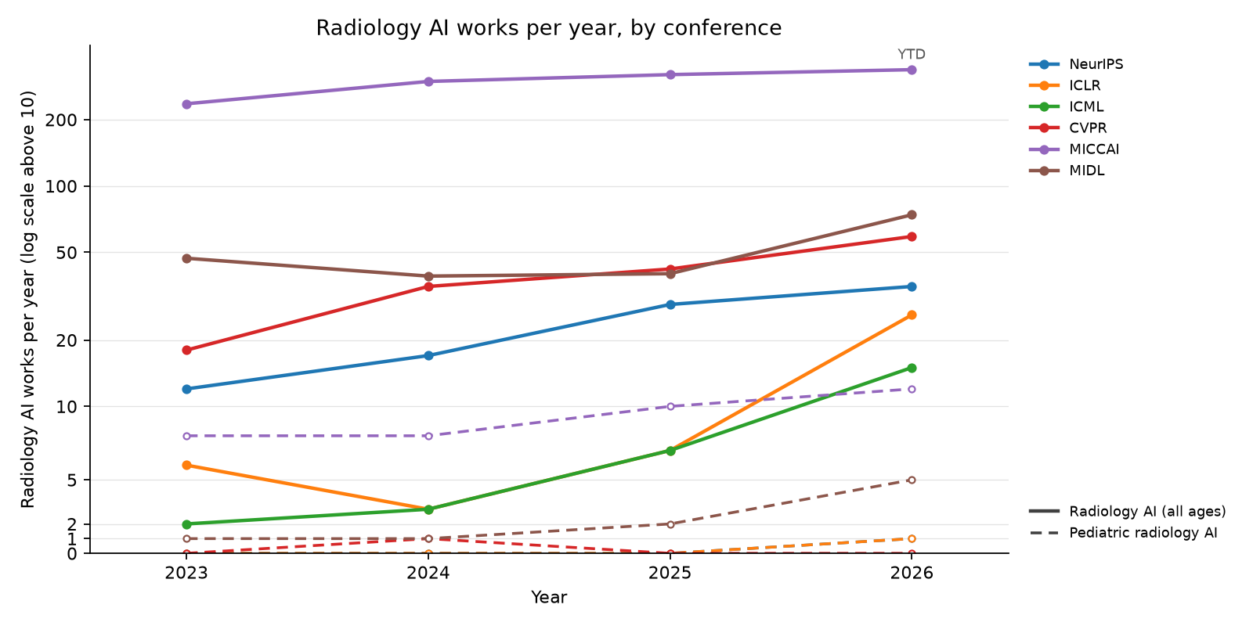
Radiology AI works per year, by conference
CONFERENCES
19 / 49

Slide 20
NeurIPS: radiology AI works, 2023–2026
CONFERENCES
Conference on Neural Information Processing Systems. Radiology-AI works accepted (from the meeting's paper list), 2023–2026: 58 (2023: 12, 2024: 17, 2025: 29); 0 pediatric (marked ★).
Year | Cites | FWCI | Paper
2025 | 24 | – | 3D-RAD: A Comprehensive 3D Radiology Med-VQA Dataset with Multi-Temporal Analysis and Diverse Diagnostic Tasks
2025 | 20 | – | Better Tokens for Better 3D: Advancing Vision-Language Modeling in 3D Medical Imaging
2024 | 47 | 2.0 | Touchstone Benchmark: Are We on the Right Way for Evaluating AI Algorithms for Medical Segmentation?
2024 | 26 | 0.9 | Eye-gaze Guided Multi-modal Alignment for Medical Representation Learning
2024 | 25 | 1.2 | Enhancing vision-language models for medical imaging: bridging the 3D gap with innovative slice selection
2024 | 20 | – | DiffusionBlend: Learning 3D Image Prior through Position-aware Diffusion Score Blending for 3D Computed Tomography Reconstruction
2023 | 144 | – | SegVol: Universal and Interactive Volumetric Medical Image Segmentation
2023 | 104 | – | LVM-Med: Learning Large-Scale Self-Supervised Vision Models for Medical Imaging via Second-order Graph Matching
2023 | 72 | – | EHRXQA: A Multi-Modal Question Answering Dataset for Electronic Health Records with Chest X-ray Images
2023 | 66 | – | SwiFT: Swin 4D fMRI Transformer
2023 | 64 | – | NeuroGraph: Benchmarks for Graph Machine Learning in Brain Connectomics
2023 | 19 | – | Knowledge-based in silico models and dataset for the comparative evaluation of mammography AI for a range of breast characteristics, lesion conspicuities and doses
20 / 49

Slide 21
ICLR: radiology AI works, 2023–2026
CONFERENCES
International Conference on Learning Representations. Radiology-AI works accepted (from the meeting's paper list), 2023–2026: 42 (2023: 6, 2024: 3, 2025: 7, 2026: 26); 1 pediatric (marked ★).
Year | Cites | FWCI | Paper
2025 | 70 | – | Large-scale and Fine-grained Vision-language Pre-training for Enhanced CT Image Understanding
2025 | 13 | – | SimXRD-4M: Big Simulated X-ray Diffraction Data and Crystal Symmetry Classification Benchmark
2025 | 9 | – | Self-Supervised Diffusion MRI Denoising via Iterative and Stable Refinement
2025 | 9 | – | Score-based Self-supervised MRI Denoising
2024 | 143 | – | MMed-RAG: Versatile Multimodal RAG System for Medical Vision Language Models
2024 | 31 | – | MediConfusion: Can you trust your AI radiologist? Probing the reliability of multimodal medical foundation models
2024 | 19 | – | The Effect of Intrinsic Dataset Properties on Generalization: Unraveling Learning Differences Between Natural and Medical Images
2024 | 16 | – | LeFusion: Controllable Pathology Synthesis via Lesion-Focused Diffusion Models
2023 | 107 | – | Advancing Radiograph Representation Learning with Masked Record Modeling
2023 | 84 | – | DDM2: Self-Supervised Diffusion MRI Denoising with Generative Diffusion Models
2023 | 40 | – | AE-FLOW: Autoencoders with Normalizing Flows for Medical Images Anomaly Detection
2023 | 18 | – | Improved Training of Physics-Informed Neural Networks Using Energy-Based Priors: a Study on Electrical Impedance Tomography
2026 | – | – | Fetal-Gauge: A Benchmark For Assessing Vision-Language Models In Fetal Ultrasound ★
21 / 49

Slide 22
ICML: radiology AI works, 2023–2026
CONFERENCES
International Conference on Machine Learning. Radiology-AI works accepted (from the meeting's paper list), 2023–2026: 27 (2023: 2, 2024: 3, 2025: 7, 2026: 15); 0 pediatric (marked ★).
Year | Cites | FWCI | Paper
2025 | 21 | – | CLIMB: Data Foundations for Large Scale Multimodal Clinical Foundation Models
2025 | 17 | – | MindLLM: A Subject-Agnostic and Versatile Model for fMRI-to-Text Decoding
2025 | 11 | – | Raptor: Scalable Train-Free Embeddings for 3D Medical Volumes Leveraging Pretrained 2D Foundation Models
2025 | 5 | – | Efficient Noise Calculation in Deep Learning-based MRI Reconstructions
2025 | 2 | – | LangDAug: Langevin Data Augmentation for Multi-Source Domain Generalization in Medical Image Segmentation
2025 | 0 | – | Staged and Physics-Grounded Learning Framework with Hyperintensity Prior for Pre-Contrast MRI Synthesis
2024 | 14 | – | Unsupervised Domain Adaptation for Anatomical Structure Detection in Ultrasound Images
2024 | 10 | – | Adaptive Sampling of k-Space in Magnetic Resonance for Rapid Pathology Prediction
2023 | 17 | – | ACAT: Adversarial Counterfactual Attention for Classification and Detection in Medical Imaging
2023 | 16 | – | Robustness of Deep Learning for Accelerated MRI: Benefits of Diverse Training Data
2023 | 15 | – | Learning High-Order Relationships of Brain Regions
2023 | 8 | – | Contextualized Policy Recovery: Modeling and Interpreting Medical Decisions with Adaptive Imitation Learning
22 / 49

Slide 23
CVPR: radiology AI works, 2023–2026
CONFERENCES
IEEE/CVF Conference on Computer Vision and Pattern Recognition. Radiology-AI works accepted (from the meeting's paper list), 2023–2026: 154 (2023: 18, 2024: 35, 2025: 42, 2026: 59); 1 pediatric (marked ★).
Year | Cites | FWCI | Paper
2025 | 68 | 265.4 | Enhanced Contrastive Learning with Multi-view Longitudinal Data for Chest X-ray Report Generation
2024 | 84 | 47.9 | Towards Generalizable Tumor Synthesis
2024 | 81 | 14.6 | Rethinking Diffusion Model for Multi-Contrast MRI Super-Resolution
2024 | 73 | 13.8 | MemSAM: Taming Segment Anything Model for Echocardiography Video Segmentation
2023 | 243 | 20.2 | Dynamic Graph Enhanced Contrastive Learning for Chest X-Ray Report Generation
2023 | 222 | 75.5 | Ambiguous Medical Image Segmentation Using Diffusion Models
2023 | 217 | 18.7 | METransformer: Radiology Report Generation by Transformer with Multiple Learnable Expert Tokens
2023 | 164 | 21.9 | MCF: Mutual Correction Framework for Semi-Supervised Medical Image Segmentation
2023 | 133 | 14.4 | KiUT: Knowledge-injected U-Transformer for Radiology Report Generation
2023 | 117 | 67.2 | Structure-Aware Sparse-View X-Ray 3D Reconstruction
2023 | 103 | 11.0 | Label-Free Liver Tumor Segmentation
2023 | 75 | 14.1 | Learning Federated Visual Prompt in Null Space for MRI Reconstruction
2024 | 22 | – | M3-UDA: A New Benchmark for Unsupervised Domain Adaptive Fetal Cardiac Structure Detection ★
23 / 49

Slide 24
MICCAI: radiology AI works, 2023–2026
CONFERENCES
Medical Image Computing and Computer-Assisted Intervention. Radiology-AI works accepted (from the meeting's paper list), 2023–2026: 854 (2023: 236, 2024: 298, 2025: 320); 26 pediatric (marked ★).
Year | Cites | FWCI | Paper
2025 | 208 | 1.1 | MedVLM-R1: Incentivizing Medical Reasoning Capability of Vision-Language Models (VLMs) via Reinforcement Learning
2024 | 133 | – | CT2Rep: Automated Radiology Report Generation for 3D Medical Imaging
2024 | 102 | – | Anatomically-Controllable Medical Image Generation with Segmentation-Guided Diffusion Models
2024 | 87 | – | MedCLIP-SAM: Bridging Text and Image Towards Universal Medical Image Segmentation
2023 | 462 | – | MedNeXt: Transformer-driven Scaling of ConvNets for Medical Image Segmentation
2023 | 128 | – | CoLa-Diff: Conditional Latent Diffusion Model for Multi-Modal MRI Synthesis
2023 | 105 | – | DiffMIC: Dual-Guidance Diffusion Network for Medical Image Classification
2023 | 97 | 13.9 | Beyond Adapting SAM: Towards End-to-End Ultrasound Image Segmentation via Auto Prompting
2023 | 95 | – | Self-Supervised MRI Reconstruction with Unrolled Diffusion Models
2023 | 83 | – | Make-A-Volume: Leveraging Latent Diffusion Models for Cross-Modality 3D Brain MRI Synthesis
2023 | 72 | 19.0 | BerDiff: Conditional Bernoulli Diffusion Model for Medical Image Segmentation
2023 | 71 | – | Ariadne's Thread: Using Text Prompts to Improve Segmentation of Infected Areas from Chest X-ray images
24 / 49

Slide 25
MICCAI: pediatric radiology AI works, 2024–2026
CONFERENCES
Year | Population | Paper
2025 | Fetal | Accurate and Efficient Fetal Birth Weight Estimation from 3D Ultrasound
2025 | Fetal | Adaptive Frame Selection for Gestational Age Estimation from Blind Sweep Fetal Ultrasound Videos
2025 | Infant / neonatal | Flexibly Distilled 3D Rectified Flow with Anatomical Constraints for Developmental Infant Brain MRI Prediction
2025 | Fetal | Fusing Radiomic Features with Deep Representations for Gestational Age Estimation in Fetal Ultrasound Images
2025 | Fetal | General Methods Make Great Domain-specific Foundation Models: A Case-study on Fetal Ultrasound
2025 | Fetal | Influence of Classification Task and Distribution Shift Type on OOD Detection in Fetal Ultrasound
2025 | Fetal | Latent Motion Profiling for Annotation-free Cardiac Phase Detection in Adult and Fetal Echocardiography Videos
2025 | Fetal | Robust Fetal Pose Estimation across Gestational Ages via Cross-Population Augmentation
2025 | Fetal | Self-supervised Normality Learning and Divergence Vector-guided Model Merging for Zero-shot Congenital Heart Disease Detection in Fetal Ultrasound Videos
2025 | Fetal | You Can Detect It: Fetal Biometric Estimation Using Ellipse Detection
2024 | Fetal | Cycle-consistent Learning for Fetal Cortical Surface Reconstruction
2024 | Pediatric | Efficient and Gender-adaptive Graph Vision Mamba for Pediatric Bone Age Assessment
2024 | Fetal | Fetal MRI Reconstruction by Global Diffusion and Consistent Implicit Representation
2024 | Fetal | Geometric Transformation Uncertainty for Improving 3D Fetal Brain Pose Prediction from Freehand 2D Ultrasound Videos
2024 | Fetal | Improving cross-domain brain tissue segmentation in fetal MRI with synthetic data
2024 | Fetal | Intrapartum Ultrasound Image Segmentation of Pubic Symphysis and Fetal Head Using Dual Student-Teacher Framework with CNN-ViT Collaborative Learning
2024 | Fetal | Pose-GuideNet: Automatic Scanning Guidance for Fetal Head Ultrasound from Pose Estimation
2024 | Infant / neonatal | Super-Field MRI Synthesis for Infant Brains Enhanced by Dual Channel Latent Diffusion
25 / 49

Slide 26
MIDL: radiology AI works, 2023–2026
CONFERENCES
Medical Imaging with Deep Learning. Radiology-AI works accepted (from the meeting's paper list), 2023–2026: 200 (2023: 47, 2024: 39, 2025: 40, 2026: 74); 9 pediatric (marked ★).
Year | Cites | FWCI | Paper
2024 | 14 | – | Imbalance-aware loss functions improve medical image classification
2023 | 78 | – | Patched Diffusion Models for Unsupervised Anomaly Detection in Brain MRI
2023 | 39 | – | MMCFormer: Missing Modality Compensation Transformer for Brain Tumor Segmentation
2023 | 29 | – | Medical diffusion on a budget: textual inversion for medical image generation
2023 | 23 | – | MProtoNet: A Case-Based Interpretable Model for Brain Tumor Classification with 3D Multi-parametric Magnetic Resonance Imaging
2023 | 22 | – | Diffusion Models for Contrast Harmonization of Magnetic Resonance Images
2023 | 20 | – | Exploring Image Augmentations for Siamese Representation Learning with Chest X-Rays
2023 | 19 | – | 3D Medical Axial Transformer: A Lightweight Transformer Model for 3D Brain Tumor Segmentation
2023 | 19 | – | Vision-Language Modelling For Radiological Imaging and Reports In The Low Data Regime
2023 | 14 | – | E(3) x SO(3)-Equivariant Networks for Spherical Deconvolution in Diffusion MRI
2023 | 14 | – | Amortized Normalizing Flows for Transcranial Ultrasound with Uncertainty Quantification
2023 | 13 | – | Selective experience replay compression using coresets for lifelong deep reinforcement learning in medical imaging
26 / 49

Slide 27
MIDL: pediatric radiology AI works, 2023–2026
CONFERENCES
Year | Population | Paper
2026 | Fetal | Calibration-Aware Semi-Supervised Fetal Head Segmentation with Boundary-Positive Contrast
2026 | Fetal | Orientation-Aware Diffusion Super-Resolution for 3T-Like Fetal MRI from Routine 1.5T Scans
2026 | Fetal | SuD-CoTAN: Sulcal Depth-guided Anatomically Consistent Fetal Cortical Surface Reconstruction
2026 | Fetal | Ultra-ECP: Ellipse-Constrained and Point-Robust Foundation Model Adaptation for Fetal Cardiac Ultrasound Segmentation
2026 | Pediatric | WristMIR: Coarse-to-Fine Region-Aware Retrieval of Pediatric Wrist Radiographs with Radiology Report-Driven Learning
2025 | Fetal | FERN: A Fetal Echocardiography Registration Network for 2D-to-3D Alignment
2025 | Pediatric | GAMBAS: Generalised-Hilbert Mamba for Super-resolution of Paediatric Ultra-Low-Field MRI
2024 | Fetal | Joint Motion Estimation with Geometric Deformation Correction for Fetal Echo Planar Images Via Deep Learning
2023 | Fetal | FUSQA: Fetal Ultrasound Segmentation Quality Assessment
27 / 49

Slide 28
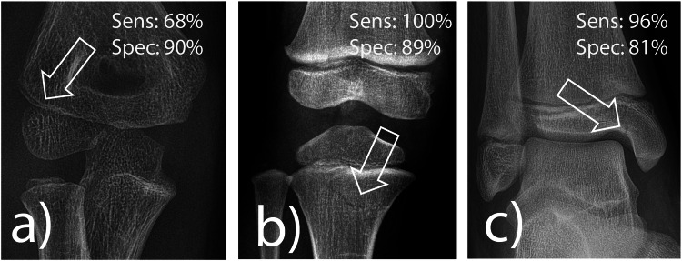
AI fracture detection in a real pediatric emergency department
JOURNALS
Ziegner et al., European Radiology 2025 (second most-cited pediatric paper of 2025)
Problem: fractures in children are missed most often by the least experienced readers, at night, in the emergency department.
Data: 1,672 consecutive radiographs of children under 18 from one tertiary pediatric emergency department, plus a selected medicolegal set (proximal tibia, radial condyle); three pediatric residents read each before and after seeing the AI.
Method: a commercially available, CE-marked deep-learning fracture detector (adult-derived, pediatric extension) run stand-alone and as a second reader.
Result: stand-alone sensitivity 92%, specificity 83%; 100% for proximal tibia but 68% for radial condyle fractures; residents' accuracy rose from 88% to 90%, and in 2% of cases they dropped a correct diagnosis after seeing the AI.
Why it matters: the first real-life pediatric ED evaluation: the gain from a cleared adult tool is real but modest, and the elbow remains the weak spot.
Ziegner et al., Eur Radiol 2025, figure 4: pediatric fractures the software found, with its per-region sensitivity and specificity
source: cdn.ncbi.nlm.nih.gov
28 / 49

Slide 29
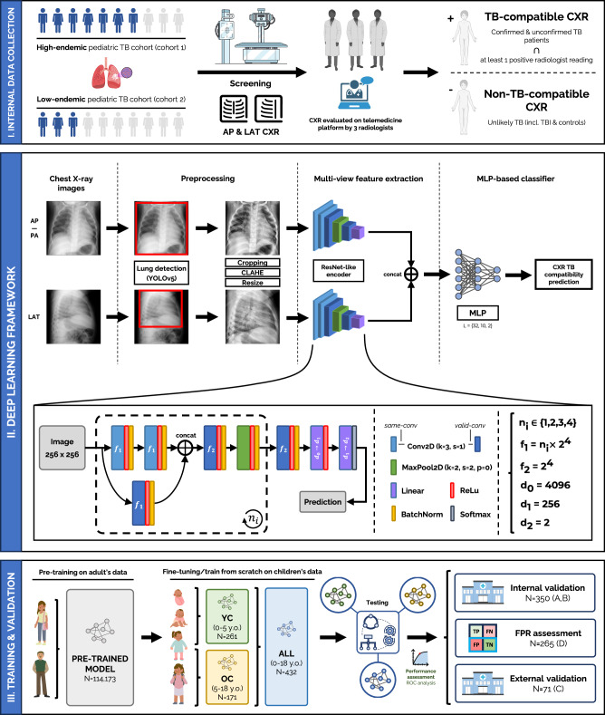
pTBLightNet: pediatric tuberculosis on frontal and lateral chest radiographs
JOURNALS
Capellán-Martín et al., Nature Communications 2025 (open access)
Problem: pediatric pulmonary TB has vaguer symptoms and subtler radiographs than adult TB; most affected children in high-burden settings are never diagnosed.
Data: pre-trained on 114,173 adult chest radiographs, then fine-tuned and tested on 918 radiographs from three pediatric TB cohorts, with lateral views.
Method: a multi-view network that scores frontal and lateral films for TB-compatible findings; separate models for under-5 and 5-18 years.
Result: AUC 0.90 on internal and 0.68 on external testing; lateral views helped most in the youngest children; age-specific models matched larger undifferentiated ones.
Why it matters: shows both the value of adult pre-training for a rare pediatric target and the internal-to-external drop that every pediatric deployment should expect.
Capellan-Martin et al., Nat Commun 2025, figure 1: the multi-view pTBLightNet pipeline
source: cdn.ncbi.nlm.nih.gov
29 / 49

Slide 30
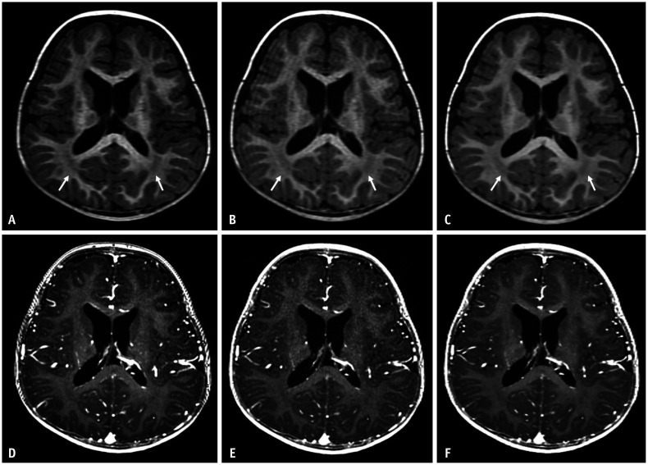
Deep-learning reconstruction shortens pediatric brain MRI
JOURNALS
Yoo et al., Korean Journal of Radiology 2025 (open access)
Problem: long 3D T1 sequences are where children move, sedation is prescribed, and scanner time is lost.
Data: 46 children scanned with both the conventional and an accelerated 3D T1 protocol (pre- and post-contrast) on one 3T scanner.
Method: vendor deep-learning reconstruction applied to the accelerated acquisition; noise, contrast, signal-to-noise and radiologist ratings compared with the conventional scan.
Result: acquisition time cut by 29% (pre-contrast) and 41% (post-contrast); the deep-learning images had lower noise, higher SNR and CNR, better overall quality and fewer artifacts than the conventional scan.
Why it matters: reconstruction AI is on the scanner today and gives children a shorter, better exam without any diagnostic model in the loop.
Yoo et al., Korean J Radiol 2025, figure 2: conventional (A, D) vs accelerated 3D T1 pediatric brain MRI without (B, E) and with (C, F) deep-learning reconstruction
source: cdn.ncbi.nlm.nih.gov
30 / 49

Slide 31
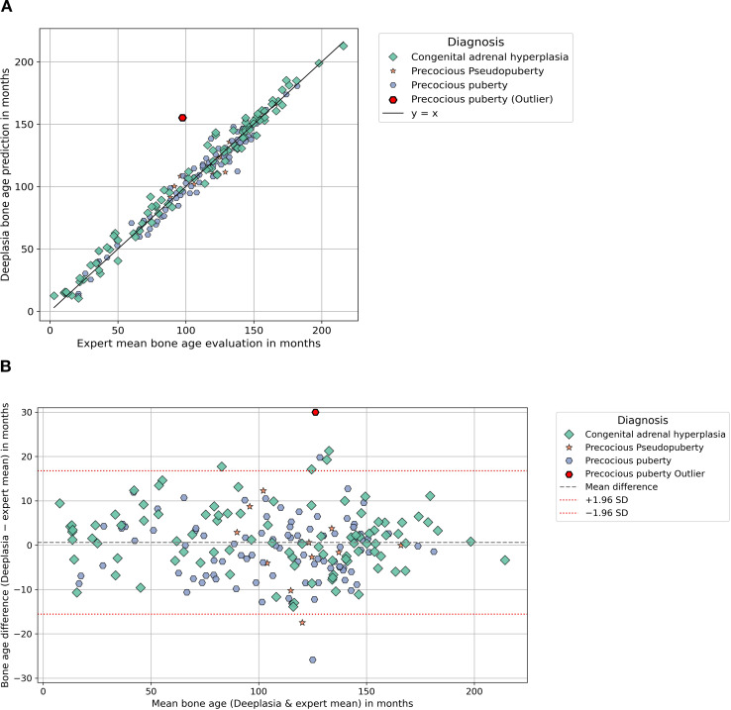
Deeplasia bone age in rare growth disorders, against multiple experts
JOURNALS
Skaf et al., Frontiers in Endocrinology 2026 (open access); external validation of Rassmann et al., Pediatr Radiol 2023
Problem: bone-age models are trained on ordinary hands; the children who need bone age most have syndromes, endocrine disease or lysosomal storage disorders that distort the skeleton.
Data: 1,138 hand radiographs from several centers: SHOX deficiency, Noonan, Silver-Russell, Turner, CAH, precocious puberty (cohort 1) and mucopolysaccharidoses and other storage disorders (cohort 2); two to five expert Greulich-Pyle readings each.
Method: the open-source Deeplasia system run unchanged; each human rater and the model scored against the remaining experts.
Result: mean absolute error 6.0 months (cohort 1) and 7.1 months (storage disorders), 1-year accuracy 90% and 81%; the model beat every individual human rater.
Why it matters: an open pediatric model validated on the hardest cases, by an outside group, on external data: the template for how a children's hospital should test any tool.
Skaf et al., Front Endocrinol 2026, figure 1: Deeplasia bone age vs the expert mean in the endocrine cohort (scatter and Bland-Altman)
source: cdn.ncbi.nlm.nih.gov
31 / 49

Slide 32
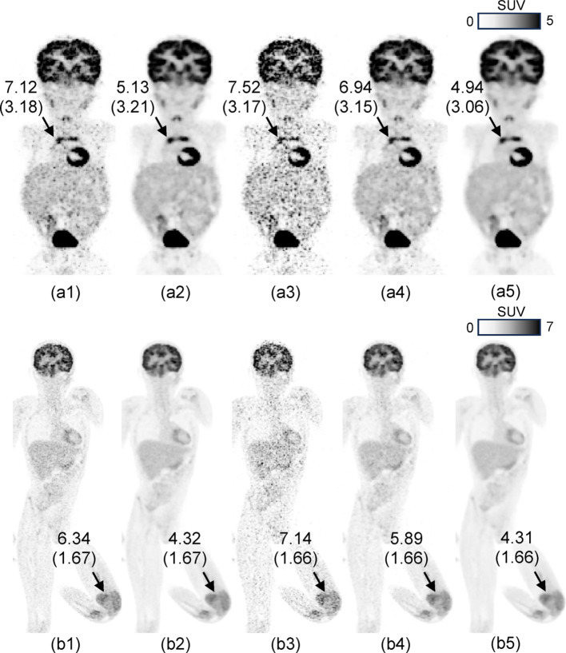
Pediatric PET at one fifth of the counts with patch-based deep learning
JOURNALS
Han et al., EJNMMI Physics 2026 (open access; Cincinnati Children's)
Problem: PET dose and scan time in children are set by noise; conventional denoising networks need large training sets that pediatric PET does not have.
Data: one high-quality pediatric exam for training; a NEMA phantom and 88 clinical whole-body FDG exams (under 12 years) with list-mode data truncated from 90 s to 20 s per bed.
Method: a patch-based network that learns local structure from a single exam and denoises the reduced-count images; blinded observer study and SUV analysis.
Result: 20-second images rated equal or better than the standard 90-second images in more than 85% of cases, with resolution, contrast and SUV preserved.
Why it matters: either a 4.5x shorter scan or about 22% of today's injected activity, from a method trainable on a single local exam.
Han et al., EJNMMI Phys 2026, figure 5: pediatric whole-body FDG PET, standard 90 s vs 20 s per bed, with and without patch-based deep-learning denoising
source: cdn.ncbi.nlm.nih.gov
32 / 49

Slide 33
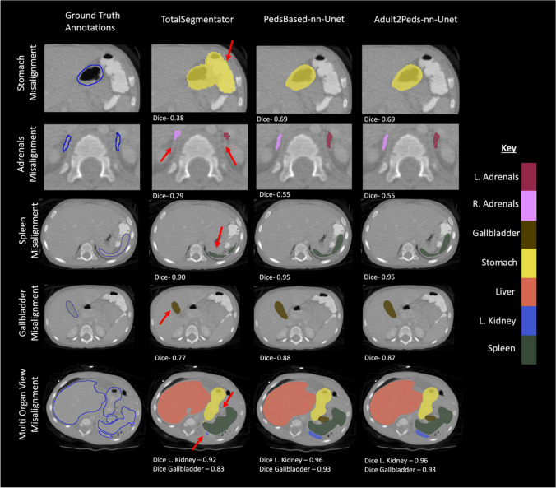
Children are not small adults: an adult CT segmentation model in children
JOURNALS
Chatterjee et al., Journal of Imaging Informatics in Medicine 2025
Problem: the most-used open CT organ segmentation model (TotalSegmentator) was trained on adults; nobody had measured how it behaves in children.
Data: external adult (n = 300) and pediatric (n = 359) abdominal CT sets with expert organ labels.
Method: TotalSegmentator scored on both sets; then a pediatric-only nnU-Net and an adult model fine-tuned on pediatric cases.
Result: mean Dice fell from 0.81 in adults to 0.73 in children, worst for the adrenals (0.69 to 0.41 and 0.35), duodenum and pancreas; pediatric training or fine-tuning recovered the loss.
Why it matters: the clearest quantitative case for local pediatric validation and fine-tuning of adult-derived tools before clinical use.
Chatterjee et al., J Imaging Inform Med 2025, figure 7: pediatric CT organ labels, ground truth vs adult-trained TotalSegmentator vs pediatric-trained models
source: cdn.ncbi.nlm.nih.gov
33 / 49

Slide 34
The biggest public pediatric radiology AI datasets
DATASETS
Dataset | Year | Modality | Size | Ages | Access
CBTN clinical MRI (Children's Brain Tumor Network) | 2023 | brain / spine tumor MRI | 23,101 exams (1,526 patients); tumor masks for 370 | pediatric | application (NCI CCDI)
GRAZPEDWRI-DX | 2022 | wrist radiographs (trauma) | 20,327 images (6,091 patients) | 0.2–19 y | open
RSNA Pediatric Bone Age Challenge | 2017 | hand radiographs | 14,236 images (bone age + sex) | mean 10.6 y | open (RSNA terms)
FETAL_PLANES_DB | 2020 | fetal ultrasound (standard planes) | 12,400 images (1,792 pregnancies) | fetal | open
ABCD Study | 2018– | brain MRI, longitudinal | 11,878 participants, up to 7 follow-ups | 9–10 y at baseline | application (NBDC)
PediCXR / VinDr-PCXR | 2023 | chest radiographs | 9,125 studies; 36 findings, 15 diagnoses | 10 y | credentialed (PhysioNet)
Guangzhou pediatric chest X-ray (Kermany) | 2018 | chest radiographs | 5,856 images (normal / bacterial / viral pneumonia) | 1–5 y | open
ABIDE I + II (autism) | 2012 / 2016 | brain MRI (structural, resting fMRI) | 2,156 subjects | 5–64 y (mostly children) | open
Regensburg Pediatric Appendicitis | 2023 | abdominal ultrasound + labs | 1,709 images (579 patients) | 0–18 y | open
dHCP (Developing Human Connectome Project) | 2022–24 | neonatal + fetal brain MRI | 886 neonatal + 297 fetal datasets, with segmentations | 20–45 weeks | open (NDA)
Pediatric-CT-SEG (TCIA) | 2022 | chest / abdomen / pelvis CT | 718 series (359 patients); 29 organ contours | 5 days – 16 y | open
BraTS-PEDs (pediatric brain tumor challenge) | 2023–25 | brain tumor MRI | 464 patients (2024 challenge); 1,649 series on TCIA | pediatric | registration / TCIA
FeTA (fetal brain tissue annotation) | 2021–24 | fetal brain MRI | 280 volumes (120 train + 160 test); 7 tissue labels | 18–35 weeks | registration
34 / 49

Slide 35
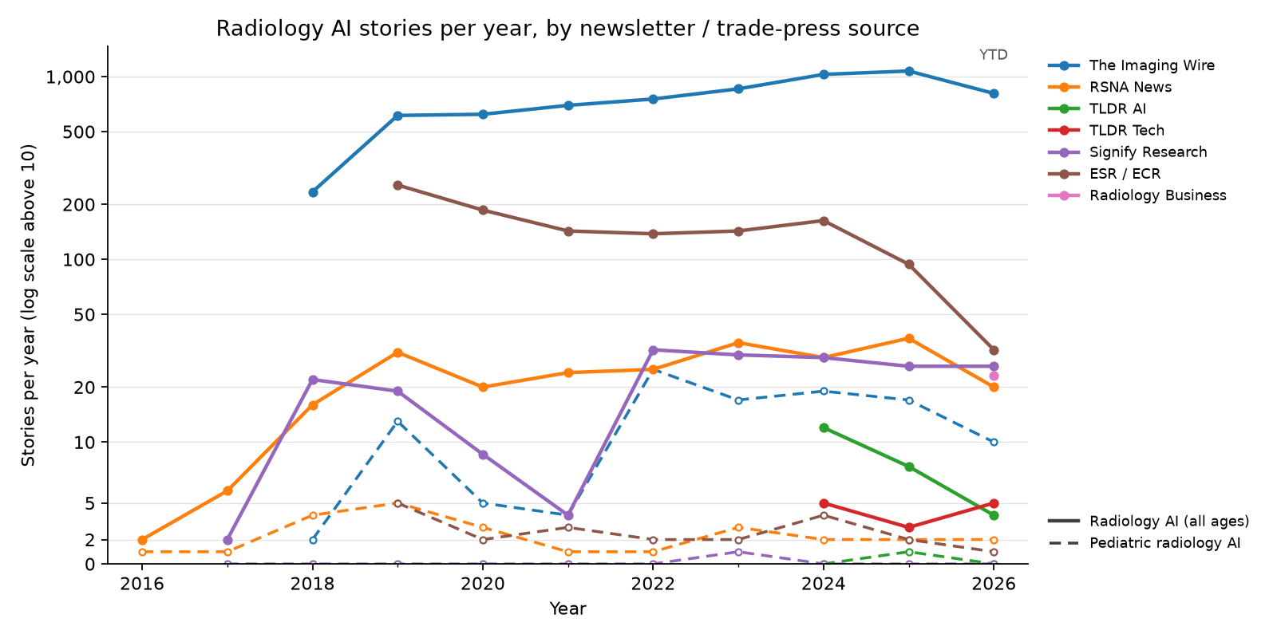
Radiology AI newsletter stories per year, by source
NEWSLETTERS
35 / 49

Slide 36
Pediatric radiology AI in the trade press, 2023 (23 stories)
NEWSLETTERS
Date | Newsletter | Story | Paper
2023-01-08 | The Imaging Wire | Gestational Age AI
2023-03-01 | The Imaging Wire | Fetal Ultrasound AI Generalizability | Sendra-Balcells et al., 2023 (Scientific Reports)
2023-03-08 | ESR / ECR | ECR 2023 – A true celebration of the cycle of life.
2023-03-17 | The Imaging Wire | When Sao Paolo's Diagnosticos da America (DASA, the world's fourth largest diagn
2023-04-07 | The Imaging Wire | Ultrasound Spots Breech Pregnancies | Knights et al., 2023 (PLOS Medicine)
2023-04-07 | The Imaging Wire | When Sao Paolo's Diagnosticos da America SA (DASA, the world's fourth largest di
2023-04-12 | Signify Research | Where do opportunities exist?
2023-04-12 | RSNA News | RSNA Webinar to Examine Impact of Large Language Models
2023-05-07 | The Imaging Wire | New C-Arm Launched
2023-06-07 | The Imaging Wire | BrightHeart's Fetal Heart AI
2023-06-12 | RSNA News | Understanding the Imaging Spectrum of non-Hodgkin Lymphoma in Children, Adolescents and Young Adults
2023-06-19 | The Imaging Wire | Better Together at SIIM
2023-06-25 | The Imaging Wire | AI Detects Child Abuse on CT
2023-07-07 | RSNA News | Survivors of Childhood Cancer: Risk of Future Disease, Screening Needs and the Role of Radiology
2023-08-02 | The Imaging Wire | MRI Radiomics Hones in on Crohn's | Liu et al., 2024 (American Journal of Roentgenology)
2023-08-02 | The Imaging Wire | Sonio Gets FDA Nod for Fetal AI
2023-09-20 | The Imaging Wire | GE Lands $44M AI Ultrasound Grant
2023-10-08 | The Imaging Wire | ChatGPT Reports for Patients | Jeblick et al., 2023 (European Radiology)
2023-11-08 | The Imaging Wire | Philips to Expand AI-Powered POCUS
2023-11-08 | The Imaging Wire | Stories of Success in Cloud and AI
2023-11-12 | The Imaging Wire | Uneven Success Against Breast Cancer | Pediatric Radiation
2023-11-26 | The Imaging Wire | AI of MRI Diagnoses Autism
2023-12-11 | ESR / ECR | Revolutionising paediatric radiology: the future impact of AI
36 / 49

Slide 37
Pediatric radiology AI in the trade press, 2024 (25 stories)
NEWSLETTERS
Date | Newsletter | Story | Paper
2024-01-10 | The Imaging Wire | AI Models Go Head-to-Head in Project AIR Study | van Leeuwen et al., 2024 (Radiology)
2024-01-15 | ESR / ECR | Hidden health risks of endocrine disruptors?
2024-01-17 | The Imaging Wire | Echo AI's RHD Impact | Brown et al., 2024 (Journal of the American Heart Association)
2024-01-20 | The Imaging Wire | Us2.ai
2024-02-07 | The Imaging Wire | Meet Gleamer at ECR 2024
2024-03-20 | The Imaging Wire | AI Helps Residents Detect Fractures
2024-04-22 | The Imaging Wire | GE Launches US Scanners
2024-05-19 | The Imaging Wire | Early Preeclampsia Risk Screening | Guerby et al., 2024 (Hypertension)
2024-06-29 | The Imaging Wire | FDA Clears New Clarius Prenatal App
2024-07-01 | ESR / ECR | AI applications in musculoskeletal imaging
2024-07-10 | RSNA News | Experts Outline Considerations to Deploy AI in Radiology
2024-08-14 | The Imaging Wire | Cardiac Ultrasound Scanner Cleared
2024-08-25 | The Imaging Wire | When Follow-Up Falls Short | Pediatric CT Use
2024-08-25 | The Imaging Wire | MAUI Emerges from Stealth
2024-09-04 | The Imaging Wire | Samsung Finalizes Sonio Acquisition
2024-09-08 | The Imaging Wire | AZmed AI Extended to Kids
2024-10-03 | ESR / ECR | On Artificial Intelligence: An interview with Susan Shelmerdine
2024-10-06 | The Imaging Wire | Fracture AI Improves Over Time
2024-10-10 | The Imaging Wire | Low-Dose CT in Kids | Hinton Nabs Nobel, Cancels MRI
2024-10-10 | The Imaging Wire | Low-Dose CT Confounds CAD in Kids | Hardie et al., 2025 (American Journal of Roentgenology)
2024-10-17 | ESR / ECR | On Artificial Intelligence: An interview with Brendan Kelly
2024-11-19 | RSNA News | Incorrect AI Advice Influences Diagnostic Decisions
2024-11-25 | The Imaging Wire | Fetal Ultrasound AI Cleared
2024-12-02 | The Imaging Wire | Milvue Joins deepc AI Platform
2024-12-15 | The Imaging Wire | Researchers Study AI for Pediatric Fractures
37 / 49

Slide 38
Pediatric radiology AI in the trade press, 2025 (22 stories)
NEWSLETTERS
Date | Newsletter | Story | Paper
2025-01-08 | The Imaging Wire | AI for Pediatric Fracture Detection
2025-01-08 | The Imaging Wire | Children's National taps Microsoft to prototype AI tools .
2025-01-29 | The Imaging Wire | Samsung Launches OB/GYN Ultrasound
2025-02-02 | The Imaging Wire | Ultrasound AI Detects Fetal Defects
2025-02-06 | ESR / ECR | Philips at #ECR2025: New AI-enabled systems, intelligent software, and imaging cloud services streamline radiology workflows, advance clinical insights
2025-02-14 | ESR / ECR | Learn more about FUJIFILM's latest innovations at ECR! | Iwan et al., 2020 (European Radiology)
2025-02-27 | The Imaging Wire | AI Detects Pediatric Epilepsy
2025-03-04 | TLDR AI | AI to diagnose invisible brain abnormalities in children with epilepsy (4 minute read)
2025-04-02 | The Imaging Wire | AZmed Gets New Chest AI Clearances
2025-04-13 | The Imaging Wire | GE's Cincinnati Pediatric Partnership
2025-05-14 | The Imaging Wire | Philips Partners with NVIDIA on AI for MRI
2025-05-18 | The Imaging Wire | New GE Clearances
2025-05-20 | RSNA News | Radiologists Share Tips to Prevent AI Bias
2025-06-01 | The Imaging Wire | BrightHeart's 3rd FDA Clearance
2025-07-03 | The Imaging Wire | DeepEcho Gets FDA Nod for Fetal AI
2025-07-10 | RSNA News | How Is AI Being Used in Daily Neuroradiology Practice?
2025-08-03 | The Imaging Wire | Radiologist Pay Jumps Nearly 8% in New Survey
2025-08-13 | The Imaging Wire | AI-Assisted Fracture Detection
2025-08-27 | The Imaging Wire | Sonio Launches New Maternal-Fetal AI Options
2025-10-01 | The Imaging Wire | Carebot Expands AI Portfolio
2025-10-08 | The Imaging Wire | Reducing CT Radiation Dose System-Wide
2025-11-09 | The Imaging Wire | AI Detects Pediatric Elbow Fractures
38 / 49

Slide 39
Pediatric radiology AI in the trade press, 2026 (year to date) (13 stories)
NEWSLETTERS
Date | Newsletter | Story | Paper
2026-01-07 | The Imaging Wire | BrightHeart Raises EUR 11M
2026-01-28 | The Imaging Wire | AHA Publishes New Stroke Guidelines | Prabhakaran et al., 2026 (Stroke)
2026-01-28 | ESR / ECR | Guerbet: Innovation and French Cooperation in the Spotlight at ECR 2026
2026-02-01 | The Imaging Wire | DL-Based CT Reduces Radiation Dose
2026-02-08 | The Imaging Wire | GE Bolsters Ultrasound with Fetal AI
2026-02-26 | ESR / ECR | MRI Unveiling at the
2026-03-29 | The Imaging Wire | Ultrasound AI Gets Breakthrough Nod
2026-05-10 | The Imaging Wire | Pediatric MRI Safety, RTs and Remote Radiology, and PSMA-PET
2026-06-22 | RSNA News | Researchers Use AI to Establish Body Charts for CT Imaging Across the Adult Lifespan
2026-06-28 | The Imaging Wire | BrightHeart's Bright Future | Zelop et al., 2025 (Obstetrics & Gynecology)
2026-07-12 | The Imaging Wire | AI's Rise in Pediatric Imaging | Shah et al., 2026 (European Radiology)
2026-08-16 | The Imaging Wire | CT vs. MRI for Pediatric TBI, Helium Vulnerability, and Ditching the Disk
2026-08-25 | RSNA News | AI Challenges Fuel Innovation Beyond the Leaderboard
39 / 49

Slide 40
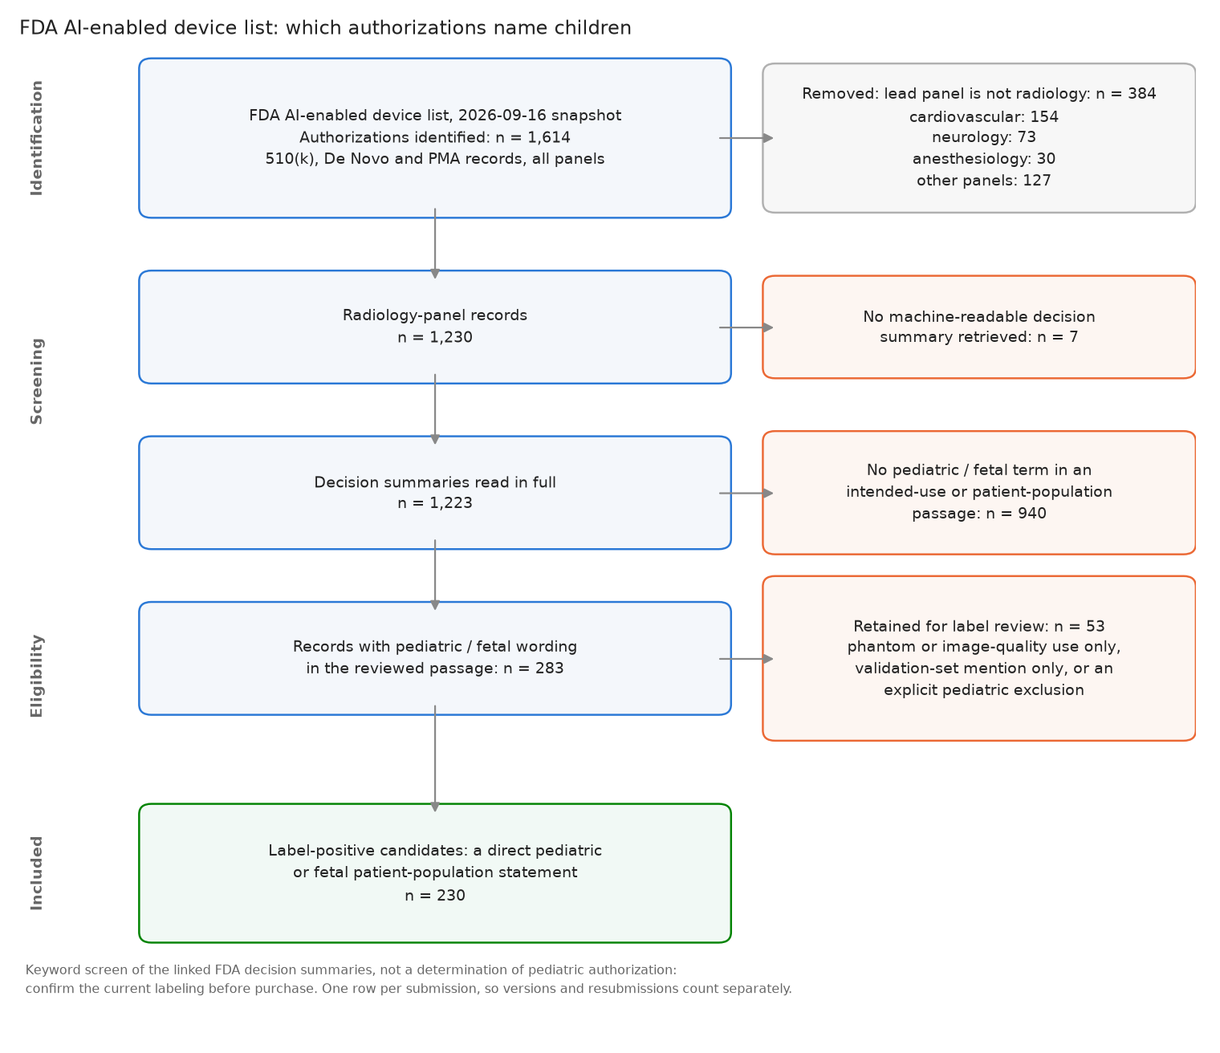
How many cleared devices actually name children?
COMMERCIAL SOFTWARE
230 of the 1,230 radiology-panel authorizations (19%) name a pediatric or fetal population in the labeling passage reviewed; 53 more name children only as a phantom, a validation set or an exclusion, and are kept for label review.
40 / 49

Slide 41
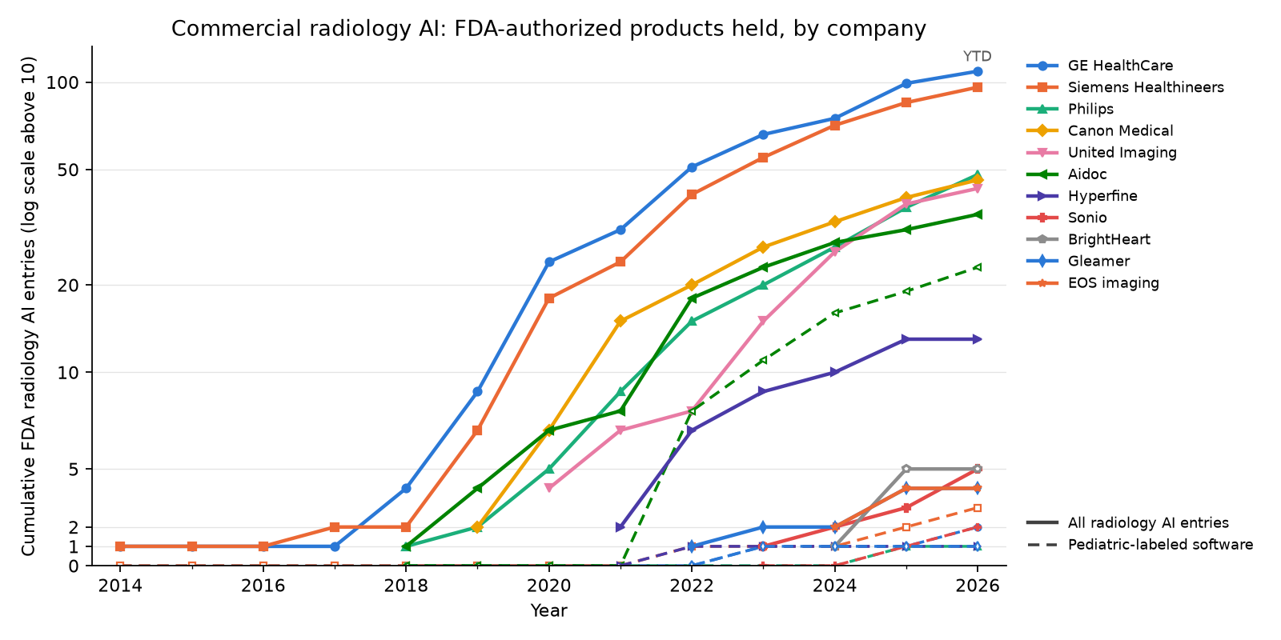
Who is building commercial radiology AI
COMMERCIAL SOFTWARE
41 / 49

Slide 42
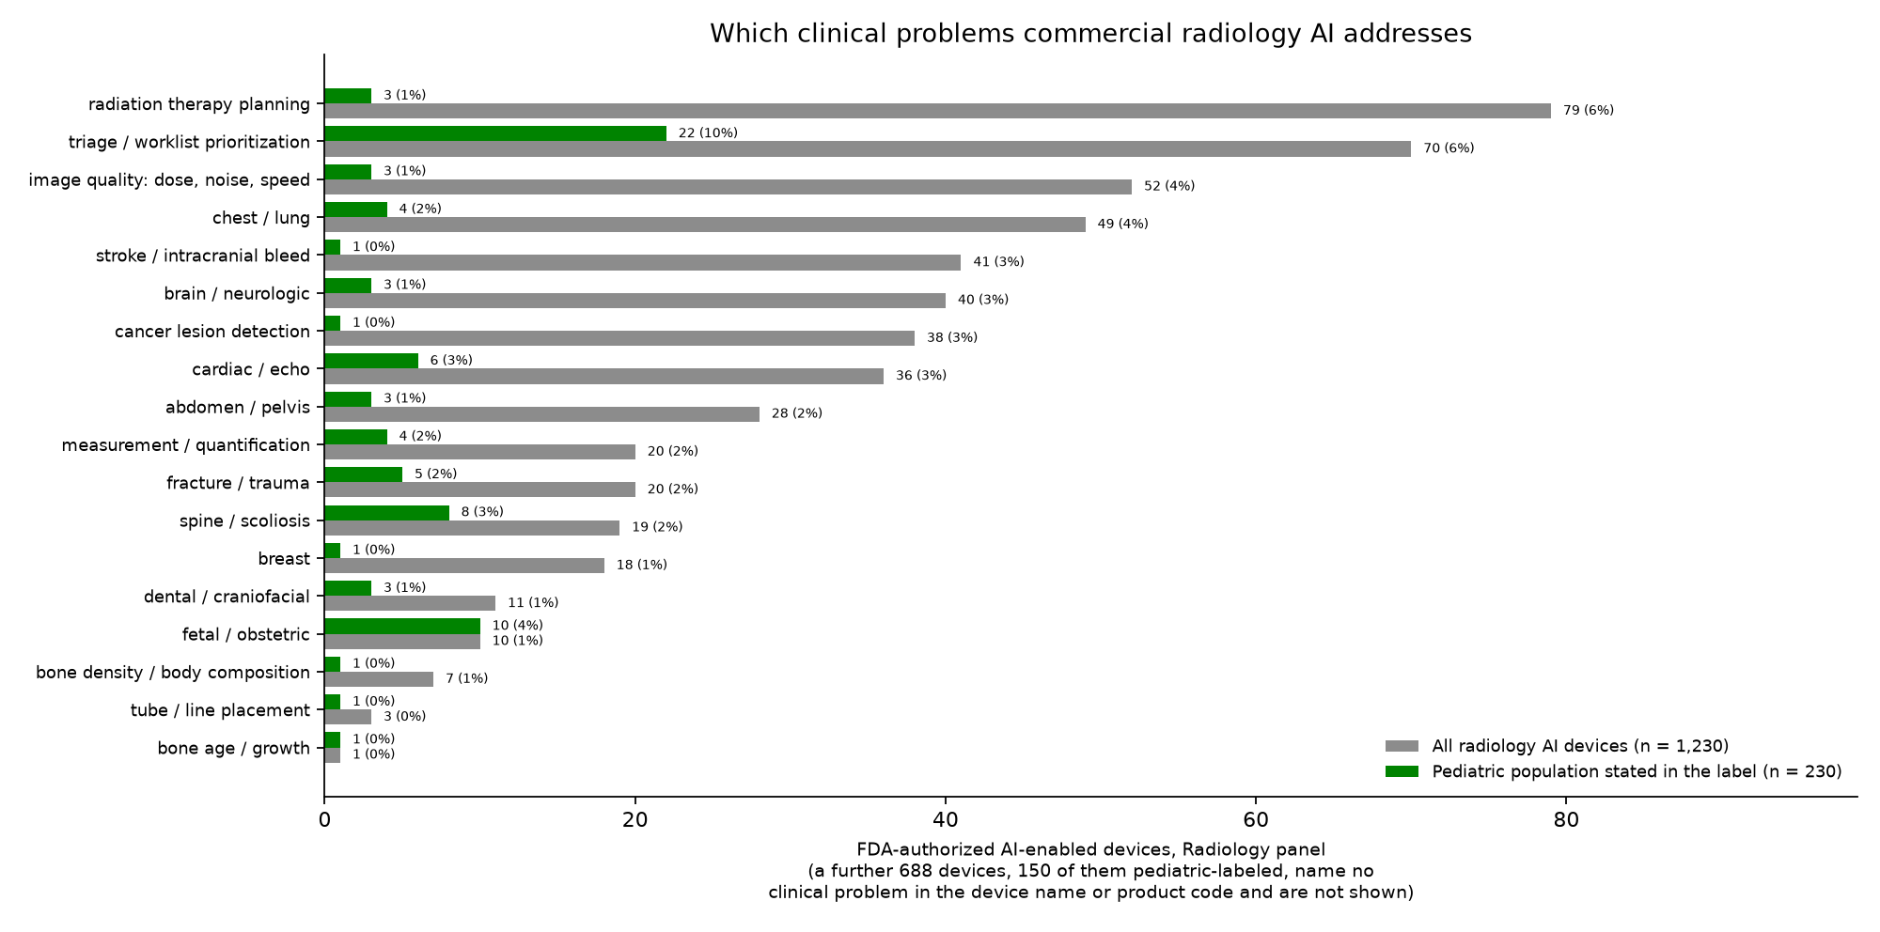
Which clinical problems the cleared products address
COMMERCIAL SOFTWARE
42 / 49

Slide 43
Products a pediatric radiologist should know (part 1)
COMMERCIAL SOFTWARE
Product | Vendor | Clinical problem | What it does | Pediatric scope | Where it stands
BoneXpert | Visiana | bone age / growth | Automated Greulich–Pyle and Tanner–Whitehouse bone age plus a Bone Health Index, from a hand radiograph | Built for children; CE-marked and in routine European use; US research use only | Widely deployed (Europe)
BoneView | Gleamer | fracture / trauma | Fracture detection on trauma radiographs, presented as regions of interest alongside the image | US indication covers ages 2–21 for specified extremity views; pelvis, hip, femur, ribs and spine are adult-only [K222176, 2023] | Widely deployed
Rayvolve (AZtrauma) | AZmed | fracture / trauma | Fracture and MSK finding detection on radiographs; sibling modules cover chest findings, measurements and bone age | US fracture indication from age 2; the bone-age module is CE-marked only [K240845, 2024] | Widely deployed
TechCare Trauma | Milvue | fracture / trauma | Trauma radiograph triage: fractures, effusions and dislocations flagged for the reader | The decision summary states a pediatric population [K242171, 2025] | Early US deployments
EFAI Bonesuite XR Bone Age Pro | Ever Fortune.AI | bone age / growth | Greulich–Pyle bone age from a PA left hand and wrist radiograph, as an adjunct to the radiologist | FDA-cleared for ages 2–16 — the pediatric-specific US bone-age clearance [K234042, 2024] | FDA-cleared, early adoption
Physis | 16 Bit | bone age / growth | Bone-age estimation with Greulich–Pyle atlas matching and draft report text | Pediatric tool; Health Canada licensed, no FDA authorization identified | Promising, limited US access
Fetal EchoScan | BrightHeart | fetal / obstetric | Flags eight morphological findings suspicious for congenital heart disease on second-trimester views | Prenatal by definition: second-trimester exams, maternal age 18+ [K252294, 2025] | Early deployments / pilots
Sonio Detect / Sonio Suspect | Sonio | fetal / obstetric | Checks that the required fetal views were obtained and are of usable quality (Detect); flags images suspicious for anomalies (Suspect) | Prenatal by definition; every FDA entry states a fetal population [K252433, 2026] | Early deployments / pilots
Delivery Date AI | Ultrasound AI | fetal / obstetric | Predicts the delivery date from a second- or third-trimester ultrasound when dating is unreliable | Prenatal; the first De Novo of its kind (a new device class) [DEN250007, 2026] | Newly authorized, unproven in practice
Swoop Portable MR + BrainInsight | Hyperfine | brain / neurologic | Bedside low-field brain MRI whose usable image quality comes from deep-learning reconstruction; BrainInsight adds automated volumes and midline shift | Decision summaries state a pediatric population; the natural use is the NICU and PICU, where transport is the risk [K253489, 2025] | In pediatric pilots
spineEOS / VEA Align | EOS imaging (Alphatec) | spine / scoliosis | Automated 3D spine and lower-limb modeling from biplanar low-dose full-body radiographs | Scoliosis follow-up is repeated imaging of a growing child, so the dose saving compounds [K251747, 2025] | Widely deployed (pediatric orthopedics)
CoLumbo | Smart Soft Healthcare | spine / scoliosis | Spine MRI segmentation, measurement and structured reporting, lumbar and cervical | Decision summaries state a pediatric population; no pediatric-specific performance reported [K254015, 2026] | Early deployments
Square brackets give the FDA submission supporting the pediatric claim and its decision year; a blank means no US authorization was identified for that product. “Where it stands” is our reading of deployment, not a measured adoption rate. A company's total of FDA AI entries is not a pediatric credential — the large vendors' entries are mostly whole scanners whose labels list pediatric imaging as one clinical application (see the authorizations-per-company figure).
43 / 49

Slide 44
Products a pediatric radiologist should know (part 2)
COMMERCIAL SOFTWARE
Product | Vendor | Clinical problem | What it does | Pediatric scope | Where it stands
BriefCase-Triage (CARE modules) | Aidoc | triage / worklist prioritization | Worklist triage on CT and CTA: intracranial hemorrhage, pulmonary embolism, pneumothorax, cervical-spine and rib fractures, free gas and more | Most entries state a pediatric population; the evidence behind them is adult, so treat pediatric use as local validation work [K253578, 2026] | Widely deployed
Viz LVO / Viz ICH | Viz.ai | stroke / intracranial bleed | Detects large-vessel occlusion and intracranial hemorrhage and pushes the case to the stroke team's phones | No pediatric population statement found in the screened summaries; pediatric stroke use would be off-label | Widely deployed (adult)
qXR-TB | Qure.ai | chest / lung | Chest radiograph screening for tuberculosis, built for high-burden settings with few readers | Vendor reports CE-marked use from age 0–15; US eligibility varies by module | Deployed in global-health screening
AIR Recon DL / TrueFidelity | GE HealthCare | image quality: dose, noise, speed | Deep-learning reconstruction: shorter MRI acquisitions at the same quality, and CT images at lower dose | Sold across ages; the pediatric benefit is fewer sedations and less dose, and it is the AI most children actually meet | Widely deployed
Deep Resolve | Siemens Healthineers | image quality: dose, noise, speed | MRI deep-learning denoising and resolution enhancement that supports accelerated acquisition | Vendor publishes pediatric protocols; scan-time reduction is the pediatric argument | Widely deployed
AiCE | Canon Medical | image quality: dose, noise, speed | Deep-learning reconstruction for both CT (noise, dose) and MRI (noise, resolution, scan time) | Vendor publishes pediatric CT galleries; protocol and version determine what is available | Widely deployed
SmartSpeed / Precise Image | Philips | image quality: dose, noise, speed | MRI acceleration with deep-learning reconstruction (SmartSpeed); CT reconstruction at reduced dose (Precise Image) | Sold across ages; pediatric protocols are the vendor's own, not a separate indication | Widely deployed
SubtleMR / SwiftMR | Subtle Medical / AIRS Medical | image quality: dose, noise, speed | Vendor-neutral MRI post-processing: denoising and sharpening so a shorter acquisition still reads | No adult-only restriction in the reviewed US indications; SwiftMR's 2026 validation includes ages 0–21 | Deployed, vendor-neutral retrofit
Butterfly iQ3; Clarius Bladder AI | Butterfly Network / Clarius | point-of-care ultrasound | Handheld ultrasound with on-device AI: bladder volume, gestational age, ejection fraction, lung and nerve tools | The scanners are labeled for adult and pediatric imaging, but each AI tool carries its own age scope and most are adult-only; Clarius Bladder AI covers ages 2 and over [K232257, 2023] | Scanners widely deployed; AI tools mostly adult-scoped
Arterys Cardio DL | Arterys (Tempus) | cardiac / echo | Cardiac MRI segmentation, flow and volume quantification with a cloud workflow | One of the earliest AI clearances to name neonates, infants, children and adolescents outright (2017) [K163253, 2017] | Historically important; now a Tempus product
Acorn 3D | Mighty Oak Medical | spine / scoliosis | Automated vertebral segmentation from CT to build patient-specific 3D models and surgical guides | Decision summaries state a pediatric population; the use case is pediatric deformity surgery [K260322, 2026] | Niche, surgical
Second Opinion Pediatric | Pearl | dental / craniofacial | Detects caries and other findings on pediatric dental radiographs | The rare device whose name and indication are pediatric from the start [K243893, 2025] | Deployed in dentistry
Square brackets give the FDA submission supporting the pediatric claim and its decision year; a blank means no US authorization was identified for that product. “Where it stands” is our reading of deployment, not a measured adoption rate. A company's total of FDA AI entries is not a pediatric credential — the large vendors' entries are mostly whole scanners whose labels list pediatric imaging as one clinical application (see the authorizations-per-company figure).
44 / 49

Slide 45
An independent scoping review of pediatric radiology AI
REVIEWS
Kamran et al., Pediatric Radiology 2026 (https://doi.org/10.1007/s00247-025-06462-5doi 10.1007/s00247-025-06462-5)
Scope: 789 pediatric-focused original articles, 2005–August 2024.
Modalities: radiography 38%, MRI 33%, ultrasound 14%, CT 11%, nuclear 2%.
Top applications: bone age (88), pneumonia (65), brain tumors (54).
Data: 65% used a single-hospital dataset.
45 / 49

Slide 46
ACR white paper: the pediatric AI gap
REVIEWS
Sammer et al., J Am Coll Radiol 2023;20:730–737 (https://doi.org/10.1016/j.jacr.2023.06.003doi 10.1016/j.jacr.2023.06.003)
Scope: ACR Pediatric AI Workgroup white paper framing limited access to pediatric AI as a health equity issue.
Availability: at the time of the review, only 6 of more than 200 FDA-cleared tools in the ACR catalog indicated pediatric use (about 3%).
Why adult AI may fail: growth, disease patterns, and imaging protocols differ; published studies show uneven performance across pediatric subgroups.
Barriers: scarce labeled pediatric data, consent and privacy concerns, and weak financial incentives for smaller pediatric markets.
Recommendations: validate in children, disclose age-specific evidence, fund pediatric development, involve families, and protect pediatric workflows. The authors introduce Image IntelliGently to advance this work.
46 / 49

Slide 47
Multisociety statement: safe pediatric AI implementation
REVIEWS
Shelmerdine et al., J Am Coll Radiol 2026;23:89–101 (https://doi.org/10.1016/j.jacr.2025.08.019doi 10.1016/j.jacr.2025.08.019)
ACR, ESPR, SPR, SLARP, AOSPR, and SPIN propose four pillars for safe adoption:
Regulation and purchasing: pediatric labeling and proposed safety ratings; diverse datasets, subgroup performance, transparency, and cybersecurity.
Implementation and integration: define a local clinical need, select tools validated in children, pilot before scaling, and involve pediatric specialists and families.
Interpretation and postmarket surveillance: retain human oversight; audit performance and patient outcomes; manage discrepancies, report adverse events, and address automation bias.
Education: foundational AI literacy for all staff, pediatric-specific training, continuing education, and patient/public engagement.
47 / 49

Slide 48
Worth knowing as a radiologist
Deep Learning: A Primer for Radiologists (Radiographics paper, 2017): a helpful introduction to the principles and applications of deep learning in radiology; essential for understanding how AI tools work and their limitations
RSNA Pediatric Bone Age Challenge (2017) (benchmark / dataset): a landmark pediatric benchmark; useful for understanding automated bone-age accuracy and its limits
Gleamer BoneView / AZmed Rayvolve (clinical products): examples of fracture-detection assistance with pediatric indications; eligibility depends on age, anatomy, and product version
FDA AI-enabled device list and linked labeling (regulatory resource): a starting point for checking authorized use and pediatric age ranges; the list is not exhaustive
CLAIM checklist (2024 update) (reporting guideline): check whether data, reference standards, and testing are adequately described; reporting completeness alone does not establish clinical benefit
TotalSegmentator (research tool): automated CT / MR organ segmentation for volumes and body composition; check accuracy in children before trusting measurements
nnU-Net (research framework): a strong baseline for training segmentation models; ask whether a new method improves on an appropriate comparator
MedSAM / segment-anything models (research models): prompt-guided contours can assist annotation; radiologists still need to review and correct the output
MONAI (research framework): infrastructure for imaging-AI development; useful when collaborating with a research team, rather than a ready-to-use diagnostic tool
48 / 49

Slide 49
Recommendations for pediatric radiologists
AI development is constrained by scarce public datasets, fragmented institutional data, rare diseases, and heterogeneous reporting practices.
Choose one task worth improving in your practice: bone-age measurements, fracture detection, or reducing CT dose / MRI scan time.
Before adopting a tool, ask which children it was tested on. Check the intended age range and test it on your own cases, including younger children and unusual anatomy.
In a local pilot, measure what changes with AI: reading time, missed findings, false alarms, dose, or scan time. Review errors and keep checking after rollout.
Help build the evidence we need: choose a pediatric problem you see often, label cases carefully, and work with other hospitals to test whether a model works beyond the site that built it.
49 / 49

