Slide 1
Ally: a supervised AI helper for job coaching
HACKREATION × ERI · PROJECT 3: JOB COACH CONNECTION
Client
I am not sure what to do first.
Ally (AI helper)
Step 1: Find aisle 3. Walk to aisle 3. The sign hangs above the shelf.
Fast first answers for the employee.
The coach stays in the loop.
Coach
Thank you for telling me.
Prototype · fictional people and data
Notes:
0:00-0:20. Open with the problem in one sentence: employees with disabilities often find it hard to ask for help, and job coaches cannot be at every worksite. Ally is our answer: a fast first response from an AI, with the coach always in the chat. Say it is a prototype with fictional people.

Slide 2
Asking for help is hard, and coaches cannot be everywhere
1
2
3
Asking is hard
Coaches cover many sites
A blank box is no help
Communication disabilities, not knowing who to contact, or not wanting to interrupt a supervisor.
A coach supports several employees across worksites and cannot always be there in person.
Typing is hard. People need pictures, short words, and a clear next step.
Source: ERI problem statement, Project 3 (Job Coach Connection)
Notes:
Use ERI's own words. This is the problem they gave us. Do not add statistics we have not sourced.

Slide 3
One chat: the client, Ally, and the coach
Client
Ally (AI helper)
Coach
Asks by typing, dictating, or sending a photo. Gets one step at a time.
Answers only from the coach's task guide, in short plain sentences.
Reads everything live, corrects Ally, and can take over at any time.
Ally never claims to be the coach and never promises a reply time.
Notes:
Name the three roles. Stress that Ally is clearly labeled as an AI in the chat, and the coach is a person who can see and override it.

Slide 4
Ally answers from the coach's guide, one step at a time
Client
@ally what is step 2 of stock the shelves?
1
One step at a time
Short, plain sentences. No long lists.
Ally (AI helper)
Step 2: Get your supplies. Get a cart. Get a box cutter. Bring both to the aisle. Did that help?
2
Never guesses
If it is not in the guide, it says so.
Client
@ally the machine I use is not working
3
Does not fix equipment
Ally (AI helper)
Please stop using it. Tell the person in charge.
It tells the client to stop and tell the person in charge.
Notes:
LIVE DEMO about 0:20-1:15. Switch to the iPhone. Client types or dictates the first question, then the machine problem. Then the coach replies in the chat so the audience sees the coach is in the loop.

Slide 5
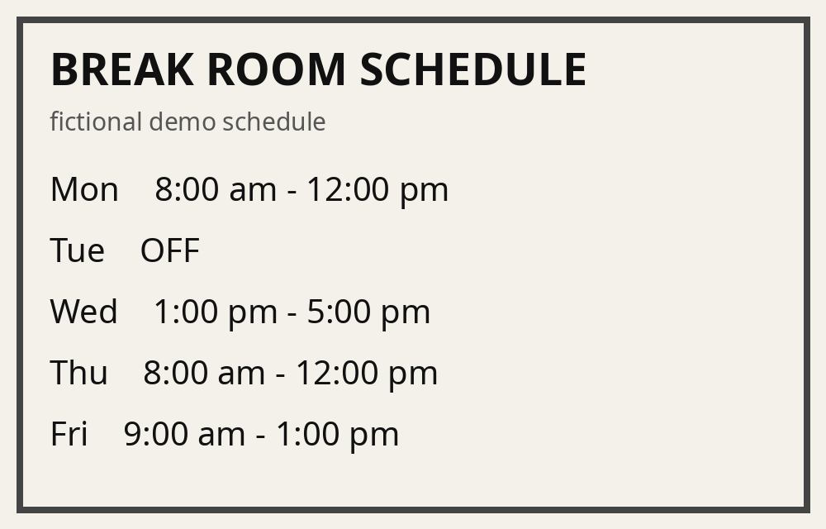
A photo works too, and the coach confirms
Client
@ally What time do I work on Wednesday? (photo attached)
Ally (AI helper)
Wednesday is 1:00 pm - 5:00 pm. Please check with the coach to be sure.
Photos are read in the private channel only. Ally never says hours are certain.
Fictional schedule, made for the demo
Notes:
LIVE DEMO 1:15-1:55. Attach the printed fake schedule photo on the iPhone. If the reading is wrong or slow, say: this is why Ally always tells the client to check with the coach, and let the coach confirm. Never use a real schedule.

Slide 6
Some things always go to a person
1
2
3
Safety or health
Pay and benefits
Not in the guide
Ally gives the 911 line and no medical advice. The coach can read the chat.
Ally points to the coach and to WIPA, 1-877-826-1752. It gives no benefits estimates.
Ally says "I am not sure. The coach can help" and does not guess.
Ally cannot tell if the coach is online, so it never says when the coach will reply.
Notes:
LIVE DEMO 1:55-2:10. Client types: I feel sick. Show the safety message. Point out there is no advice, only the 911 line and the coach.

Slide 7
The employer sees the work, not the client's private help
Client and coach only
Everyone
Client
Coach
Ally
Client
Coach
Employer
Ally
Help requests, confusion, and photos belong here.
Task steps only. Ally will not discuss how the client is doing or read photos.
Employer asks how the client is doing: "I cannot share that. The client can choose to share it."
Notes:
LIVE DEMO 2:10-2:45. Switch to the employer's screen in the Everyone channel. Ask how the client is doing, then ask for the mail cart steps. Point out the support tool is not a monitoring tool: the client's private help stays between the client and the coach.

Slide 8
Built to work with the phone's own accessibility tools
1
Dictation
2
Speak Screen and VoiceOver
Speak a message instead of typing it.
Hear Ally's replies read aloud.
3
Larger Text
4
Guided Access
Bigger words on the phone, and Ally's replies stay plain.
Lock the phone to one app for a calm screen.
Next: a full keyboard and screen reader pass on a real iPhone. We do not claim compliance.
Notes:
Say what these tools are, not that we are accessible. Only claim what you tested on the device before presenting. If you ran VoiceOver or Speak Screen in rehearsal, say exactly that.

Slide 9
A prototype today, real with the right next steps
Today
To ship
Fictional people and workplace
Shared demo accounts on one laptop
The AI helper can be switched off
Real logins and protected transport
Client consent before any AI use
A retention policy and a coach review
Supervised. Simple. Private.
Notes:
2:45-3:00. Be honest about what is real. DVR requires the client's consent before any AI tool sees their information, so production would record consent first. Production also needs real authentication, protected transport, a retention policy, and an ERI-owned AI policy. Then take questions; see DEMO.md for likely ones.

