Slide 1
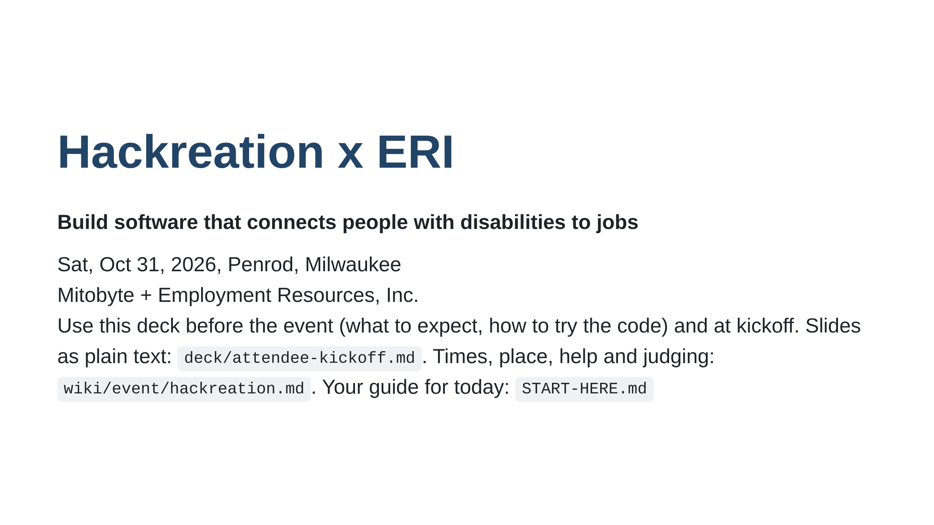
Notes:
Speaker: welcome, thank ERI, Wisconsin Tech Month closer. Read the challenge list aloud. Publish this deck as text next to the slides. Introduce the ERI liaison, and any judge who is here, by name; others are introduced when they arrive. Say where the front-table sheet is. Kickoff target: 10 minutes, hacking by 9:30. SPEAK only these: this one, The theme, The four projects, Three doors, Roles, How you're judged. Everything else is read on your own (before the event it is the whole deck). The rest are read on your own (the text copy is linked on this slide).

Slide 2
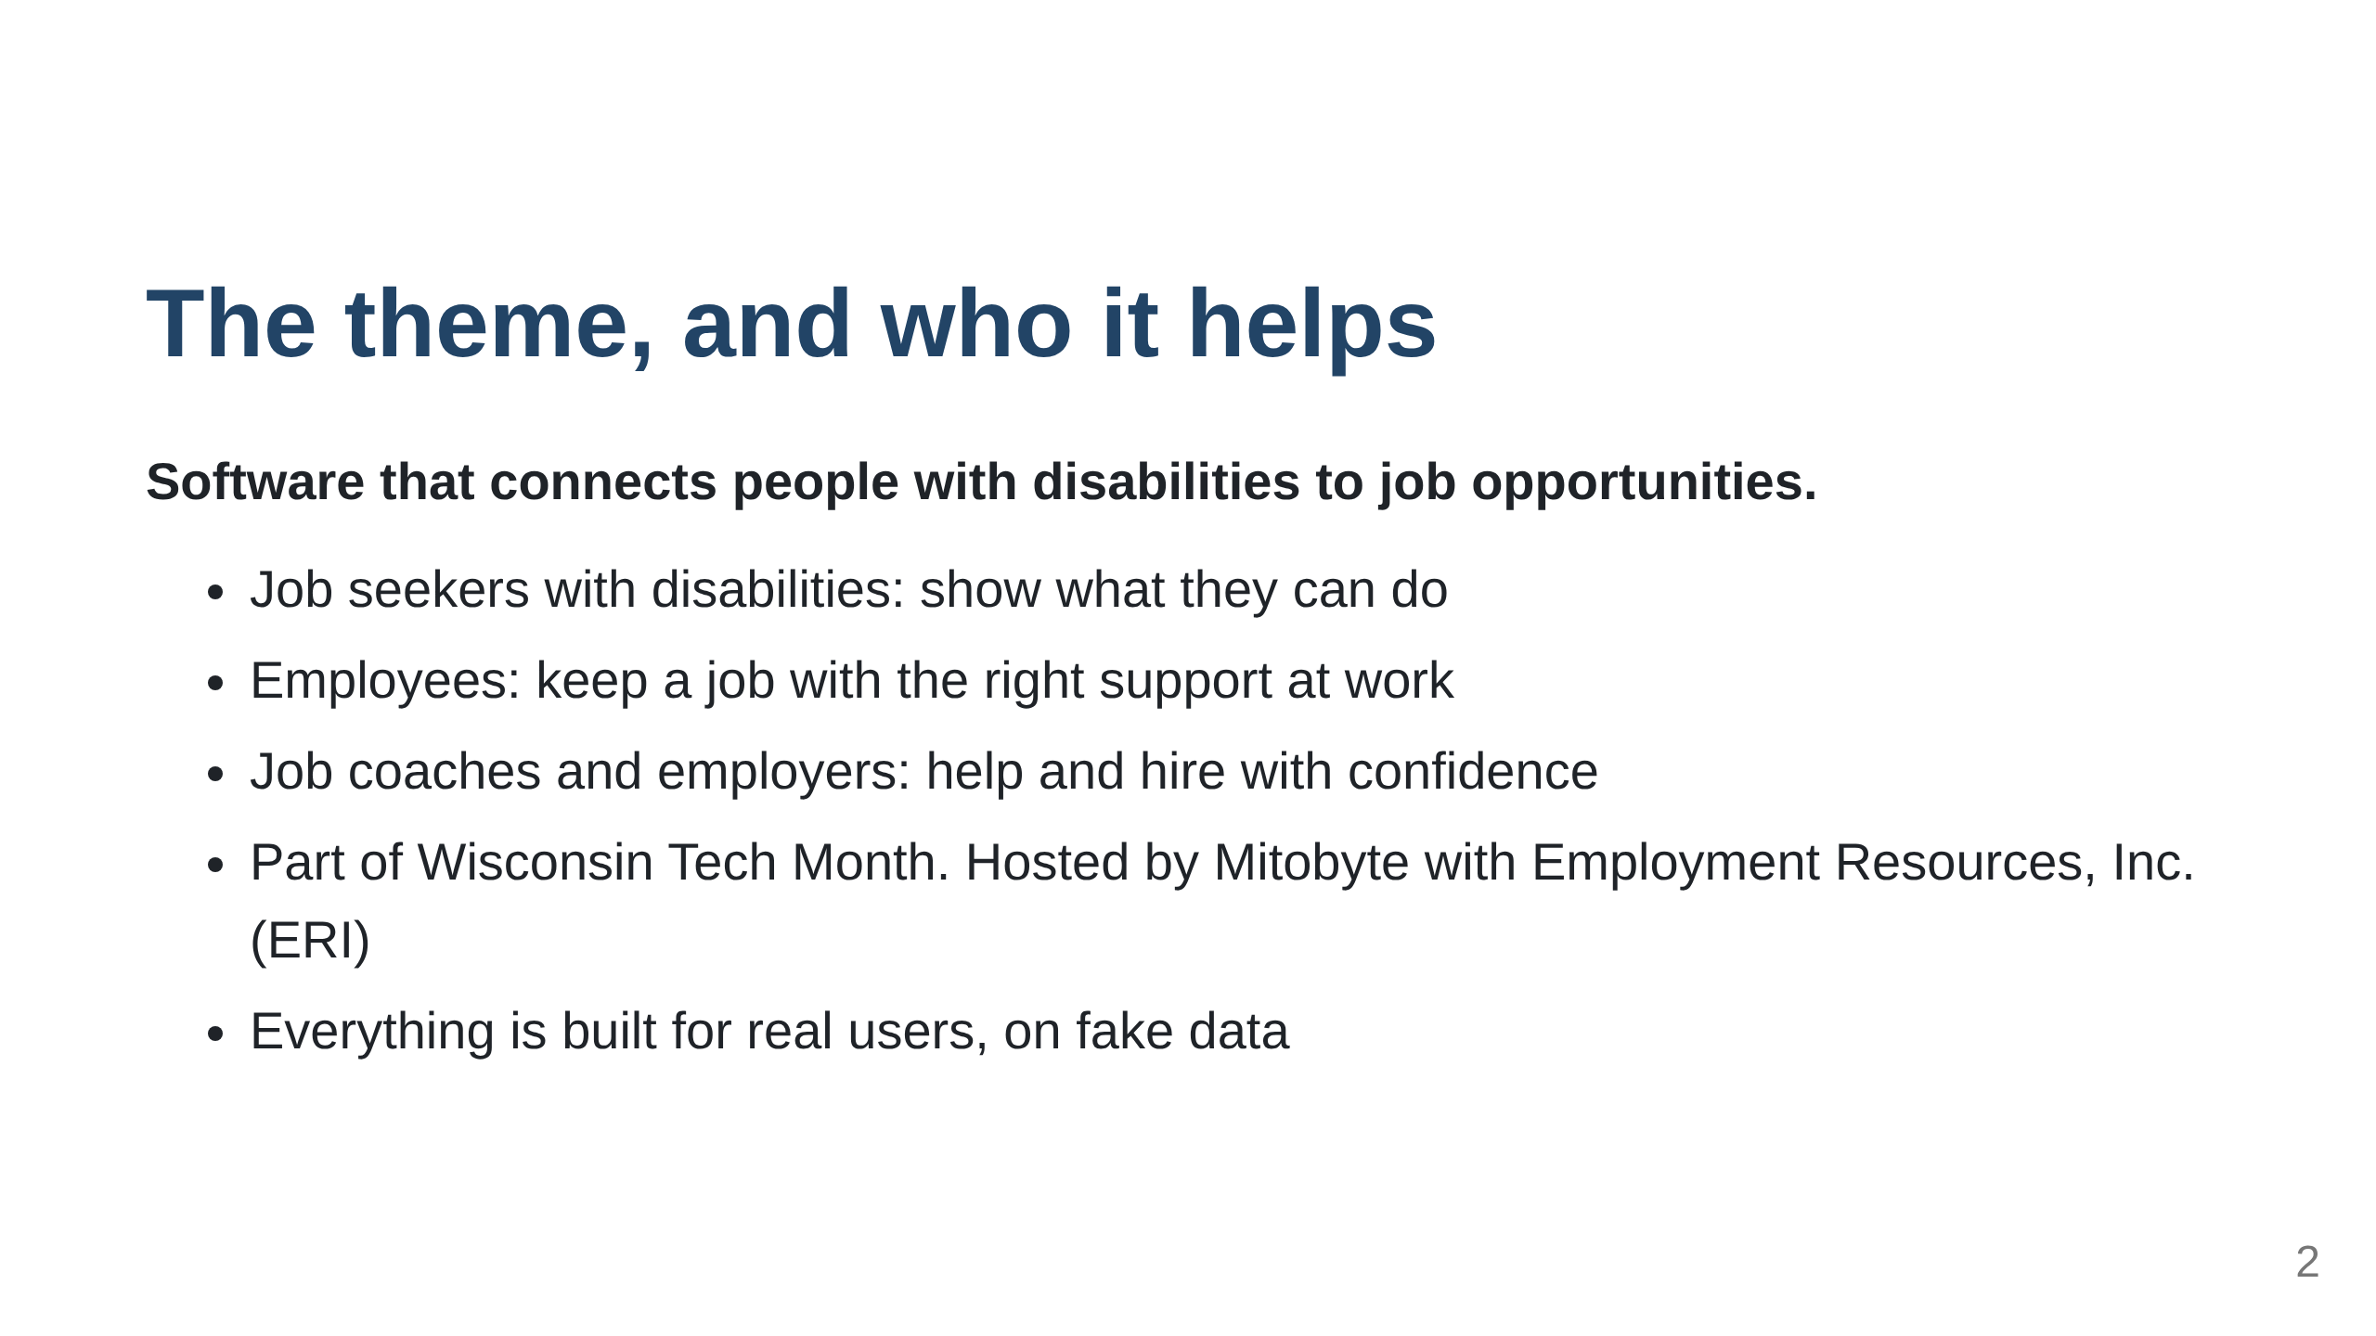

Slide 3
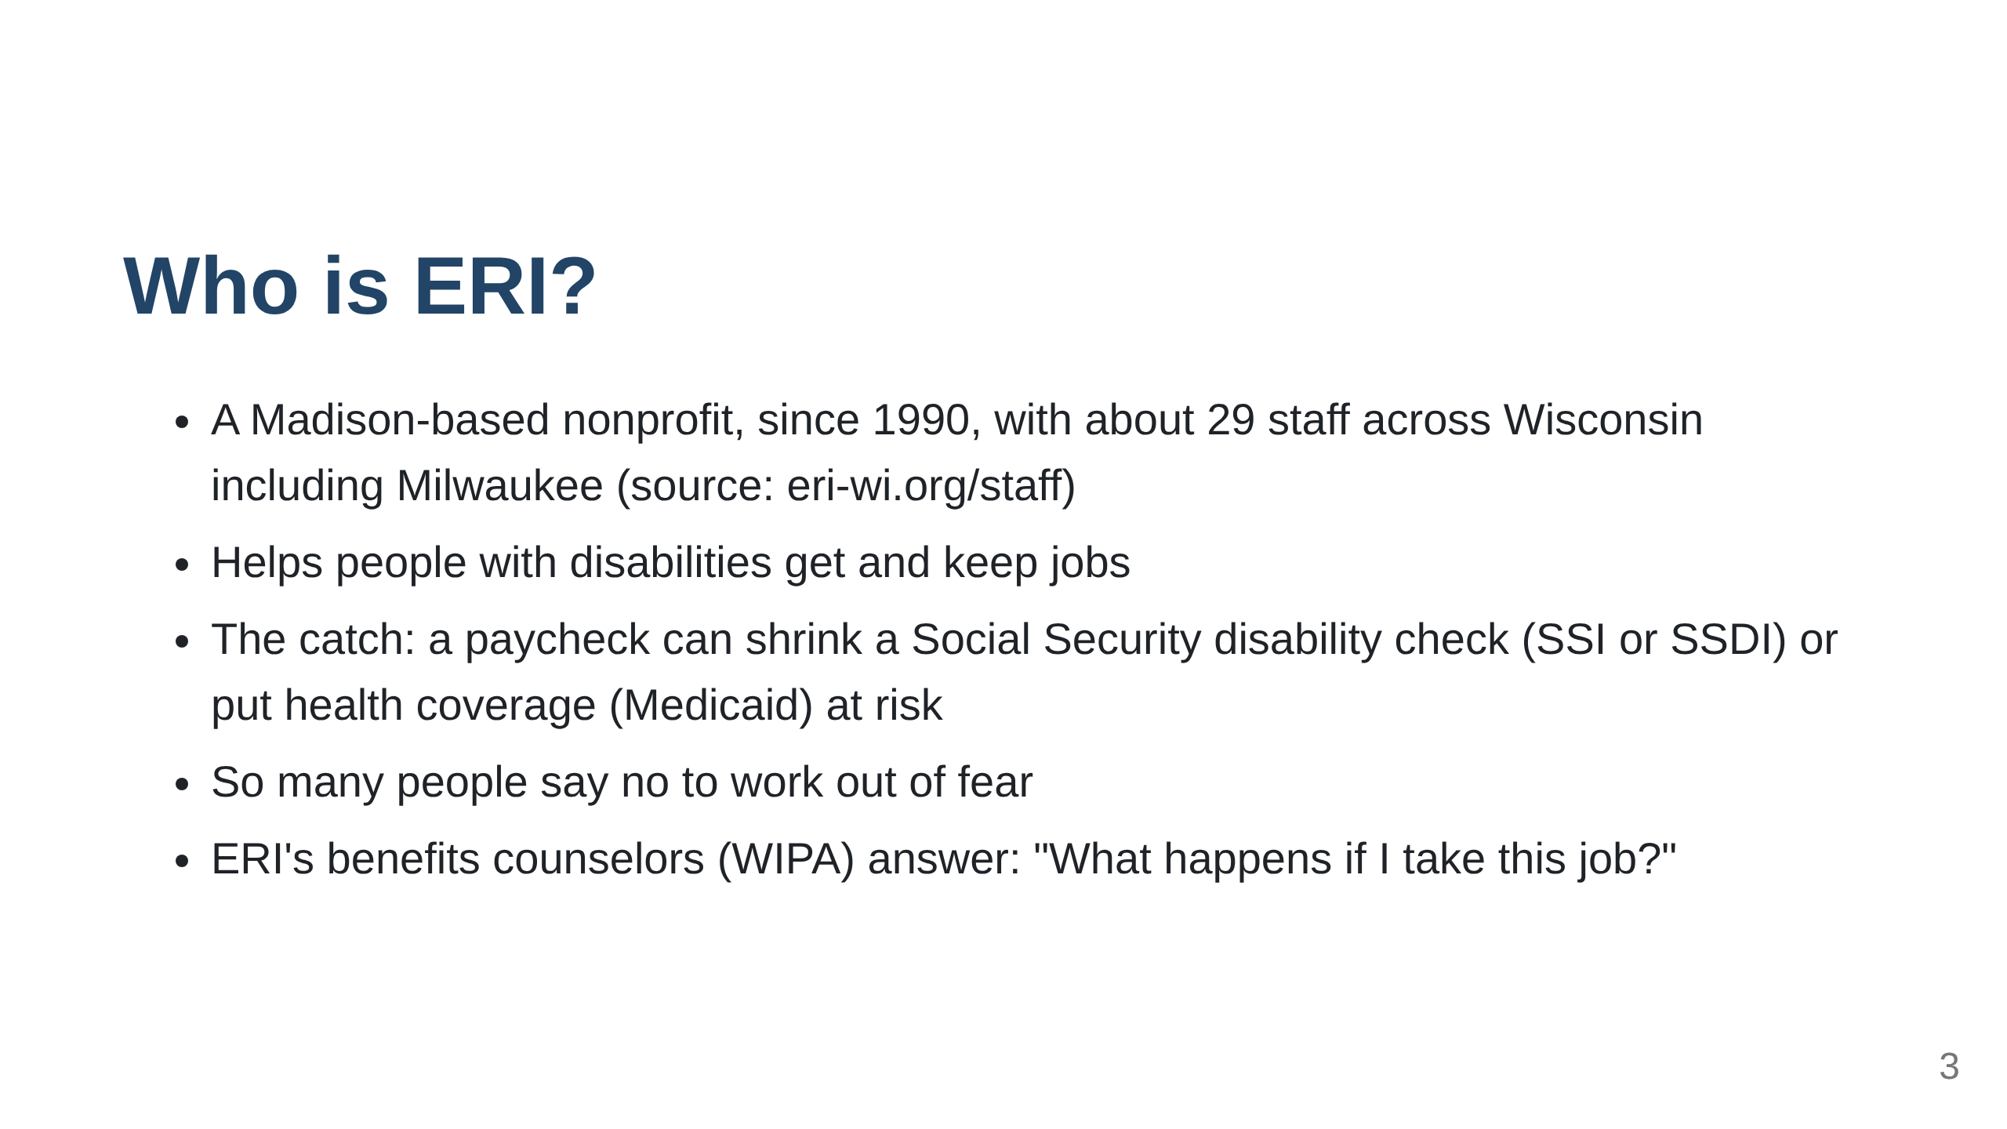

Slide 4
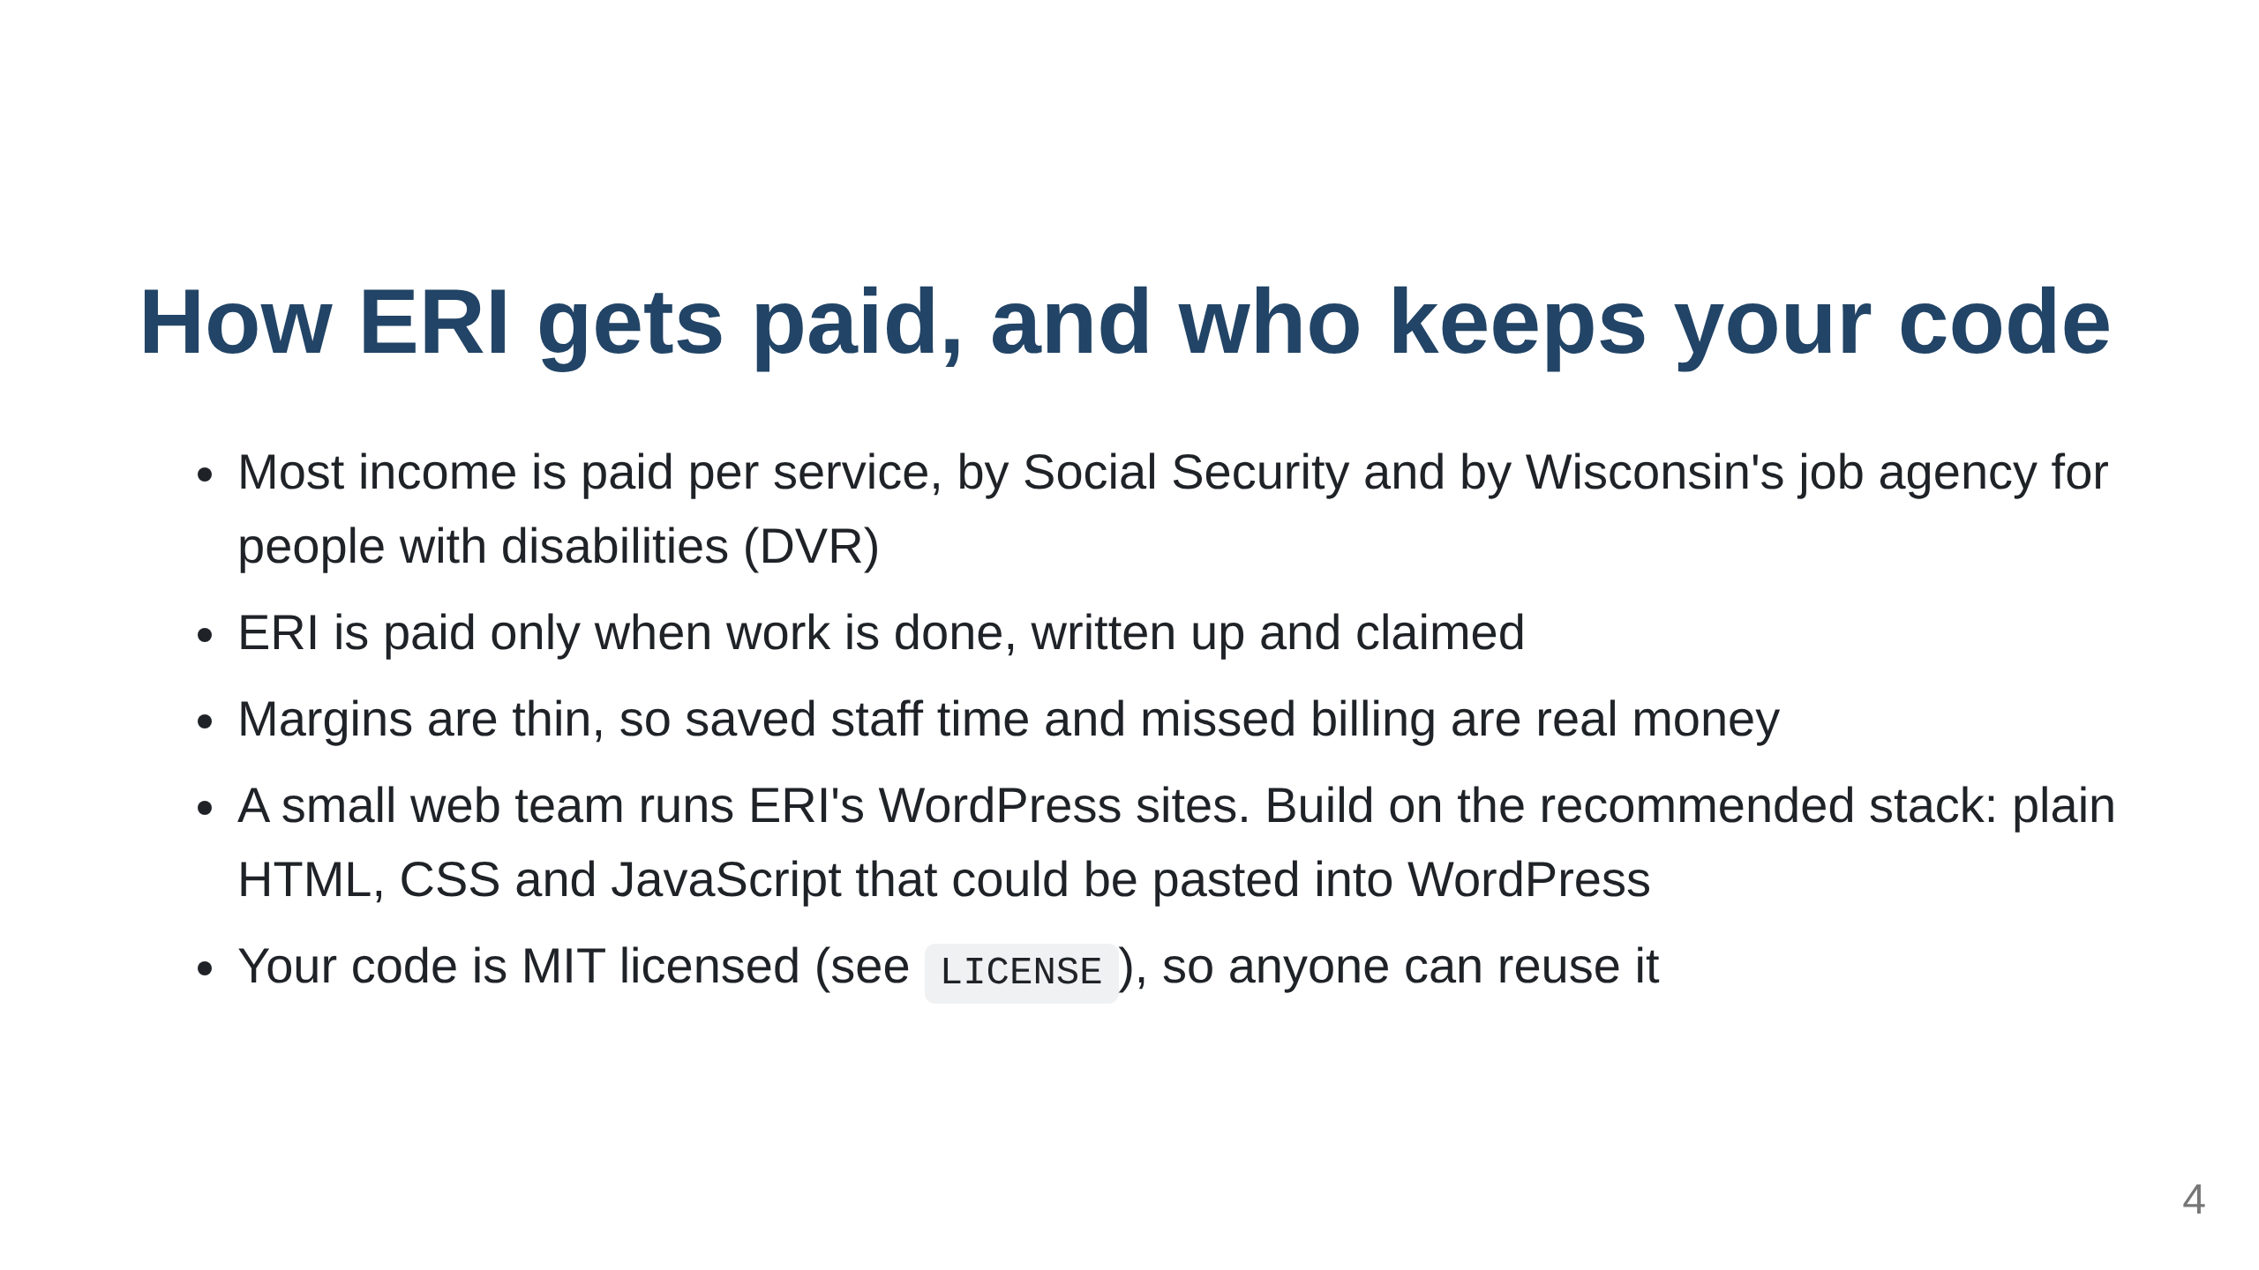

Slide 5
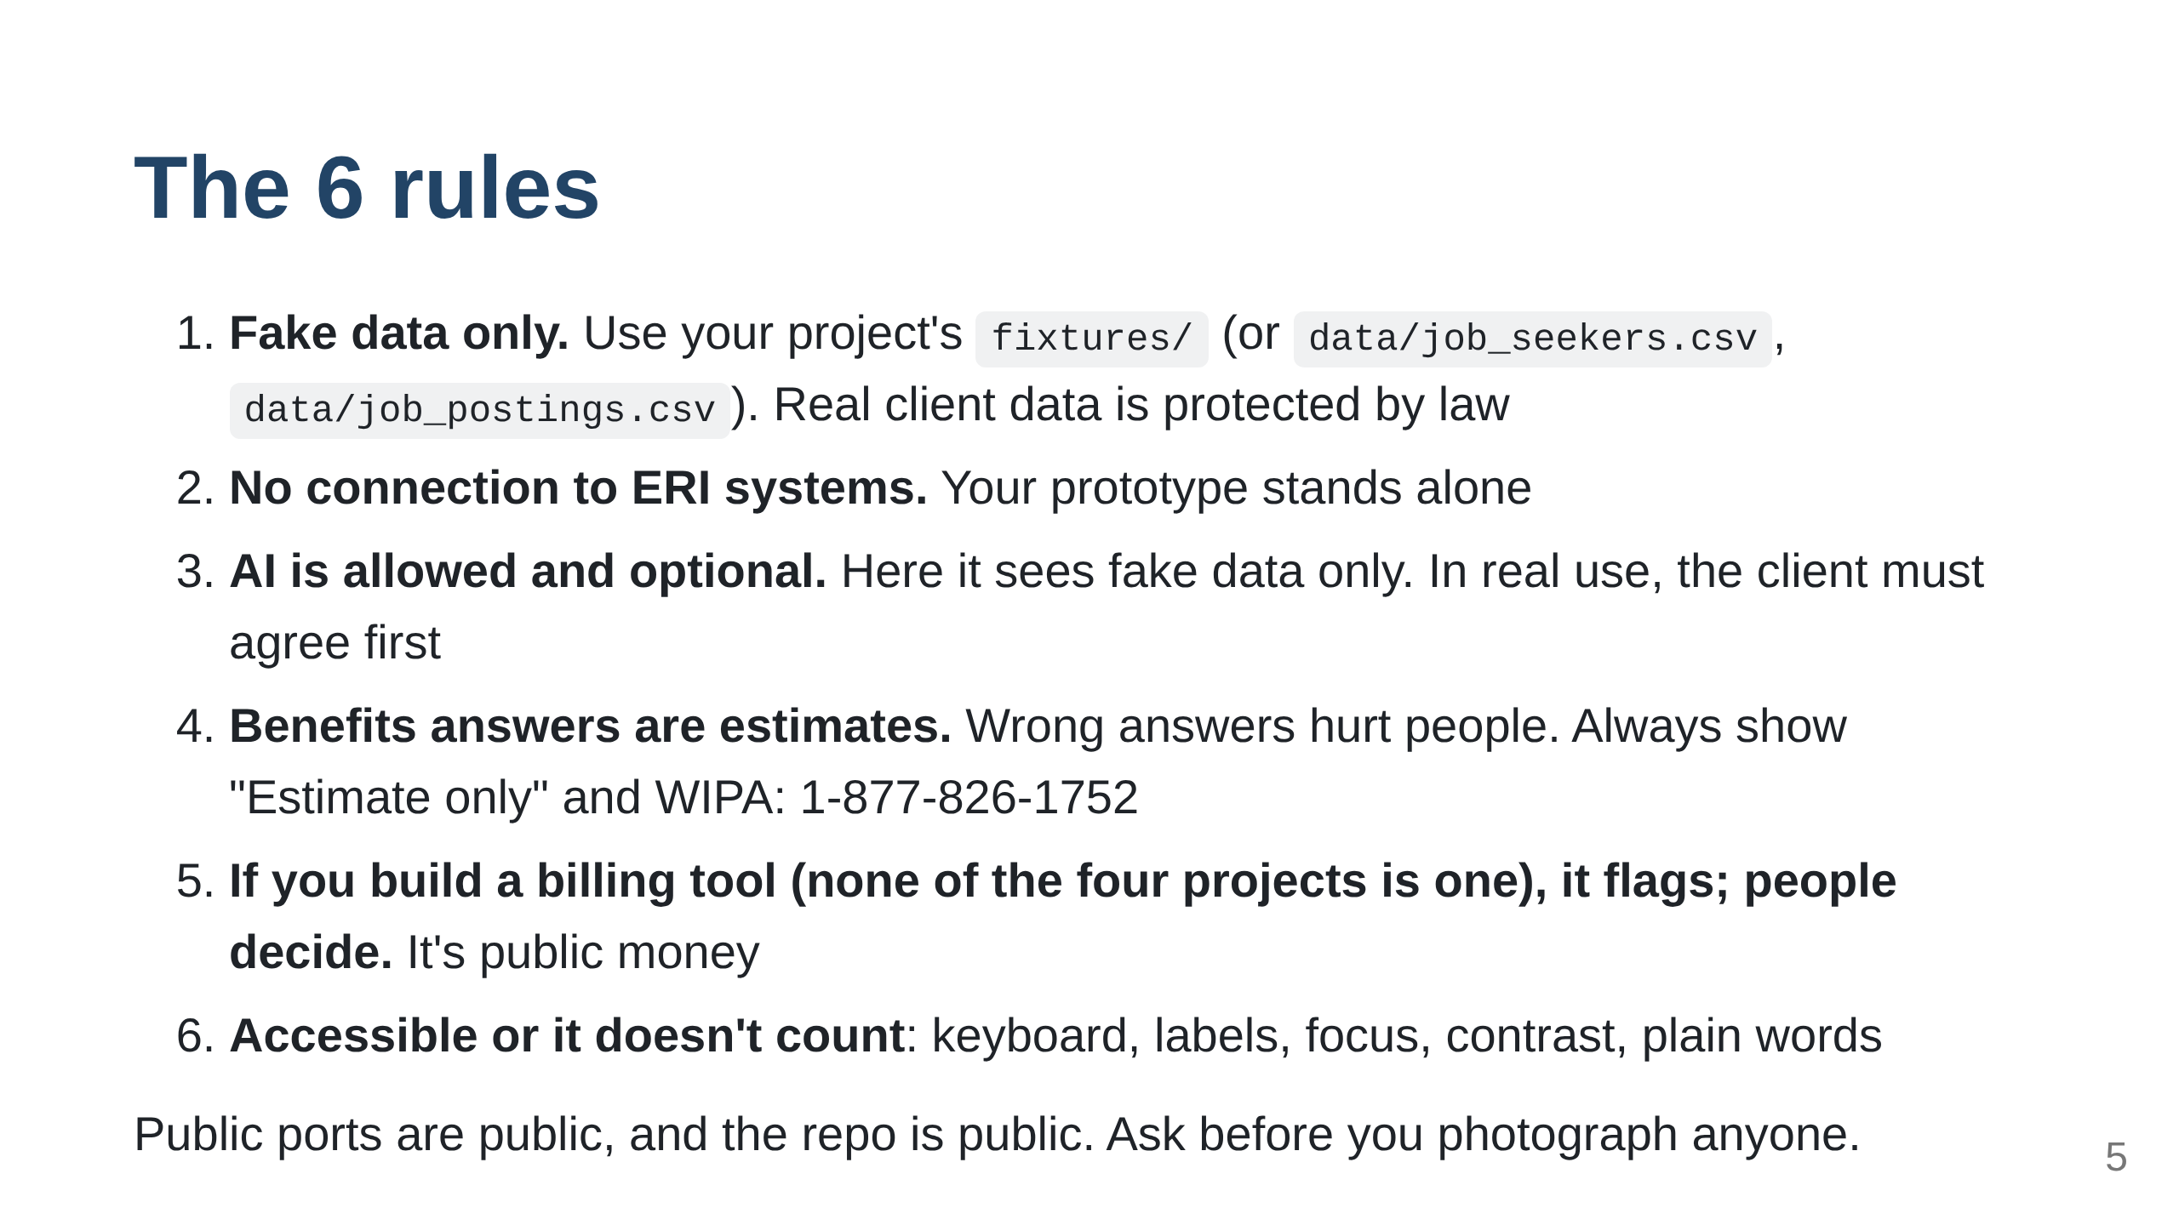

Slide 6
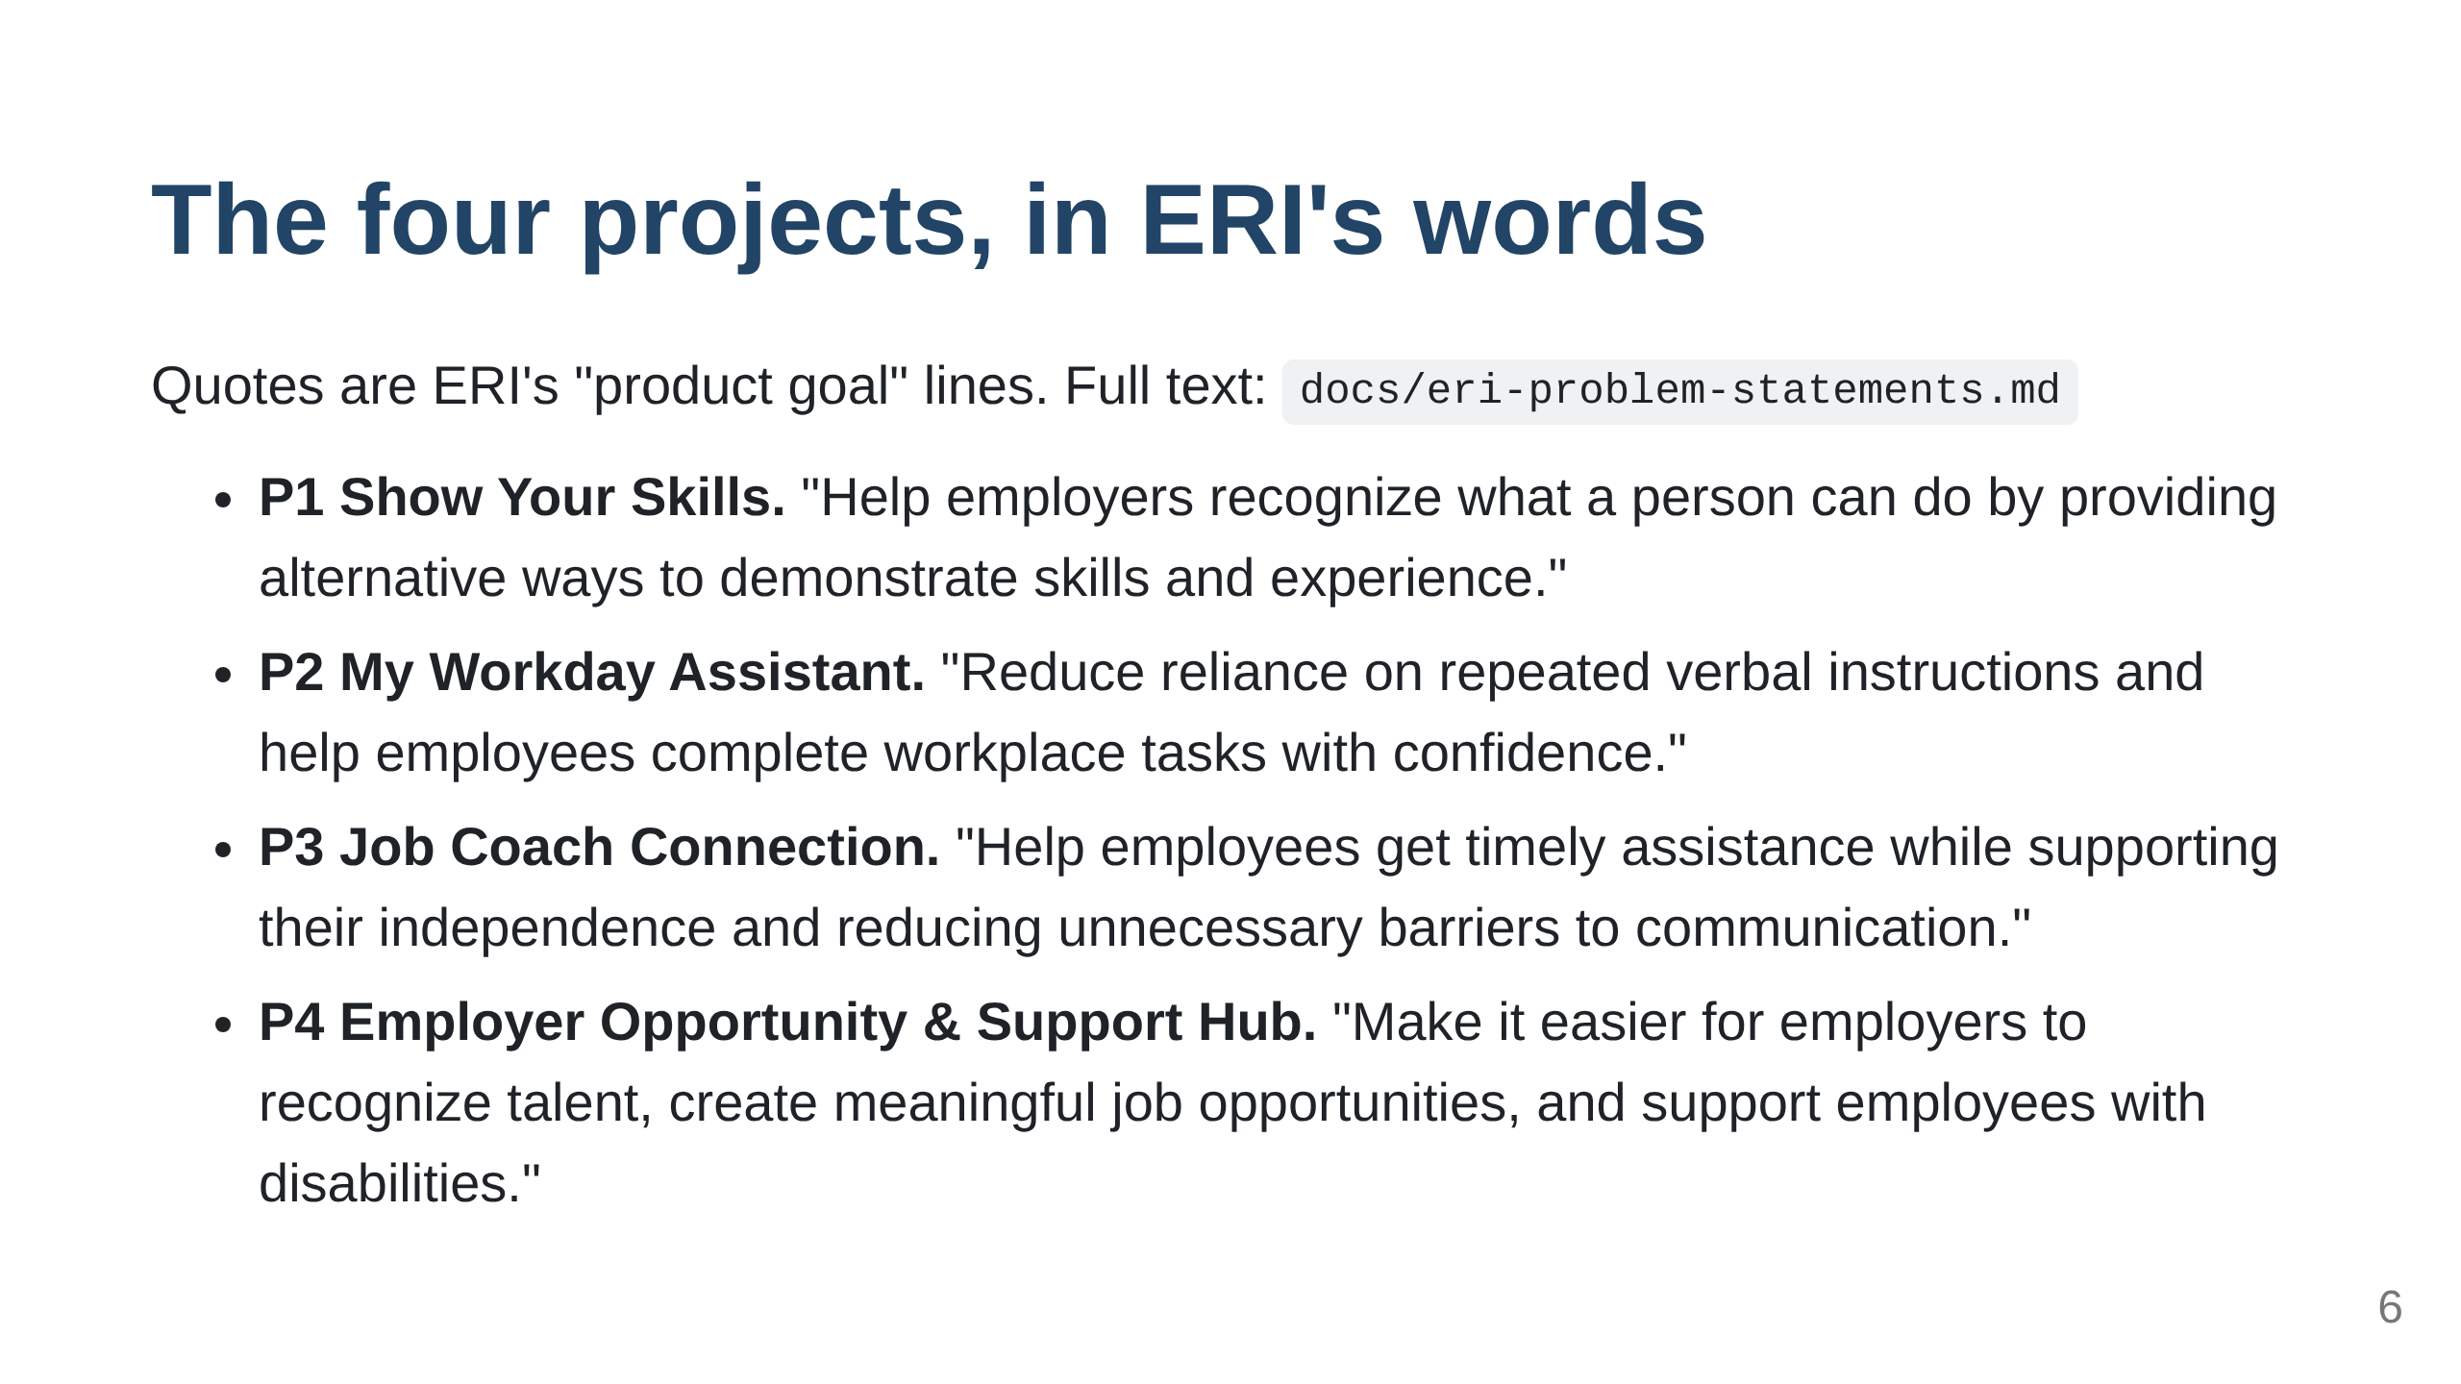

Slide 7
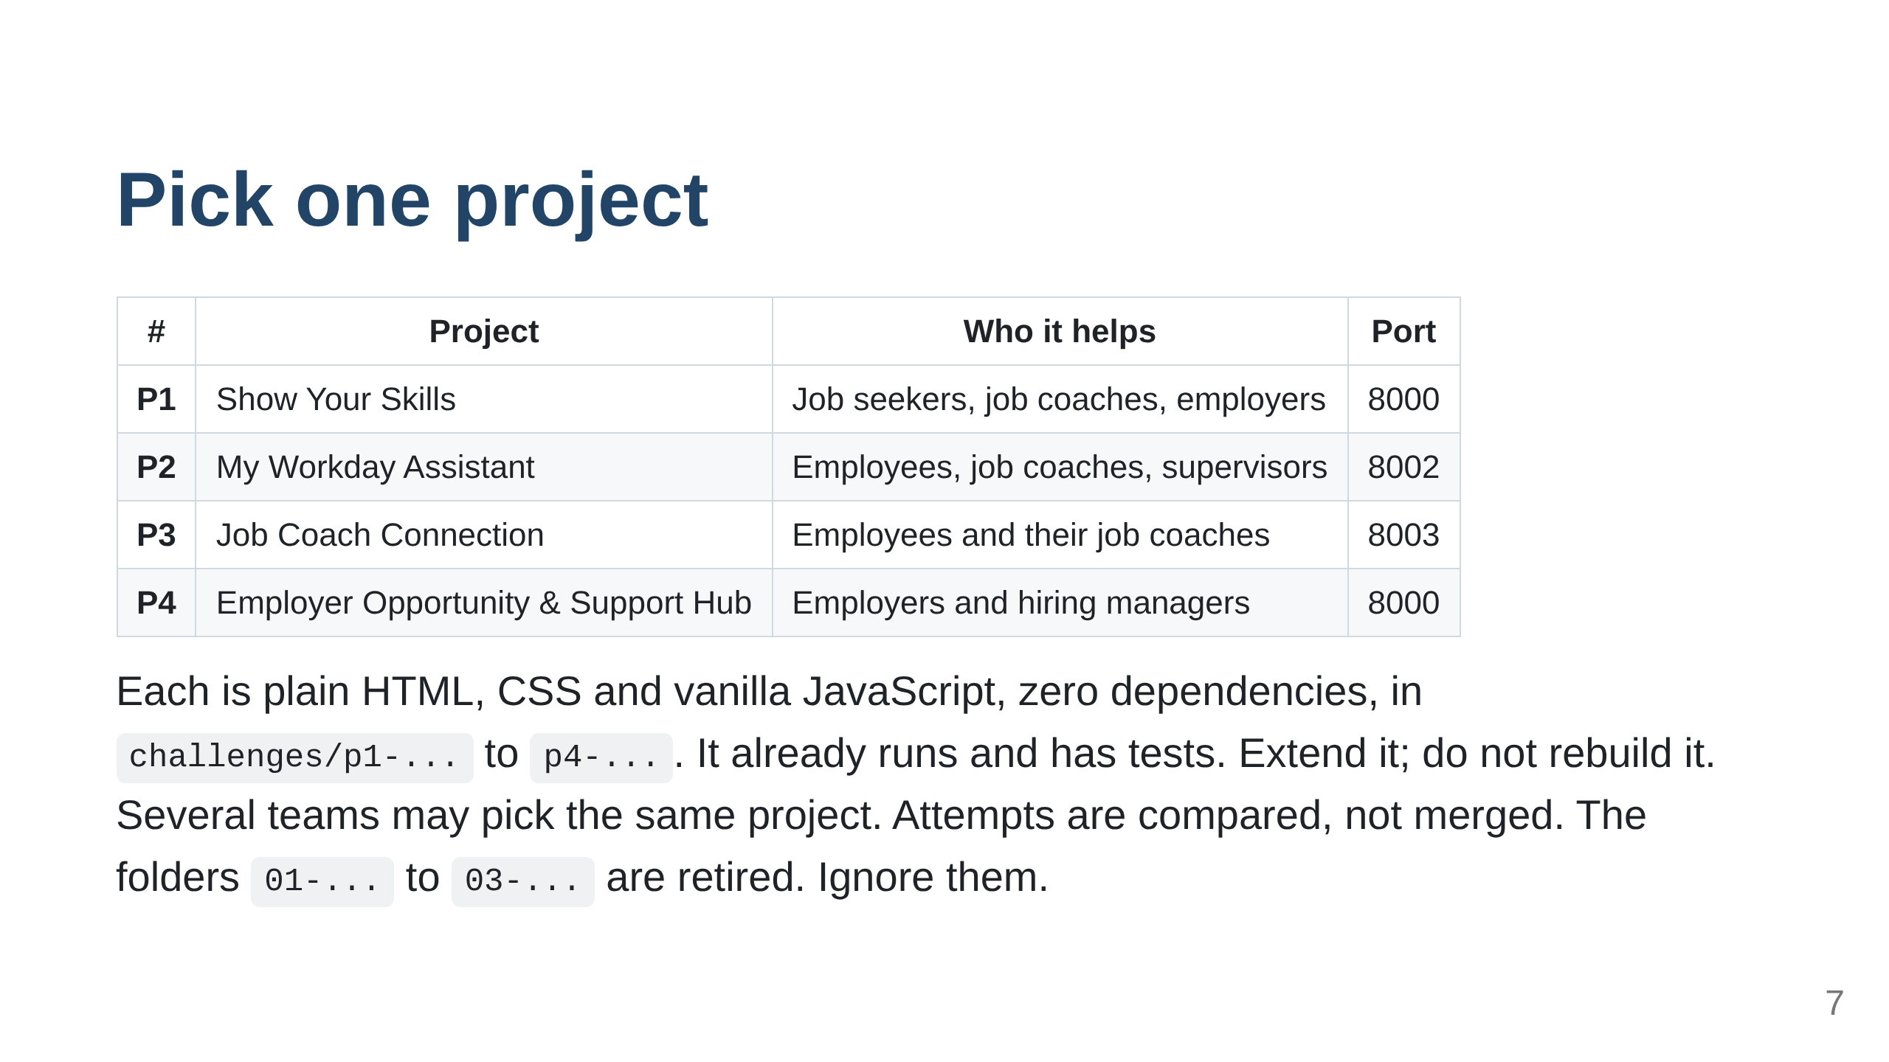

Slide 8
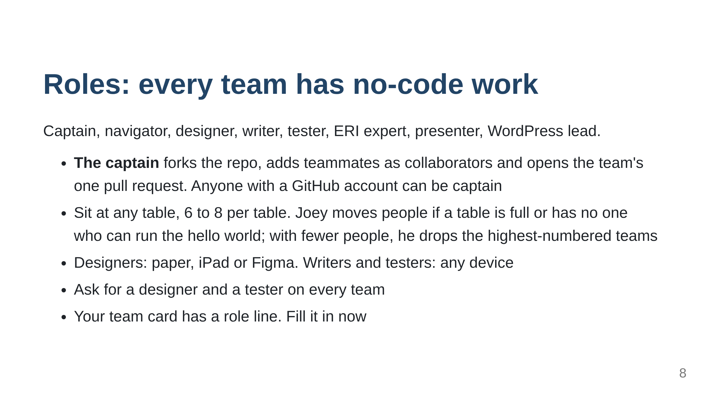

Slide 9
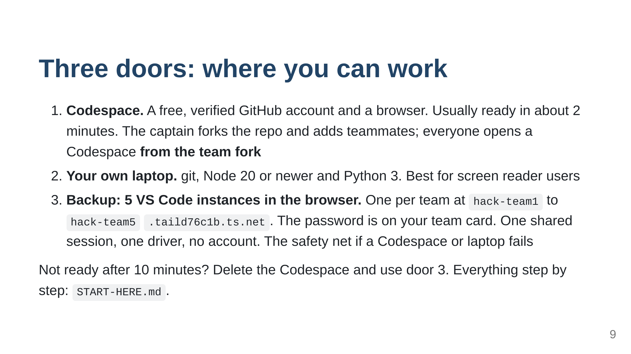

Slide 10
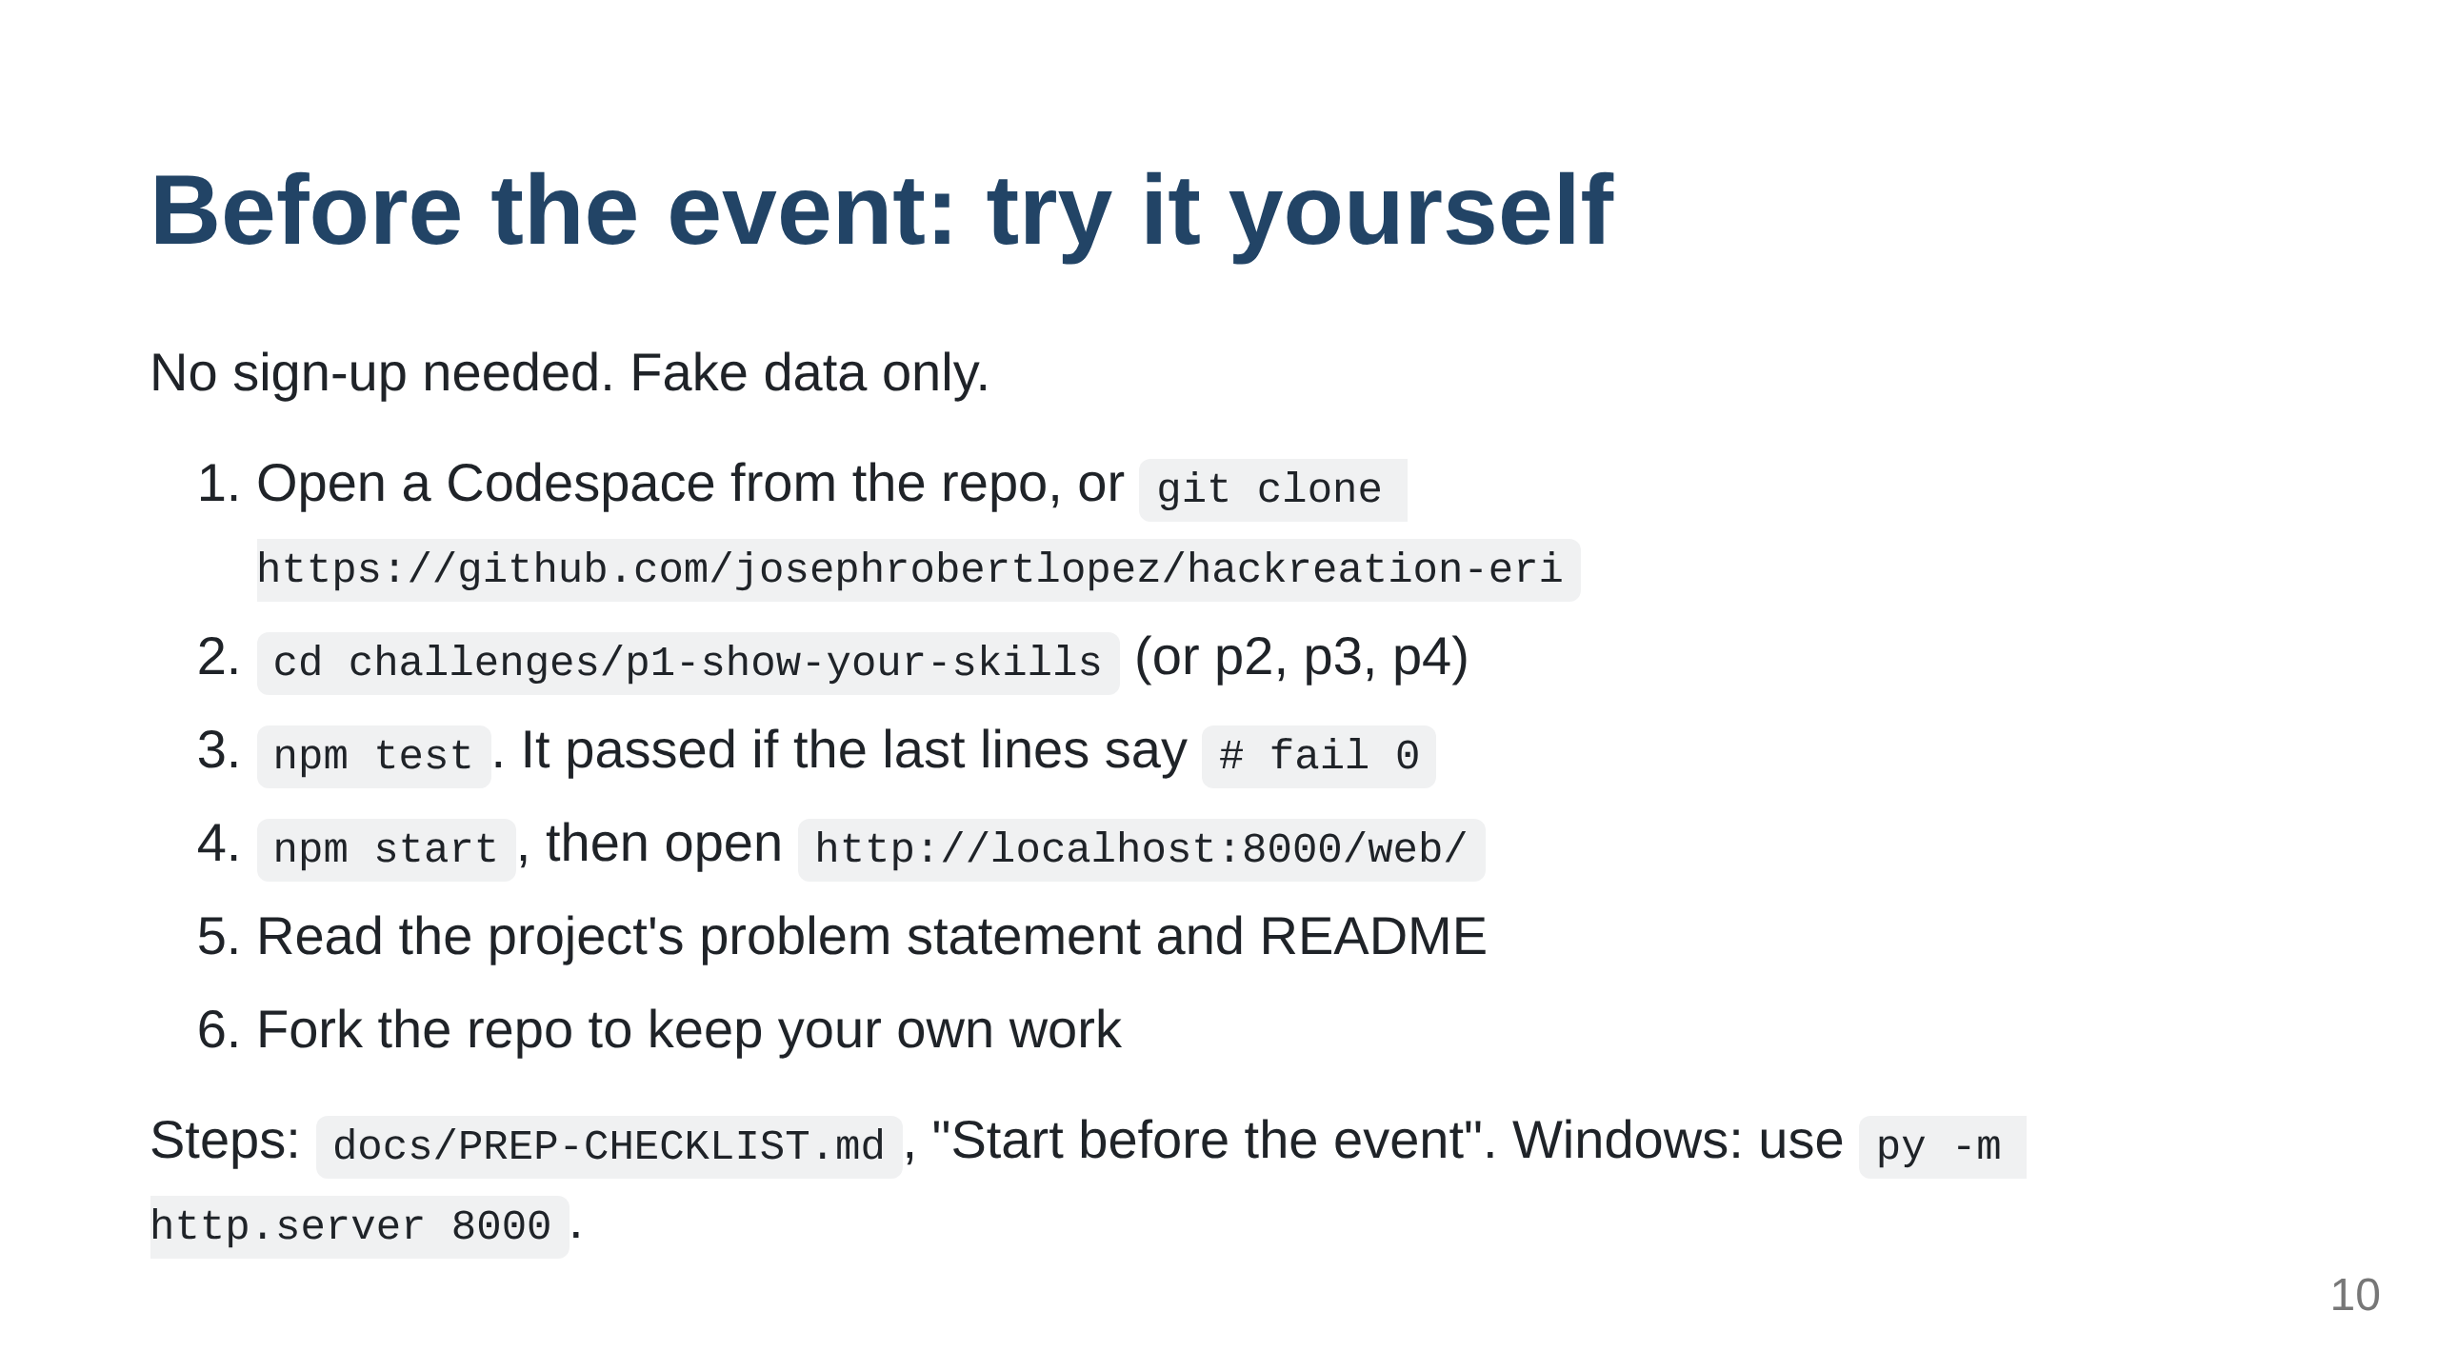

Slide 11
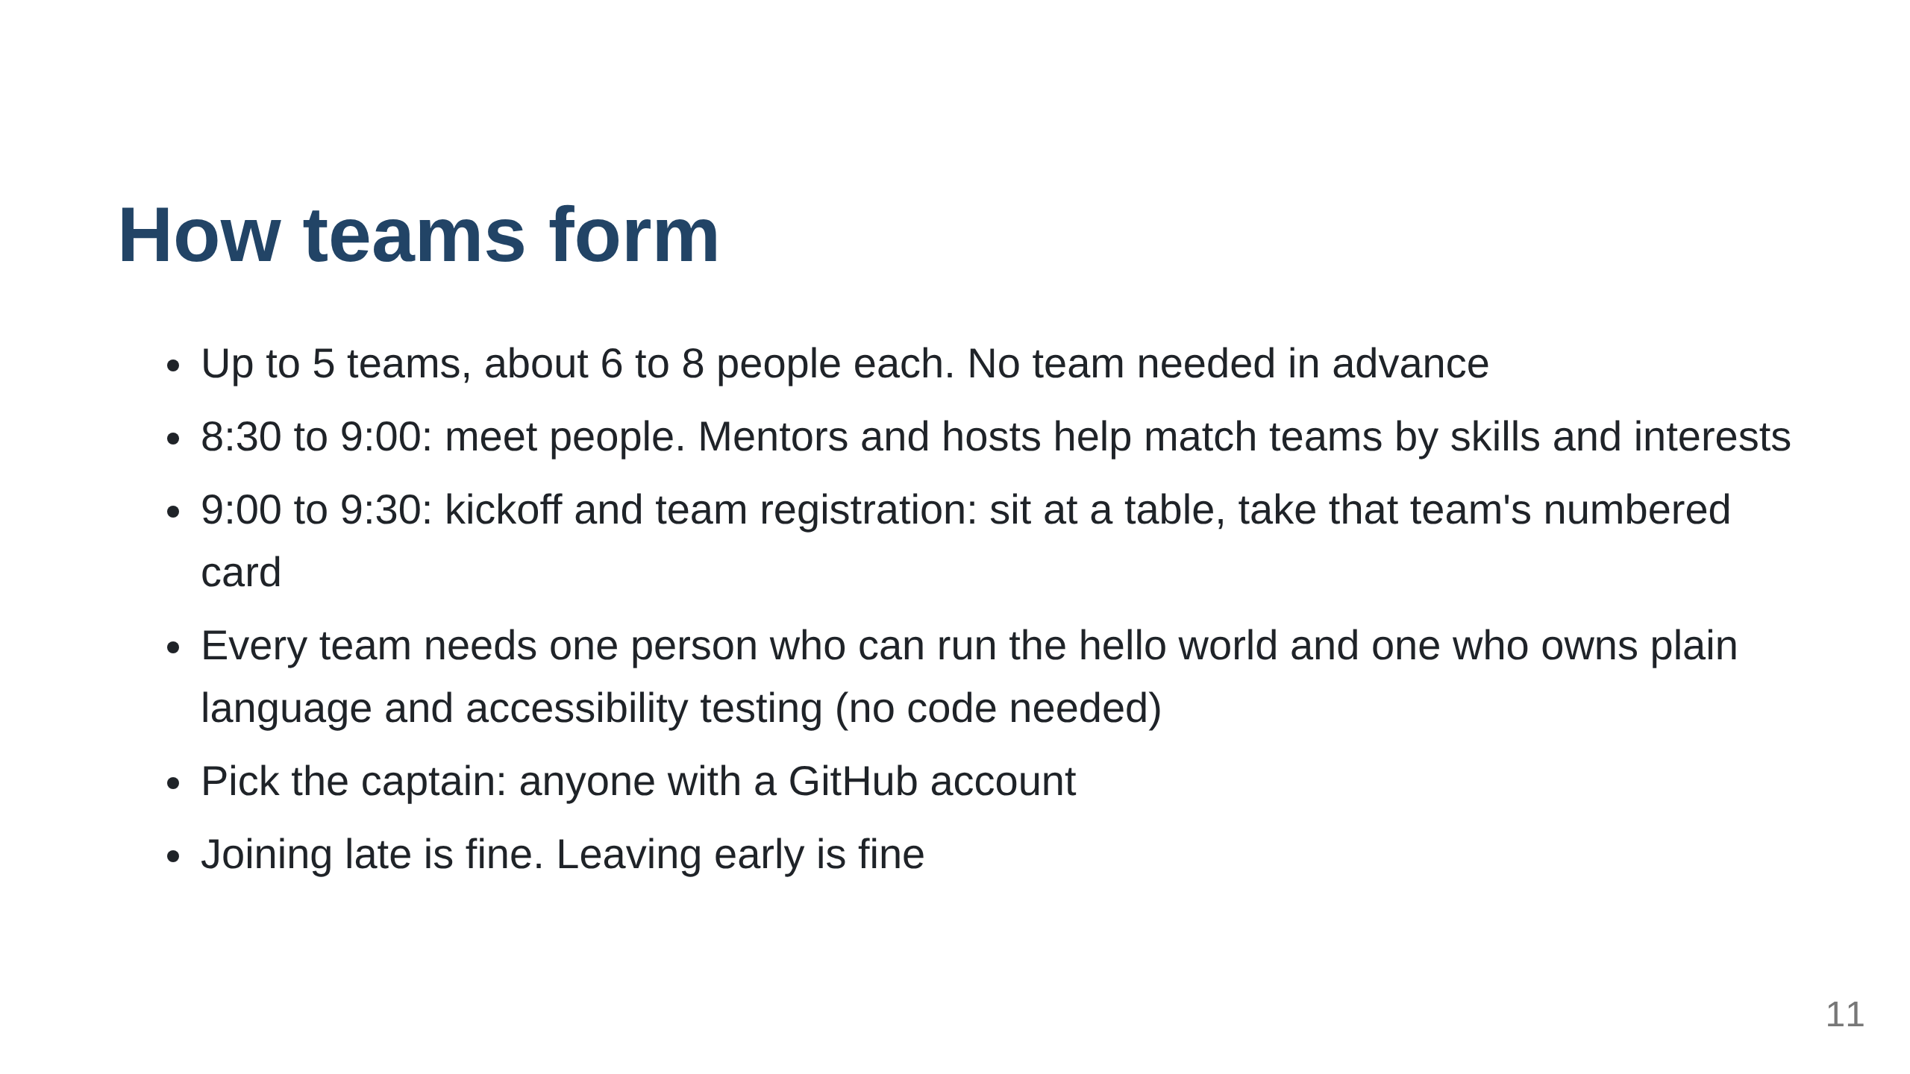

Slide 12
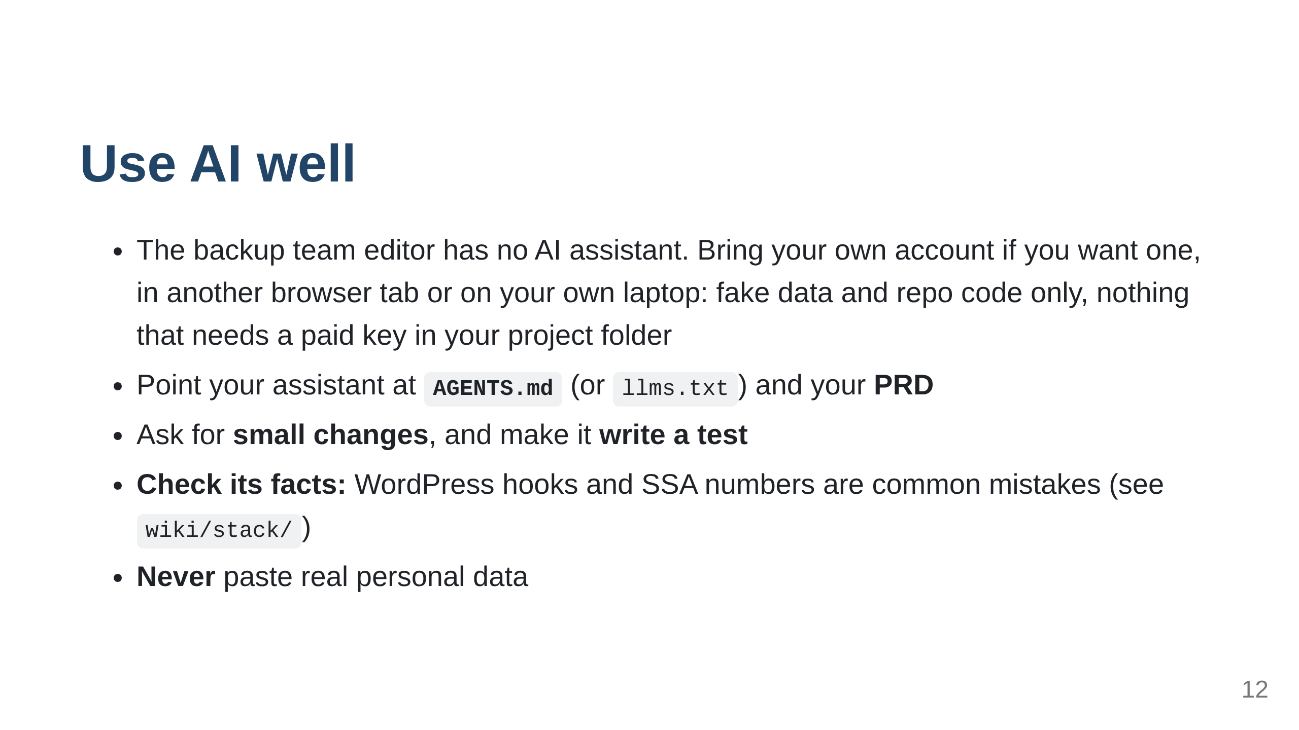

Slide 13
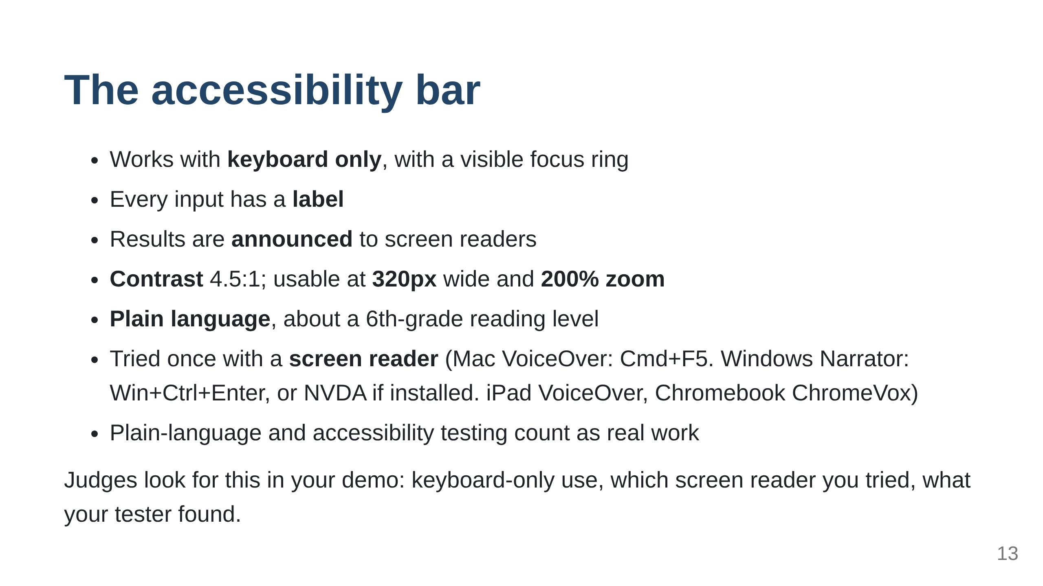

Slide 14
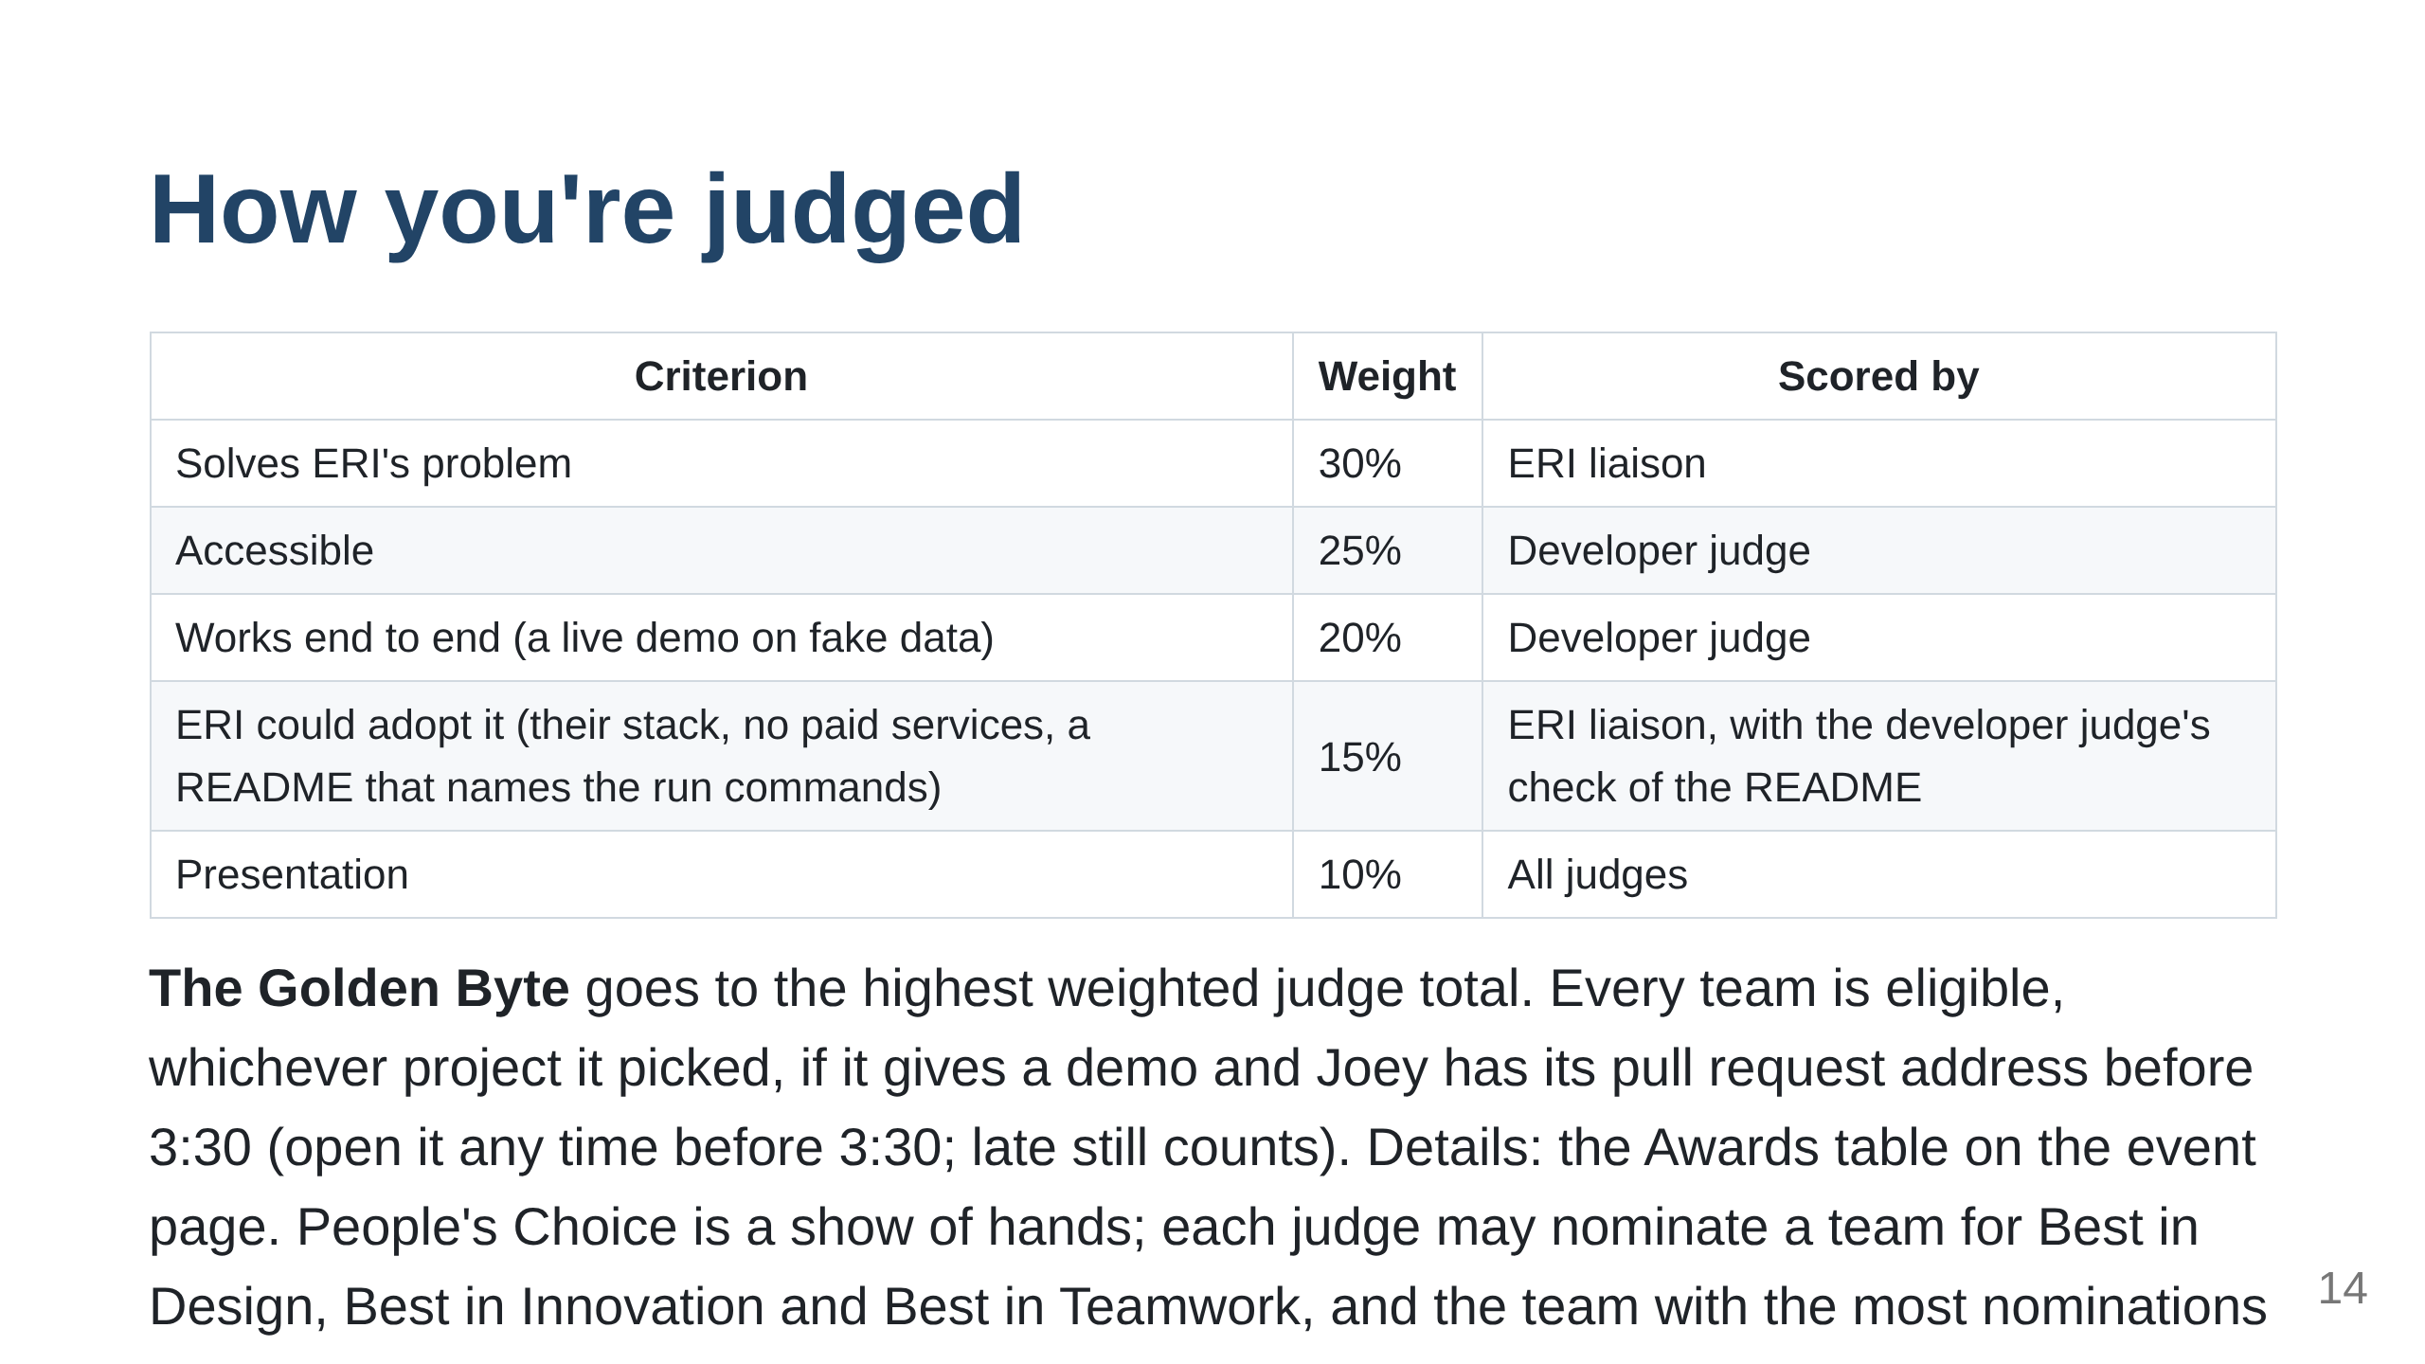

Slide 15
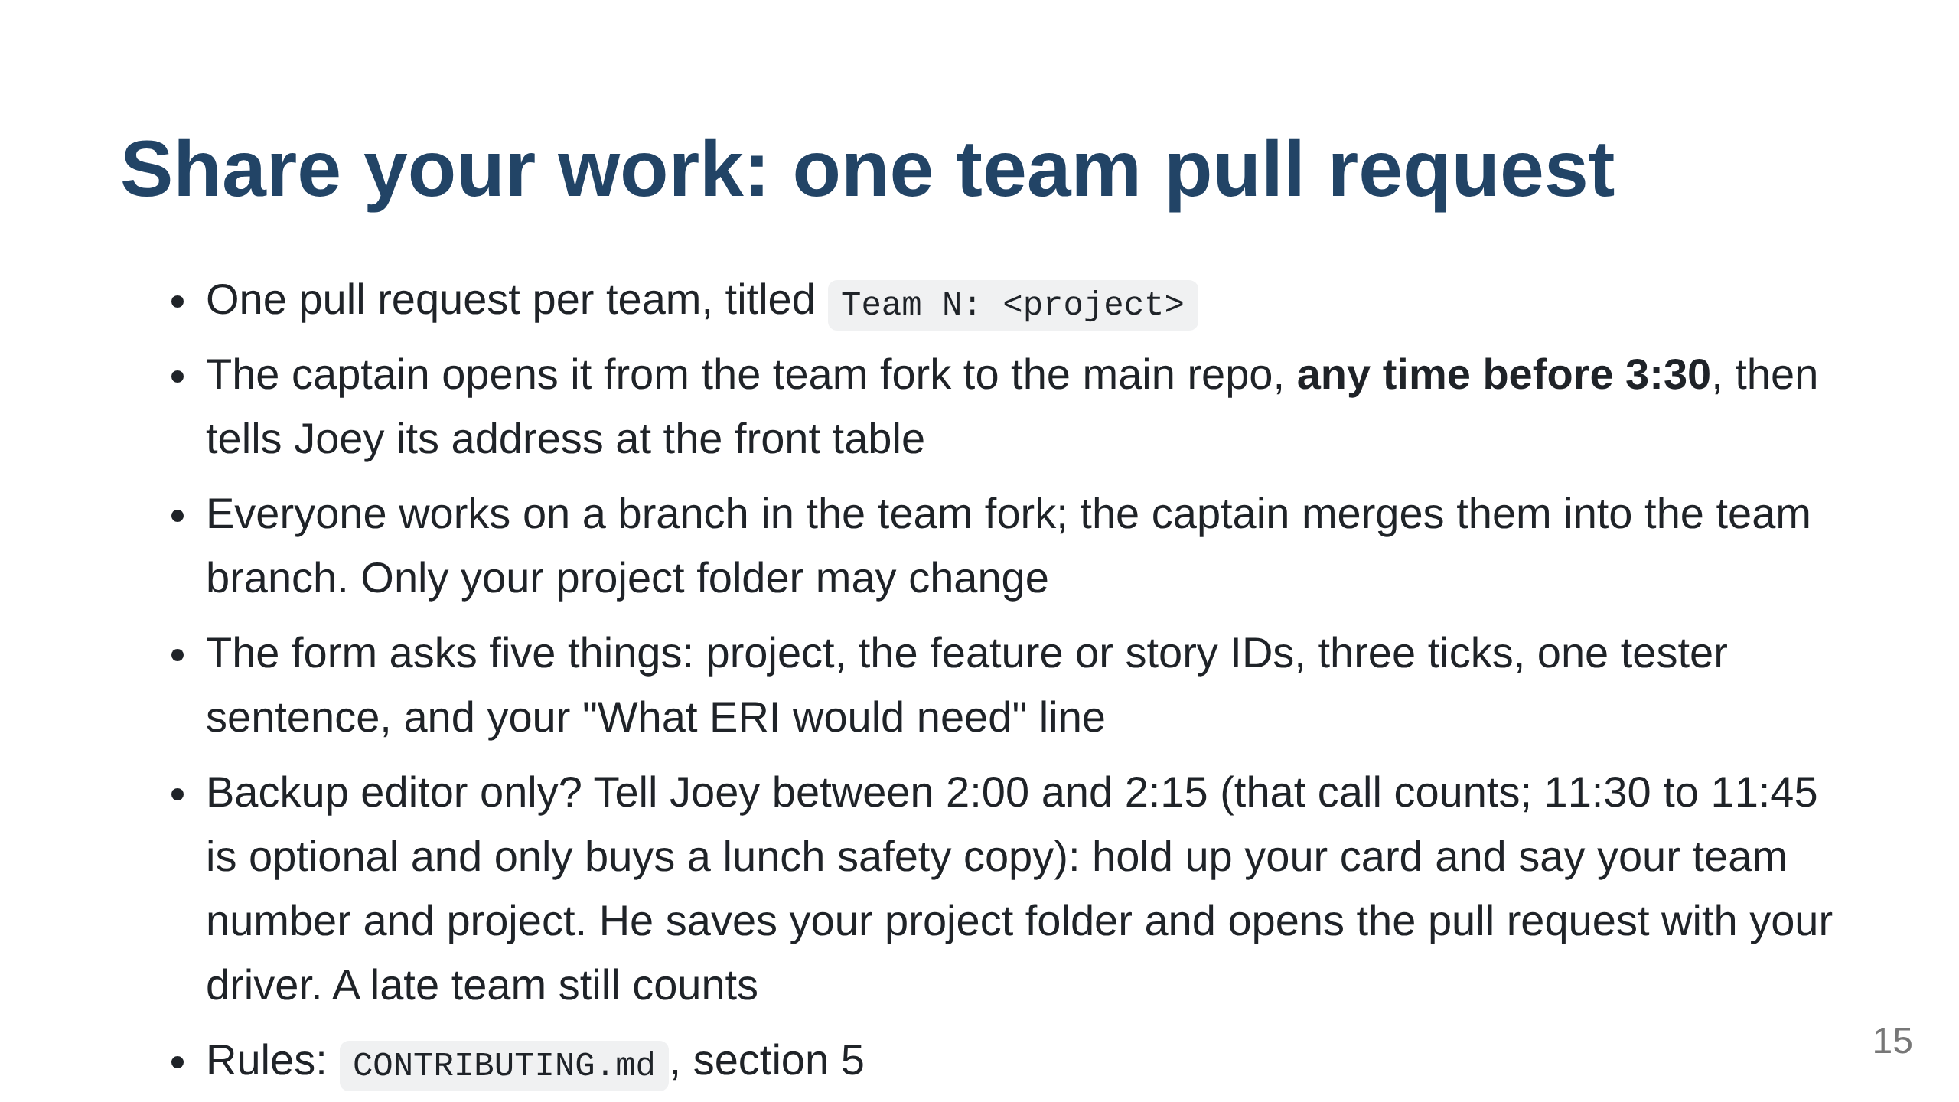

Slide 16
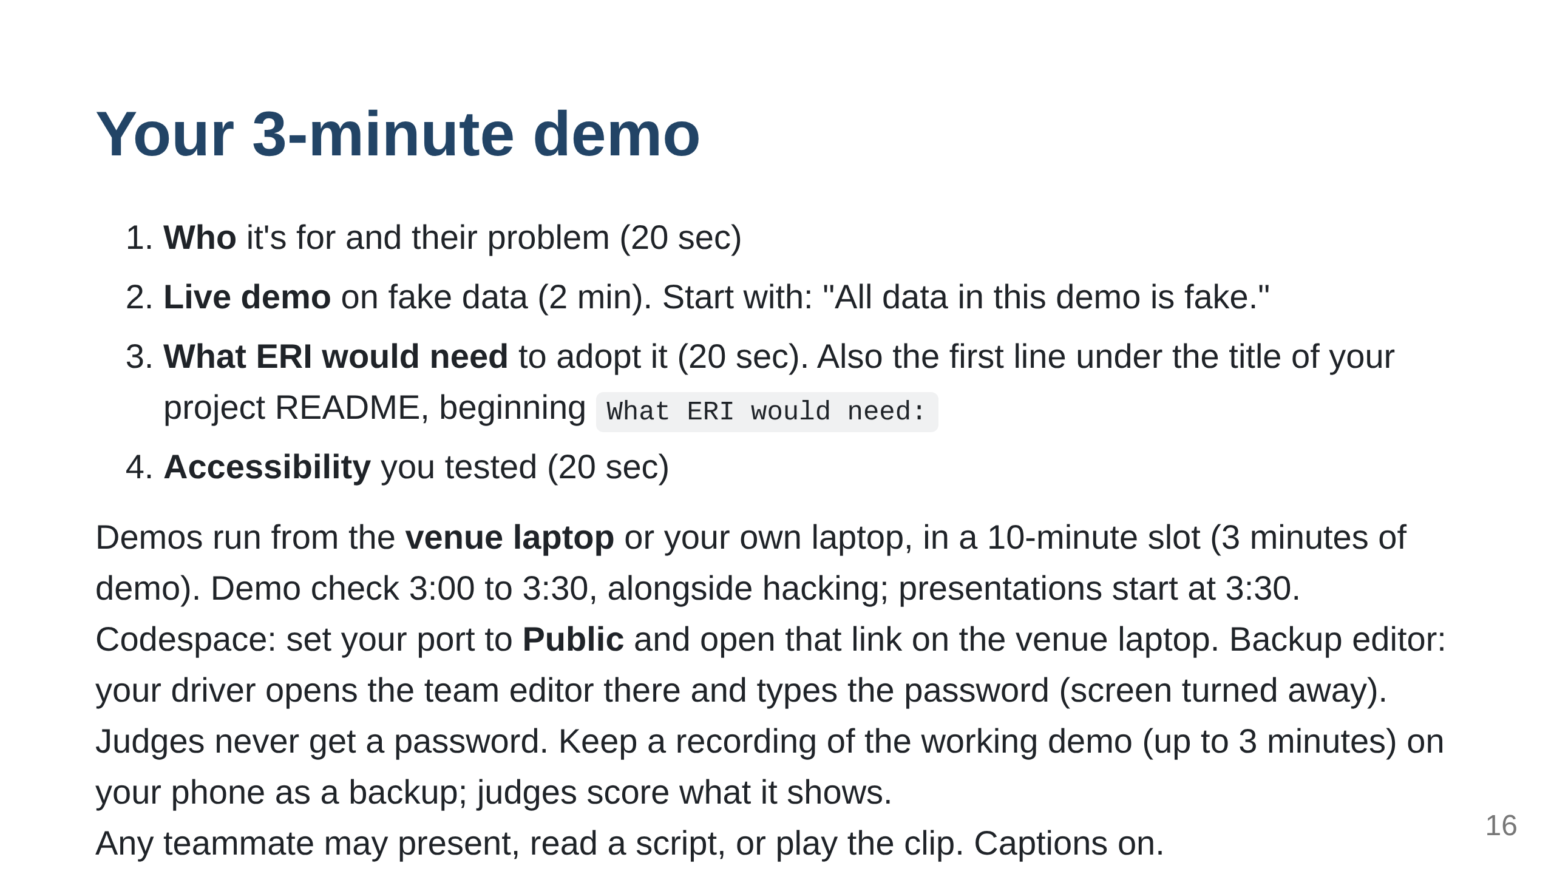

Slide 17
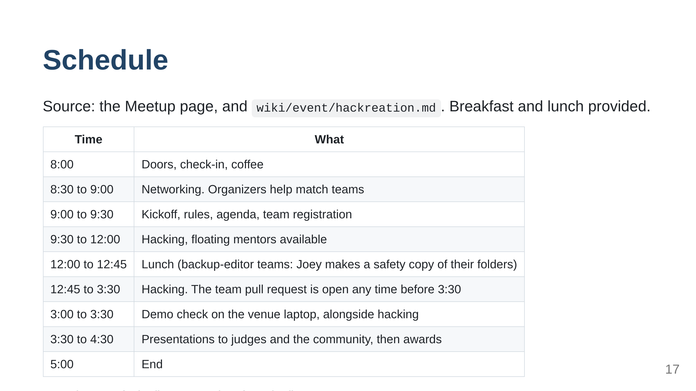

Slide 18
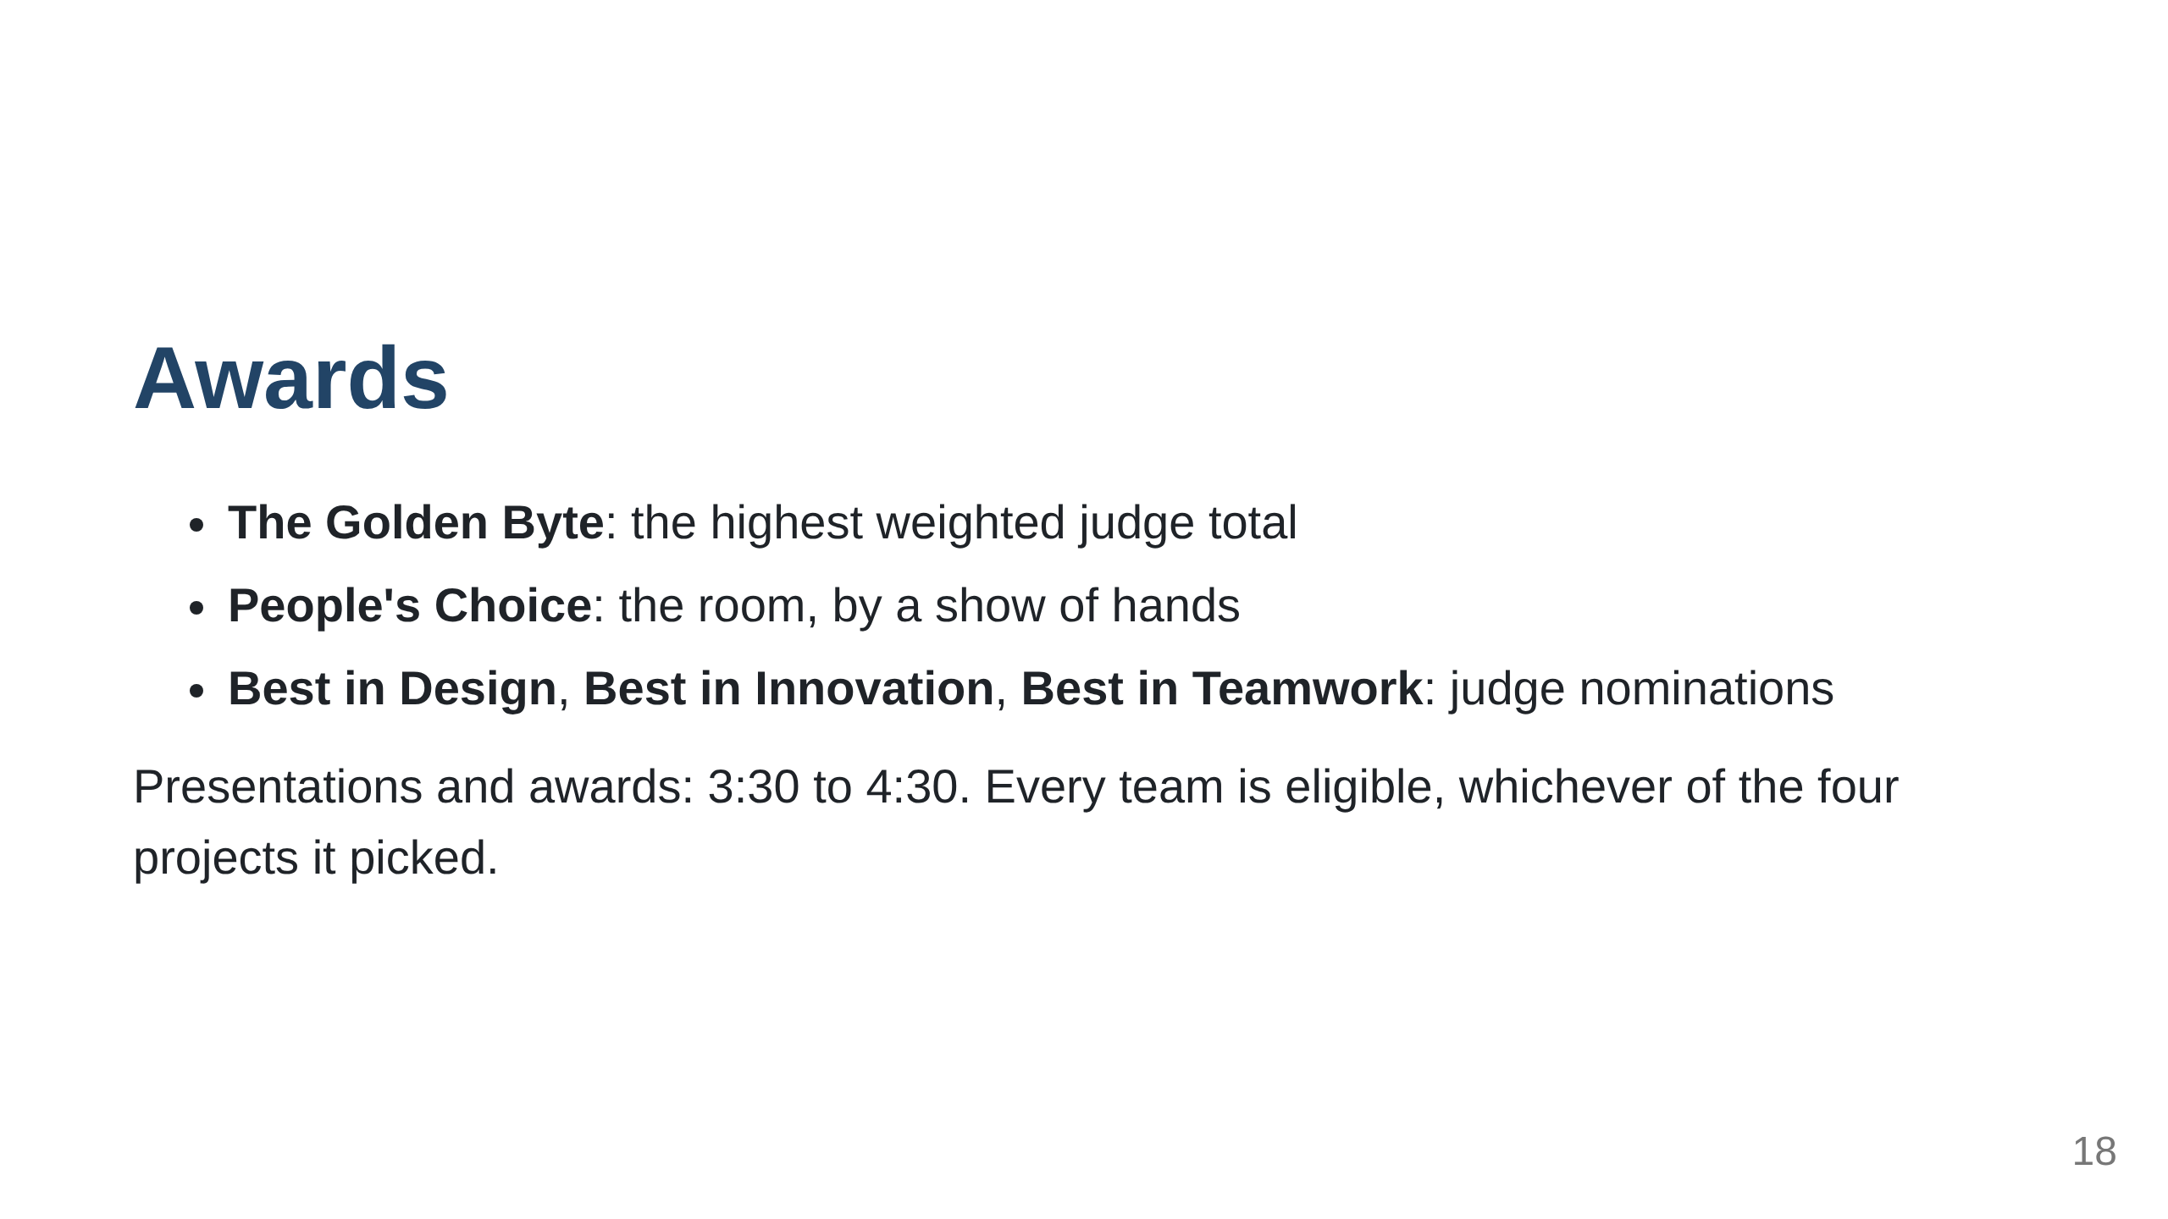

Slide 19
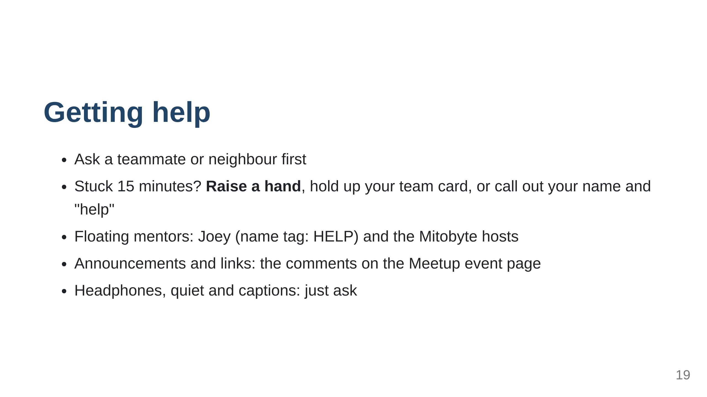

Slide 20
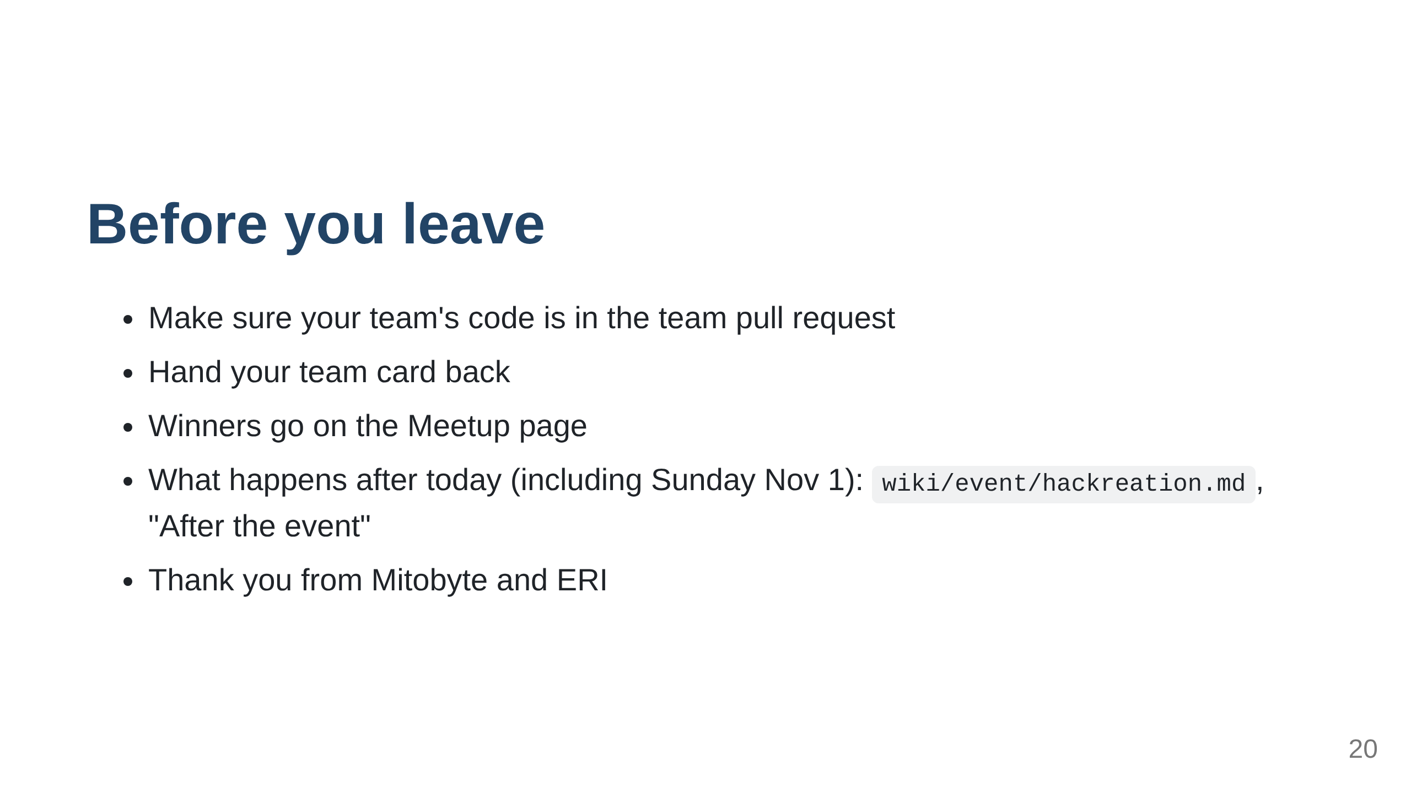

Slide 21
