Slide 1

CEAtlas
Investor guide
Business model, operating plan, use of funds, and path to profitability
Friends and family discussion | September 2026
Notes:
Discussion draft. All forecasts and unit economics are management assumptions unless identified as current product facts. Nothing in this guide constitutes an offer to sell securities.

Slide 2
Investment summary
$500,000
18 months
$1.9M
Target raise
Planned runway
Illustrative annual break-even revenue
Purpose of this round
Evidence required
Fund a full-time founder and turn the existing platform into a reliable, measurable marketplace with initial revenue.
Repeat usage, provider demand, an acquisition channel, and real transaction economics.
Next financing
Current status
Prepare a $1.0M to $2.0M seed round after the company can show a repeatable growth model.
Live beta and 64,658 repository catalog records. No audited revenue or customer traction claimed.
CEAtlas | Confidential investor discussion
02
Notes:
The $500,000 target supports an illustrative 18-month operating plan and $6,000 monthly gross founder salary. The break-even model uses an 85% gross margin and $135,000 monthly operating expense at scale. These are planning assumptions.

Slide 3
The customer problem
Search spans too many sources
Eligibility remains uncertain
Professionals move among provider sites, associations, board resources, and search engines.
Profession, jurisdiction, credit type, format, and timing determine whether an activity counts.
Travel changes the decision
Providers struggle to reach qualified buyers
Course price alone does not show flights, hotels, time away, or companion scheduling.
Many providers lack normalized distribution and measurable demand data across professional audiences.
CEAtlas organizes the entire decision before registration
CEAtlas | Confidential investor discussion
03
Notes:
Use a concrete example from the audience. These are customer hypotheses that CEAtlas must validate through interviews and observed behavior.

Slide 4
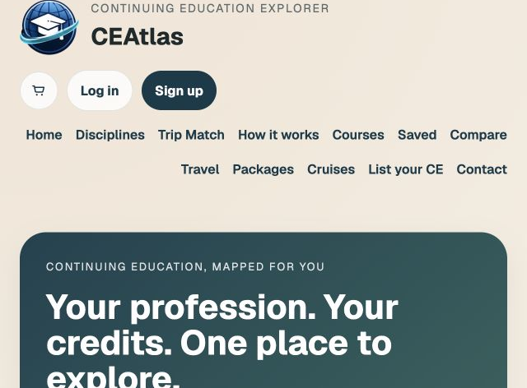
The CEAtlas product
One searchable layer
Current accredited courses across professions
CEAtlas course-detail pages before provider registration
Flights and hotels organized around the activity
Saved searches, comparison, and paired-profession trip matching
CEAtlas | Confidential investor discussion
04
Notes:
Registration remains on the provider's site today. Travel inventory uses preview data until commercial APIs and agreements are complete.

Slide 5
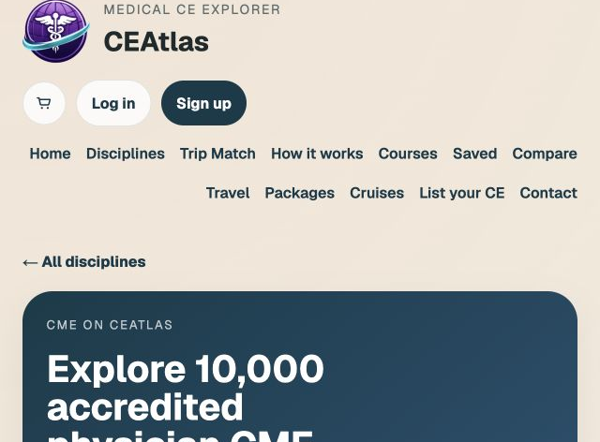
Current product evidence
32,834
Nursing
10,119
Law
10,000
Medicine
6,990
Dental fallback
4,715
Veterinary
64,658 repository records
Catalog volume demonstrates infrastructure. It does not demonstrate paying demand.
CEAtlas | Confidential investor discussion
05
Notes:
Repository counts observed September 4, 2026. Counts include fallback/generated catalog records and should not be presented as independently verified unique live courses without a formal audit.

Slide 6
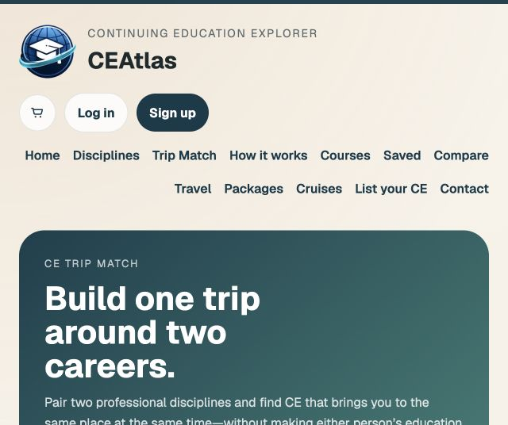
Initial customer and expansion sequence
1
Traveling physicians and dentists
High income, recurring education requirements, and meaningful trip value.
2
Practices, hospitals, and professional groups
Team planning, budget oversight, and compliance workflows.
3
Education providers and travel partners
Qualified referrals, promotion, analytics, and transactions.
CEAtlas | Confidential investor discussion
06
Notes:
Multi-profession inventory supports the platform thesis, while physicians and dentists provide the recommended initial acquisition wedge.

Slide 7
Bottom-up market model
Professional segment
U.S. employment
Annual addressable revenue assumption
Illustrative opportunity
Physicians and surgeons
839,000
$75 per professional
$62.9M
Registered nurses
3,159,000
$20 per professional
$63.2M
Lawyers
864,800
$35 per professional
$30.3M
Veterinarians
86,400
$60 per professional
$5.2M
Dentists
Not yet sourced
Excluded pending validation
Excluded
Initial modeled annual revenue pool
$161.6M before dentistry
Planning model only. Revenue assumptions combine subscriptions, provider economics, and travel referrals.
CEAtlas | Confidential investor discussion
07
Notes:
Employment sources: U.S. Bureau of Labor Statistics Occupational Outlook Handbook, 2024 employment. Physicians 839,000; registered nurses 3,159,000; lawyers 864,800; veterinarians 86,400. URLs: https://www.bls.gov/ooh/healthcare/physicians-and-surgeons.htm ; https://www.bls.gov/ooh/healthcare/registered-nurses.htm ; https://www.bls.gov/ooh/legal/lawyers.htm ; https://www.bls.gov/ooh/healthcare/veterinarians.htm. Per-professional revenue values are CEAtlas management assumptions.

Slide 8
Competitive position
Alternative
What it does well
What remains fragmented
Search engines
Broad discovery
Accreditation context and normalized comparison
Boards and compliance databases
Rules and credit records
Shopping, travel, and provider choice
Provider websites
Authoritative course information
Cross-provider comparison
Travel platforms
Flight and hotel inventory
Course eligibility and education context
CEAtlas
Course decision plus trip planning
Must prove data quality and distribution
Defensibility must come from verified data, provider integrations, user behavior, and workflow depth
CEAtlas | Confidential investor discussion
08
Notes:
The interface alone does not create defensibility. Investors should evaluate the data rights, verification process, provider relationships, and user retention.

Slide 9
Five revenue streams with different start dates
Provider referrals
M1 to M6
Fee per qualified lead or completed registration
Sponsored placement
M4 to M9
Clearly labeled promotion sold to providers
Travel affiliate revenue
M6 to M12
Commission on flights, hotels, or packages
Subscriptions
M9 to M18
Professional, practice, and employer tools
Marketplace transactions
M18+
Registration take rate after contracts and compliance work
CEAtlas | Confidential investor discussion
09
Notes:
Timing represents the operating plan, not completed contracts. CEAtlas should launch simpler referral economics before assuming merchant-of-record responsibilities.

Slide 10
Provider revenue model
Offer
Illustrative price
Customer value
Proof required
Enhanced provider profile
$299 per month
Brand control, analytics, richer listings
10 paid pilots
Sponsored placement
$750 per month
Incremental qualified visibility
Positive provider ROI
Qualified registration lead
$20 to $50
Measurable buyer intent
Attribution agreement
Registration take rate
8% to 12%
Demand plus checkout infrastructure
Contracts and payment operations
Illustrative provider ARR at 100 profiles
$358,800
Pricing remains unvalidated until providers sign and renew.
CEAtlas | Confidential investor discussion
10
Notes:
All pricing is a management assumption for testing. Provider ARR calculation: 100 providers x $299 x 12 months.

Slide 11
Travel revenue model
Course selected
Travel search
Tracked booking
Planning assumption
Base case
Sensitivity
Travel search after course detail
30%
15% to 45%
Booking conversion from travel search
8%
4% to 12%
Average eligible booking value
$750
$450 to $1,200
Net commission rate
4%
2% to 6%
Revenue per travel search
$2.40
$0.36 to $8.64
CEAtlas | Confidential investor discussion
11
Notes:
Illustrative economics only. Base revenue per travel search equals 8% booking conversion x $750 booking value x 4% commission. Supplier contracts and attribution determine actual economics.

Slide 12
Subscription and employer economics
Plan
Illustrative price
Primary user
Included value
Professional Plus
$99 per year
Individual professional
Advanced alerts, trip watchlists, records
Practice
$249 per month
Small practice
Team planning and budget visibility
Employer
Custom annual contract
Hospital or group
Roster workflows and reporting
Provider Analytics
Included in $299 profile
Education provider
Demand and referral reporting
Paid conversion target
Validation method
4% of registered professionals
Preorders, pilots, and renewal behavior
CEAtlas | Confidential investor discussion
12
Notes:
Prices and conversion targets are planning assumptions. CEAtlas should not recognize subscription demand from survey intent alone.

Slide 13
Go-to-market sequence
Months 1 to 3
Founder-led cohort
Recruit 100 professionals from direct relationships and specialty communities.
Months 2 to 6
Search content
Publish high-intent destination, specialty, date, and credit pages tied to live inventory.
Months 4 to 9
Provider distribution
Sign pilot providers that link to CEAtlas and pay for measured demand.
Months 7 to 12
Referral loops
Course alerts, saved trips, colleague sharing, and paired-profession planning.
After proof
Paid acquisition
Scale only where contribution margin supports the channel.
CEAtlas | Confidential investor discussion
13
Notes:
The first year prioritizes channel learning. Paid media remains a controlled experiment until CEAtlas measures conversion and gross profit by source.

Slide 14
Search acquisition plan
Programmatic destination pages
Course-detail indexing
Examples include physician CME in New York, dental CE in Las Vegas, and veterinary CE cruises.
Every current course receives structured metadata, canonical URLs, and expiration handling.
State and specialty guidance
Email capture and return visits
Useful planning pages connect licensure questions to relevant searchable inventory.
Alerts convert one-time search traffic into a recurring planning relationship.
Monthly scorecard
Indexed pages | nonbrand clicks | signup rate | detail views | outbound registration clicks
CEAtlas | Confidential investor discussion
14
Notes:
Targets should be established after Search Console produces a baseline. Avoid projecting SEO traffic before indexation and click-through rates are observed.

Slide 15
Direct and partnership marketing
Channel
First action
90-day success measure
Founder network
Invite former colleagues into a structured beta
100 activated professionals
Professional communities
Demonstrations and useful destination guides
20% landing-page signup rate
CE providers
Offer measurable referral pilots
10 active pilots
Associations and employers
Pitch member or team planning workflows
3 design partners
Newsletters and podcasts
Founder story plus live product demonstration
Trackable qualified visits
CEAtlas | Confidential investor discussion
15
Notes:
Metrics are proposed operating targets. An activated professional completes a search and at least one high-intent action such as saving, comparing, or opening registration.

Slide 16
Course data operating model
1
Acquire
Provider pages, feeds, APIs, and approved directories
2
Normalize
Profession, date, location, price, format, and credit fields
3
Verify
Accreditation evidence, active dates, source URL, and freshness
4
Publish
CEAtlas detail page with provenance and expiration controls
5
Monitor
Change detection, failed sources, duplicates, and user reports
CEAtlas | Confidential investor discussion
16
Notes:
Data rights and source permissions require source-by-source review. Course count should never outrank accreditation evidence and freshness.

Slide 17
Product and commercial roadmap
Period
Product delivery
Commercial outcome
0 to 90 days
Analytics, QA dashboard, saved searches, stable course details
100-user cohort and 10 provider conversations
Months 4 to 6
Alerts, provider claiming, referral attribution
First paid provider pilots
Months 7 to 9
Production travel APIs and itinerary workflow
First attributed travel revenue
Months 10 to 12
Practice dashboard and premium plan
Initial recurring revenue and renewals
Months 13 to 18
Checkout or deeper provider integrations
Seed-funded growth, subject to evidence
CEAtlas | Confidential investor discussion
17
Notes:
Roadmap dates begin when financing closes. Travel and marketplace timing depend on partner contracts, API access, and legal review.

Slide 18
Lean team plan
Role
Timing
Cash plan
Accountability
Founder / CEO
Months 1 to 18
$108,000 salary
Customer discovery, fundraising, product direction, partnerships
Contract product engineer
Months 1 to 18
Within $140,000 product budget
Reliability, accounts, analytics, travel
Data contractor
As needed
Within $65,000 data budget
Scrapers, normalization, verification
Growth contractor
Months 4 to 18
Within $65,000 acquisition budget
Search content, lifecycle, measurement
Professional advisers
As needed
Within $28,000 legal budget
Securities, contracts, privacy, accounting
CEAtlas | Confidential investor discussion
18
Notes:
The plan assumes a $6,000 monthly gross founder salary for 18 months. The total founder allocation is $120,000 after estimated employer payroll costs and a modest administrative allowance. Other roles remain contractors until traction supports hiring.

Slide 19
Detailed use of the $500,000 raise
Category
Amount
Share
Deliverables
Product and engineering
$140,000
28%
Core product, analytics, accounts, travel integration
Founder salary and payroll
$120,000
24%
$6,000 gross salary for 18 months plus payroll costs
Course data and accreditation
$65,000
13%
Scrapers, normalization, freshness, verification
Marketing and provider sales
$65,000
13%
SEO, cohort recruitment, provider pilots
Legal, accounting, insurance
$28,000
6%
Fundraise, contracts, privacy, bookkeeping
Infrastructure and software
$22,000
4%
Hosting, database, email, monitoring
Travel and partner integration
$15,000
3%
API onboarding and commercial setup
Operating reserve
$45,000
9%
Unexpected costs and runway protection
TOTAL
$500,000
100%
18-month operating plan
CEAtlas | Confidential investor discussion
19
Notes:
Proposed budget. Founder salary equals $108,000 over 18 months. The $120,000 category includes approximately $12,000 for employer payroll costs and administration. Arithmetic: amounts total $500,000.

Slide 20
Cash deployment and runway
$25.3K
Average monthly deployment before reserve
18 months
Planned operating runway
Begin seed preparation by month 10
CEAtlas | Confidential investor discussion
20
Notes:
Quarterly deployment assumption totals $455,000 plus a $45,000 reserve. Average monthly deployment equals $455,000 / 18 = $25,278.

Slide 21
Illustrative three-year operating case
$000 except users
Year 1
Year 2
Year 3
Average monthly active users
10,000
75,000
250,000
Revenue
$55
$600
$2,200
Gross profit at 85%
$47
$510
$1,870
Operating expense
$305
$900
$1,650
Operating result
($258)
($390)
$220
Ending team size
1 founder + contractors
5 to 7
10 to 14
Forecast status
Illustrative management case. No historical revenue supports this forecast yet.
CEAtlas | Confidential investor discussion
21
Notes:
All values are planning assumptions. Year 1 operating expense approximates 12 months of the 18-month deployment plan. Revenue mix and hiring should change based on observed contribution margin. Gross profit is modeled at 85% of revenue. Operating result equals gross profit minus operating expense.

Slide 22
Year 3 revenue composition
Provider subscriptions
$700K
Sponsored and referral
$450K
Professional and employer
$500K
Travel affiliate
$250K
Transactions and other
$300K
Total: $2.2M
CEAtlas | Confidential investor discussion
22
Notes:
Illustrative revenue mix only. The model deliberately avoids dependence on a single stream, but management should concentrate resources after one stream demonstrates superior margins and retention.

Slide 23
Unit economics scorecard
Metric
Target before scaling
Why it matters
Visitor to registered user
8% or higher
Measures usefulness and capture
Activated user rate
40% or higher
Search plus save, compare, or outbound action
90-day returning user rate
25% or higher
Shows recurring planning behavior
Blended acquisition cost
Below $25
Must fit expected gross profit
12-month gross profit per user
Above $75
Supports a 3x LTV to CAC threshold
Provider pilot renewal
60% or higher
Validates business-side value
Travel revenue per engaged user
Above $2.40
Tests base affiliate assumption
CEAtlas | Confidential investor discussion
23
Notes:
These are operating gates, not current results. LTV should use realized gross profit and churn, not topline revenue or survey willingness to pay.

Slide 24
Path to operating break-even
$135K
85%
$159K
Monthly operating expense at scaled team
Illustrative gross margin
Monthly revenue required for break-even
Target timing
Capital implication
Base case reaches monthly operating break-even during Year 3.
The $500,000 round funds the validation stage. A seed round supports the team and growth required to reach break-even.
Break-even revenue = $135,000 monthly expense / 85% gross margin
CEAtlas | Confidential investor discussion
24
Notes:
Illustrative break-even calculation. Timing depends on actual pricing, adoption, gross margin, and hiring. This model excludes financing costs and taxes.

Slide 25
Milestones that unlock the seed round
Area
Month 6 evidence
Month 12 evidence
Users
1,000 registered; 250 activated
10,000 registered; 2,500 returning
Providers
10 pilots; attribution live
25 paying or contracted providers
Revenue
First paid pilot
$10K to $20K monthly run rate
Acquisition
Two measurable organic channels
One channel with CAC below $25
Product
Reliable course details and alerts
Travel plus practice workflow in production
Data
Freshness dashboard operational
90% of viewed records pass freshness checks
CEAtlas | Confidential investor discussion
25
Notes:
These targets are proposed financing milestones. They are ambitious and should be revised after the first 90 days of baseline data.

Slide 26
Financing plan after the $500,000 round
Months 0 to 9
Months 10 to 12
Close the round, instrument the product, recruit users, and convert provider pilots into revenue.
Prepare seed materials while at least six months of runway remains.
Months 13 to 18
Additional runway sources
Target a $1.0M to $2.0M seed round if retention, provider demand, and CAC support growth.
Revenue, cloud credits, strategic pilots, and carefully selected non-dilutive programs reduce dilution.
Fundraising route requires securities counsel
Friends and family, angel, seed, and crowdfunding labels do not replace federal and state compliance.
CEAtlas | Confidential investor discussion
26
Notes:
SEC source: https://www.sec.gov/resources-small-businesses/capital-raising-building-blocks/early-stage-investors. Regulation Crowdfunding permits eligible issuers to raise up to $5 million in 12 months through a registered intermediary, subject to rules and disclosures: https://www.sec.gov/resources-small-businesses/exempt-offerings/regulation-crowdfunding. Obtain legal advice before soliciting or accepting funds.

Slide 27
Principal risks and controls
Risk
Why it matters
Near-term control
Course accuracy
Bad listings damage trust and may affect licensure decisions
Provenance, freshness checks, user reporting, disclaimers
Data rights
Some sources may restrict automated collection
Source review, provider feeds, contracts, rate limits
Marketplace liquidity
Many listings do not guarantee buyer activity
Narrow customer wedge and demand measurement
Travel dependency
APIs and commissions can change
Multiple suppliers and no revenue concentration assumption
Long purchase cycle
CE decisions may happen only a few times each year
Alerts, compliance tools, and employer workflows
Capital requirements
Scale may require more than the first round
Milestone financing and early revenue tests
CEAtlas | Confidential investor discussion
27
Notes:
This slide should start diligence conversations rather than minimize risk. Add counsel-reviewed disclosures before any formal offering.

Slide 28
Open diligence questions
Demand
Willingness to pay
How many professionals plan destination CE annually, and how often do they return to search?
Which party pays first: professional, employer, provider, or travel partner?
Data defensibility
Economics
Which provider relationships can replace fragile scraping with authorized structured feeds?
What realized gross profit follows each acquired professional over 12 months?
The first round exists to answer these questions with observed behavior
Investor reporting should publish actual versus plan every month.
CEAtlas | Confidential investor discussion
28
Notes:
A credible early-stage guide distinguishes known facts from questions the financing will answer.

Slide 29
CEAtlas
$500,000 for an 18-month validation plan
Current platform
Live beta and multidisciplinary catalog infrastructure
Next evidence
Retained users, paying providers, attributable transactions, and scalable acquisition
ceatlas.co
CEAtlas | Confidential investor discussion
29
Notes:
Close with the exact $500,000 ask and 18-month operating plan. Do not discuss investment terms until counsel has prepared the offering structure and disclosures.

