Slide 1

CEAtlas
Continuing education discovery and travel planning in one place
Friends and family investment discussion
Joseph Slaughter | Founder | September 2026
Notes:
Opening: Licensed professionals must complete continuing education throughout their careers, but finding the right course and planning the trip remain fragmented. CEAtlas brings those decisions together. This deck is a discussion draft and contains forward-looking plans, not guaranteed outcomes.

Slide 2
Professional education is difficult to shop for
1
Discovery is fragmented
The result
Professionals search provider sites, association calendars, board resources, and general search engines.
Too much searching before a professional can make one confident choice
2
Eligibility is hard to evaluate
Credit type, state rules, profession, format, and expiration dates all affect whether a course is useful.
The real cost is hidden
Current alternatives solve pieces of the problem. None organizes the full decision around the professional.
3
Registration is only one part of an in-person course. Flights, hotels, dates, and companion schedules shape the decision.
CEAtlas | Confidential discussion draft
02
Notes:
Describe one real CE search from the audience's perspective. Avoid claiming that every professional experiences the problem identically. The key pain is fragmented decision making.

Slide 3
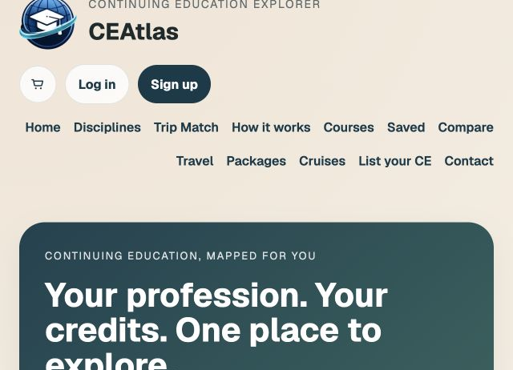
One place to explore CE across professions
CEAtlas helps users
Find current accredited activities
Compare credit, format, dates, provider, price, and location
Open a CEAtlas detail page before leaving for provider registration
Plan flights and hotels around the course
CEAtlas | Confidential discussion draft
03
Notes:
Live product shown at ceatlas.co. Registration currently occurs with the accredited provider. CEAtlas does not yet act as the merchant for course registration.

Slide 4
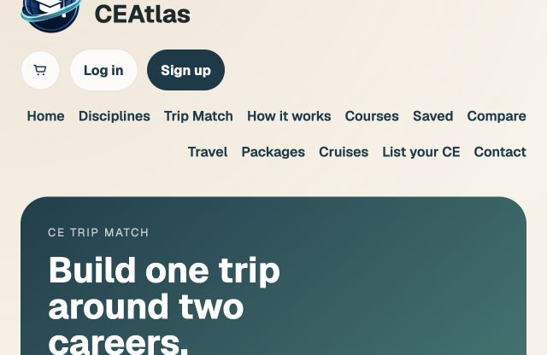
Destination CE creates a stronger starting point
A memorable use case
A dentist and a physician want CE in the same city during the same week
CEAtlas can match two professions, compare overlapping dates, and organize one shared trip.
This combines professional necessity with a high-value travel decision.
CEAtlas | Confidential discussion draft
04
Notes:
Use the spouse example because it makes the concept tangible. The broader insight is that continuing education often affects a household or professional team, not only one learner.

Slide 5
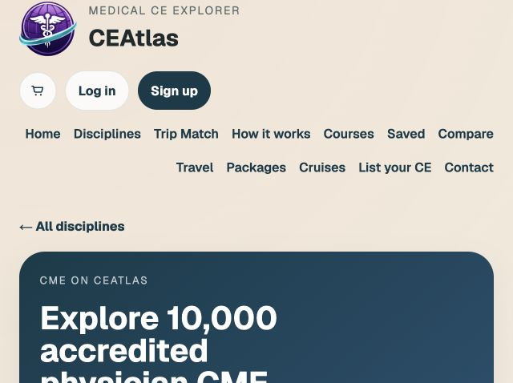
The working product already supports 64,658 catalog records
32,834
Nursing
10,119
Law
10,000
Medicine
6,990
Dental fallback
4,715
Veterinary
Catalog records, not customer traction
CEAtlas | Confidential discussion draft
05
Notes:
Catalog counts reflect the repository data generated September 4, 2026. They demonstrate data infrastructure, not unique paying customers or revenue. Veterinary inventory remains below 10,000 because verified source inventory is currently more limited.

Slide 6
The first customer is the traveling professional
Initial user
Expansion
Physicians and dentists planning accredited, in-person education
Practices and employers
Team planning, compliance support, budget visibility, and group travel.
They need confidence about the course and clarity about the total trip.
Education providers
Qualified discovery, measurable referrals, and demand insight.
CEAtlas | Confidential discussion draft
06
Notes:
Keep the wedge narrow in conversation. Multiple disciplines show platform potential, but initial customer acquisition should focus on professionals who travel for CE.

Slide 7
Revenue develops in stages
NOW
Referral and lead economics
Provider referrals, sponsored listings with clear disclosure, and travel affiliate revenue.
NEXT
Professional and employer tools
Premium alerts, saved planning, compliance support, practice dashboards, and group coordination.
LATER
Marketplace transactions
Course registration and packaged travel after supplier contracts, licensing review, and payment operations are ready.
CEAtlas | Confidential discussion draft
07
Notes:
No revenue claims are made here. Explain that the company will test willingness to pay and unit economics before committing to a single long-term monetization model.

Slide 8
A bottom-up market model keeps the opportunity credible
Eligible professionals
×
Annual CE purchase occasions
×
Course and travel value
×
CEAtlas net revenue rate
Initial obtainable market
Validation required before publishing TAM
U.S. physicians and dentists who travel for CE
Confirm annual spending, travel incidence, achievable take rate, and acquisition cost with primary research.
CEAtlas | Confidential discussion draft
08
Notes:
Do not use a top-down market number until the sources and assumptions are ready. Investors should be able to recreate the model from licensed professional counts, purchase frequency, transaction value, and net revenue rate.

Slide 9
CEAtlas connects categories that currently remain separate
ALTERNATIVE
STRENGTH
OPENING FOR CEATLAS
Google and directories
Broad discovery
Limited normalization and professional context
Boards and compliance databases
Eligibility records
Limited shopping and travel planning
Provider websites
Authoritative registration
One provider at a time
Travel platforms
Flights and hotels
No CE eligibility or course context
CEAtlas
Course decision plus trip
Provider registration today, marketplace later
CEAtlas | Confidential discussion draft
09
Notes:
Acknowledge competitors directly. The defensibility thesis depends on normalized accreditation data, provider integrations, eligibility intelligence, verified user behavior, and cross-profession trip matching. The current interface alone is not a moat.

Slide 10
The first growth engine combines search and trusted distribution
01
02
Search demand
Course alerts
Location and specialty pages for terms such as CME in New York and dental CE in Las Vegas.
Visitors save criteria and return when matching courses or travel windows appear.
03
04
Provider distribution
Professional communities
Partners link to CEAtlas detail pages and receive qualified referral traffic.
Founder-led outreach through past colleagues, associations, newsletters, and specialty groups.
CEAtlas | Confidential discussion draft
10
Notes:
The near-term goal is learning, not buying growth. Track search-to-detail clicks, saved searches, provider outbound clicks, return visits, and email conversion before spending heavily on advertising.

Slide 11
The next 12 months should prove demand and economics
0 to 3 months
3 to 6 months
6 to 12 months
Recruit the first professional cohort
Measure repeatable behavior
Test revenue
Interviews, course alerts, analytics, and provider outreach
Organic discovery, return usage, referral clicks, and travel engagement
Provider pilots, affiliate economics, and one employer or practice workflow
Decision point
Scale the channel and revenue model that demonstrate the strongest retention and margins
CEAtlas | Confidential discussion draft
11
Notes:
Replace time-based goals with dated targets once the operating plan is approved. The next financing should follow evidence of repeat demand and an initial revenue path.

Slide 12
Working proposal: a $250,000 friends and family round
40%
Product and data reliability
Target outcome
A validated customer wedge, measurable acquisition channel, initial provider economics, and a clear case for the next round
25%
Customer acquisition experiments
20%
Provider and travel partnerships
15%
Legal, compliance, and operations
Draft assumption. Final amount, instrument, valuation terms, and runway require a detailed operating budget and securities counsel.
CEAtlas | Confidential discussion draft
12
Notes:
This $250,000 target is a working assumption for discussion. Do not offer investment terms from this slide alone. Finalize the budget, financing instrument, disclosures, and investor eligibility with counsel before soliciting commitments.

Slide 13
The opportunity
Make professional education easier to find, evaluate, and experience
CEAtlas has a functioning platform and substantial catalog infrastructure. The next phase must prove customer demand, provider value, and revenue economics.
Discussion
ceatlas.co
CEAtlas | Confidential discussion draft
13
Notes:
Close by asking for questions and candid feedback. For a friends and family audience, trust in the founder matters, but the risks and early stage should remain explicit.

