Slide 1

LFS101: Introduction to Linux
Instructor: Jerry Cooperstein
Program Director at The Linux Foundation
www.linuxfoundation.org
Student: Joseph Steven Martinez
Information Technology / CS
www.josephsmartinez.com/linux

Slide 2
Chapters
The Linux Foundation
Linux Philosophy and Concepts
Linux Basics and System Startup
Graphical Interface
System Configuration from the Graphical Interface
Common Application
Command Line Operation
Finding Linux Documentation
Processes
File Operations
Text Editors
User Environments
Manipulating Text
Networking Operations
Bash Shell Scripting I
Bash Shell Scripting II
Printing
Local Security Principles

Slide 3
Chapter 14: Networking Operations
In this lesion we are going to be discussing IP addressing, name resolution, configuration file, remote commands, and trouble shooting.

Slide 4
Chapter 14: Networking Operations Sections
Introduction / learning objectives
Network Addresses and DNS
Networking Configuration and Tools
Browser
Transferring Files
Summary

Slide 5
Learning Objectives
Explain basic networking concepts, including types of networks and addressing issues.
Configure networking interfaces and use basic networking utilities, such as ifconfig, ip, ping, route, & traceroute.
Use graphical and non-graphical browser, such as Lynx, w3w, Firefox, Chrome and Epiphany.
Transfer files to and from clients and servers using both graphical and text mode application such as Filezilla, ftp, sftp, and wget.

Slide 6

Introduction to Networking
A network is a group of computers and computing devices connected together through communication channels, such as cables or wireless media. The computers connected over a network may be located in the same geographical area or spread across the world.
A network is used to:
Allow the connected devices to communicate with each other
Enable multiple users to share devices over the network, such as printers and scanners
Share and manage information across computers easily.
Most organizations have both an internal network and an Internet connection for users to communicate with machines and people outside the organization. The Internet is the largest network in the world and is often called "the network of networks".

Slide 7
Network Addresses and DNS Section 1

Slide 8
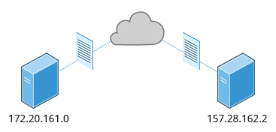
IP Addresses
Devices attached to a network must have at least one unique network address identifier known as the IP (Internet Protocol) address. The address is essential for routing packets of information through the network.
Exchanging information across the network requires using streams of small packets, each of which contains a piece of the information going from one machine to another. These packets contain data buffers together with headers which contain information about where the packet is going to and coming from, and where it fits in the sequence of packets that constitute the stream. Networking protocols and software are rather complicated due to the diversity of machines and operating systems they must deal with, as well as the fact that even very old standards must be supported.

Slide 9
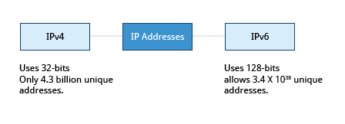
IPv4 and IPv6
There are two different types of IP addresses available: IPv4 (version 4) and IPv6 (version 6). IPv4 is older and by far the more widely used, while IPv6 is newer and is designed to get past the limitations of the older standard and furnish many more possible addresses.
IPv4 uses 32-bits for addresses; there are only 4.3 billion unique addresses available. Furthermore, many addresses are allotted and reserved, but not actually used. IPv4 is considered inadequate for meeting future needs because the number of devices available on the global network has increased enormously in recent years.
IPv6 uses 128-bits for addresses; this allows for 3.4 X 10³⁸ unique addresses. If you have a larger network of computers and want to add more, you may want to move to IPv6, because it provides more unique addresses. However, it can be complex to migrate to IPv6; the two protocols do not always inter-operate well. Thus, moving equipment and addresses to IPv6 requires significant effort and has not been quite as fast as was originally intended. We will discuss IPv4 more than IPv6 as you are more likely to deal with it.

Slide 10
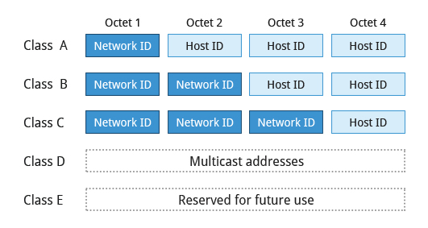
Decoding IPv4 Addresses
A 32-bit IPv4 address is divided into four 8-bit sections called octets.
Example: IP address → 172 . 16 . 31 . 46 Bit format → 10101100.00010000.00011111.00101110
(Octet us just another word for bytes)
Network addresses are divided into five classes: A, B, C, D, and E. Classes A, B, and C are classified into two parts: Network addresses (Net ID) and Host address (Host ID). The Net ID is used to identify the network, while the Host ID is used to identify a host in the network. Class D is used for special multicast applications (information is broadcast to multiple computers simultaneously) and Class E is reserved for future use. In this section you will learn about classes A, B, and C

Slide 11
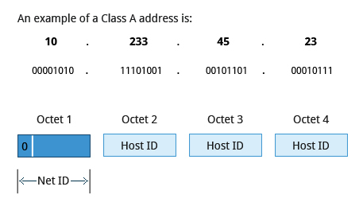
Class A Network Addresses
Class A addresses use the first octet of an IP address as their Net ID and use the other three octets as the Host ID. The first bit of the first octet is always set to zero. So you can use only 7-bits for unique network numbers. As a result, there are a maximum of 126 Class A networks available (the addresses 0000000 and 1111111 are reserved). Not surprisingly, this was only feasible when there were very few unique networks with large numbers of hosts. As the use of the Internet expanded, Classes B and C were added in order to accommodate the growing demand for independent networks.
Each Class A network can have up to 16.7 million unique hosts on its network. The range of host address is from 1.0.0.0 to 127.255.255.255.
Note: The value of an octet, or 8-bits, can range from 0 to 255.

Slide 12
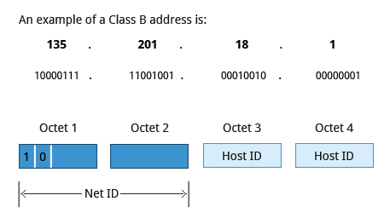
Class B Network Addresses
Class B addresses use the first two octets of the IP address as their Net ID and the last two octets as the Host ID. The first two bits of the first octet are always set to binary 10, so there are a maximum of 16,384 (14-bits) Class B networks. The first octet of a Class B address has values from 128 to 191. The introduction of Class B networks expanded the number of networks but it soon became clear that a further level would be needed.
Each Class B network can support a maximum of 65,536 unique hosts on its network. The range of host address is from 128.0.0.0 to 191.255.255.255.

Slide 13
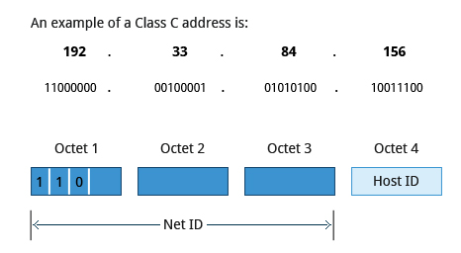
Class C Network Addresses
Class C addresses use the first three octets of the IP address as their Net ID and the last octet as their Host ID. The first three bits of the first octet are set to binary 110, so almost 2.1 million (21-bits) Class C networks are available. The first octet of a Class C address has values from 192 to 223. These are most common for smaller networks which don't have many unique hosts.
Each Class C network can support up to 256 (8-bits) unique hosts. The range of host address is from 192.0.0.0 to 223.255.255.255.

Slide 14
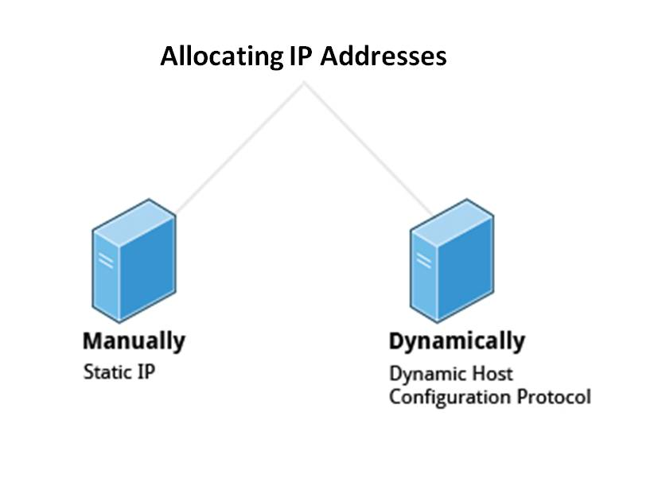
IP Address Allocation
Typically, a range of IP addresses are requested from your Internet Service Provider (ISP) by your organization's network administrator. Often, your choice of which class of IP address you are given depends on the size of your network and expected growth needs.
You can assign IP addresses to computers over a network manually or dynamically. When you assign IP addresses manually, you add static (never changing) addresses to the network. When you assign IP addresses dynamically (they can change every time you reboot or even more often), the Dynamic Host Configuration Protocol (DHCP) is used to assign IP addresses.

Slide 15
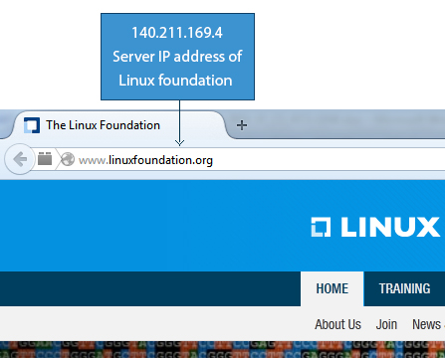
Name Resolution
Name Resolution is used to convert numerical IP address values into a human-readable format known as the hostname. For example, 140.211.169.4 is the numerical IP address that refers to the linuxfoundation.org hostname. Hostnames are easier to remember.
Given an IP address, you can obtain its corresponding hostname. Accessing the machine over the network becomes easier when you can type the hostname instead of the IP address.
You can view your system’s hostname simply by typing hostname with no argument.
Note: If you give an argument, the system will try to change its hostname to match it, however, only root users can do that.
The special hostname localhost is associated with the IP address 127.0.0.1, and describes the machine you are currently on (which normally has additional network-related IP addresses).
Note: The next two screens cover the demonstration and Try-It-Yourself activity. You can view a demonstration and practice the procedure through the Try-It-Yourself activity.

Slide 16
Using Domain Name System (DNS) and Name Resolution
Let’s try some using some commands to practice.
Display contents of etc/hosts file:
$cat /etc/hosts
To display the contents of /etc/resolv.conf:
$cat /etc/resolv.conf
To look up hostnames using DNS(IP address of the hostname will display):
$host linuxfoundation.org
To look up name servers interactively(IP of the domain name will displayed):
$nslookup linuxfoundation.org
To look up domain name information from the nameserver(domain name information will display):
$dig linuxfoundation.org

Slide 17
Networking Configuration and Tools Section 2

Slide 18
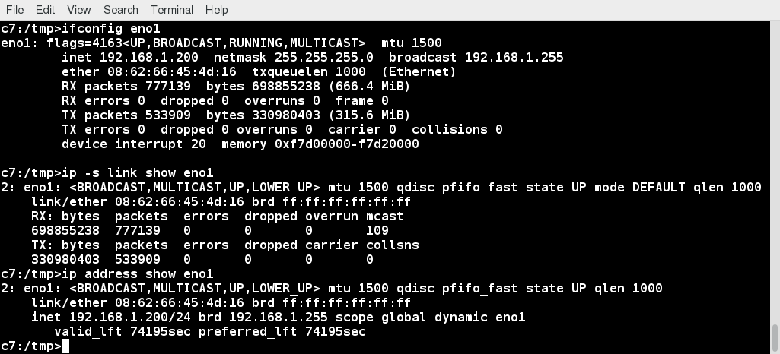
Network Interfaces
Network interfaces are a connection channel between a device and a network. Physically, network interfaces can proceed through a network interface card (NIC), or can be more abstractly implemented as software. You can have multiple network interfaces operating at once. Specific interfaces can be brought up (activated) or brought down (de-activated) at any time.
Information about a particular network interface or all network interfaces can be reported by the ifconfig utility, which you may have to run as the superuser, or at least, give the full path, i.e., /sbin/ifconfig, on some distributions. Similar information can be obtained with ip, a newer utility with far more capabilities, but uglier output for humans. Some new Linux distributions do not install the older net-tools package to which ifconfig belongs and you may have to install it to use it.

Slide 19
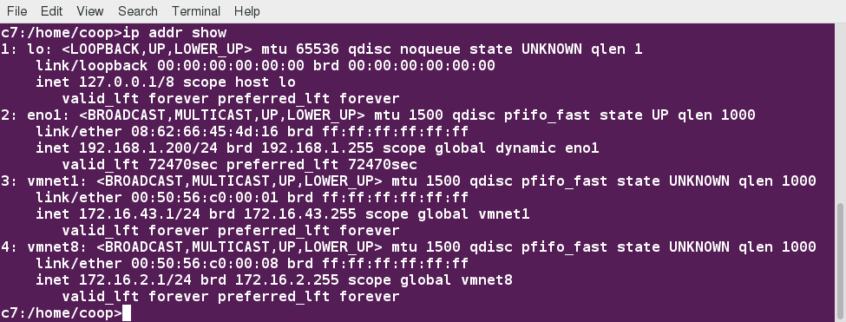
The ip Utility
To view the IP address: $ /sbin/ip addr show
To view the routing information: $ /sbin/ip route show
ip is a very powerful program that can do many things. Older (and more specific) utilities such as ifconfig androute are often used to accomplish similar tasks. A look at the relevant man pages can tell you much more about these utilities.

Slide 20
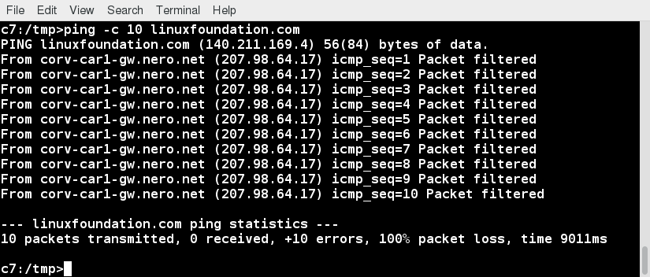
ping
ping is used to check whether or not a machine attached to the network can receive and send data; i.e., it confirms that the remote host is online and is responding.
To check the status of the remote host, at the command prompt, type ping <hostname>.
ping is frequently used for network testing and management; however, its usage can increase network load unacceptably. Hence, you can abort the execution of ping by typing CTRL-C, or by using the -c option, which limits the number of packets that ping will send before it quits. When execution stops, a summary is displayed.

Slide 21
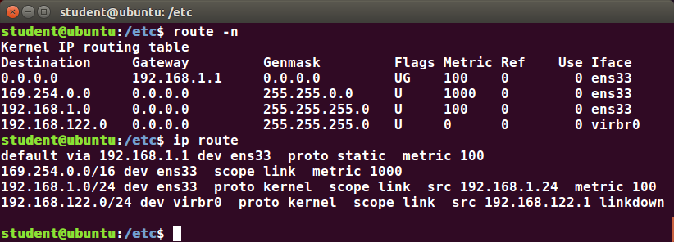
route
A network requires the connection of many nodes. Data moves from source to destination by passing through a series of routers and potentially across multiple networks. Servers maintain routing tables containing the addresses of each node in the network. The IP Routing protocols enable routers to build up a forwarding table that correlates final destinations with the next hop addresses.
One can use the route utility or the newer ip route command to view or change the IP routing table to add, delete, or modify specific (static) routes to specific hosts or networks. The table explains some commands that can be used to manage IP routing:
Task | Command
Show current routing table | $ route –n or ip route
Add static route | $ route add -net address or ip route add
Delete static route | $ route del -net address or ip route del

Slide 22
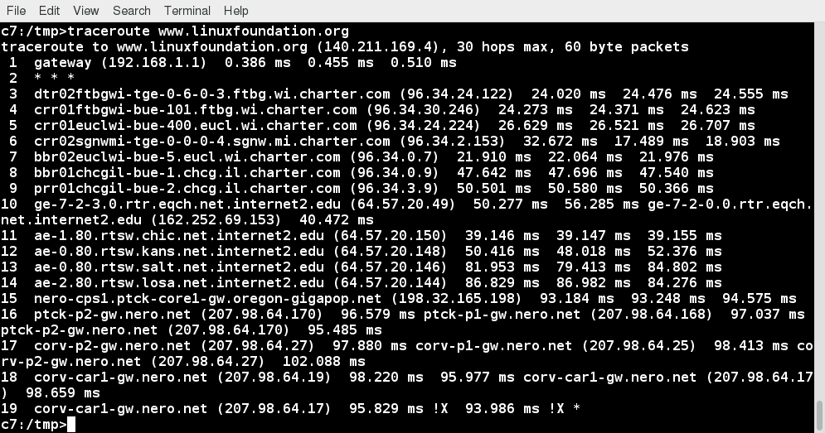
traceroute
traceroute is used to inspect the route which the data packet takes to reach the destination host, which makes it quite useful for troubleshooting network delays and errors. By using traceroute, you can isolate connectivity issues between hops, which helps resolve them faster.
To print the route taken by the packet to reach the network host, at the command prompt, type traceroute <address>.
Note: The next screen covers the Try-It-Yourself activity through which you can practice the procedure.

Slide 23
Try-It-Yourself: Using ping, route, and traceroute
Let’s try some using some commands to practice.
Tasks to be performed:Confirm that the remote host (google.com) is online and is responding
$ping google.com
View the current routing table.
$route -n
Check the route which the data packet takes to reach the destination host (google.com).
$traceroute google.com

Slide 24
More Networking Tools
Now, let’s learn about some additional networking tools. Networking tools are very useful for monitoring and debugging network problems, such as network connectivity and network traffic.
Note: The next two screens cover the demonstration and Try-It-Yourself activity. You can view a demonstration and practice the procedure through the Try-It-Yourself activity.
Networking Tools | Description
ethtool | Queries network interfaces and can also set various parameters such as the speed.
netstat | Displays all active connections and routing tables. Useful for monitoring performance and troubleshooting.
nmap | Scans open ports on a network. Important for security analysis
tcpdump | Dumps network traffic for analysis.
iptraf | Monitors network traffic in text mode.
mtr | Combines functionality of ping and traceroute and gives a continuously updated display.
dig | Tests DNS workings. A good replacement for host and nslookup.

Slide 25
Using More Networking Tools
Let’s get started on using More Networking Tools. Let start by opening the command prompt.
To query network interface connected to eth0 :
$sudo ethtool eth0
To display all active connections and routing tables (all active connection and routing tables will be displayed):
$netstat -r
To display open ports on a network:
$sudo nmap –sP 10.0.2.15/24

Slide 26
Graphical and Non-Graphical Browsers Section 3

Slide 27
Browsers are used to retrieve, transmit, and explore information resources, usually on the World Wide Web. Linux users commonly use both graphical and non-graphical browser applications.
The common graphical browsers used in Linux are:
Firefox
Google Chrome
Chromium
Epiphany
Opera.
Konqueror
Sometimes, you either do not have a graphical environment to work in (or have reasons not to use it) but still need to access web resources. In such a case, you can use non-graphical browsers, such as the following:
Non-Graphical Browsers | Description
lynx | Configurable text-based web browser; the earliest such browser and still in use.
links or elinks | Based on lynx. It can display tables and frames.
w3m | Another text-based web browser with many features.

Slide 28
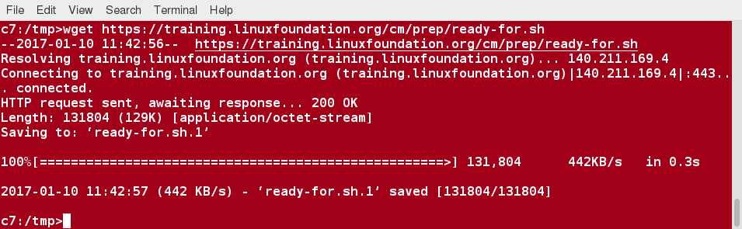
wget
Sometimes, you need to download files and information, but a browser is not the best choice, either because you want to download multiple files and/or directories, or you want to perform the action from a command line or a script. wget is a command line utility that can capably handle the following types of downloads:
Large file downloads
Recursive downloads, where a web page refers to other web pages and all are downloaded at once
Password-required downloads
Multiple file downloads.
To download a webpage, you can simply type wget <url>, and then you can read the downloaded page as a local file using a graphical or non-graphical browser.

Slide 29
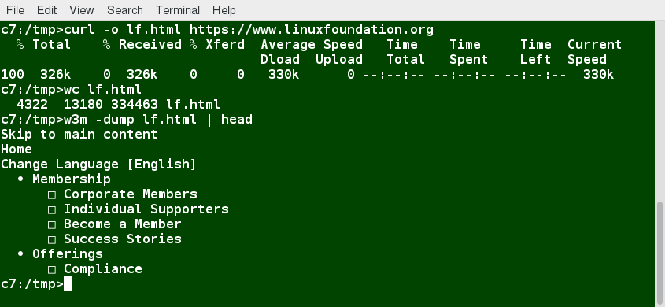
curl
Besides downloading, you may want to obtain information about a URL, such as the source code being used. curl can be used from the command line or a script to read such information. curl also allows you to save the contents of a web page to a file, as does wget.
You can read a URL using curl <URL>. For example, if you want to read http://www.linuxfoundation.org , type curl http://www.linuxfoundation.org.
To get the contents of a web page and store it to a file, type curl -o saved.htmlhttp://www.mysite.com. The contents of the main index file at the website will be saved in saved.html.
Note: The next screen covers the Try-It-Yourself activity through which you can practice the procedure.

Slide 30
Try-It-Yourself: Using wget and curl
Let’s try some using some commands to practice.
Task to be performed
Download the FAQ from the Linux Foundation website (http://www.linuxfoundation.org/about/faq) using wget.
$curl http://www.linuxfoundation.org/about/faq
Read information about https://lwn.net using curl and place the output in a file named lwn.out.
$curl –o lwn.out https://lwn.net/

Slide 31
Transferring Files Section 4

