Slide 1

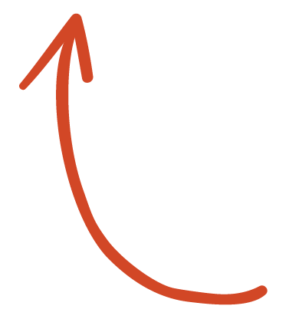
Here's your outline to get started
Key facts about your topic
Data analysis is a process of inspecting, cleansing, transforming and modeling data with the goal of discovering useful information, informing conclusion and supporting decision-making. Data analysis has multiple facets and approaches, encompassing diverse techniques under a variety of names, and is used in different business, science, and social science domains. In today's business world, data analysis plays a role in making decisions more scientific and helping businesses operate more effectively.
See more: Open the Notes below for more information.
Notes:
QuickStarter has created an outline to help you get started on your presentation. Some slides include information here in the notes to provide additional topics for you to research.

Slide 2
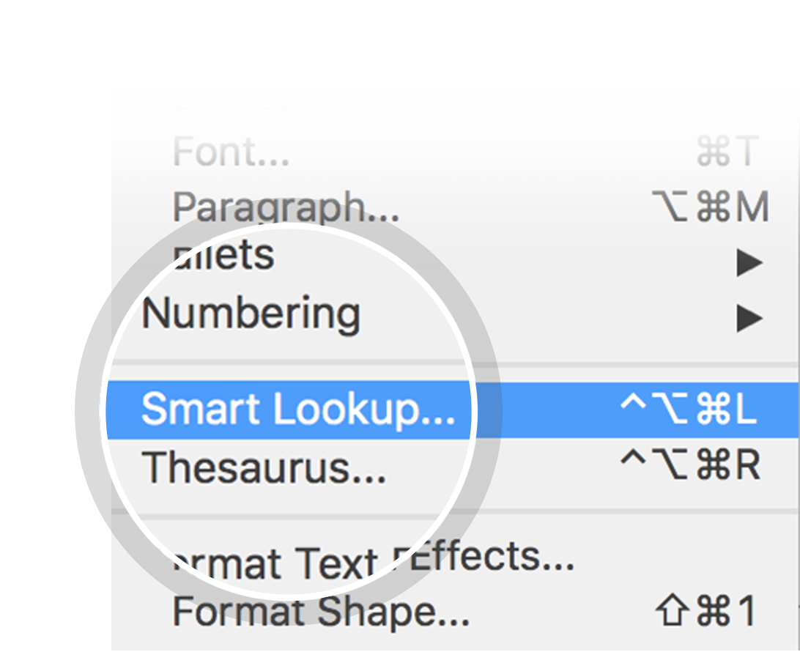
Related topics to research
SPSS
SQL
Software engineering
Presentation
MicroStrategy
Marketing
Data farming
Use Smart Lookup to learn more
1
Highlight one of the related topics
Right-click on the topic
Choose "Smart Lookup"
2
3

Slide 3
Predicting Rates of car collisions
By August stapf

Slide 4
Contents
The process of data analysis
Techniques for analyzing quantitative data
Analytical activities of data users
Barriers to effective analysis
Practitioner notes

Slide 5
The process of data analysis
The data was originally over 190,000 rows and had 37 attributes
Pre-processing included picking the significant variables, standardizing the data, and converting categorical variables into binary options.
After pre-processing, the data shape was converted to 155,000 rows and 32 attributes, which included many binary variables.
Notes:
Consider talking about:
Data requirements
Data collection
Data processing
Data cleaning
Exploratory data analysis
Modeling and algorithms
Data product
Communication

Slide 6
Techniques for analyzing quantitative data
I utilized 3 machine learning algorithms in order to train and test models and determine the most accurate model
K Nearest Neighbors
Decision Trees
Logistic Regression

Slide 7
Analytical Outcomes of the approaches
Accuracy was measured by the jaccard prediction accuracy score
KNN: 0.719815
Decision Tree: 0.742468
Logistic Regression: 0.727854
Decision Tree had the highest accuracy at almost 75%, which represents the significance of the attributes

Slide 8
Barriers to effective analysis
The data was sparse in how the severity code was measured
Severity code usually has 5 possibilities, but the data only included two of the possibilities
Notes:
Consider talking about:
Confusing fact and opinion
Cognitive biases
Innumeracy

Slide 9
Practitioner notes
Thankyou to IBM for this great opportunity!
Notes:
Consider talking about:
Initial data analysis
Main data analysis

