Slide 1
WeSafe
InnovAct 2025
Prioritizing Safe Routes for Solo Women Travelers
Track: AI & BLOCKCHAIN
Our Team:IR2025-995896
SIVASANGAR.A
23BCI0092
ARYA MULAY
23BIT0131
JOSEPH SYRUS
23BCI0047
BAVYA.J
23BCE2007
ARUNAYA.K
23BIT0277

Slide 2


Problem Statement
2
Women traveling alone face heightened safety concerns globally. Many navigation apps only optimize for the shortest path, ignoring crime hotspots and unsafe areas.
35%
of US female travelers express concern about personal safety (Booking.com, 2025)
21%
have feared for their safety in the last year (Solo Female Travelers Club, 2024)
80%+
experience harassment on or around public transportation routes (UN Women Cairo Study)
There is a critical need for navigation solutions designed with women's safety as the priority.

Slide 3





Why This Problem Matters
3
Limited Mobility
Safety concerns significantly restrict women's freedom of movement, especially at night or in unfamiliar areas.
Professiofial Impact
Women often decline career opportunities requiring travel or late work hours due to transportation safety concerns.
Real-World Examples
29%
of solo female travelers experienced theft or scams in 2024 (Condor Ferries Travel Safety Report)
67%
of women regularly change their travel routes to avoid areas they perceive as unsafe
83%
of women feel unsafe using public transportation or walking alone after dark
Existing navigation solutions focus on speed and efficiency but fail to accoufit for real-time safety factors that are crucial for women's travel decisions.

Slide 4

Our Solution: WeSafe App
4
WeSafe is a mobile app that uses crime, lighting, and crowd-sourcing data to recommend the safest—not just the fastest—routes for solo women travelers.
Key Features
Dyfiamic Safest-Route Guidafice
Prioritizes safety over speed for all journeys
Real-time Crime & Ificidefit Overlay Visualize potential danger zones on your map
Safe spot police station
Crowdsourced police station nearby
SOS & Emergeficy Cofitact
One-tap alert system for immediate assistance

Slide 5



What Makes WeSafe Innovative?
5
Unlike existing map or alert apps, WeSafe takes a comprehensive approach to women's safety:
Multi-Source Safety Data
Integrates crime statistics, crowd-sourced reports, lighting conditions, and transport hub proximity to create comprehensive safety maps
Advaficed A* Algorithm
Uses improved A* pathfinding with custom risk scoring to calculate routes that balance safety and efficiency
Safety Index Metrics
Assigns visual safety ratings to each route option, allowing women to make informed decisions based on personalized risk tolerance
Women Centered Design
Built with extensive input from women users, focusing on their specific concerns and empowering them with control and choice
Our innovation lies in prioritizing women's safety as the primary factor in route selection—not just an afterthought.

Slide 6

Technical Approach
6
Technology Stack
Frontend
HTML&CSS
Backend
Node.js with Express
Database & Storage
MongoDB
Security Features
End-to-end encrypted user data Anonymized incident reporting Secure authentication protocols Privacy-first location tracking
Route Optimization Algorithm
Modified A* pathfinding algorithm incorporating: Crime data API risk scoring
Street lighting information
User-reported safety
No.of .nearest police station
System Architecture
Mobile App (React Native)
UI/UX, Location Services, SOS Triggers
API Gateway (Node.js)
Route Processing, Auth, Data Aggregation
Safety Data
Maps API
User Reports

Slide 7




WeSafe Architecture & Workflow
7
Mobile App (React Native)
Backend Server (Node.js)
Database (Firebase)
External APIs (Maps, Crime Data)
System Workflow
User Requests Route
User inputs start and destination points in the WeSafe app interface
1
Backend Fetches Route Options
Server retrieves multiple routes with geo-risk overlays from external APIs
2
A* Algorithm Evaluates Routes
Modified A* algorithm analyzes routes based on safety factors and travel time
3
4
App Displays Safest Route
User interface shows route with highest safety index and alternative options
5
Real-time Updates & Reporting
User can report issues or activate SOS at any point during journey

Slide 8
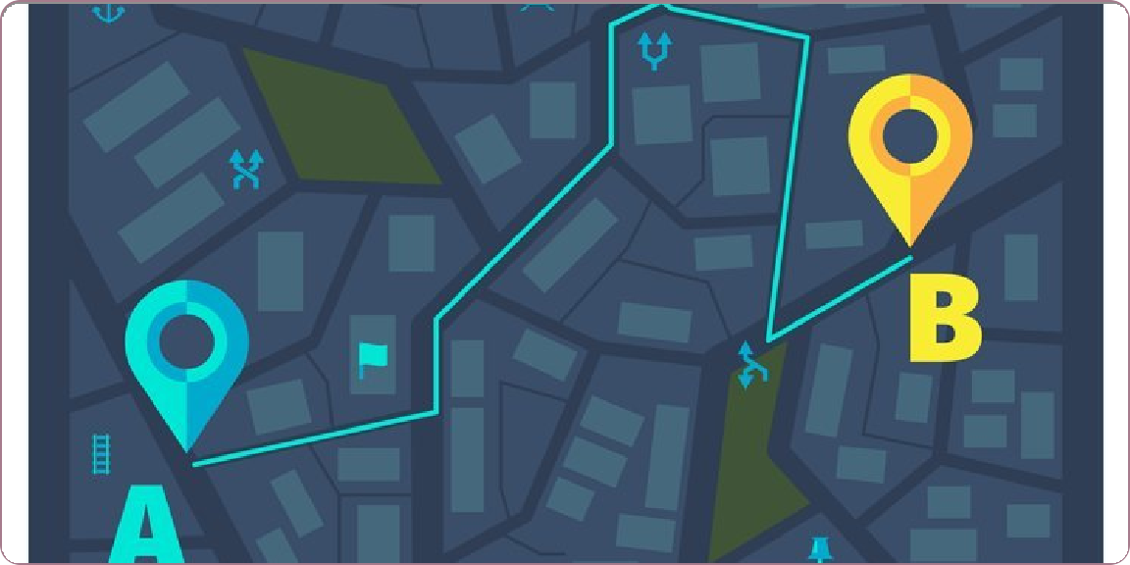

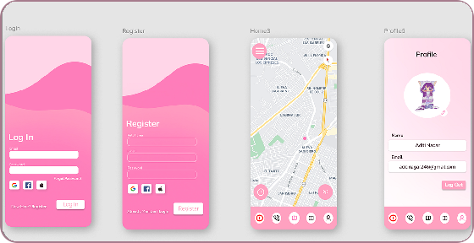





Demo: WeSafe in Action
Safe HASoplSemoOrt₈eSs
WeSafe's intuitive interface prioritizes safety without sacrificing usability. Our dark-themed UI enhances visibility at night while preserving battery life.
Safe Route Navigation
Safest Route Display
Color-coded paths prioritize safety over speed
Key Features Demonstrated:
Real-time safety route optimization
One-touch SOS emergency contacts
Crime hotspot visualization
Community-verified safe locations

Slide 9

Key Features Highlight
9
Real-time Safest Route Navigation
Unique algorithm that prioritizes safety over speed, using crime data, lighting conditions, and crowd-sourced safety reports to guide women through the safest paths.
Interactive Safety Map
Visual overlay of safety incidents, well-lit areas, and safe zones. Color-coded map helps users understand safety levels of different locations at a glance.
Immediate SOS Triggers
One-tap emergency alert system that notifies trusted contacts with your precise location and begins audio recording. Works even with low battery and poor connectivity.
Community Safety Network
Crowd-sourced safety reports and verified safe spots. Community members can flag hazards and mark safe areas for others, creating a dynamic safety database.
User Benefits
Peace of mind for women traveling alone Instant emergency response capabilities
Reduced anxiety through informed route choices
Community support through shared safety data

Slide 10






Impact & Use Cases
10
Who Befiefits
Solo Women Commuters
Daily travelers navigating between work, home, and social activities
Night Travelers
Women traveling through unfamiliar areas during late hours
Students & Tourists
Those navigating new campuses, cities or countries
Applications
Urban Navigation
Safe routes through cities with crime hotspot avoidance
Campus Safety
Navigating educational institutions with crowd-sourced safety data
Public Transit Integration
Safe connections between transit modes and walking paths
Event Safety
Navigate safely to and from large gatherings and festivals
Scaling Potential
Expandable to global coverage with localized safety data
Adaptable for other vulfierable groups including elderly and differently-abled individuals
Potential partfierships with ride-sharifig and transit authorities for integrated safety solutions
Made with Genspark

Slide 11





Challenges & Overcoming Them
11
Development Challenges
Our Solutions
Accessing Accurate Safety Data
Limited public API access to real-time crime and safety data across different regions
Multi-Source Data Integration
Combined public APIs, open data portals, and our community-sourced reports to create a comprehensive safety database
Privacy-Preserving Reports
Balancing detailed incident reporting while protecting user anonymity and preventing misuse
Robust Anonymization
Implemented location fuzzing, data aggregation, and opt-in sharing controls to protect privacy while maintaining usefulness
Safety vs. Route Efficiency
Creating an algorithm that doesn't excessively increase travel time while prioritizing safety
Optimized A* Algorithm
Developed a modified A* pathfinding algorithm with custom risk scoring that offers multiple route options with safety/time tradeoffs

Slide 12



Future Scope & Vision
12
Improvements
Deeper integration with local law enforcement alerts Predictive AI for safety risk forecasting
Expanded offline capabilities for areas with poor connectivity
Long-term Vision
Building a global safety database
Empowering community-based safety networks across cities
Integration with smart city initiatives for better urban safety
Conclusion
WeSafe reimagines navigation by prioritizing women's safety over speed.
Our solution leverages data-driven insights and community feedback to create a safer world for women travelers.
With WeSafe, we're not just building an app—we're building a movement toward greater safety and freedom of movement.
Made with Genspark

Slide 13
CONCLUSION HerWay combines crime, police, and streetlight data into a single system to ensure safer route recommendations. By prioritizing security over distance, it helps women travelers choose safer journeys. The unified dataset provides accurate insights into risk levels across routes. This approach not only enhances personal safety but also aids authorities in resource allocation. WeSafe transforms raw data into actionable, real-world impact for safer urban travel.

