Slide 1



Technical Case Study of Yakanzeka.com
Technical Implementation Plan:
High-Precision Web Tracking & Data Engineering
bQ Yusur ĽAS

Slide 2
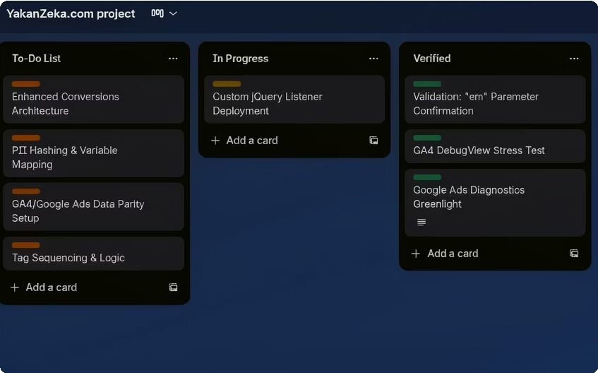
Project Governance: Agile Framework for Tracking Deployment
Ľcch"ical dcploQmc"ť ícquiícs a íigoíous ma"agcmc"ť ríamcwoík ťo mai"ťai" daťa i"ťcgíiťQ. A" Agilc/Ka"ba" ríamcwoík was uťilizcd as a sťíaťcgic "cccssiťQ ťo píc:c"ť daťa discícpa"cics a"d c"suíc sťíucťuíal sťabiliťQ duíi"g complcx migíaťio"s.
Píocgss Aíckitgctuíg: «Q scgmc"ťi"g ťhc migíaťio" i"ťo disťi"cť u"iťs or woík, c"gi"ccíi"g ťcams idc"ťirQ a"d miťigaťc "daťa bícaks" bcroíc ťhcQ ícach píoducťio".
Lkg Woíkflow: E:cíQ ťag a"d ťíiggcí mo:cs ťhíough a sťíucťuícd pipcli"c
—ríom "«acklog" ťo "Vcíiricd"—o"lQ o"cc spcciric ťcch"ical bc"chmaíks aíc mcť.
Woíkstígams: Ma"agcd E"ha"ccd Co":císio"s aíchiťccťuíc, PII Hashi"g píoťocols, a"d Ľag Scquc"ci"g ťo píc:c"ť íacc co"diťio"s.

Slide 3
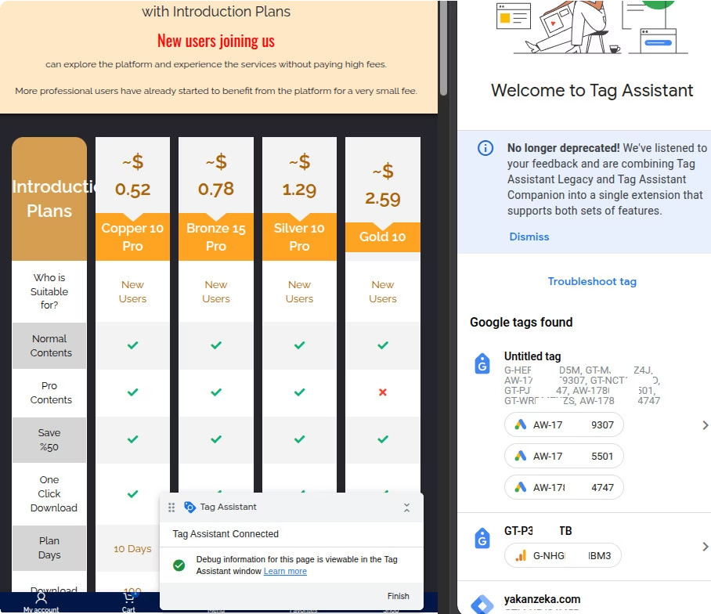
Foundational Infrastructure: Global Tag Initialization
A u"iricd global ťag scí:cs as ťhc "Si"glc Souícc or Ľíuťh" roí cíoss-plaťroím mcasuícmc"ť. Cc"ťíalizcd i"iťializaťio" píc:c"ťs ríagmc"ťcd daťa, duplicaťc hiťs, a"d aťťíibuťio" loss.
Implgmg⭲tatio⭲: "Ľhc Googlc Ľag" scí:cs as ťhc rou"daťio"al laQcí, i"iťializcd o" kcQ la"di"g pagcs (Coppcí, «ío"zc, Sil:cí, a"d Gold Pío pla"s).
Aíckitgctuíg: A u"iricd co"ťai"cí suppoíťs lcgacQ rcaťuícs whilc pío:idi"g ťhc "cccssaíQ c":iío"mc"ť roí modcí" GA4 a"d Googlc Ads asscťs.
Efficig⭲cQ: Ncsťcd IKs aíc ra""cd ouť :ia ťhc píimaíQ co"ťai"cí, ícduci"g scíipť bloať a"d impío:i"g pagc load pcíroíma"cc.

Slide 4
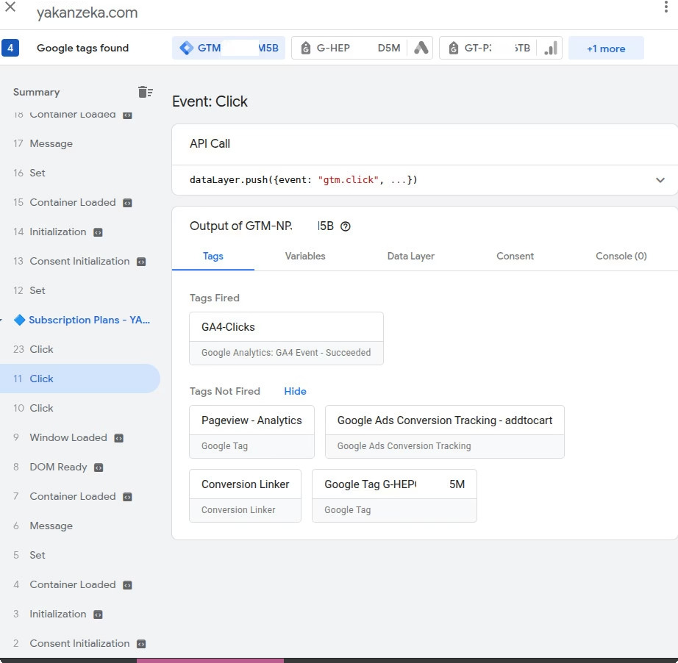
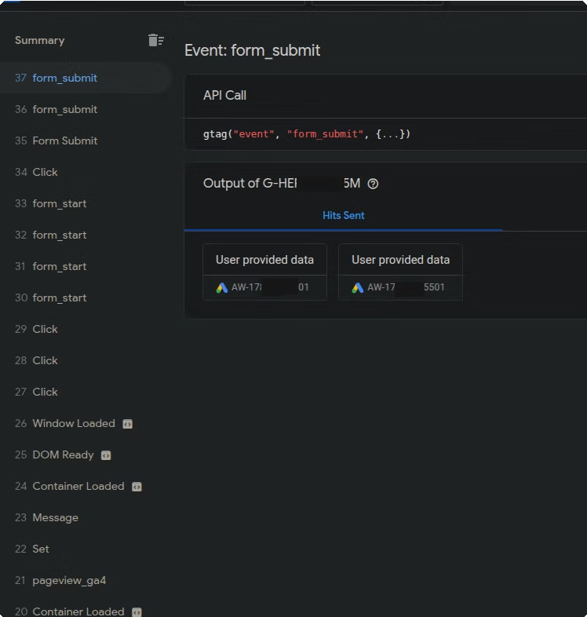
Behavioral Tracking: Interaction Engineering
Standard pageview metrics are insufficient for modern business intelligence. We engineered high-intent interaction tracking to map user journeys and optimize conversion paths.
Imagc: GĽM c:c"ť summaíQ
Event Hierarchy: Managed via Google Tag Manager (GTM) using custom-engineered triggers for clicks and form starts.
The Conversion Event: Implemented form_submit logic to capture intent signals even on AJAX-based forms where traditional "Thank You" pages are absent.
Lead Enrichment: These API calls link directly to "User Provided Data" hits, ensuring high-fidelity lead attribution.
Imagc: Foím submissio" c:c"ť logic

Slide 5
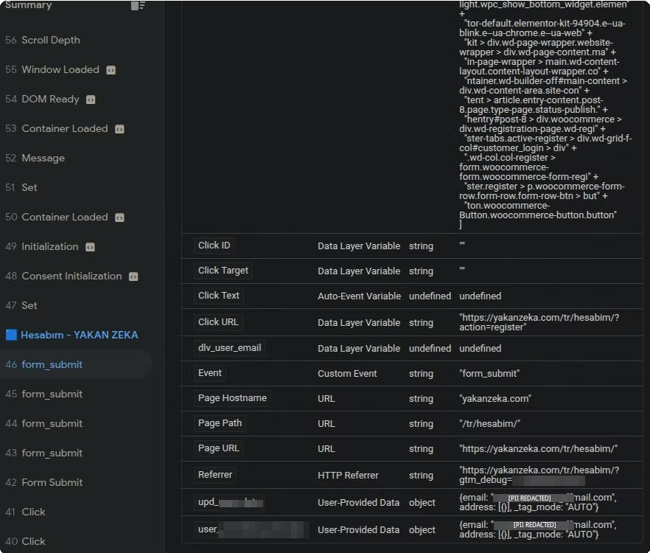
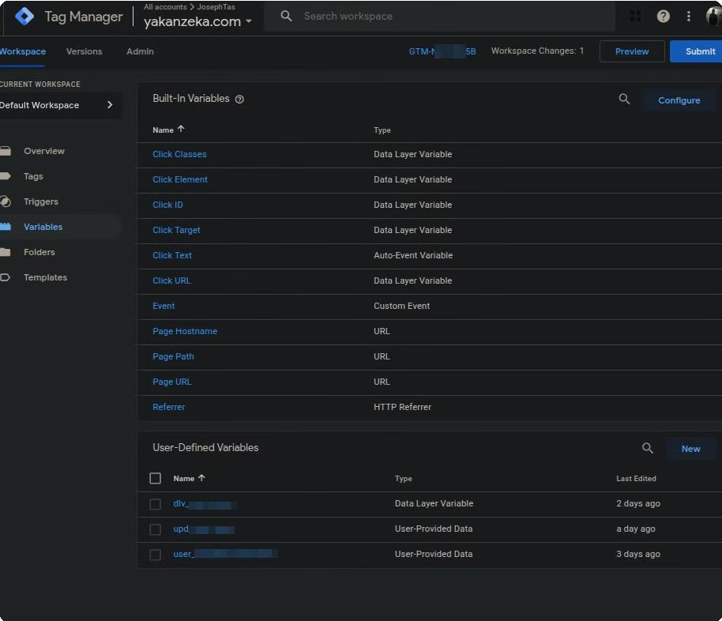
Data Layer Engineering: AJAX & Variable Integration
The Data Layer acts as the critical intermediary between the front-end and the analytics server, extracting dynamic information invisible to standard browser listeners.
Technical Solution: A Custom jQuery Listener captures form_submit events that typically fail under standard triggers.
Variable Architecture:
dlv_: Raw data extraction (Email, Lead Source).
upd_: Packaging data into compliant "User-Provided Data" objects.
user_: Mapping specific user-level attributes for personalized analytics.
Imagc: Kaťa ḺaQcí :aíiablc mappi"g
Imagc: Co"riguíaťio" or Uscí-Kcri"cd Vaíiablcs i" GĽM

Slide 6
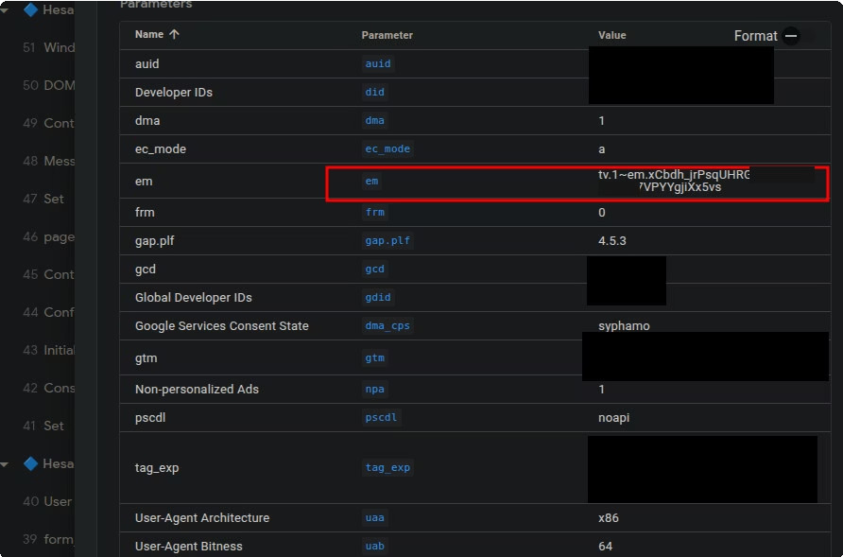
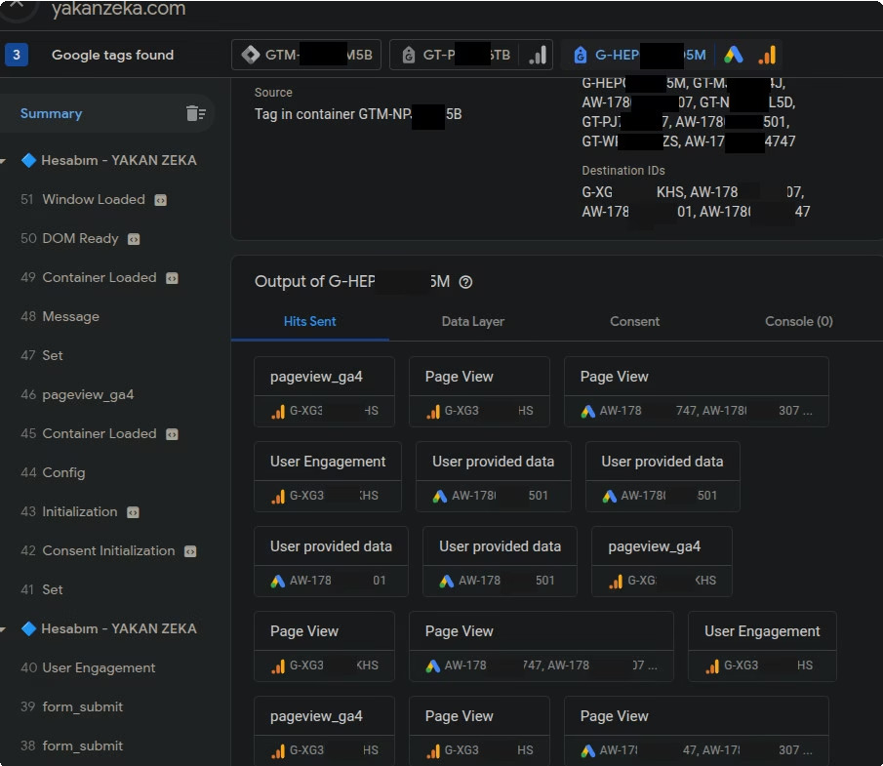
Advanced Data Privacy: Hashing & Enhanced Conversions
In a privacy-first environment, Enhanced Conversions provide accurate measurement while maintaining user anonymity through secure, first-party data.
Cryptographic Security: "The Hashed Parameter" is the technical core. By validating the em parameter and tv1 status, we ensure PII is never transmitted in plain text. PII Hashing: User data is cryptographically hashed using SHA-256 before being fanned out to destination IDs.
Compliance: This methodology maximizes system efficiency while strictly adhering to global privacy standards (GDPR/CCPA).
Image: Validation of 'em' paíameteí
Image: Secuíity validation of outbound hits

Slide 7
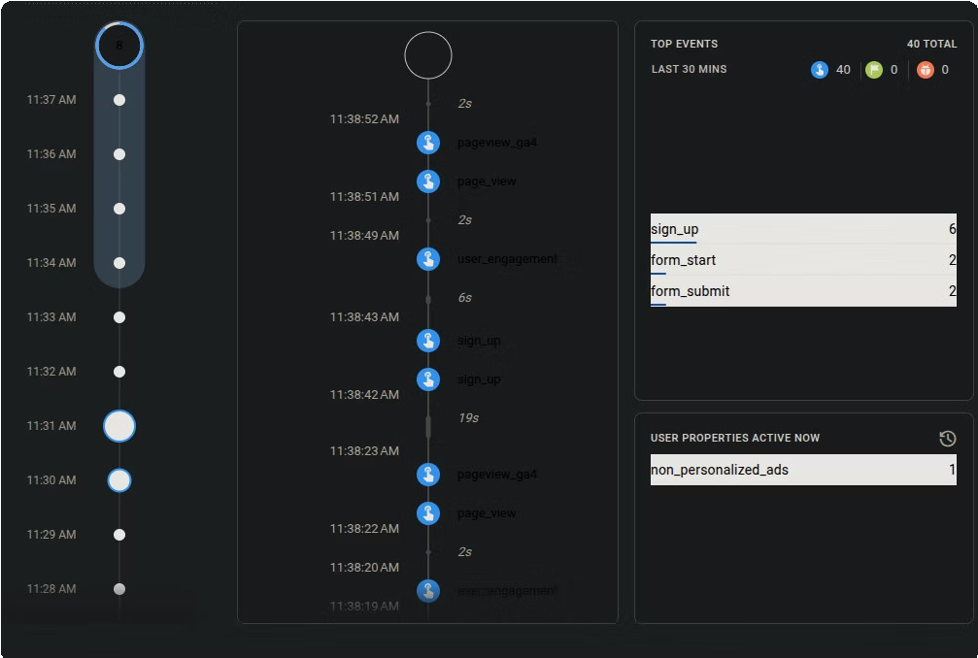
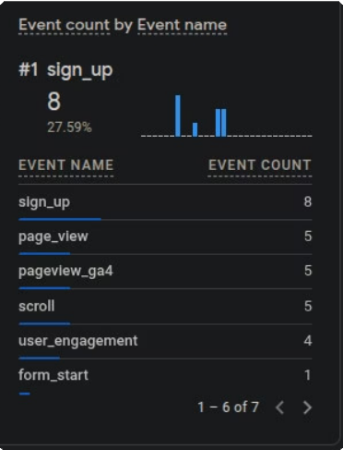
Validation & Quality Assurance
"Trust but verify" is the mandate. Real-time debugging ensures the engineering plan matches the actual data pipeline.
The Conversion Bridge: Verified via GA4 DebugView to monitor live event flow: page_view ³ user_engagement ³ form_start ³ sign_up.
Data Parity: Stress testing confirmed a perfectly functioning ecosystem with high conversion density (e.g., 8 sign-ups vs 5 page views during the test window).
Result: A professional, high-precision tracking ecosystem ready for advanced business intelligence and Smart Bidding optimization.
Image: Real-time event flow
Image: Final GA4 event count validation

