Slide 1
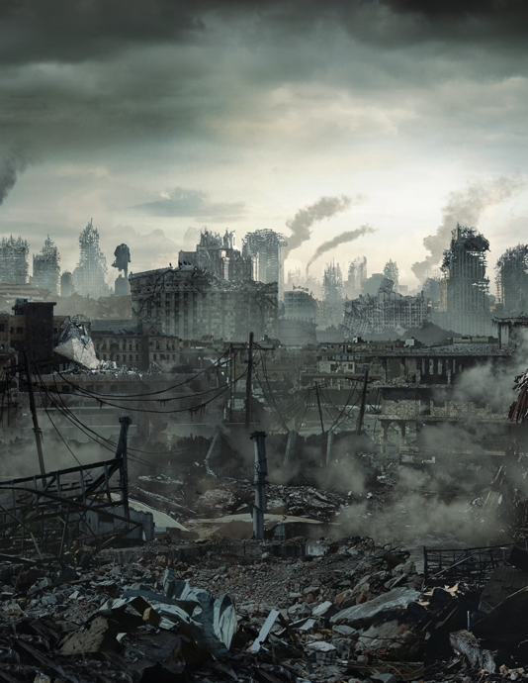
Galaxy news
Special Thanks
Fulton Student Engagement
KEEN Engineering Unleashed
ASU Rossum Robotics.
ILLUSTRATED WEEKLY NEWSPAPER
Est. 1997
Saturday, November 24, 2277
Price 62d
FULTON FURNACE FALLOUT
John Asigbekye
Kari Sanford
Joseph Thweatt
William Weigand
The chaotic environment created in the post-apocalyptic world has resulted in the uneven distribution of resources amongst the population. This lack of access to fundamental resources results in shortages, hoarding, and civil unrest that affects entire communities that may be poorly managed. In order to address the mismanagement of communities, we need to provide access to information regarding inventory of resources (what we have), gaps in
resources (what is needed), and communication between communities.
We propose a personal management system that allows individuals to record what they have and what they need, as well as providing a means of communication between people. The proposed solutions range from extremely low-tech to a more high-tech solution.
The first approach in solving this problem is a typical pen-and-paper approach. In this solution, the user will write their inventory and needs on a list. The user
will also scribe handwritten notes to communicate with others.
The second solution is a mobile personal management system. This system is a bracelet that communicates with the wearer by telling them what they have, what they need, and can be used as a gate tag for entrance into different communities.
The third solution is a more centralized solution that is a fully integrated software program that works similarly to solution two. In addition to keeping track of inventory, the

Slide 2
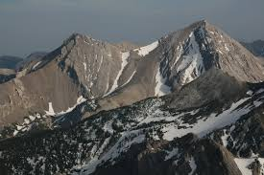


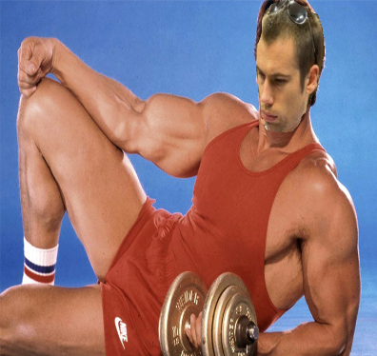

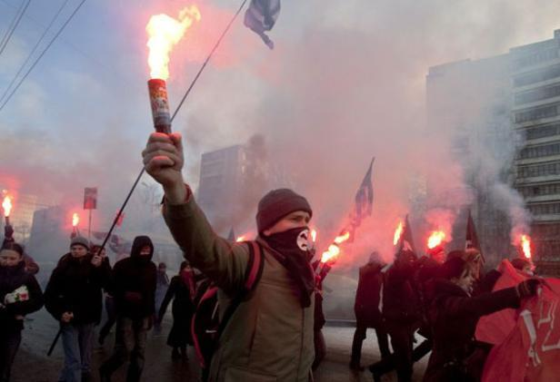
EXPOSITION
Megaton
2077
Allocate Resource
Leader
Zak Zot
Prevent Social Unrest

Slide 3
Golden Circle
WHY
HOW
WHAT

   
 
Notes:
WHY- The only way an entire community can benefit from technologies- water filtration and irrigation, power systems, personalized medicines, etc- is if they cooperate. Our service helps leaders determine which resources should be used to develop such technologies and sustain the population. Community members use the service to connect to their leader, providing feedback and contributing to the effort of rebuilding society. Without an inventory service, resources might be hoarded amongst members, and people miss the opportunity to innovate together.
HOW- a solution that records inventory, calculates the estimated time range of supply, and serves as a bridge of communication between the leader and the community members.
WHAT- an inventory service, primarily for a leader, but ultimately for the benefit of a community

Slide 4
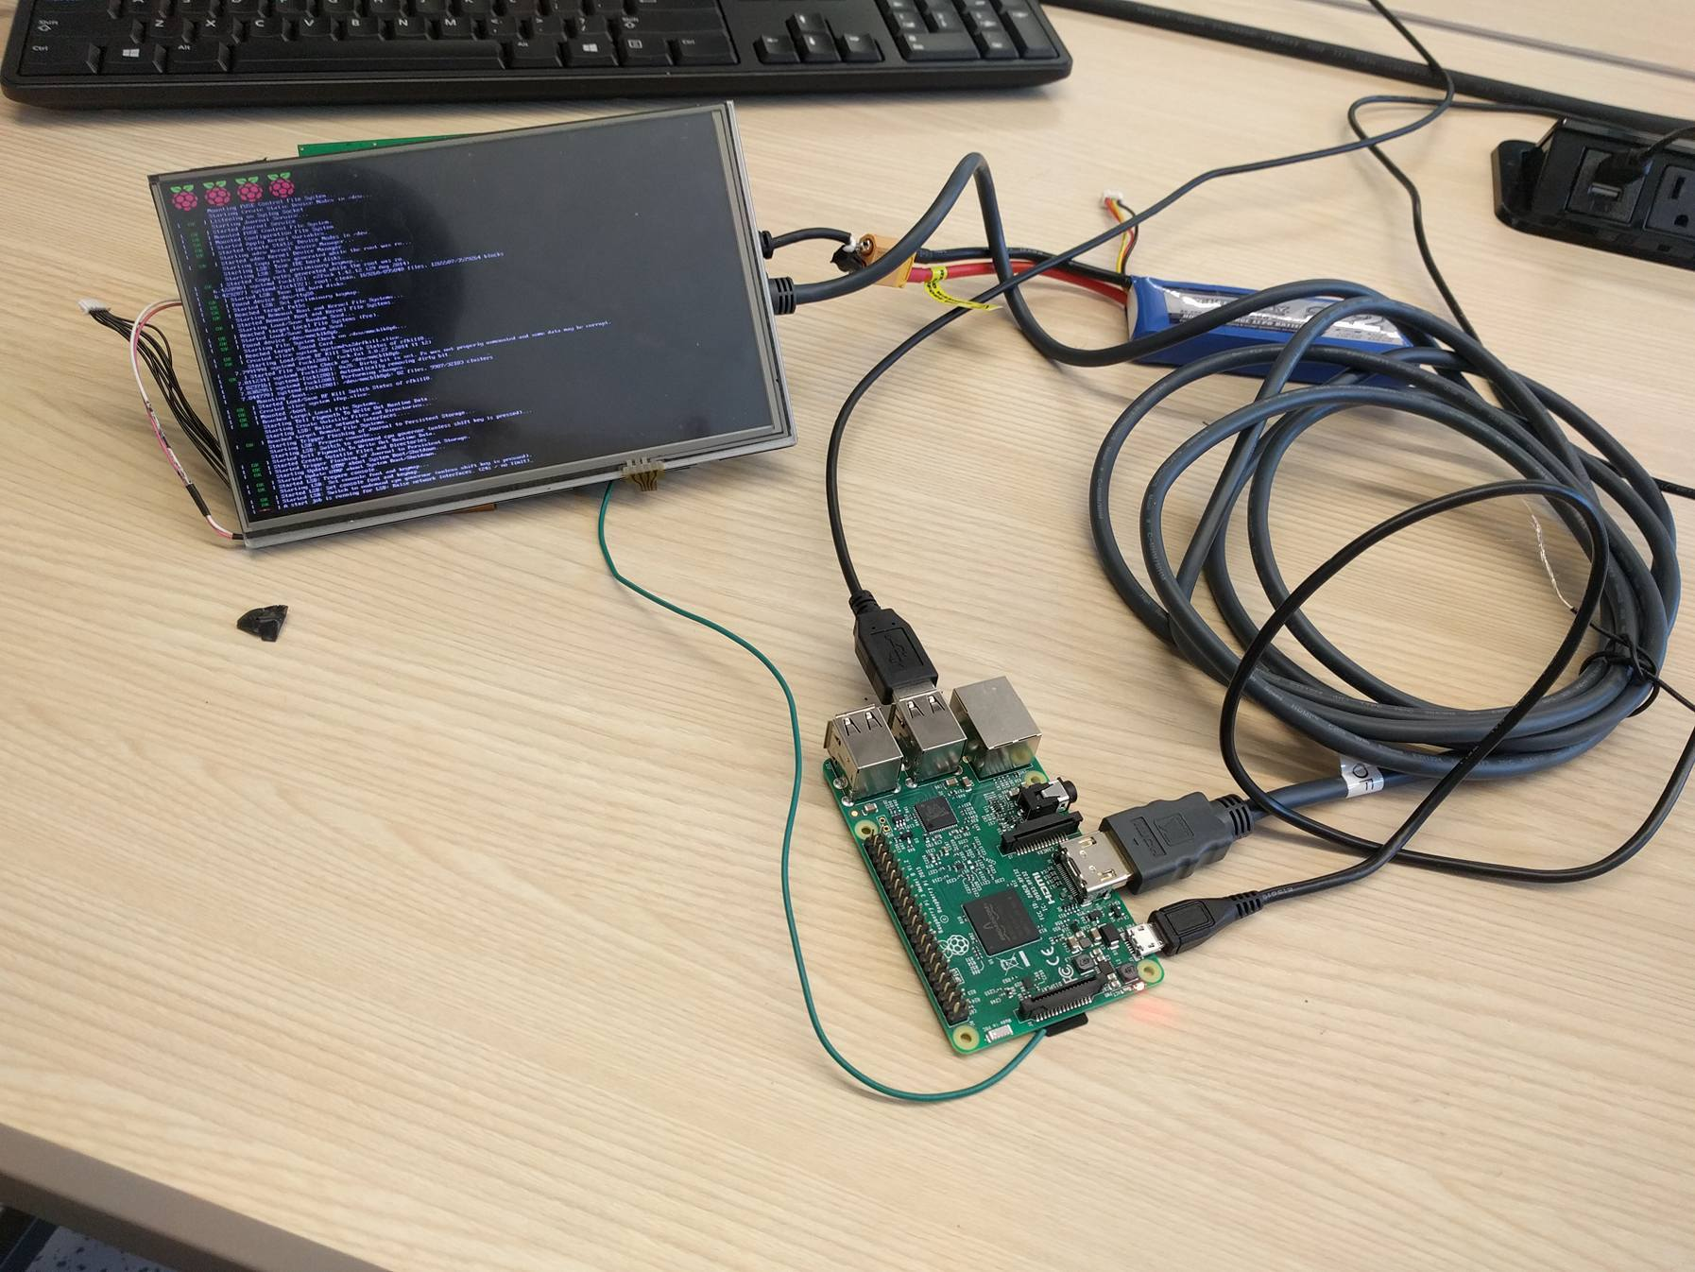
VERY ADVANCED TECHNOLOGICAL SYSTEM
Notes:
Include how it works– hardware aspect

Slide 5
HOW IT RUNS
DATABASE
Inventory
Rate of consumption
Calculated times to depletion
Community alerts
Optimization advice
VATS BACK-END
Calculate times to depletion
Attempt optimization
Archive outdated alerts and feedback
LEADER INTERFACE
Log inventory
Log rate of consumption
View inventory
View feedback
UML Diagram

Slide 6
STOCHASTIC MODEL
2 2
1 11 21
Single Town: x’ = r x – r x - r xy
2 2
1 11 12
Trading Partners: x’ = r x – r x - r xy
2 2
1 11 21
y’ = r y – r y - r xy
x = density of resource in Town1
= = rate of growth
Growth rate = (r - r x – r y)
X’ 1
x s
1 11 12

Slide 7
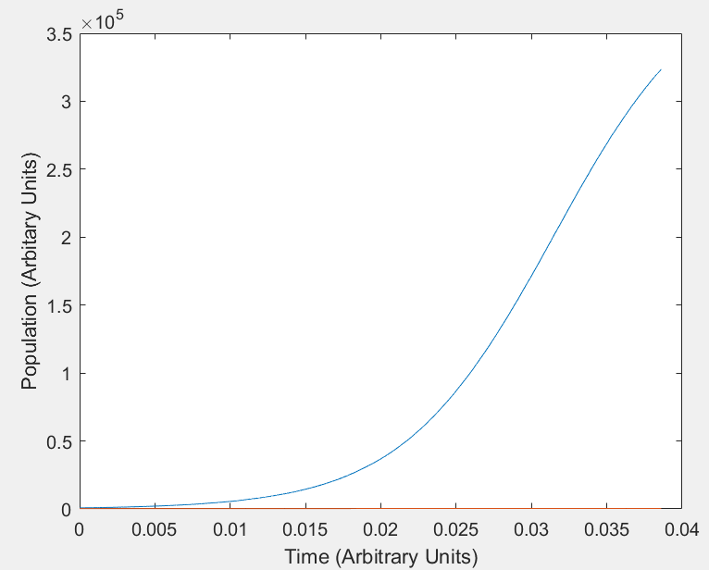
SCENARIO: TOWN A DOMINATES
Scenario 1
Legend
Town A
Town B
Notes:
Town A has more of the resource and produces more overall. Does not share. Both use minimal amount of resource per unit time.

Slide 8
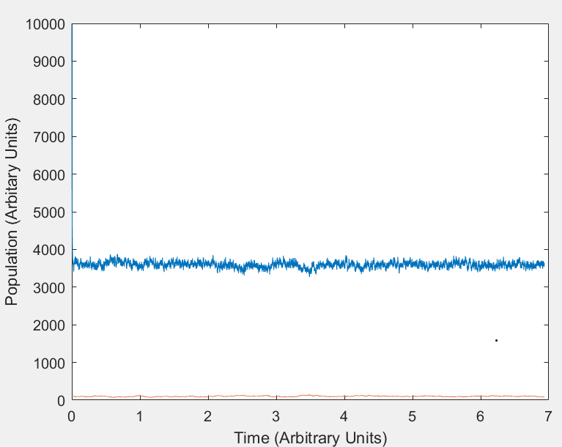
SCENARIO: TOWN B DEPENDS ON A
Scenario 2
Legend
Town A
Town B
Notes:
Town A has a large amount of resource and trades some amount with town B which has a small amount of resource but still produces.

Slide 9
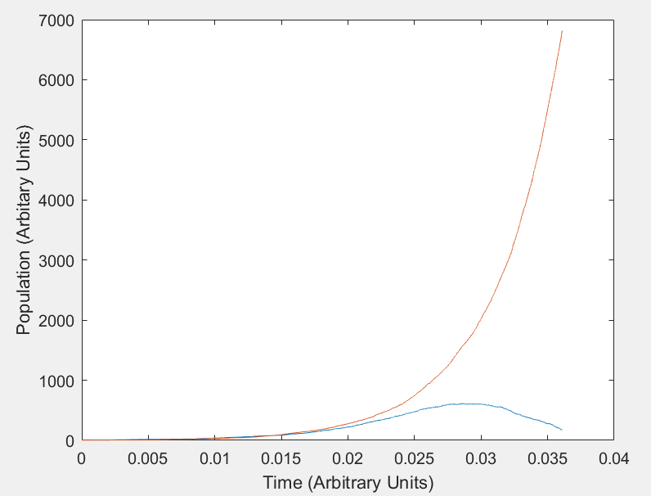
SCENARIO: RANDOMIZED
Scenario 3
Legend
Town A
Town B
Notes:
Both start with same amount of resource and produce/spend same amount. Randomness takes control here.

Slide 10
FINANCIAL REQUEST
Marketing ($500)
Software
($100)
Hardware
($300)

Slide 11
THANK YOU


