Slide 1
The Continuous World of
Dungeon Siege
GDC 2003
Scott Bilas
scott@gaspowered.com
Gas Powered Games
“Everything on fire, all the time”

Slide 2
Cell Phones?

Slide 3
Overview
What is Continuous World?
Concepts
Terrain
Game Objects
World Streamer
Odds and Ends

Slide 4
What is Continuous World? V1.0
Many games have similar sounding feature
  Jak & Daxter, Drakan PS2, Spec Ops, flight sims…
What does it mean to Dungeon Siege?
  No loading screens except initial game load
  Gameplay never stops from begin to end
  Seamless indoor/outdoor transition
  Extreme changes in environment
  Constantly changing working set of resources
  8-Way client/server multiplayer (#@!!)

Slide 5
What is Continuous World? V2.0
Realized new advantages during development
  Fine-grained streaming avoids choke points
  No arbitrary constraints in any direction
  Extreme density and variety of content possible
Scary things too
  Teleportation across the map
  Took over entire game despite our best efforts

Slide 6
(Fun) Demo!

Slide 7
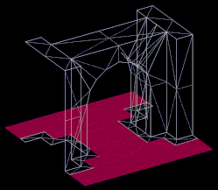
Concept: Siege Node
Basic 3D terrain element (“tile”)
  Drives entire game
3D artist makes mesh and exports to game
  Mesh is completely arbitrary, no engine constraints on size, shape, lights, textures, connections…
  Can mark polys as floor, water, etc.
Map = instanced meshes placed into graph
  Placement done with Siege Editor
  Similar to Lego system “snap pieces together”

Slide 8
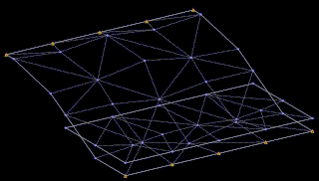
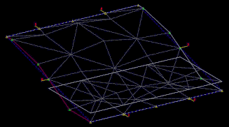
Concept: Siege Door
Nodes are connected along doors
  Legacy term from when they really were doors
Artists choose verts for each door in Max tool

Slide 9
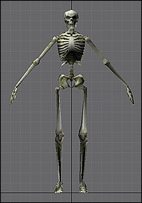
Concept: Game Object
Represents all non-terrain and
interactive logic content
Similar: Entity, Actor, Object, Pawn, etc.
99% are based in Siege Nodes
  Node = spatial owner (this is key)
Result: terrain engine drives game objects
  Nodes act as buckets for spatial sorting
  Nodes used for relative queries (“who’s near me?”)

Slide 10
Concept: World “Frustum”
Visualize as a box moving through the world
  One owned by and centered on each party member
  Intersect with world node graph to decide which nodes and Go’s are kept in memory and active
  Box dimensions configurable by code or content
  Large superset of view frustum
  Anything outside the box does not exist
Term is misleading and inaccurate (sorry)

Slide 11
(Happy) Demo!

Slide 12
The Precision Issue
Gigantic continuous world != numerical stability
Increasing distance leads to quantized space
  Eventually everything is “in the same place”
  Increasing float precision will not solve
Conclusion: axe the unified coordinate system
  Segment the world
  Periodically reset precision by switching
  coordinate systems
  Now you can go in any direction forever, worry free!

Slide 13
The Precision Issue (cont.)
Experimented for a while
Ended up with variation on portal engine
  Each chunk of geometry has its own “space”
  Geometry (nodes) are linked together into terrain
Evolved beyond FPU precision solution
  Became primary method of subdividing space
  Root of countless optimizations
“There is no world space!”

Slide 14
Engine Mechanics
3D Position had to be augmented
  SiegePos = node ID + x,y,z (relative to node origin)
  Can represent a position anywhere in the map
Rendering to avoid seams
  Just render nodes on top of each other
  “Stitching” to form continuous mesh not necessary

Slide 15
Engine Mechanics (cont.)
Node graph = entire continuous world terrain
  Each node has a unique ID
  Linking done through doors
  “Door” really = “transform” under the hood
Engine is 3D, but up is always up
  Nodes are rotated in flat space to hook together
  Can think of engine as old fashioned 2D tiles
  Permits significant optimizations (e.g. pathfinder)
  Had to alter some design elements such as flying

Slide 16
Constructing Worlds
Maps built using our Siege Editor tool
  Choose a start node, the type of node you want to place near it, and flip through orientations
  Drop objects into nodes and customize properties
  Repeat hundreds of thousands of times!
  Sarah Boulian is giving a talk on this in an hour
  (go see it!!)

Slide 17
Constructing Worlds (cont.)
Maps broken into regions
  Editor not continuous; edit in chunks that fit in RAM
  “Stitch” regions together, game sees as continuous
Allows terrain that “bends space”
  Convenient for designers (easier to make things fit)
  Fading = interpenetrating terrain invisible to player
  Goofy possibilities: infinite desert, moebius strips

Slide 18
(Fading) Demo!

Slide 19
“World Space”
Ok, we actually do have world space
  For one frame
  Maybe longer, but don’t count on it
  Need world space for diff calcs, render tris, etc.
Space is tracked by choosing a “target node”
  This node defines space (its origin = world origin)
  We just use the center of the current world frustum
  Frustum moves with each party member
  Party member crosses node: new coord system

Slide 20
“World Space” (cont.)
Why change at node boundaries?
  Good balance of testing vs. efficiency
  Need to change as often as possible to avoid boundary conditions
The Space Walk
  New coordinate system = must rebuild space
  Each node requires transform to target node space
  Walk outward from target node, visit neighbors, accumulate transforms (similar to skeletal animation system)

Slide 21
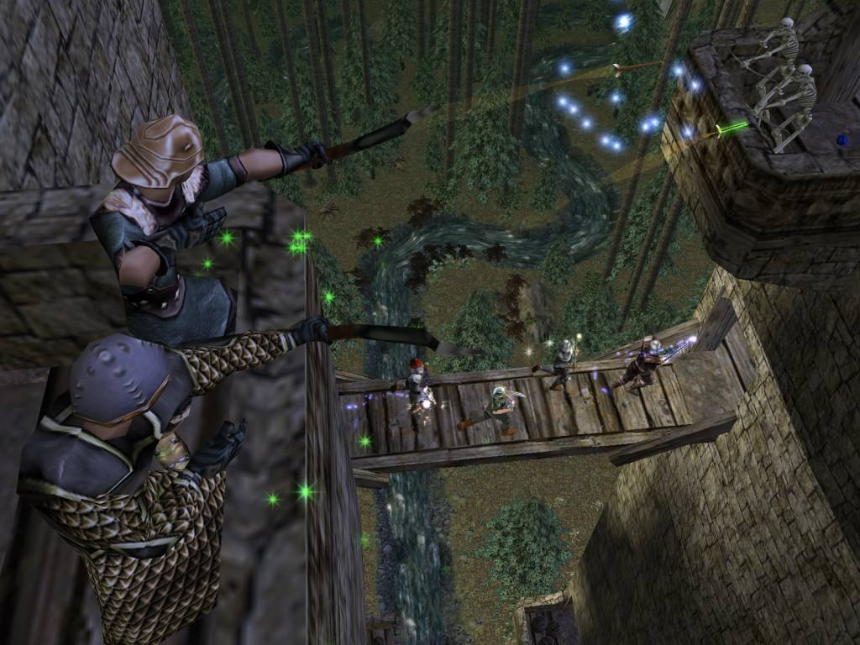
War Story
The “Arrow Problem”
Walking process
  Find containing node for arrow to collide Go’s
  Relative coords requires starting node for ray trace
  Ray trace has to walk outwards to max depth
  Arrows can fly right through people!
Arrows would break every couple weeks
  Fading, scaling, attaching, spawning, collisions…
  Had frequent problems with node-straddling systems (projectiles, particle system, etc.)

Slide 23
Evicting Nodes
Frustum = cache management system
  Anything inside is kept active in memory
  Anything outside is thrown away or put on death row
Algorithm
  Walk outward from target node
  Any nodes intersecting frustum box are loaded
  All others are deleted, and contained Go’s notified that they have “left the world”
  Complicated by multiple frustums!

Slide 24
Multiple Frustums
Originally implemented for party-split feature
  Later required for multiplayer anyway
Implementation
  Multiple simultaneous coordinate systems
  “Glomming” technology to determine winner
Single player still needs it
  One is considered “active” and its contents get time
  Everything else, time is frozen (by design, but good for CPU also)

Slide 25
(Multi-Frustums) Demo!

Slide 26
Great World Detail
World originally sparsely populated
Artists started experimenting with density just to see how it would perform, what it would look like, and…

Slide 27
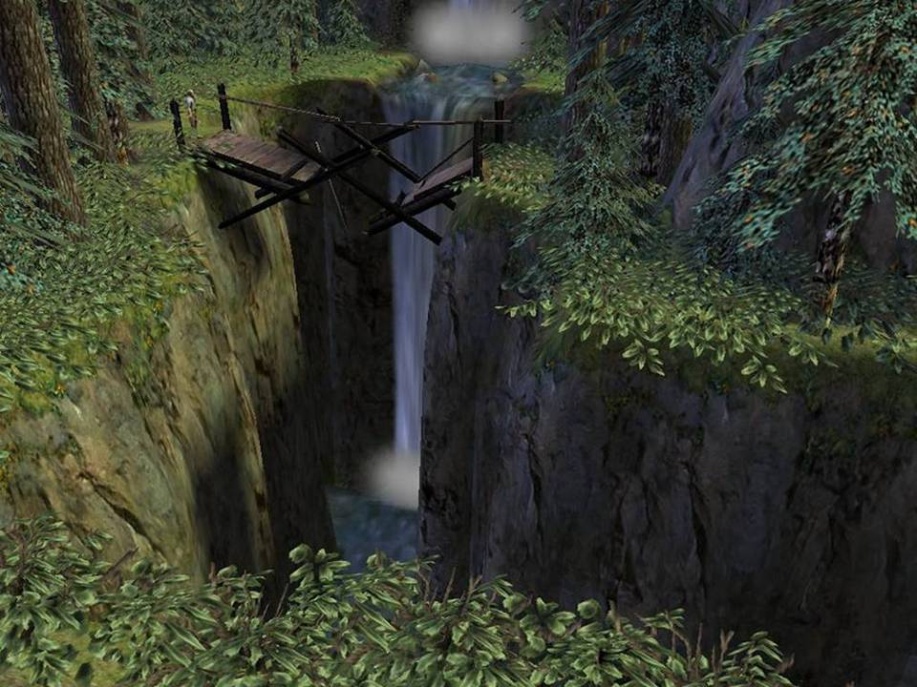

Slide 28
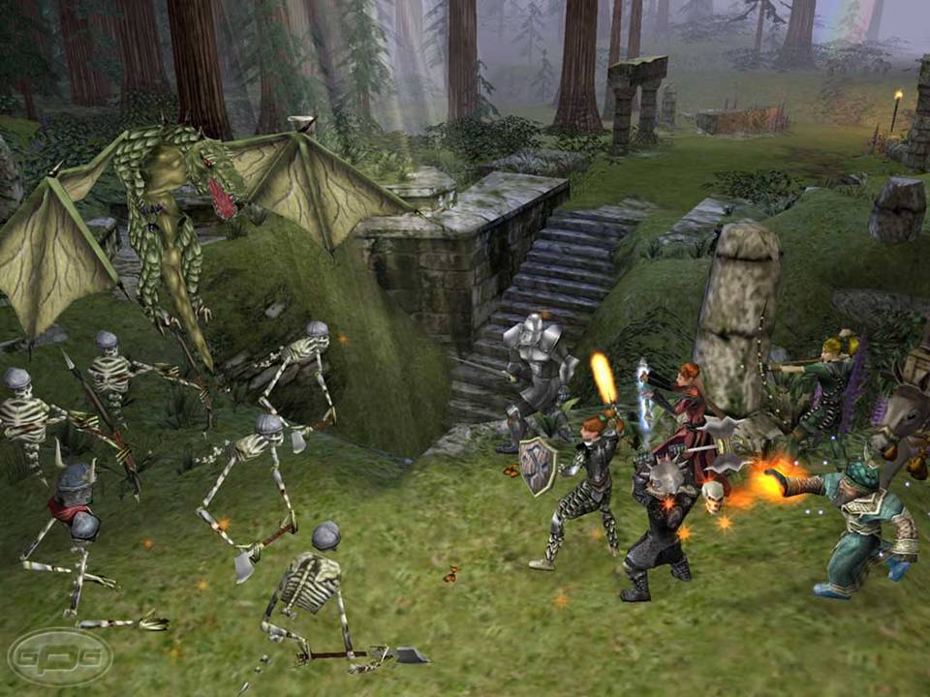

Slide 29
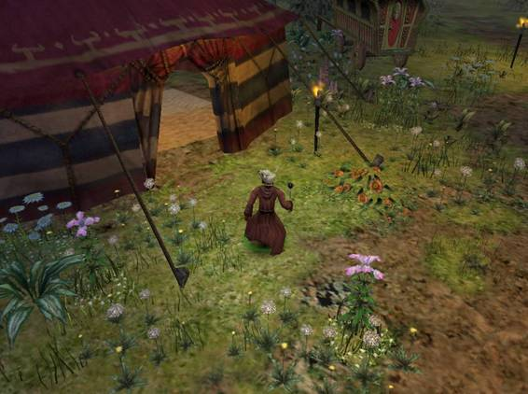
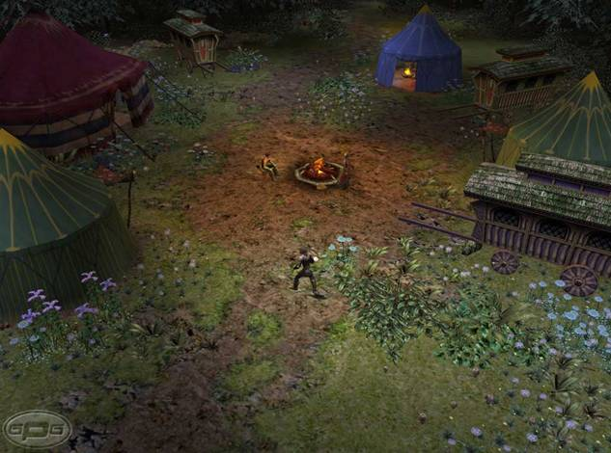

Slide 30
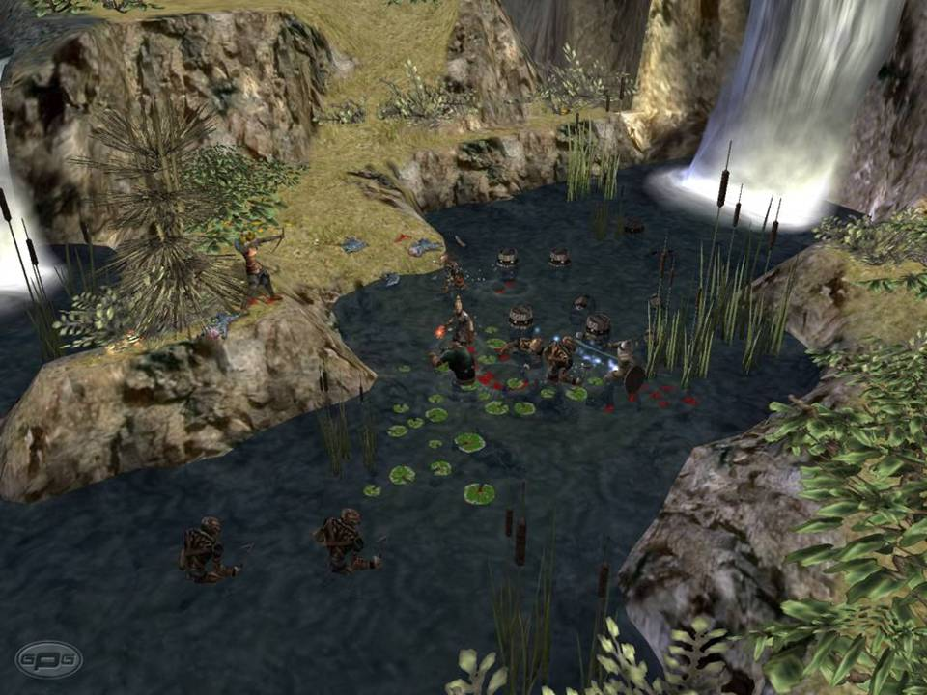

Slide 31
Evicting Game Objects
With 60,000 Go’s per map, very important
  That can take up a lot of memory
  Have to classify critical/non-critical
Deciding what to throw out (not like nodes!)
  Keep everything: machine runs out of memory
  Keep nothing: lose critical quest states and “have I killed boss X and gotten loot Y” triggers
  Want to try for “keep nothing” but err on the side of “keep everything”.

Slide 32
Eviction Strategies
Fluff removal
  lodfi
Automatic expiration on leaving the world
Scid retirement
  (Scid = static content identifier)
  Try to self destruct everything possible
Data reduction
  Scidbits
  Model/texture purging

Slide 33
Continuous Logic
Building interactive logic without levels is hard
  No fixed places (like level transitions) to delete everything old and load everything new
  No entry/exit points to hang scripted events
  Long term game stability far more important
  Difficult to affect objects not immediately nearby
Not only is world continuous, but logic is too!
  This took years for us to fully grok
  Can’t cover very much of it today!

Slide 34
Continuous Logic (cont.)
Continuous world = constant change
  0.4% of the game’s resources are in memory
  Go’s are constantly entering and leaving the world
  Leaving is the hard one!
Dependencies among Go’s must be weak
  Your referenced Go may leave world next frame
  It may get deleted, too
  A new one may get put in its place with the same ID (although this is unlikely)

Slide 35
Two men enter, one man leaves

Slide 36
Continuous Logic (cont.)
Game must be very tolerant of failure
  Especially at frustum boundaries
  Added a number of self-healing features
  Multiplayer complicated things a little

Slide 37
Multiplayer
Each machine only knows about local frustum
  Too expensive for bandwidth, CPU, otherwise
  Server tells each client to create objects that are in its frustum, and deletes them outside (no expiration)
  Frustum membership used to route RPC packets
State delta transfer
  Track “dirty” Go’s
  Send delta packet with creation request
  Transfer minimum visual data required for client

Slide 38
(Dirty Go’s) Demo!

Slide 39
World Streamer Implementation
Secondary thread, loads resources
  Primary thread makes requests:
  nodes, textures, Go’s
  Textures use blank (or white) placeholder on load
  Go’s fade in when loaded
  System bets on the objects being there

Slide 40
Streamer Problems
CPU performance
  Must be < 20% on second thread or player notices
  Want to keep the load steady, not bursty
  Original intention was DMA only, but zlib killed that
  Kept load balanced by throttling work order filling
Continuous performance
  We are experts at thread contention (not good!)

Slide 41
Thread Contention
Bad threading model for Go’s
  Much of Go load path on second thread
  …including parameterized content (gah!)
  Most of game had to be thread protected
  SmartHeap had to run serialized (5% perf loss!)
Not fully solved
  Still hitches due to lack of serious time spent on it
  Maintenance of systems too difficult

Slide 42
Odds and Ends
Teleporting hackery (H.U.B. system)
  Became critical must-have feature
  Engineering nearly drank the Kool-Aid
Implementation
  Elevator system and invisible nodes
  Wacky node swapping
  Frustum size and fog changes to smooth load
  Complicated level designer wiring of objects
  It works!! Ship it!!!

Slide 43
(Teleporter) Demo!

Slide 44
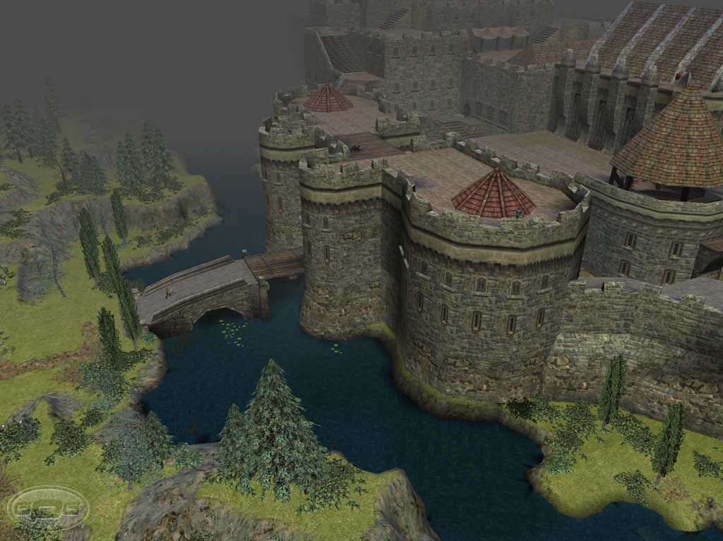
Pathological Cases
The Castle Ehb
“It’s slow”
  Blamed on high poly for a long time (partially true)
  Was at end of game so few played it
Profiling reveals…
  Implicit optimizations towards farmhouse nodes
  Lighting expects small nodes (relatively few verts)
  Game db’s expects few node occupants
Lesson learned
  Um, play the game… (not obvious!)

Slide 46
Pathological Cases
U-Shaped Terrain
Direction of motion
through world matters!
Exposed extremely obscure bug
  Occurred in a totally normal-looking area
  Caused Edge-of-World Syndrome™
  Complicated by multiple frustums, as usual ☺
Lesson learned
  Build test maps for all possible boundary conditions
  Not as obvious as this may seem

Slide 47
Hardware Problems
Setup issues collide with streaming data perf
  Hard drive fragmentation
  Heavy reliance on DMA transfers enabled
  Other games just load slower – DS is paralyzed
Exercise of most computer systems at once
  CPU, video, HD, network, sound all constantly used
  L33t overclocker troublemakers!
  “Quake 3 runs fine”

Slide 48
Fun! Before and After

Slide 49
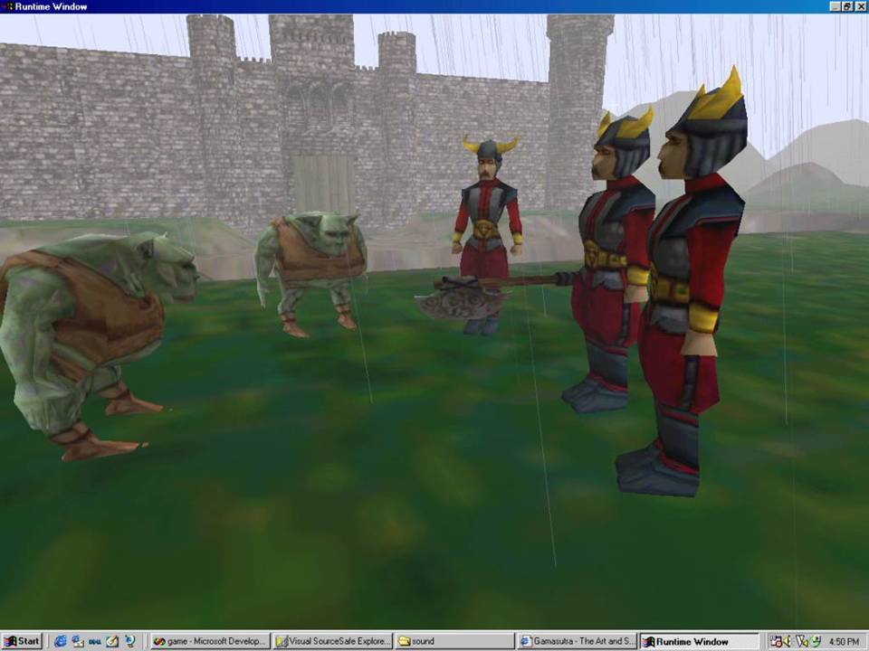

Slide 50
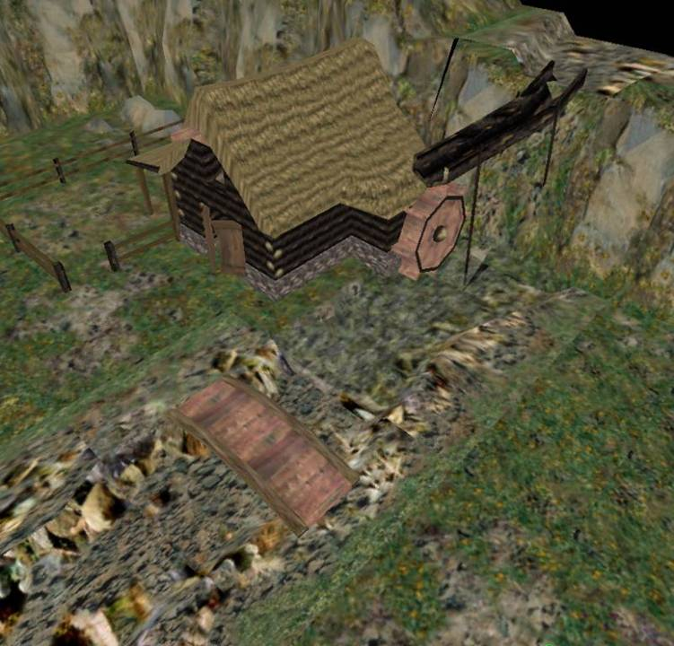

Slide 51
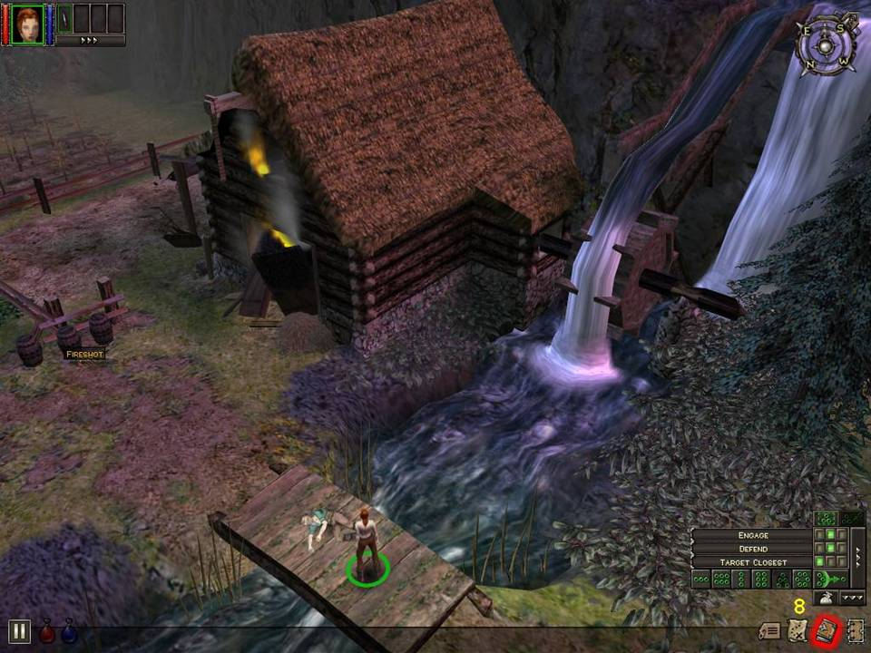

Slide 52
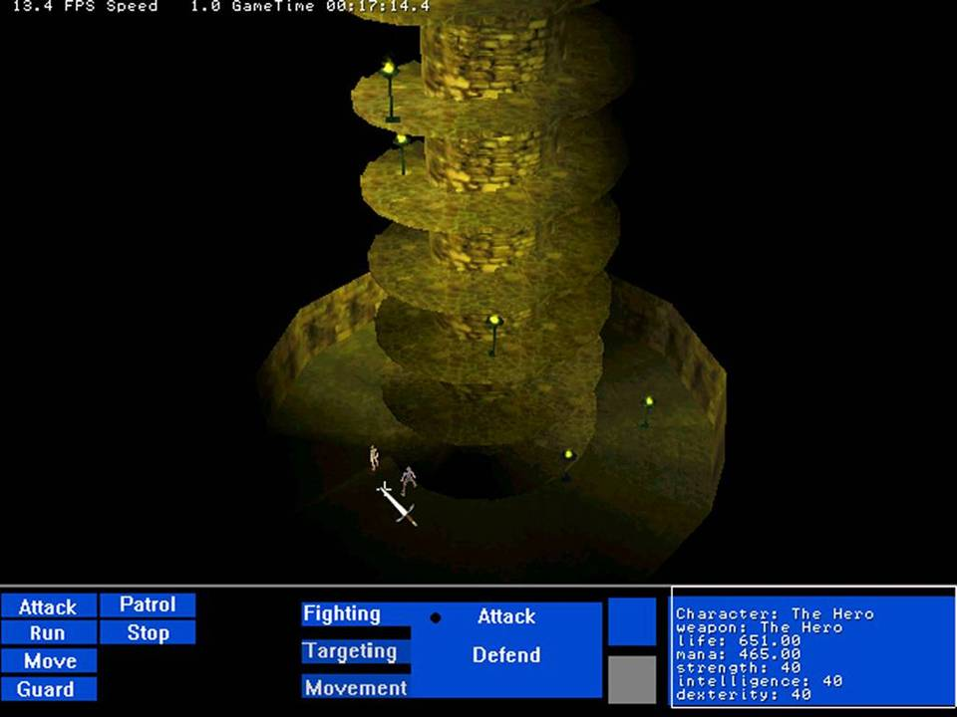

Slide 53
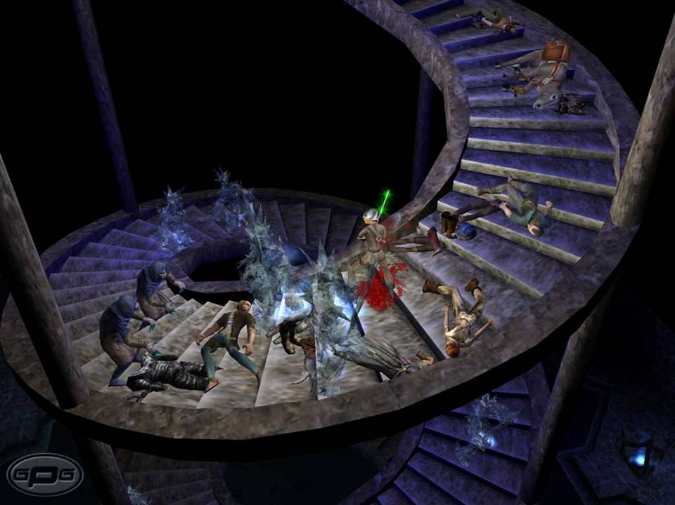

Slide 54
Further Reading
GDC
  “Neverwinter Nights Client/Server Postmortem”,
  Mark Brockington, Scott Greig
  “Highly Detailed Continuous Worlds”,
  Stuart Denman
  “Building an Object System”, Alex Duran
  “Technology of Jak & Daxter”, Stephen White
  “A Data-Driven Game Object System”, Scott Bilas

Slide 55
Further Reading (cont.)
Papers
  “Postmortem: Gas Powered Games’ Dungeon Siege” by Bartosz Kijanka (on Gamasutra)
  Be sure to read my paper in the Proceedings, it goes into details in many places this lecture did not

Slide 56
Done!
Suggested Comments:
This is the (best/worst) talk I’ve ever (been to/slept through)
<Insert name of speaker> changed my life forever.
I H4X0R YUO ALL!@!1!!
(He/she) didn’t go into enough detail, and bored me to death.
(He/she) went into too much detail, and bored me to death.

Slide 57
Contact Info
Scott Bilas
scott@gaspowered.com
http://www.drizzle.com/~scottb/gdc
Paper is posted there currently
Slides will be posted sometime next week

