Slide 1
ELEC4320 Project Proposal
Laurence Ng, Joseph Yim

Slide 2
Image Resize Algorithm (Level-5)
You will implement the “Bilinear Interpolation” technique to resize an input image. You will store a 100 x 100 size input image in on-chip memory. You will send the scale up factor as an input to the FPGA from the PC using a hyper-terminal. The supported scale up factors should be 1.2 and 1.4. Similarly, you will send the scale down factor as an input to the FPGA. The supported scale down factors should be 0.8 and 0.6. You will need to show both the original and the scaled images on the PC by transferring the output image pixel values to the PC over the serial bus using UART protocol. You need to receive and process the RGB data and construct both original and scaled images. A simple python script can be written on your PC using OpenCV to construct and show the output images using the RGB data received from FPGA.

Slide 3
Setup
FPGA
FSM: control data transfer and image processing
Status registers
UART transceiver
BRAM for input buffer (100x100x3 bytes)
BRAM for output buffer (140x140x3 bytes)
Image Processor
Computer
GUI (Processing)
USB/BT-Serial

Slide 4
FSM
Reuse existing image
Idle
Set scaling factor
Receive image
Process image
Output image

Slide 5
Communication (Computer-driven)
Code (byte) | Action
8`d000 | Reset Response: 8`d0
8`d1x | Set scaling factor, where x= 0: 0.6, 1: 0.8, 2: 1.2, 3: 1.4 Response: 8`d1
8`d2x<one row of image, i.e. 100x3 bytes> | Set input image, where x indicates rows [0-99] Response: 8`d2 (upon receiving 100x3 bytes)
8`d3 | Process image Response: 8`d3 (upon receiving) Response: 8`d4 (upon completion)
8`d4x | Read output image, where x indicates rows [0-140] Response: <one row of image, i.e. 140x3 bytes>
For reading output image, 140x3 bytes each row will be read regardless of scaling factor. It is up to computer to render graphics correctly.

Slide 6
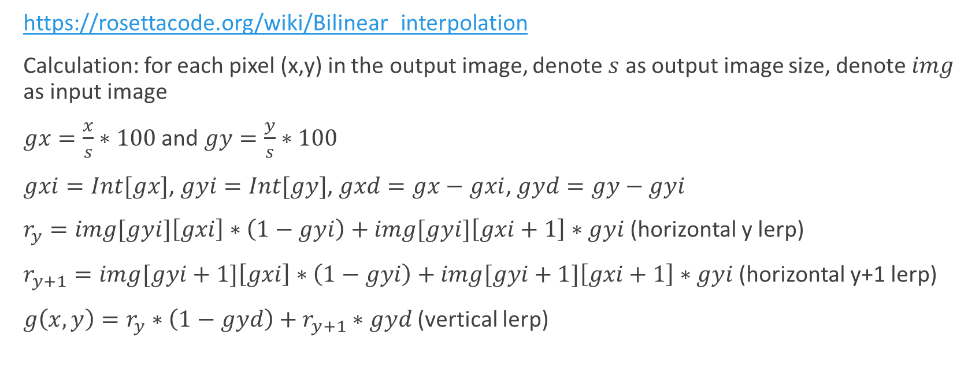
Bilinear transformation
https://rosettacode.org/wiki/Bilinear_interpolation
Calculation: for each pixel (x,y) in the output image, denote $s$ as output image size, denote $img$ as input image
$gx=\frac{x}{s}∗100$ and $gy=\frac{y}{s}∗100$
$gxi=Int[gx]$, $gyi=Int[gy]$, $gxd=gx−gxi$, $gyd=gy−gyi$
$r_{y}=img[gyi]\left[gxi\right]∗\left(1−gyi\right)+img[gyi]\left[gxi+1\right]∗gyi$ (horizontal y lerp)
$r_{y+1}=img[gyi+1]\left[gxi\right]∗\left(1−gyi\right)+img[gyi+1]\left[gxi+1\right]∗gyi$ (horizontal y+1 lerp)
$g\left(x,y\right)=r_{y}∗\left(1−gyd\right)+r_{y+1}∗gyd$ (vertical lerp)

Slide 7
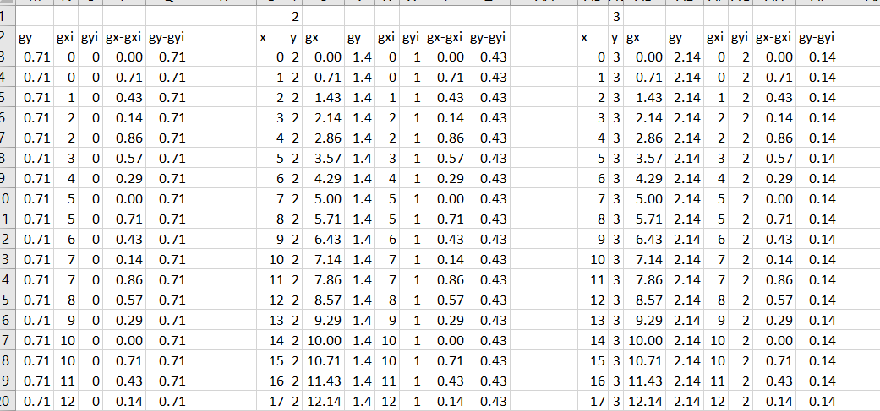
Bilinear transformation

Slide 8
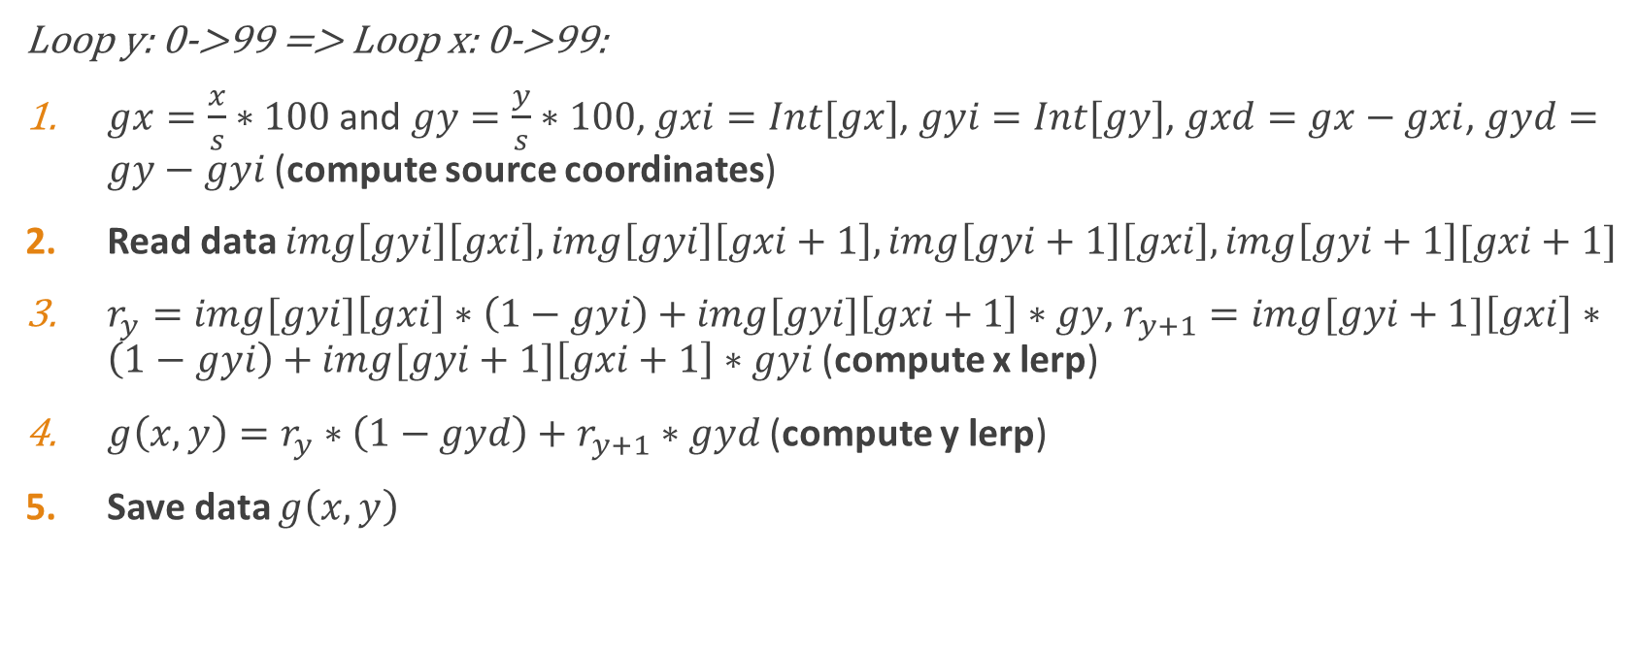
Image Processor Pipelining
Loop y: 0->99 => Loop x: 0->99:
$gx=\frac{x}{s}∗100$ and $gy=\frac{y}{s}∗100$, $gxi=Int[gx]$, $gyi=Int[gy]$, $gxd=gx−gxi$, $gyd=gy−gyi$ (compute source coordinates)
Read data $img\left[gyi\right]\left[gxi\right], img\left[gyi\right]\left[gxi+1\right],img\left[gyi+1\right]\left[gxi\right],img\left[gyi+1\right][gxi+1]$
$r_{y}=img[gyi]\left[gxi\right]∗\left(1−gyi\right)+img[gyi]\left[gxi+1\right]∗gy$, $r_{y+1}=img[gyi+1]\left[gxi\right]∗\left(1−gyi\right)+img[gyi+1]\left[gxi+1\right]∗gyi$ (compute x lerp)
$g\left(x,y\right)=r_{y}∗\left(1−gyd\right)+r_{y+1}∗gyd$ (compute y lerp)
Save data $g\left(x,y\right)$

Slide 9
Potential speedup
Load rows of image to be accessed into registers first (keeping 2 rows of 100x3 bytes register for faster access) Once one row is used up, load another from memory
Use precomputed memory location map

