Slide 1
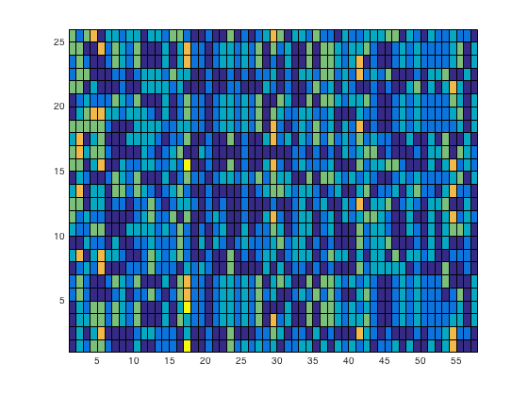
trans.
trans.
trans.
trans.
trans.
ON
ON motor
ON
ON motor
AUD
BF
3
MOT
DAN
1
2
DMN
Prec.
FRONT.

Slide 2
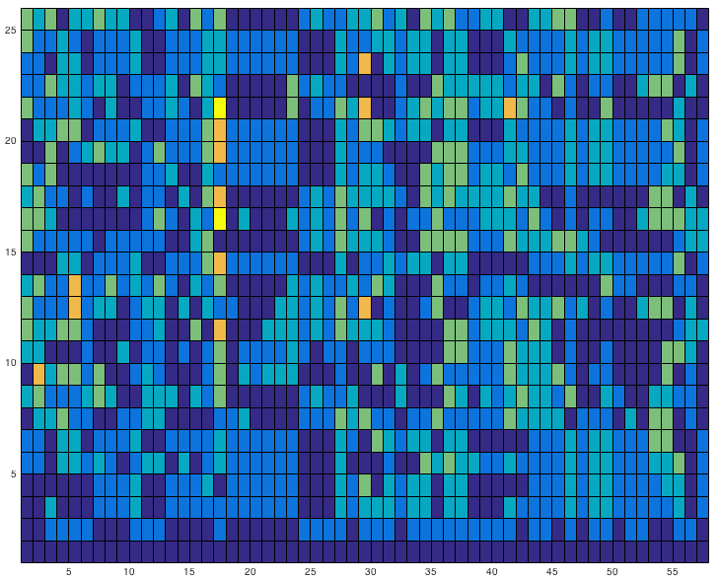
trans.
trans.
trans.
trans.
ON
ON motor
ON
ON motor
3
AUD
BF
3
MOT
DAN
1
2
DMN
Prec.
FRONT.

Slide 3
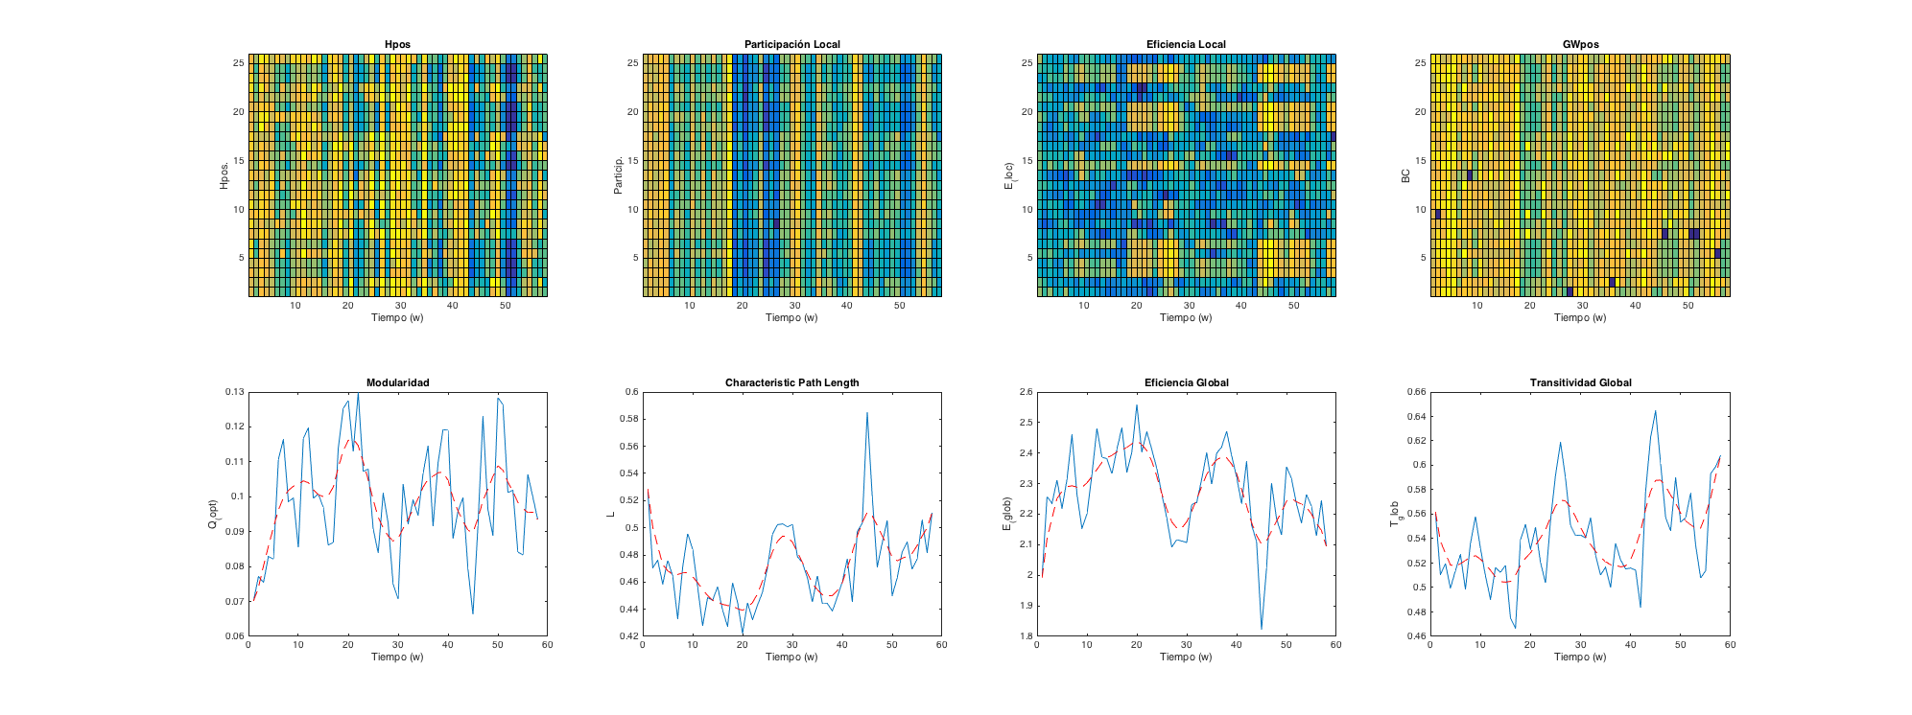
Estimulo
Estimulo + tarea
ON
ON
ON
ON
ON
ON
ON
ON
ON
ON
ON
ON
ON
ON
ON
ON

Slide 4
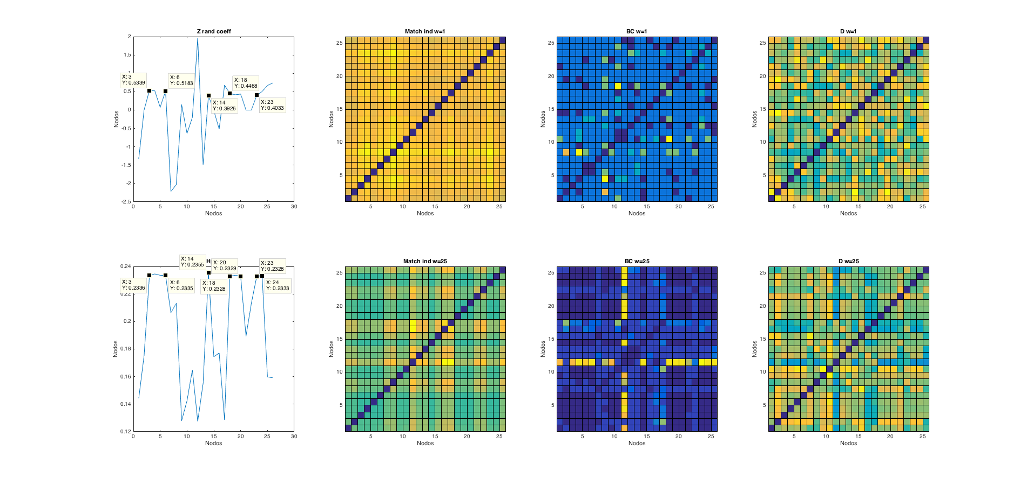

Slide 6
