Slide 1
Improving NHL Season and Playoff Outcomes
By: Josepp Benvenuto

Slide 2
Overview
Analysis Questions:
Can a model be created to help predict season wins?
How do season wins impact making the playoffs? / Can a model be created to help NHL teams make the playoffs?
Models Used:
Logistic regression
Multiple Linear Regression
Method:
Because more than 60% of teams make the playoffs, the analysis seeks to understand the relationships between the model features and not making the playoffs.
In understanding why teams don’t make the playoffs, adjustments can be made to better the chances of increasing team season wins and making playoffs.

Slide 3
Key Insights & Recommendations
Can a model be created to help predict season wins?
These five features proved to be strong drivers for seasons wins (r2: 0.90):
Penalty kill percentage
Shooting percentage
Failed shots per game
Save percentage
Saves per game

Slide 4
Outcomes
How do season wins impact making the playoffs? / Can a model be created to help NHL teams make the playoffs?
The five previously mentioned features described 90% of season win variance and were observed to predict what teams missed the playoffs with high accuracy.
Four of the strongest drivers used to predict season wins were the same four features used to predict whether or not teams missed the playoffs, with an average f1 score across ten k-folds of 0.86.
Season wins, as described by the four features, significantly impact missing or not missing the playoffs.

Slide 5
Outcomes
Intuitively, season wins showed to be a strong driver in making the playoffs.
Season wins must be measured as the deviation from the season average per team to account for the varying number of games played and strength across the different teams.
The four features used to predict both season wins and teams that missed that playoffs should be used as high level KPIs to build off of when determining team building and strategy.

Slide 6
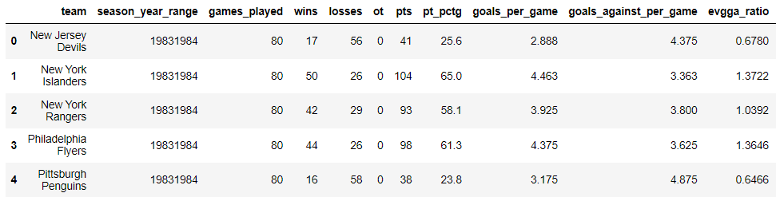
Data
The data are derived from the NHL’s API.
The data are from 1983 – 2021 for 31 teams and their historical season stats.
Note – This is a snippet of the actual data set and not all rows and columns are included.

Slide 7
Linear Regression

Slide 8
Data Audit, Cleaning, & Preprocessing
Full Data 100%
Train Data 70%
Test Data 30%
Nrows: 926
Ncols / Features: 36
Na Values:
None
Duplicate Rows:
None
Redundant features:
games_played, losses, wins, win_opp_score_first, win_lead_first_per, win_lead_second_per, win_outshoot_opp, win_outshot_by_opp, pts, pt_pctg, evgga_ratio, power_play_goals, power_play_goals_against, power_play_opportunities, ot, All faceoff features
Nrows: 645
Ncols / Features: 5
Dummy Features:
None
Numeric Features:
All features are numeric
Duplicate Rows:
None
Removed Features:
Five features were dropped due to multicollinearity (VIF > 5), one due to a weak correlation (Pearson: -0.07), and one due to not being statistically significant at p > 0.05
Nrows: 277
Ncols / Features: 5

Slide 9
Data Audit, Cleaning, & Preprocessing
The target variable is the Season Adjusted Wins Deviation and can be described as:
Team deviation of adjusted wins per season
Formula: deviation of (wins + (ties / 2))
The data is continuous
There is no duplicate or null data
Outliers were removed from Season Adjusted Wins to remove any bias generated from any anomalies in the data acting as a form of regularization.

Slide 10
Feature Selection
Outside of redundant features, the features were measured and selected from the test sample to reduce overfitting the model.
Redundant features can be described as features where a team cannot control and therefore plan to make adjustments to better their season, unknown features, unkept stats from earlier season, features that heavily influence the target variable or are essentially another representation of the target variable, and features that have no value. 24 features were removed.
Features with weak correlation were removed with a threshold of < 30. 1 Feature was removed.
Multicollinearity was surveyed through the data using Variance Inflation Factor scores with a threshold of > 5. 12 features removed.
Features not statistically significant were removed from the data with threshold of p > 0.05. 1 feature was removed.

Slide 11
Feature Selection
5 features were used in the predictive analysis:
Penalty kill percentage
Shooting percentage
Failed shots per game
Save percentage
Saves per game

Slide 12
K-Fold Cross Validation
The training data set was shuffled and split into 10 separate data sets.
With nine data sets at a time, with one hold out set and each set taking a turn as a hold out, a Linear Regression was trained on the alternating nine data sets and their scores recorded to test the model against data variance.

Slide 13
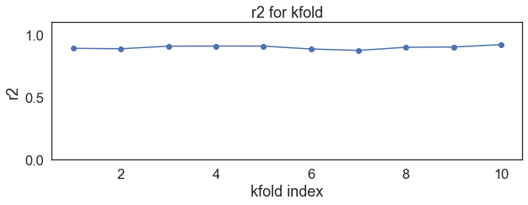
K-Fold Cross Validation
Training a Linear Regression using the k-folds created, the following results were generated:
r2 (percentage of variance covered by the model): 90%

Slide 14
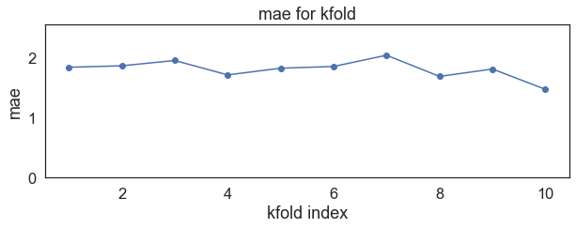
K-Fold Cross Validation
Training a Linear Regression using the k-folds created, the following results were generated:
MAE (mean absolute error): 1.8%

Slide 15
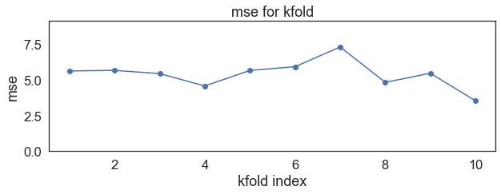
K-Fold Cross Validation
Training a Linear Regression using the k-folds created, the following results were generated:
MSE (mean squared error): 5.39%

Slide 16
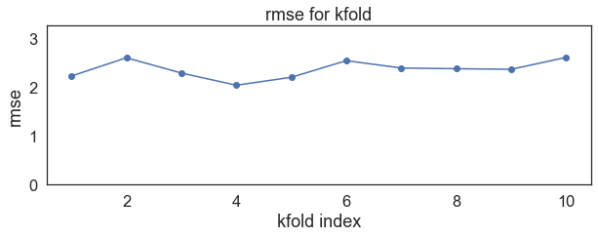
K-Fold Cross Validation
Training a Linear Regression using the k-folds created, the following results were generated:
RMSE (root mean squared error): 2.37%

Slide 17
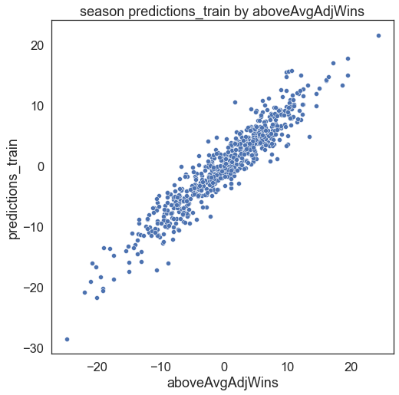
Model Training & Evaluation
The model was trained on the train data.
Results:
r2: 90%
MAE: 1.8
MSE: 5.54
RMSE: 2.35

Slide 18
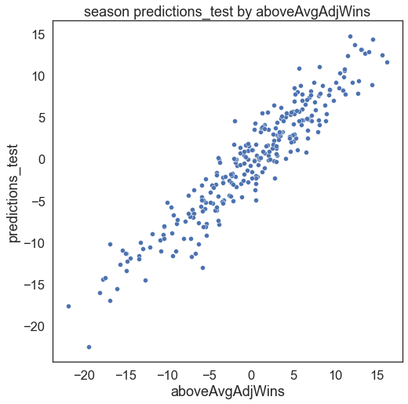
Model Testing & Evaluation
The trained model was tested against the test hold out data set.
Results:
r2: 90%
MAE: 1.92
MSE: 5.63
RMSE: 2.37

Slide 19
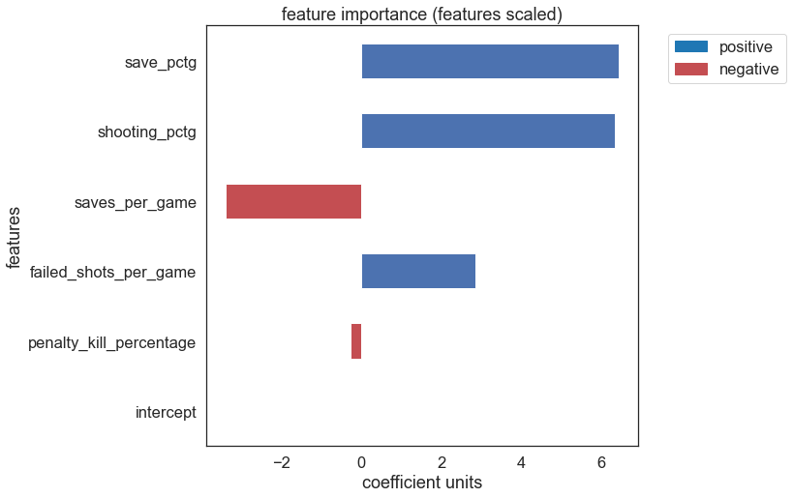
Model Finalization & Feature Importance
To the right the feature importance can be viewed.
Feature Importance (Scaled):
Save Percentage (save_pctg):
Coefficient: 6.44
Shooting Percentage (shooting_pctg):
Coefficient: 6.34
Saves per Game (saves_per_game):
Coefficient: -3.39
Shots on Net (failed_shots_per_game):
Coefficient: 2.84
Penalty Kill Percentage (penalty_kill_percentage):
Coefficient: -2.70

Slide 20
Multiple Linear Regression Model Summary
The model displays strength when predicting the Season Adjusted Wins Deviations.
The model does deliver consistency and little variance when being tested against different data sets as seen in the k-fold cross validation and test data.
Can These variables that predict the Season Adjusted Wins Deviation also predict whether teams will miss the playoffs? This will be an indication that the Season Adjusted Wins Deviation in addition to its predictor variables be high level KPIs.

Slide 21
Logistic Regression

Slide 22
Data Audit, Cleaning, & Preprocessing
Full Data 100%
Train Data 70%
Test Data 30%
Nrows: 926
Ncols / Features: 5
Na Values:
None
Duplicate Rows:
None
Redundant features:
None
Outliers:
4 outliers removed from the adjWins feature
Nrows: 645
Ncols / Features: 5
Dummy Features:
None
Numeric Features:
All features are numeric
Duplicate Rows:
None
Removed Features:
One feature was dropped due to not being statistically significant at p > 0.05
Stratified:
Yes
Nrows: 277
Ncols / Features: 5
Stratified:
Yes

Slide 23
Data Audit, Cleaning, & Preprocessing
The target variable is Missed Playoffs and can be described as:
Binary data that flags every team that missed the playoffs for a given season.

Slide 24
Feature Selection
Outside of redundant features, the features were measured and selected from the test sample to reduce overfitting the model.
Features not statistically significant were removed from the data with threshold of p > 0.05. 1 feature was removed.
4 features were used in the predictive analysis:
Shooting percentage
Failed shots per game
Save percentage
Saves per game

Slide 25
K-Fold Cross Validation & Grid Search
The training data set was shuffled and split into 10 separate data sets.
With nine data sets at a time, with one hold out set and each set taking a turn as a hold out, a Logistic Regression was trained on the alternating nine data sets and their scores recorded to test the model against data variance. ​

Slide 26
K-Fold Cross Validation & Grid Search
Hyper Parameters:​
Solver: LBFGS
Solver used to optimize the cost function (Maximum Likelihood).​
Penalty: L2​
Adding lambda * coef^2 to the cost function (max likelihood) and therefore reducing the size of the coefficients to reduce overfitting. This increases model bias but reduces variance when tested against other data sets.​
C: 10​
When L2 regularization is set, instead of choosing an alpha value, C (1 / lambda) is selected as an inverse to the regularization.​
Best F1 score: 86%​
The harmonic mean between Precision and Recall. ​

Slide 27
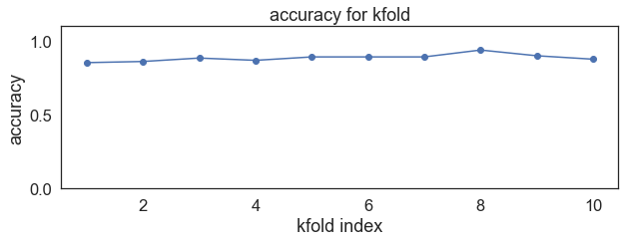
K-Fold Cross Validation & Grid Search
After optimizing the grid search best parameters were observed using the k-folds created:​
Accuracy (percentage of correct predictions): 89%

Slide 28
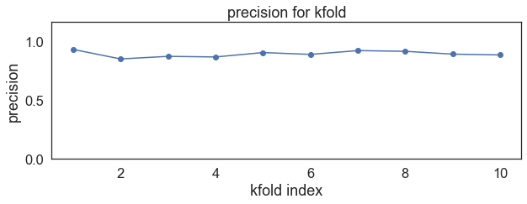
K-Fold Cross Validation & Grid Search
Training a Linear Regression using the k-folds created, the following results were generated:
Precision (True Positives / True Positives + False Positives): 89%​
Demonstrates out of all the not likely to recommend predictions, what percentage were correct?

Slide 29
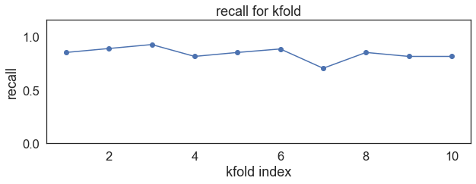
K-Fold Cross Validation & Grid Search
After optimizing the grid search best parameters were observed using the k-folds created:​
Recall (True Positives / True Positives + False Negatives): 84% ​
Demonstrates out of all the possible not likely to recommend values, what percentage was predicted by the model?

Slide 30
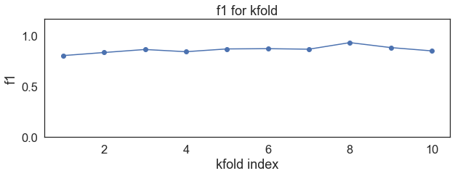
K-Fold Cross Validation & Grid Search
After optimizing the grid search best parameters were observed using the k-folds created:​
F1 (2 * (precision * recall) / (precision + recall) : 86%​
The harmonic mean between precision and recall.

Slide 31
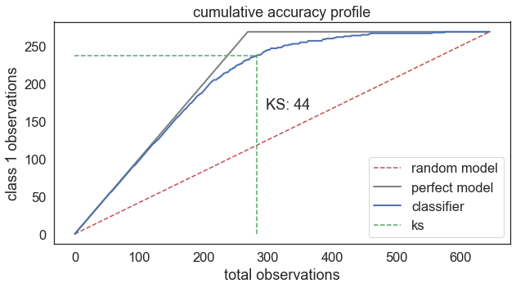
Model Training & Evaluation
The model was trained on the train data.
Results:
Accuracy: 89%
Precision: 88%
Recall: 84%
F1: 86%
Kolmogorov-Smirnov Measure (KS): 44
KS ordered the model’s largest probable outcomes in descending order and then showed that in the first four deciles of data, the model predicted 84% of the data’s not likely to make playoffs. The difference between the model and what a random model predicts is KS (84% - 40% = 44%).
Notes:
So the strongest part of the model is the first three deciles of ordered probabilities.

Slide 32
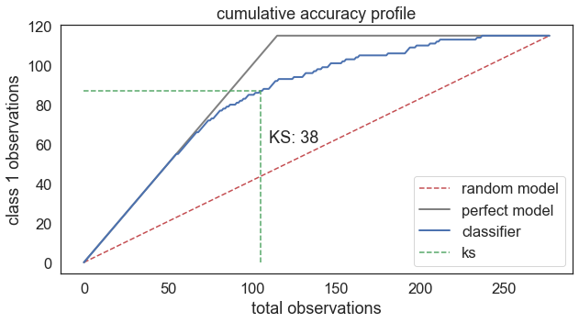
Model Testing & Evaluation
The trained model was tested against the test hold out data set.
Results:
Accuracy: 84%
Precision: 86%
Recall: 72%
F1: 78%
Kolmogorov-Smirnov Measure (KS): 38
(38% at the 4th decile, a cumulative percentage 1.95 (78% (model) / 40% (random model)) greater than a random model.

Slide 33
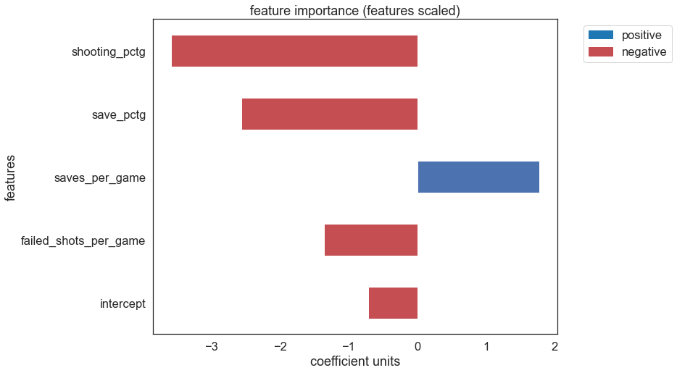
Model Finalization & Feature Importance
To the right the feature importance can be viewed.
Feature Importance (Scaled):
Shooting Percentage (shooting_pctg):
Coefficient: -3.58
Save Percentage (save_pctg):
Coefficient: -2.56
Saves per Game (saves_per_game):
Coefficient: 1.77
Shots on Net (failed_shots_per_game):
Coefficient: -1.35

Slide 34
Logistic Regression Model Summary
The model displays strength when predicting playoff outcomes.
The model does deliver consistency and little variance when being tested against different data sets as seen in the k-fold cross validation and test data.

Slide 35
Review
These four features successfully predicted season wins and playoff outcomes:
Shooting percentage
Failed shots per game
Save percentage
Saves per game
The four features used to predict both season wins and teams that missed that playoffs should be used as high level KPIs to build off of when determining team building and strategy.

Slide 36
END
Notes:
With that, we can open it up for questions.

Slide 37
Appendix
CTRL Click - Analysis Notebook Link

