Slide 1
Improving NHL Season & Playoff Outcomes
By : Josepp Benvenuto
Date: 10/04/2021

Slide 2
Intro

Slide 3
Problem Statement
What metrics can NHL organizations focus on to help improve their season outcomes and chances of making the playoffs?

Slide 4
Why?
Achieving successful campaigns can potentially lead to increased revenue for all stakeholders through ticket sales, salary increases, endorsement deals, fair book value of the organization, greater economic activity for the represented city, etc.

Slide 5
Data
NHL API Team Stats 1983 - 2020:
https://www.kevinsidewar.com/iot/2017/7/1/the-undocumented-nhl-stats-api
Historical Playoff Records 1983 - 2020:
https://en.wikipedia.org/wiki/List_of_NHL_playoff_series

Slide 6
Approach
Use multiple linear regression to find metrics that can predict season outcomes (above average adjusted wins).
Use logistic regression to predict playoff outcomes with predicted season outcomes (made playoffs or not).
Conduct A/B testing to generate specific targets per metric for teams that made the playoffs vs teams that did not.

Slide 7
Approach Visual Map
Predicted Playoff Outcome
Logistics Regression
Predicted Above Average Adjusted Wins
Multiple Linear Regression
Predictive Metrics

Slide 8
Purpose of Approach
The metrics discovered as impactful in making predictions, can serve as guide lines for NHL organizations to Improve their yearly campaigns.

Slide 9
Multiple Linear Regression

Slide 10
Multiple Linear Regression Metrics
Shooting Percentage:
percent of shots leading to goals
Save Percentage:
percent of shots against that are saved
Average Saves Per Game:
saves per game

Slide 11
Multiple Linear Regression Metrics
Average Shots Per Game:
shot attempts per game
Teams Winning >61% of Games They Score First:
Total Games Won When Scoring First / Total Games Scored First

Slide 12
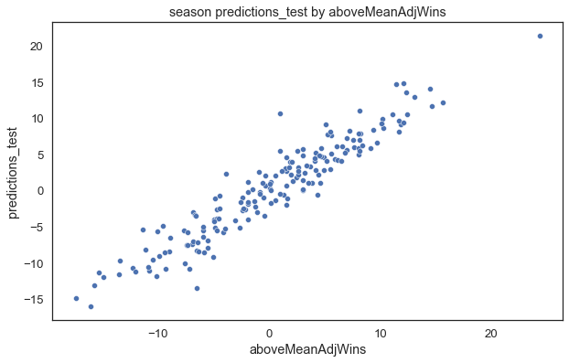
Multiple Linear Regression Test Results
R2: 0.90
RMSE: 2.31
The tight line shows small error in above average adjusted win predictions

Slide 13
Logistic Regression

Slide 14
Logistic Regression Metric
Above Average Adjusted Wins:
(Total Team Wins + (Total Team Ties / 2)) –
((Total League Wins + (Total League Ties / 2)) / Total Number of Teams)
Above Average Adjusted Wins Summary:
(Wins (score = 1) + plus ties (score = 0.5)) / league season average

Slide 15
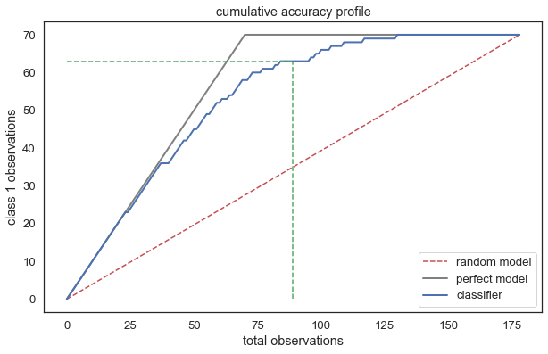
Logistic Regression Test Results
Precision: 0.94
Recall: 0.85
F1: 89
KS of 44% (predicts 84% of target vs 40% using a random model) at the 4th decile

Slide 16
A/B Testing metrics

Slide 17
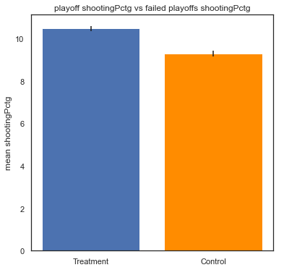
Shooting Percentage
P-Value: < 0.05
95% Confidence Interval: (0.99, 1.36)
Distribution: (10.3, 10.48, 10.67)
Metric Impact : 33%
Coefficient: 3.96
Playoffs
Missed Playoffs

Slide 18
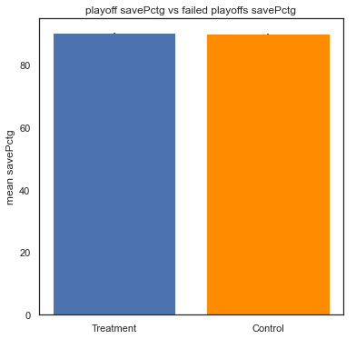
Save Percentage
P-Value: < 0.05
95% Confidence Interval: (0.21, 0.59)
Distribution: (90.02, 90.21, 90.4)
Metric Impact : 32%
Coefficient: 4.13
Playoffs
Missed Playoffs

Slide 19
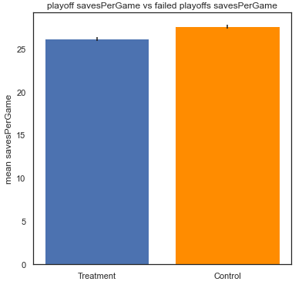
Average Saves Per Game
P-Value: < 0.05
95% Confidence Interval: (-1.75, -1.15)
Distribution: (25.82, 26.12, 26.42)
Metric Impact : 17%
Coefficient: -1.35
Playoffs
Missed Playoffs

Slide 20
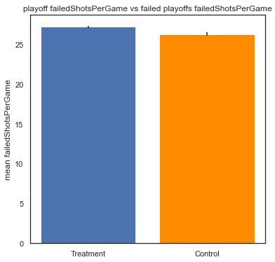
Average Shots Per Game
P-Value: < 0.05
95% Confidence Interval: (0.64, 1.16)
Distribution: (26.91, 27.17, 27.43)
Metric Impact : 15%
Coefficient: 1.37
Playoffs
Missed Playoffs

Slide 21
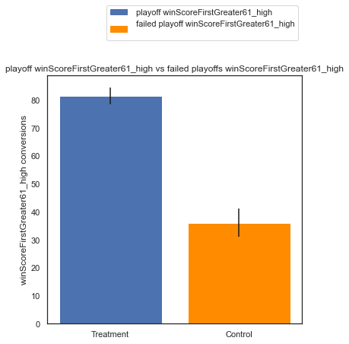
Teams Winning > 61% of Games They Score First
P-Value: < 0.05
95% Confidence Interval: (39%, 52%)
Distribution: (75%, 82%, 88%)
Metric Impact : 3%
Coefficient: 1.36
Playoffs
Missed Playoffs

Slide 22
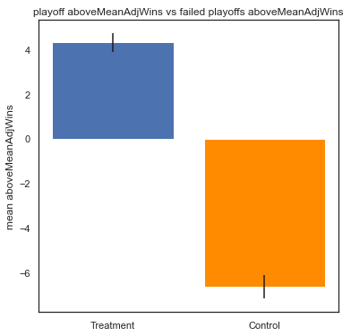
Above Average Adjusted Wins
P-Value: < 0.05
95% Confidence Interval: (10.24, 11.6)
Distribution: (3.62, 4.30, 4.98)
Coefficient: Log -0.52
Playoffs
Missed Playoffs

Slide 23
Summary

Slide 24
Recommendations
Playoffs
Above Average Adjusted Wins
(3.62, 4.30, 4.98)
Shooting Percentage
Range:
(10.30, 10.48, 10.67)
Importance: 1
Save Percentage
Range:
(90.02, 90.21, 90.40)
Importance: 2
Average Saves Per Game
Range:
(25.82, 26.12, 26.42)
Importance: 3
Average Shots Per Game
Range:
(26.91, 27.17, 27.43)
Importance: 4
Teams Winning >61% of Games They Score First
Win >61% of game when scoring first
Importance: 5

Slide 25
Next Steps
How can we achieve these ranges per metric?
Slowly take steps to achieve the recommended ranges per metric starting with the two most important:
Shooting Percentage
Save Percentage
Collect more data on the approaches taken to achieve the recommended ranges per metric to generate a greater understanding of what influences them.

Slide 26
End

