Slide 1
Competition Programming Challenges
Preparation for the Intercollegiate Programming Competition

Slide 2

Tips
Read the sample inputs and output tables first to try to figure out what is required.
Don’t read all text from the problem.
Make comments in your code about steps to be taken to solve the problem.
Have a code template ready to solve all your problems.
Solve the easier problems first and then go for the harder ones.
Before submitting a solution, test it on your computer.

Slide 3
Intercollegiate Programming Competition
Go to https://www.seminolestate.edu/computers/competition to get info about the competition.
Go to https://github.com/joseprleader/Source_Code/tree/main/Competition and read the focus.txt file

Slide 4


Programming languages to cover
Python Java
Straightforward Essential for CS
Less wordy More detailed and specific

Slide 5
Replit
Join my Python Replit: https://replit.com/join/sigyotdfjb-joseprogrammer
Join my Java Replit: https://replit.com/join/ppzekhgqyr-joseprogrammer
If you don’t have a replit account, create it at: https://replit.com/signup

Slide 6
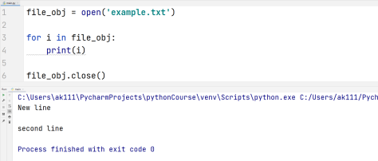
How to read a file
Python

Slide 7
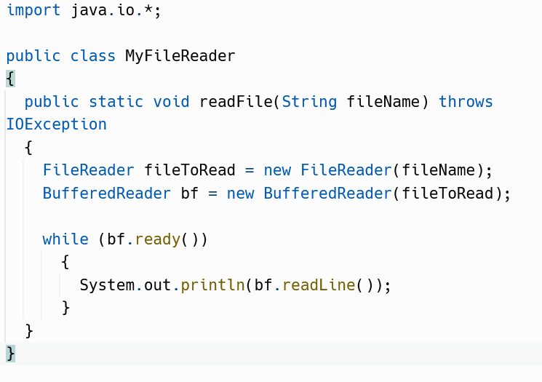
How to read a file
Java

Slide 8
Challenges Covered
2021 Blue Track Challenges
Electric Charges
Where Am I
Glad to be one
2021 Golden Track Challenge
Find the Missing Side

Slide 9
Challenges Covered
2019 Blue Track Challenges
Consecutive Numbers
Let’s Make a Call
Glad to be one
2019 Golden Track Challenge
Parallel or Intersecting Lines
Weighted Sum
Overlapping Rectangles

Slide 10
Solutions
All solutions to this challenges will be posted by Friday at: https://github.com/joseprleader/Source_Code/tree/main/Competition

Slide 11

CHALLENGE SOLVING TIME
Let’s get to solve these challenges.

