Slide 1

LLM-Check: Investigating Detection of Hallucinations in LLMs
Dr. José Ramón Iglesias
DSP-ASIC BUILDER GROUP
Director Semillero TRIAC
Ingenieria Electronica
Universidad Popular del Cesar

Slide 2
What are Hallucinations in LLMs?
Model outputs that are fallacious, incorporating fictional details
Responses are partly misleading or entirely fabricated
Seem plausible, appearing tenable before further scrutiny

Slide 3
What are Hallucinations in LLMs?
Model outputs that are fallacious, incorporating fictional details
Responses are partly misleading or entirely fabricated
Seem plausible, appearing tenable before further scrutiny
Present a significant challenge towards the deployment of LLMs
Mitigation is seen to be very challenging practically

Slide 4
What are Hallucinations in LLMs?
Let’s look at some real examples:
Prompt: Who are some notable alumni from Monta Vista High School in Cupertino?
Claude-3 Sonnet: Monta Vista High School in Cupertino, California has had some notable alumni, though I don't have fully comprehensive information about all of their accomplished former students. A few that stand out are:

Slide 5
What are Hallucinations in LLMs?
Let’s look at some real examples:
Prompt: Who are some notable alumni from Monta Vista High School in Cupertino?
Claude-3 Sonnet: Monta Vista High School in Cupertino, California has had some notable alumni, though I don't have fully comprehensive information about all of their accomplished former students. A few that stand out are:
Steve Wozniak - Co-founder of Apple Computer. He attended Monta Vista and graduated in 1971. Kamala Harris - Current Vice President of the United States. She graduated from Monta Vista in 1981.
Jeremy Lin - Professional basketball player who had a stint in the NBA and gained fame during 'Linsanity' with the New York Knicks in 2012. He graduated from Monta Vista in 2006.
Amanda Crew - Actress known for films like Silicon Valley and Haunting of Molly Hartley.

Slide 6


What are Hallucinations in LLMs?
Most popular models hallucinate!
Prompt: Who are some notable alumni from Monta Vista High School in Cupertino?
Claude-3 Sonnet Gemini
GPT-4 GPT-4o
ChatGPT

Slide 7
Why can’t LLMs help themselves from fabricating details?
LLMs are really well trained - but not optimally so!
Appreciable degree of world-knowledge

Slide 8
Why can’t LLMs help themselves from fabricating details?
LLMs are really well trained - but not optimally so!
Appreciable degree of world-knowledge
Autoregressive generation: once a token is sampled, it’s fixed!
LLM attempts to nonetheless maximize likelihood of overall response

Slide 9
Why can’t LLMs help themselves from fabricating details?
LLMs are really well trained - but not optimally so!
Appreciable degree of world-knowledge
Autoregressive generation: once a token is sampled, it’s fixed!
LLM attempts to nonetheless maximize likelihood of overall response
Hallucinations are absent in some of the repeated model generations for the same prompt
Consistency across different generations can be leveraged

Slide 10
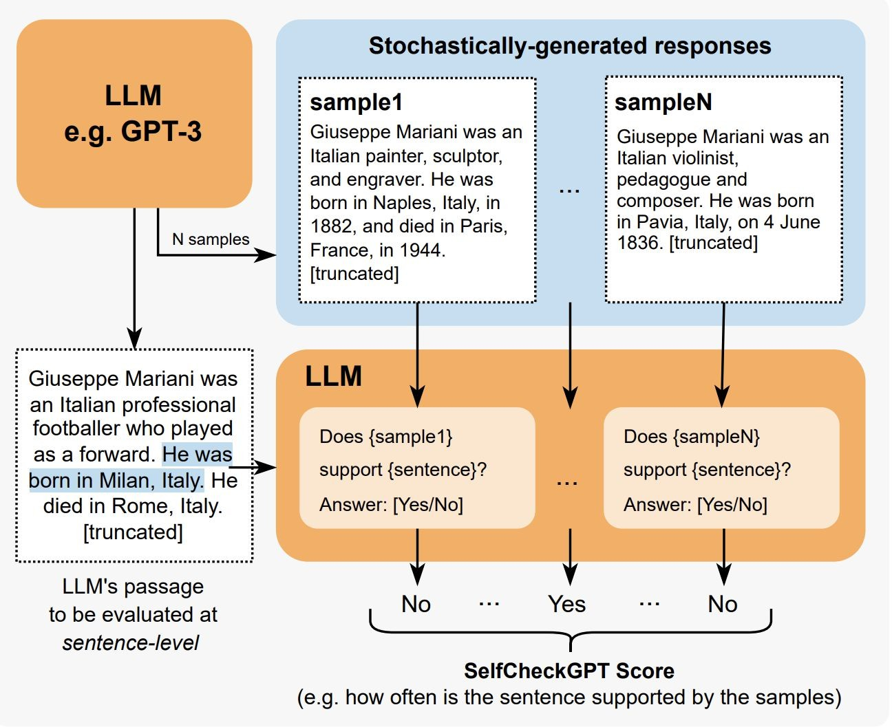
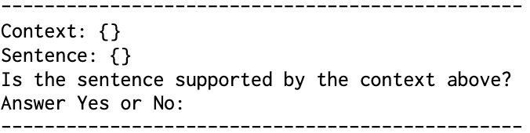
Multi-Response Consistency-Based Detection Methods
Detection scores with:
BERTScore
Question Answering
N-gram Analysis
Natural Language Inference
SelfCheckGPT - Prompt
Manakul et al. SELFCHECKGPT: Zero-Resource Black-Box Hallucination Detection for Generative Large Language Models

Slide 11
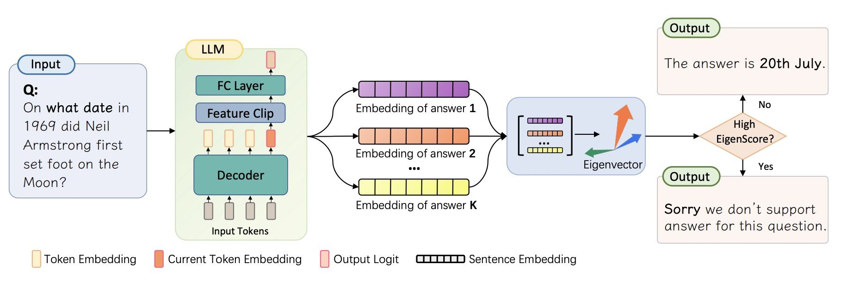
Multi-Response Consistency-Based Detection Methods
Population-level detection with INSIDE
Chen et al. INSIDE: LLMs' Internal States Retain the Power of Hallucination Detection

Slide 12
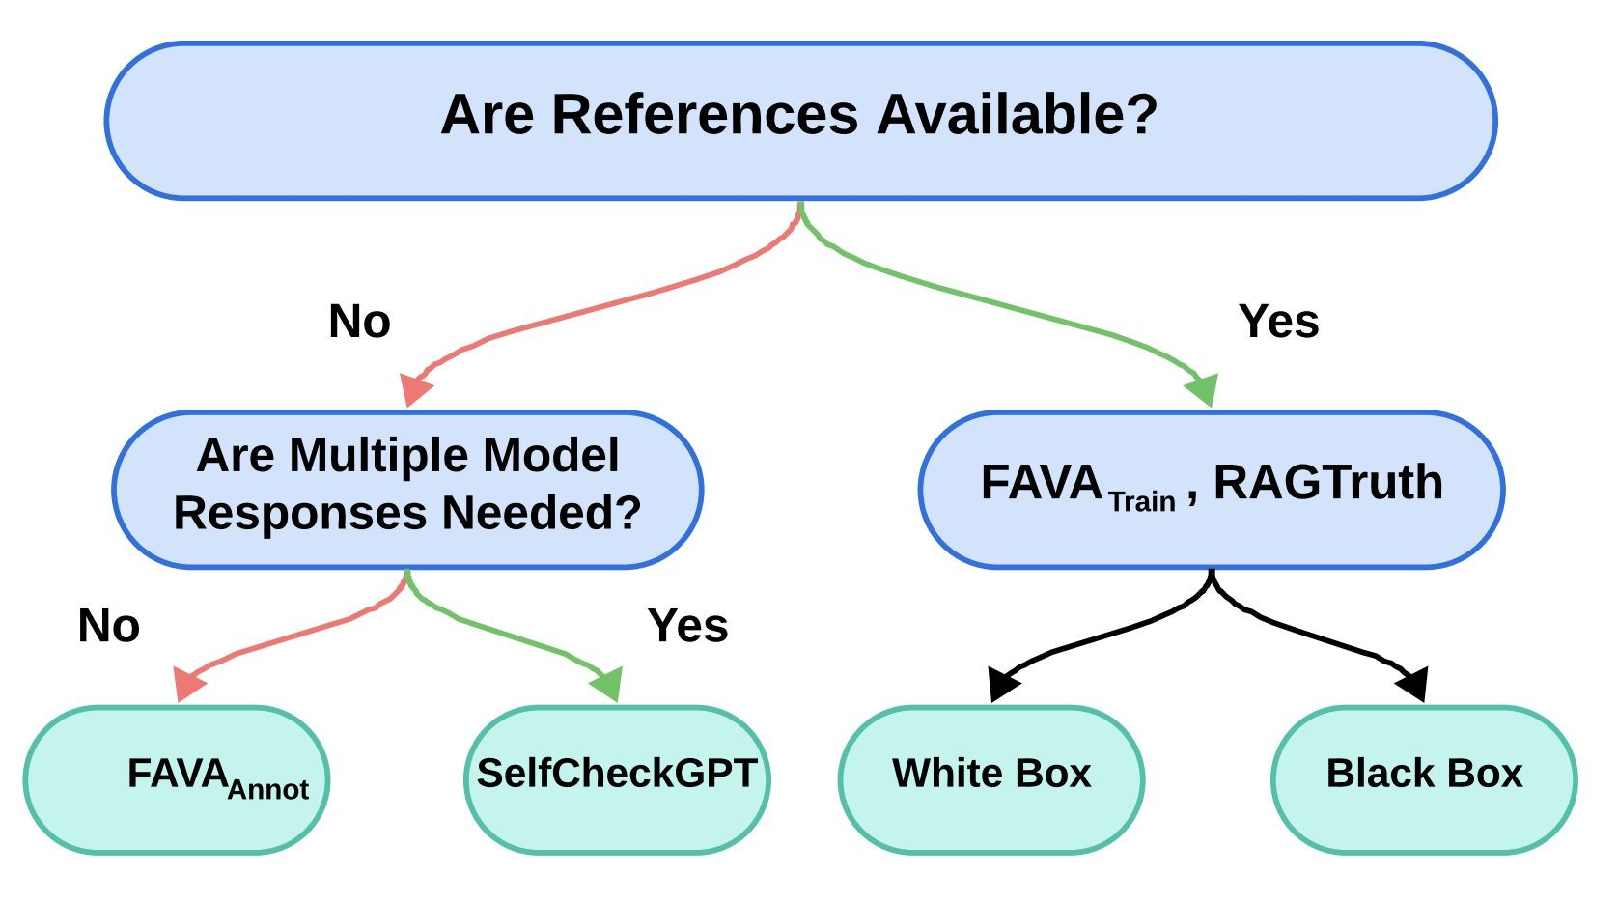
Classification of Hallucination Detection Settings

Slide 13
Classification of Hallucination Detection Settings

Slide 14
Detection of Hallucinations in LLMs
Multiple LLM responses - inference time overheads and expensive
Retraining a model - train-time overhead and generalization issues
● Broad-ranging settings: with/without references, whitebox vs blackbox
● Population vs Single-response analysis
● Without finetuning/retraining or considerable inference time overheads
● Can we leverage the rich semantic representations in LLMs?
● Analyze all model-related latent and output observables available with a single
forward-pass

Slide 15
Detection of Hallucinations in LLMs
Multiple LLM responses - inference time overheads and expensive
Retraining a model - train-time overhead and generalization issues
Broad-ranging settings: with/without references, whitebox vs blackbox
Population vs Single-response analysis
Without finetuning/retraining or considerable inference time overheads
● Can we leverage the rich semantic representations in LLMs?
● Analyze all model-related latent and output observables available with a single
forward-pass

Slide 16
Detection of Hallucinations in LLMs
Multiple LLM responses - inference time overheads and expensive
Retraining a model - train-time overhead and generalization issues
Broad-ranging settings: with/without references, whitebox vs blackbox
Population vs Single-response analysis
Without finetuning/retraining or considerable inference time overheads
Can we leverage the rich semantic representations in LLMs?
Analyze all model-related latent and output observables available with a single forward-pass of an LLM using teacher-forcing

Slide 17
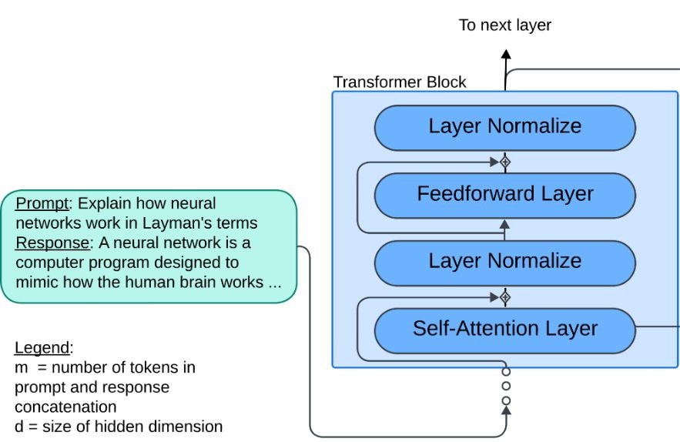
LLM-Check: Detection of Hallucinations in LLMs
Eigenvalue Analysis of Internal LLM Representations
Output Token Uncertainty Quantification

Slide 18
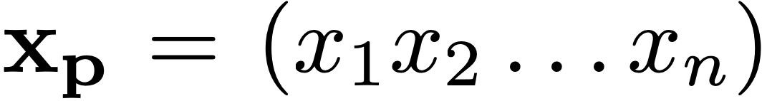
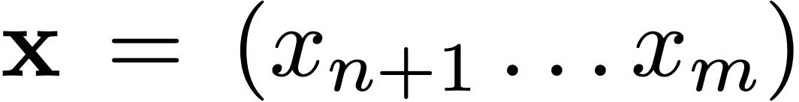
LLM-Check: Analyzing model internals
Prompt
Response

Slide 19
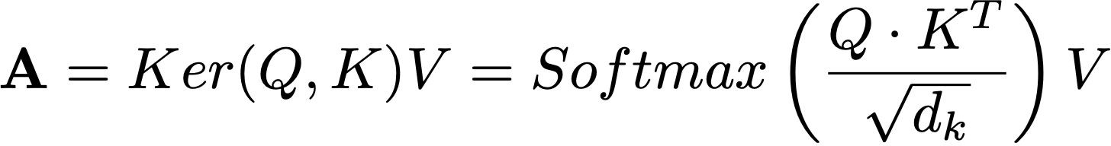
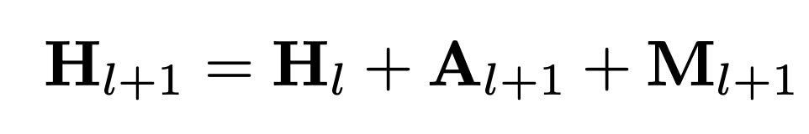
LLM-Check: Analyzing model internals
Prompt
Response
Attention Kernels
Hidden Activations

Slide 20
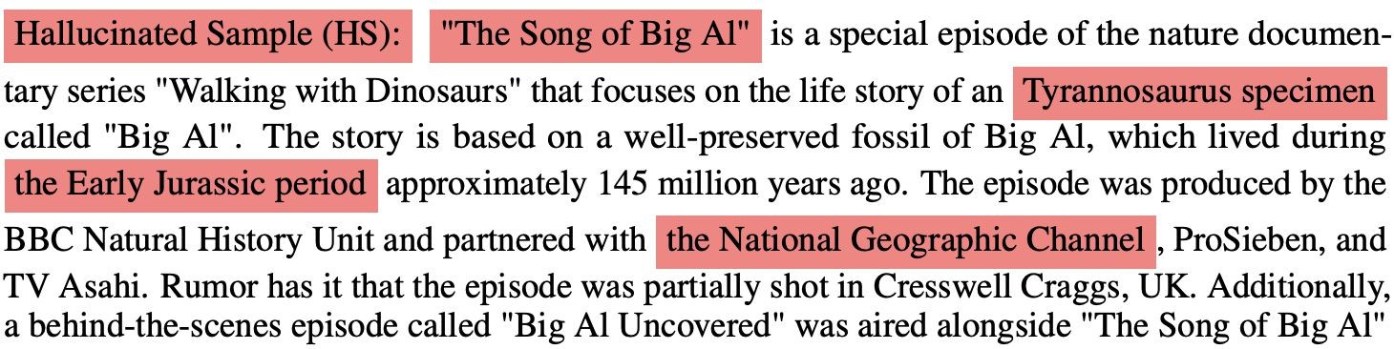
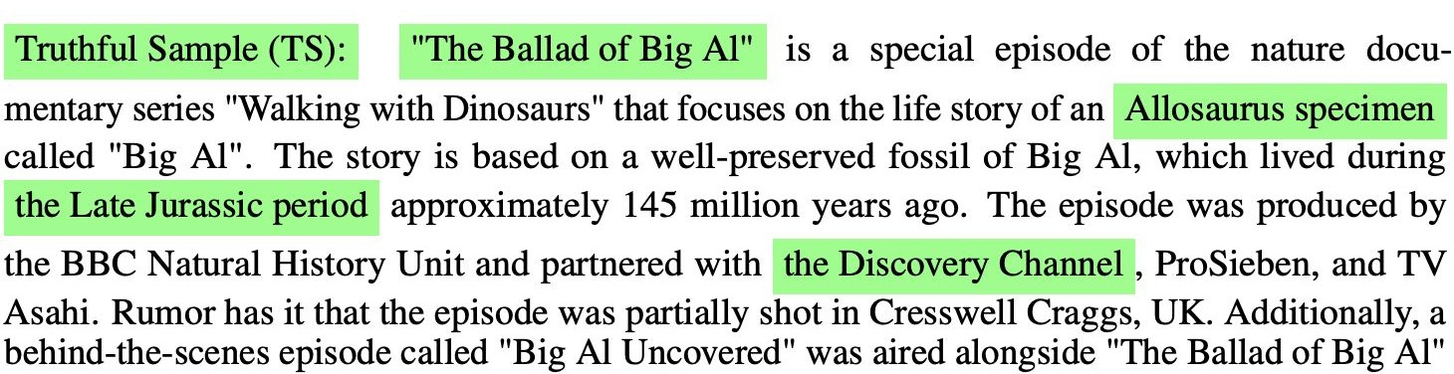
LLM-Check: Analyzing model internals
Based on References [1, 2, 3, 4, 5], write a blog article:

Slide 21
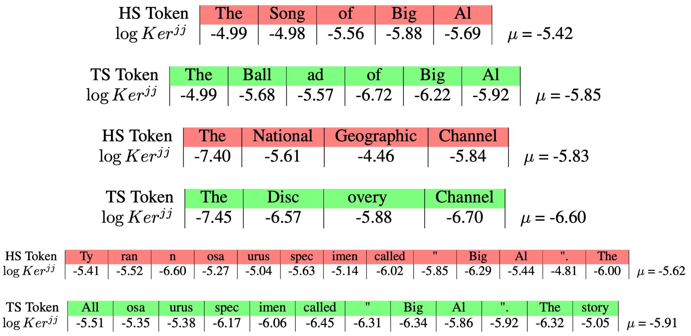
LLM-Check: Detection of Hallucinations in LLMs

Slide 22
LLM-Check: Hidden Score
Distinct changes in model internals within a given hallucinated response
Quantify this saliency within representations using eigen-analysis

Slide 23
LLM-Check: Hidden Score
Distinct changes in model internals within a given hallucinated response
Quantify this saliency within representations using eigen-analysis
For seq. of m tokens, hidden representations matrix of shape (d × m)
Compute the mean log-det of its (m x m) covariance matrix:

Slide 24
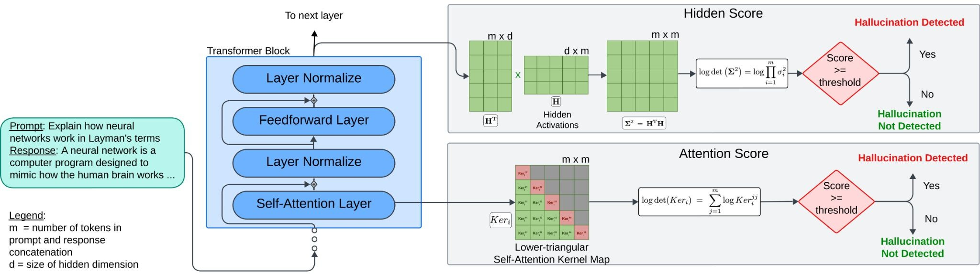
LLM-Check: Hidden Score

Slide 25
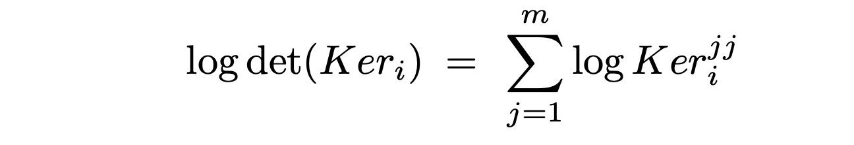
LLM-Check: Attention Score
Sensitivity to hallucinations acutely reflected in attention mechanism
Attention kernels are tensors of the shape (a × m × m)
For each attention head, Ker_{i} is lower-triangular square matrix of size (m × m)
Capture distribution shift using Log-determinant, which easily reduces as:

Slide 26
LLM-Check: Detection of Hallucinations in LLMs

Slide 27
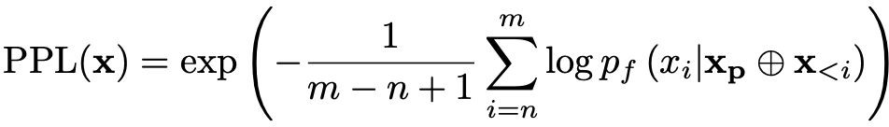
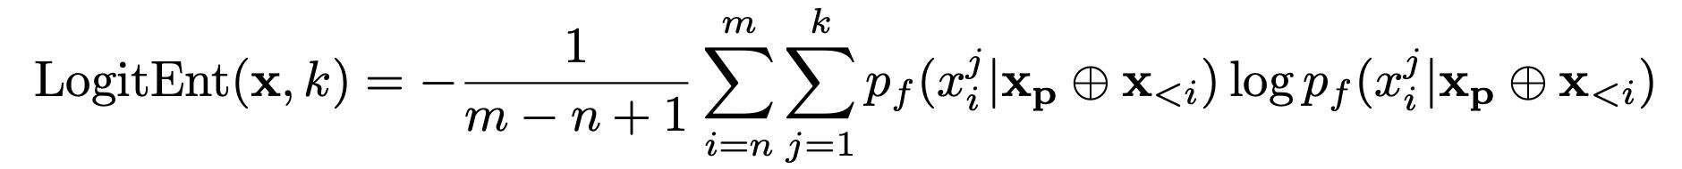
LLM-Check: Output Uncertainty Quantification
Perplexity
Logit Entropy
y
Windowed Logit Entropy score

Slide 28
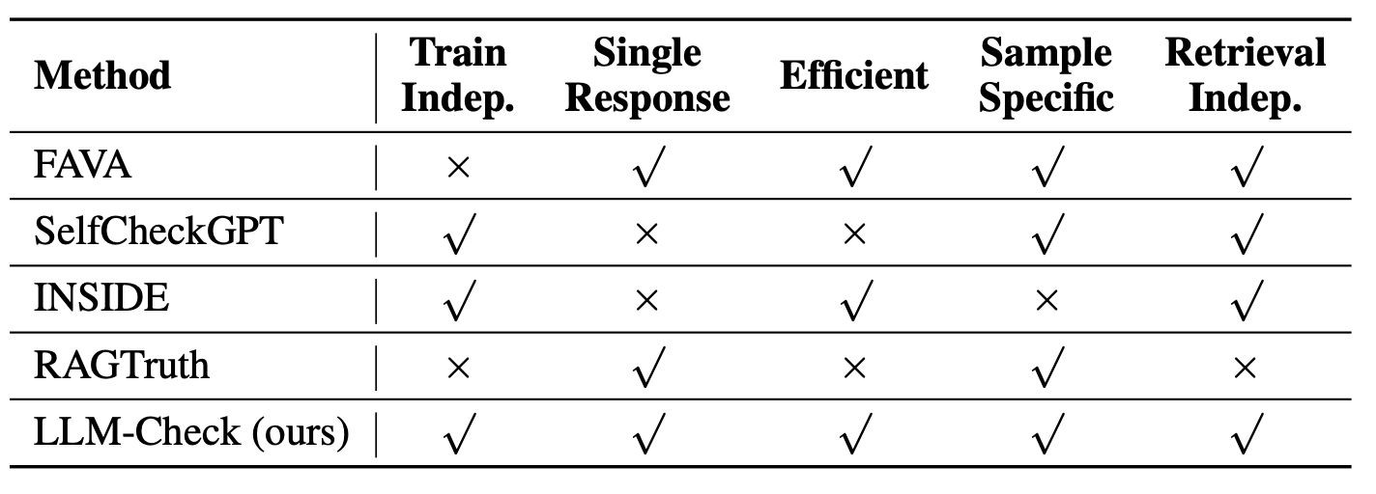
LLM-Check: Comparing with Prior Works

Slide 29
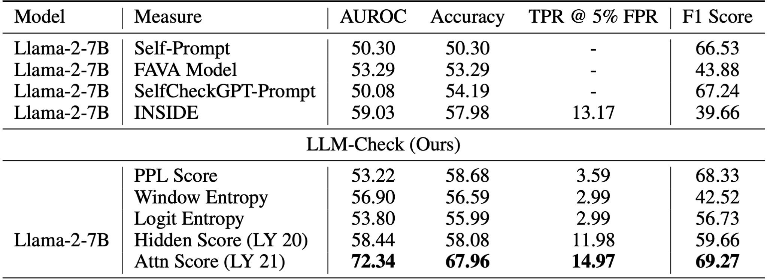
Results on FAVA-Annot (Single Response, No References)

Slide 30
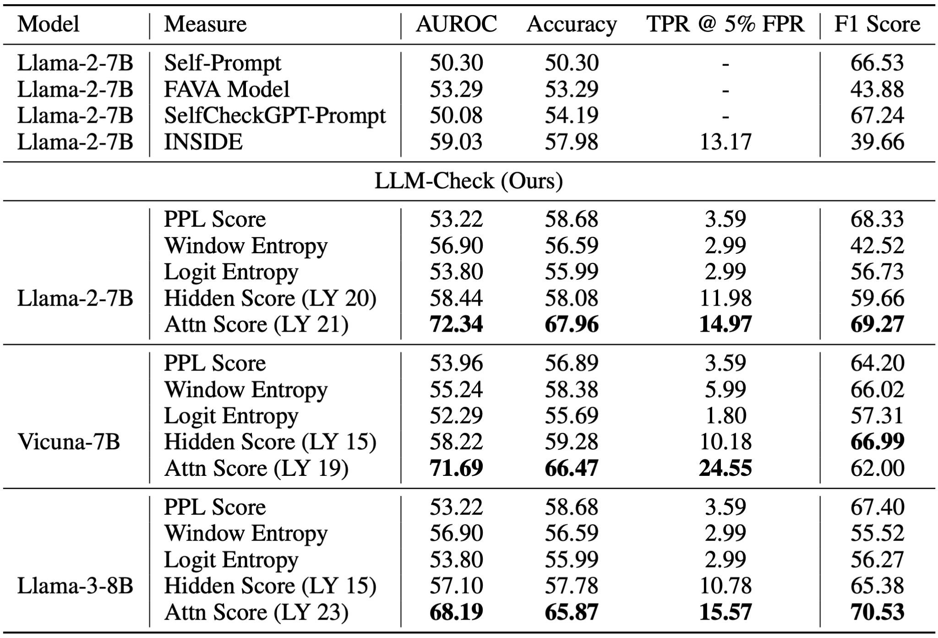
Results on FAVA-Annot (Single Response, No References)

Slide 31
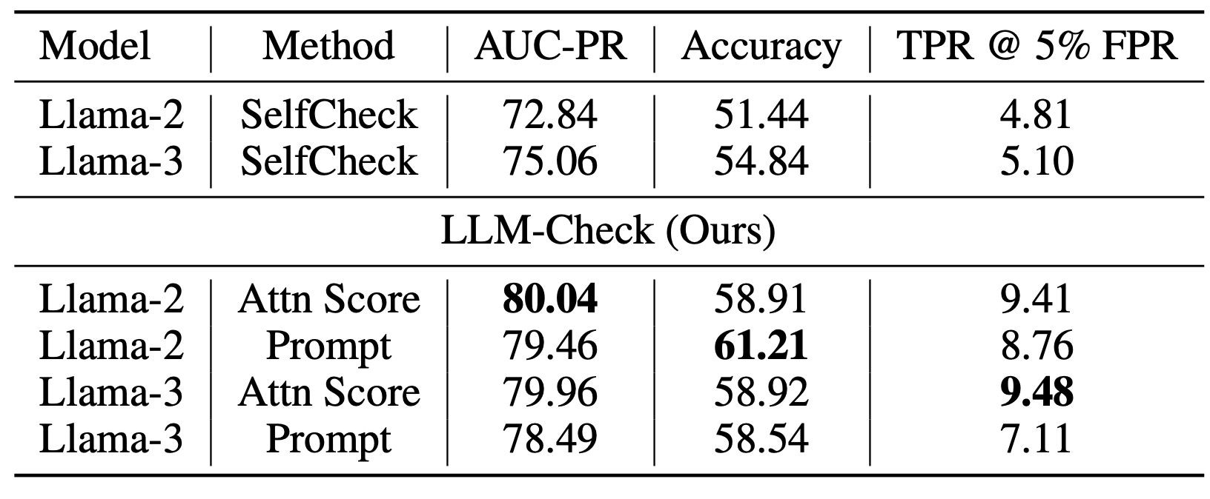
Results on SelfCheckGPT Dataset (Multi-responses, No Refs.)

Slide 32
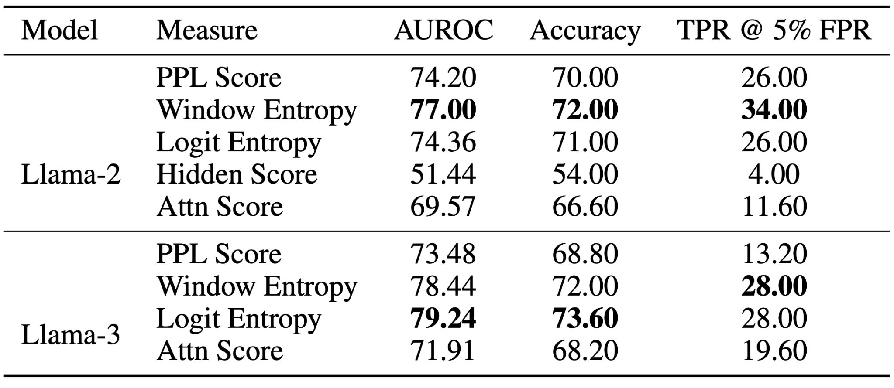
Results on Synthetic Hallucinations on FAVA Train Split

Slide 33
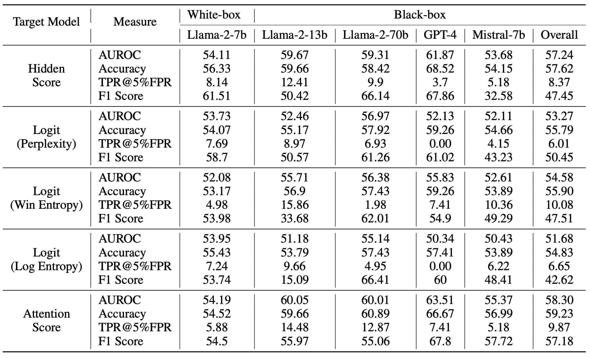
Results on RAGTruth (with External References)

Slide 34
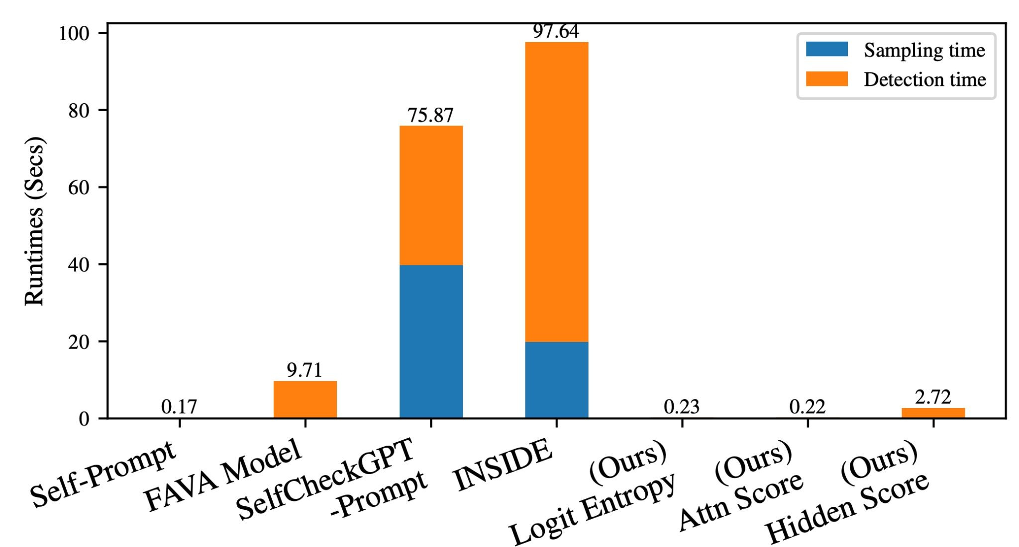
LLM-Check: Compute Efficiency
Upto 45x and 450x Speedup!

Slide 35
Summary
LLM-Check - suite of simple, effective detection techniques over current LLMs
Analyses hidden representations, attention kernel maps and logit outputs
Considerable improvements over prior methods over diverse detection settings
Applicable with/without RAG, single/multiple responses, white/black box settings
Extremely compute-efficient: upto 45x and 450x speedup

Slide 36


Thank You!
Poster Session 1: 11am — 2pm PST, Wed Dec 11th

