Slide 1

Machine Learning Systems Design
Lecture 15: ML Infrastructure & Platform
Dr. José Ramón Iglesias
DSP-ASIC BUILDER GROUP
Director Semillero TRIAC
Ingenieria Electronica
Universidad Popular del Cesar

Slide 2
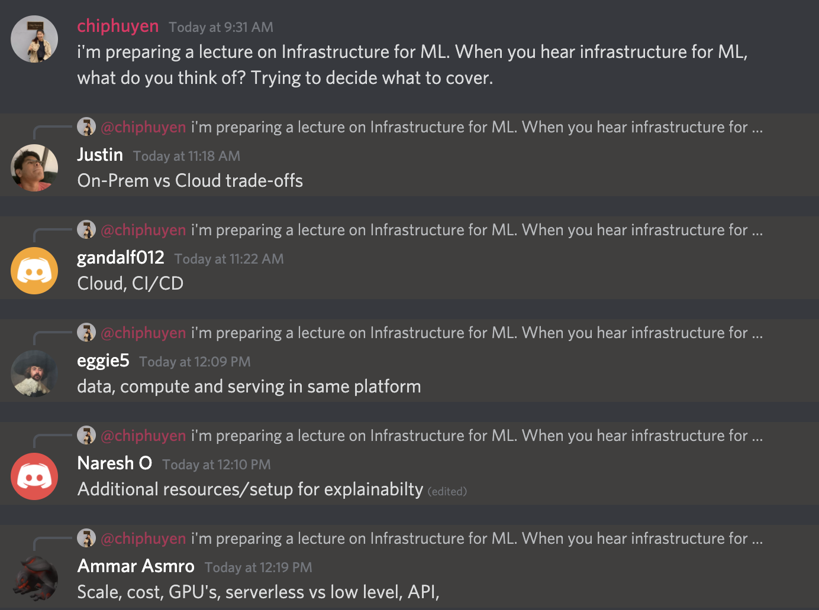
What does infrastructure mean?

Slide 3
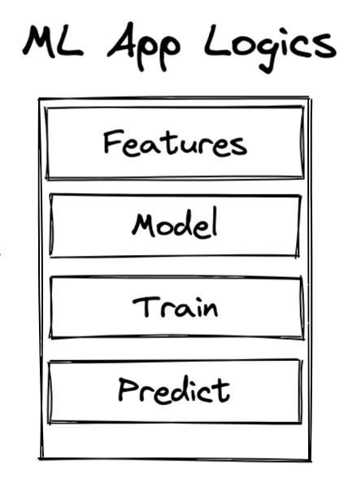

ML systems are complex
More components
A request might jump 20-30 hops before response
A problem occurs, but where?
Containers
Schedulers
Serverless
Lambda functions
Mesh routing
Load balancers
Microservices

Slide 4
More complex systems, better infrastructure needed
Automate boilerplate code
Reuse/share code
Reduce surface area for bugs
Notes:
Also true for SWE

Slide 5
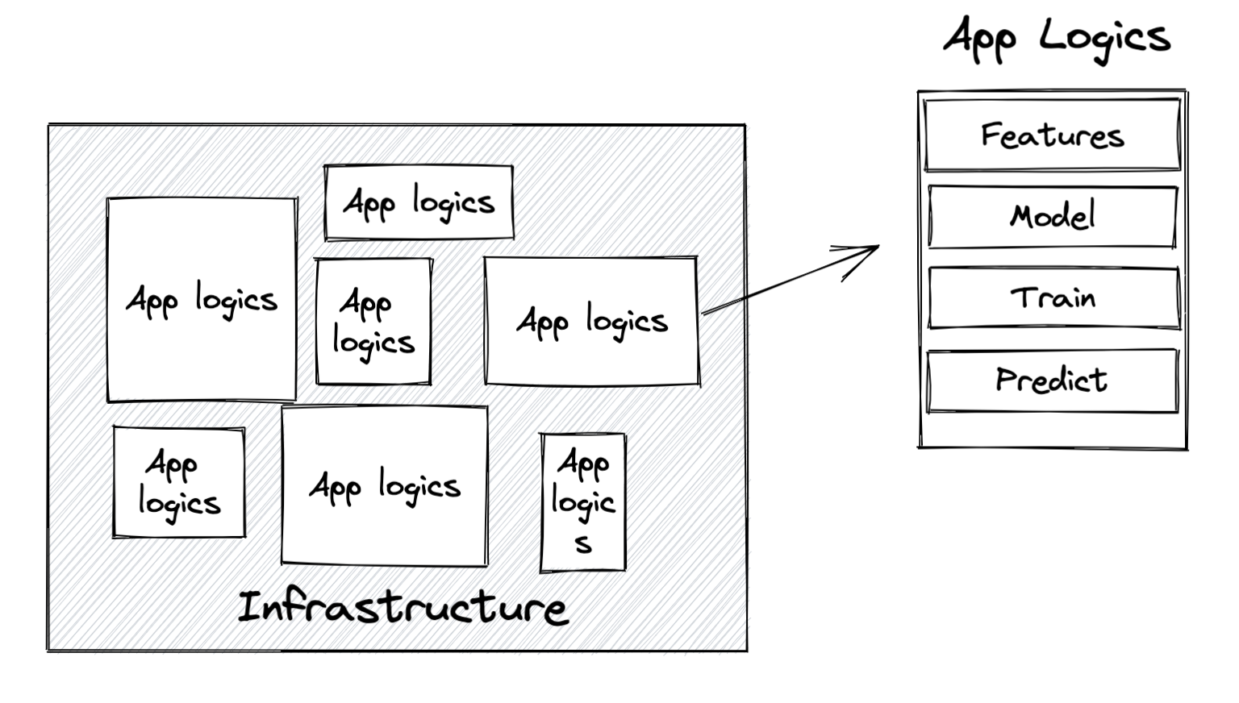
Infrastructure: the set of fundamental facilities and systems that support the sustainable functionality of households and firms.
ML infrastructure: the set of fundamental facilities that support the development and maintenance of ML systems.

Slide 6
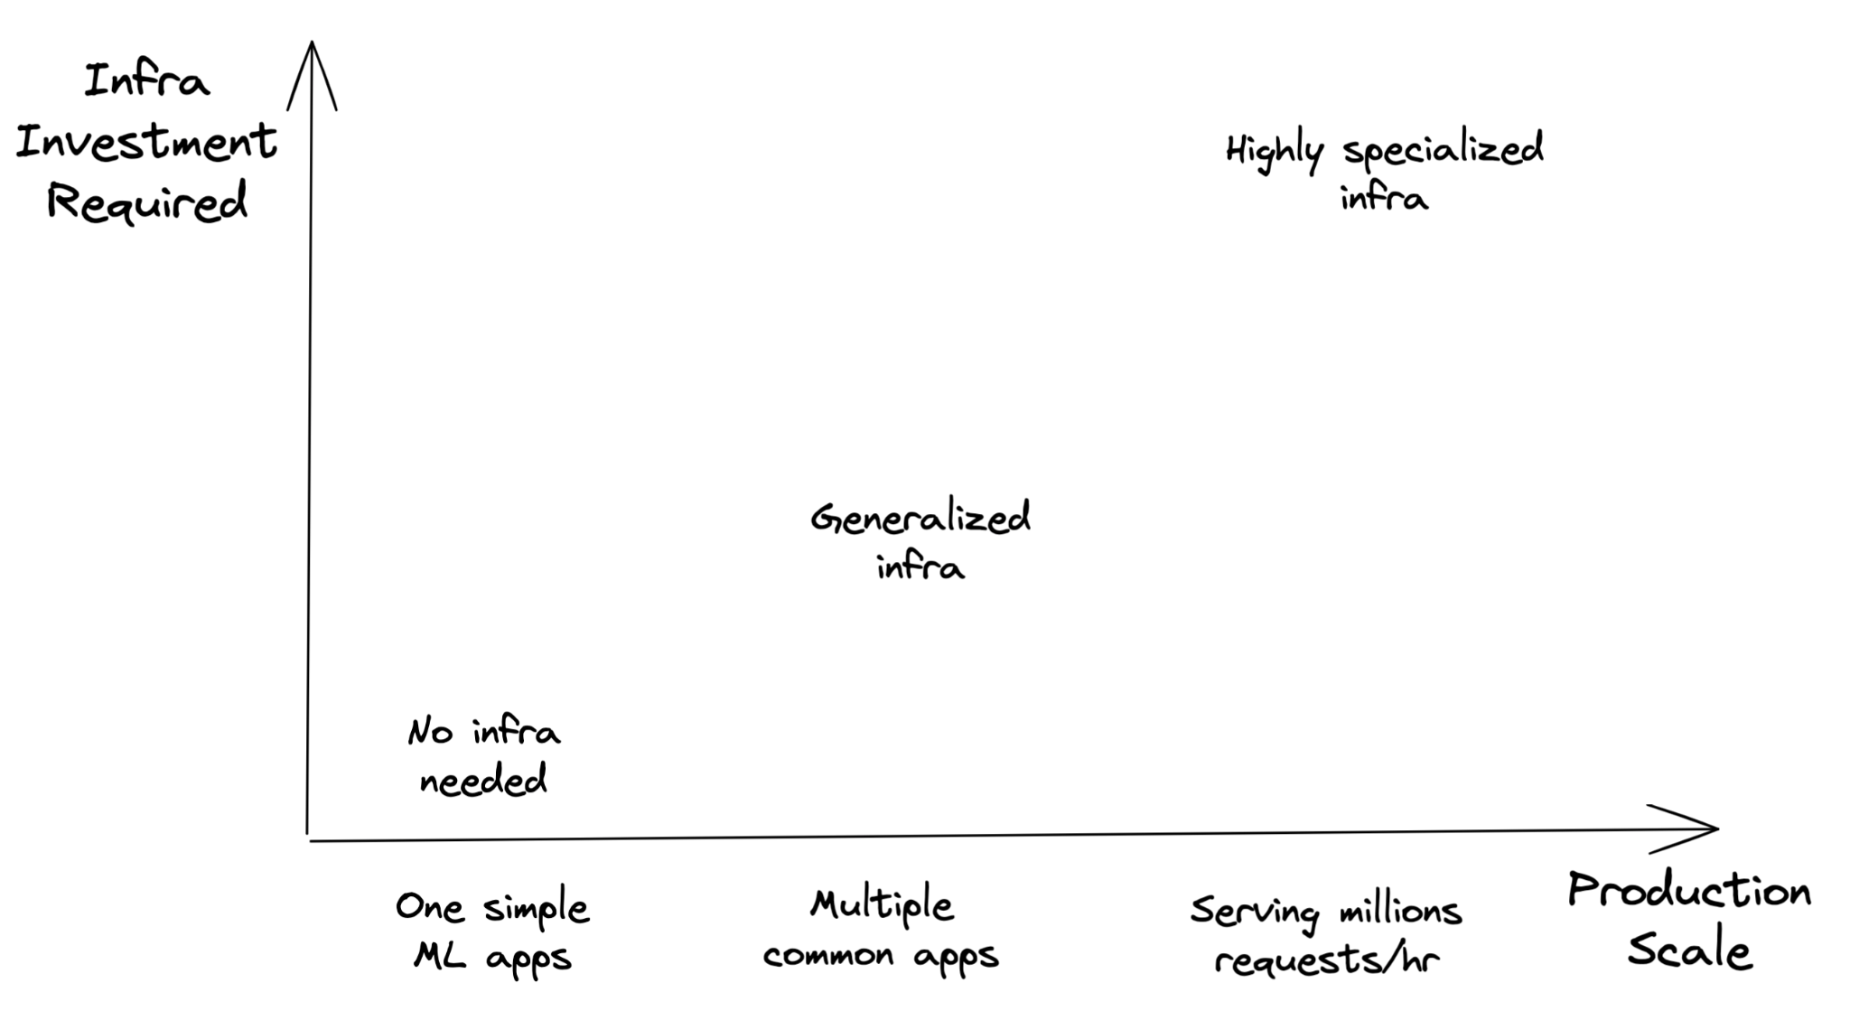
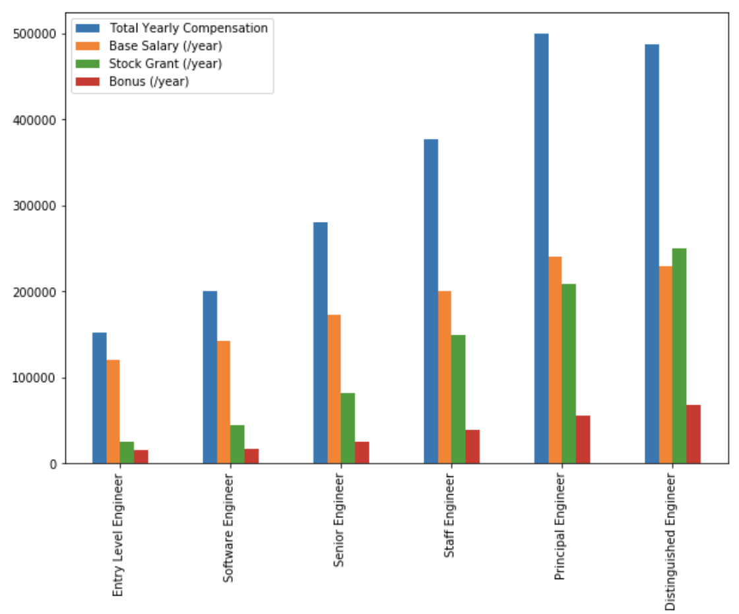
Every company’s infrastructure needs are different
Notes:
For example, back in 2018, Uber was adding tens of terabytes of data a day to their data lake, and Zillow’s biggest dataset was bringing in 2 terabytes of uncompressed data a day. In contrast, even back in 2014, Facebook was generating 4 petabytes of data a day.

Slide 7
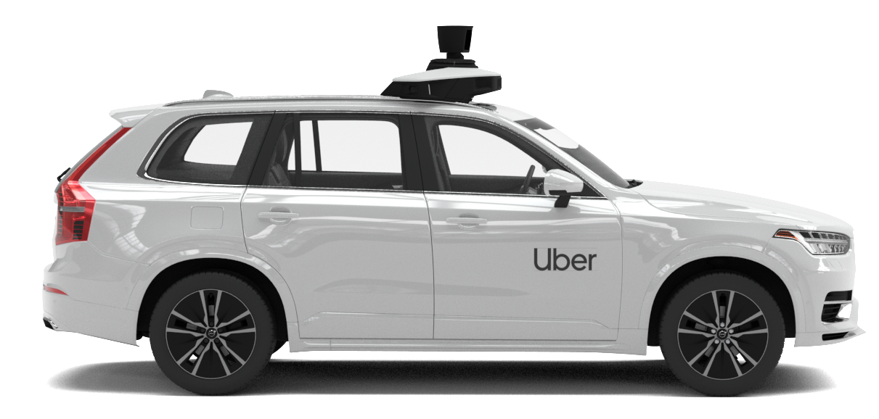

Every company’s infrastructure needs are different
63K requests/sec
234M requests/hr
Notes:
For example, back in 2018, Uber was adding tens of terabytes of data a day to their data lake, and Zillow’s biggest dataset was bringing in 2 terabytes of uncompressed data a day. In contrast, even back in 2014, Facebook was generating 4 petabytes of data a day.

Slide 8
Every company’s infrastructure needs are different
63K requests/sec
234M requests/hr
GB - TBs of data daily
10s - 100s data scientists
3+ models
Notes:
For example, back in 2018, Uber was adding tens of terabytes of data a day to their data lake, and Zillow’s biggest dataset was bringing in 2 terabytes of uncompressed data a day. In contrast, even back in 2014, Facebook was generating 4 petabytes of data a day.

Slide 9
Every company’s infrastructure needs are different
63K requests/sec
234M requests/hr
Vast majority of apps (reasonable scale)
Notes:
Google: 63,000 search queries a second, which translates to 234 million search queries an hour, like Google does

Slide 10
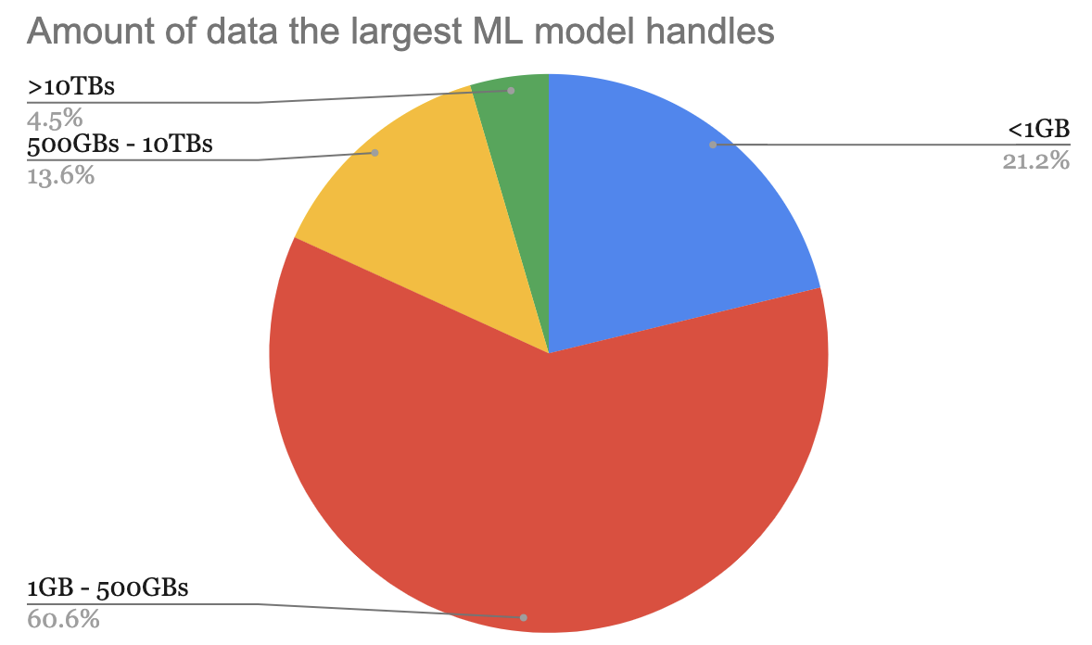
n=66 | claypot.ai

Slide 11
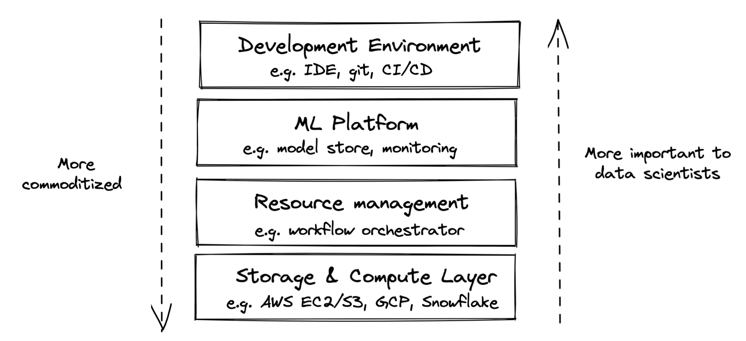
Infrastructure Layers

Slide 12
Infrastructure Layers
2
4
3
1

Slide 13
Storage & Compute Layer

Slide 14
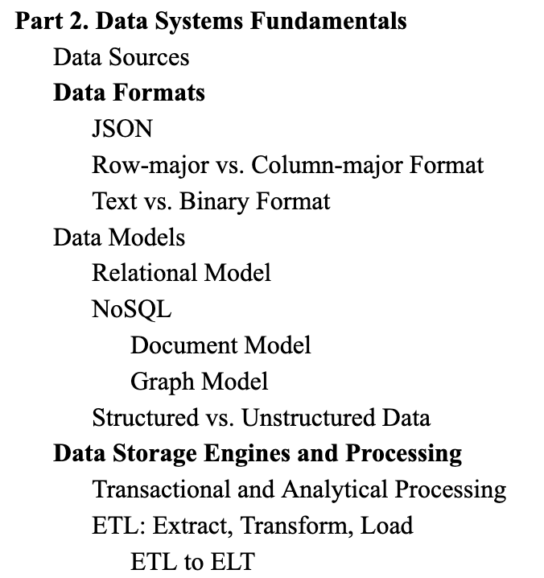
Storage
Where data is collected and stored
Simplest form: HDD, SSD
More complex forms: data lake, data warehouse
Examples: S3, Redshift, Snowflake, BigQuery
See Lecture 2

Slide 15
Storage: heavily commoditized
Most companies use storage provided by other companies (e.g. cloud)
Storage has become so cheap that most companies just store everything

Slide 16
Compute layer: engine to execute your jobs
Compute resources a company has access to
Mechanism to determine how these resources can be used

Slide 17
Compute layer: engine to execute jobs
Simplest form: a single CPU/GPU core
Most common form: cloud compute

Slide 18
Compute unit
Compute layer can be sliced into smaller compute units to be used concurrently
A CPU core might support 2 concurrent threads, each thread is used as a compute unit to execute its own job
Multiple CPUs can be joined to form a large compute unit to execute a large job

Slide 19




Compute unit
Compute layer can be sliced into smaller compute units to be used concurrently
A CPU core might support 2 concurrent threads, each thread is used as a compute unit to execute its own job
Multiple CPUs can be joined to form a large compute unit to execute a large job
Wrapper around container
Unit: job
Unit: pod

Slide 20
Compute layer: how to execute jobs
Load data into memory
Perform operations on that data
Operations: add, subtract, multiply, convolution, etc.
To add arrays A and B
Load A & B into memory
Perform addition on A and B

Slide 21
Compute layer: how to execute jobs
Load data into memory
Perform operations on that data
Operations: add, subtract, multiply, convolution, etc.
If A & B don’t fit into memory, it’ll be possible to do the ops without out-of-memory algorithms
To add arrays A and B
Load A & B into memory
Perform addition on A and B

Slide 22
Compute layer: how to execute jobs
Load data into memory
Perform operations on that data
Operations: add, subtract, multiply, convolution, etc.
To add arrays A and B
Load A & B into memory
Perform addition on A and B
Important metrics of compute layer:
Memory
Speed of computing ops

Slide 23
Compute layer: memory
Amount of memory
Straightforward
An instance with 8GB of memory is more expensive than an instance with 2GB of memory

Slide 24
Compute layer: memory
Amount of memory
I/O bandwidth: speed at which data can be loaded into memory

Slide 25
Compute layer: speed of ops
Most common metric: FLOPS
Floating Point Operations Per Second
“A Cloud TPU v2 can perform up to 180 teraflops, and the TPU v3 up to 420 teraflops.”
- Google, 2021

Slide 26
Compute layer: speed of ops
Most common metric: FLOPS
Contentious
What exactly is an ops?
If 2 ops are fused together, is it 1 or 2 ops?
Peak perf at 1 teraFLOPS doesn’t mean your app will run at 1 teraFLOPS

Slide 27
Compute layer: utilization
Utilization = actual FLOPS / peak FLOPS
If peak 1 trillion FLOPS but job runs 300 billion FLOPS
-> utilization = 0.3

Slide 28
Compute layer: utilization
The higher, the better
Utilization = actual FLOPS / peak FLOPS
Dependent on how fast data can be loaded into memory
Tensor Cores are very fast. So fast … that they are idle most of the time as they are waiting for memory to arrive from global memory.
For example, during BERT Large training, which uses huge matrices — the larger, the better for Tensor Cores — we have utilization of about 30%.
- Tim Dettmers, 2020

Slide 29
Compute layer: if not FLOPS, then what?

Slide 30
Compute layer: if not FLOPS, then what?
How long it will take this compute unit to do common workloads
MLPerf measure hardware on common ML tasks e.g.
Train a ResNet-50 model on the ImageNet dataset
Use a BERT-large model to generate predictions for the SQuAD dataset

Slide 31
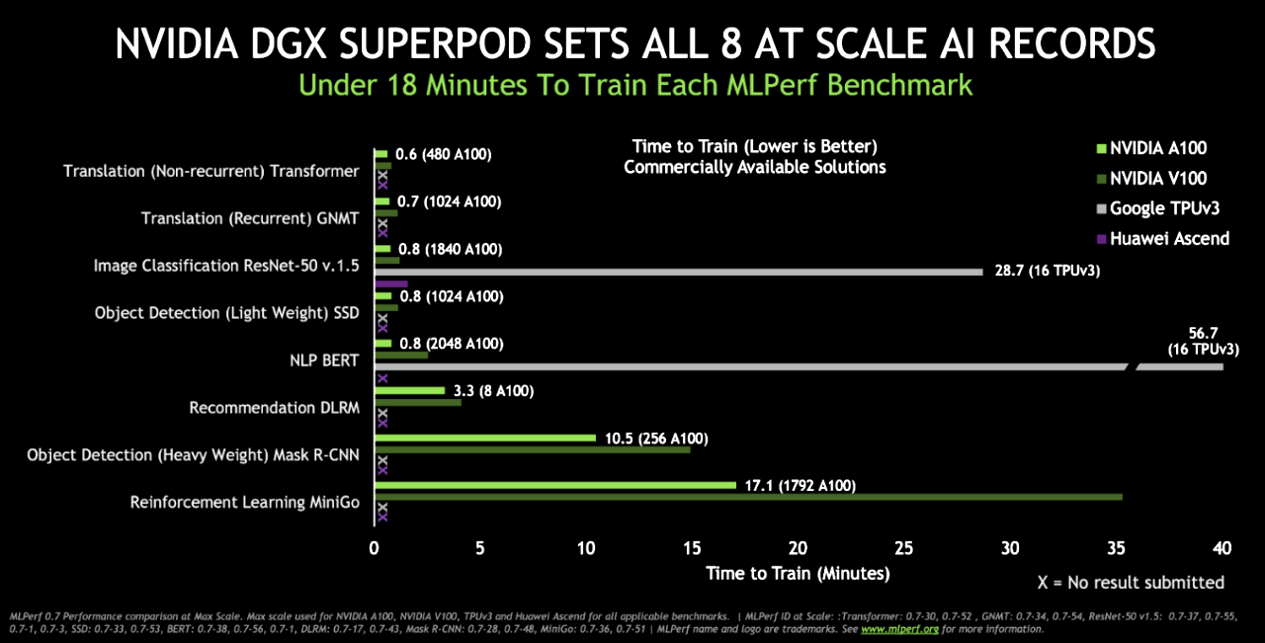
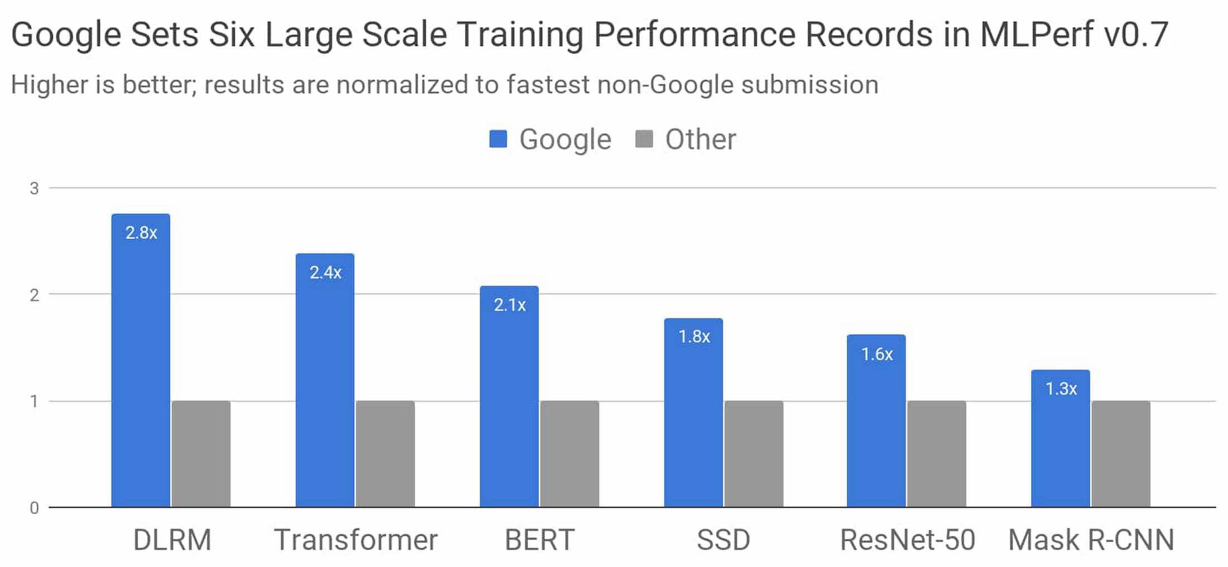
MLPerf is also contentious

Slide 32
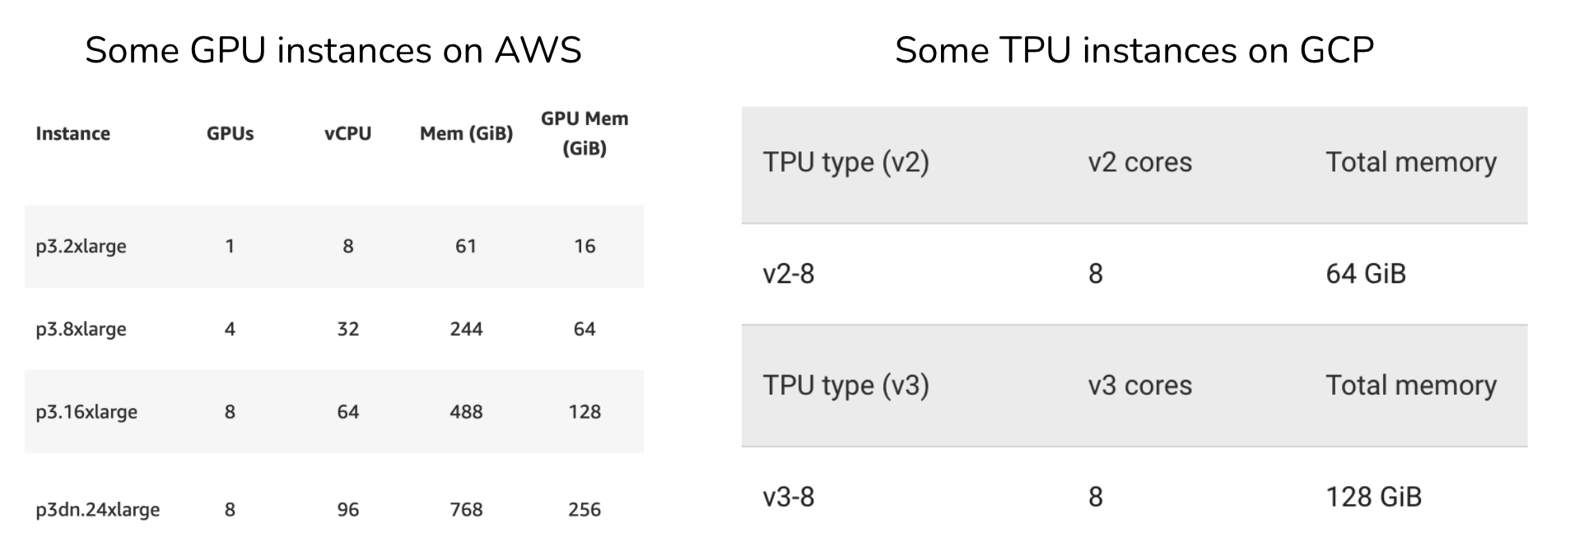
Compute layer: evaluation
Memory
Cores
I/O bandwidth
Cost

Slide 33
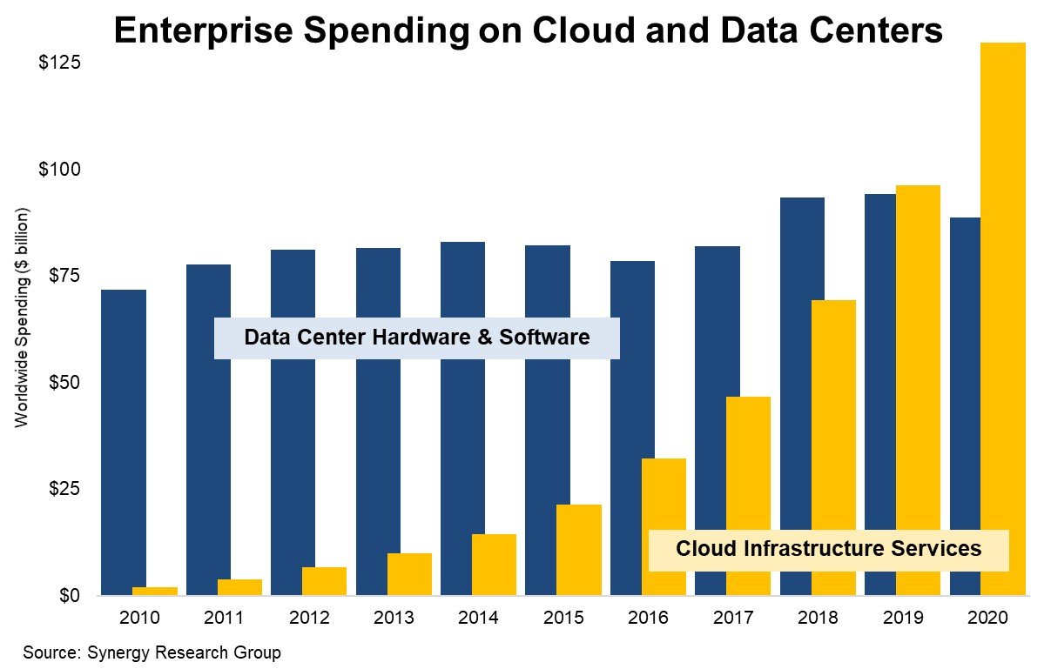
Public Cloud vs. Private Data Centers
Like storage, compute is largely commoditized
2020 – The Year that Cloud Service Revenues Finally Dwarfed Enterprise Spending on Data Centers | Synergy Research Group

Slide 34
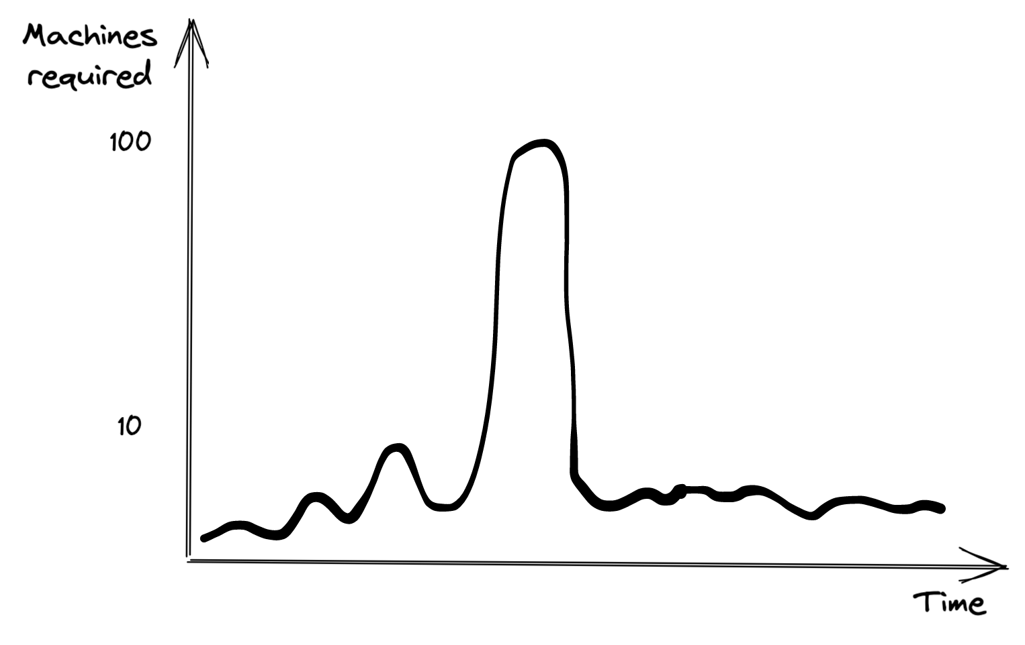
Benefits of cloud
Easy to get started
Appealing to variable-sized workloads
Private: would need 100 machines upfront, most will be idle most of the time
Cloud: pay for 100 machines only when needed

Slide 35
Benefits of cloud
Easy to get started
Appealing to variable-sized workloads
Private: would need 100 machines upfront, most will be idle most of the time
Cloud: pay for 100 machines only when needed
Autoscaling!

Slide 36
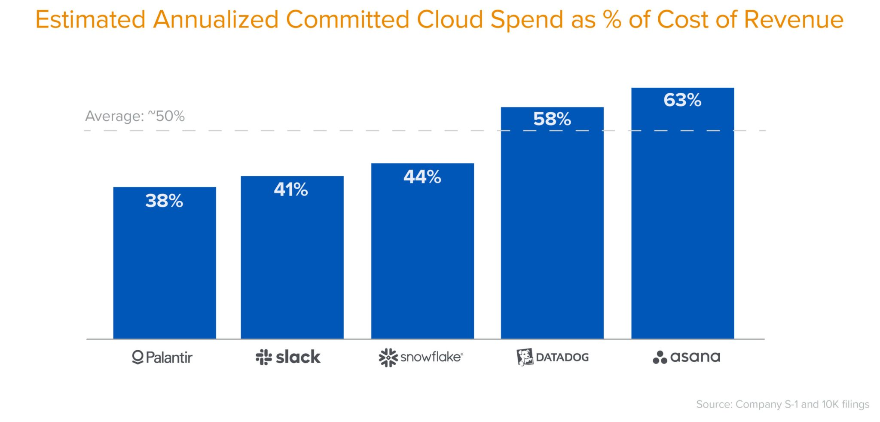
Drawbacks of cloud: cost
Cloud spending: ~50% cost of revenue
The Cost of Cloud, a Trillion Dollar Paradox | Andreessen Horowitz (2021)

Slide 37
Drawbacks of cloud: cost
“Across 50 of the top public software companies currently utilizing cloud infrastructure, an estimated $100B of market value is being lost … due to cloud impact on margins — relative to running the infrastructure themselves.”
The Cost of Cloud, a Trillion Dollar Paradox | Andreessen Horowitz (2021)

Slide 38
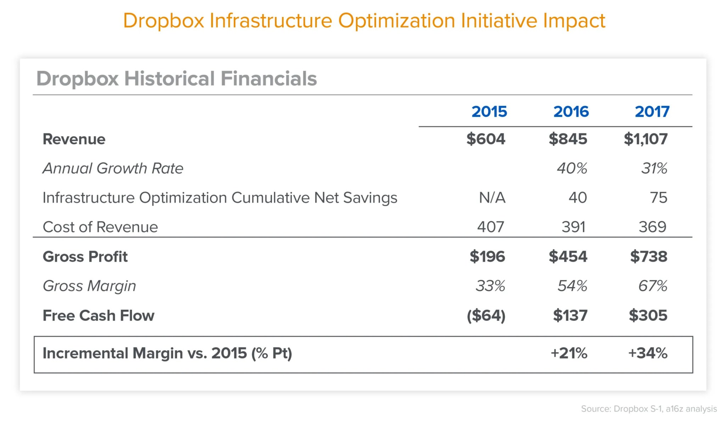
Cloud repatriation
Process of moving workloads from cloud to private data centers
A large chunk due to cloud repatriation

Slide 39
Multicloud strategy
To optimize cost
To avoid cloud vendor lock-in
“81% of respondents said they are working with two or more providers”
- Gartner (2019)

Slide 40
Development Environment

Slide 41
Development Environment
Text editors & notebooks
Where you write code, e.g. VSCode, Vim

Slide 42
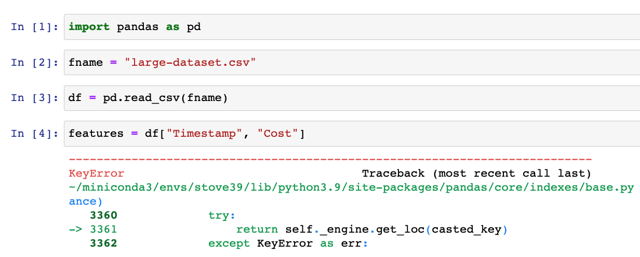
Development Environment
Notebook: Jupyter notebooks, Colab
Also works with arbitrary artifacts that aren’t code (e.g. images, plots, tabular data)
Stateful
Only need to run from the failed step instead from the beginning

Slide 43
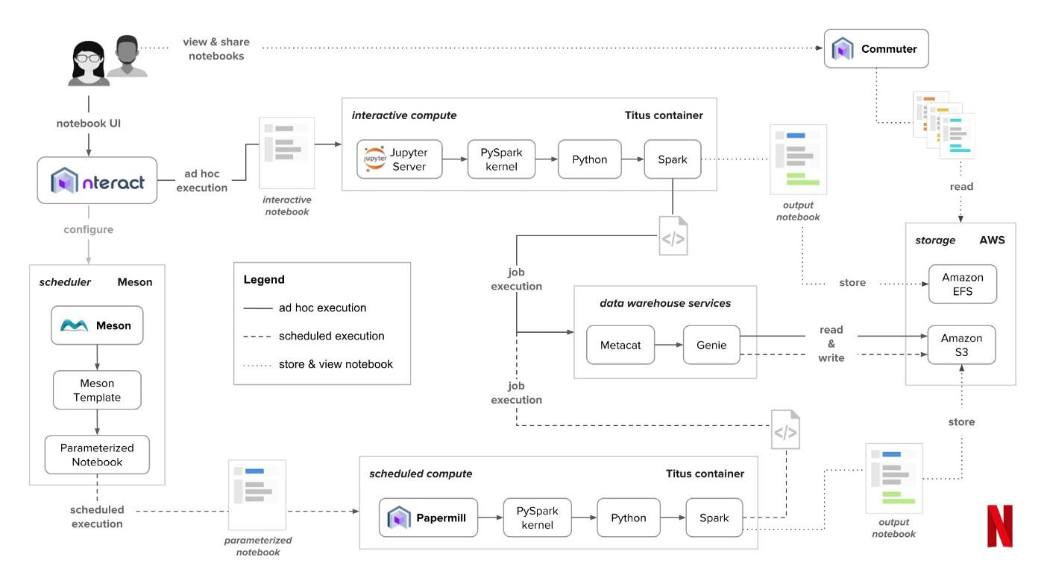
Development Environment
Notebook at Netflix

Slide 44
Development Environment
Text editors & notebooks
Versioning
Git: code versioning
DVC: data versioning
WandB: experiment versioning

Slide 45
Development Environment
Text editors & notebooks
Versioning
CI/CD test suite: test your code before pushing it to staging/prod

Slide 46
Dev env: underestimated
“if you have time to set up only one piece of infrastructure well, make it the development environment for data scientists.”
Ville Tuulos, Effective Data Science Infrastructure (2022)

Slide 47
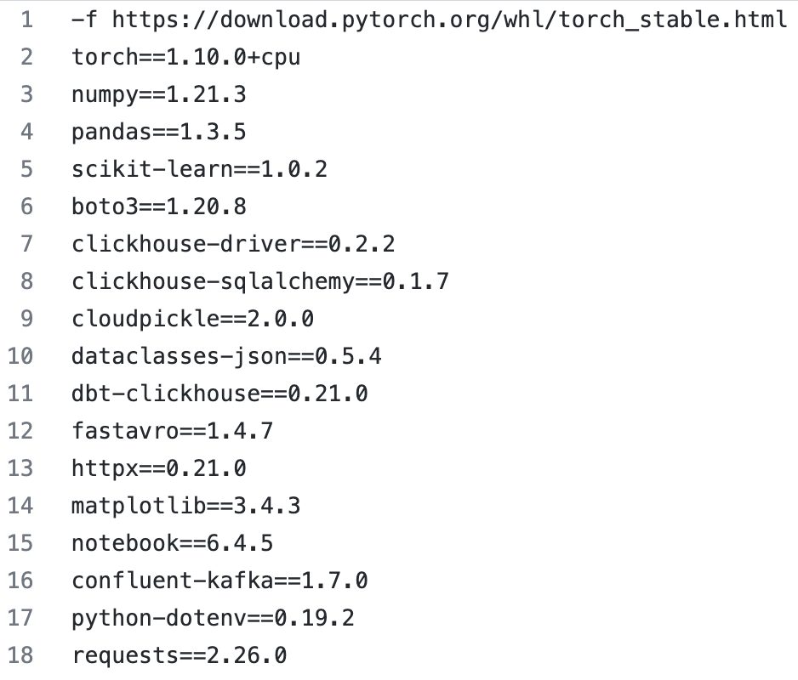
Standardize dev environments
Standardize dependencies with versions

Slide 48
Standardize dev environments
Standardize dependencies with versions
Standardize tools & versions

Slide 49
Standardize dev environments
Standardize dependencies with versions
Standardize tools & versions
Standardize hardware: cloud dev env
Simplify IT support
Security: revoke access if laptop is stolen
Bring your dev env closer to prod env
Make debugging easier

Slide 50
Dev to prod
Elastic compute: can stop/start instances at will
How to recreate the required environment in a new instance?

Slide 51
Container
Step-by-step instructions on how to recreate an environment in which your model can run:
install this package
download this pretrained model
set environment variables
navigate into a folder
etc.

Slide 52
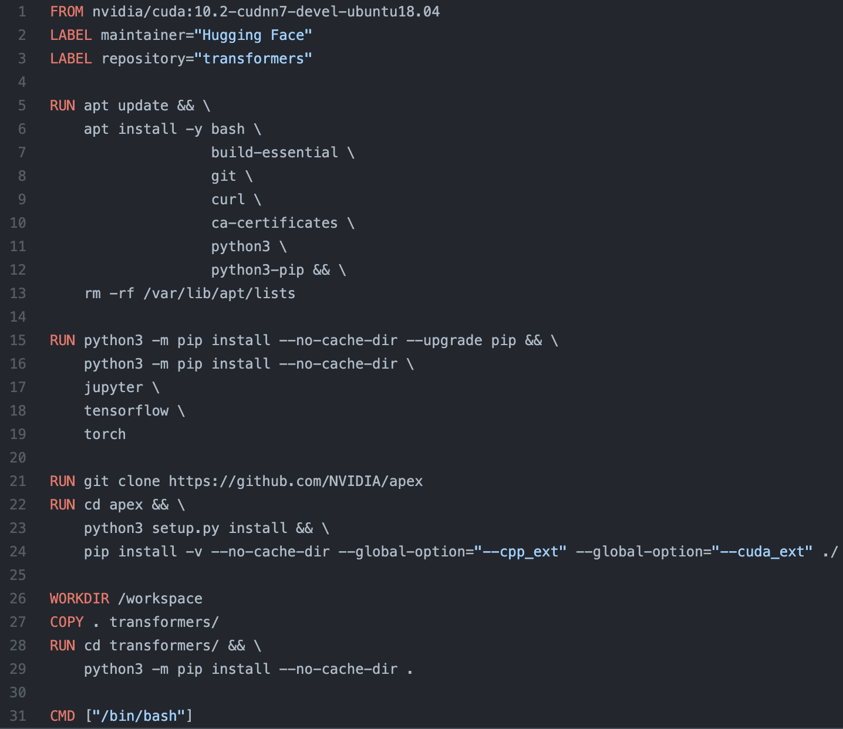
Transformers Dockerfile
CUDA/cuDNN
bash/git/python3
Jupyter notebook
TensorFlow/Pytorch
transformers

Slide 53
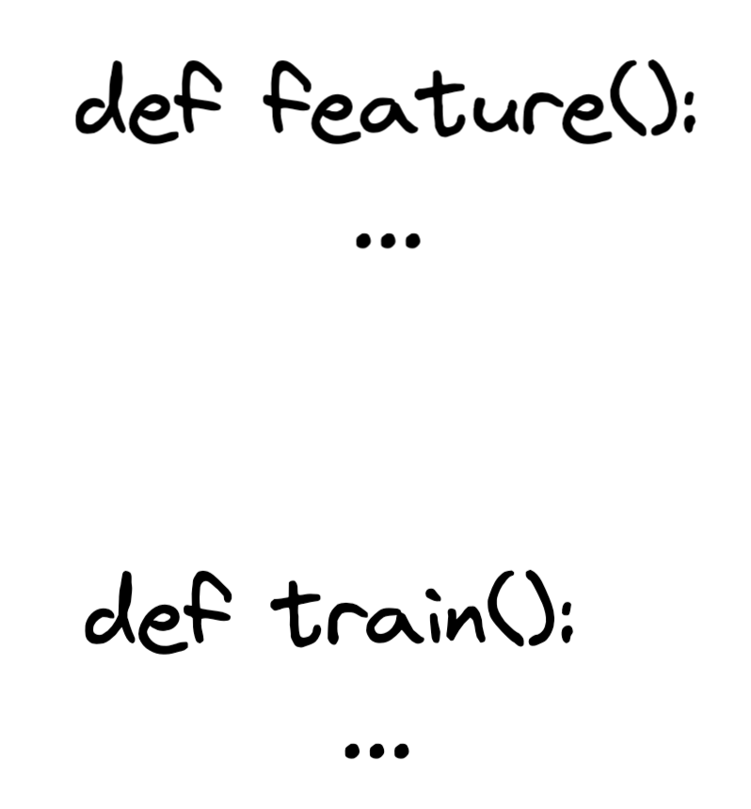
Multiple containers: dependency management
NumPy 1.21
Numpy 0.8

Slide 54
Multiple containers: cost saving
More memory
CPU ok
Less memory
Need GPU

Slide 55

Container orchestration
Help deploy and manage containerized applications to a serverless cluster
Spinning up/down containers
Notes:
K8s wasn’t created especially for ML. It works but can make life difficult for data scientists

Slide 56
Breakout exercise

Slide 57
Group of 4, 10 mins
What has been the most difficult parts of working on the project?
What else do you need to work on for the final demo?

Slide 58
Resource Management

Slide 59
Resource management
 | Pre-cloud | Cloud
Resources | Finite | Practically infinite
Implication | More resources for an app = less resources for other apps | More resources for an app don’t have to affect other apps
Goal | Utilization | Utilization + cost efficiency

Slide 60
Resource management
 | Pre-cloud | Cloud
Resources | Finite | Practically infinite
Implication | More resources for an app = less resources for other apps | More resources for an app don’t have to affect other apps
Goal | Utilization | Utilization + cost efficiency
Simplify the allocation challenge

Slide 61
Resource management
 | Pre-cloud | Cloud
Resources | Finite | Practically infinite
Implication | More resources for an app = less resources for other apps | More resources for an app don’t have to affect other apps
Goal | Utilization | Utilization + cost efficiency
OK to use more resources if help engineers to be more productive

Slide 62
ML workloads
Repetitive
Batch prediction
Periodical retraining
Periodical analytics
Dependencies
E.g. train depends on featurize

Slide 63
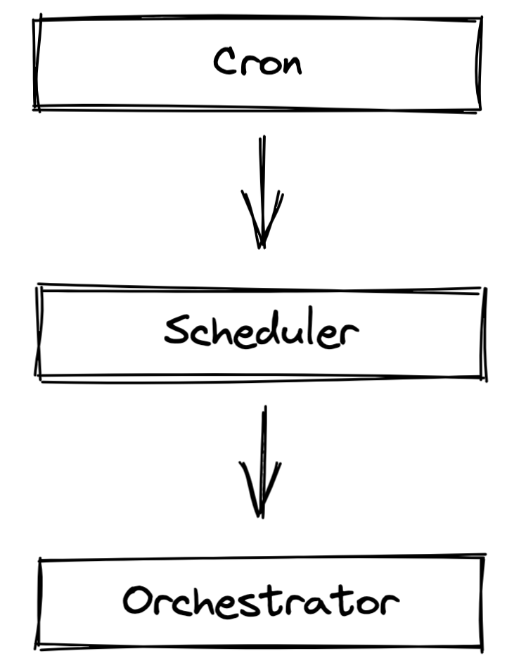
ML workloads
Repetitive
Batch prediction
Periodical retraining
Periodical analytics
Dependencies
E.g. train depends on featurize

Slide 64
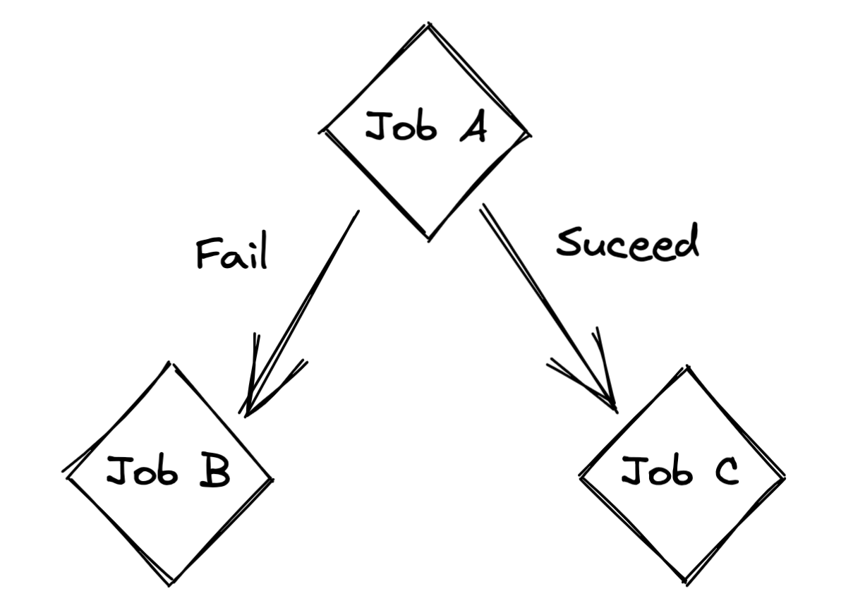
Cron: extremely simple
Schedule jobs to run at fixed time intervals
Report the results

Slide 65
Cron: extremely simple
Schedule jobs to run at fixed time intervals
Report the results
Cron can’t handle this

Slide 66
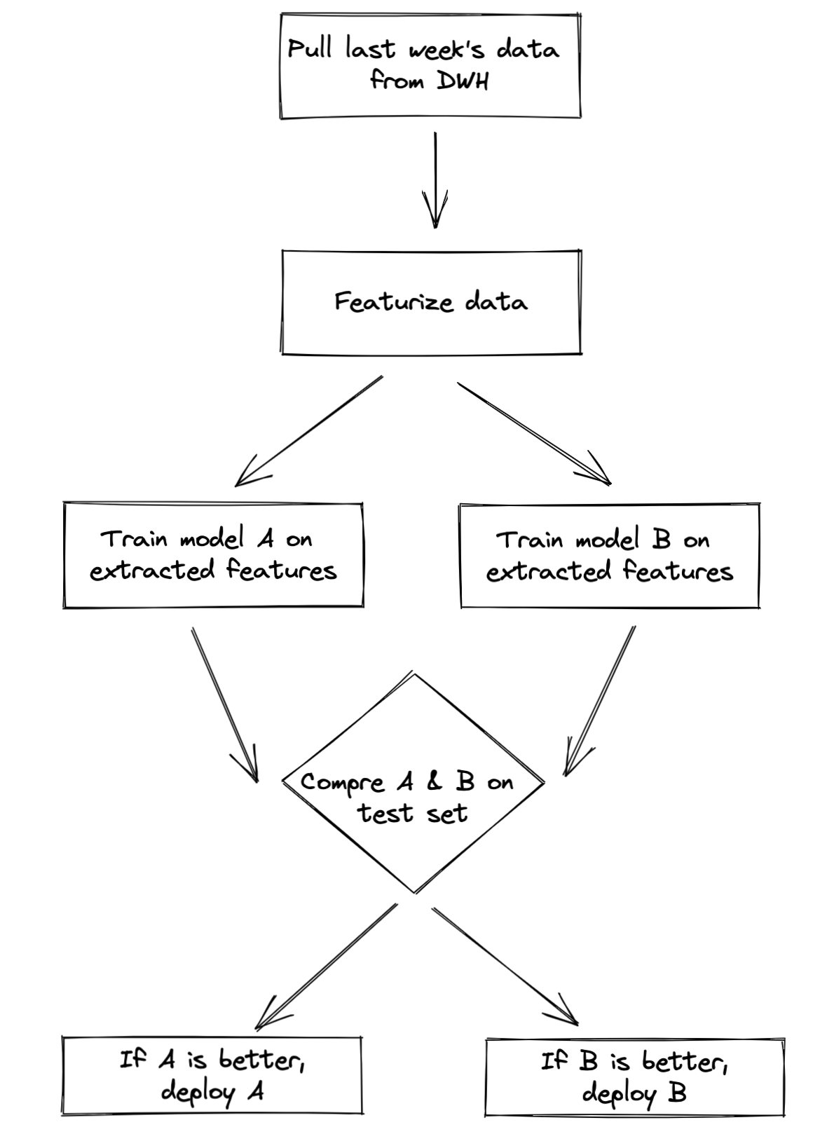
Scheduler
Schedulers are cron programs that can handle dependencies

Slide 67
Scheduler
Most schedulers require you to specify your workloads as DAGs
This is a DAG
Directed
Acyclic
Graph

Slide 68
Scheduler
Can handle event-based & time based triggers
Run job A whenever X happens
If a job fails, specify how many times to retry before giving up
Jobs can be queued, prioritized, and allocated resources
If a job requires 8GB of memory and 2 CPUs, scheduler needs to find an instance with 8GB of memory and 2 CPUs

Slide 69
Scheduler: SLURM example
#!/bin/bash
#SBATCH -J JobName
#SBATCH --time=11:00:00 # When to start the job
#SBATCH --mem-per-cpu=4096 # Memory, in MB, to be allocated per CPU
#SBATCH --cpus-per-task=4 # Number of cores per task

Slide 70
Scheduler: optimize utilization
Schedulers aware of:
resources available
resources needed for each job
Sophisticated schedulers (e.g. Google Borg) can reclaim unused resources
If I estimate that my job needs 8GB and it only uses 4GB, reclaim 4GB for other jobs

Slide 71
Scheduler challenge
General purpose schedulers are extremely hard to design
Need to handle any workload with any number of concurrent machines
If scheduler is down, every workflow this scheduler touches will also be down

Slide 72
Scheduler to Orchestrator
Scheduler: when to run jobs
Orchestrator: where to run jobs

Slide 73
Scheduler to Orchestrator
Scheduler: when to run jobs
Handle jobs, queues, user-level quotas, etc.
Orchestrator: where to run jobs
Handle containers, instances, clusters, replication, etc.
Provision: allocate more instances to the instance pool as needed

Slide 74
Scheduler to Orchestrator
Scheduler: when to run jobs
Handle jobs, queues, user-level quotas, etc.
Typically used for periodical jobs like batch jobs
Orchestrator: where to run jobs
Handle containers, instances, clusters, replication, etc.
Provision: allocate more instances to the instance pool as needed
Typically used for long-running jobs like services

Slide 75
Scheduler & orchestrator
Schedulers usually have some orchestrating capacity and vice versa
Schedulers like SLURM and Google’s Borg have some orchestrating capacity
Orchestrators like HashiCorp Nomad and K8s come with some scheduling capacity
Often, schedulers are run on top of orchestrators
Run Spark’s job scheduler on top of K8s
Run AWS Batch scheduler on top of EKS

Slide 76
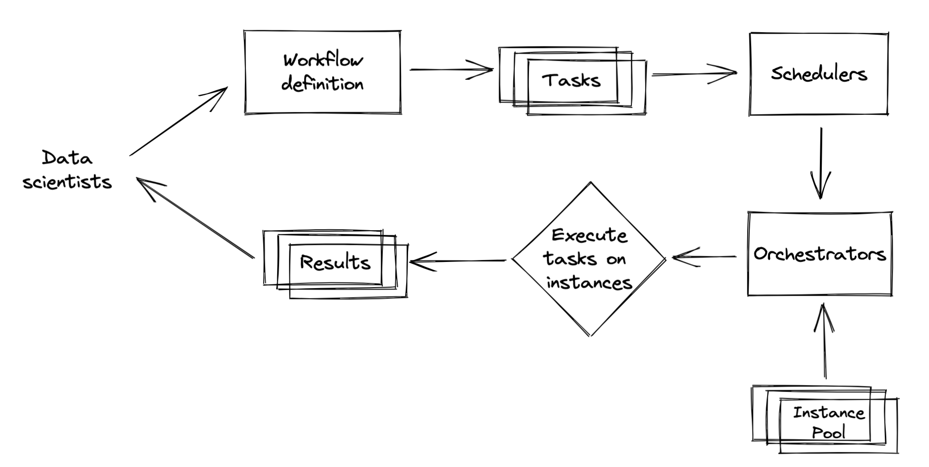
Data science workflow management

Slide 77
Data science workflow
Can be defined using:
Code (Python)
Configuration files (YAML)
Examples: Airflow, Argo, KubeFlow, Metaflow

Slide 78
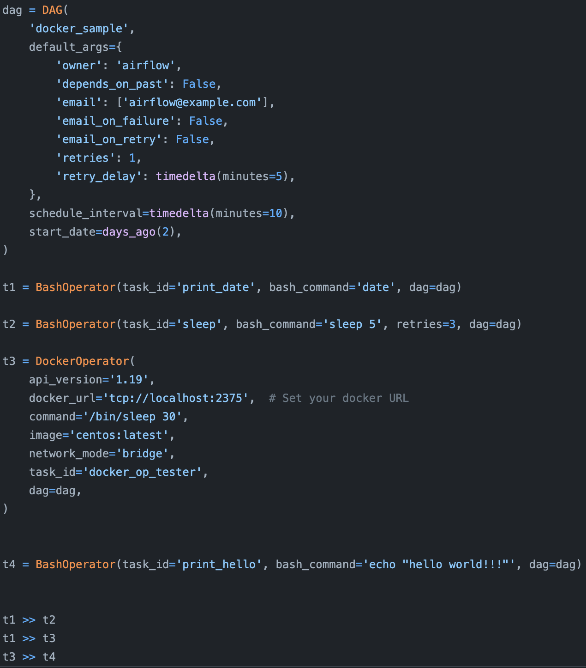
Airflow
1st gen data science workflow management
Champion of “configuration-as-code”
Wide range of operators to expand capabilities

Slide 79
Airflow: cons
Monolithic
The entire workflow as a container
Non-parameterized
E.g. need to define another workflow if you want to change learning rate
Static DAG
Can’t handle workloads with unknown number of records

Slide 80
Argo: next gen
Created to address Airflow’s problems
Containerized
Fully parameterized
Dynamic DAG

Slide 81
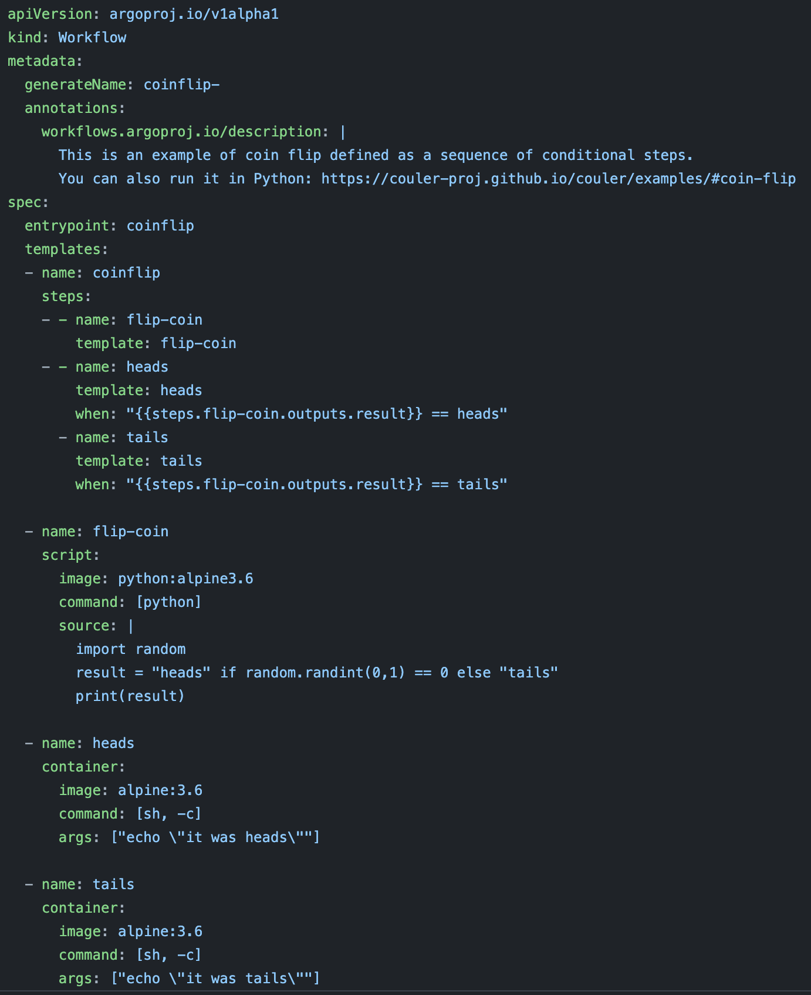
Argo: cons
YAML-based configs
Can get very messy
Only run on K8s clusters
Can’t easily test in dev environment

Slide 82
Kubeflow & Metaflow: same code in dev & prod
Allows data scientists to use the same code in both dev and prod environments

Slide 83
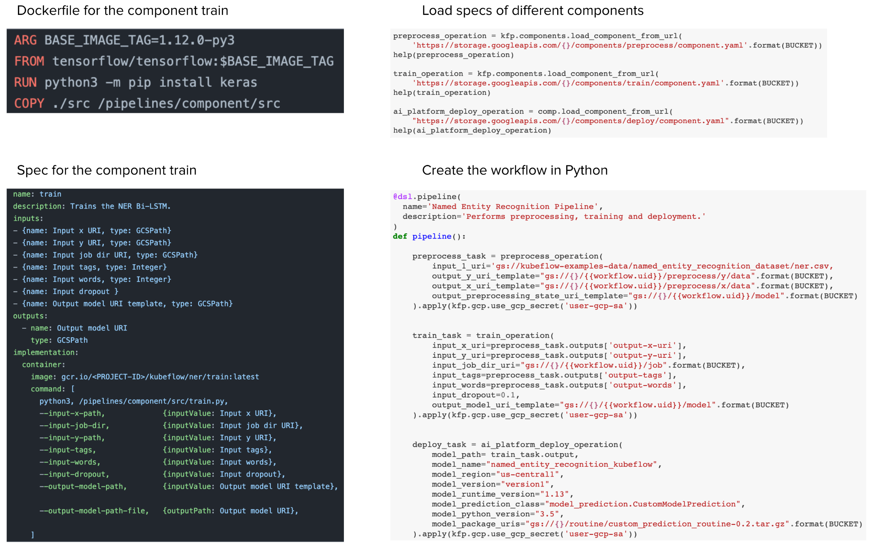
Kubeflow: more mature but more boilerplate

Slide 84
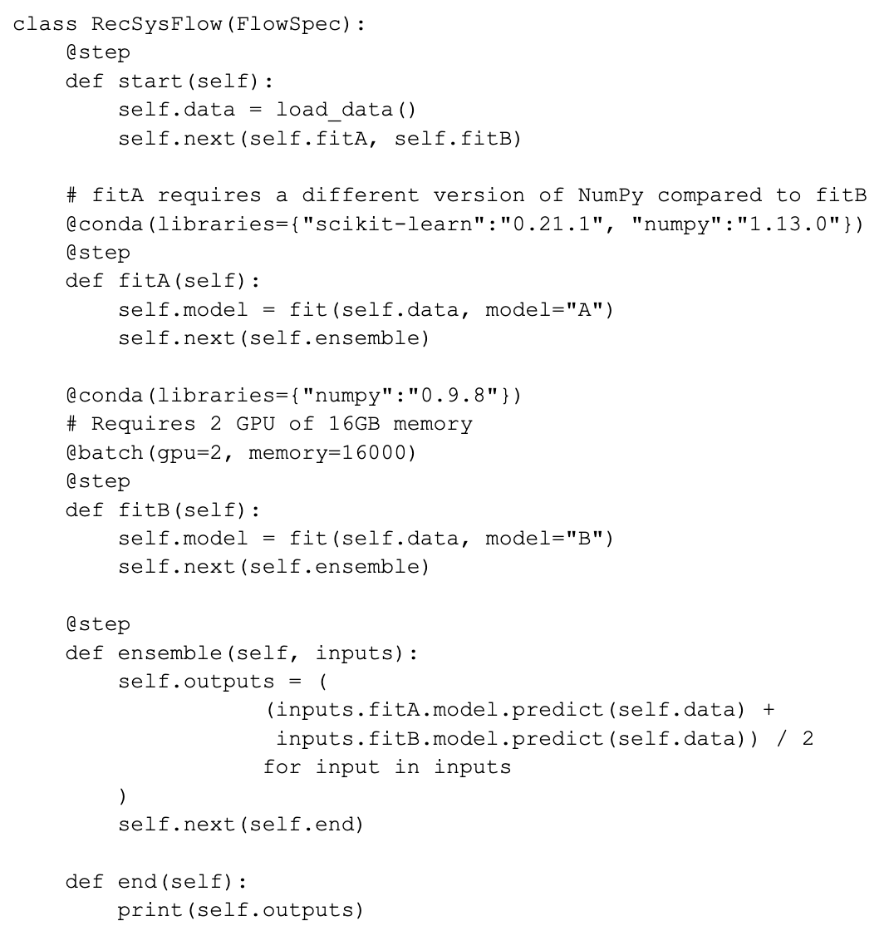
Metaflow: less mature but cleaner API
Run note code in cloud with a line of code (@batch)
Run experiments locally
Once ready, run code on AWS Batch
Can run different steps of the same workflow in different envs

Slide 85
ML Platform

Slide 86
Model platform: story time
Anna started working on recsys at company X
To deploy recsys, Anna’s team need to build tool like model deployment, model store, feature store, etc.
Other teams at X started deploying models and needed to build the same tools
X decided to have a centralized platform to serve multiple ML use cases
ML Platform

Slide 87
ML platform: key components
Model deployment
Model store
Feature store

Slide 88
Deployment: online | batch prediction
See Lecture 8
Deployment service:
Package your model & dependencies
Push the package to production
Expose an endpoint for prediction

Slide 89
Deployment: online | batch prediction
Deployment service:
Package your model & dependencies
Push the package to production
Expose an endpoint for prediction
The most common MLOps tool
Cloud providers: SageMaker (AWS), Vertex AI (GCP), AzureML (Azure), etc.
Independent: MLflow Models, Seldon, Cortex, Ray Serve, etc.

Slide 90
Deployment: online | batch prediction
Deployment service:
Package your model & dependencies
Push the package to production
Expose an endpoint for prediction
The most common MLOps tool
Not all can do batch + online prediction well
e.g. some companies use Seldon for online prediction, but Databricks for batch

Slide 91
Deployment service: model quality challenge
How to ensure a model’s quality pre- and during deployment?
Traditional code: CI/CD, PR review
ML: ???, ???

Slide 92
Model store
Simplest form: store all models in blob storage like S3
Problem:
When something happens, how to figure out:
Who/which team is responsible for this model?
If the correct model binary was deployed?
If the features used are correct?
If the code is up-to-date?
If something happened with the data pipeline?

Slide 93
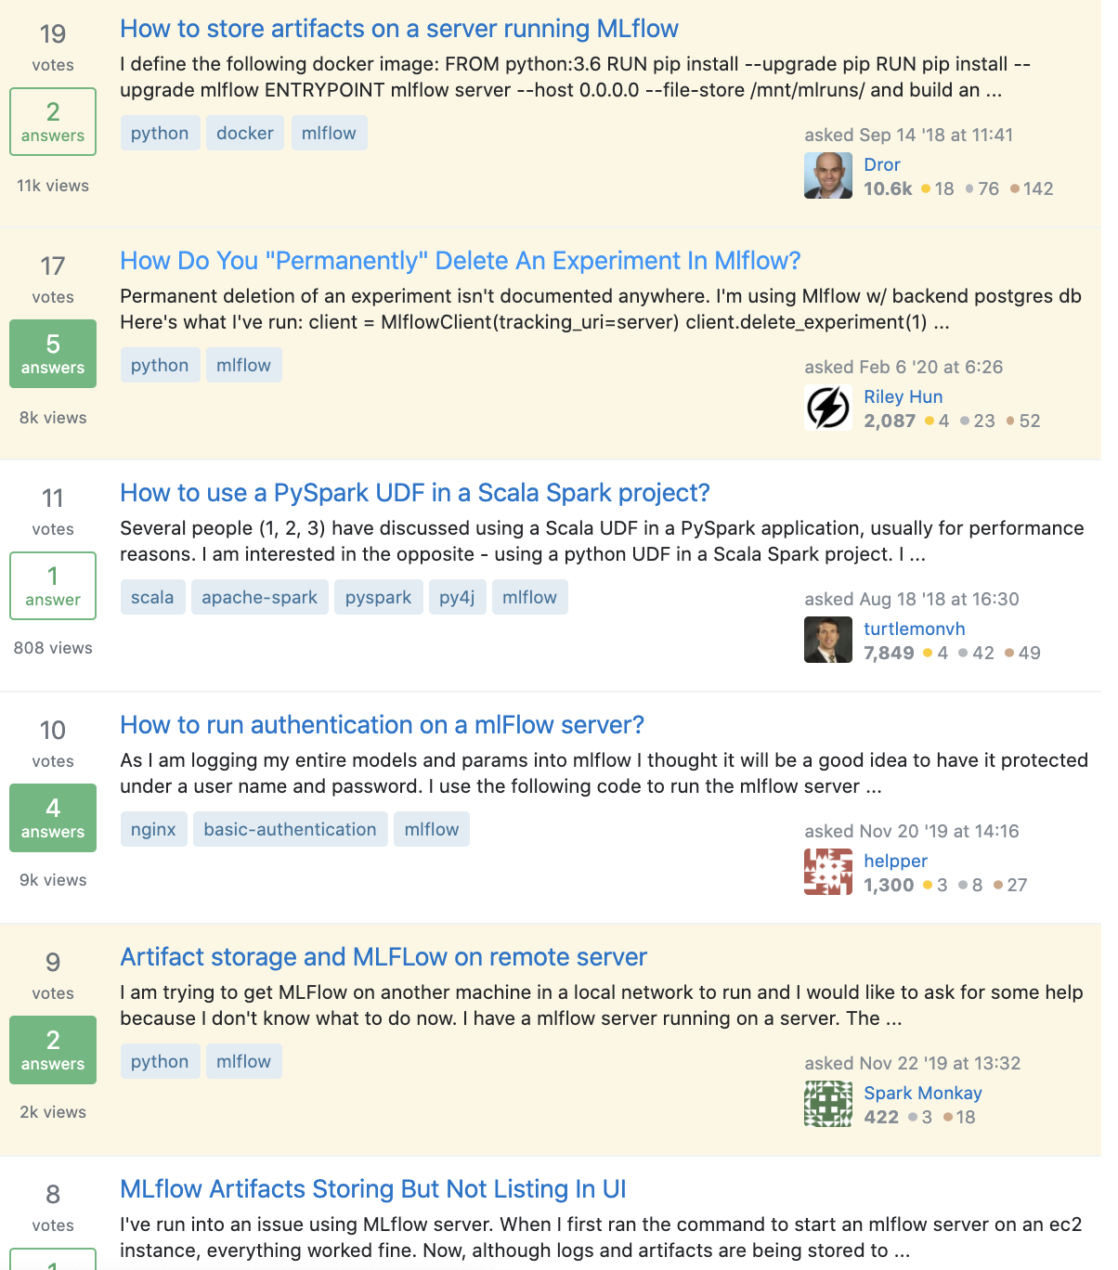
Model store: artifact tracking
Track all metadata necessary to debug a model later
Severely underestimated

Slide 94
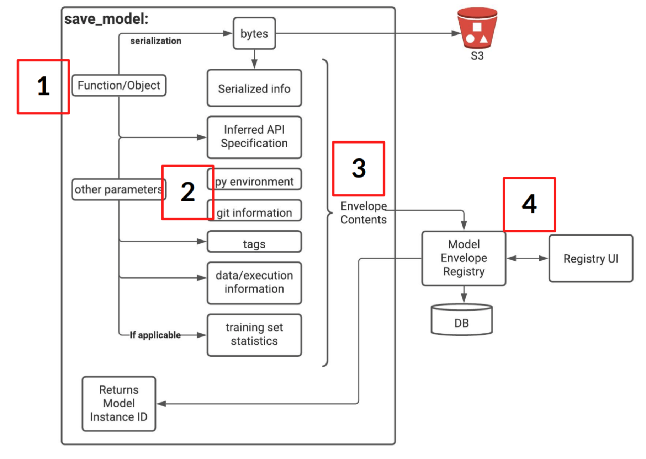
Model store: artifact tracking at Stitch Fix

Slide 95
Feature store: key challenges
Feature management
Multiple models might share features, e.g. churn prediction & conversion prediction
How to allow different teams to find & use high-value features discovered by other teams?

Slide 96
Feature store: key challenges
Feature management
Feature consistency
During training, features might be written in Python
During deployment, features might be written in Java
How to ensure consistency between different feature pipelines?

Slide 97
Feature store: key challenges
Feature management
Feature consistency
Feature computation
It might be expensive to compute the same feature multiple times for different models
How to store computed features so that other models can use?

Slide 98
Feature store: key challenges
Feature management
Feature consistency
Feature computation
Feature catalog
Data warehouse

Slide 99
Other ML platform components
Monitoring (ML & ops metrics)
Experimentation platform
Measurement (business metrics)

Slide 100
Evaluate MLOps tools
Does it work with your cloud provider?
Open-source or managed service?
Data security requirements

Slide 101
Machine Learning Systems Design
Next class: Final project workshops

