Slide 1
Accidents database analysis facts and curiosities
teamwork József Orbán, Brigi Szabó, Gyula Aranyos
JDS Academy – 2020, database analysis project

Slide 2
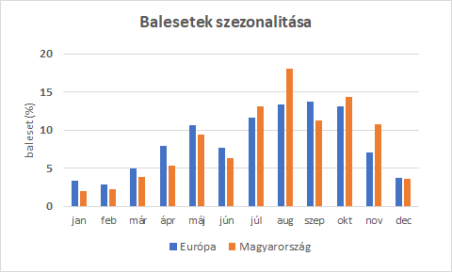
Seasonality of accidents
Seasonality
40% of accidents occurred between August and the end of October, compared with only 10% between December and February. In terms of accident seasonality in our country, August is the month with the highest accident number probably due to summer holidays traffic.
relative accident counts (%)
EU
HUN
Friday 13th! Fun facts
Crashers on Friday 13 caused 123% more average damage than non-Friday 13 crashers. If the 0-items are removed, Friday 13 accidents still cause more average damage, but the difference is only 50%. 4.7% of accidents on Friday 13th were costly, compared to average 3.1% on other days. Let's be even more careful on the roads on Friday the 13th than usual! ☺ (Note: There are 13 costly accidents on Friday 13th in the database...)
Thursday, the most dangerous day of the week!
Thursday is the day with the highest accident rate, with 16.4% of accidents occurring on Thursday. Slightly difference compared to Tuesday and Wednesday, which have similar accident rates ~16%. Almost half (48.2%) of accidents occur between Tuesday and Thursday. It is possible that there are fewer drivers on the roads at the weekend than on weekdays as there is no work related traffic, and perhaps drivers are more relaxed.

Slide 3
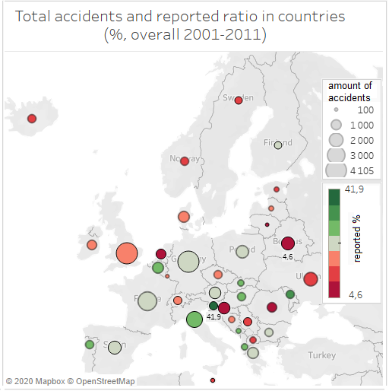
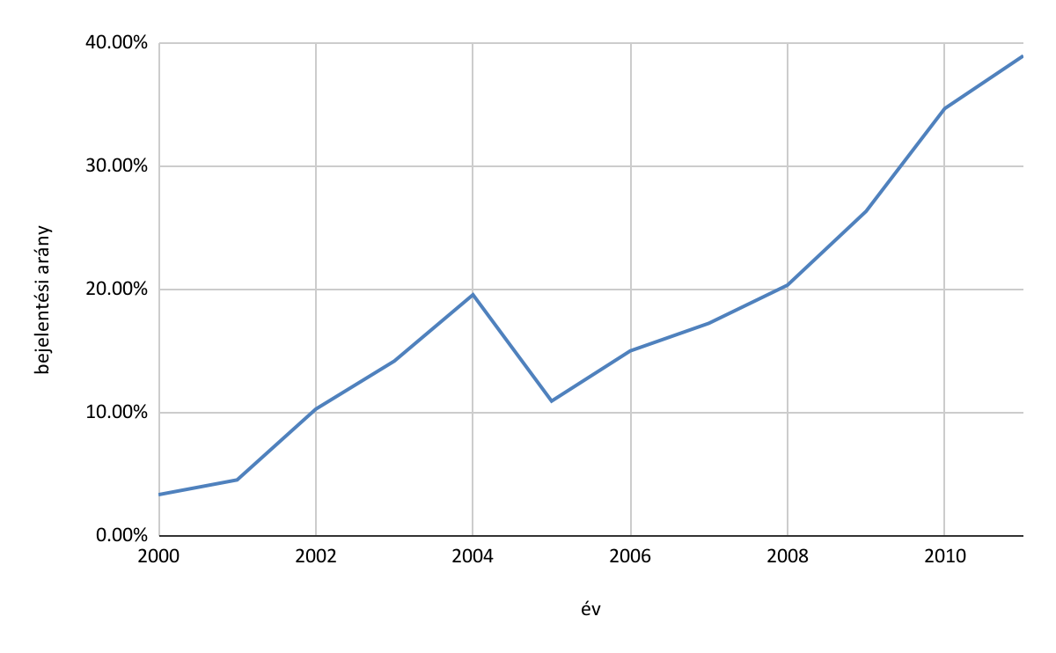
The most diligent accident reporters
are Slovenians, with a 42% reporting rate. They are followed by Moldova with 33% and Italy with 31%. Belarus is the last, reporting less than 5% of accidents. Netherlands is ahead of them with 6% and Croatia with 9.2%. The Hungarians are among the more diligent reporters, reporting 29% of cases, ranking 5th in the reporting list including 38 countries (in the dataset).
There are 38 countries in the database. The top 7 countries with the number of cases (DE, UK, FR, IT, UA, BY, DK) account for 41% of all cases.
Accidents with costs are reported in a higher proportion.
Only 19% of all accidents were reported, on the other hand, if the zero-euro damage values ​​are filtered out, the reporting rate becomes 30%.
The willingness to report increased year by year, although there was a slight decline in 2005.
increasing reporting ratio
accident reporting ratio (%)
year

Slide 4
Car brands
The database contains 24 car brands. Volkswagen, Renault and Ford cars dominate the dataset, accounting for 59% of the database.
The causes of the 'expensive accidents'
Surprisingly, the highest average damage value was produced by Opels (looking at accidents with a non-zero value), followed by Lada and Fiat (the average damage value for all three is over EUR 2,000). Volvo car caused non-zero damage only once - although there are only 27 Volvo cases in the entire table - and it costed only 2 euros. BMWs are the other leading drivers, with their average damage value of only EUR 140.
Electric or traditional car?
The proportion of electric cars in the database is only 1.25%. (2001-2011!)
We can observe that gasoline+diesel cars caused the accidents with a higher average cost if we only take the accidents with a cost greater than 0. However, if all accidents are taken into account, the average cost of electric cars is higher. This is due to the fact that 13.4% of electric cars caused accidents with a cost greater than 0, while only 3% of gasoline + diesel cars caused accidents with conventional fuel - if the cost is not 0, then - it is much higher, as in the case of electric cars.

