Slide 1
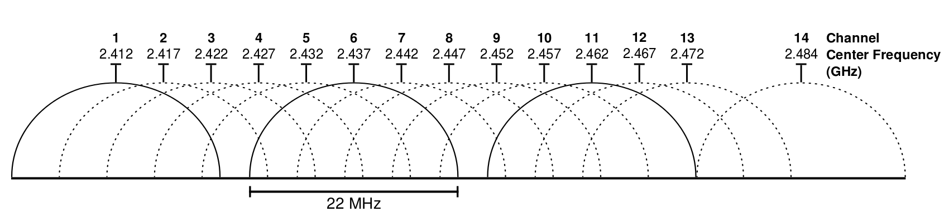
802.11
IEEE 802.11 is a set of media access control (MAC) and physical layer (PHY) specifications for implementing wireless local area network (WLAN) computer communication in the 900 MHz and 2.4, 3.6, 5, and 60 GHz frequency bands.
Datagrams are called frames. The standards specify frame types for use in transmission of data as well as management and control of wireless links.
Frames are divided into very specific and standardized sections. Each frame consists of a MAC header(s), frame check sequence (FCS). and optional payload.

Slide 2
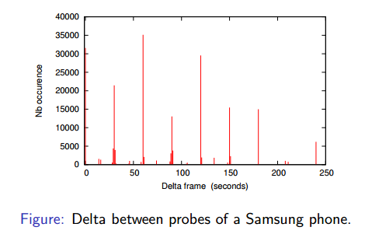
Passive Tracking
All devices connected to a Wifi Network are sending or receiving frames.
Mobile devices NOT connected to a Wifi network are also sending PROBE frames (active scanning to save battery).
Even if payload data is encrypted, frame
header information can be read by anyone
listening. This header may contains some
information: MAC addresses, signal strength,
timestamp, preferred SSID network,…
Let’s build a device that “sniffs” and stores the sniffed data. By correlating timestamps and signal strength values for a MAC address is possible to get an idea of the device position.

Slide 3
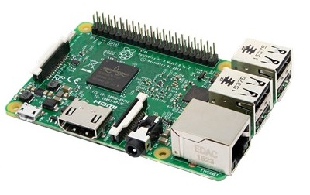
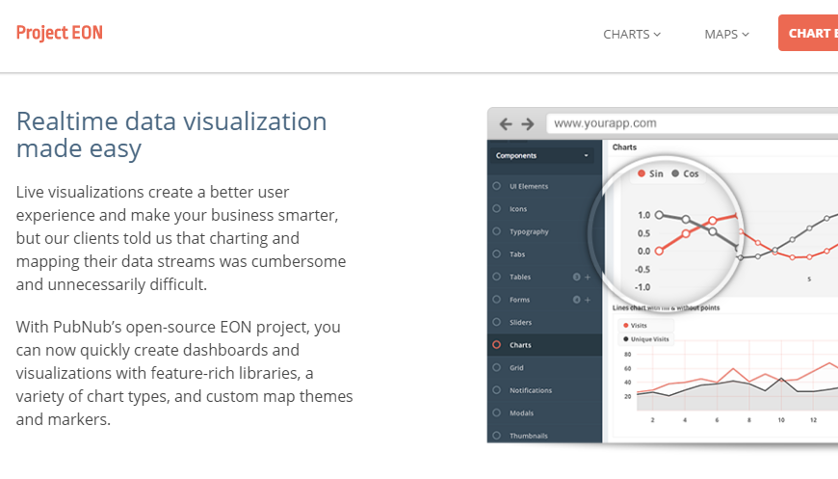
Implementation
Hardware:
Raspberri PI (30€)
Wifi Dongle (6€)
Software:
O.S. Raspbian
www.aircrack-ng.org, to create a “monitor” interface
Own tracking library (in C) which captures frames and stores its data. It includes a custom build of libpnp statically linked.
Http server (in GO) that hosts the tracking library and publishes is data in JSON
HTML+CSS+JavaScript application
Building:
Gcc compiler + toolchain
Go compiler + Go tools
TODO:
Integrate with Project EON
IoT !!!!

Slide 4
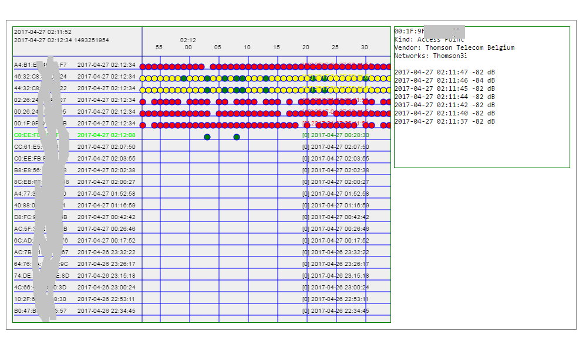
Prototype
Don´t look at this slide…check the real thing

Slide 5
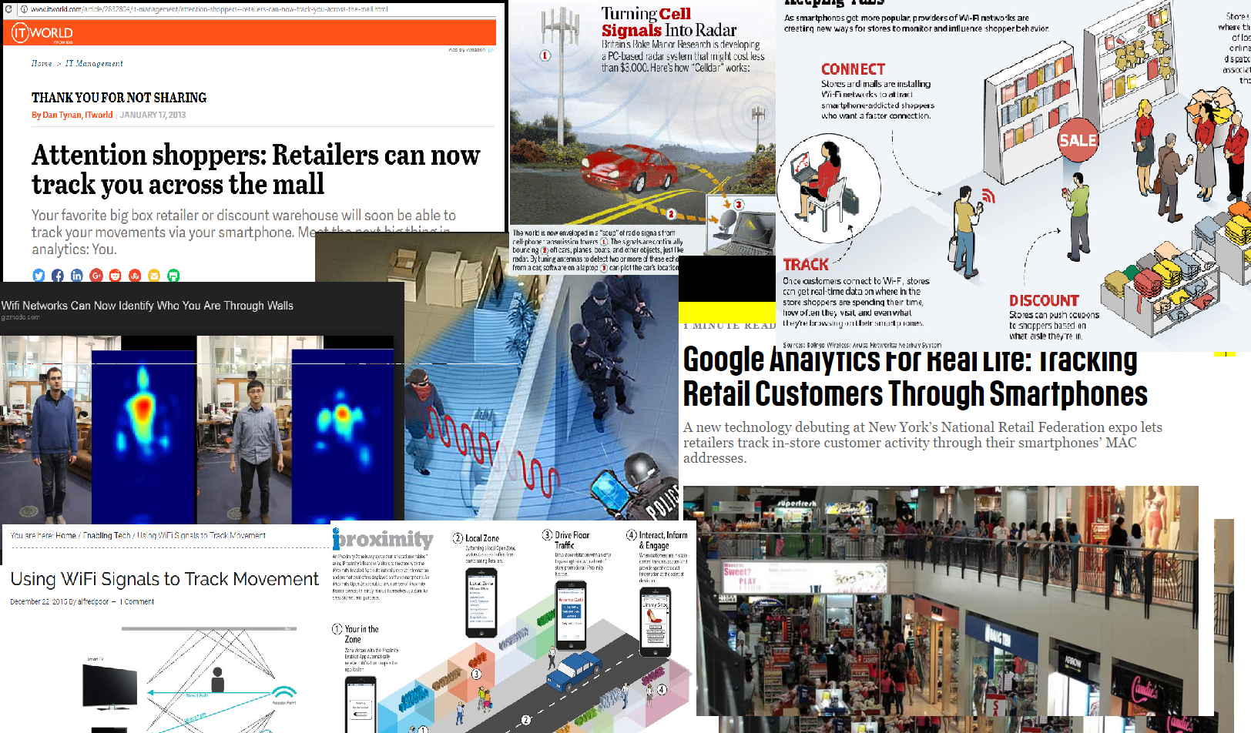
Applications

Slide 6
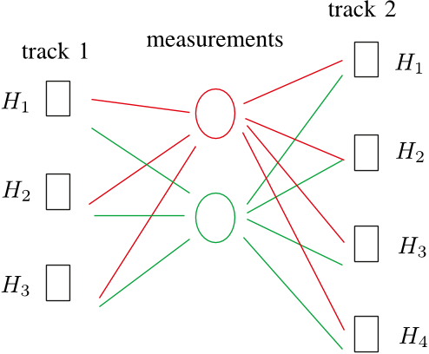
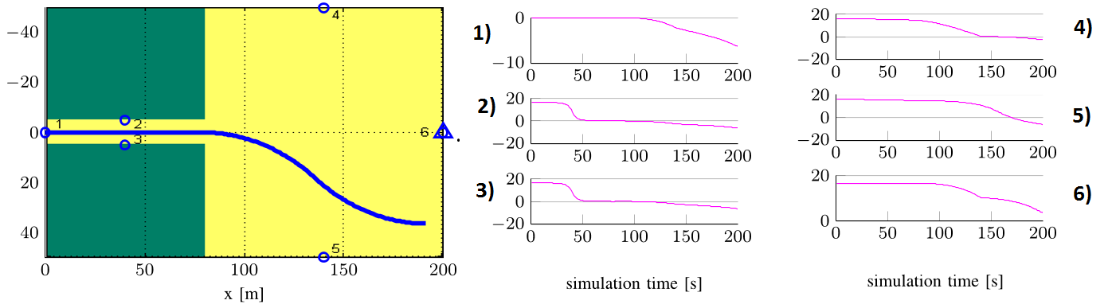
Extensions (1)
A single device can provide proximity detection
With more than one device, in principle,
it is possible to “triangularize”: position detection
Position detection extended in time results in motion detection

Slide 7
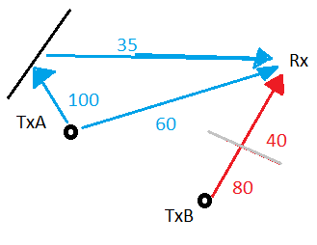
Extensions (2)
These “cools” results are only valid in “open spaces” (large malls, football fields,…)
In “in-doors” scenarios walls may “increase” a signal strength (because of bouncing) or “decrease” it (because of filtering when passing through)

Slide 8
Extensions (3)
One solution for tracking position “in-doors” is to generate a “fingerprint” map of the area to cover. Later on when actual values for a device are available the system has to look for a matching pattern in the fingerprint map.
This task is very well suited for recognition techniques (Neural Networks , Machine Learning,…). Some systems (www.internalpositioning.com, github.com/schollz/find) claim geolocation precision below 10 sq. Feet.

Slide 9
Extensions (4)
On the cutting edge (jan 2017) the Fresnel zone model, claims centimeter scale human activity sensing (doi.ieeecomputersociety.org/10.1109/MC.2017.7 , www.youtube.com/watch?v=R_vR6O8706g). This would open the door to new possibilities: detect walking or respiration.

Slide 10
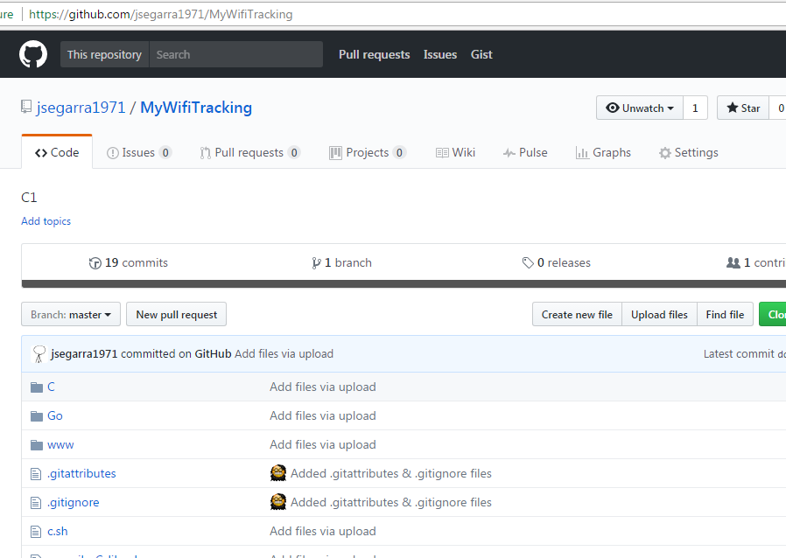
Source code
Check https://github.com/jsegarra1971/MyWifiTracking

