Slide 1
AI - Privacy and data
Joseph Hayes
Onur Celebi
Liam Salazar-Endara
Faisal Hamdan

Slide 2
Overview
What is data?
Introduction of the cyberspace
How data can be compromised
How AI can prevent cyber attacks with the use of blockchain
The applications and advantages of AI in cybersecurity
Limitations of AI in cybersecurity

Slide 3
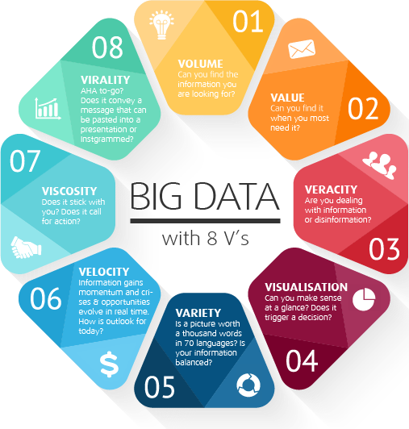
Understanding the Nature of Data
Figure 1 displays the 8 V’s of Big Data (blockchainjournal.news, 2019)
What is Data?
Data has become such a vital component that it helps maintain the stability of the CNI of a given economy.
Data can become Big Data when it is drawn from multiple sources..
Data platforms can be described as a means to bring data from a decentralized state to a centralized state.
Cloud computing is where data can be stored and accessed over the internet of one’s computer storage media

Slide 4

Into the Cyberspace
A figurative environment where computers are able to communicate via an interdependent network such as the internet
According to Martin C. Libicki, cyberspace is comprised of 3 layers: Physical, Syntactic and Semantic.
Figure 2 displays a visual interpretation of cyberspace (icrc.org, 2020)
Understanding cyberspace is key to understanding the principles of cybersecurity

Slide 5
Privacy can be compromised
How is data used?
Data is used by companies to create “consumer profiling”
Recently privacy has been a significant aspect of people’s lives and companies collect and store collected data to find out more information about the user to then use that information against them (Mazurek et al., 2019)

Slide 6
Cyberattacks and How AI with blockchain can prevent it
Cyber attacks mainly occur due to a loss of data from a TTP
Once a loss of data occurs many ransomware and phishing attacks occurs
AI’s prevention of cyberattacks: - The use of “blockchain” - which is composed of 3 parts
Data
Hash
If one block is tampered the following blocks become tampered and invalid
AI will be necessary as there needs to be strict access protocol and secured data analysis so no data can be selective.
Hash of previous block

Slide 7
A purpose of AI in cyber security
There are regular cyber attacks with the objectives of industrial sabotage and data theft
Trying to keep a secure trustworthy environment plays a major key task and that is where AI should be considered.
Through deployment of AI algorithms, problems related to tremendous amount of information that are not possible to asses with limited resources can be assessed with limited resources

Slide 8
Advantages of AI techniques in Cyber Security
Two main applications of AI in cyber security are identification and authentication.
Detection of malicious software using 2 methods: machine learning and classification techniques.
AI algorithm in cybersecurity is used to create prediction, plan preventions and take actions

Slide 9
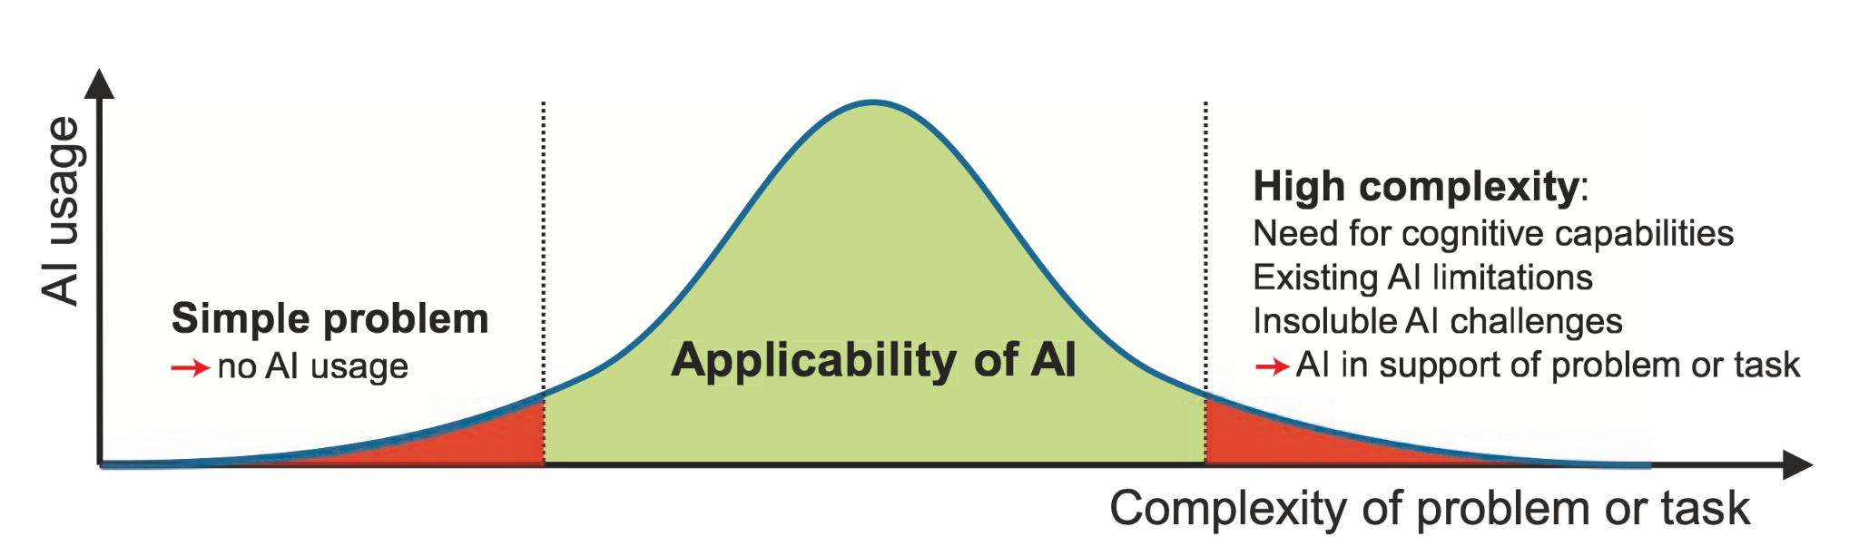
Limitations
AI can be applied to many areas; however, there are some instances where AI is not as effective as the human brain. Unique features of the human brain are needed in some cases such as innovation and interpretation of decisions.
Figure 13-1, Deploying AI in Enterprise

Slide 10
Limitations of AI in cybersecurity
Use of AI in too simple or too complex systems
Obtaining enough and correct data for learning operation
Costly and time consuming learning process
Insoluble challenges may cause not to use AI
Explainability of decisions

Slide 11
Summary
Companies should control what data is being used for AI and what this can lead to (Future prospects)
There are many applications of AI however, there are cases where there are limitations to AI which can be solved in the future which could lead to what
We are for the progression of AI in terms of privacy and data

Slide 12
References
Benzid, I. et al. (2019) “The Application of Artificial Intelligence for Cybersecurity in Industry 4.0.” doi: 10.18420/inf2019_ws29.
Hechler, E., Oberhofer, M. and Schaeck, T. (2020). Deploying AI in Enterprise. [Online]. Available at: https://link-springer-com.manchester.idm.oclc.org/content/pdf/10.1007%2F978-1-4842-6206-1.pdf
Jahankhani, H., Kendzierskyj, S., Chelvachandran, N. and Ibarra, J. (2020). Cyber Defence in the Age of AI, Smart Societies and Augmented Humanity. Cham: Springer. [Online]. Available at: http://link.springer.com/10.1007/978-3-030-35746-7 (Accessed: 5 December 2021).
Mazurek, Grzegorz, and Karolina Małagocka. “Perception of Privacy and Data Protection in the Context of the Development of Artificial Intelligence.” Journal of management analytics 6.4 (2019): 344–364. Web. [Online] Available at: https://www.tandfonline.com/doi/abs/10.1080/23270012.2019.1671243 (Accessed: 5th December 2021)

