Slide 1
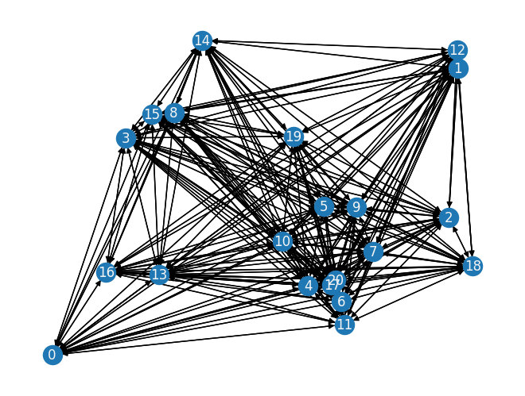


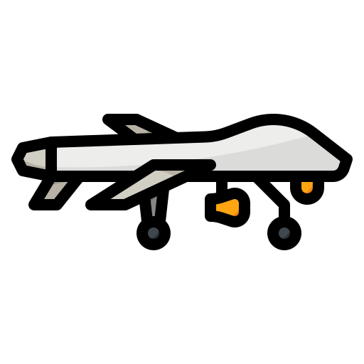

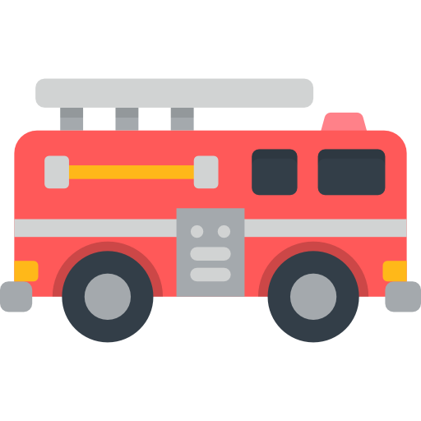
Enhancing Wildfire Detection Through MAVs and Agent-Based Simulation
I₁
I₃
I₆
Intensity per node
I₁ : 250
I₂ : 350
I₃ : 400
I₄ : 150
Capacities
I₂
I₄
I₅ : 150
I₆ : 150
80
5
I₅
1
10

