Slide 1
Packing Process
Enquiry
Survey
(To update in Sales SMS)
Need Assessment
Material consumption
Quotation
Job Measurement
Job weight
Packing Type
Job Type
Pine wood
Country wood
Rubber wood
Ply wood
Foam sheet
Bubble sheet
Vci
Nails
Screw
Aluminium foil
Customer Requirement
Consumption
Labour
Transport
Margin 30%
Fabrication
Bill of material
PO Approval
Customer Negotiation
Finance Approval
Rework
In-house Packing
Trading
Documentation
Customers Acknowledgement
Close
Consumption Report
Inspection Report
Invoicing
E-way bill
Gate pass
Packing at Onsite

Slide 2
Height
6
8 Inch
Length
10 Ft
Width
6 Inch

Slide 3
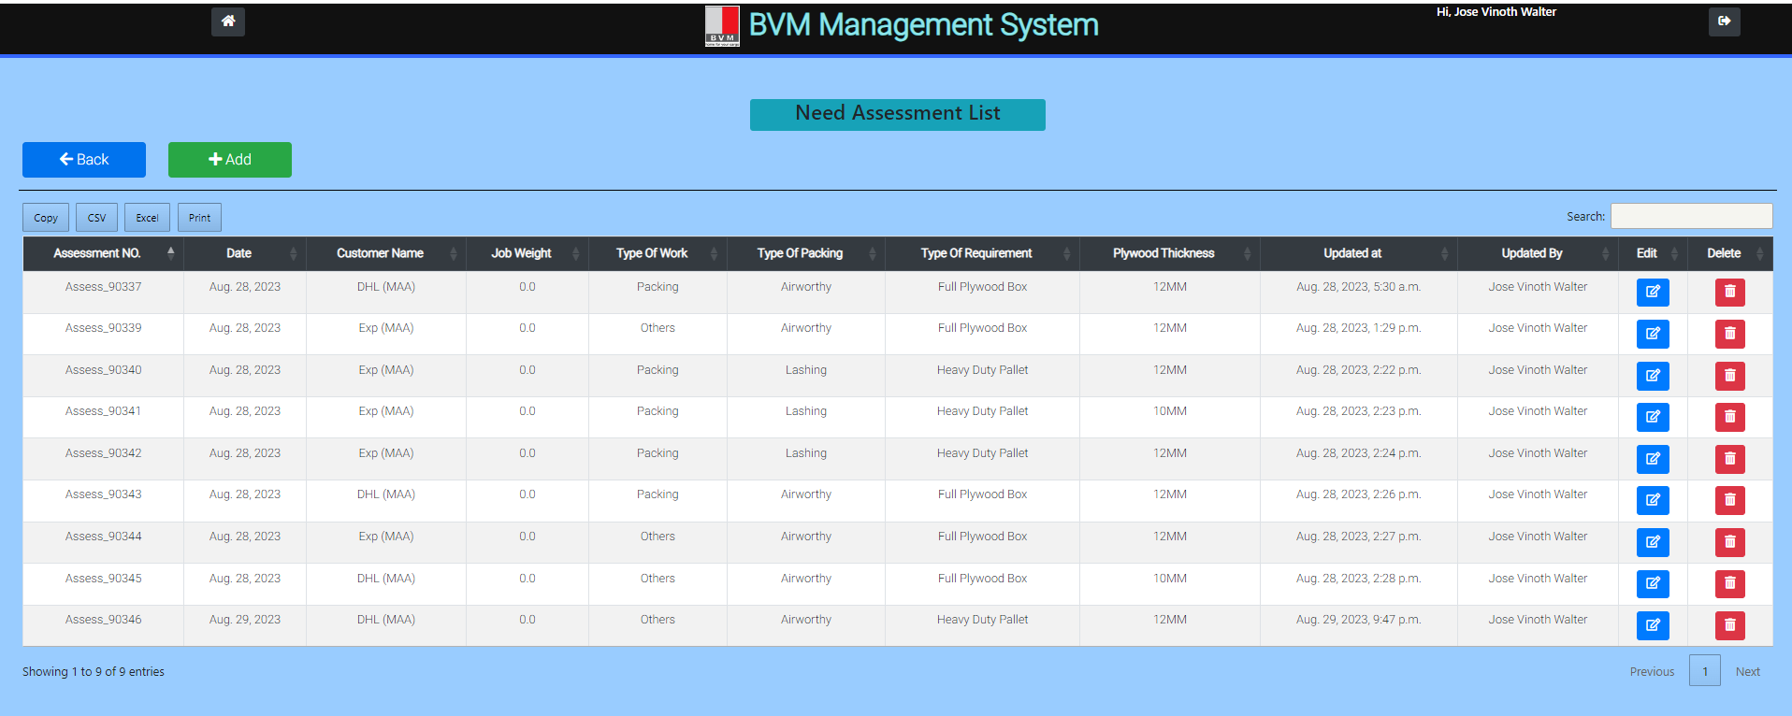
Costing

Slide 4
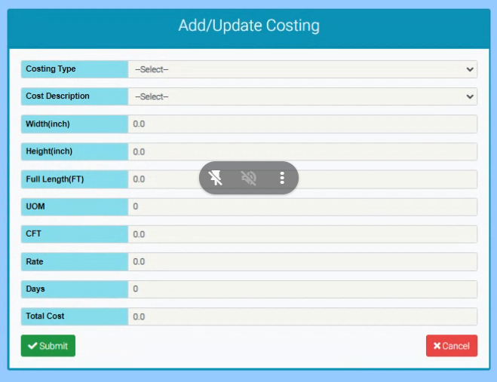
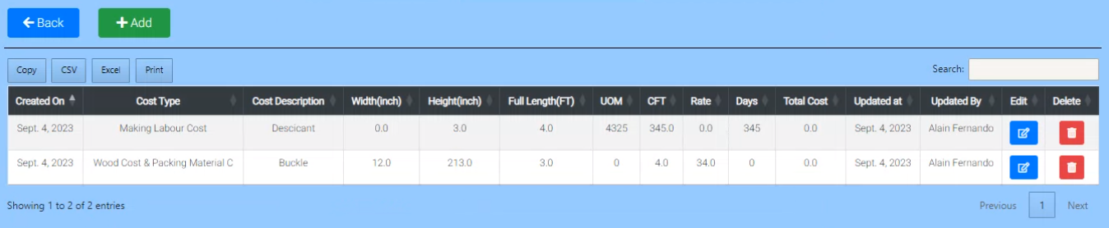
Add/Update Costing Summary
Assessment Number
Assess_90337
WOOD COST
PACKING MATERIAL COST
ENGINEER Cost
LABOUR COST
TOTAL COST (Without Margin)
MARGIN
TOTAL COST (With Margin)
RATE PER CFT

Slide 5
Assessment Number
Assess_90337
QTY
Wood Type
Drop Down with wood names

Slide 6
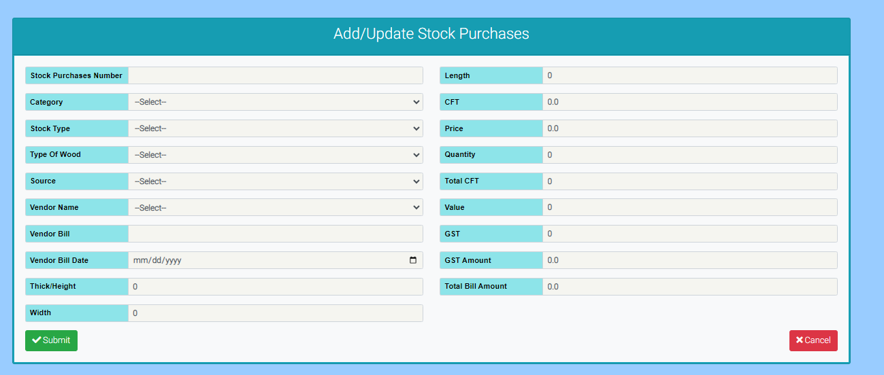
Stock In Date
Date Field

Slide 7
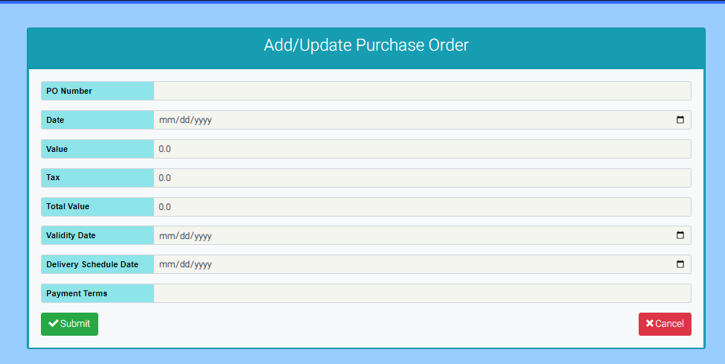
Attachment
attachment Field

Slide 8
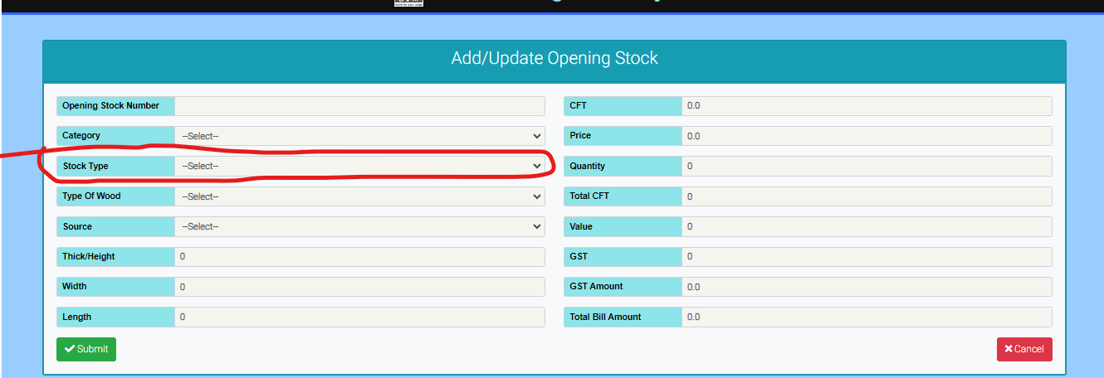
Create a mod file “packing_stock_type_info”. Same as stock_type_mod
Add RAW MATERIALS , CONSUMABLES as drop down values.
Assign it as foreign key for stock type

Slide 9
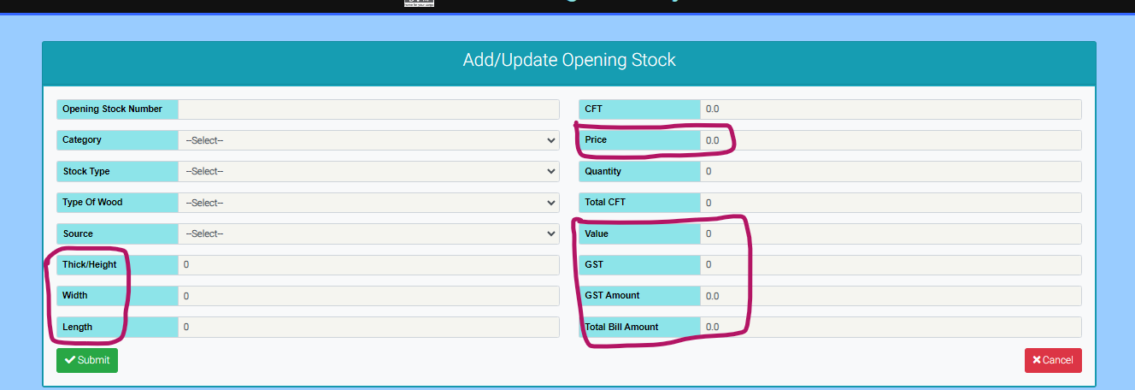
Thick/Height→ Thick/Height (In)
Width → Width(In)
Length→ Length (Ft)
Price → Price (INR)
Value→ Value (INR)
GST→ GST(%)
GST Amount→ GST Amount(INR)
Total Bill Amount→ Total Bill Amount(INR)
# CFT field should be calculated field and disable it.
(Formula = (Height * Width * Length)/144
# Total CFT should be calculated field and disable it.
(Formula = CFT * Quantity)
# CFT field should be calculated field and disable it.
(Formula = (Height * Width * Length)/144
# Total CFT should be calculated field and disable it.
(Formula = CFT * Quantity)
# value should be calculated field and disable it
(Formula = price * Total CFT)
# Total CFT, Value and GST should be float type and default value should be 0.0. Check data type in mod file. # GST amount should be calculated field and disable it
(Formula = Value * GST)
# Total Bill amount should be calculated field and disable it
(Formula = # GST amount + Value)

Slide 10
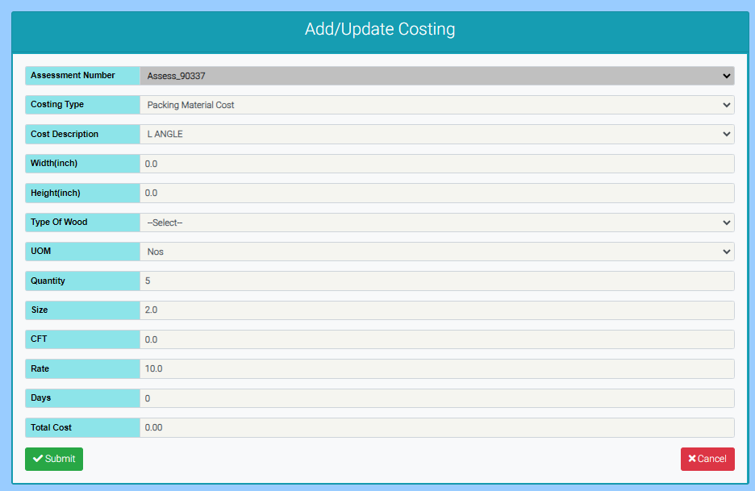
# Include “Length (ft)” next to Height (inch)
# CFT should be calculated field and disable it.
Formula=(Length* height*width)/144

Slide 11
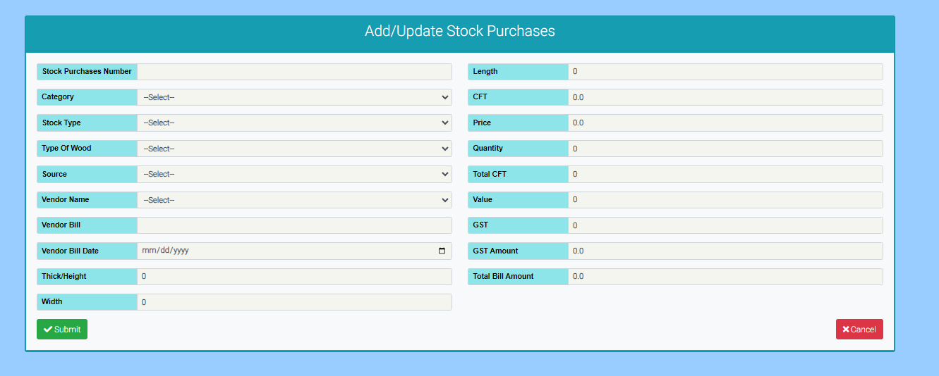
# Add consumable type next to stock type. This is same as Cost Description in costing sheet.
# Add UOM and size next to quantity same as costing sheet.
# if Stock Type is raw material, then enable Type of Wood, height, length, width, CFT, Total CFT and disable UOM and size

Slide 12
