Slide 1
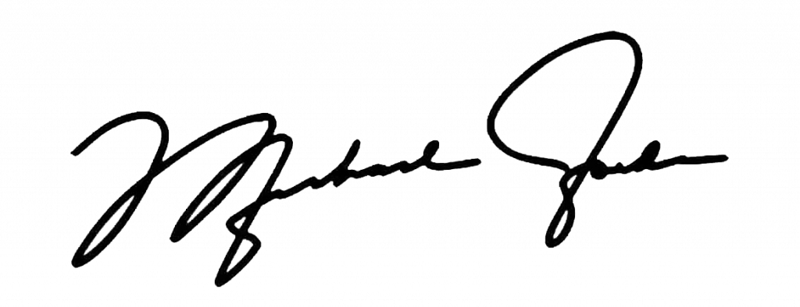








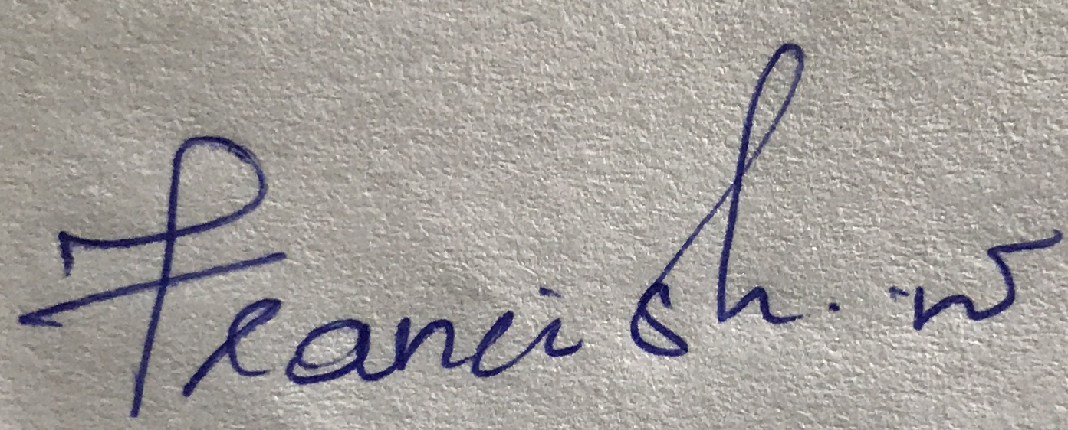


R2 Solutions
Your Success, Our Code
#3DD2CC
https://looka.com/editor/189443024

Slide 2
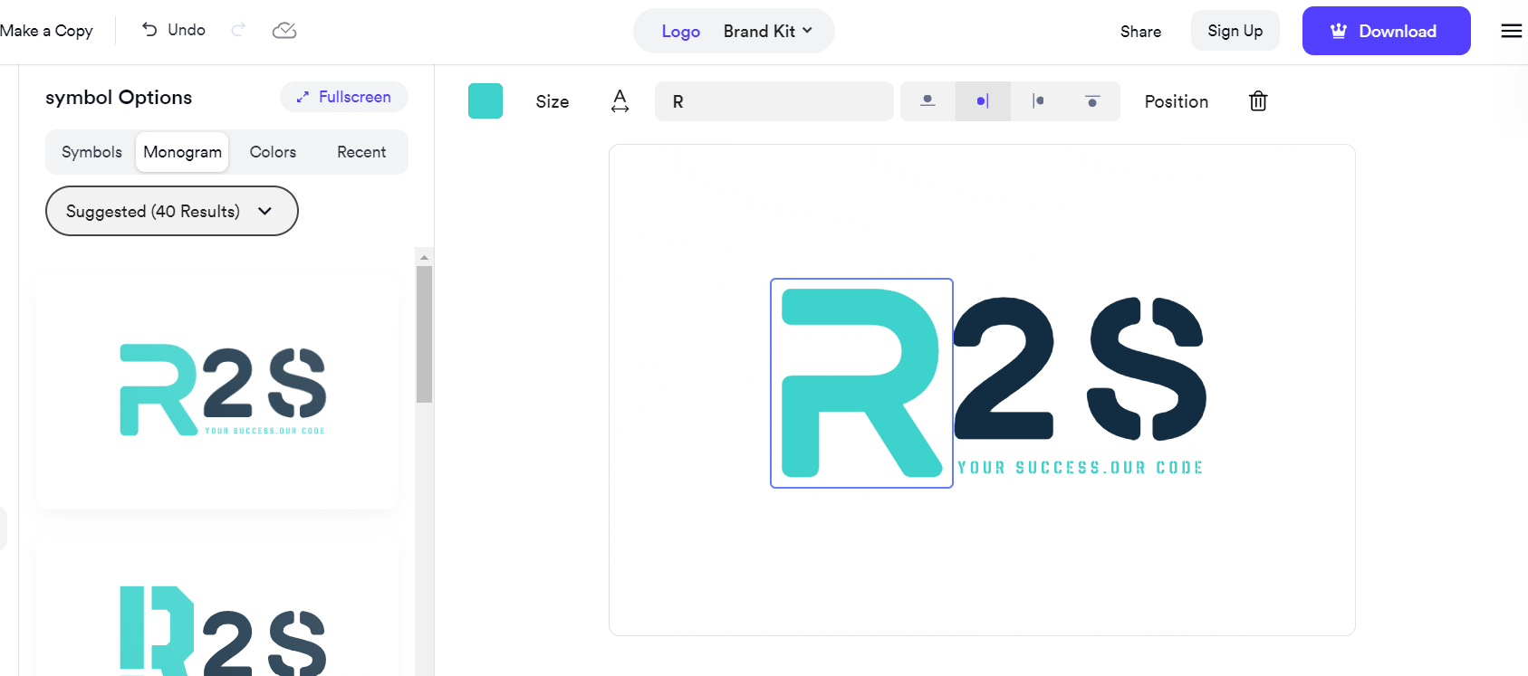
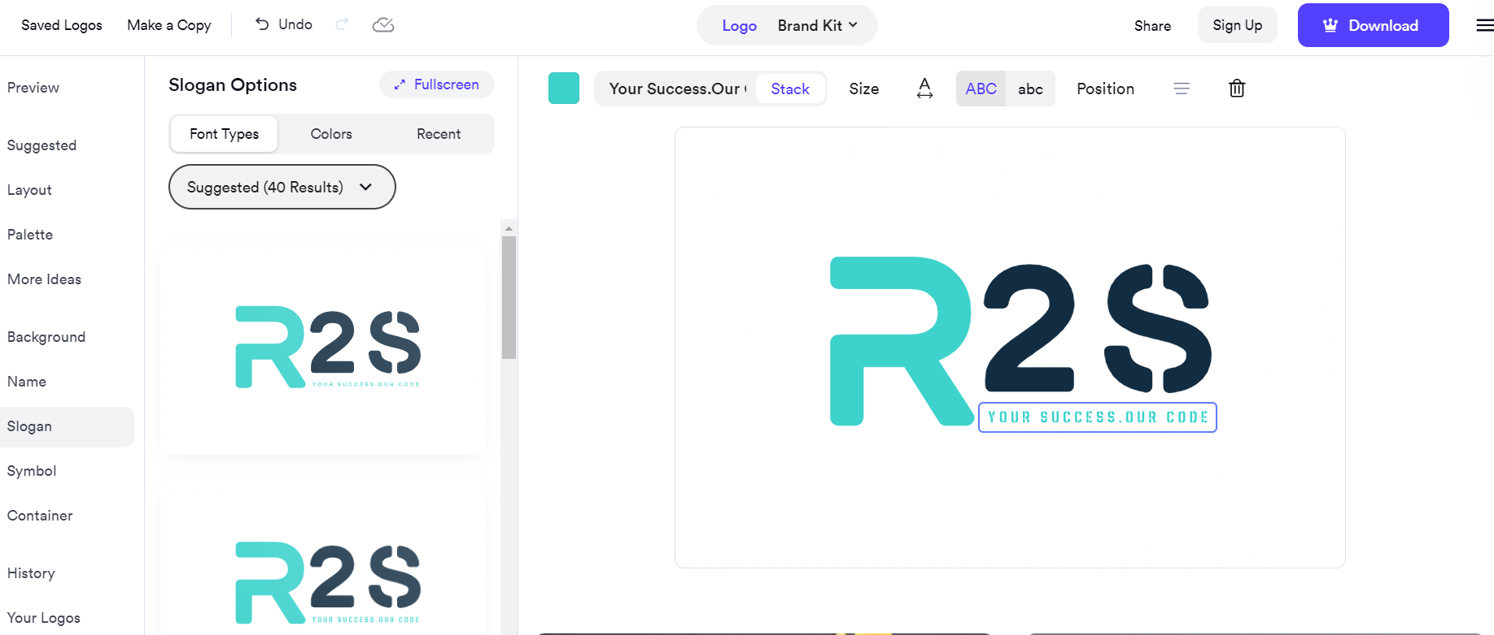
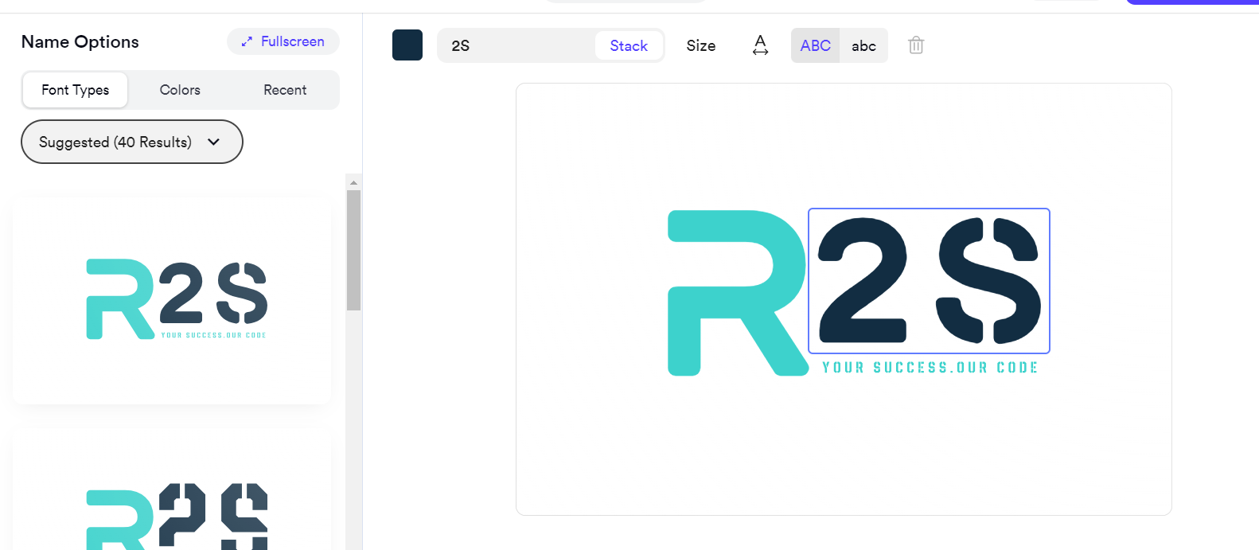

https://looka.com/editor/189443024

Slide 3


R2 Solutions

