Slide 1
BVM Service Management System
Application Progress & Updates

Slide 2
Agenda
Application Features & Benefits
Key Business Benefits
Return of Investment
Where we stand today?
What is pending?
Help needed?

Slide 3
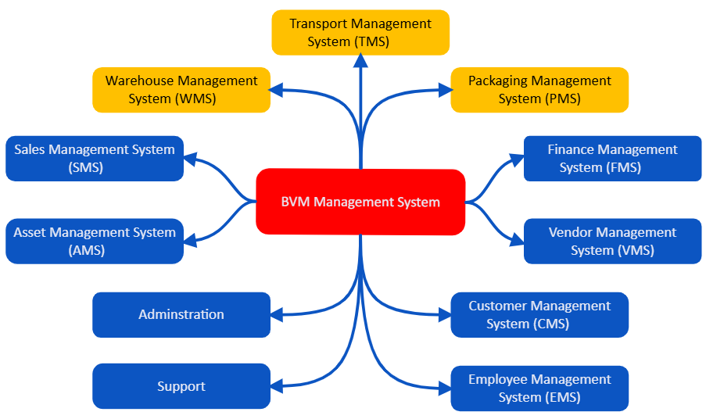
BVM Management System – Master Layout

Slide 4
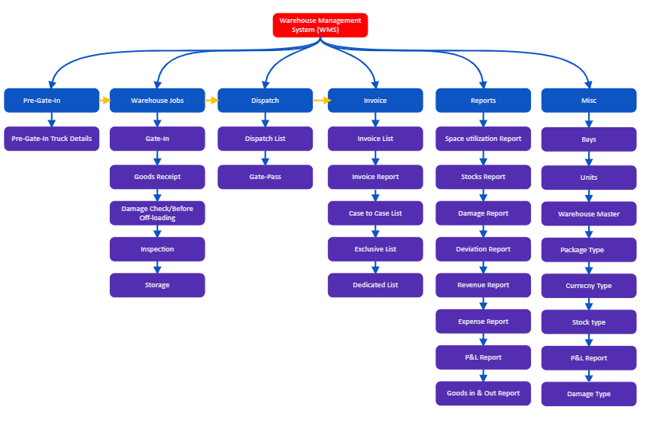







Warehouse Management System (WMS)
Features & Benefits
Streamline Truck Entries
More accurate goods handling process (QR Coded)
Damage Identification reduces inventory rework
Detailed invoice lists reduce billing errors
Comprehensive reports provide valuable insights
Immediate access to data reduces stocking risk
Timely and accurate order fulfillment
Notes:
Pre-Gate-In involves managing truck details before they enter the warehouse.
Warehouse Jobs encompass the entire process from gate-in to storage, including inspection and damage checks.
Dispatch handles the preparation and issuance of dispatch lists and gate passes.
Invoice covers the creation and management of invoices, including detailed reports and specific lists.
Reports provide various analyses and overviews on space utilization, stocks, damages, deviations, revenue, expenses, and more.
Miscellaneous includes managing different attributes such as bays, units, warehouse master data, and various types related to packages, currency, stocks, and damages.
Improved Efficiency:
Pre-Gate-In Process: Streamlines the entry of trucks with pre-gate-in truck details, reducing waiting times and improving the overall flow of goods into the warehouse.
Warehouse Jobs: Automated processes for gate-in, goods receipt, damage check, inspection, and storage lead to faster and more accurate handling of goods.
Enhanced Accuracy:
Goods Receipt and Inspection: Ensures accurate recording of received goods and identification of any damages before off-loading, reducing errors and discrepancies in inventory.
Invoice Management: Detailed invoice lists and reports help in maintaining accurate financial records and reducing billing errors.
Better Inventory Control:
Reports Module: Comprehensive reports on space utilization, stocks, damages, deviations, and goods in & out provide valuable insights for better inventory management and planning.
Real-Time Data: Immediate access to data on inventory levels, locations, and movements improves decision-making and reduces the risk of stockouts or overstocking.
Cost Reduction:
Expense and P&L Reports: Detailed expense and profit & loss reports enable better financial management, helping identify cost-saving opportunities and improve profitability.
Damage and Deviation Reports: Identifying and addressing damages and deviations promptly can reduce losses and operational costs.
Improved Customer Service:
Dispatch Management: Efficient management of dispatch lists and gate-passes ensures timely and accurate order fulfillment, enhancing customer satisfaction.
Case to Case and Exclusive Lists: Tailored invoicing options provide flexibility to meet specific customer requirements.
Enhanced Visibility and Control:
Warehouse Master Data: Centralized management of warehouse attributes such as bays, units, and package types improves overall control and coordination within the warehouse.
Real-Time Tracking: Continuous tracking of goods from pre-gate-in to dispatch provides full visibility into warehouse operations.
Scalability and Flexibility:
Miscellaneous Module: The ability to manage various types of data (e.g., currency, stock, damage types) allows the system to adapt to different operational needs and scale as the business grows.
Customizable Reports: Tailored reports can be generated to meet specific business needs and regulatory requirements.
Enhanced Decision-Making:
Revenue and Expense Reports: Detailed financial reporting supports informed decision-making regarding pricing, budgeting, and resource allocation.
Deviation and Damage Reports: Insights into operational inefficiencies and damages help in making corrective actions and improving processes.

Slide 5
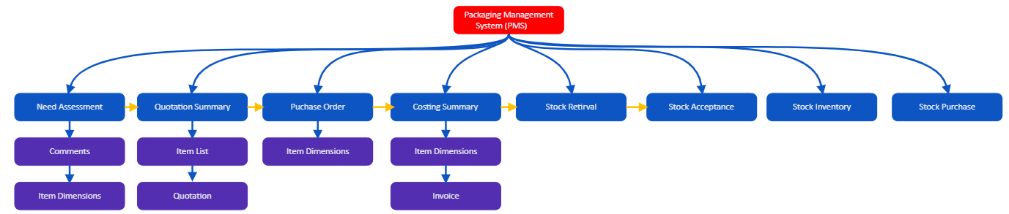








Packaging Management System (PMS)
Key Features
Key Benefits
Identifies packaging requirements accurately
Provides a consolidated view of quotations
Streamlines purchase orders
Offers a detailed breakdown of costs
Maintains an up-to-date inventory
Facilitates efficient purchasing of stock
Ensures quick and accurate retrieval
Captures and analyzes packaging requirements
Retrieval of packaging materials
Consolidates quotations for easy comparison
Acceptance and inspection of incoming stock
Create, Track, and Approve Purchase Orders
Up-to-date packaging materials inventory
Provides a detailed breakdown of packaging costs
Purchase of stock based on inventory levels
Notes:
Need Assessment:
Benefit: Identifies packaging requirements accurately, ensuring that resources are allocated efficiently and reducing the risk of overstocking or understocking packaging materials.
Icon: Magnifying glass over a checklist
Quotation Summary:
Benefit: Provides a consolidated view of quotations from different suppliers, facilitating quick comparison and decision-making, leading to cost savings and better supplier selection.
Icon: Document with a dollar sign
Purchase Order:
Benefit: Streamlines the creation and management of purchase orders, reducing errors and ensuring timely procurement of packaging materials.
Icon: Clipboard with a checkmark
Costing Summary:
Benefit: Offers a detailed breakdown of costs associated with packaging materials, helping in budget management and cost control.
Icon: Bar chart with dollar signs
Stock List:
Benefit: Maintains an up-to-date inventory of packaging materials, ensuring transparency and aiding in inventory management.
Icon: Inventory list or boxes stacked
Stock Purchase:
Benefit: Facilitates efficient purchasing of stock, reducing lead times and ensuring that packaging materials are available when needed.
Icon: Shopping cart or purchase box
Stock Retrieval:
Benefit: Ensures quick and accurate retrieval of packaging materials, enhancing operational efficiency and reducing delays.
Icon: Hand retrieving a box
Stock Acceptance:
Benefit: Manages the acceptance process of incoming stock, ensuring quality control and accurate record-keeping.
Icon: Handshake or checkmark on a box
Conclusion: By leveraging the Packaging Management System (PMS), businesses can achieve significant improvements in their packaging operations. The system ensures accurate need assessment, efficient procurement, detailed cost analysis, and effective stock management. These benefits translate into cost savings, enhanced productivity, and improved operational efficiency, ultimately contributing to better business performance and customer satisfaction.

Slide 6
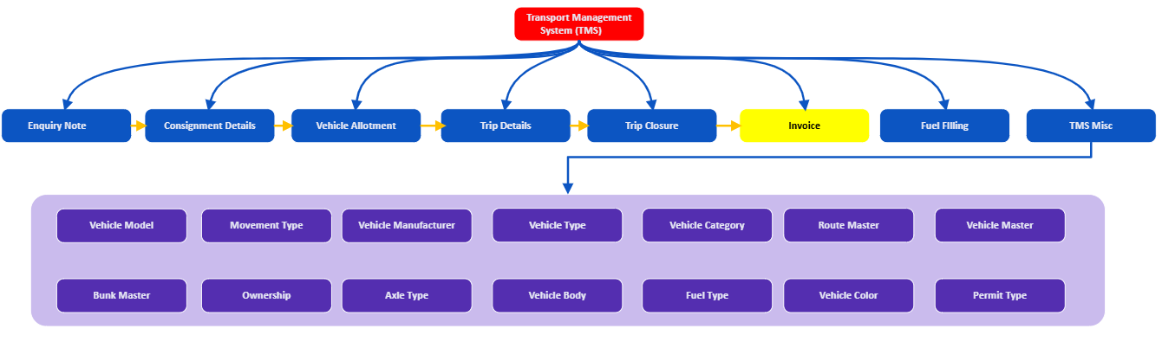








Transport Management System (TMS)
To be developed
Key Features
Key Benefits
Record and track requests from customers
Finalize trip details upon completion
Streamlines the initial inquiry process
Optimizes the allocation of vehicles to consignments
Captures comprehensive trip information
Ensures all trips are properly closed out
Standardized and consistent data management across the TMS
Accurate reporting, efficient resource management
Compliance with regulatory requirements
Track shipment contents, origin, destination
Monitor and manage fuel consumption and cost
Optimize vehicle utilization based on availability
Ensure all necessary documentation is recorded
Manage trip scheduling, routes, and logistics
Flexibility to manage various operational needs
Notes:
Key Features:
Enquiry Note:
Capture initial transportation inquiries.
Record and track requests from customers or internal departments.
Consignment Details:
Maintain detailed information about consignments.
Track shipment contents, origin, destination, and special handling instructions.
Vehicle Allotment:
Assign vehicles to specific consignments.
Optimize vehicle utilization based on availability and suitability.
Trip Details:
Record comprehensive trip information.
Manage trip scheduling, routes, and logistics.
Trip Closure:
Finalize trip details upon completion.
Ensure all necessary documentation is recorded and stored.
Invoice:
Generate invoices based on trip and consignment data.
Automate billing processes to reduce manual work.
Fuel Filling:
Track fuel usage and filling events.
Monitor and manage fuel consumption and costs.
TMS Miscellaneous (Misc):
Handle additional tasks within the TMS.
Provide flexibility to manage various operational needs.
Additional Master Data Features:
Vehicle Model:
Standardize and manage vehicle model information.
Movement Type:
Categorize and track different types of vehicle movements.
Vehicle Manufacturer:
Maintain records of vehicle manufacturers for reference and reporting.
Vehicle Type:
Classify vehicles based on type for better management and reporting.
Vehicle Category:
Further categorize vehicles for specific operational needs.
Route Master:
Define and manage standard routes for transportation.
Vehicle Master:
Central repository for all vehicle-related information.
Bunk Master:
Manage and track bunking locations and related data.
Ownership:
Track ownership details of vehicles.
Axle Type:
Record and manage information about vehicle axle types.
Vehicle Body:
Maintain details about the body types of vehicles.
Fuel Type:
Standardize and manage different fuel types used by the fleet.
Vehicle Color:
Track and record vehicle color information.
Permit Type:
Manage different types of permits required for vehicle operations.
Key Benefits:
Enquiry Note:
Benefit: Streamlines the initial inquiry process, ensuring all transportation requests are recorded and tracked from the beginning.
Consignment Details:
Benefit: Provides detailed information on each consignment, improving tracking, and ensuring accurate documentation for shipments.
Vehicle Allotment:
Benefit: Optimizes the allocation of vehicles to consignments, ensuring the most efficient use of transportation resources.
Trip Details:
Benefit: Captures comprehensive trip information, aiding in route planning, trip scheduling, and overall trip management.
Trip Closure:
Benefit: Ensures all trips are properly closed out, with all necessary documentation and data recorded, facilitating accurate reporting and analysis.
Invoice:
Benefit: Automates the generation of invoices based on trip and consignment details, reducing manual errors and speeding up the billing process.
Fuel Filling:
Benefit: Tracks fuel usage and filling events, helping to monitor fuel consumption and manage fuel costs effectively.
TMS Miscellaneous (Misc):
Benefit: Handles additional miscellaneous tasks within the TMS, providing flexibility to accommodate various operational needs.
Additional Master Data Benefits:
Vehicle Model, Movement Type, Vehicle Manufacturer, Vehicle Type, Vehicle Category, Route Master, Vehicle Master, Bunk Master, Ownership, Axle Type, Vehicle Body, Fuel Type, Vehicle Color, Permit Type:
Benefit: These master data elements ensure standardized and consistent data management across the TMS. They facilitate accurate reporting, efficient resource management, and compliance with regulatory requirements.
Overall, the TMS enhances operational efficiency, improves resource utilization, provides accurate and timely information for decision-making, and ensures compliance with industry standards and regulations.

Slide 7
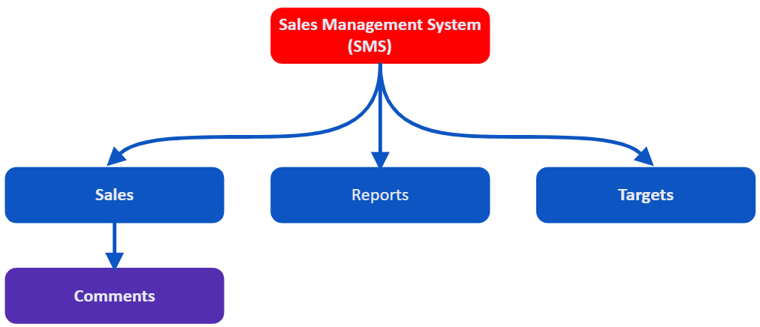
Sales Management System (SMS)
Customer Relationship Management (CRM) Integration
Lead and Opportunity Management
Sales Automation
Sales Forecasting
Performance Metrics and Reporting
Sales Target Management
Analytics and Insights
Increased Sales Efficiency
Improved Sales Performance
Enhanced Customer Relationships
Better Sales Forecasting
Effective Lead and Opportunity Management
Improved Data Accuracy and Reporting
Improved Customer Service
Key Features
Key Benefits
Notes:
Key Features of a Sales Management System (SMS)
Customer Relationship Management (CRM) Integration:
Centralized customer database
Customer interaction history
Contact management
Customer segmentation
Lead and Opportunity Management:
Lead capture and tracking
Opportunity tracking
Sales pipeline management
Lead scoring and prioritization
Sales Automation:
Automated follow-ups and reminders
Workflow automation
Email marketing automation
Task management
Sales Forecasting:
Predictive analytics
Historical sales data analysis
Trend identification
Forecast accuracy tracking
Performance Metrics and Reporting:
Sales performance dashboards
Customizable reports
Real-time data analytics
Key performance indicators (KPIs) tracking
Sales Target Management:
Goal setting and tracking
Individual and team targets
Progress monitoring
Incentive and commission tracking
Product and Pricing Management:
Product catalog management
Price list management
Discount and promotion management
Inventory tracking
Order and Invoice Management:
Order processing
Quotation and proposal generation
Invoice generation
Payment tracking
Mobile Access:
Mobile app for on-the-go access
Offline data access
Real-time synchronization
Push notifications
Integration Capabilities:
Integration with ERP systems
Integration with marketing automation tools
API for custom integrations
Third-party app integration
Security and Access Control:
Role-based access control
Data encryption
User authentication and authorization
Audit trails
Customization and Scalability:
Customizable workflows
Custom fields and modules
Scalable architecture
Multi-language and multi-currency support
Training and Support:
User training and onboarding
Customer support
Knowledge base and documentation
Community forums
Collaboration Tools:
Team communication and collaboration
Shared calendars and task lists
Document sharing
Internal messaging system
Analytics and Insights:
Sales trend analysis
Customer behavior analysis
Market segmentation insights
Competitive analysis
These features collectively ensure that a Sales Management System can comprehensively support the sales processes, improve efficiency, and enhance sales performance for any business.
Key Benefits of a Sales Management System (SMS)
Increased Sales Efficiency:
Automates repetitive tasks
Streamlines sales processes
Reduces manual data entry
Improved Sales Performance:
Provides insights into sales performance
Identifies high-performing strategies and areas for improvement
Enables better goal setting and tracking
Enhanced Customer Relationships:
Centralizes customer data and interaction history
Facilitates personalized communication and follow-ups
Improves customer satisfaction and retention
Better Sales Forecasting:
Utilizes historical data for accurate forecasting
Helps anticipate future sales trends and adjust strategies
Supports informed decision-making and planning
Effective Lead and Opportunity Management:
Tracks and prioritizes leads and sales opportunities
Manages the sales pipeline efficiently
Increases the chances of closing deals
Streamlined Order and Invoice Management:
Simplifies order processing and invoicing
Reduces errors and delays in order fulfillment
Enhances financial accuracy and transparency
Improved Data Accuracy and Reporting:
Provides real-time data and reports
Facilitates accurate performance tracking and analysis
Helps in identifying trends and making data-driven decisions
Enhanced Collaboration and Communication:
Supports team collaboration through shared tools and communication channels
Ensures alignment among sales team members and other departments
Facilitates efficient information sharing
Customizable and Scalable:
Adapts to the specific needs of the business
Scales with business growth and changing requirements
Allows for customization of workflows and features
Better Customer Insights:
Analyzes customer behavior and preferences
Helps in understanding customer needs and market trends
Supports targeted marketing and sales strategies
Increased Accountability:
Tracks individual and team performance
Provides visibility into sales activities and results
Facilitates performance reviews and accountability
Cost Savings:
Reduces the need for manual processes and paperwork
Minimizes errors and inefficiencies
Lowers operational costs through automation
Enhanced Mobility and Accessibility:
Provides mobile access to sales data and tools
Supports remote work and on-the-go sales activities
Ensures real-time updates and synchronization
Improved Customer Service:
Enables faster response times and resolution of issues
Provides a comprehensive view of customer interactions
Enhances overall customer experience
Data Security and Compliance:
Ensures secure handling of sensitive customer information
Provides role-based access control and data encryption
Supports compliance with regulatory requirements
By leveraging these benefits, businesses can optimize their sales processes, boost team productivity, and drive overall growth.

Slide 8
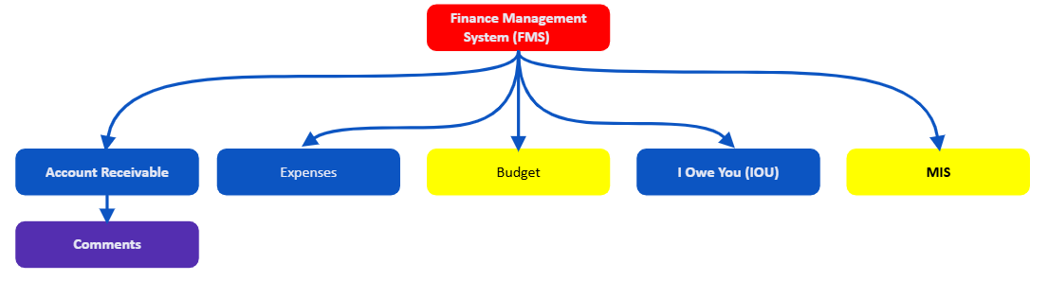
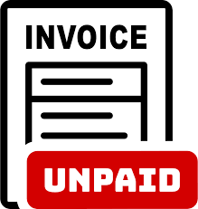



Finance Management System (FMS)
To be developed
Provides a detailed audit trail and communication history
Enables better expense tracking
Budget management
Financial reporting
Keeps track of small loans or amounts owed and settled promptly
Track outstanding invoices and payments
Allows adding notes and comments
Key Features
Key Benefits
Record and categorize all business expenses
Manage informal debts or short-term borrowings
Notes:
Features and Benefits:
Accounts Receivable:
Feature: Track outstanding invoices and payments due from customers.
Benefit: Helps manage cash flow by ensuring timely collections and reducing overdue receivables.
Accounts Receivable Comments:
Feature: Allows adding notes and comments related to specific accounts receivable entries.
Benefit: Provides a detailed audit trail and communication history, aiding in dispute resolution and follow-ups.
Expenses:
Feature: Record and categorize all business expenses.
Benefit: Enables better expense tracking, budget management, and financial reporting, ensuring all expenditures are accounted for.
IOU (I Owe You):
Feature: Manage informal debts or short-term borrowings.
Benefit: Keeps track of small loans or amounts owed, ensuring they are not forgotten and are settled promptly.
These features collectively improve financial tracking, enhance cash flow management, and provide detailed financial insights, aiding in better decision-making and efficient financial operations.

Slide 9
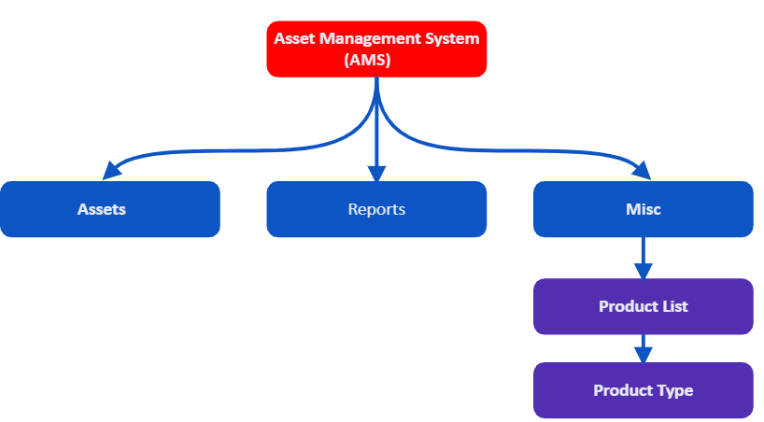




Asset Management System (AMS)
Ensures accurate Inventory and scheduled maintenance
Insights & analytics on asset usage, performance, maintenance
Centralized repository of products for easy access
Organizing and managing assets by their types
Easier to track and maintain assets
Comprehensive tracking and management of assets
Generate various reports related to assets
Key Features
Key Benefits
Detailed list of all products
Categorize and manage different types of products
Notes:
Key Features:
Assets:
Feature: Comprehensive tracking and management of all assets.
Benefit: Ensures accurate inventory, maintenance schedules, and lifecycle tracking of assets.
Reports:
Feature: Generate various reports related to assets.
Benefit: Provides insights and analytics on asset usage, performance, and maintenance, aiding in informed decision-making.
AMS Misc:
Product List
Feature: Maintain a detailed list of all products within the asset management system.
Benefit: Provides a centralized repository of products for easy access and management.
Product Type
Feature: Categorize and manage different types of products.
Benefit: Helps in organizing and managing assets by their types, making it easier to track and maintain them.
These features collectively enhance the management of assets, provide detailed reporting and analytics, and ensure efficient categorization and tracking of products within the asset management system.

Slide 10
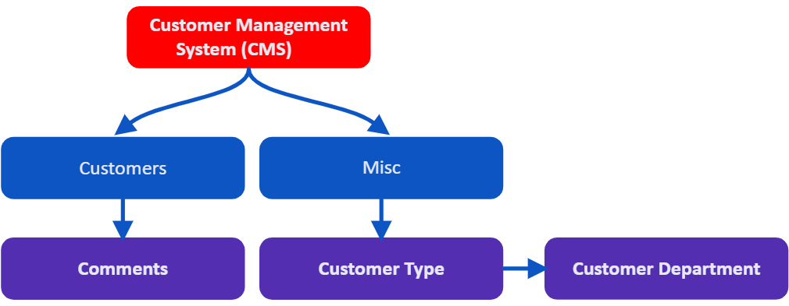
Customer Management System (CMS)
Centralized storage of customer information
Easy access and retrieval of customer data
Grouping customers based on various criteria
Detailed contact details, communication history
Interaction tracking
Targeted communication
Logging of all customer interactions
Improved customer service thru interaction tracking
Easy access to comprehensive customer data
Reduced data silos and improved data accuracy
Enhanced collaboration among teams
Identification of trends and patterns
Efficient handling of customer inquiries and issues
Enhanced overall customer experience
Key Features
Key Benefits
Notes:
Key Features of a Customer Management System (CMS)
Customer Database:
Centralized storage of customer information
Detailed contact details, communication history, and purchase records
Easy access and retrieval of customer data
Contact Management:
Detailed profiles for each contact
Interaction tracking (emails, calls, meetings)
Notes and follow-up reminders
Customer Segmentation:
Grouping customers based on various criteria (demographics, purchase behavior)
Customized marketing campaigns
Targeted communication
Interaction Tracking:
Logging of all customer interactions
Email and call tracking
Activity history
Customer Support Management:
Ticketing system for customer inquiries and issues
Case management and resolution tracking
Integration with support channels (phone, email, chat)
Sales Tracking:
Monitoring sales opportunities and leads
Pipeline management
Sales forecasting
Automated Workflows:
Automation of repetitive tasks (follow-up emails, reminders)
Workflow customization
Task assignment and tracking
Reporting and Analytics:
Customizable reports and dashboards
Real-time data analytics
Key performance indicators (KPIs) tracking
Integration Capabilities:
Integration with other business systems (ERP, marketing automation)
API for custom integrations
Third-party app integration
Mobile Access:
Mobile app for on-the-go access
Offline data access
Real-time synchronization
Push notifications
Security and Access Control:
Role-based access control
Data encryption
User authentication and authorization
Audit trails
Customization and Scalability:
Customizable workflows and fields
Scalable architecture
Multi-language and multi-currency support
Collaboration Tools:
Team communication and collaboration features
Shared calendars and task lists
Document sharing
Internal messaging system
Key Benefits of a Customer Management System (CMS)
Enhanced Customer Relationships:
Improved customer service through detailed interaction tracking
Personalized communication and follow-ups
Increased customer satisfaction and loyalty
Improved Sales and Marketing Efficiency:
Streamlined sales processes and lead management
Targeted marketing campaigns based on customer segmentation
Better sales forecasting and planning
Centralized Information:
Easy access to comprehensive customer data
Reduced data silos and improved data accuracy
Enhanced collaboration among teams
Increased Productivity:
Automation of repetitive tasks
Efficient task management and assignment
Time savings for sales and support teams
Data-Driven Insights:
Real-time reporting and analytics
Identification of trends and patterns
Informed decision-making based on accurate data
Scalability and Flexibility:
Adaptable to the growing needs of the business
Customizable to specific business requirements
Supports multi-language and multi-currency operations
Improved Customer Support:
Efficient handling of customer inquiries and issues
Timely resolution of support tickets
Enhanced overall customer experience
Increased Accountability:
Tracking of individual and team performance
Visibility into sales and support activities
Facilitated performance reviews and accountability
Cost Savings:
Reduced manual processes and paperwork
Minimization of errors and inefficiencies
Lower operational costs through automation
Enhanced Mobility:
Access to customer data and tools from anywhere
Support for remote work and on-the-go activities
Real-time updates and synchronization
By leveraging these features and benefits, businesses can optimize their customer management processes, improve customer satisfaction, and drive overall growth.

Slide 11
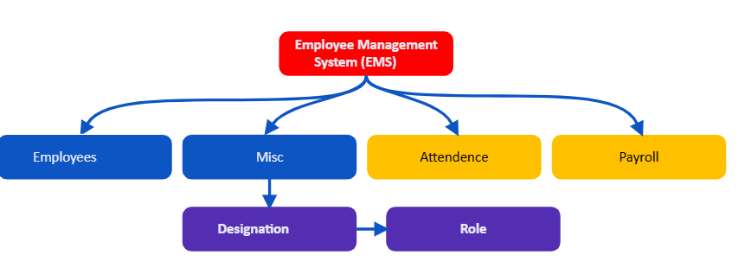
Employee Management System (EMS)
Future Scope.
Not included in project estimation
Centralized storage for all employee information
Track attendance, leaves with automated workflows
Automated payroll processing
Employees can view and update personal information
Define & manage roles, job descriptions, responsibilities.
Assign and manage permissions for different roles
Create and manage workflows tailored to specific roles
Reduces errors and redundancies
Streamlined processes for HR tasks
Automated tracking of compliance requirements
Improve employee experience
Enhance operational efficiency.
Improve organizational efficiency
Enhance employee skills and performance
Key Features
Key Benefits
Notes:
Employees
Employee Database Management: Centralized storage for all employee information.
Attendance and Leave Management: Track attendance, leaves, and absences with automated workflows.
Performance Management: Set goals, conduct performance reviews, and track metrics.
Payroll Management: Automated payroll processing including calculations, deductions, and disbursements.
Employee Self-Service Portal: Employees can view and update personal information, apply for leave, and access pay slips.
Document Management: Store and manage important documents such as contracts, certifications, and IDs.
EMS Misc
Customizable Dashboards: Tailor dashboards to display key metrics and reports.
Notifications and Alerts: Automated notifications for important events and updates.
Integration with Other Systems: Seamless integration with CRM, ERP, and accounting software.
Reporting and Analytics: Generate detailed reports and analytics for workforce insights.
Designation
Role-Based Access Control: Define and manage access levels based on designations.
Designation Hierarchy Management: Create and manage a hierarchical structure of designations.
Promotion and Transfer Management: Track and manage promotions, transfers, and designation changes.
Skill Mapping: Associate required skills and competencies with specific designations.
Role
Role Definition and Management: Define and manage roles, job descriptions, and responsibilities.
Permission Management: Assign and manage permissions for different roles.
Role-Based Workflows: Create and manage workflows tailored to specific roles.
Training and Development: Associate training programs and development plans with specific roles.
These key features ensure that an Employee Management System efficiently handles various aspects of employee management, improving overall organizational efficiency and employee satisfaction.
Employees
Improved Data Accuracy: Centralized and automated data management reduces errors and redundancies.
Enhanced Productivity: Streamlined processes for HR tasks free up time for strategic activities.
Better Compliance: Automated tracking of compliance requirements such as tax filings and labor laws.
Employee Satisfaction: Easy access to information and self-service options improve employee experience.
EMS Misc
Centralized Information: All relevant employee data and metrics in one place for easy access and management.
Informed Decision-Making: Data-driven insights help in making strategic HR decisions.
Efficiency: Reduced manual work and streamlined workflows enhance operational efficiency.
Scalability: Easily scale the system as the organization grows and evolves.
Designation
Clear Role Definitions: Well-defined designations and roles ensure clarity in responsibilities and expectations.
Enhanced Security: Role-based access control ensures that sensitive information is accessible only to authorized personnel.
Career Development: Structured designation hierarchy supports career progression and development.
Skill Alignment: Ensures that employees are matched with roles that align with their skills and competencies.
Role
Operational Clarity: Clear definitions of roles and responsibilities improve organizational efficiency.
Security and Compliance: Proper permission management ensures compliance with security policies and regulations.
Targeted Training: Role-specific training programs enhance employee skills and performance.
Streamlined Processes: Role-based workflows ensure that tasks and approvals are handled efficiently.

Slide 12
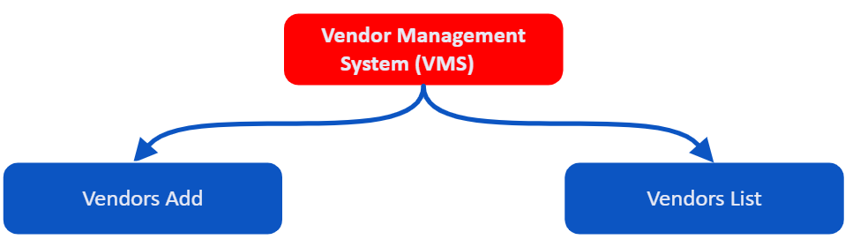
Vendor Management System (VMS)
Centralized repository for storing vendor information
Tracking and management of vendor contracts
Analytics for evaluating vendor performance
Vendor Compliance Management
Vendor Risk Management
Communication and Collaboration Tools
Invoice and Payment Management
Ability to integrate with other systems
Improved Efficiency
Enhanced Compliance
Cost Savings
Better Vendor Relationships
Increased Transparency
Risk Management
Improved Performance Monitoring
Key Features
Key Benefits
Notes:
Vendor Database: Centralized repository for storing vendor information, including contact details, service types, and contract terms.
Onboarding and Registration: Tools for onboarding new vendors, including application forms, compliance checks, and document management.
Contract Management: Tracking and management of vendor contracts, including start and end dates, renewal reminders, and terms.
Performance Monitoring: Metrics and dashboards for evaluating vendor performance based on criteria like quality, delivery, and service levels.
Compliance Management: Ensures vendors meet regulatory requirements and company standards, including audits and certifications.
Risk Management: Identification and mitigation of potential risks associated with vendors, including financial stability and operational risks.
Communication and Collaboration Tools: Features to facilitate communication between vendors and internal teams, including messaging and file sharing.
Invoice and Payment Management: Tracking and processing of vendor invoices, managing payment schedules, and ensuring timely payments.
Analytics and Reporting: Tools for generating reports and insights on vendor performance, spend analysis, and contract compliance.
Integration Capabilities: Ability to integrate with other systems such as ERP, procurement, and finance systems for seamless data flow.
Vendor Evaluation and Selection: Processes for assessing and selecting vendors based on predefined criteria and historical performance.
Incident Management: Handling and resolution of issues or disputes with vendors, including tracking and documentation.
User Management: Role-based access control to ensure appropriate levels of access and security for different users within the system.
Customizable Workflows: Ability to tailor processes and workflows according to organizational needs and vendor management practices.
Document Management: Storage and retrieval of important vendor documents such as contracts, certifications, and compliance records.
These features help streamline vendor interactions, enhance transparency, and improve overall efficiency in vendor management.
Improved Efficiency: Streamlines vendor-related processes, reducing manual work and administrative overhead.
Enhanced Compliance: Ensures vendors adhere to regulatory requirements and company policies, reducing the risk of non-compliance.
Cost Savings: Helps identify and negotiate better terms with vendors, track spending, and manage costs more effectively.
Better Vendor Relationships: Facilitates clear communication and collaboration, leading to stronger and more productive vendor partnerships.
Increased Transparency: Provides visibility into vendor performance, contract status, and financial transactions, making it easier to manage vendor relationships.
Risk Management: Identifies and mitigates potential risks associated with vendors, such as financial instability or service failures.
Improved Performance Monitoring: Tracks and evaluates vendor performance based on predefined metrics, helping to ensure high-quality service delivery.
Streamlined Onboarding: Simplifies the process of onboarding new vendors, including documentation and compliance checks.
Enhanced Reporting and Analytics: Provides insights into vendor performance, spending patterns, and contract compliance, aiding in better decision-making.
Better Contract Management: Manages contract lifecycles effectively, including renewals, amendments, and terminations, reducing the risk of missed deadlines.
Optimized Procurement Processes: Integrates with procurement systems to ensure seamless data flow and improved procurement efficiency.
Improved Incident Management: Helps track and resolve issues or disputes with vendors more effectively, minimizing disruptions.
Centralized Data Management: Maintains a centralized repository of vendor information and documents, making it easy to access and manage data.
Enhanced Security: Protects sensitive vendor information with role-based access controls and data security measures.
Scalability: Adapts to the growing needs of the organization, supporting the management of an increasing number of vendors and contracts.
These benefits collectively contribute to more effective and efficient vendor management, ultimately supporting organizational goals and improving overall business performance.

Slide 13
Key Business Benefits
Warehouse Management System
Transport Management System
Sales Management System
Packaging Management System
Asset Management System
Reduced Inventory Costs
Lower Labor Costs
Increased Order Accuracy
Improved Space Utilization
Reduced Transportation Costs
Lower Fleet Operating Costs
Improved Freight Negotiations
Increased Efficiency
Increased Revenue
Reduced Sales Cycle Time
Improved Forecasting
Reduced Administrative Costs
Reduced Packaging Costs
Lower Storage Costs
Increased Efficiency
Cost-Effective Quality Control
Reduced maintenance Cost
Optimized Asset Utilization
Accurate Depreciation Tracking
Lower Replacement Costs
Finance Management System
Vendor Management System
Employee Management System
Customer Management System
Better User Experience
Cost Savings on Accounting
Improved Financial Forecasting
Enhanced Cash Flow Management
Reduced Compliance Costs
Cost Savings on Contracts
Reduced Risk Costs
Improved Procurement Efficiency
Enhanced Compliance
Reduced Payroll Errors
Lower Recruitment Costs
Increased Productivity
Reduced Absenteeism
Increased Revenue
Cost Savings on Marketing
Higher Customer Retention
Improved Sales Efficiency
Improved
Collaboration
Enhanced Data Management
Notes:
Asset Management System (AMS)
Reduced Maintenance Costs: Preventive maintenance reduces the need for costly emergency repairs and extends asset lifespan.
Optimized Asset Utilization: Maximizes the use of assets, reducing the need for additional purchases.
Accurate Depreciation Tracking: Helps in precise financial reporting and tax deductions related to asset depreciation.
Lower Replacement Costs: Identifies underperforming assets early, reducing the cost of premature replacements.
Customer Management System (CMS)
Increased Revenue: Improved customer relationships and sales tracking can boost sales and repeat business.
Cost Savings on Marketing: Targeted marketing efforts reduce wasted expenditure on broad, ineffective campaigns.
Higher Customer Retention: Retaining existing customers is more cost-effective than acquiring new ones.
Improved Sales Efficiency: Reduces administrative costs and errors in sales processes.
Employee Management System (EMS)
Reduced Payroll Errors: Minimizes payroll discrepancies and associated costs due to automation.
Lower Recruitment Costs: Streamlines hiring processes, reducing costs associated with job postings and recruitment agencies.
Increased Productivity: Better performance management and employee satisfaction lead to higher productivity and reduced turnover.
Reduced Absenteeism: Efficient attendance tracking can minimize the costs associated with employee absenteeism.
Finance Management System (FMS)
Cost Savings on Accounting: Automates financial processes, reducing the need for extensive manual labor and potential errors.
Improved Financial Forecasting: Better forecasting reduces the risk of financial mismanagement and unexpected costs.
Enhanced Cash Flow Management: Provides tools for better cash flow planning and management, reducing the need for costly short-term financing.
Reduced Compliance Costs: Minimizes the risk of non-compliance fines and penalties through accurate financial reporting.
Packaging Management System (PMS)
Reduced Packaging Costs: Optimizes packaging processes to minimize material usage and waste.
Lower Storage Costs: Better management of packaging materials reduces storage needs and associated costs.
Increased Efficiency: Streamlined operations reduce labor costs and improve overall efficiency.
Cost-Effective Quality Control: Ensures packaging quality without the need for extensive manual inspection.
Sales Management System (SMS)
Increased Revenue: Optimizes sales processes and improves lead conversion rates, directly boosting sales.
Reduced Sales Cycle Time: Shortens the time required to close deals, accelerating revenue generation.
Improved Forecasting: Accurate sales forecasts help in better financial planning and inventory management, reducing carrying costs.
Reduced Administrative Costs: Automates sales tasks, reducing the need for manual data entry and administrative overhead.
Vendor Management System (VMS)
Cost Savings on Contracts: Negotiates better terms and conditions with vendors, reducing procurement costs.
Reduced Risk Costs: Minimizes the financial impact of vendor-related risks and issues through better risk management.
Improved Procurement Efficiency: Streamlines procurement processes, reducing administrative costs and procurement cycle time.
Enhanced Compliance: Avoids costly fines and penalties related to non-compliance with regulations.
Transport Management System (TMS)
Reduced Transportation Costs: Optimizes routing and reduces fuel consumption, lowering transportation expenses.
Lower Fleet Operating Costs: Improves vehicle maintenance and reduces breakdowns, saving on repair and replacement costs.
Improved Freight Negotiations: Better data for negotiating more favorable shipping rates and terms.
Increased Efficiency: Streamlined logistics operations reduce labor costs and operational inefficiencies.
Warehouse Management System (WMS)
Reduced Inventory Costs: Improved inventory accuracy and management reduce the costs of excess inventory and stockouts.
Lower Labor Costs: Streamlines warehouse operations, reducing the need for manual labor and associated costs.
Increased Order Accuracy: Fewer errors in order fulfillment reduce the costs of returns and reprocessing.
Improved Space Utilization: Optimizes warehouse space, reducing the need for additional storage facilities.
By leveraging these systems effectively, organizations can achieve significant cost savings and enhance their overall financial performance.

Slide 14
Return of Investment
15 % Effort Reduction
Y-o-Y Returns
INR 18 Lakhs

Slide 15
Where We Stand Today?
Jan 23 | Feb 23 | Mar 23 | Apr 23 | May 23 | Jun 23 | Jul 23 | Aug 23 | Sep 23 | Oct 23 | Nov 23 | Dec 23 | Jan 24 | Feb 24 | June 24 | July 24 | Aug-Dec 24
SMS (Sales)
FMS (AR, Invoice)
WMS (Warehouse)
PMS (Packing)
TMS (Transport)
CMS (Customer)
VMS (Vendor)
Admin
AMS (Assets)
EMS (Employee)
Reports (PBI)
Internal Rollout
for testing
98%
Jan 15 - Jun 30
80%
15 Jan 23 – 29 Feb 24
Bugs
&
Improvements
98%
Jan 01 - Jul 15
80%
01 May 23 – June May 24
70%
01 Feb 23 – 30 Apr 24
Additional Testing
98%
Jan 01 – Jun 30
98%
Jan 01 – Jun 30
Final Deployment
(Operational)
98%
Jan 01 – Jun 30
98%
Jan 01 – Jun 30
Final Deployment
(Finance)
98%
Jan 01 – Jun 30
01 Jun 23 –31 May 24
30%
Post Deployment
Enhancements

Slide 16
What is Pending?
Description | Module | Expected Completion Date
Warehouse Budget template to be created under FMS | Warehouse (WMS) | Aug 2024
QR Scanning in production | Warehouse (WMS) | Aug 2024
Email Alert in production | All Modules | Aug 2024
High value checklist and process to be provided by BVM | Warehouse (WMS) | Sep 2024
Improvement points in packing | Packing (PMS) | Sep 2024
Attendance & Payroll (Based on approval from BVM) | Employee (EMS) | Oct 2024
Invoice | Transport (TMS) | Nov 2024
Mobile Application | Transport (TMS) | Nov 2024

Slide 17
Help Required
Dedicated testing team for each module

