Slide 1
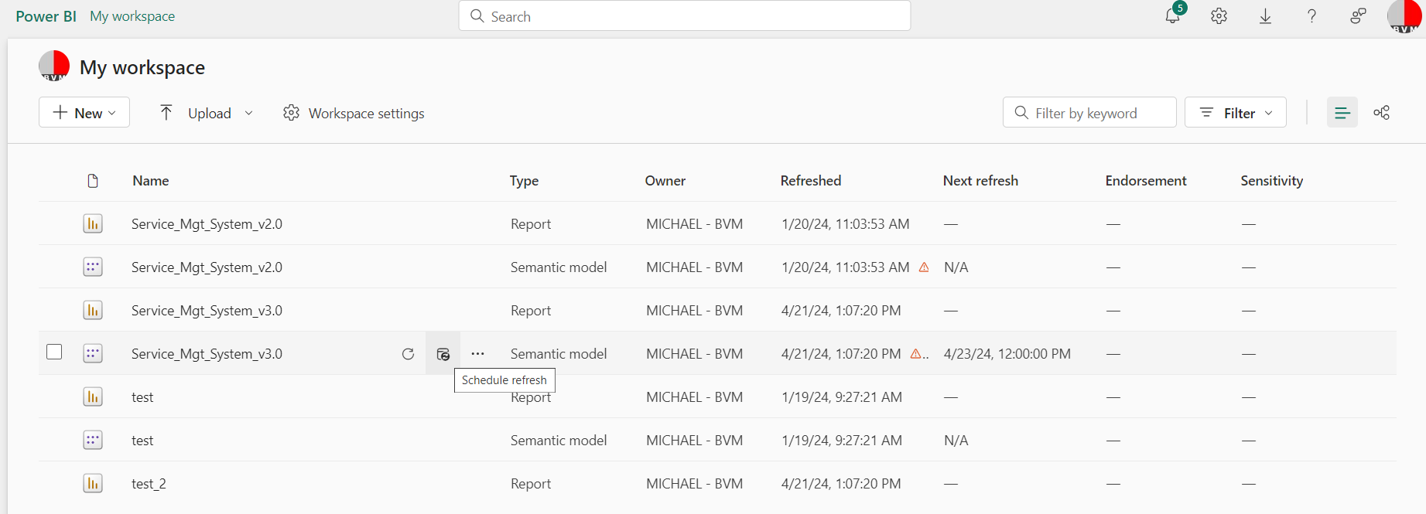
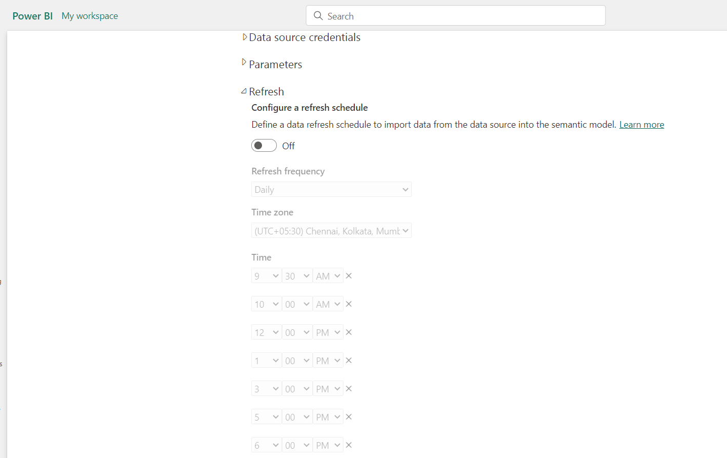
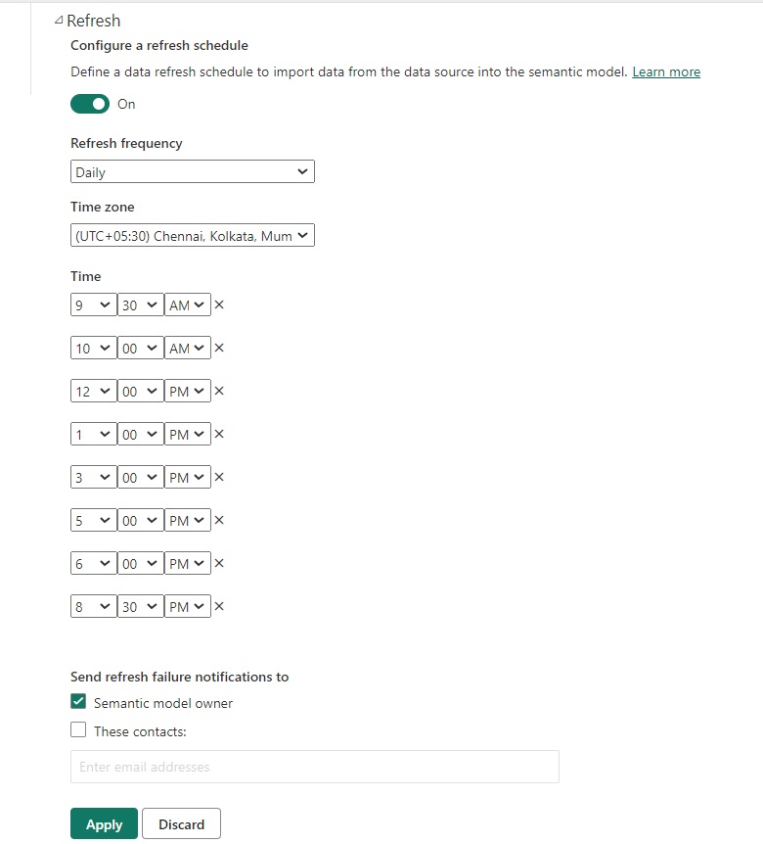
Step 1: Open this link https://app.powerbi.com/groups/me/list?experience=power-bi
Step 2: Click ‘Scheduled Refresh’
Step 3: Expand ‘Refresh’ and switch on the button and click ‘Apply’ button

