Slide 1
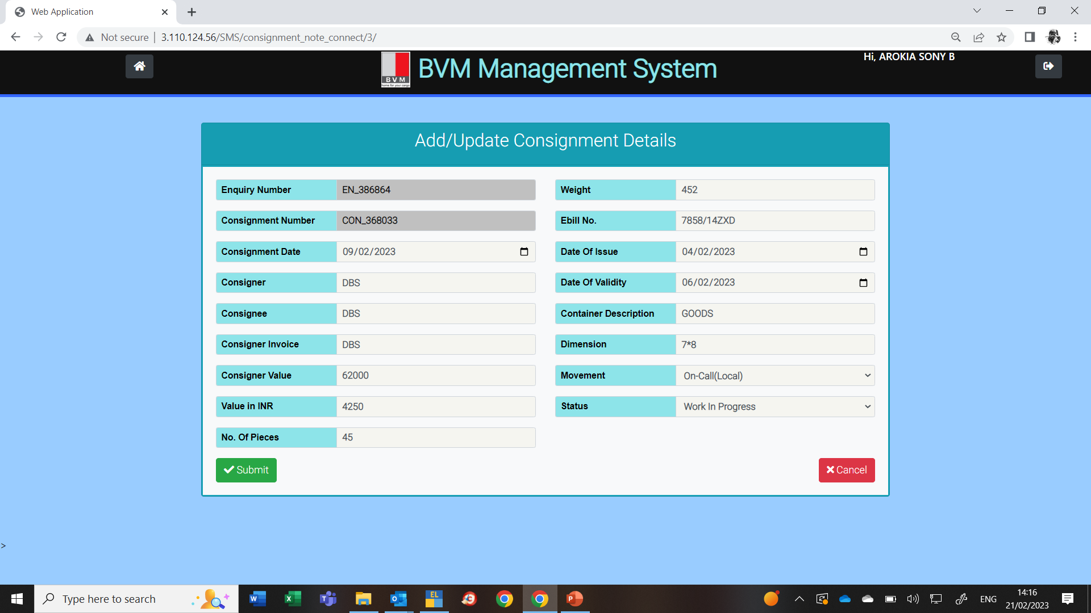
To be moved to next screen
To be provided to add as a line item
Remove Container
Movement Type : FTL, LTL
Consignment Type
Freight Amount to be included
Touch point to be added
GST Payable by : Customer / Consignor

Slide 2
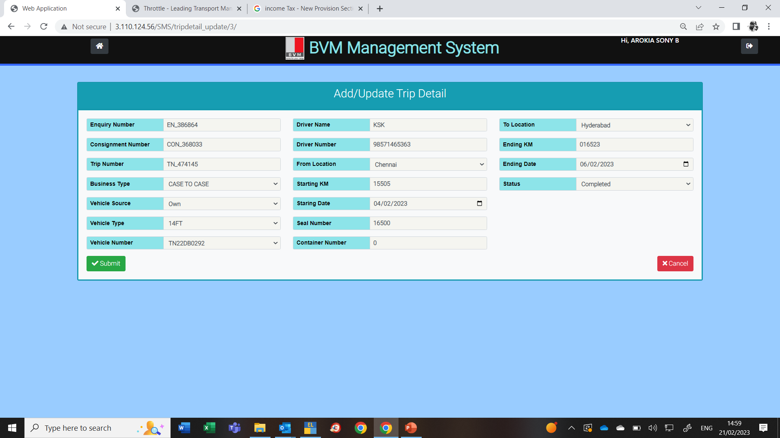
Vehicle Type Requested
Vehicle Type Placed
To be provided as line item
Billing Type
Loading / Unloading : start time & end time required
Driver Licenses No

Slide 3
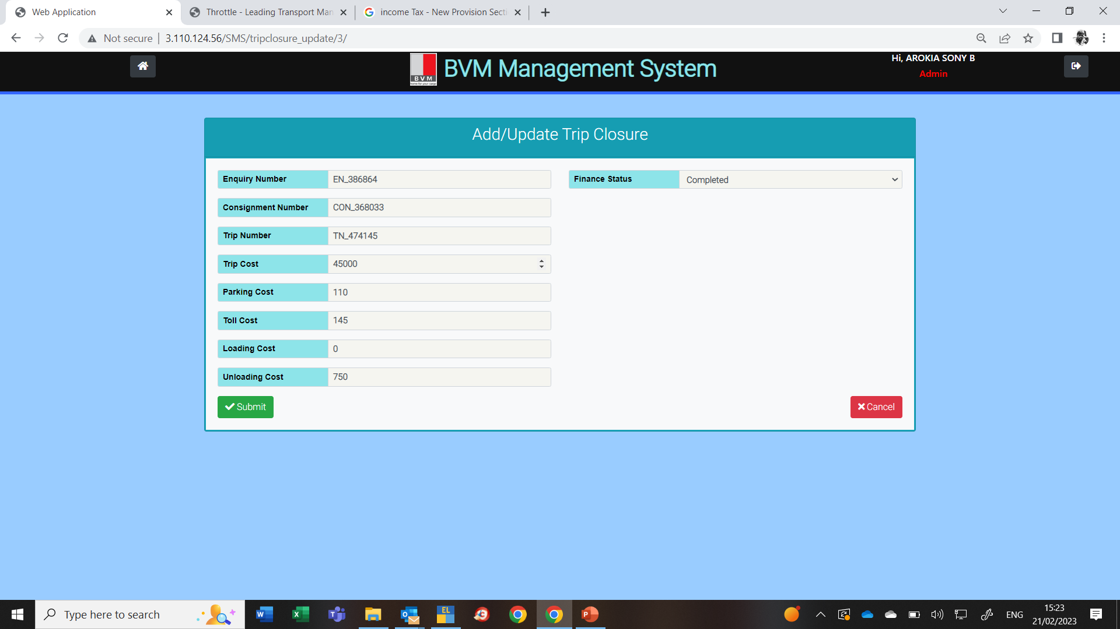
All cost to be changed as Charges
Handling Charges
Halting Charges
Customer Ref no to be added

