Slide 1

SuricataLog

Slide 2
Who I am?
I'm a System Administrator/ DevOps / Software developer who enjoys automating solutions to solve problems. Since I discovered GNU tools and the Slackware Linux distribution there was not turning back from me and since then I enjoyed working with anything related to Open Source.
After Linux I discovered Perl and eventually fell in love with Python.
Python and Linux are like a Peanut Butter sandwich, but better as you can keep mixing them together to make more interesting stuff.
I’m allergic to doing things manually more than twice, like to automate things.

Slide 3
What is Suricata?
Suricata is a genus of mongoose that is endemic to Africa. But is not very good at detecting intruders on the network… Oh wait, you are thinking about the Suricata Intrusion Detection System (IDS)!
Suricata (https://suricata.io/) is a high performance Network IDS, IPS and Network Security Monitoring engine. It is open source and owned by a community-run non-profit foundation, the Open Information Security Foundation (OISF). Suricata is developed by the OISF.

Slide 4
Why SuricataLog?
You just got to the point where running Bash scripts with jq is not fun anymore. Let’s be honest, sometimes jq syntax can be a little be challenging.
You want tables. Pretty print the results on your screen (sorry/ not sorry JSON)
Used all these as an excuse to write a Python application which I named 'SuricataLog'. As the name implies, this tool can let you browse through the contents of your event files, run several canned reports and even share the contents with other trusted users
KISS: Keep it simple. You want to run this on the terminal, quickly. Install it quickly too, without tons of dependencies.
The icing on the cake: It is Open Source and you can change the code to fit your needs.
Yes, you can still and should use jq :-)

Slide 5
Agenda
Installing Suricata
Installing SuricataLog
Making sure Suricata works
Running SuricataLog tools
Getting the source code

Slide 6
Installing Suricata (lots of SUDO)
# RTFM: https://docs.suricata.io/en/suricata-7.0.6/index.html
sudo dnf install dnf-plugins-core
sudo dnf copr enable @oisf/suricata-7.0
sudo dnf install suricata
sudo vi /etc/sysconfig/suricata (setup network interfaces, etc)
sudo suricata-update && sudo suricata-update update-sources
for source in et/open osif/trafficid ptresearch/attackdetection tgreen/hunting malsilo/win-malware; do sudo suricata-update enable-source $source; done
sudo sudo suricata-update
sudo suricata-update list-enabled-sources
Sudo vi /etc/suricata/suricata.yaml # Bare minimum edit HOME_NET and make sure ‘payload: yes’
sudo systemctl enable suricata.service –now
sudo systemctl enable suricata-update.service –now
dnf -y install wireshark wireshark-cli # Yeah, it is super useful.

Slide 7
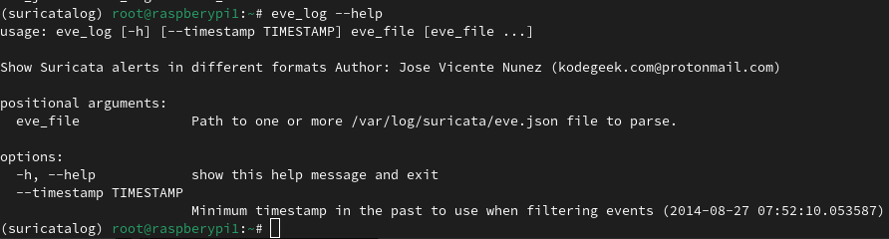
Installing SuricataLogs
sudo python3 -m venv /usr/local/venvs/suricatalog &&
sudo -i # Yeah, let’s install this for all the users
. /usr/local/venvs/suricatalog/bin/activate
pip install –upgrade pip
pip install suricatalog # Watch the magic unfold!!!
eve_log --help

Slide 8
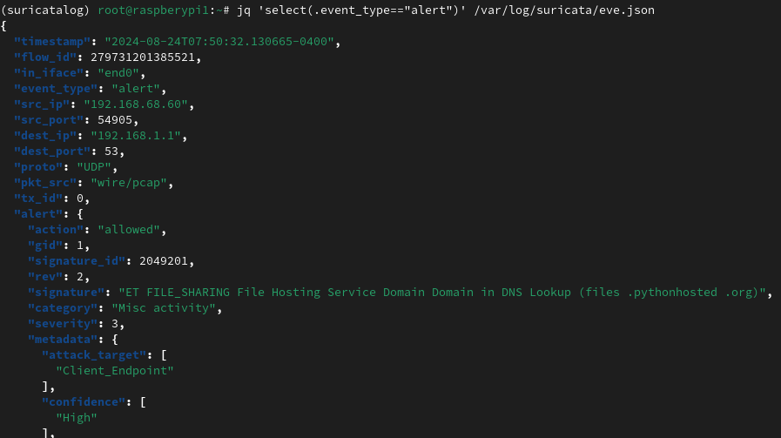
Making sure Suricata works
Initial eve.json file is verbose, but no real events (jq 'select(.event_type=="alert")' /var/log/suricata/eve.json)
I saw quite a bit of activity on my eve.json file after I downloaded a pip file

Slide 9
Making sure Suricata works
Let’s pretend there was some malicious traffic on our network
password protected: https://www.malware-traffic-analysis.net/about.html
Let’s get EMOTET WITH COBALT STRIKE
# Download
curl --fail --silent --location \
--remote-name https://www.malware-traffic-analysis.net/2022/02/08/2022-02-08-Emotet-epoch4-infection-start-and-spambot-traffic.pcap.zip \
--output /mnt/data/malware/2022-02-08-Emotet-epoch4-infection-start-and-spambot-traffic.pcap.zip\
|| echo "ERROR"
# Unzip
unzip
# What is inside?
capinfos 2022-02-08-Emotet-epoch4-infection-start-and-spambot-traffic.pcap

Slide 10
Making sure Suricata works (continuation)
# Use -l to save eve.json to a separate directory, for now
root@raspberypi1:/mnt/data/malware# sudo suricata -r /mnt/data/malware/2022-02-08-Emotet-epoch4-infection-start-and-spambot-traffic.pcap -k none --runmode autofp -c /etc/suricata/suricata.yaml -l /mnt/data/malware/
i: suricata: This is Suricata version 7.0.6 RELEASE running in USER mode
i: threads: Threads created -> RX: 1 W: 4 FM: 1 FR: 1 Engine started.
i: suricata: Signal Received. Stopping engine.
i: pcap: read 1 file, 44949 packets, 32163467 bytes
# There is a lot of content
jq 'select(.event_type=="alert")' /mnt/data/malware/eve.json

Slide 11
Running SuricataLogs tools
eve_log /mnt/data/walmware/eve.json # eve.json as a nice table
eve_json --nxdomain /mnt/data/walmware/eve.json # DNS domains involved, queries
eve_json --useragent /mnt/data/walmware/eve.json # Any browser user agent?
eve_json --flow /mnt/data/walmware/eve-2.json # Packets by traffic

Slide 12
Getting the source code
sudo dnf install -y git
git clone https://github.com/josevnz/SuricataLog
python3 -m venv ~/venv/suricatalog
. ~/venv/suricatalog/bin/activate
pip install –upgrade pip && pip install build
python3 -m build . # Get an wheelhouse
pip install --editable . # To really play
python3 -m unittest discover -s test -t test # Run unit tests

Slide 13
The future
Performance improvements: Handle very large eve.log files. For that I may use a shared memory file, to only load records that are visible on the TUI.
Keep up with updates of tools like Textualize and Python, improvements and cool features for free
Do not plan to add a Web interface or a GUI. Keeping it simple on purpose, it must run on a terminal!
¿Alguien quiere ver SuricataLog en Español? Localization may be a desirable feature.

Slide 14
Resources
I work on SuricataLog in my spare time. However I’m always checking for bug reports, thinking how I can make it more useful. Also open to suggestions for new features.
The tutorial that started all: https://www.freecodecamp.org/news/home-network-security-with-suricata-raspberrypi4-python/

