Slide 1
AI & Machine Learning
for Business
TODAY'S DECISION
When several models fit the past equally well, which one should we trust with a policy decision?
Week 8 • Support Vector Machines, Model Selection & BookingGuard
Rahul Lath
MSc in Business Analytics and Artificial Intelligence
Notes:
Week 8 opener. The decision question frames the whole session: SVM motivation (many boundaries fit), model selection (many models fit), BookingGuard (a probability must support a policy).
Sources: course syllabus; IENYC faculty guidance.

Slide 2
Course status and required notices
CLASS OPENING
PLAN › SAVE OR LET GO › MIDTERM › CAPSTONE › BOOKINGGUARD
Week 8 of 15
COURSE PROGRESS
Weeks 1–7 built probability, validation, regularization, nonlinear features, trees, forests and boosting.
Today adds the last classifier family before the midterm, then turns it into a model-selection habit.
SAVE OR LET GO
Closed Wednesday, October 14. Confirm your Blackboard receipt today.
Its threshold, sensitivity and memo habits return in BookingGuard.
MIDTERM
Friday, October 30, in the 3:00–6:00 PM class block.
Sessions 1–8, so today's SVM content is in scope.
CAPSTONE
Interest Exchange is complete. Register a proposed team by Tuesday, October 27, 11:59 PM ET.
Teams become official only after instructor confirmation on October 28.
BOOKINGGUARD
Exercise 03 launches today. Due Sunday, November 15, 11:59 PM ET.
Individual exercise. It applies today's model-selection framework to a deposit policy.
Notes:
Mirror of the Week 7 opening. Dates: Save or Let Go closed Wed Oct 14, 11:59 PM ET. Capstone registration Tue Oct 27, 11:59 PM ET; confirmation Wed Oct 28, 6:00 PM ET. Midterm Fri Oct 30 in the 3:00–6:00 PM block. BookingGuard due Sun Nov 15, 11:59 PM ET.
Sources: course handoff; Blackboard status snapshot; midterm plan.

Slide 3
Blackboard is the home for everything this week
WHERE THINGS LIVE
PLAN › SAVE OR LET GO › MIDTERM › CAPSTONE › BOOKINGGUARD
Week 8 of 15
When a slide shows the teal Blackboard tag in its lower right corner, that is where to go.
WEEK 8 PAGE
Slides (PDF), the in-class SVM workbook (opens in Colab), and the retrieval check
EXERCISE 02
Save or Let Go: closed October 14. Your submission receipt is under Exercises › Save or Let Go
EXERCISE 03
BookingGuard: brief, starter notebook, policy_costs.csv, rubric and submission field. Due November 15
CAPSTONE AREA
01. Assessment & Grading › Group Capstone Project: team registration, confirmed teams, proposal template
MIDTERM
Friday, October 30. Format and access instructions are posted on Blackboard
Workbooks: open from Blackboard, then File › Save a copy in Drive. Work in your copy; the original stays read-only.
BLACKBOARD › Week 8
Notes:
Same structure as Week 7 slide 3, advanced one week: Exercise 02 is now a receipt check, Exercise 03 is live.

Slide 4
Three hours: build the foundation, add the SVM, then put it to work
SESSION PLAN
PLAN › SAVE OR LET GO › MIDTERM › CAPSTONE › BOOKINGGUARD
Week 8 of 15
TIME | BLOCK | BY THE END YOU CAN…
0–10 min | Opening, notices, Save or Let Go closeout | Name this week's deadlines and confirm your Exercise 02 receipt
10–25 min | Midterm: format and one example of each question type | Answer each question type the way it is scored
25–45 min | Foundations: bias–variance and the Week 7 bridge | Place the SVM among the classifiers you already know
45–90 min | SVM: why → margin → soft margin → kernels → probabilities | Explain margin, C, scaling, gamma and calibration
90–105 min | Break
105–130 min | In-class SVM workbook, Tasks 1–5 | Tune and judge an SVM with validation evidence
130–150 min | Model-selection framework | Defend a model choice as a business decision
150–168 min | BookingGuard launch | State the prediction moment and a first hypothesis
168–180 min | Capstone proposals and exit ticket | Recognize a strong proposal before November 8
Notes:
Timing is a guide. Protect the lab (Tasks 1–5) and the BookingGuard launch; the appendix is optional.

Slide 5
Six dates between today and November 15
THIS WEEK
PLAN › SAVE OR LET GO › MIDTERM › CAPSTONE › BOOKINGGUARD
Week 8 of 15
Three arrive before Friday. Put them in your calendar now.
MON OCT 26
TUE OCT 27
WED OCT 28
FRI OCT 30
SUN NOV 8
SUN NOV 15
BookingGuard launches
Today
Register capstone team
11:59 PM ET
Teams confirmed
6:00 PM ET
Midterm
3:00–6:00 PM
Proposal + signed contract
11:59 PM ET
BookingGuard due
11:59 PM ET
BEFORE FRIDAY
Register your team, confirm the Save or Let Go receipt, and finish your one double-sided midterm reference sheet.
AFTER FRIDAY
Proposal and contract by November 8; BookingGuard by November 15. Start BookingGuard's first hypothesis tonight.
Notes:
Dates per course handoff and Blackboard. Nov 2 is the first class after the midterm and is used to align capstone proposals (Week 7 plan).

Slide 6
Confirm the submission, then carry its habits into BookingGuard
SAVE OR LET GO · CLOSEOUT
PLAN › SAVE OR LET GO › MIDTERM › CAPSTONE › BOOKINGGUARD
Week 8 of 15
THE ASK · TODAY
1 Open Blackboard › Exercises › Save or Let Go.
2 Confirm the receipt lists your memo and methodology deck.
3 If a file or receipt is missing, raise it with the instructor today, not after the midterm.
4 Keep your threshold and sensitivity code: BookingGuard reuses the pattern.
WHAT CARRIES FORWARD
IN SAVE OR LET GO | RETURNS IN BOOKINGGUARD AS
Threshold from campaign economics, not 0.50 | Deposit threshold from policy_costs.csv
Validation that represents future use | Train on earlier arrivals, validate on a later period
Sensitivity to contact cost and retained value | Sensitivity to deposit recovery and guest friction
Contact volume under a capacity limit | Deposits per 1,000 bookings
One-page memo: who acts, how many, value, limitation | One-page memo plus a decision file
BLACKBOARD › Exercises › Save or Let Go
Notes:
The ask is administrative (receipt) plus intellectual (reuse). Save or Let Go and BookingGuard share one evidence standard: economics-driven threshold, future-like validation, sensitivity, decision memo.

Slide 7
Midterm first: the final preparation window
MIDTERM · FRIDAY, OCTOBER 30
FORMAT › MCQ › APPLIED › INTEGRATED › REFERENCE SHEET
Week 8 of 15
105
15
3
1
minutes
multiple-choice concept checks
applied written responses
integrated written case
RULES
One double-sided reference sheet and a basic calculator. No AI tools, internet, collaboration or coding.
SCOPE
Sessions 1–8. BookingGuard and capstone logistics are excluded.
CONCEPT CHECKS
Multiple choice: one best answer from four. Distractors are common misconceptions.
WRITTEN ITEMS
Calculation or evidence with units → decision → the assumption that would reverse it.
Notes:
Format per midterm plan. One worked example of each question type follows, drawn from Weeks 1–7 only. The exam is Friday, after the instructor returns.

Slide 8
Concept check: choose the one best answer
MIDTERM · EXAMPLE 1 OF 3 · MULTIPLE CHOICE
FORMAT › MCQ › APPLIED › INTEGRATED › REFERENCE SHEET
Week 8 of 15
Commit to a letter in 60 seconds, then check the key. A practice item, not an exam item.
Fraud is 1% of transactions. A new model scores 99% accuracy on validation data. What should you conclude?
A
The model is excellent
B
The model is overfitting
C
Accuracy alone is uninformative here; compare precision, recall or PR-AUC with the 1% baseline
D
The data must contain leakage
Answer C. Predicting “no fraud” for everyone also scores 99%, so accuracy cannot separate a useful model from a useless one.
Notes:
Answer: C. Predicting 'no fraud' for every transaction also scores 99%, so accuracy alone says nothing. Compare precision, recall or PR-AUC with the 1% prevalence baseline. A and B are tempting misreadings; D has no evidence.

Slide 9
Classification threshold: show the calculation, then the reversal
MIDTERM · EXAMPLE 2 OF 3 · APPLIED WRITTEN
FORMAT › MCQ › APPLIED › INTEGRATED › REFERENCE SHEET
Week 8 of 15
Written prompt · A retention model assigns p(churn) = 0.40. An intervention costs $20 and saves $80 when churn would occur. Should the team intervene? State one assumption that could reverse your answer.
MODEL ANSWER
CALCULATE
Expected recovery = 0.40 × $80 = $32
Net expected value = $32 − $20 = +$12
Break-even p* = $20 ÷ $80 = 0.25
DECIDE
Intervene: 0.40 is above the 0.25 break-even, under these assumptions.
Units: dollars per customer contacted.
REVERSAL
If the offer works only half the time: 0.40 × 0.5 × $80 = $16 < $20.
Then do not intervene. Break-even success rate: 62.5%.
Show units, compare value with cost, connect the arithmetic to the action, then name the assumption that flips it.
Notes:
Break-even p* = cost / saved value = 20 / 80 = 0.25. Reversal: if the offer succeeds only half the time, expected recovery = 0.40 × 0.5 × $80 = $16 < $20. Break-even success rate: 20 / (0.40 × 80) = 0.625.

Slide 10
Audit an end-to-end modeling workflow
MIDTERM · EXAMPLE 3 OF 3 · INTEGRATED WRITTEN
FORMAT › MCQ › APPLIED › INTEGRATED › REFERENCE SHEET
Week 8 of 15
Written prompt · A subscription team predicts churn 30 days before renewal with gradient boosting. They target-encode the plan field using all 2023–2025 rows, split randomly 80/20, check test AUC after every tuning run, include a field recording whether a retention offer was accepted, and act when p ≥ 0.50.
EVIDENCE BREAK | WHY IT MISLEADS | REPAIR
Offer-accepted field | Known only after the decision: target leakage | Keep only fields known 30 days before renewal
Encoding on all rows; random split | Validation labels shape features; mixes years | Fit encoding on earlier rows; validate on a later period
Test AUC after every run | The test set becomes tuning data: optimistic | Tune on validation; touch the test set once
Acting at p ≥ 0.50 | A habit, not a policy | Break-even from offer cost and saved value; stress-test it
Notes:
Expect four breaks. Debrief by naming the broken evidence boundary before discussing the model family (same discipline as Week 7's leakage sample).

Slide 11
Build your one double-sided reference sheet before Friday
MIDTERM · REFERENCE SHEET
FORMAT › MCQ › APPLIED › INTEGRATED › REFERENCE SHEET
Week 8 of 15
FORMULAS
Expected value and break-even p* = cost ÷ value saved
Precision, recall, F1
Log loss and Brier score
Expected cost under a capacity limit
DIAGNOSTICS
Train vs validation patterns for bias and variance
Leakage test: known at the prediction moment?
Capacity knob for each model family
Validation-curve stopping rule
DECISIONS
Random vs temporal validation
Model comparison: same rows, split, metrics
Threshold under capacity
Recommendation + reversal trigger
Notes:
Encourage students to write the sheet themselves; choosing what goes on it is retrieval practice. Add today's SVM material after class.

Slide 12
WEEK 8 · PART 1
The classifier toolkit so far
Seven building blocks, one lens, and the question Week 7 left open
Notes:
Purpose: before introducing SVMs, show that every idea it needs is already in the room.

Slide 13
Seven building blocks you already own
BUILDING BLOCKS
TOOLKIT › BIAS–VARIANCE › MODEL MAP › WEEK 7 BRIDGE
Week 8 of 15
BUILDING BLOCK | WHAT IT GAVE US | THE QUESTION IT ANSWERS
Probability & thresholds | Scores become actions through costs | When is a prediction worth acting on?
Validation | Evidence that represents future use | Will this work on next month's data?
Regularization | A penalty that trades fit for stability | How do we keep a flexible model stable?
Nonlinear features | Curved boundaries by adding features | What if a straight boundary is not enough?
Trees | Piecewise rules; feature scale does not matter | Can we capture interactions without formulas?
Forests | Averaging cuts variance | How do we steady an unstable model?
Boosting | Loss + gradient steps + capacity control | How do we fix what the model still gets wrong?
Today's new model reuses every one of these blocks. We will name each link once the model is on the table.
Notes:
Recall only. Do not preview today's model here; each block is reused once the SVM is explained, and the comparison slides after the SVM section make those links explicit.

Slide 14
The target and the decision identify the learning problem
PROBLEM FAMILIES
TOOLKIT › BIAS–VARIANCE › MODEL MAP › WEEK 7 BRIDGE
Week 8 of 15
Today stays inside classification: an event or category that triggers an action.
REGRESSION
Predict a number
Revenue, demand, length of stay
CLASSIFICATION
Predict an event or category
Churn, fraud, cancellation: today's focus
CLUSTERING
Discover groups with no label
Customer segments for a campaign
REDUCTION
Compress features, keep structure
Many survey items to a few factors
Same question first, every time: what action follows the prediction, and when is it needed?
Notes:
Midterm concept-check territory. Ask: which family is BookingGuard? (Classification: will the booking cancel?) Which family is Segment Studio? (Clustering.)
Source: ISLP; course sequence.

Slide 15
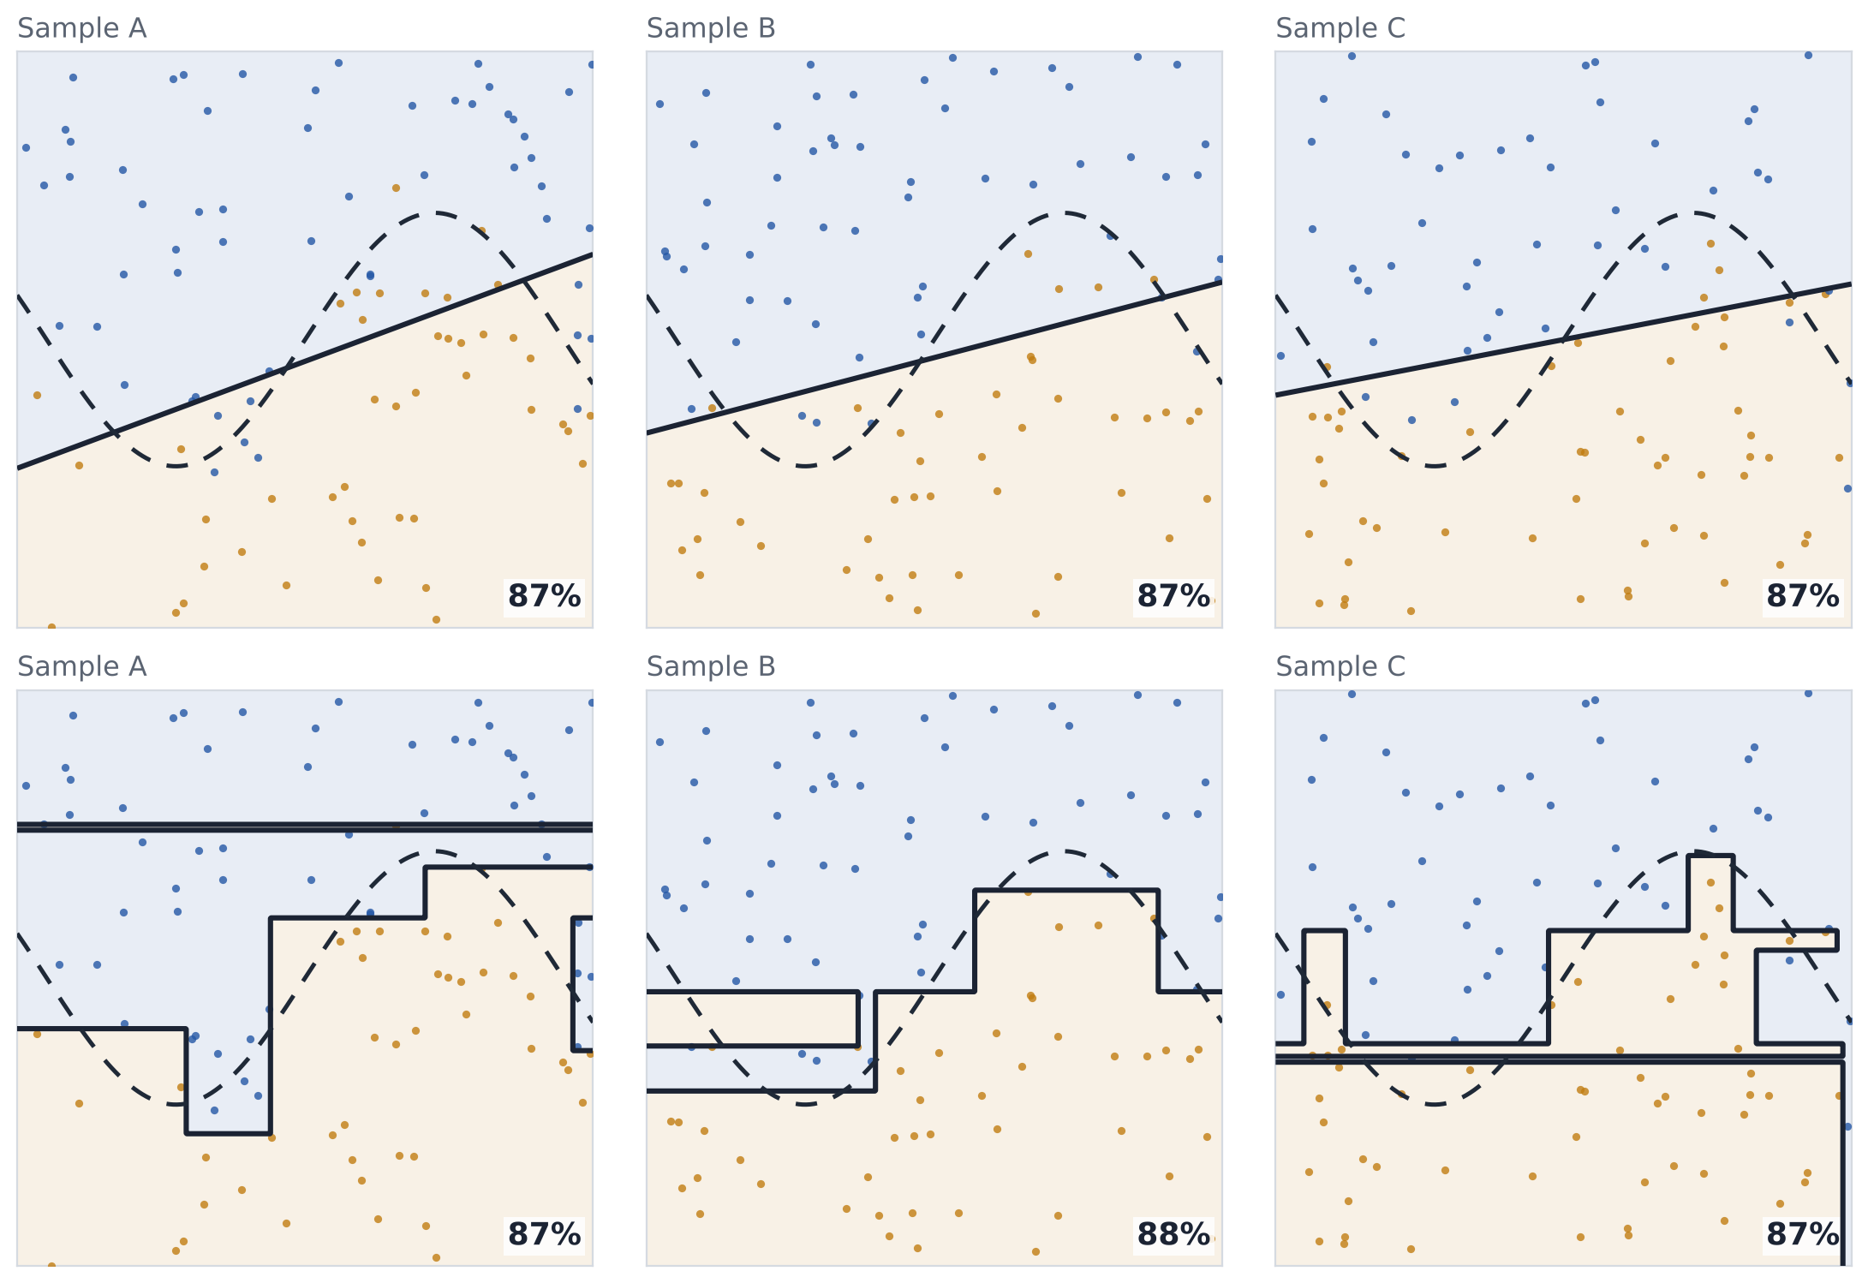
Bias and variance are different ways to be wrong
GENERALIZATION
TOOLKIT › BIAS–VARIANCE › MODEL MAP › WEEK 7 BRIDGE
Week 8 of 15
The same two models refit on three samples of 100 customers from one population. Dashed curve: the true boundary.
HIGH BIAS
Logistic regression
The three lines nearly coincide, and all three cut straight through the curve. More data will not fix this: a line cannot bend.
HIGH VARIANCE
Unpruned decision tree
Every sample produces a different rule, including thin strips around single customers. The rule describes the sample, not the population.
Same accuracy on new customers (about 87%), opposite reasons. Bias asks whether the model can represent the pattern; variance asks whether the learned pattern is stable.
Notes:
Simulated population used on every slide: two standardized customer features; the true boundary is the dashed curve x2 = 1.1·sin(1.4·x1); labels are noisy, so even the true boundary misclassifies about 8% of customers (irreducible error). All accuracies are measured on 20,000 fresh customers from the same population. Code: figs.py.
What to point at: the logistic lines barely move between samples but all cut straight through the curve (bias). The tree boundaries change shape with every sample, including thin strips around single customers (variance). Both score about 87% on new customers, for opposite reasons. Averaged over 100 samples: logistic 13.2% error, unpruned tree 13.9%.
Sources: James et al., ISLP §2.2.2 and Fig. 2.11–2.12 (repeated-sample view); Cornell CS4780 Lecture 12, Bias–Variance Tradeoff; scikit-learn example 'Single estimator versus bagging: bias-variance decomposition'.

Slide 16
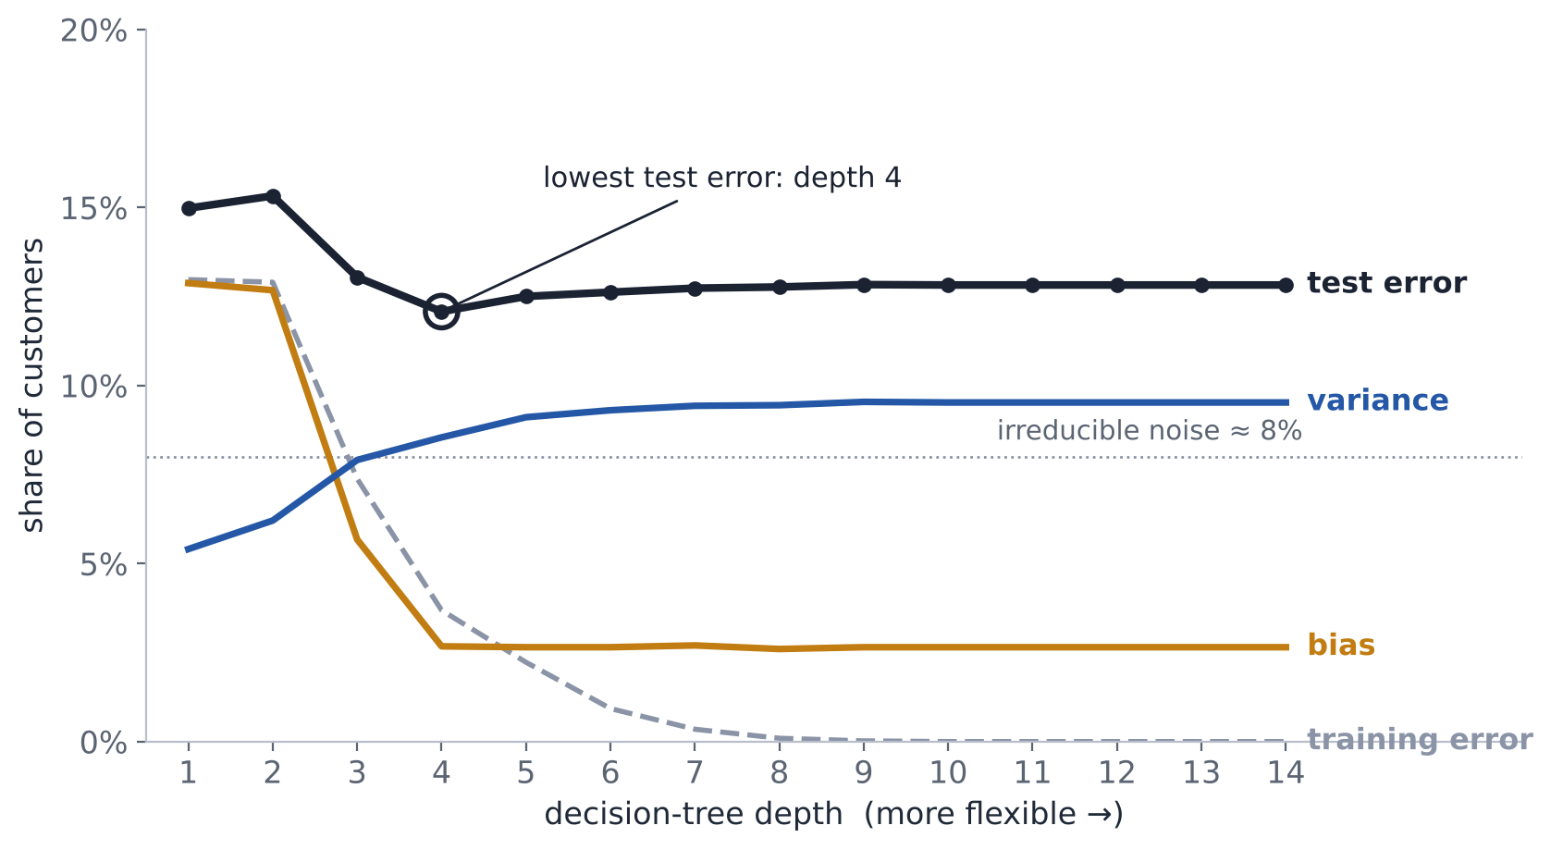
Model flexibility trades bias for variance
GENERALIZATION
TOOLKIT › BIAS–VARIANCE › MODEL MAP › WEEK 7 BRIDGE
Week 8 of 15
Decision trees of depth 1–14, each refit on 100 samples of 150 customers. Errors measured on 4,000 new customers.
BIAS
Average-vote prediction wrong vs. the true boundary.
Falls from 13% to 3% by depth 4, then stays flat.
VARIANCE
Refits that disagree with the average vote.
Rises from 5% to 10%: deeper trees chase each sample.
TRAINING ERROR
Falls to 0% and keeps looking better.
It cannot see variance, so it cannot pick the depth.
CHOOSE
Depth 4: the lowest error on new customers.
Found with validation data, never with training fit.
Notes:
Simulated population used on every slide: two standardized customer features; the true boundary is the dashed curve x2 = 1.1·sin(1.4·x1); labels are noisy, so even the true boundary misclassifies about 8% of customers (irreducible error). All accuracies are measured on 20,000 fresh customers from the same population. Code: figs.py.
Decomposition for 0-1 loss follows Domingos (2000), 'A Unified Bias-Variance Decomposition': the main prediction is the majority vote across the 100 refits; bias = share of customers where that vote disagrees with the true boundary; variance = share of individual predictions that disagree with the vote. Unlike squared error, the pieces do not simply add, so read the shapes, not a sum. Values: test error 15.0%, 15.3%, 13.0%, 12.1%, 12.5%, 12.6% … for depths 1–6. Trees stop growing near depth 9 at this sample size, so the curves flatten.
Caveat for discussion: the U-shape is typical, not universal (Neal et al. 2019, 'On the Bias-Variance Tradeoff: Textbooks Need an Update').
Sources: ISLP Fig. 2.9, 2.12, 2.17; Domingos 2000 (ICML); scikit-learn 'Validation curves'.

Slide 17
Which methods fix which failure
BIAS AND VARIANCE
TOOLKIT › BIAS–VARIANCE › MODEL MAP › WEEK 7 BRIDGE
Week 8 of 15
Every method from Weeks 1–7 either adds flexibility or constrains and averages it.
HIGH BIAS → ADD FLEXIBILITY
Symptom: training and validation error both high, and close together
Nonlinear features and interactions
Deeper trees; more boosting rounds
A weaker regularization penalty
HIGH VARIANCE → CONSTRAIN OR AVERAGE
Symptom: low training error, much higher validation error
A stronger regularization penalty
Shallower trees, larger minimum leaf
Bagging and random forests
Early stopping; more training data
Training error alone cannot tell these apart. Always compare it with validation error.
EXPLORE IT MLU-Explain: The Bias–Variance Tradeoff (interactive)
Notes:
Diagnose first, then pick the lever. Ask: which side does boosting sit on? (Mainly the left: it reduces bias; early stopping and a small learning rate guard against variance.)
Interactive: MLU-Explain, The Bias–Variance Tradeoff (mlu-explain.github.io/bias-variance).

Slide 18
Five families, five learning behaviors
MODEL MAP
TOOLKIT › BIAS–VARIANCE › MODEL MAP › WEEK 7 BRIDGE
Week 8 of 15
Week 7's map, unchanged. Read the middle column as how each model spends its effort.
MODEL FAMILY | HOW IT LEARNS | PRIMARY EFFECT
Logistic | One global linear score in transformed feature space | Low variance; explicit coefficients
One tree | One recursive partition | Readable; unstable
Bagging | Independent trees on resampled rows, then average | Reduces variance
Random forest | Bagging plus feature sampling | Decorrelates trees
Boosting | Sequential shallow trees fit the current loss signal | Reduces remaining systematic error
Boosting is the only family here that changes its target after every stage.
Notes:
Week 7 slide 15. Leave the SVM off this map until it has been explained; it returns as a full comparison after Part 2.
Sources: ISLP Ch. 4, 8.

Slide 19
The question Week 7 left open
WEEK 7 → WEEK 8
TOOLKIT › BIAS–VARIANCE › MODEL MAP › WEEK 7 BRIDGE
Week 8 of 15
WHAT WEEK 7 ESTABLISHED
TODAY'S QUESTION
Several boundaries classify last month's customers perfectly.
Which one should we trust with next month's?
LOSS
Every model minimizes a loss; the loss decides what counts as an error.
HARD CASES
Boosting asks “what is still wrong?”: large residuals pull the next tree hardest.
CAPACITY
Flexibility knobs are chosen on validation evidence, never on training fit.
Part 2 answers it with a new model, then we compare it with everything above.
Notes:
The segue, using only Week 7 ideas. Boosting asked 'what is still wrong?'. Pose today's question and let the room answer before Part 2: when many boundaries fit, which do you trust? Do not name the SVM's mechanics yet.

Slide 20
WEEK 8 · PART 2
Support vector machines: from why to how
Motivation → margin → soft margin → scaling → kernels → probabilities
Notes:
45 minutes. Every figure on the following slides is reproduced in the in-class workbook, so students can rerun and modify it.

Slide 21
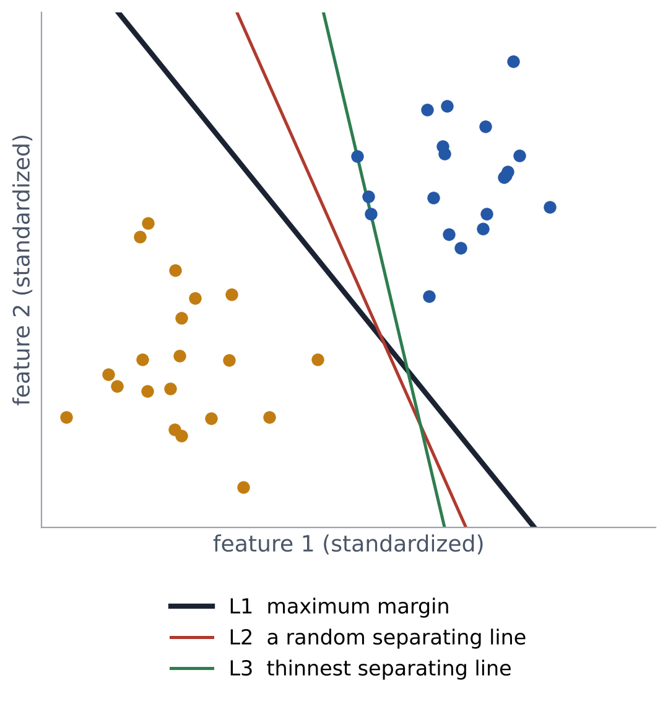
The problem: several boundaries fit the past equally well
WHY AN SVM
WHY › MARGIN › SOFT MARGIN › SCALING › KERNELS › PROBABILITIES › COMPARE
Week 8 of 15
SITUATION
A classifier must sort next month's customers, not last month's.
THE TRAP
Every line on the right has 0% training error, so the leaderboard cannot choose.
THE BET
Prefer the boundary that stays farthest from every training case, so small shifts in new data do not flip decisions.
THE TEST
Only validation on new data shows whether the bet paid off.
Notes:
All three lines have 0% training error on these 40 customers. Ask the room which they would deploy and why, before revealing the next slide.
Figure: simulated data, workbook Part A.

Slide 22
Across 200 fresh samples, the widest margin generalizes best on average
WHY AN SVM · EVIDENCE
WHY › MARGIN › SOFT MARGIN › SCALING › KERNELS › PROBABILITIES › COMPARE
Week 8 of 15
Error on 20,000 new customers, averaging over 189 training samples of 40 customers where competing lines existed.
1.8%
2.4%
3.2%
Maximum margin
Any separating line
Thinnest separating line
The widest margin beat or tied a random separating line in 69% of samples: a sound bet, not a guarantee. That is why we still validate.
Notes:
Workbook Part A, second cell. Honest framing: the maximum-margin line was at least as good as a random separating line in 69% of samples, not 100%. A margin is a sound bet, not a guarantee, which is exactly why we still validate.

Slide 23
Where SVMs earn their place, and where they do not
WHY AN SVM · IN PRACTICE
WHY › MARGIN › SOFT MARGIN › SCALING › KERNELS › PROBABILITIES › COMPARE
Week 8 of 15
STRONG FIT
Text on sparse word features: spam filters, support-ticket routing, sentiment
Wide data with more features than rows: gene expression, sensor signatures
Small-to-medium datasets with smooth nonlinear boundaries
A robust benchmark beside regularized logistic regression
WEAKER FIT
Kernel SVM on hundreds of thousands of rows: fit time grows at least quadratically with rows
Mixed-type business tables, where boosting usually leads
Decisions that need explainable coefficients or native probabilities
Many categorical features with missing values: more preprocessing to get right
Know the tool's home ground before you put it on a leaderboard.
Notes:
Scaling fact: scikit-learn documents that kernel SVC fit time scales at least quadratically with the number of samples and can be impractical beyond tens of thousands of rows; LinearSVC scales far better.
Source: scikit-learn SVC documentation and SVM user guide.

Slide 24
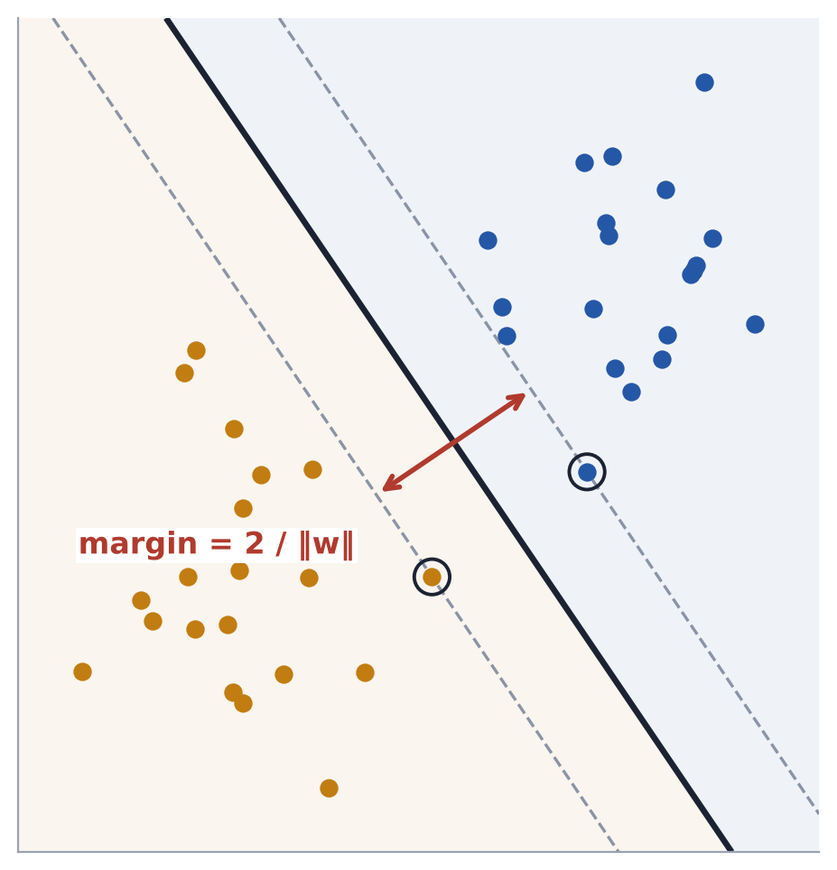
Picture the widest street between two neighborhoods
VISUAL MECHANISM
WHY › MARGIN › SOFT MARGIN › SCALING › KERNELS › PROBABILITIES › COMPARE
Week 8 of 15
BOUNDARY
The center line, w·x + b = 0. The sign of the score gives the class.
MARGIN
The street's width, 2 / ‖w‖. A wider street means a smaller ‖w‖.
SUPPORT VECTORS
The houses on the curb. They alone fix where the street runs.
EVERYONE ELSE
Houses set back from the street can move or vanish; the street does not change.
So what? Borderline cases control the fit: their data quality and scaling matter most.
Notes:
Workbook Part B: deleting the point farthest from the boundary changed the fitted boundary by 0.0000; deleting a support vector moved it. This is the property to remember for the midterm.
Figure: simulated, workbook Part B.

Slide 25
The whole idea fits in one optimization
MAXIMAL-MARGIN CLASSIFIER
WHY › MARGIN › SOFT MARGIN › SCALING › KERNELS › PROBABILITIES › COMPARE
Week 8 of 15
maximize 2 / ‖w‖ ⇔ minimize ½‖w‖²
subject to yᵢ (w · xᵢ + b) ≥ 1 for every training point i
SCORE
f(x) = w·x + b. The sign gives the class; the size is a distance from the boundary.
CONSTRAINT
Labels are coded y = ±1. Every point must sit on its own side, at least at the margin edge.
THE CATCH
When classes overlap, no such street exists. Real data needs a softer rule: next slide.
Notes:
Maximizing 2/‖w‖ is the same as minimizing ½‖w‖² (squared for convenience). The constraint says every training point is on the correct side and at least at the margin edge. ISLP section 9.1.

Slide 26
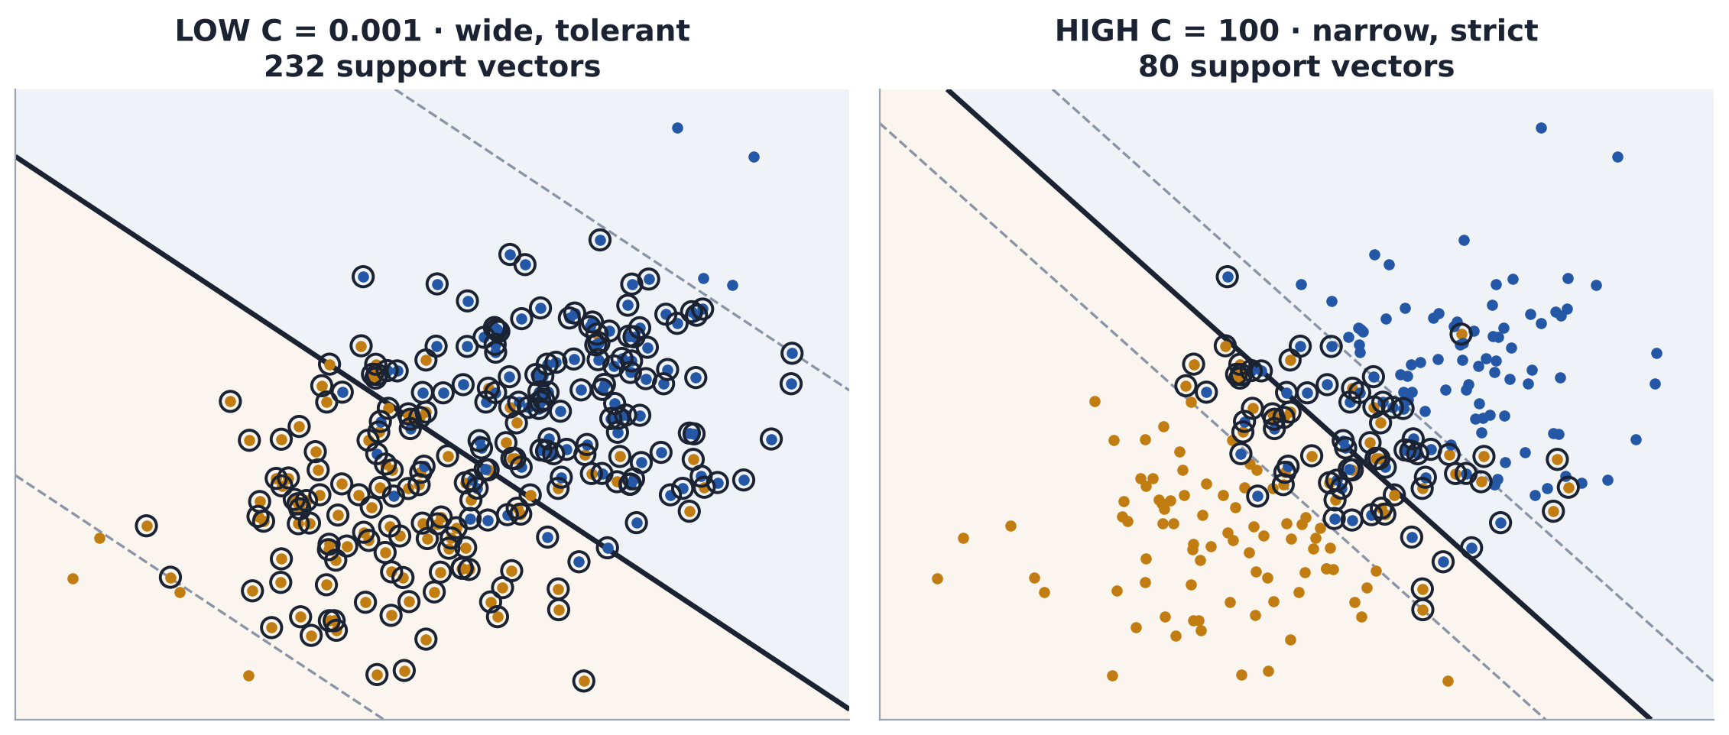
Soft margins buy a wider street by allowing some violations
SOFT MARGIN
WHY › MARGIN › SOFT MARGIN › SCALING › KERNELS › PROBABILITIES › COMPARE
Week 8 of 15
C is the price of each violation. Same 240 training customers, two prices.
C
Penalty per point inside the margin or misclassified
HIGH C
Narrow street, few violations, fewer support vectors: more variance
LOW C
Wide street, many support vectors: more bias, more stability
CHOOSE
By validated decision value, never by training accuracy
Notes:
Workbook Task 2 table: C=0.001 → 232 support vectors, val acc 0.869; C=100 → 80 support vectors, val acc 0.850. With heavy overlap the validation gap is small: do not over-read it. ISLP 9.2; scikit-learn SVC.

Slide 27
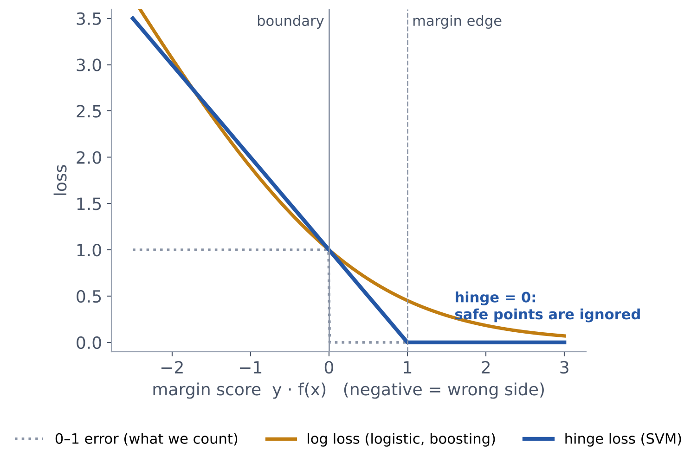
The SVM is Week 7's recipe with a different loss
HINGE LOSS
WHY › MARGIN › SOFT MARGIN › SCALING › KERNELS › PROBABILITIES › COMPARE
Week 8 of 15
minimize ½‖w‖² + C · Σ max(0, 1 − yᵢ f(xᵢ))
PENALTY
½‖w‖² keeps the street wide, like the logistic penalty.
LOSS
Hinge charges only points inside the margin or on the wrong side.
CONSEQUENCE
Points with y·f(x) ≥ 1 cost nothing, so only support vectors shape the fit.
CONTRAST
Log loss never reaches zero, so every row nudges logistic and boosting.
Notes:
Regularized logistic regression: minimize log loss + penalty. Soft-margin SVM: minimize C × hinge loss + ½‖w‖². C plays the role of 1/λ. The flat zero region of the hinge is the mathematical reason only support vectors matter.
ISLP 9.5 (relationship to logistic regression).

Slide 28
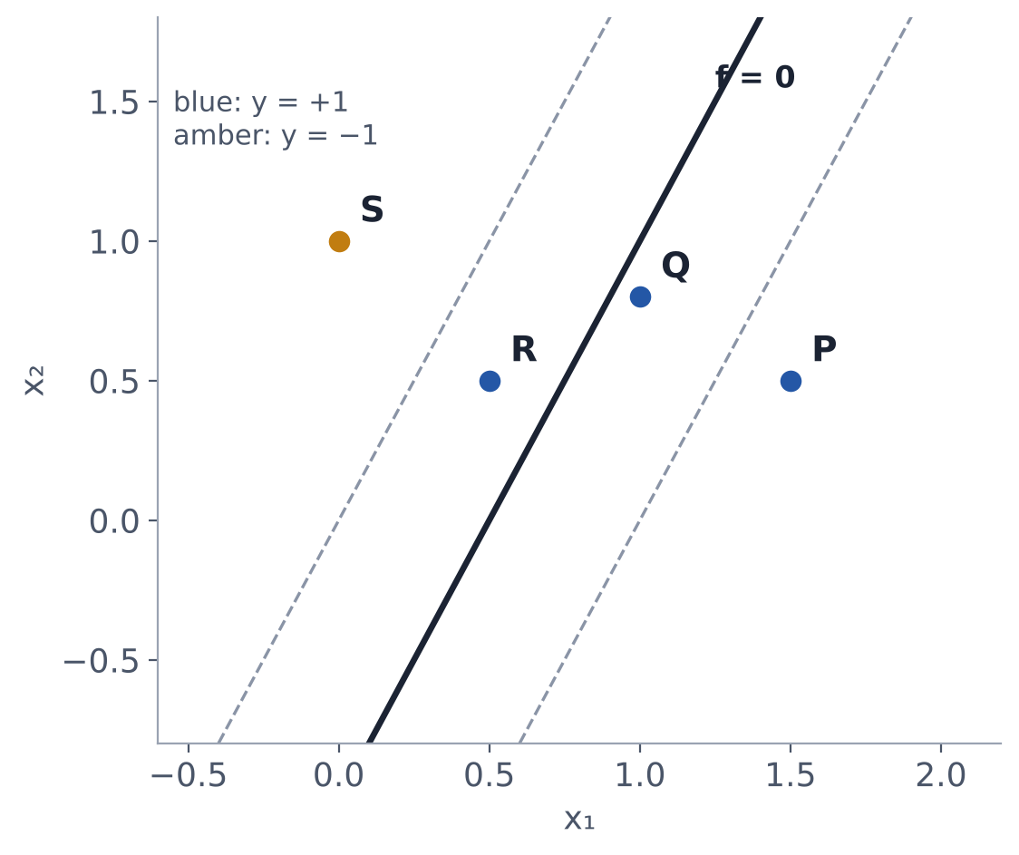
Score four customers by hand
WORKED EXAMPLE
WHY › MARGIN › SOFT MARGIN › SCALING › KERNELS › PROBABILITIES › COMPARE
Week 8 of 15
w = (2, −1), b = −1, so f(x) = 2x₁ − x₂ − 1. Margin width = 2 / ‖w‖ = 2 / √5 ≈ 0.89
CUSTOMER | X | Y | F(X) | Y·F(X) | HINGE | STATUS
P | (1.5, 0.5) | +1 | 1.5 | 1.5 | 0 | Safe
Q | (1.0, 0.8) | +1 | 0.2 | 0.2 | 0.8 | Inside margin
R | (0.5, 0.5) | +1 | −0.5 | −0.5 | 1.5 | Misclassified
S | (0.0, 1.0) | −1 | −2.0 | 2.0 | 0 | Safe
If this were the fitted model, Q and R would be support vectors. P and S contribute nothing to the loss.
Notes:
Arithmetic: P: 3 − 0.5 − 1 = 1.5. Q: 2 − 0.8 − 1 = 0.2. R: 1 − 0.5 − 1 = −0.5. S: 0 − 1 − 1 = −2.0, and y = −1, so y·f = 2.0.
Midterm-style: show f, then y·f, then the hinge, then the status.

Slide 29
Commit to a decision before seeing the model answer
PREDICT BEFORE REVEAL
WHY › MARGIN › SOFT MARGIN › SCALING › KERNELS › PROBABILITIES › COMPARE
Week 8 of 15
A churn SVM uses annual spend in dollars and app sessions per week (0–20). Spend dominates the geometry.
A
B
C
Interpret as-is
Scale then refit
Raise C only
Vote silently → defend with one piece of evidence → name what would change your mind.
Distance-based geometry is meaningful only after feature scales are defensible.
Notes:
Reveal: B. Scale then refit. Spend in dollars has a variance millions of times larger than sessions 0–20, so it dominates every distance; raising C only changes the violation price, not the geometry. Next slide shows the result.
Sources: IENYC faculty guidance; ISLP; scikit-learn.

Slide 30
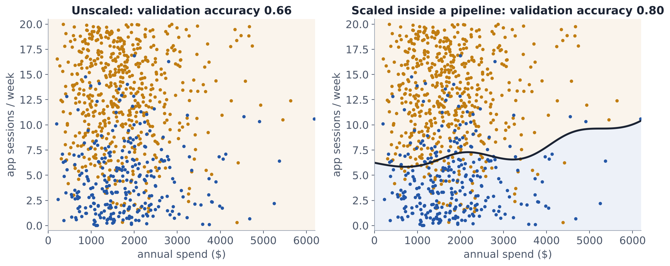
Scaling changes distance, and therefore the model
PREPROCESSING
WHY › MARGIN › SOFT MARGIN › SCALING › KERNELS › PROBABILITIES › COMPARE
Week 8 of 15
Same RBF SVM, same 840 training customers. Churn (blue) is driven mainly by low app sessions.
UNITS
Unscaled, dollars swamp sessions: 0.66 accuracy, exactly the majority baseline.
STANDARDIZE
Mean 0, standard deviation 1 for every numeric feature: 0.80 accuracy.
PIPELINE
Fit the scaler on training rows only, inside every fold. Scaling all rows first is leakage.
Notes:
Unscaled validation accuracy 0.66 equals the majority-class baseline: the model predicts 'stays' for everyone because spend swamps the distance. Scaled: 0.80. Workbook Task 3.

Slide 31
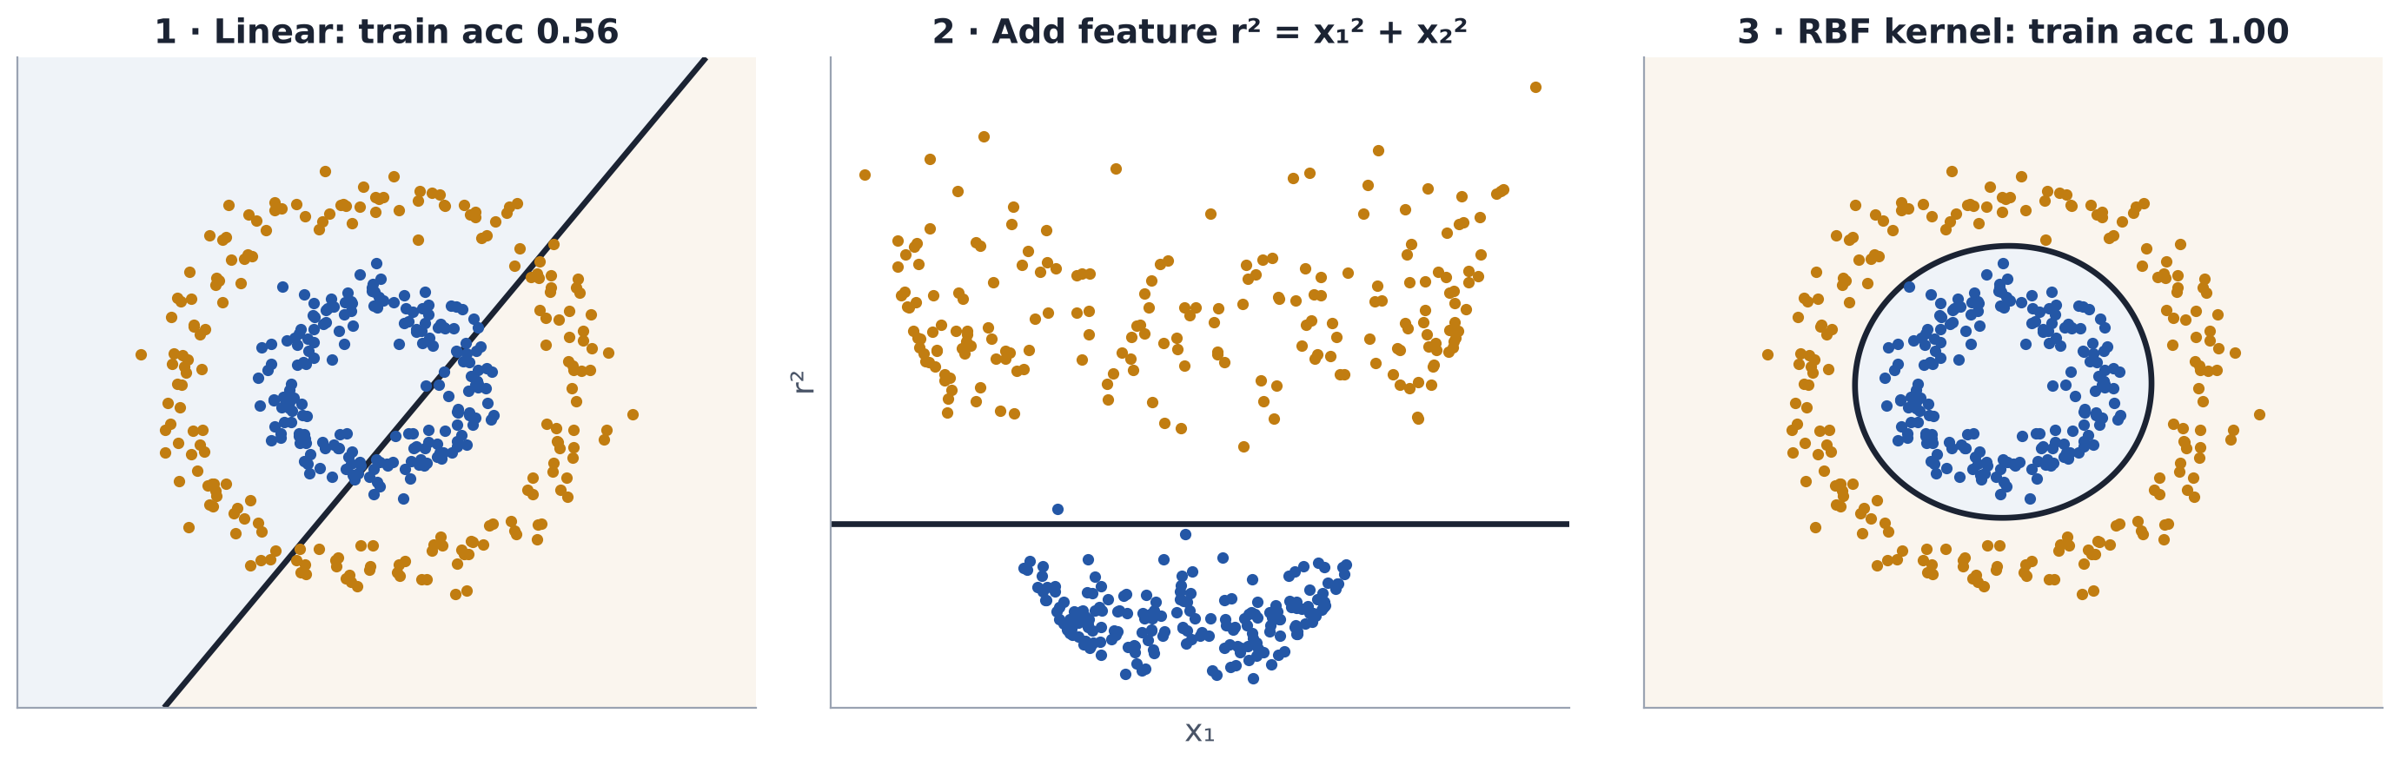
When no line works, add features, or let a kernel add them for you
KERNELS
WHY › MARGIN › SOFT MARGIN › SCALING › KERNELS › PROBABILITIES › COMPARE
Week 8 of 15
1 · LINEAR
Rings cannot be split by a line: 0.56 training accuracy.
2 · ADD A FEATURE
With r² = x₁² + x₂², a flat cut separates them: the move you already know.
3 · RBF KERNEL
Same result without building the feature: similarity decays with distance.
Notes:
Panel 2 is the feature-engineering move students already know: add r² and a flat cut separates the rings. The RBF kernel computes similarity as if such features existed, without building them (the 'kernel trick'). Workbook Part E.

Slide 32
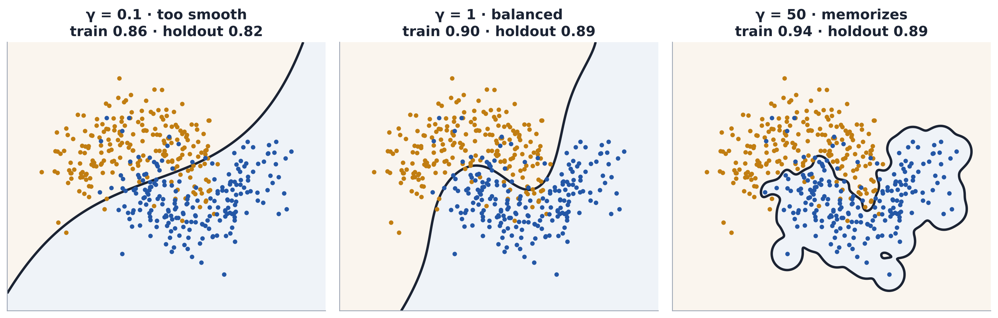
Gamma sets each point's reach: the bias–variance dial for kernels
RBF KERNEL
WHY › MARGIN › SOFT MARGIN › SCALING › KERNELS › PROBABILITIES › COMPARE
Week 8 of 15
Same 420 training rows, C = 1. Holdout = 180 rows the model never saw.
γ = 0.1
Train 0.86 · holdout 0.82. Too smooth: high bias.
γ = 1
Train 0.90 · holdout 0.89. Balanced.
γ = 50
Train 0.94 · holdout 0.89. Memorizes islands: high variance.
Notes:
K(x, z) = exp(−γ‖x − z‖²). Small γ: wide reach, smooth boundary. Large γ: each point is an island. Note that training accuracy keeps rising with γ while holdout does not improve: the signature of variance. Workbook Task 4.

Slide 33
Tune C and gamma together, as you tuned learning rate and rounds
TUNING
WHY › MARGIN › SOFT MARGIN › SCALING › KERNELS › PROBABILITIES › COMPARE
Week 8 of 15
5-fold cross-validated accuracy on training rows only (workbook Task 4).
 | γ = 0.1 | γ = 1 | γ = 10 | γ = 50
C = 0.1 | 0.860 | 0.883 | 0.907 | 0.855
C = 1 | 0.860 | 0.893 | 0.907 | 0.871
C = 10 | 0.869 | 0.905 | 0.881 | 0.836
C = 100 | 0.893 | 0.905 | 0.819 | 0.831
PAIR
More reach × a stricter penalty = more capacity. They interact.
SEARCH
Log-spaced grid, folds built from training rows only; time-aware folds when time matters.
SELECT
The simplest setting within noise of the best: here C = 0.1, γ = 10.
TEST ONCE
0.878 on untouched rows. No more tuning after this number.
Notes:
Values from the executed workbook (make_moons, noise 0.32, seed 42). Two configurations tie at 0.907; prefer the simpler (lower C) one. Test accuracy, measured once: 0.878.

Slide 34
An SVM returns a distance, not a probability
FROM SCORE TO PROBABILITY
WHY › MARGIN › SOFT MARGIN › SCALING › KERNELS › PROBABILITIES › COMPARE
Week 8 of 15
DECISION_FUNCTION
Signed distance from the boundary.
On the workbook churn data it ranges from −1.25 to 0.59. Not a probability.
WHY IT MATTERS FOR BOOKINGGUARD
The break-even deposit threshold in the worked example is a probability: 0.127.
A threshold applied to an uncalibrated score has no economic meaning, even when the ranking is excellent.
PROBABILITY=TRUE
Platt scaling with internal 5-fold cross-validation.
Slower; probabilities can disagree with predict().
CALIBRATEDCLASSIFIERCV
An explicit score → probability mapping you can inspect.
Check it with a reliability curve, log loss and Brier score on later data.
Notes:
scikit-learn: SVC(probability=True) fits Platt scaling with internal 5-fold cross-validation, is slower, and its predict_proba can disagree with predict. CalibratedClassifierCV makes the mapping explicit and checkable. Workbook Task 5 shows decision_function ranging from −1.25 to 0.59 on the churn validation set.
Sources: scikit-learn SVM user guide (scores and probabilities); probability calibration guide.

Slide 35
A five-step workflow for any SVM
SVM ALGORITHM
WHY › MARGIN › SOFT MARGIN › SCALING › KERNELS › PROBABILITIES › COMPARE
Week 8 of 15
1
Pipeline
2
Start linear
3
Grid C (and γ)
4
Calibrate
5
Test once
Scaler + SVC together, so preprocessing refits inside every fold
Move to RBF only if validation improves materially
Log scale, time-aware folds, training rows only
Map scores to probabilities on a later window
Refit the selected pipeline; evaluate on untouched data
pipe = make_pipeline(StandardScaler(), SVC(kernel="rbf"))
grid = {"svc__C": [0.1, 1, 10, 100], "svc__gamma": [0.01, 0.1, 1]}
search = GridSearchCV(pipe, grid, cv=TimeSeriesSplit(5), scoring="roc_auc").fit(X_train, y_train)
cal = CalibratedClassifierCV(FrozenEstimator(search.best_estimator_), method="sigmoid")
cal.fit(X_calibration, y_calibration) # a later window than X_train
p = cal.predict_proba(X_validation)[:, 1] # now a threshold has economic meaning
Requires scikit-learn ≥ 1.6 for FrozenEstimator. Rows sorted by time for TimeSeriesSplit.
Notes:
FrozenEstimator requires scikit-learn 1.6 or later; it replaces the deprecated cv='prefit'. TimeSeriesSplit assumes rows are sorted by time. scoring='roc_auc' works with decision_function, so no probabilities are needed during the search.

Slide 36
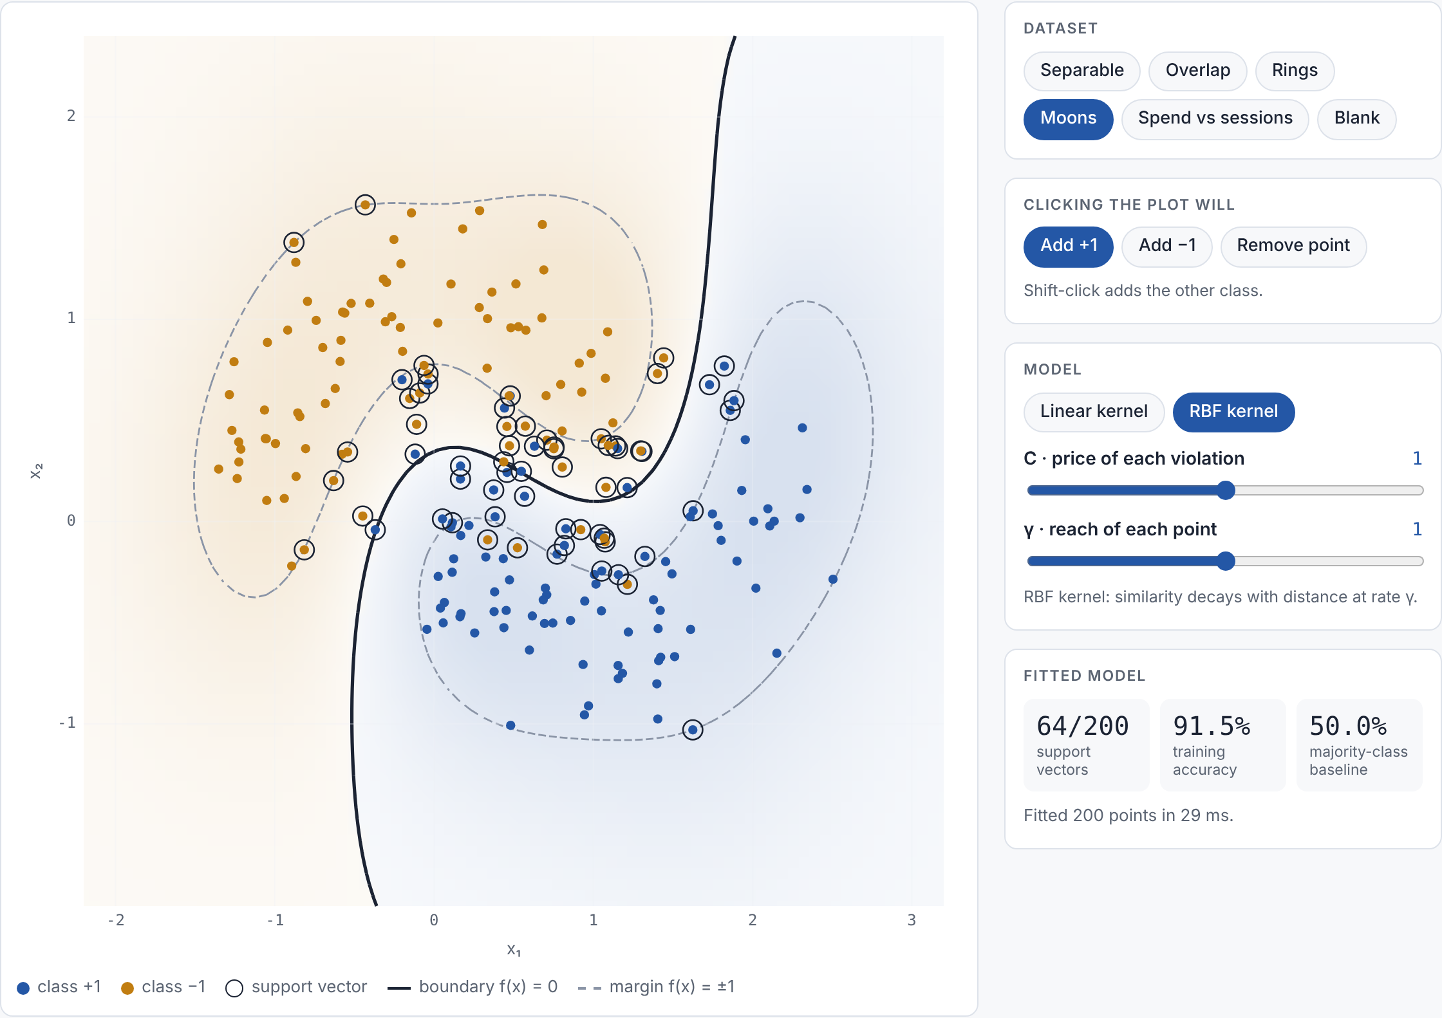
SVM Margin Explorer: move C and gamma, watch the margin respond
EXPLORE IT YOURSELF
WHY › MARGIN › SOFT MARGIN › SCALING › KERNELS › PROBABILITIES › COMPARE
Week 8 of 15
OPEN THE EXPLORER
SVM Margin Explorer
Separable | Remove a far point, then a ringed one. Only the second moves the line.
Overlap | Slide C from 0.001 to 1000. The street narrows; support vectors fall.
Spend vs sessions | Untick Standardize. Dollars swamp distance.
Rings | Compare the linear and RBF kernels.
Moons | Move γ from 0.01 to 100. Training accuracy rises; does the boundary?
Notes:
Interactive page built for this course: https://lathrahul.github.io/modern-ai-ml-exercises/week-08/svm-margin-explorer.html. Same solver family as scikit-learn's SVC (SMO, tol 0.001); on test datasets it reproduces SVC's support vectors and decision values. Use it live after the gamma slide, or assign it as pre-lab exploration. The link is private until shared from the page's Share menu.

Slide 37
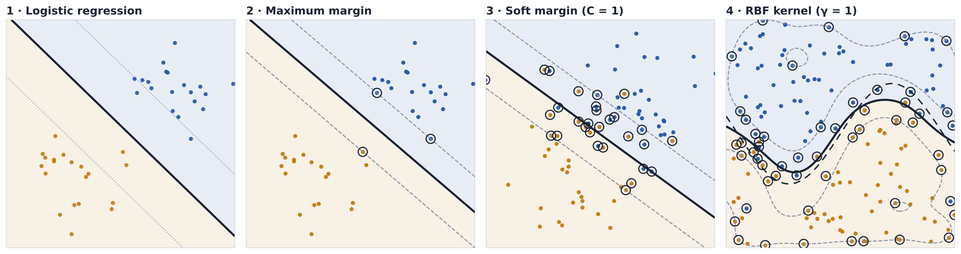
SVM adds an explicit margin and a controlled path to nonlinearity
PUTTING IT TOGETHER · THE SVM PATH
WHY › MARGIN › SOFT MARGIN › SCALING › KERNELS › PROBABILITIES › COMPARE
Week 8 of 15
Four real fits. Solid line: boundary. Dashed: margin edges (panel 1 dotted: 10% and 90% probability). Rings: support vectors.
Every customer pulls on the line through log loss.
Widest street between classes. Only 3 customers fix it.
C prices points inside the street. 29 of 80 now matter.
Similarity to support vectors bends the boundary. γ sets how local.
DISCIPLINE
Standardize features, tune C and γ on validation data, evaluate the test set once.
Notes:
Panels 1–2 use the same 40 separable customers; panel 3 uses 80 overlapping customers; panel 4 uses 150 customers from the curved population. Support vectors: 3 of 40 (max margin), 29 of 80 (soft margin, C=1), 54 of 150 (RBF). On the curved population a logistic model reaches 86.8% accuracy on new customers; the RBF SVM reaches 90.9%.
Sources: scikit-learn Support Vector Machines user guide; scikit-learn 'SVM: Maximum margin separating hyperplane'; ISLP Ch. 9 (Fig. 9.3, 9.7, 9.9).

Slide 38
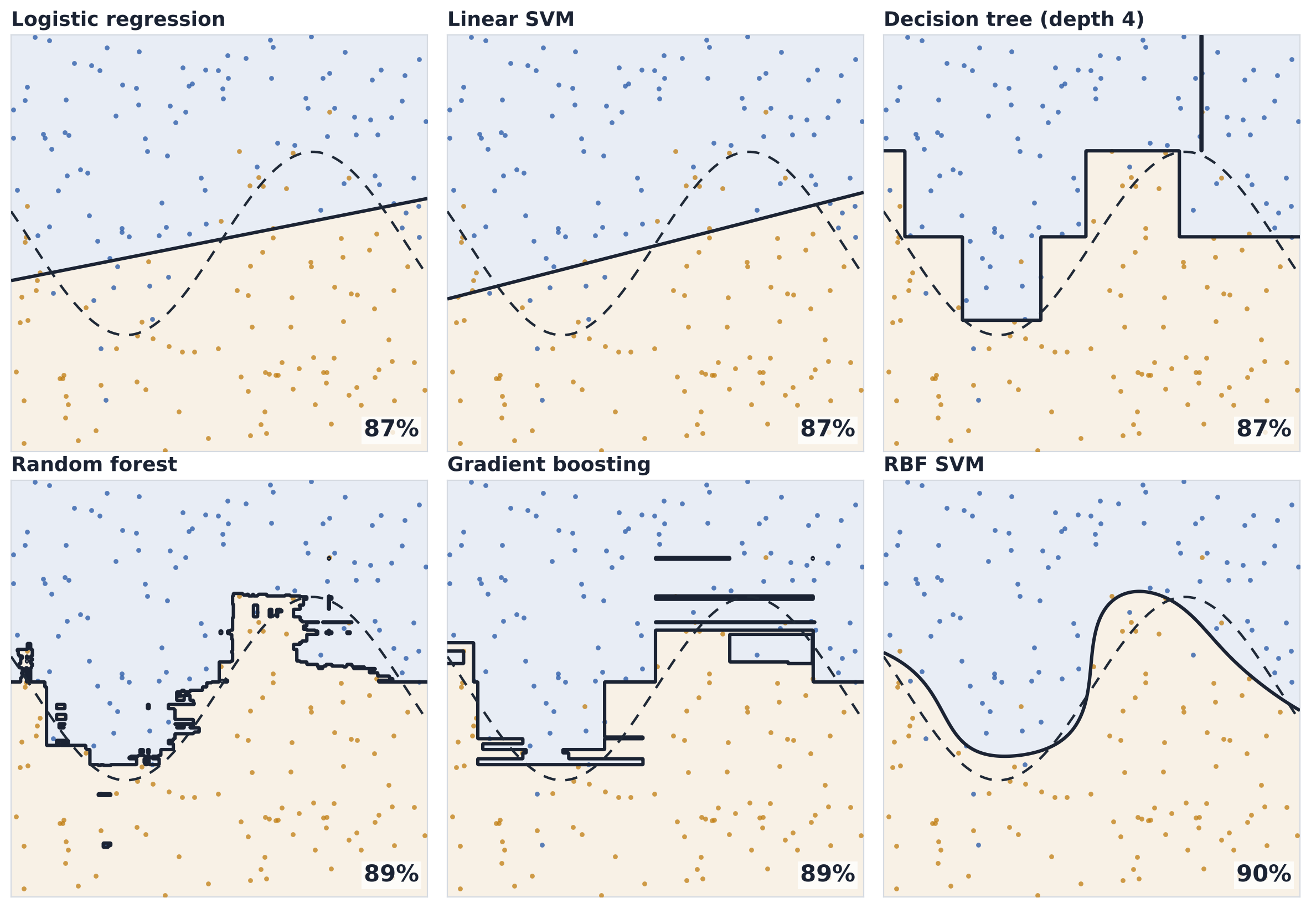
Six ways to turn customer features into a classification rule
PUTTING IT TOGETHER · SIX MODELS
WHY › MARGIN › SOFT MARGIN › SCALING › KERNELS › PROBABILITIES › COMPARE
Week 8 of 15
One sample of 200 customers, six models. Big number: accuracy on 20,000 new customers. Dashed curve: the true boundary.
MODEL | LEARNS | BOUNDARY
Logistic | linear log-odds | straight line
Linear SVM | widest-margin line | straight line
Tree | if/then splits | axis-aligned steps
Random forest | average of many trees | smoother steps
Boosting | sum of small trees | refined steps
RBF SVM | similarity to support vectors | smooth curve
Only the flexible families can follow the curve. Whether they follow it stably is the next question.
Notes:
Simulated population used on every slide: two standardized customer features; the true boundary is the dashed curve x2 = 1.1·sin(1.4·x1); labels are noisy, so even the true boundary misclassifies about 8% of customers (irreducible error). All accuracies are measured on 20,000 fresh customers from the same population. Code: figs.py.
Layout follows scikit-learn's 'Classifier comparison' example: same data, real fitted boundaries, held-out accuracy in the corner. Settings: logistic (C=1); linear SVM (C=1); tree max_depth=4; random forest 200 trees, max_depth=6; gradient boosting 100 stages, depth 2, rate 0.1; RBF SVM C=1, γ=1. Accuracies: Logistic regression 86.9%; Linear SVM 87.1%; Decision tree (depth 4) 86.8%; Random forest 89.3%; Gradient boosting 88.9%; RBF SVM 90.1%. The point is the boundary shape each family can draw, not a leaderboard: one sample, default-ish settings.
Source: scikit-learn, Classifier comparison (plot_classifier_comparison).

Slide 39
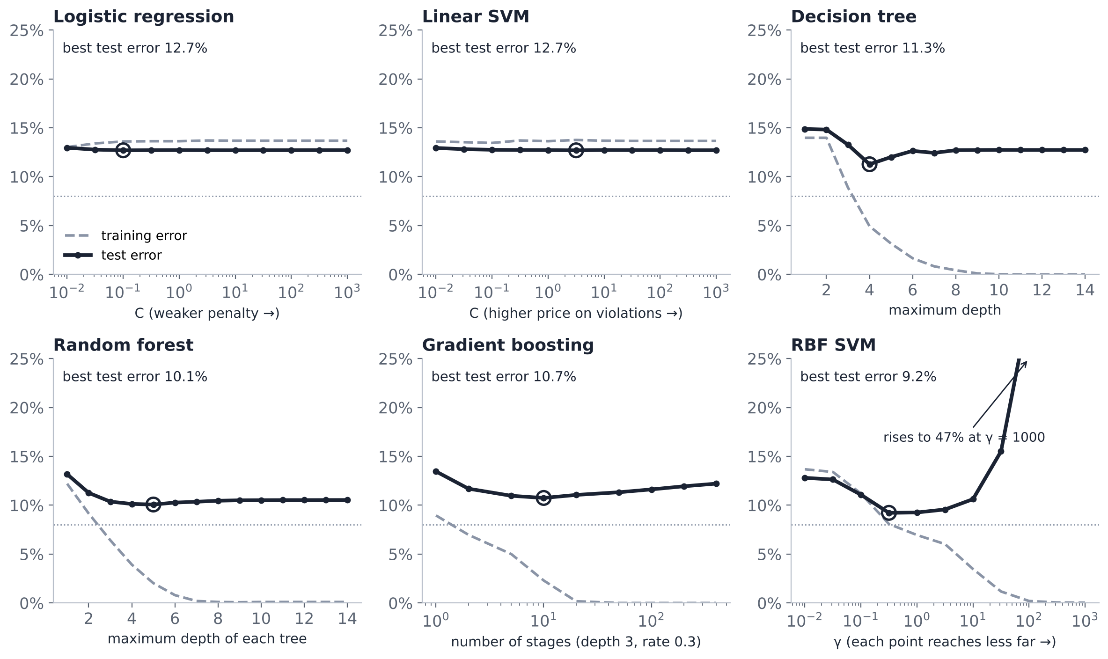
Every model family has a flexibility control
PUTTING IT TOGETHER · FLEXIBILITY KNOBS
WHY › MARGIN › SOFT MARGIN › SCALING › KERNELS › PROBABILITIES › COMPARE
Week 8 of 15
Training and test error as each family's knob moves. Averages over 20 samples of 200 customers; dotted line = 8% irreducible error.
LINEAR
Flat curves stuck at 12.7%.
The knob cannot add curvature: bias stays.
TREES
A shallow U, best near depth 4–5.
Averaging (forest) flattens the right side.
RBF SVM
Lowest error here: 9.2%.
Push γ too far and test error climbs to 47%.
The algorithm name does not fix bias or variance. The knob setting does.
Notes:
Simulated population used on every slide: two standardized customer features; the true boundary is the dashed curve x2 = 1.1·sin(1.4·x1); labels are noisy, so even the true boundary misclassifies about 8% of customers (irreducible error). All accuracies are measured on 20,000 fresh customers from the same population. Code: figs.py.
Knob ranges: logistic and linear SVM C from 0.01 to 1000; tree and forest max_depth 1–14; boosting stages 1–400 (depth 3, rate 0.3); RBF SVM γ from 0.01 to 1000 at C=1. Best test error: Logistic regression 12.7%; Linear SVM 12.7%; Decision tree 11.3%; Random forest 10.1%; Gradient boosting 10.7%; RBF SVM 9.2%. RBF SVM test error rises to 47% at γ = 1000 while its training error reaches 0%.
Sources: scikit-learn 'Validation curves: plotting scores to evaluate models'; ISLP §2.2.

Slide 40
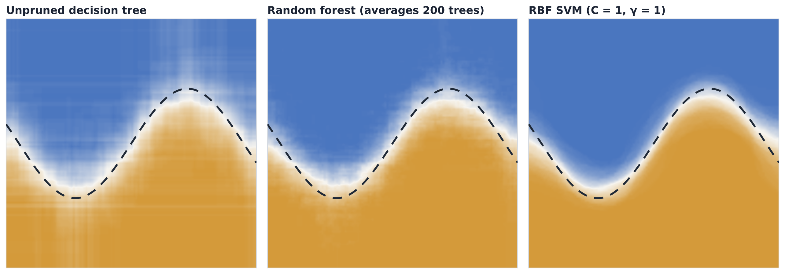
Averaging and margins reduce boundary movement
PUTTING IT TOGETHER · STABILITY
WHY › MARGIN › SOFT MARGIN › SCALING › KERNELS › PROBABILITIES › COMPARE
Week 8 of 15
Each map stacks 100 refits on 150-customer samples. Color = share of refits predicting blue; white = the refits disagree.
Test error 12.9%
bias 2.9% · variance 9.6%
Test error 10.5%
bias 3.5% · variance 6.3%
Test error 9.4%
bias 2.4% · variance 4.7%
■ all refits say blue ■ refits split ■ all say amber
Forests cut variance by averaging trees. The RBF SVM gets a smooth, stable boundary from its margin.
Notes:
Simulated population used on every slide: two standardized customer features; the true boundary is the dashed curve x2 = 1.1·sin(1.4·x1); labels are noisy, so even the true boundary misclassifies about 8% of customers (irreducible error). All accuracies are measured on 20,000 fresh customers from the same population. Code: figs.py.
How to read: a sharp blue-to-amber edge means the refits agree (low variance); a wide white or streaky band means they disagree (high variance). The dashed curve is the truth, so an edge that is sharp but in the wrong place would be bias. Numbers use the Domingos (2000) 0-1 decomposition as on the flexibility slide.
Sources: scikit-learn 'Single estimator versus bagging: bias-variance decomposition'; Breiman (1996) Bagging predictors; scikit-learn 'RBF SVM parameters'.

Slide 41
Every building block returned in the SVM
PUTTING IT TOGETHER
WHY › MARGIN › SOFT MARGIN › SCALING › KERNELS › PROBABILITIES › COMPARE
Week 8 of 15
The recap from Part 1, now with the links named.
BUILDING BLOCK | WHAT IT GAVE US | WHERE IT SHOWED UP TODAY
Probability & thresholds | Scores become actions through costs | SVM scores must be calibrated before a threshold
Validation | Evidence that represents future use | C and gamma are chosen on validation folds
Regularization | A penalty that trades fit for stability | ½‖w‖² is the penalty; C sets its price
Nonlinear features | Curved boundaries by adding features | Kernels add those features implicitly
Trees | Piecewise rules; feature scale does not matter | Contrast: SVM geometry depends on scaling
Forests | Averaging cuts variance | Contrast: SVM gets stability from the margin
Boosting | Loss + gradient steps + capacity control | Same recipe, different loss: hinge
Notes:
Return to the Part 1 building-blocks slide. Each right-hand cell points back to a slide in this section.

Slide 42
From “what is still wrong?” to “where is the safest line?”
PUTTING IT TOGETHER · WEEK 7 → WEEK 8
WHY › MARGIN › SOFT MARGIN › SCALING › KERNELS › PROBABILITIES › COMPARE
Week 8 of 15
GRADIENT BOOSTING · WEEK 7
SUPPORT VECTOR MACHINE · TODAY
Core question | What does the ensemble still get wrong? | Where is the widest safe street between classes?
Hard cases get attention by | Large residuals pull the next tree hardest | Only points on or inside the margin shape the fit
Loss | Log loss (classification) | Hinge loss
Capacity controls | Learning rate × rounds, depth, early stopping | C, kernel, gamma, chosen by validation
Preprocessing | Trees ignore feature scale | Standardize every feature, inside the pipeline
Output | Log-odds score that maps to a probability | Signed distance; calibrate before thresholds
Both focus on hard cases. Boosting does it by reweighting errors; the SVM does it by geometry.
Notes:
Both models concentrate on hard cases. Boosting does it by fitting the gradient of the loss (large residuals pull hardest). The SVM does it geometrically: only points on or inside the margin have non-zero hinge loss, so only they shape the boundary.

Slide 43
Every classifier this term answers the same five questions
PUTTING IT TOGETHER
WHY › MARGIN › SOFT MARGIN › SCALING › KERNELS › PROBABILITIES › COMPARE
Week 8 of 15
Read across a row to compare models; read down a column to describe one.
QUESTION | LOGISTIC | RANDOM FOREST | BOOSTING | SVM
Minimizes what? | Log loss + penalty | Impurity, split by split; then averages | Log loss, one tree per gradient step | Hinge loss + ½‖w‖²
Capacity knob? | Penalty, features | Leaf size, features per split | Learning rate × rounds, depth | C, kernel, gamma
Needs from preprocessing? | Scaling for the penalty; encoding | Encoding only | Encoding only | Standardization is essential
More flexible (less bias) | More features, weaker penalty | Deeper trees, smaller leaves | More rounds, deeper trees | Higher C, larger γ
More stable (less variance) | Stronger penalty | More trees averaged | Early stopping, smaller rate | Lower C, smaller γ: a wider margin
Outputs? | Probability | Vote share; check calibration | Probability; check calibration | Distance; calibrate first
The last row is why calibration matters for BookingGuard: the deposit threshold is a probability.
Notes:
A good reference-sheet table. The bottom row is the bridge to BookingGuard: a deposit threshold is a probability, so an SVM needs calibration first. Forest and boosting probabilities should still be checked for calibration on later data.

Slide 44
Which classifier to try first
IMPLEMENTATION CHOICE
WHY › MARGIN › SOFT MARGIN › SCALING › KERNELS › PROBABILITIES › COMPARE
Week 8 of 15
Week 7's decision tree, with the SVM added. Every path ends at the same validation gate.
1
Must you explain each factor's effect, or need native probabilities?
yes →
LOGISTIC FIRST Credit scorecards, insurance pricing
2
Sparse text, or more features than rows?
yes →
LINEAR SVM Ticket routing, spam, document tagging
3
Up to tens of thousands of rows with a smooth nonlinear boundary?
yes →
RBF SVM Sensor fault detection, small clinical or survey data
4
Large mixed-type business table?
yes →
BOOSTING Churn, cancellations, demand: HistGB or LightGBM
Every candidate then faces the same rows, time split, metrics, calibration check and policy constraints.
Notes:
A starting point, not a verdict. 'Tens of thousands of rows' is the practical limit scikit-learn documents for kernel SVC.

Slide 45
WEEK 8 · PART 3
In-class lab: the SVM workbook
Predict, change, run, record, decide
Notes:
30 minutes after the break. All data in the workbook is simulated and seeded, so every pair should see the same numbers.

Slide 46
Instructor demonstration, then paired investigation
IN-CLASS LAB
HOW IT WORKS › TASK 1 › TASK 2 › TASK 3 › TASK 4 › TASK 5 › RETRIEVAL
Week 8 of 15
Open Blackboard → Week 8 → In-class SVM workbook. Save a copy in Drive before editing.
8 MIN · WATCH
Instructor runs Part A (why a margin) and Part B (which points decide the boundary).
20 MIN · INVESTIGATE
Pairs complete Tasks 1–5: predict in the markdown cell first, then run and record.
5 MIN · DEBRIEF
Pause after Task 4 and Task 5: what changed, which evidence, what would change the decision.
WORKBOOK PART | QUESTION IT ANSWERS | MINUTES
Part A · Part B | Why prefer one separating line? Which points decide it? | 8
Task 1 | Hinge loss by hand | 4
Task 2 | What does C trade off? | 4
Task 3 | Why must features be scaled? | 3
Task 4 | What do kernels and gamma buy, and at what risk? | 4
Task 5 | Can an SVM score support a threshold policy? | 5
BLACKBOARD › Week 8 › In-class SVM workbook
Notes:
Demonstrate Parts A and B live (why a margin; which points matter), then release pairs to Tasks 1–5. Pause for debrief after Task 4 and after Task 5. Full workbook runs in under 30 seconds on Colab CPU.

Slide 47
Task 1 · Hinge loss by hand
IN-CLASS LAB
HOW IT WORKS › TASK 1 › TASK 2 › TASK 3 › TASK 4 › TASK 5 › RETRIEVAL
Week 8 of 15
w = (1.5, −1), b = −0.5. Work in pairs. Show the arithmetic, then one sentence of interpretation.
CUSTOMER | X₁ | X₂ | Y | F(X) | Y·F(X) | HINGE | STATUS
A | 2.0 | 1.0 | +1
B | 1.0 | 0.5 | +1
C | 0.5 | 1.0 | −1
D | 1.0 | −1.0 | −1
DELIVERABLE
Fill the four columns, compute the margin width 2/‖w‖, then explain in one sentence why customer A would not change the fitted boundary.
BLACKBOARD › Week 8 › In-class SVM workbook › Task 1
Notes:
Answers (do not show until debrief): A f=1.5, y·f=1.5, hinge 0, safe. B f=0.5, y·f=0.5, hinge 0.5, inside margin. C f=−0.75, y·f=0.75, hinge 0.25, inside margin. D f=2.0, y·f=−2.0, hinge 3.0, misclassified. Margin width 2/‖w‖ = 2/√3.25 ≈ 1.109. The workbook check cell confirms each entry.

Slide 48
Task 2 · What does C trade off?
IN-CLASS LAB
HOW IT WORKS › TASK 1 › TASK 2 › TASK 3 › TASK 4 › TASK 5 › RETRIEVAL
Week 8 of 15
Linear SVM on overlapping classes. Change C_VALUES in the cell; record one row per value. ✏️
C | PREDICTED DIRECTION | SUPPORT VECTORS | MARGIN WIDTH | TRAIN ACC | VAL ACC | KEEP / REJECT
0.001
0.1
10
100
PREDICT
As C rises, which way do support vectors, margin width, training accuracy and validation accuracy move?
EXPLAIN
In one sentence: why is C the SVM's version of the regularization penalty from logistic regression?
BLACKBOARD › Week 8 › In-class SVM workbook › Task 2
Notes:
Debrief: support vectors fall as C rises (232 → 80); margin narrows (7.0 → 1.76); validation accuracy is flat to slightly falling (0.869 → 0.850). Lesson: with heavy overlap the C choice matters little for accuracy but a lot for stability and support-vector count; do not over-read a 0.02 gap.

Slide 49
Task 3 · Why must features be scaled?
IN-CLASS LAB
HOW IT WORKS › TASK 1 › TASK 2 › TASK 3 › TASK 4 › TASK 5 › RETRIEVAL
Week 8 of 15
RBF SVM, annual spend ($) and app sessions per week. Compare unscaled with a StandardScaler pipeline.
VERSION | YOUR PREDICTION | VALIDATION ACCURACY | MAJORITY BASELINE | WHAT DOMINATED DISTANCE?
Unscaled
Scaled in a pipeline
COMPARE
Is the unscaled model better than predicting the majority class for everyone? What does that tell you?
TRANSFER
Would a random forest on the same two features need the scaler? Defend your answer in one sentence.
BLACKBOARD › Week 8 › In-class SVM workbook › Task 3
Notes:
Debrief: unscaled 0.664, identical to the majority baseline: the model predicts 'stays' for everyone. Scaled pipeline 0.803. Follow-up question: would a random forest need the scaler? (No: splits are per-feature thresholds.)

Slide 50
Task 4 · Kernels and gamma: flexibility, and its price
IN-CLASS LAB
HOW IT WORKS › TASK 1 › TASK 2 › TASK 3 › TASK 4 › TASK 5 › RETRIEVAL
Week 8 of 15
RBF SVM on curved data. Read the three panels, run the C × γ grid, then test once.
RECORD | YOUR VALUE
Which γ overfits? Evidence from the three panels
Best (C, γ) from the 5-fold grid
Best CV accuracy
Test accuracy, run once
Gap between CV and test, and why it exists
EXPLAIN · WEEK 7 LINK
Why are C and γ one decision, not two, in the same way that learning rate and number of rounds were one decision for boosting?
BLACKBOARD › Week 8 › In-class SVM workbook › Task 4
Notes:
Debrief: γ=50 has the highest training accuracy and a lower CV score: variance. Best CV 0.907 (ties at C=0.1 and C=1 with γ=10); test once: 0.878. Link to Week 7: C × γ is a capacity pair like learning rate × rounds.

Slide 51
Task 5 · From an SVM score to a policy decision
IN-CLASS LAB
HOW IT WORKS › TASK 1 › TASK 2 › TASK 3 › TASK 4 › TASK 5 › RETRIEVAL
Week 8 of 15
Simulated churn. Train months 1–16, validate 17–20, test 21–24. Offer costs $20 and recovers $80, so break-even p = 0.25.
MODEL | LOG LOSS | PR-AUC | BRIER | CONTACTED @ 0.25 | NET VALUE | FIT SECS
Logistic
SVM (RBF) + calibration
HistGB
FOUR LINES (SAME AS WEEK 7)
Model and exact configuration
Two pieces of evidence
One risk
The next check before deployment
SENSITIVITY
Set COST = 30 and rerun. Which moves: the model ranking, the threshold, or both? Then run the test cell once, for your chosen model only.
BLACKBOARD › Week 8 › In-class SVM workbook › Task 5
Notes:
Debrief numbers (validation): Logistic log loss 0.409, PR-AUC 0.373, Brier 0.128, 173 contacted, net $1,580, 0.05 s. SVM+calibration 0.446, 0.300, 0.139, 58 contacted, $760, 0.6 s. HistGB 0.418, 0.362, 0.131, 159, $1,140. Contact nobody $0; contact everybody −$5,200.
Teaching point: the most flexible model did not win because the simulated churn signal is close to linear-logistic. Validation, not model prestige, decides. Sensitivity: COST=30 moves the threshold to 0.375 and shrinks contact volume for every model.

Slide 52
Retrieval check
IN-CLASS LAB
HOW IT WORKS › TASK 1 › TASK 2 › TASK 3 › TASK 4 › TASK 5 › RETRIEVAL
Week 8 of 15
Complete individually before the group debrief.
1
Several lines separate the training data perfectly. What property does the SVM use to choose, and why should it help next month?
2
A point lies far outside the margin on the correct side. What is its hinge loss, and what happens if you delete it?
3
An RBF SVM reaches the highest training accuracy at γ = 50 but loses to γ = 1 on validation. Name the error pattern and the evidence.
4
Why can't you set a deposit or retention threshold directly on decision_function output? What do you do instead?
BLACKBOARD › Week 8 › Retrieval check
Notes:
These four items are written at midterm difficulty.

Slide 53
WEEK 8 · PART 4
Model selection: from a leaderboard to a decision
You now have five classifier families. Which one goes into production is a separate question.
Notes:
20 minutes. Each slide pairs the framework with a BookingGuard example, so the framework is immediately usable tonight.

Slide 54
Model selection starts before algorithms
FRAME
FRAME › DATA › BASELINES › EVIDENCE › MATRIX › TRUST › MEMO
Week 8 of 15
Four questions settle what 'best' means. Answer them before opening a notebook.
QUESTION | ASK | BOOKINGGUARD ANSWER
Decision | What action follows the prediction? | Require a deposit, or not
Unit | What receives one prediction? | One booking
Moment | When must the output exist, and what is known then? | A fixed point before arrival; only fields known by then
Cost | Which errors matter, and how much? | A missed cancellation loses room revenue; an unnecessary deposit adds guest friction
If two people answer these four differently, they will disagree about the 'best' model, and both will be right.
Notes:
Fill the right column live with the class using the BookingGuard brief.
Sources: BookingGuard brief; ISLP; instructor practice.

Slide 55
Data geometry narrows the candidate set
DATA
FRAME › DATA › BASELINES › EVIDENCE › MATRIX › TRUST › MEMO
Week 8 of 15
WHAT THE DATA LOOKS LIKE | TRY FIRST | WHY
Many rows, a few dozen mixed features | Boosting, logistic | Interactions and scale; fast to tune
Wide or sparse (text, flags) | Linear SVM, regularized logistic | Linear boundaries work well in high dimensions
Modest rows, smooth nonlinear boundary | RBF SVM, boosting | Kernels bend smoothly; training stays affordable
Rows ordered in time | Any of the above | The validation design dominates the model choice
BookingGuard is a time-ordered, mixed-type table: start from logistic and boosting, and let the temporal split judge.
Notes:
Rules of thumb, not laws. The last row overrides everything above it: with temporal data, a weak model honestly validated beats a strong model validated on a random split.

Slide 56
Baselines show how hard the problem is; evidence is a portfolio
BASELINES AND EVIDENCE
FRAME › DATA › BASELINES › EVIDENCE › MATRIX › TRUST › MEMO
Week 8 of 15
BASELINES
Rule: the existing policy (no deposits, or deposits for every non-refundable rate)
Naive: majority class, recency, or the training-period rate
Linear: logistic regression with honest preprocessing
Value: incremental decision gain over the best of the above
EVIDENCE PORTFOLIO
Primary: a metric aligned to the decision (log loss, policy value)
Calibration: do predicted risks match observed rates?
Slices: who loses: hotel, market segment, new vs repeat guest
Stability: across folds, seeds and time periods
Notes:
A model that cannot beat 'deposit nobody' or 'deposit everybody' under the published costs has no business case, whatever its AUC.

Slide 57
A selection matrix makes the trade-offs explicit
SELECTION MATRIX
FRAME › DATA › BASELINES › EVIDENCE › MATRIX › TRUST › MEMO
Week 8 of 15
Illustrative starting judgments for a mid-sized business table. Your validation evidence overrides every cell.
CRITERION | LOGISTIC | RANDOM FOREST | BOOSTING | RBF SVM
Quality | Strong when effects are near-linear | Good with interactions | Often strongest on tabular data | Strong on smooth boundaries
Robustness | Stable across samples | Stable; averaging removes variance | Sensitive to rate and rounds | Sensitive to scaling, C and γ
Operability | Fast to train and score | Large model files | Fast scoring; tuning takes time | Slow beyond tens of thousands of rows
Governance | Coefficients explain direction | Needs local explanations | Needs local explanations | Hard to explain; calibrate first
Choose the simplest model whose gain is material, stable, reproducible and operationally acceptable.
Notes:
Use the four rows as the structure of the BookingGuard memo's model-choice paragraph.

Slide 58
Interpretability is a property of the use case, not the model
TRUST
FRAME › DATA › BASELINES › EVIDENCE › MATRIX › TRUST › MEMO
Week 8 of 15
Four questions different stakeholders will ask about the same deposit model.
GLOBAL
Revenue manager
Which factors drive deposit requests across the portfolio?
LOCAL
Front desk
Why did this guest receive a deposit request?
PROCESS
Auditor
Which data, model version, threshold and date produced it?
CONTEST
Guest or agent
How is a wrong request corrected, and how fast?
Design the explanation for the person who must act on it.
Notes:
A deep model can satisfy all four with the right process; a linear model can fail 'contest' if no one can act on an explanation.

Slide 59
A decision memo: recommendation plus reversibility
COMMUNICATION
FRAME › DATA › BASELINES › EVIDENCE › MATRIX › TRUST › MEMO
Week 8 of 15
Illustrative example: a card-fraud review queue. Use the same four headings in BookingGuard.
CHOOSE
Linear SVM with sigmoid calibration on sparse merchant and device flags; review when p ≥ 0.08.
WHY
Recall +6 points at equal review volume versus logistic on March–April validation; calibration within tolerance.
WATCH
Weekly calibration by merchant category; daily review volume above the team's capacity of 1,200.
FALLBACK
The current logistic model runs in shadow; revert if precision falls two weeks in a row.
Notes:
Illustrative numbers. The point is the structure: what, why, what to watch, and the safe fallback.

Slide 60
Selection check
PARTICIPATION
FRAME › DATA › BASELINES › EVIDENCE › MATRIX › TRUST › MEMO
Week 8 of 15
A model wins AUC by 0.002 but triples latency and loses calibration. What is the best default decision?
A
B
C
D
Ship it
Reject automatically
Quantify decision value
Tune on test
Commit → discuss with a neighbor → reveal. Explain the mechanism, not merely the letter.
Notes:
Reveal: C. A 0.002 AUC gain is almost certainly immaterial; the latency and calibration losses may not be. Quantify decision value on validation before deciding. D (tune on test) is never acceptable.
Sources: IENYC faculty guidance; ISLP; scikit-learn.

Slide 61
EXERCISE 03 · LAUNCHES TODAY
BookingGuard: which bookings should require a deposit?
Individual exercise · due Sunday, November 15, 11:59 PM ET
Notes:
15 minutes. Goal before students leave: state the prediction moment in one sentence and write the first experiment hypothesis.

Slide 62
Protect revenue without requiring a deposit from everyone
BOOKINGGUARD · PROBLEM
PROBLEM › DECISION MAP › LEAKAGE › VALIDATION › POLICY › SUBMIT
Week 8 of 15
PREDICT
Cancellation risk for one booking at a fixed point before arrival.
VALIDATE
Use earlier arrivals to predict later arrivals.
COMPARE
Logistic regression, random forest and one boosting implementation.
DECIDE
A deposit threshold chosen from the published costs.
CHECK
Calibration, deposit volume, cost sensitivity and three operational groups.
SUBMIT
Executed notebook, experiment record, one-page memo, decision file, AI-use disclosure.
BLACKBOARD › Exercises › Exercise 03
Notes:
Sources: BookingGuard brief, starter notebook, policy costs.

Slide 63
From a booking record to a deposit decision
BOOKINGGUARD · DECISION MAP
PROBLEM › DECISION MAP › LEAKAGE › VALIDATION › POLICY › SUBMIT
Week 8 of 15
Prediction is one stage of four. Each stage has its own question and its own failure mode.
1
2
3
4
›
›
›
BOOKING FACTS
Is every field known at the decision moment?
CANCELLATION RISK
Are probabilities calibrated on later arrivals?
POLICY THRESHOLD
Does the threshold follow the published costs?
DEPOSIT ACTION
Who bears the friction, and how many?
FAILS BY Leakage
FAILS BY Drift, miscalibration
FAILS BY 0.50 by habit
FAILS BY Volume or group harm
Validate data timing, probability calibration, cost assumptions and policy effects separately.
Notes:
Validate each stage separately: data timing, probability calibration, cost assumptions, policy effects.

Slide 64
A feature is valid only if it exists at the decision point
BOOKINGGUARD · PREDICTION MOMENT
PROBLEM › DECISION MAP › LEAKAGE › VALIDATION › POLICY › SUBMIT
Week 8 of 15
AVAILABLE
Lead time, stay details, customer history, booked channel.
TARGET
canceled: appears in training data only.
EXCLUDE
reservation_status and any post-arrival or post-cancellation information.
AUDIT
Write down when each field becomes known, before fitting anything.
First checkpoint: state the prediction moment in one sentence, then list every field that fails it.
Notes:
Sources: BookingGuard data dictionary and brief. Week 7 integrated sample used days_before_cancellation as the leakage example; reservation_status is the same failure in this dataset.

Slide 65
Later data is the real test
BOOKINGGUARD · TEMPORAL VALIDATION
PROBLEM › DECISION MAP › LEAKAGE › VALIDATION › POLICY › SUBMIT
Week 8 of 15
Random cross-validation mixes demand regimes and hides drift.
FIT
Earlier arrivals: fit preprocessing and models
VALIDATE
Latest labeled months before July 2017
TEST
July–August 2017: no labels
time →
FREEZE
Fit preprocessing on training rows only.
MEASURE
Log loss, PR-AUC, ROC-AUC, calibration and policy value on the later period.
DECIDE
Keep, revise or reject the model and threshold.
REPORT
What changed when the calendar moved forward.
Notes:
Test window July–August 2017 is unlabeled in the student release (per the brief). Validation therefore comes from the latest labeled months before July 2017.

Slide 66
A deposit policy begins with expected value
BOOKINGGUARD · POLICY
PROBLEM › DECISION MAP › LEAKAGE › VALIDATION › POLICY › SUBMIT
Week 8 of 15
Worked example with the published policy costs.
1
Booking revenue
3 nights × $150
$450
READ IT AS A RULE
Require a deposit when calibrated p(cancel) ≥ 0.127.
p* = deposit cost ÷ (recovery rate × loss rate × booking revenue)
Every input is an assumption: the sensitivity analysis varies each one.
2
Cancellation loss
0.70 × $450
$315
3
Deposit recovery
0.45 × $315
$141.75
4
Break-even probability
$18 ÷ $141.75
≈ 0.127
This is why the SVM's distance score must be calibrated: 0.127 is a probability.
Notes:
Arithmetic: 3 × $150 = $450. 0.70 × $450 = $315. 0.45 × $315 = $141.75. $18 ÷ $141.75 = 0.127. The $18 is the per-request deposit cost from policy_costs.csv; confirm the label against the brief before class.
Source: BookingGuard policy_costs.csv.

Slide 67
A probability becomes useful only through a declared policy
BOOKINGGUARD · WORKED DECISION CHECK
PROBLEM › DECISION MAP › LEAKAGE › VALIDATION › POLICY › SUBMIT
Week 8 of 15
1
Why is 0.50 not an automatic deposit threshold?
Answer with the decision, the calculation and one failure mode.
2
What evidence says the predicted probabilities can support a policy?
Answer with the decision, the calculation and one failure mode.
3
Which cost change would move the break-even threshold upward?
Answer with the decision, the calculation and one failure mode.
The final threshold must survive calibration, time shift, cost sensitivity and group checks.
Notes:
Leave these unanswered in class: they map directly to memo sections. Students answer each with the decision, the calculation and one failure mode.

Slide 68
Write one hypothesis that can survive a result
BOOKINGGUARD · FIRST EXPERIMENT
PROBLEM › DECISION MAP › LEAKAGE › VALIDATION › POLICY › SUBMIT
Week 8 of 15
Record the hypothesis before running anything.
CHANGE
One parameter, feature decision or modeling choice.
EXAMPLE · BOOSTING
Lowering the learning rate from 0.10 to 0.05 with early stopping will reduce later-period log loss, because smaller steps overfit the 2016 demand pattern less.
EXPECT
The direction of change, and why.
MEASURE
Validation period, runtime and the required metrics.
EXAMPLE · TODAY'S SVM (OPTIONAL)
A calibrated linear SVM will match logistic log loss within 0.005 but not beat it, because both draw linear boundaries; record runtime.
DECIDE
Keep, reject or follow up, based on the declared evidence.
Notes:
If a student tries an SVM in BookingGuard, it is one declared experiment, not a requirement. Kernel SVC on the full training set may be slow; record runtime honestly. The required comparison remains logistic, random forest and one boosting implementation.

Slide 69
A complete package connects evidence to a deposit decision
BOOKINGGUARD · SUBMISSION CONTRACT
PROBLEM › DECISION MAP › LEAKAGE › VALIDATION › POLICY › SUBMIT
Week 8 of 15
COMPONENT | WHAT IT MUST CONTAIN
Notebook | Executed and reproducible, with at least five deliberate experiments
Decision file | booking_id, cancellation_probability, require_deposit
Memo | One page: recommendation, threshold, expected value
Analysis | Calibration, cost sensitivity, time shift, and three operational groups
Disclosure | Document consequential AI-assisted work
Due Sunday, November 15, 11:59 PM ET. Individual exercise.
BLACKBOARD › Exercises › Exercise 03
Notes:
Sources: BookingGuard brief, rubric and submission guidelines.

Slide 70
Interest Exchange complete; proposals now take shape
CAPSTONE · TEAM FORMATION
TIMELINE › ANATOMY › REWRITE › EXAMPLES › RED FLAGS
Week 8 of 15
OCT 27
Register a proposed team
11:59 PM ET
OCT 28
Instructor confirms teams
6:00 PM ET
NOV 2
Class: align the proposal
In class
NOV 8
Proposal + signed contract
11:59 PM ET
WHAT THE PROPOSAL MUST SETTLE
Stakeholder · decision · unit and moment · permitted data · baseline · evaluation · risks and kill criterion
Teams become official only after instructor confirmation. Model choice comes last, not first.
BLACKBOARD › Capstone area
Notes:
Nov 2 class is used to align proposals (Week 7 plan). Teams become official only after instructor confirmation.
Sources: capstone brief and proposal template.

Slide 71
A strong proposal defines the decision before the model
CAPSTONE · PROPOSAL ANATOMY
TIMELINE › ANATOMY › REWRITE › EXAMPLES › RED FLAGS
Week 8 of 15
Seven fields, each with the question a reviewer will ask.
FIELD | THE REVIEWER'S QUESTION
Stakeholder | Who acts on the output, and do they want it?
Decision | What changes because of the prediction: which action, how many, how often?
Unit and moment | What receives one prediction, and at what point in time?
Permitted data | Can you get it by Week 10, is it allowed, and is every feature known at the moment?
Baseline | What happens today, and what does a simple rule achieve?
Evaluation | Which metric, on which later data, translated into what decision value?
Risks and kill criterion | Which result ends or reshapes the project?
Notes:
These map to the proposal template headings.

Slide 72
Rewrite: from a topic to a decision
CAPSTONE · WEAK → STRONG
TIMELINE › ANATOMY › REWRITE › EXAMPLES › RED FLAGS
Week 8 of 15
STRONG
WEAK
“Use machine learning to predict customer churn for a telecom company.”
No owner, no action, no moment, no baseline, no way to fail.
Owner | Retention team lead
Decision | Which customers receive a save call this week, at most 500 calls
Unit · moment | One customer, 30 days before contract renewal
Data | Public IBM Telco Customer Churn data: account, services, charges
Baseline | Call month-to-month customers with tenure under 12 months
Evidence | Net retained value at 500 calls versus the rule; calibration; segment slices
Risk · kill | No event dates, so no true time split: say so. Stop if value gain < 10% over the rule
Notes:
IBM Telco Customer Churn is a widely used public dataset; it has no event dates, which the strong version names as a risk rather than hiding.

Slide 73
Two strong proposals: text routing and public-service triage
CAPSTONE · EXAMPLE PROPOSALS
TIMELINE › ANATOMY › REWRITE › EXAMPLES › RED FLAGS
Week 8 of 15
Each names the action, the moment, data known at that moment, a beatable baseline and a way to fail.
A · SUPPORT-TICKET ROUTING
B · NYC 311 SLOW-CASE ALERT
Decision | Route each new ticket to the right queue within five minutes; a human handles ambiguous cases
Data | Ticket text known at submission (e.g., public Customer Support on Twitter data)
Baseline | Current keyword-routing rule
Evidence | Macro F1 and routing delay on later tickets; language slices; abstention rate
Kill | Gains over the rule disappear on later tickets
Decision | Flag new 311 requests likely to stay open more than 10 days, so supervisors act early; 50 flags a day
Data | NYC Open Data 311 fields known at creation: type, agency, location, time
Baseline | Historical median closure time by complaint type
Evidence | Precision at 50 flags a day on later months; borough slices
Kill | No lift over the complaint-type rule in later months
Notes:
Data sources are public; teams must still check each source's license and permitted use in the proposal. Example A is a natural home for today's linear SVM (sparse text). Example D shows a capstone need not be classification.

Slide 74
Two more: an operations alert and a regression problem
CAPSTONE · EXAMPLE PROPOSALS
TIMELINE › ANATOMY › REWRITE › EXAMPLES › RED FLAGS
Week 8 of 15
Each names the action, the moment, data known at that moment, a beatable baseline and a way to fail.
C · LATE-DELIVERY OUTREACH
D · NEW-LISTING PRICE GUIDANCE
Decision | At dispatch, send a proactive delay message to orders likely to arrive late
Data | Public Olist e-commerce orders: seller, customer region, weight, promised date. Exclude actual delivery date
Baseline | Rule on seller–customer distance and promised window
Evidence | Recall at a fixed message volume; calibration; later months
Kill | Precision at 5% flagged no better than the rule
Decision | Suggest a nightly price range to a new host at listing creation
Data | Inside Airbnb NYC: listing attributes and location. Exclude reviews and occupancy (known only later)
Baseline | Neighborhood × room-type median price
Evidence | MAE on listings created later; error by borough and price band
Kill | MAE gain under 10% versus the baseline
Notes:
Data sources are public; teams must still check each source's license and permitted use in the proposal. Example A is a natural home for today's linear SVM (sparse text). Example D shows a capstone need not be classification.

Slide 75
Six proposal red flags to fix before November 8
CAPSTONE · RED FLAGS
TIMELINE › ANATOMY › REWRITE › EXAMPLES › RED FLAGS
Week 8 of 15
NO DECISION OWNER
Nobody would act on the output.
TARGET KNOWN ONLY AFTER THE DECISION
The label leaks into features or arrives too late.
DATA YOU CANNOT GET BY WEEK 10
Access, license or privacy blocks the build.
NO BASELINE
There is no way to show the model adds value.
METRIC NOT TIED TO ACTION
Accuracy improves; nobody's decision does.
SCOPE BIGGER THAN FIVE WEEKS
Weeks 10–14 cannot absorb it; cut to one decision.
Notes:
Each red flag maps to a field on the anatomy slide.

Slide 76
Near-term work and the course finish
UPCOMING WORK
UPCOMING › EXIT TICKET
Week 8 of 15
Blackboard controls dates. Complete only released work.
DATE | ITEM | WHERE
Tue Oct 27, 11:59 PM ET | Register proposed capstone team | Capstone area
Wed Oct 28, 6:00 PM ET | Official teams confirmed | Capstone area
Fri Oct 30, 3:00–6:00 PM | Midterm | In class
Sun Nov 8, 11:59 PM ET | Capstone proposal and signed contract | Capstone area
Sun Nov 15, 11:59 PM ET | BookingGuard (Exercise 03) | Exercises
Pending release | Segment Studio and Problem Set 03 | Blackboard
After Week 14 | Final exam; date to be confirmed | Blackboard
BLACKBOARD › Course outline
Notes:
Week 15 is reserved for capstone presentations and individual defenses. Final exam: a separate block after Week 14 and before Week 15; date to be confirmed in Blackboard.
Sources: course handoff; live Blackboard course outline.

Slide 77
Exit ticket: three next actions
CLOSE · 2 MINUTES
UPCOMING › EXIT TICKET
Week 8 of 15
1
Register your proposed capstone team
By Tuesday, October 27, 11:59 PM ET
2
Finish the midterm reference sheet
Add today's margin, hinge loss and scaling rules
3
Open BookingGuard and record the first hypothesis
Change · expect · measure · decide
Next class meeting: the midterm, Friday, October 30.
Notes:
Next class meeting: the midterm, Friday, October 30.

Slide 78
APPENDIX
Optional references
SVM mathematics, kernel functions and further study

Slide 79
Soft-margin SVM: primal and dual
APPENDIX MATH
PRIMAL / DUAL › KERNELS › LEARN MORE
Week 8 of 15
Primal: minimize ½‖w‖² + C Σᵢ ξᵢ
subject to yᵢ(w·xᵢ + b) ≥ 1 − ξᵢ, ξᵢ ≥ 0
Dual: f(x) = Σᵢ αᵢ yᵢ K(xᵢ, x) + b, 0 ≤ αᵢ ≤ C
SLACK ξᵢ
How far point i intrudes past its margin edge; ξᵢ > 1 means misclassified.
αᵢ > 0
Only for support vectors. Every other point drops out of f(x).
K(Xᵢ, X)
Data enter only through similarities, so a kernel can replace the dot product.
Notes:
ISLP Ch. 9; scikit-learn SVM user guide, mathematical formulation. The dual shows why only support vectors matter (αᵢ = 0 for every other point) and why kernels work (data enter only through inner products).

Slide 80
Common kernels and their parameters
APPENDIX MATH
PRIMAL / DUAL › KERNELS › LEARN MORE
Week 8 of 15
KERNEL | KERNEL FUNCTION | PARAMETERS | USE WHEN
Linear | x · z | C | Sparse or wide data; a fast baseline
Polynomial | (γ x · z + r)ᵈ | C, γ, r, degree d | Known low-order interactions
RBF (Gaussian) | exp(−γ ‖x − z‖²) | C, γ | General smooth nonlinear boundary
Sigmoid | tanh(γ x · z + r) | C, γ, r | Rarely the first choice
scikit-learn default: gamma = “scale” = 1 / (n_features × variance of X). Another reason to standardize first.
Notes:
scikit-learn default gamma='scale' = 1 / (n_features × X.var()). With unscaled mixed-unit features, X.var() is dominated by the largest-unit column, which is another route to the Task 3 failure.

Slide 81
Visual explainers and references for SVMs
LEARN MORE
PRIMAL / DUAL › KERNELS › LEARN MORE
Week 8 of 15
TEXTBOOK
ISLP, Chapter 9: Support Vector Machines.
statlearning.com
USER GUIDE
scikit-learn: Support Vector Machines, including scores and probabilities.
scikit-learn.org/stable/modules/svm.html
CALIBRATION
scikit-learn: Probability calibration.
scikit-learn.org/stable/modules/calibration.html
INTERACTIVE
SVM classifiers on the iris dataset: compare linear and RBF boundaries.
scikit-learn.org/stable/auto_examples/svm/plot_iris_svc.html
INTERACTIVE
RBF SVM parameters: watch C and γ reshape the boundary.
scikit-learn.org/stable/auto_examples/svm/plot_rbf_parameters.html
COURSE TOOL
SVM Margin Explorer: add points, move C and γ, toggle scaling.
lathrahul.github.io/modern-ai-ml-exercises/week-08/svm-margin-explorer.html
BIAS–VARIANCE
MLU-Explain: The Bias–Variance Tradeoff (interactive).
mlu-explain.github.io/bias-variance
Notes:
The iris SVC example was the original Week 8 core live activity; it is now an optional extension after the workbook.

