Slide 1
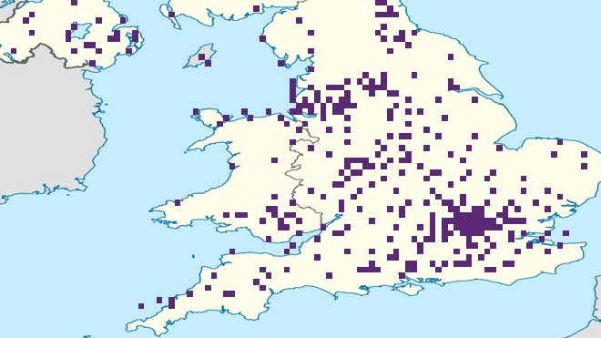
STACS HACK 10 Team Arrays the Roof
Marcus Elizondo-Darwin
Joshua James-Lee
Sophia Terry

Slide 2
Our Approach
Incorporate:
8-bit – STACS
JSON data – NCR Atleos
Promoting Accessibility – BlackRock

Slide 3
Our solution
We created a Restful Web API to interact with and query the accessibility of Santander ATMs and Branches across the country.
The goal of the program is to illustrate the coverage of inclusive financial hubs, whether that be ATMs or branches.
We at SantanWare care, because money should be for the many, not the few.

Slide 4

The Backend
RESTful server backend handles API requests from client programs.

Slide 5
GET /data/______
Request information on branches or atms. Supplies the NCR datasets to client applications as a JSON response.
Limit scope of request by specifying Branch or ATM ID.
Query ATMs and Branches by Town, Postcode, Accessibility Features and a combination of the above.

Slide 6

API usage – AKA "Le Docs"
The easy-to-read documentation provided, demonstrates usage of the API in an interactive fashion, encouraging other programmers to use the infrastructure we've created. The documentation includes:
-Interactive demos to query ATMs and branches
-Explanations of the data you will receive from the API
-API Reference showing basic requests to the API
This Photo by Unknown author is licensed under CC BY-SA-NC.

Slide 7

Data Visualization
Populated a grid to scale with the UK based on latitude(61N - 49N) and longitude(8W-2E).
Interactive pixels in purple showing areas where Santander ATMs are located.
Using the API, can view information on the accessibility of all the ATMs in a given area.

Slide 8

Demo

