Slide 1

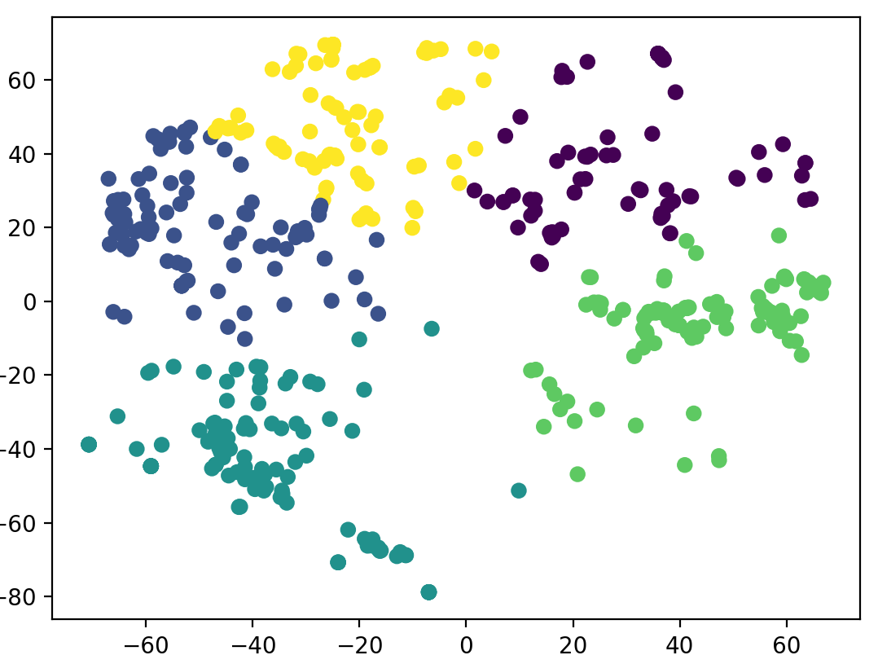
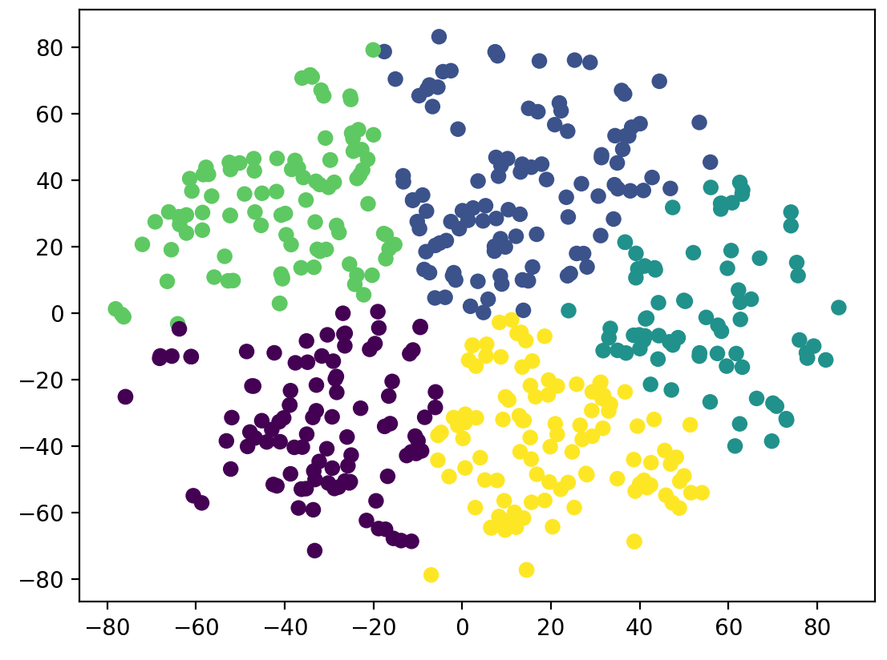

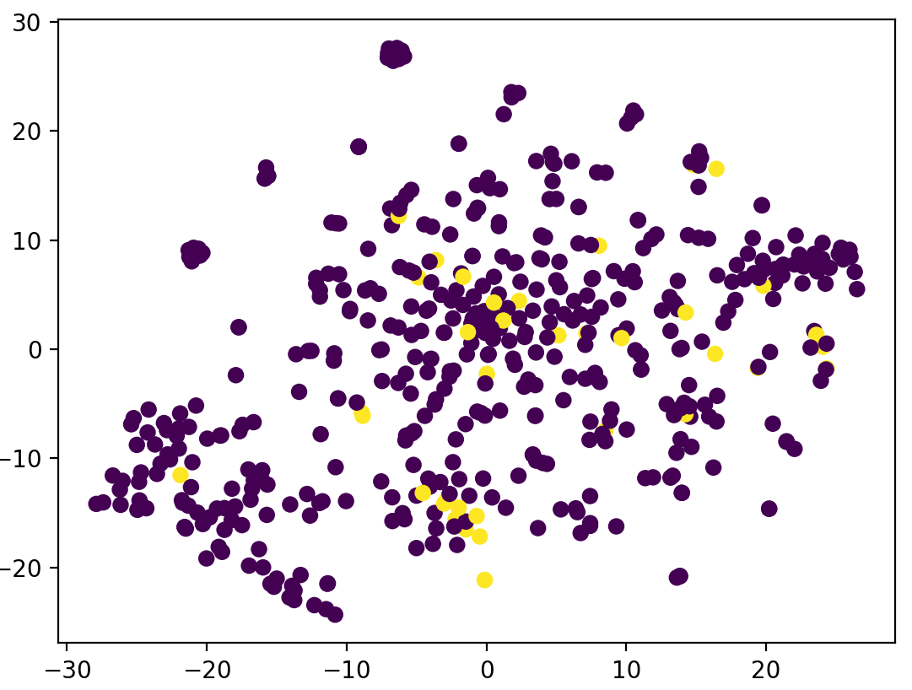
Twitter Hate Speech Clustering and Classification
Joshua Donelly-Higgins – jdh536@nyu.edu
Introduction to Machine Learning, New York University Paris
Abstract
Clustering
Classification cont.
This project aimed first to successfully classify hate speech from normal speech on Twitter and following that to ascertain if there are significant differences between different types of hate speech.
The classification of hate speech was done using a supervised learning model, which when trained on labeled tweets, was able to accurately predict whether a given tweet contained hate speech or not.
To test if differences appeared between different types of hate speech, an unsupervised model was used that first significantly reduced the dimensionality of the data and then performed clustering.
My motivation for this project was personal as someone who uses Twitter regularly and encounters the racism, sexism, homophobia, and violent speech exhibited on that platform. My hope is that this project will help provide insight into the structure of that speech and potentially lead to systems that filter out hate speech before a user ever even sees it.
After applying SVMs, the second method used was a neural net both with and without PCA. The neural net with PCA performed fairly well with 94.81% accuracy and the net without PCA achieved 95.27%. However, while performing better, the net without PCA was very impractical to train on a dataset of ~30,000 tweets each being 20,000 TF-IDF elements. This is because neural nets are not optimized for sparse inputs like a linear SVM kernel is (kernels scale with the number of datapoints, not the number of dimensions).
The neural net used here was fairly simple and involved 3 dense layers with sigmoid activations. The first being 200 neurons, the second 128, and the third 32.
Input: 200 dimensions
Layer 1: 200 neurons
Layer 2: 128 neurons
K-Means with 5 clusters on all speech (n=500)
It appears that tweets were fairly evenly distributed on the 2d TSNE plane. Clustering was used here, but no significant clusters appear to exist, indicating that significant language patterns did not form.
Layer 2: 32 neurons
K-Means with 5 clusters on only hate speech (n=500)
When looking at only hate speech one can see a ‘hole’ in the middle of the plot generated by TSNE. This is notable as all the data was taken through the same TSNE transformer and, when compared to the plot to the right, normal speech appears in the middle of the plot while hate speech does not. This may reflect a heavier presence of more ‘extreme’ language within hate speech.
Output: 1 dimension
In order to visualize the data on a 2d plane, the PCA-processed data was again reduced with PCA to 50 dimensions, and finally reduced to 2 dimensions using TSNE (t-distributed stochastic neighbor embedding).
Clustering was largely unsuccessful as the data did not reveal any significant clusters, nonetheless a 5-cluster K-means algorithm was run and labeled the data shown above. The one interesting result of this dimensionality reduction was the apparent hole in the middle of the hate speech data, which should be investigated further and may demonstrate a lower use of common words in hate speech.
Results and Further Steps
Dataset
In summary:
Classification was successful using both a linear SVM and a neural net; both achieved similar accuracy.
Clustering was unsuccessful however TSNE manifold learning produced different results for hate speech versus normal speech. The manifold reveals that most speech is fairly evenly distributed across the vector space.
The data used for this project consisted of ~50,000 tweets taken from a Kaggle dataset on Twitter hate speech (1). 2/3 of that data came labeled as being hate speech or normal speech and the remaining 1/3 was unlabeled. Before vectorization all tweets were cleaned and words were standardized.
In order to use the textual data my models needed a vector space representation of that data, so all tweets were fed into a TF-IDF vectorizer. TF-IDF (illustrated on the right) refers to “term frequency inverse document frequency” and aims to measure the frequency of a term within a tweet relative to the frequency with which that term occurs over the whole dataset. Using this, each tweet was transformed into a 20000-element TF-IDF vector for the 20000 most common words in the dataset.
As these were very sparse vectors, PCA was employed to reduce them to 200 element dense vectors while keeping almost all useful information encoded in each vector. PCA is a dimensionality reduction technique which takes a singular value decomposition of the covariance matrix of the data and keeps the highest singular values and their singular vectors as they represent the most significant components of the data.
Classification
Classification was done with 2 methods. First, an SVM kernel classifier was used on the sparse TF-IDF vectors. A kernel SVM, or kernel support vector machine, aims to separate data by looking at the similarity between a test datapoint and training datapoints in each category. Given a test datapoint and a set of training datapoints, the SVM computes a measure of distance between that test datapoint and each training datapoint then weights that score by the label given to the training datapoint. If the test datapoint is very close to a training datapoint they are considered similar and therefore the test is likely to be of the same category as the training.
The Linear SVM without PCA performed the best with 96.2% accuracy but was very costly to run. The SVM with PCA performed at 94.2% accuracy which may reflect some loss of information occurring when PCA is applied.
Classifier | Accuracy
SVM Without PCA: | 0.9620
SVM PCA (n_components=200) | 0.9420
Neural Net Wihout PCA | 0.9527
Neural Net PCA (n_components=200) | 0.9481
Further Steps:
Investigate vector encoding of individual words to produce structure and look at LSTM (Long Short Term Memory) Recursive Neural Nets to improve classification.
Look at other potentially more expansive datasets to more definitively answer whether there are differences between different types of hate speech.
Apply the classification model to real twitter data and develop a tool allowing users to mute hate speech.
Tweet:
”the quick brown fox jumped over the lazy dog”
TF-IDF (Sparse):
<0.1, 0, 0.5, 0.21, 0, 0, 0.56, 0, 0, 0.04 …> x 20000
PCA (Dense):
<0.15, 0.57, 0.98, 0.87, 0.12, 0.65, 0…> x 200
References
2d representation of classified data:
Purple points represent non hate speech and yellow points represent hate speech. Some clusters of hate speech are visible but the K-means clustering algorithm did not find strong clusters of hate speech separated from the rest of the data, indicating hate speech still shares the same common language patterns with regular speech.
https://www.kaggle.com/arkhoshghalb/twitter-sentiment-analysis-hatred-speech
https://www.quentinfily.fr/tf-idf-pertinence-lexicale/ (tf-idf diagram)
Notes:
Behavioral results: make bar graphs of RT?
fMRI results: labels, figure caption, make blues in graph the same color
References: add marcel 2004, add numbers, rearrange

