Slide 1
RC 1.1
RC 1.4
RC 1.6
Create Reimbursement
DEPLOY TO STG
Details
CAPSTONE OVERVIEW
Requestor can create a reimbursement Draft
Include the required fields
Drafts can be saved and edited before submission
Validation prevents submission
Graceful error handling
for
Josh Kenshi M. Dimpas

Slide 2
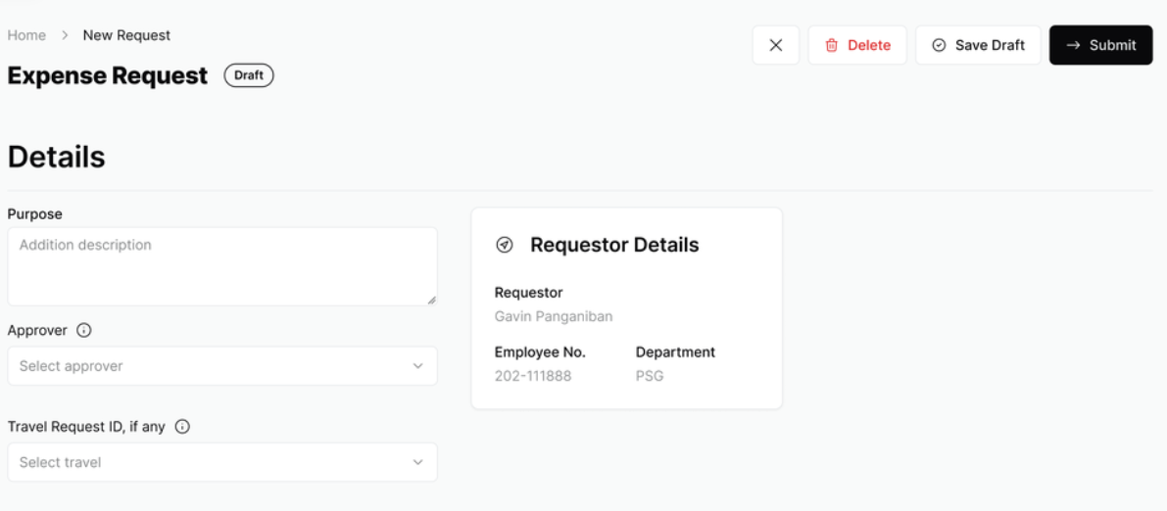
RC 1.1
RC 1.4
RC 1.6
Create Reimbursement
DEPLOY TO STG
Details
Requestor can create a reimbursement Draft
Include the required fields
Drafts can be saved and edited before submission
Validation prevents submission
Graceful error handling
CAPSTONE OVERVIEW
for
Josh Kenshi M. Dimpas

Slide 3
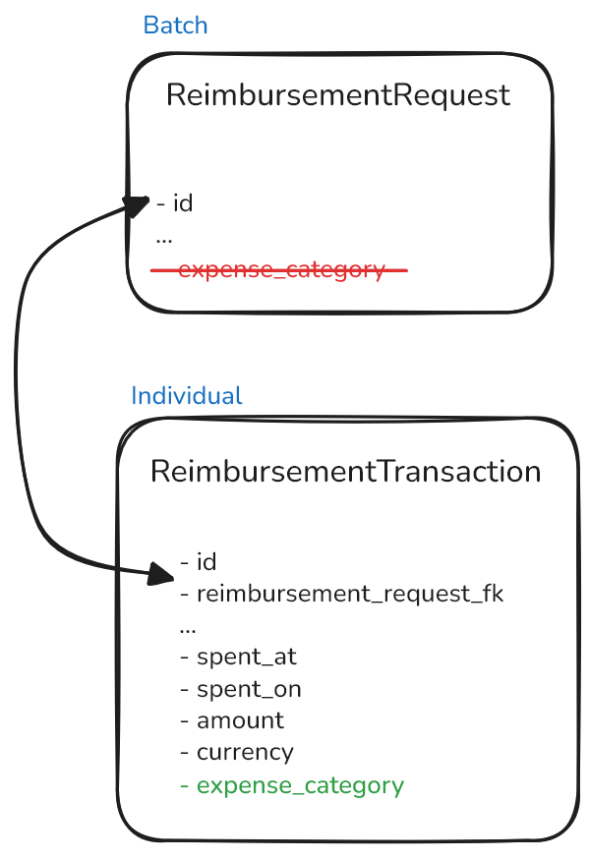
RC 1.1
RC 1.4
RC 1.6
Create Reimbursement
DEPLOY TO STG
Details
Details
Moving Expense Category Field
Requestor can create a reimbursement Draft
Include the required fields
Drafts can be saved and edited before submission
Validation prevents submission
Graceful error handling
Initial Thoughts
Data Migration
Handle references on backend and frontend

Slide 4
RC 1.1
RC 1.4
RC 1.6
Create Reimbursement
DEPLOY TO STG
Details
Details
Moving Expense Category Field
Requestor can create a reimbursement Draft
Include the required fields
Drafts can be saved and edited before submission
Validation prevents submission
Graceful error handling
Initial Thoughts
Data Migration
Handle references on backend and frontend

Slide 5
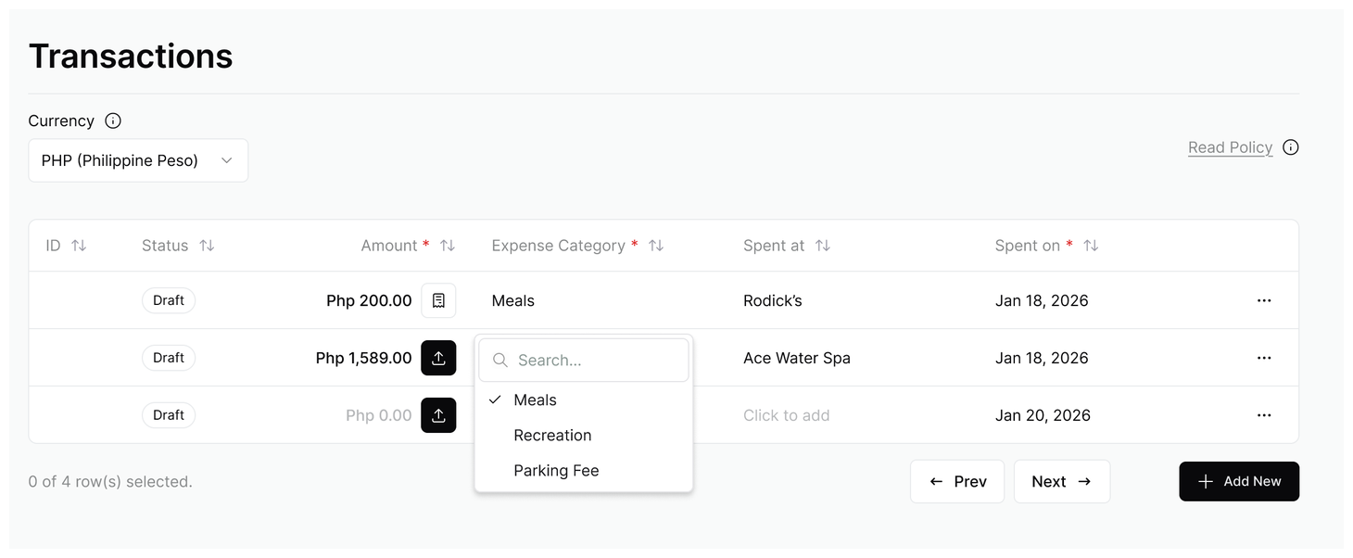
RC 1.1
RC 1.4
RC 1.6
Create Reimbursement
DEPLOY TO STG
Moving Expense Category Field
Initial Thoughts
Data Migration
Handle references on backend and frontend

Slide 6
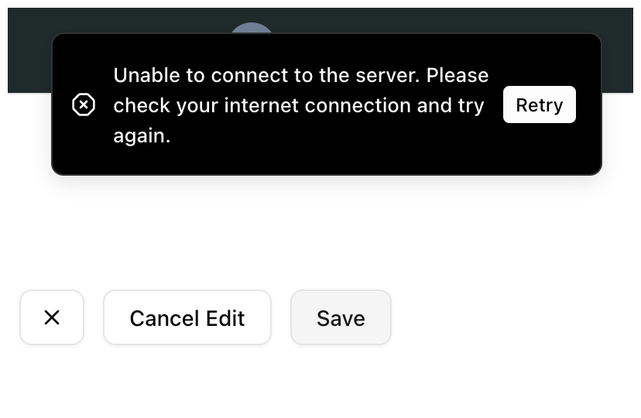
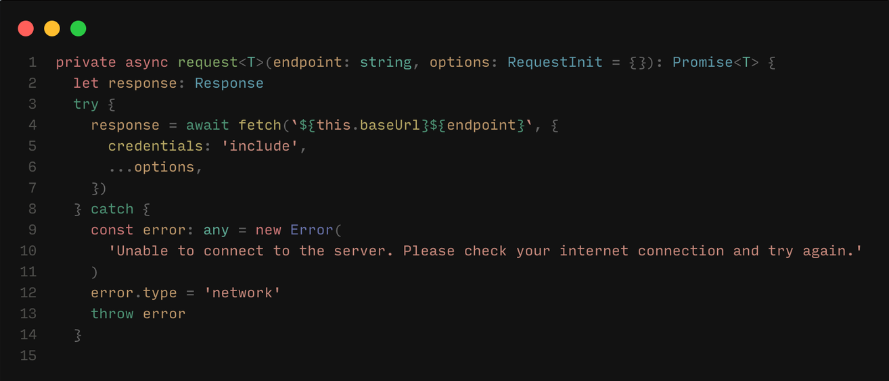
RC 1.1
RC 1.4
RC 1.6
Create Reimbursement
DEPLOY TO STG
Moving Expense Category Field
Graceful Error Handling
Save or network failures show a user-friendly error with a retry option; no silent failures

Slide 7
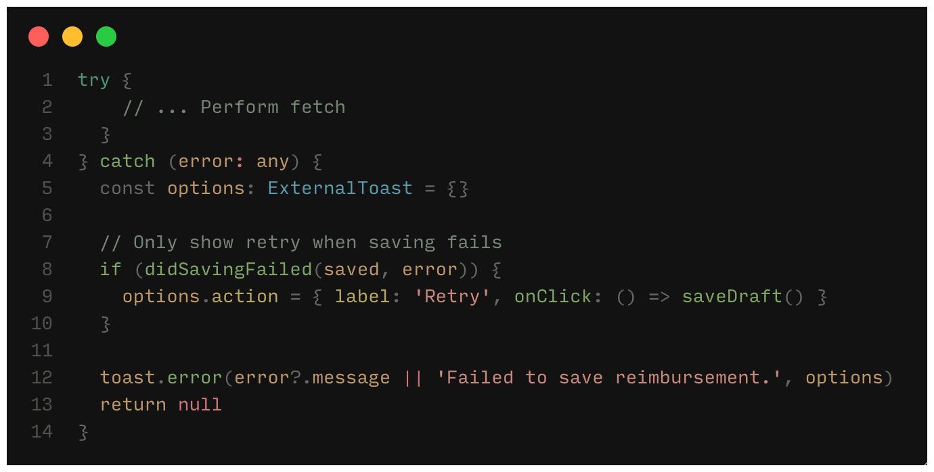
RC 1.1
RC 1.4
RC 1.6
Create Reimbursement
DEPLOY TO STG
Graceful Error Handling
Save or network failures show a user-friendly error with a retry option; no silent failures

Slide 8
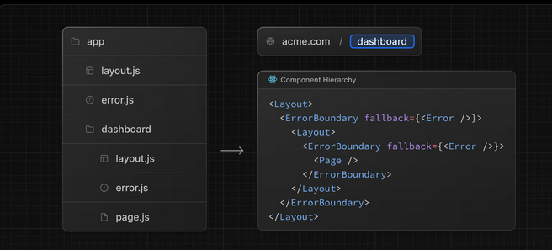
RC 1.1
RC 1.4
RC 1.6
Create Reimbursement
DEPLOY TO STG
Link Travel Request
DEPLOY TO STG
Graceful Error Handling
Details
Save or network failures show a user-friendly error with a retry option; no silent failures

Slide 9
RC 1.1
RC 1.4
RC 1.6
Create Reimbursement
DEPLOY TO STG
Link Travel Request
DEPLOY TO STG
Graceful Error Handling
Details
Save or network failures show a user-friendly error with a retry option; no silent failures
Travel ID should be populated when creating a Reimbursement from a completed Travel
Travel ID validation
Link is immutable after submission
Travel module receives liquidation signal upon submission. Travel status changes to Pending Reimbursement

Slide 10
RC 1.1
RC 1.4
RC 1.6
Create Reimbursement
Link Travel Request
DEPLOY TO STG
Graceful Error Handling
Details
All Travelers can create a Request
Travel ID should be populated when creating a Reimbursement from a completed Travel
Travel ID validation
Link is immutable after submission
Travel module receives liquidation signal upon submission. Travel status changes to Pending Reimbursement
TravelRequest
Traveler2
Traveler1
Reimbursement1
Reimbursement2

Slide 11
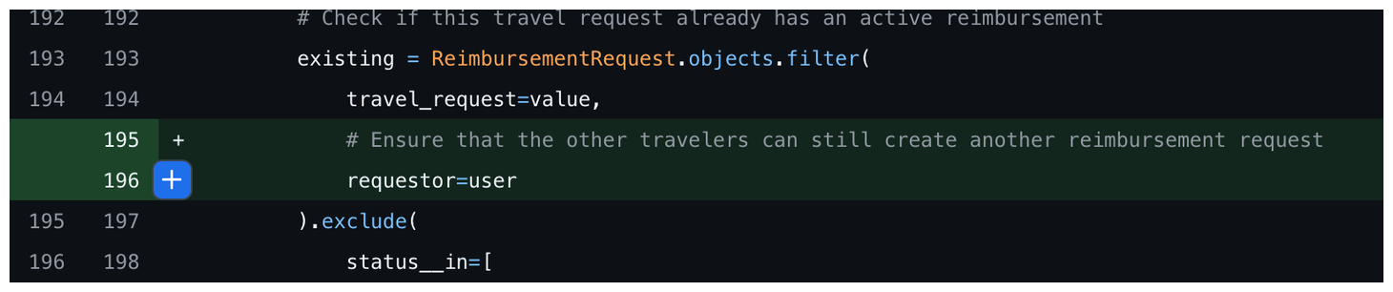
RC 1.1
RC 1.4
RC 1.6
Create Reimbursement
Link Travel Request
DEPLOY TO STG
Reimbursement Queue
DEPLOY TO STG
Graceful Error Handling
Details
All Travelers can create a Request
Details
Travel ID should be populated when creating a Reimbursement from a completed Travel
Travel ID validation
Link is immutable after submission
Travel module receives liquidation signal upon submission. Travel status changes to Pending Reimbursement

Slide 12
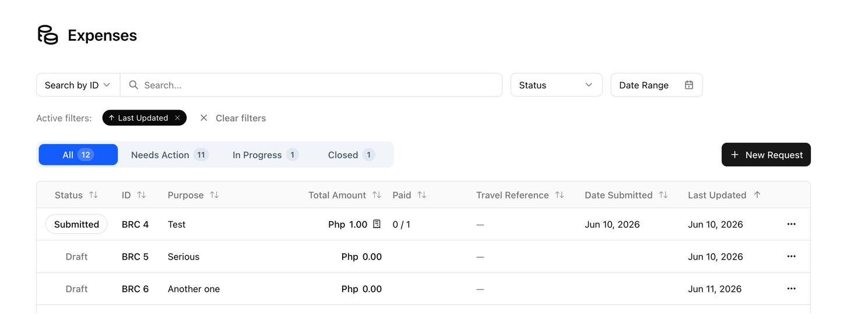
RC 1.1
RC 1.4
RC 1.6
Link Travel Request
Create Reimbursement
Reimbursement Queue
DEPLOY TO STG
DEPLOY TO STG
Graceful Error Handling
Details
Details
All Travelers can create a Request
Travel ID should be populated when creating a Reimbursement from a completed Travel
Travel ID validation
Link is immutable after submission
Travel module receives liquidation signal upon submission. Travel status changes to Pending Reimbursement
Requestor view for their own requests
Sorting by id, paid progress, amount, status, date submitted and last updated
Filter by ID, Reference No, or Purpose
Visual Indicator for Deadline Flags (expiring and expired)
Invoice Preview Dialog
Row operations (Delete and View)

Slide 13
RC 1.1
RC 1.4
RC 1.6
Reimbursement Queue
DEPLOY TO STG
Details
Search Target Filter
Requestor view for their own requests
Sorting by id, paid progress, amount, status, date submitted and last updated
Filter by ID, Reference No, or Purpose
Visual Indicator for Deadline Flags (expiring and expired)
Invoice Preview Dialog
Row operations (Delete and View)
Travel ID should be populated when creating a Reimbursement from a completed Travel
Travel ID validation
Link is immutable after submission
Travel module receives liquidation signal upon submission. Travel status changes to Pending Reimbursement

Slide 14
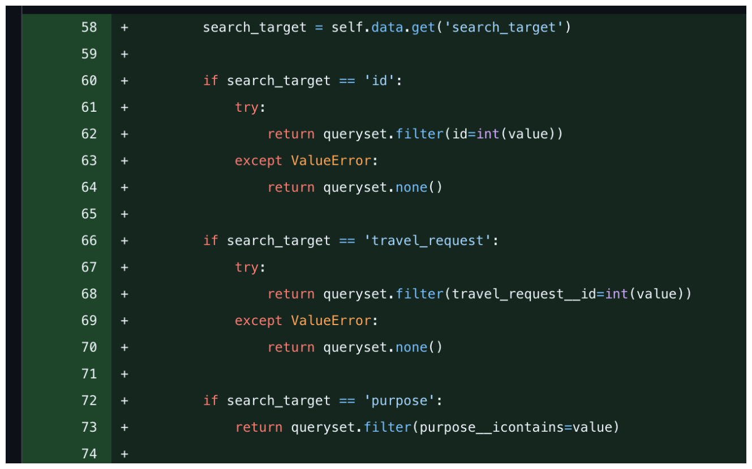
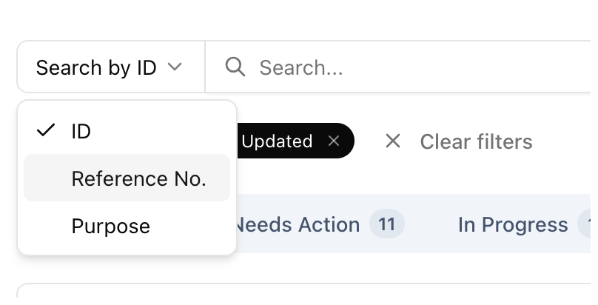
RC 1.1
RC 1.4
RC 1.6
Reimbursement Queue
DEPLOY TO STG
Details
Search Target Filter
Requestor view for their own requests
Sorting by id, paid progress, amount, status, date submitted and last updated
Filter by ID, Reference No, or Purpose
Visual Indicator for Deadline Flags (expiring and expired)
Invoice Preview Dialog
Row operations (Delete and View)
Travel ID should be populated when creating a Reimbursement from a completed Travel
Travel ID validation
Link is immutable after submission
Travel module receives liquidation signal upon submission. Travel status changes to Pending Reimbursement

Slide 15
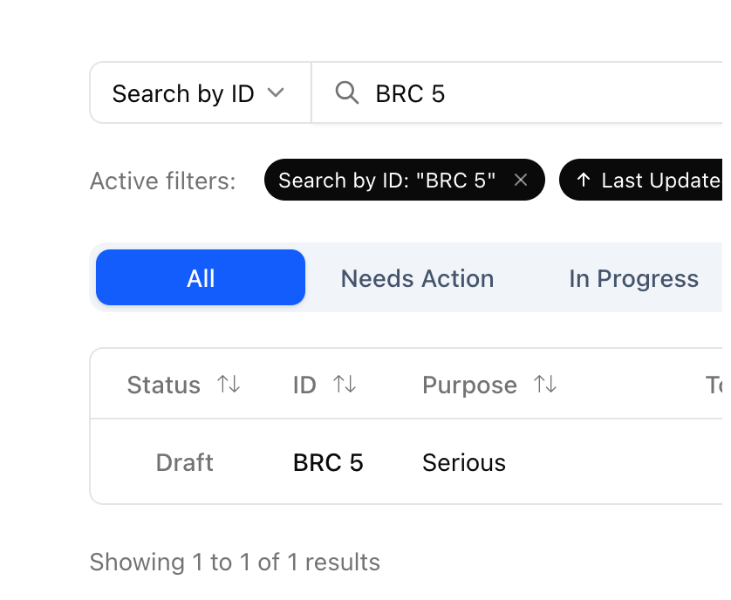
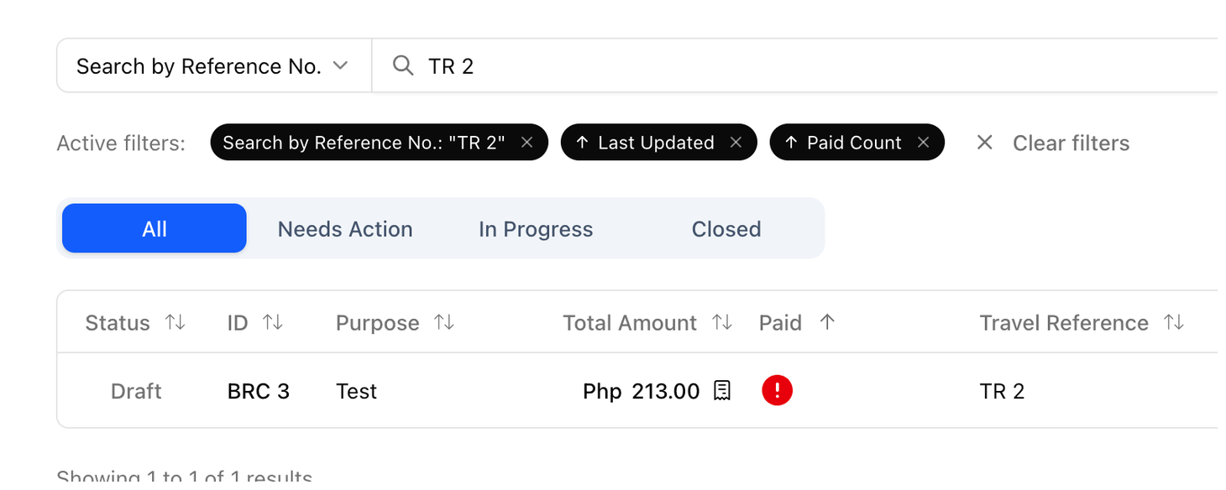
RC 1.1
RC 1.4
RC 1.6
Reimbursement Queue
DEPLOY TO STG
Details
Search Target Filter
Requestor view for their own requests
Sorting by id, paid progress, amount, status, date submitted and last updated
Filter by ID, Reference No, or Purpose
Visual Indicator for Deadline Flags (expiring and expired)
Invoice Preview Dialog
Row operations (Delete and View)
Travel ID should be populated when creating a Reimbursement from a completed Travel
Travel ID validation
Link is immutable after submission
Travel module receives liquidation signal upon submission. Travel status changes to Pending Reimbursement

Slide 16
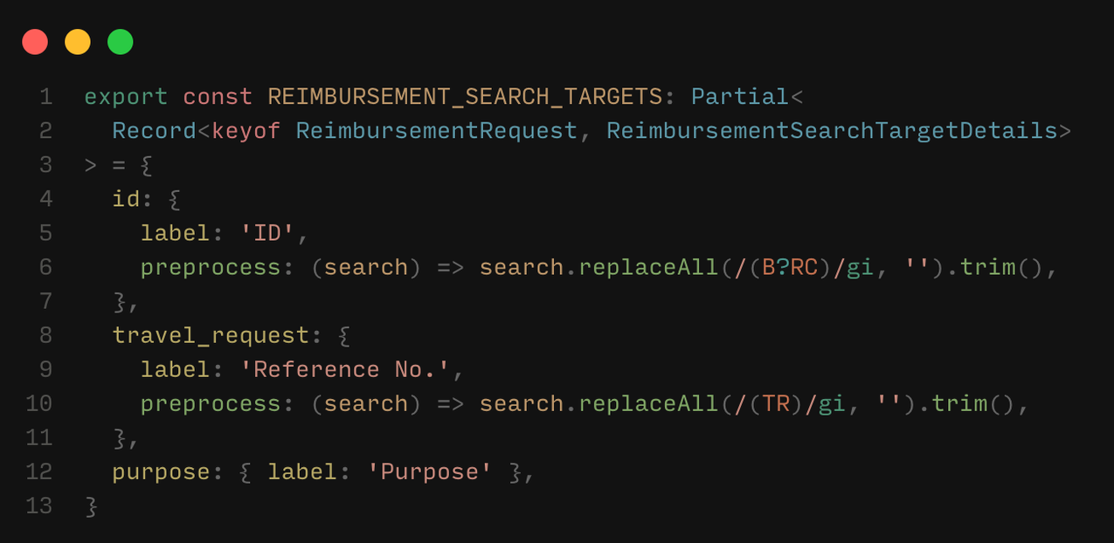
RC 1.1
RC 1.4
RC 1.6
Reimbursement Queue
DEPLOY TO STG
Search Target Filter

Slide 17
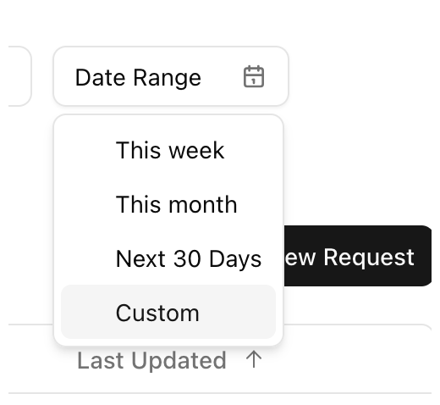
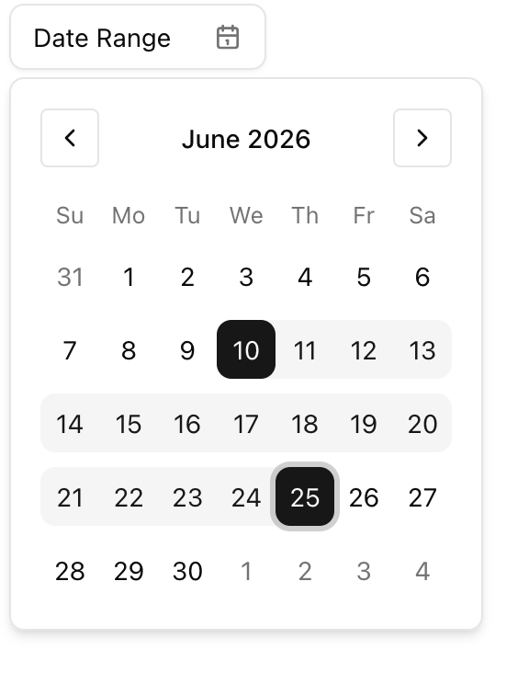
RC 1.1
RC 1.4
RC 1.6
Reimbursement Queue
DEPLOY TO STG
Search Target
Date Range Filter

Slide 18
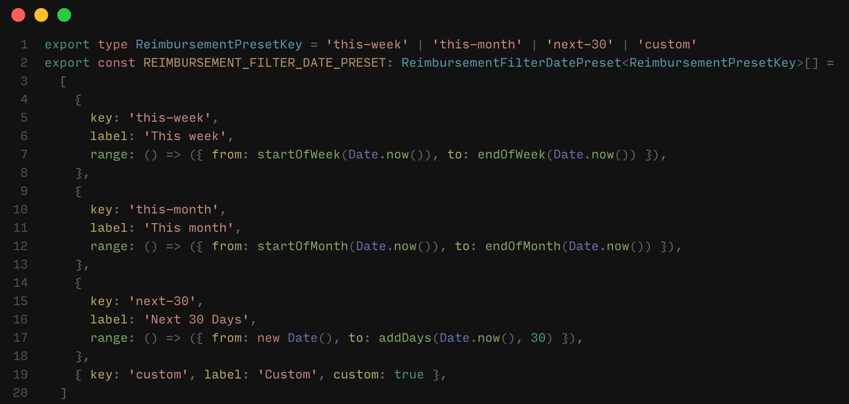
RC 1.1
RC 1.4
RC 1.6
Reimbursement Queue
DEPLOY TO STG
Date Range Filter

Slide 19
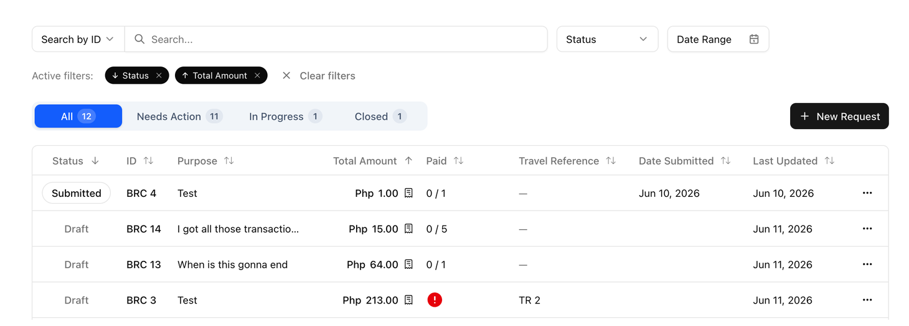
RC 1.1
RC 1.4
RC 1.6
Reimbursement Queue
DEPLOY TO STG
Date Range Filter
Multi Field Sorting

Slide 20
RC 1.1
RC 1.4
RC 1.6
Reimbursement Queue
DEPLOY TO STG
Date Range Filter
Multi Field Sorting
SearchParam Format: ?sort_strategy=<field1:order>,<field2:order>…
e.g.
sort=status:asc,total_amountv:des
sort=last_submitted:des

Slide 21
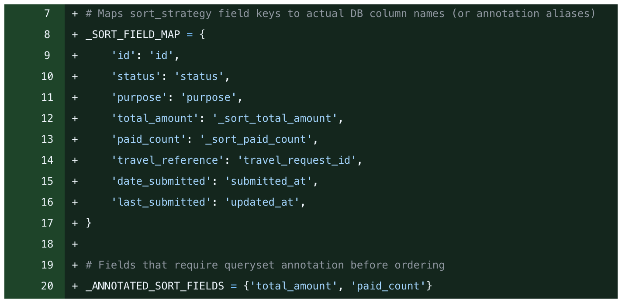
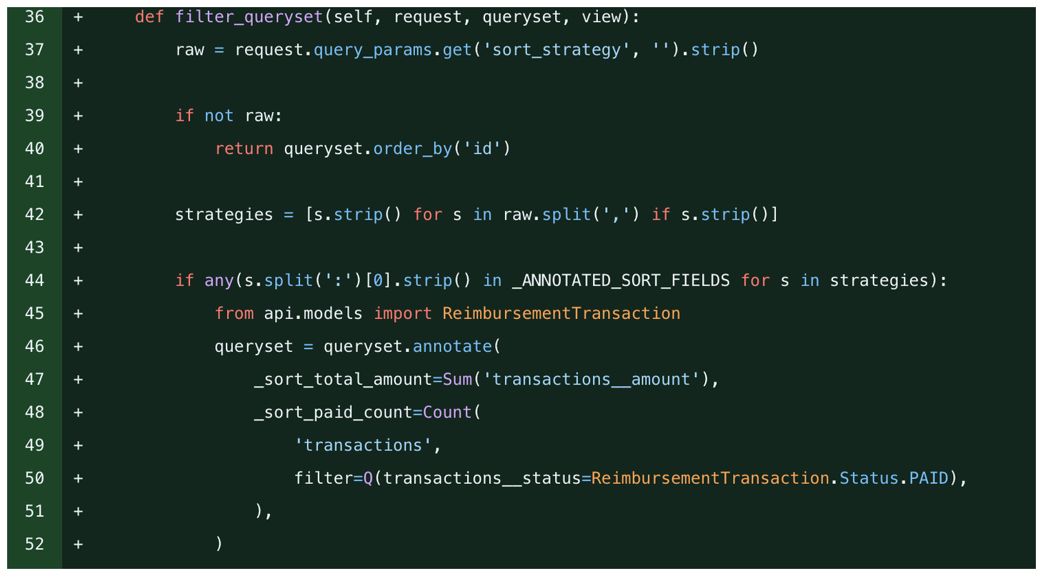
RC 1.1
RC 1.4
RC 1.6
Reimbursement Queue
DEPLOY TO STG
Date Range Filter
Multi Field Sorting

Slide 22
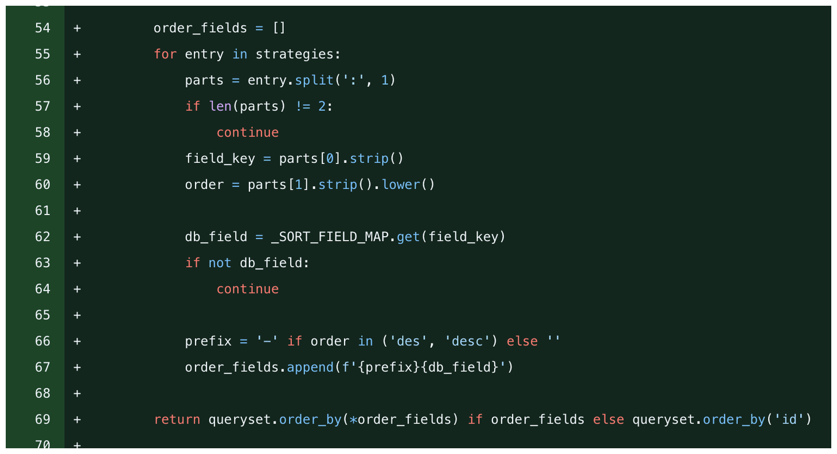
RC 1.1
RC 1.4
RC 1.6
Reimbursement Queue
DEPLOY TO STG
Date Range Filter
Multi Field Sorting

