Slide 1
CS679: Pattern Recognition
A Statistical Method for 3D Object Detection
Applied to Faces and Cars
H. Schneiderman and T. Kanade
Robotics Institute at Carnegie Mellon University
International Journal of Computer Vision, 46(1), 81-96, 2002
By Rod Pickens and Josh Gleason
Advisement of Professor Bebis, UNR CS

Slide 2
Topics
Introduction
Purpose
Approach
Classifier Design
Features
Bayesian
Results
Training data

Slide 3
Introduction
Purpose
Develop a method for detecting same class 3D objects at various rotational poses in 2D imagery
E.g. faces in images or cars in images
Approach
Train on photographs with many examples of
Cars
People’s faces
Use wavelet based features for both sets
Apply likelihood ratio test classifier
Test performance on many examples

Slide 4
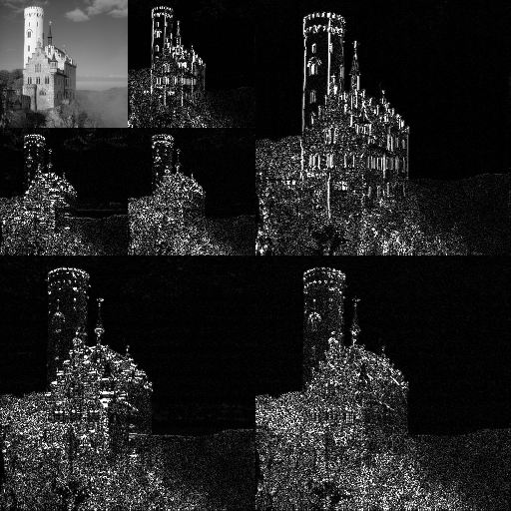



Wavelet Transform
A function $φ∈ L^{2} (ℝ)$ is an orthonormal wavelet if it can be used to define a Hilbert basis.
L² implies the function (basis) has an
inner product (squared integrable function).
$$A∙B=\left\|A\right\|\left\|B\right\|\cos\left(θ\right)$$
$$\left\langle f,g\right\rangle =\int_{a}^{b}{f\left(x\right)g\left(x\right)dx}$$
Allessio Damato, Wiki Commons
May 17, 2007, Lichtenstein Castle

Slide 5


Hilbert Space and Basis
Hilbert space
A generalization of Euclidean space
An abstract vector space containing the structure of an inner product
Extends the methods of vector algebra and calculus to any finite or infinite dimensional space
Hilbert basis
A set of orthogonal vectors that span a Hilbert space
For examples, the vectors i, j, k in 3D
Z
Euclidean 3D Space
Is a Hilbert Space
A
y
B
x
$$A∙B=\left\|A\right\|\left\|B\right\|\cos\left(θ\right)$$
$$\left\langle f,g\right\rangle =\int_{a}^{b}{f\left(x\right)g\left(x\right)dx}$$

Slide 6
Wavelet: Basics with Haar
y = H x
H = [1/2 ½; ½ -1/2];
Observe behavior (plot in matlab)

Slide 7
Wavelet Coefficients
LL
HL
HL
LH
HH
LH
HH

Slide 8
Wavelet Features
Intra-suband
Inter-frequency
Inter-orientation
Inter-orientation
and inter-orientation

Slide 9

Likelihood Ratio Classifier
$$\frac{P(image|ω_{1}=object)}{P(image|ω_{2}=non−object)}\begin{matrix}\begin{matrix}ω_{1} \\ >\end{matrix} \\ \begin{matrix}< \\ ω_{2}\end{matrix}\end{matrix}\frac{P(non−object)}{P(object)}=λ$$

