Slide 1
Fundamental Performance Limits in Image Registration By Dirk Robinson and Peyman Milanfar IEEE Transactions on Image Processing Vol. 13, No. 9, 9/2004
CS679: Pattern Recognition
Josh Gleason and Rod Pickens

Slide 2
Topics
Application
Image registration and errors
Parameter estimation and errors
Performance limits (bounds) of estimators
Cramer-Rao lower bound

Slide 3
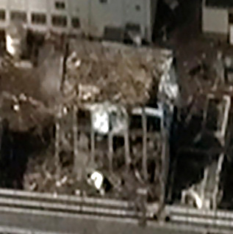
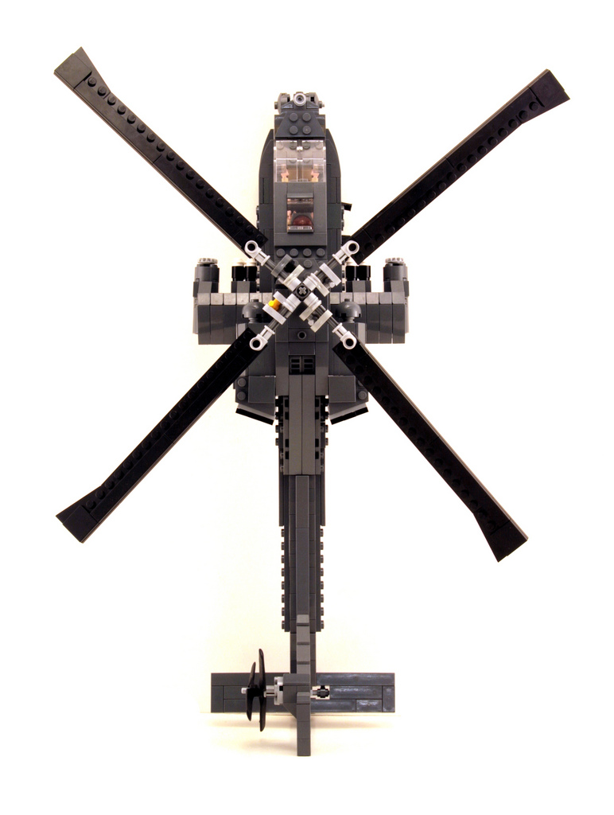
Robotic Rotor Wing to Inspect Fukushima Reactors
Purpose
Fly through damaged buildings
Navigation Approach: SLAM
Install stereo sensors on craft
Stereo vision → 3D model
Fly through 3D model
Critical Algorithm
Image registration
Issue: Probability of collision
How much bias in position?
How much variance in position?
Analyze Accuracy of SLAM
Errors in image registration
Decision:
Rotor wing will or will not perform the mission?
Fukushima Facility Building
Wiki Commons: Digital Globe

Slide 4

Registration Errors
Translational errors
Δx and Δy
Performance for many trials
Bias
E(Δx) ≠ 0 and E(Δy) ≠ 0
Variance
σ² = E{(Δx+Δy)²} – E(Δx)E(Δy) > 0
Higher order errors
Not modeled
Errors: Δx and Δy

Slide 5
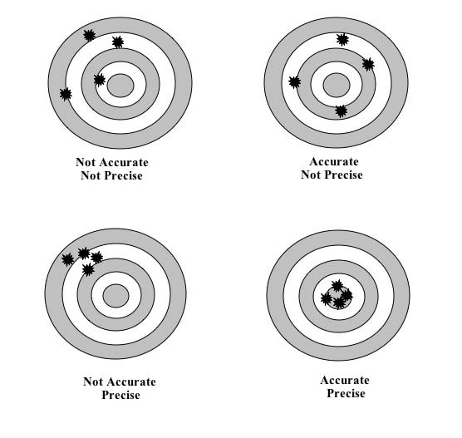
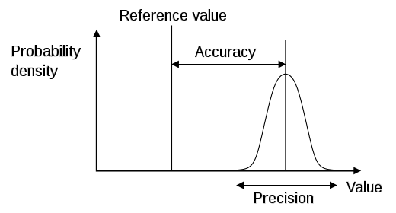
Estimation: Accuracy and Precision
Target Practice
1D Error Distribution
(Bias)
(Variance)
WikiCommons: Pekaje

Slide 6
Performance Limits
How accurate?
Error about true position
How precise?
Error about mean of estimator
What is best?
What are performance limits?
Is this best performance?

Slide 7
Robot Rotor Wing in Fukushima: Navigation Errors (Entering Room 2 through wall openings)
Room 2
Room 1
Low Bias, Low Variance
Large Bias, Low Variance
Large Bias, Large Variance
Enter Room 2
Low Bias, High Variance
Collide with Wall

Slide 8
Cramer-Rao Lower Bound (CRLB)
Var(θ)
Best
CRLB is a minimum
variance unbiased estimator

Slide 9
Fisher Information Matrix (FIM)
Fisher Information Matrix

Slide 10
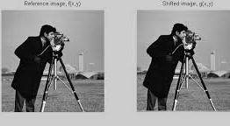
Registration, ML Estimation, and CRLB
f(m,n)=truth
v(m,n)=shift
ε(m,n)=Gaussian noise
Imagery
Log-likelihood function
Objective Function

Slide 11
FIM

Slide 12
CRLB

Slide 13
Conclusion

