Slide 1
Fundamental Performance Limits in Image Registration By Dirk Robinson and Peyman Milanfar IEEE Transactions on Image Processing Vol. 13, No. 9, 9/2004
CS679: Pattern Recognition
Josh Gleason and Rod Pickens

Slide 2
Topics
Example Application of Performance Limits
Image registration and errors
Parameter estimation and errors
Performance limits (bounds) of estimators
Cramer-Rao lower bound

Slide 3
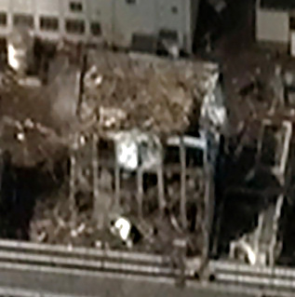
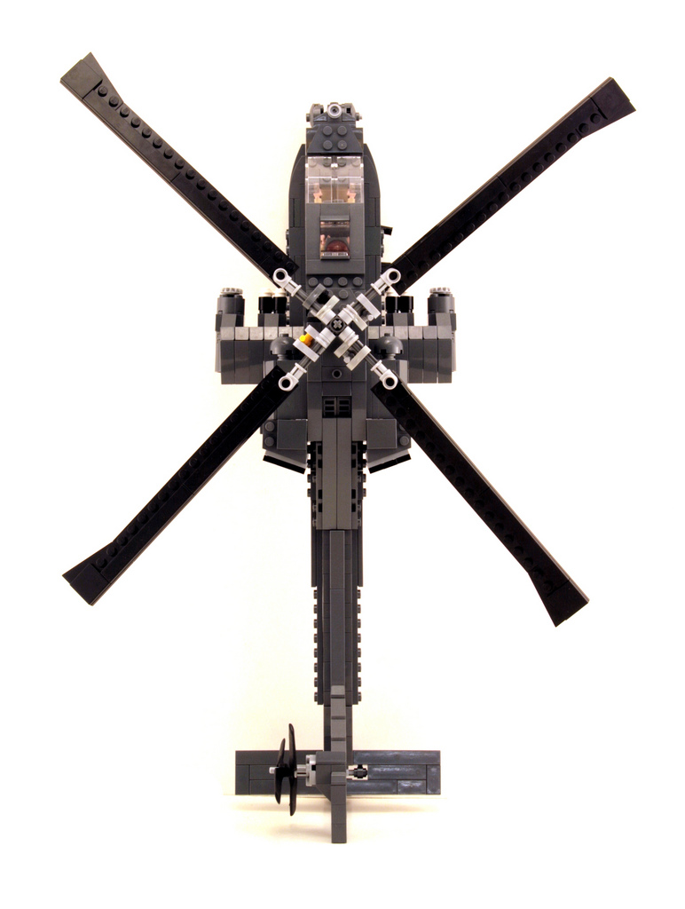
Robotic Helicopter to Inspect Fukushima Reactors
Purpose
Fly through damaged buildings
Navigation Approach: SLAM
Install stereo sensors on craft
Stereo vision → 3D model
Fly through 3D model
Critical Algorithm
Image registration
Issue: Probability of collision
How much bias in position?
How much variance in position?
Analyze Accuracy of SLAM
Errors in image registration
Decision: Will or will not helicopter
successfully perform inspection?
Fukushima Facility Building
Wiki Commons: Digital Globe
SLAM: Simultaneous Localization and Mapping
Helicopter: http://flickrhivemind.net/Tags/apache,lego

Slide 4

Image Registration Errors
Errors
Assume only translational errors
Δx and Δy
Higher order errors
Not modeled
Asymptotic performance
Bias
E(Δx) ≠ 0 and E(Δy) ≠ 0
Variance
σ² = E{(Δx+Δy)²} – E(Δx)E(Δy) > 0
Errors: Δx and Δy > 0
WikiCommons: Jazzjohn, 2012

Slide 5
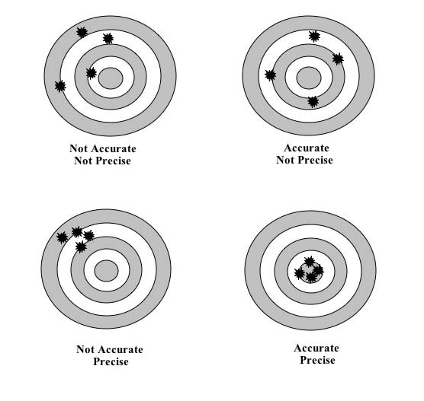
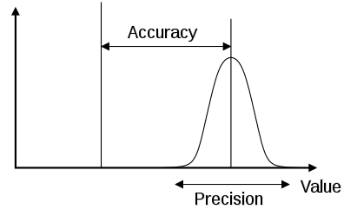
Estimation: Accuracy and Precision
Target Practice
1D Error Distribution
Likelihood
Function
(Bias)
Truth
Parameter
Value
(Variance)
PDF: WikiCommons: Pekaje
Targets: www.caroline.com/teacher-resources

Slide 6
Performance Limits
How accurate? Bias
Error about true position
How precise? Variance
Error about mean of estimator
What is best? Optimal
What are performance limits?
Is this best performance?
Targets: www.caroline.com/teacher-resources

Slide 7
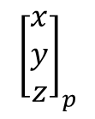
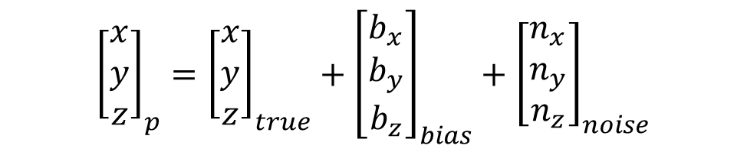
Registration Errors Impact Navigation
Image 1
Stereo Vision
3D Model
Navigation
$${\left[\begin{matrix}x \\ y \\ z\end{matrix}\right]}_{p}$$
Image 2
$${\left[\begin{matrix}x \\ y \\ z\end{matrix}\right]}_{p}={\left[\begin{matrix}x \\ y \\ z\end{matrix}\right]}_{true}+{\left[\begin{matrix}b_{x} \\ b_{y} \\ b_{z}\end{matrix}\right]}_{bias}+{\left[\begin{matrix}n_{x} \\ n_{y} \\ n_{z}\end{matrix}\right]}_{noise}$$

Slide 8



Registration Errors Impact Navigation (Image registration errors cause 3D world model errors)
Room 2: Fukushima Reactor
Enters Room 2: 3D mapping algorithm is a
minimum variance, unbiased estimator (MVUE).
Small Bias, Small Variance
Damaged Wall
$$Δx$$
$$Δx$$
$$Δx$$
Damaged Wall
Large Bias, Small Variance
Large Bias, Large Variance
Small Bias, Large Variance
Enters Room 2: MVUE algo
Room 1: Fukushima Reactor
Collides with Wall: not MVUE algo
Notes:
Introduce, we want to fly though the building and fly from room to room. Look at various cases of bias and variance.

Slide 9
Minimum Variance, Unbiased Estimator: Cramer-Rao Lower Bound (CRLB)
Var(θ)
CRLB is Best MVUE
Best
CRLB is a minimum
variance unbiased estimator

Slide 10
Modeling Registration Errors and CRLB
Log likelihood function as in Maximum Likelihood (ML) Estimation
J=Fisher Information Matrix (FIM)
$MSE\left(Φ\right)=\frac{∂E\{\hat{Φ}\}}{∂Φ}J^{−1}(Φ$)$\frac{{∂E\{\hat{Φ}\}}^{T}}{∂Φ}+\left(E\left\{\hat{Φ}\right\}−Φ\right){\left(E\left\{\hat{Φ}\right\}−Φ\right)}^{T}$
Variance
Bias
MSE = Mean Square Error used as measure of registration error
Notes:
The CRLB may be completely described by the FIM which is the variance term of the MSE

Slide 11
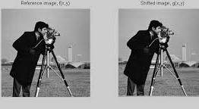
Registration, ML Estimation, and Objective Function
Imagery
Log-likelihood function
Objective Function
f(m,n) = truth
v = shift
ε(m,n) = Gaussian noise
Image courtesy Matlab
Notes:
Because only the second term contains unknown parameters v1 and v2, the problem of maximum likelihood is really a minimization of this term. The normalization by f^2 is normalizing by the energy of the cost.

Slide 12

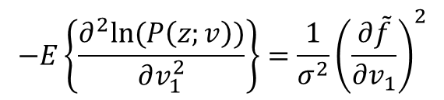

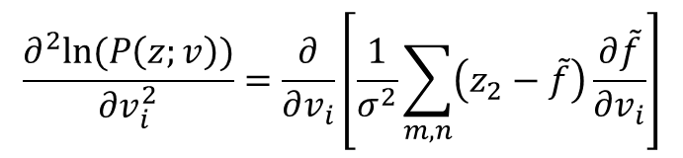

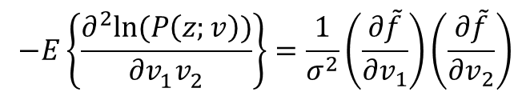
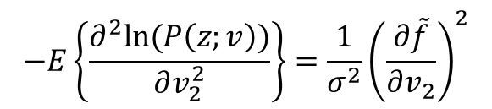
Deriving J(Φ) = FIM (Fisher Information)
Second partials of log likelihood
$$\frac{∂^{2}ln⁡(P\left(z;v\right))}{∂v_{i}^{2}}=\frac{∂}{∂v_{i}}\left[\frac{1}{σ^{2}}\sum_{m,n}{\left(z_{2}−\tilde{f}\right)\frac{∂\tilde{f}}{∂v_{i}}}\right]$$
Expected value of second partials
$$−E\left\{\frac{∂^{2}ln⁡(P\left(z;v\right))}{∂v_{1}^{2}}\right\}={\frac{1}{σ^{2}}\left(\frac{∂\tilde{f}}{∂v_{1}}\right)}^{2}$$
$$−E\left\{\frac{∂^{2}ln⁡(P\left(z;v\right))}{∂v_{2}^{2}}\right\}={\frac{1}{σ^{2}}\left(\frac{∂\tilde{f}}{∂v_{2}}\right)}^{2}$$
$$−E\left\{\frac{∂^{2}ln⁡(P\left(z;v\right))}{∂v_{1}^{}v_{2}^{}}\right\}=\frac{1}{σ^{2}}\left(\frac{∂\tilde{f}}{∂v_{1}}\right)\left(\frac{∂\tilde{f}}{∂v_{2}}\right)$$
Equating $v_{1}$ to x and $v_{2}$ to y
$\frac{∂\tilde{f}}{∂v_{1}}$= $\frac{∂\tilde{f}}{∂x}=f_{x}(m−v_{1},m−v_{2})$
$\frac{∂\tilde{f}}{∂v_{2}}$= $\frac{∂\tilde{f}}{∂y}=f_{y}(m−v_{1},m−v_{2})$

Slide 13
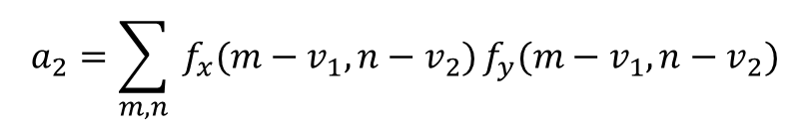

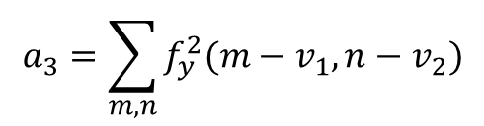
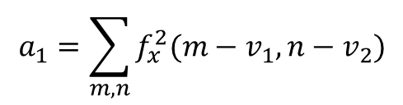
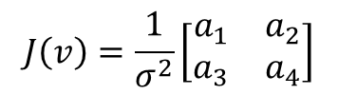

The Fisher Information Matrix (FIM)
Given
$\frac{∂\tilde{f}}{∂v_{1}}$= $\frac{∂\tilde{f}}{∂x}=f_{x}(m−v_{1},m−v_{2})$
$\frac{∂\tilde{f}}{∂v_{2}}$= $\frac{∂\tilde{f}}{∂y}=f_{y}(m−v_{1},m−v_{2})$
The FIM is
$$J\left(v\right)=\frac{1}{σ^{2}}\left[\begin{matrix}a_{1} & a_{2} \\ a_{3} & a_{4}\end{matrix}\right]$$
$$recall:MSE\left(v\right)≥{J\left(v\right)}^{−1}=CRLB (unbiased)$$
Where
$$a_{1}=\sum_{m,n}{f_{x}^{2}(m−v_{1},n−v_{2})}$$
$$a_{3}=\sum_{m,n}{f_{y}^{2}(m−v_{1},n−v_{2})}$$
$$a_{2}=\sum_{m,n}{ f_{x}(m−v_{1},n−v_{2})}f_{y}(m−v_{1},n−v_{2})$$
Notes:
Notice the FIM is dependent on the structure of the image. This makes sense because variance on an image which is a smooth gradient will be very large while variance on a corner will be smaller. For those who have taking computer vision, this matrix is very similar to the harris corner detor’s structure tensor (second moment matrix) without the windowing.

Slide 14
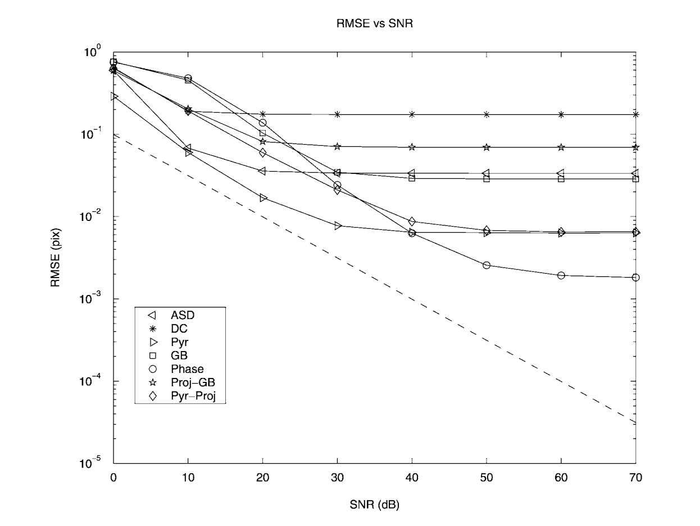

Results: Registration Error Analysis
Sloping: Estimator variance
Flat: Estimator bias
CRLB: MSE$≥J^{−1}(Φ$)
ASD: average square distance
DC: maximum direct correlator
Pyr: multiscale gradient-based
GB: gradient-based method
Proj-GB: project GB
Pyr-Proj: Project Pyr
Phase: relative phase

Slide 15
Conclusion
Variance & Bias of an estimator
Fisher Information
Cramer-Rao lower bound (CRLB)
Quantitative measure of estimator performance
Application of CRLB to image registration
Notes:
In this slide I will just reiterate what we have learned and what is important to take away from this presentation.
Relate my experience. I’m building a registration estimator and I’m dealing with these issues at work.

