Slide 1
Fundamental Performance Limits in Image Registration By Dirk Robinson and Peyman Milanfar IEEE Transactions on Image Processing Vol. 13, No. 9, 9/2004
CS679: Pattern Recognition
Josh Gleason and Rod Pickens

Slide 2
Topics
Example Application of Performance Limits
Image registration and errors
Parameter estimation and errors
Performance limits (bounds) of estimators
Cramer-Rao lower bound

Slide 3
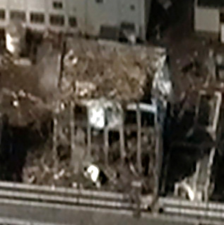
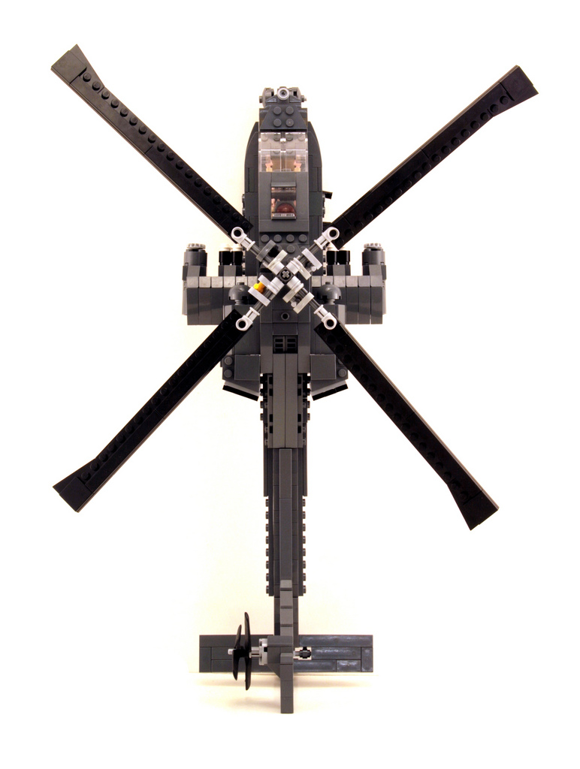
Robotic Helicopter to Inspect Fukushima Reactors
Purpose
Fly through damaged buildings
Navigation Approach: SLAM
Install stereo sensors on craft
Stereo vision → 3D model
Fly through 3D model
Critical Algorithm
Image registration
Issue: Probability of collision
How much bias in position?
How much variance in position?
Analyze Accuracy of SLAM
Errors in image registration
Decision: Will or will not helicopter
successfully perform inspection?
Fukushima Facility Building
Wiki Commons: Digital Globe
Helicopter: http://flickrhivemind.net/Tags/apache,lego

Slide 4

Registration Errors
Errors
Assume only translational errors
Δx and Δy
Higher order errors
Not modeled
Asymptotic performance
Bias
E(Δx) ≠ 0 and E(Δy) ≠ 0
Variance
σ² = E{(Δx+Δy)²} – E(Δx)E(Δy) > 0
Errors: Δx and Δy
WikiCommons: Jazzjohn, 2012

Slide 5
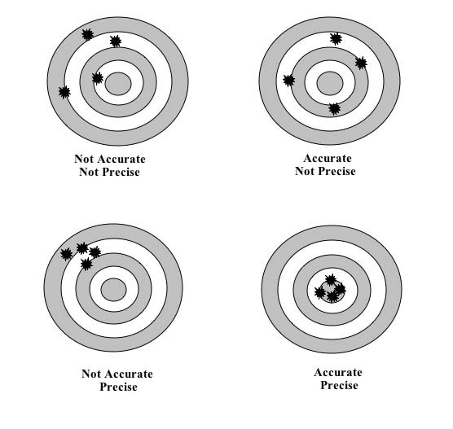
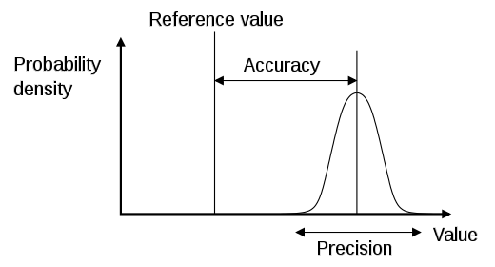
Estimation: Accuracy and Precision
Target Practice
1D Error Distribution
(Bias)
(Variance)
PDF: WikiCommons: Pekaje
Targets: www.caroline.com/teacher-resources

Slide 6
Performance Limits
How accurate? Bias
Error about true position
How precise? Variance
Error about mean of estimator
What is best? Optimal
What are performance limits?
Is this best performance?
Targets: www.caroline.com/teacher-resources

Slide 7



Navigation Errors due to Image Registration Errors (Entering Room 2 from Room 1 through wall openings)
Room 2
$$Δx$$
Helo enters Room 2
$$Δx$$
$$Δx$$
Damaged
Wall
Room 1
Low Bias, Low Variance
Large Bias, Low Variance
Large Bias, Large Variance
Enters Room 2
Low Bias, High Variance
Collides with Wall

Slide 8
Minimum Variance, Unbiased Estimator: Cramer-Rao Lower Bound (CRLB)
Var(θ)
CRLB is Best
Best
CRLB is a minimum
variance unbiased estimator

Slide 9
Modeling Registration Errors
Log likelihood function as in Maximum Likelihood (ML) Estimation
J=Fisher Information Matrix (FIM)
$MSE\left(Φ\right)=\frac{∂E\{\hat{Φ}\}}{∂Φ}J^{−1}(Φ$)$\frac{{∂E\{\hat{Φ}\}}^{T}}{∂Φ}+\left(E\left\{\hat{Φ}\right\}−Φ\right){\left(E\left\{\hat{Φ}\right\}−Φ\right)}^{T}$
Variance
Bias
MSE = Mean Square Error: Measure of Registration Error

Slide 10
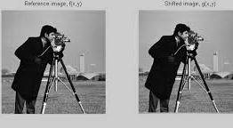
Registration, ML Estimation, and Objective Function
Imagery
Log-likelihood function
Objective Function
f(m,n) = truth
v(m,n) = shift
ε(m,n) = Gaussian noise
Image courtesy Matlab

Slide 11

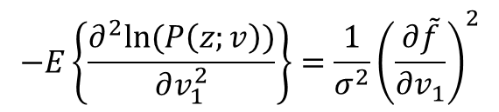

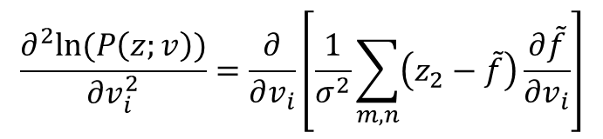

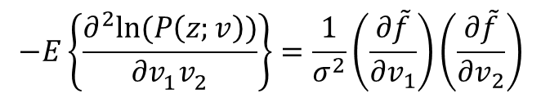
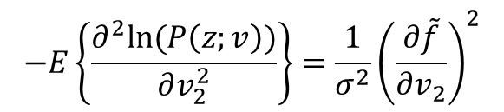
Deriving J(Φ) = FIM (Fisher Information)
Second partials of log likelihood
$$\frac{∂^{2}ln⁡(P\left(z;v\right))}{∂v_{i}^{2}}=\frac{∂}{∂v_{i}}\left[\frac{1}{σ^{2}}\sum_{m,n}{\left(z_{2}−\tilde{f}\right)\frac{∂\tilde{f}}{∂v_{i}}}\right]$$
Expected value of second partials
$$−E\left\{\frac{∂^{2}ln⁡(P\left(z;v\right))}{∂v_{1}^{2}}\right\}={\frac{1}{σ^{2}}\left(\frac{∂\tilde{f}}{∂v_{1}}\right)}^{2}$$
$$−E\left\{\frac{∂^{2}ln⁡(P\left(z;v\right))}{∂v_{2}^{2}}\right\}={\frac{1}{σ^{2}}\left(\frac{∂\tilde{f}}{∂v_{2}}\right)}^{2}$$
$$−E\left\{\frac{∂^{2}ln⁡(P\left(z;v\right))}{∂v_{1}^{}v_{2}^{}}\right\}=\frac{1}{σ^{2}}\left(\frac{∂\tilde{f}}{∂v_{1}}\right)\left(\frac{∂\tilde{f}}{∂v_{2}}\right)$$
Equating $v_{1}$ to x and $v_{2}$ to y
$\frac{∂\tilde{f}}{∂v_{1}}$= $\frac{∂\tilde{f}}{∂x}=f_{x}(m−v_{1},m−v_{2})$
$\frac{∂\tilde{f}}{∂v_{2}}$= $\frac{∂\tilde{f}}{∂y}=f_{y}(m−v_{1},m−v_{2})$

Slide 12

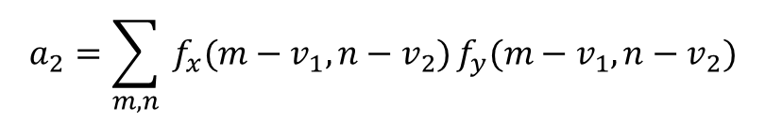

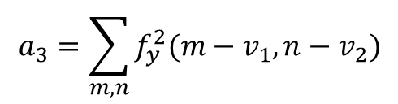
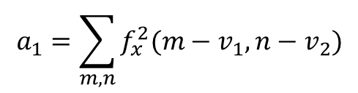
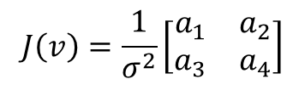
The FIM
Given
$\frac{∂\tilde{f}}{∂v_{1}}$= $\frac{∂\tilde{f}}{∂x}=f_{x}(m−v_{1},m−v_{2})$
$\frac{∂\tilde{f}}{∂v_{2}}$= $\frac{∂\tilde{f}}{∂y}=f_{y}(m−v_{1},m−v_{2})$
The FIM is
$$J\left(v\right)=\frac{1}{σ^{2}}\left[\begin{matrix}a_{1} & a_{2} \\ a_{3} & a_{4}\end{matrix}\right]$$
$$recall:MSE\left(v\right)≥{J\left(v\right)}^{−1}=CRLB (unbiased)$$
Where
$$a_{1}=\sum_{m,n}{f_{x}^{2}(m−v_{1},n−v_{2})}$$
$$a_{3}=\sum_{m,n}{f_{y}^{2}(m−v_{1},n−v_{2})}$$
$$a_{2}=\sum_{m,n}{ f_{x}(m−v_{1},n−v_{2})}f_{y}(m−v_{1},n−v_{2})$$

Slide 13
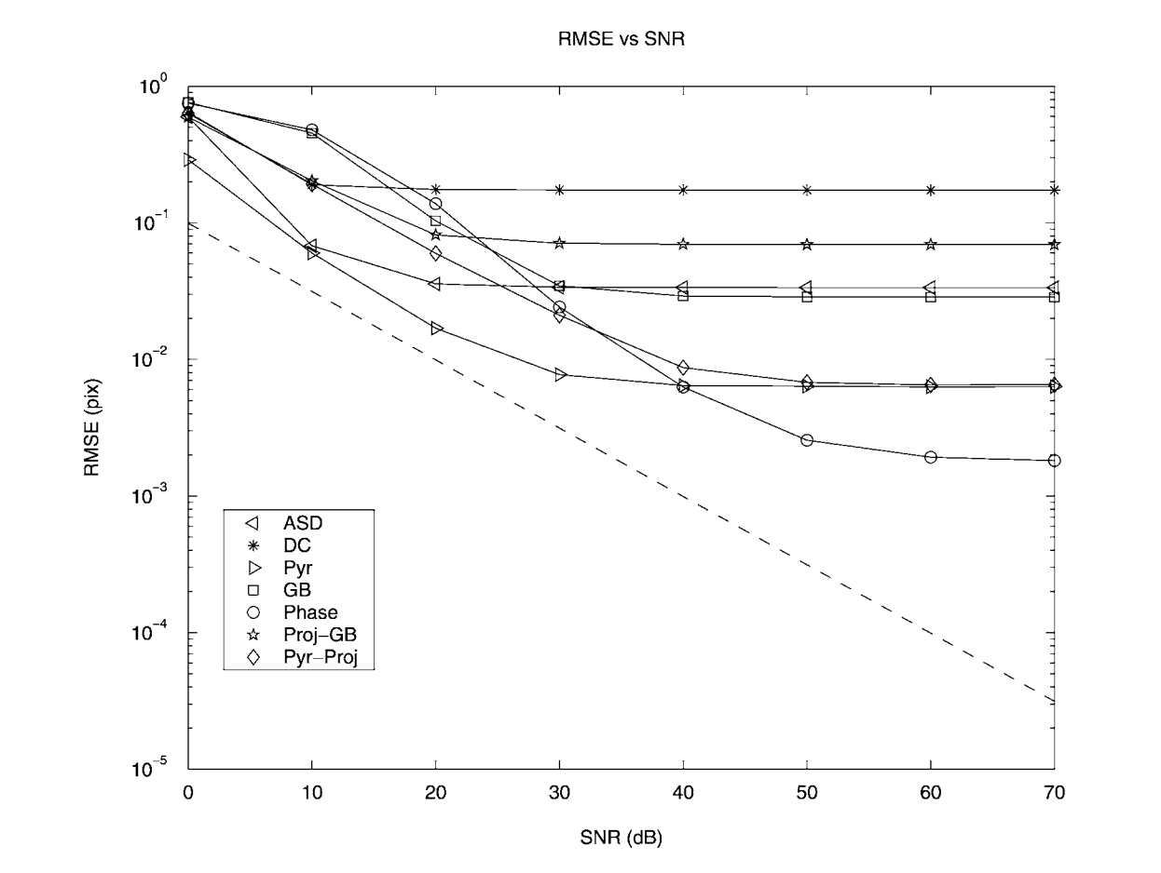

Results: Variance and Bias Errors
Sloping: Estimator variance
Flat: Estimator bias
CRLB: MSE$≥J^{−1}(Φ$)
ASD: average square distance
DC: maximum direct correlator
Pyr: multiscale gradient-based
GB: gradient-based method
Proj-GB: project GB
Pyr-Proj: Project Pyr
Phase: relative phase

Slide 14
Conclusion
Variance of an estimator
Fisher Information
Cramer-Rao lower bound (CRLB)
Quantitative measure of estimator performance
Application of CRLB to image registration

