Slide 1
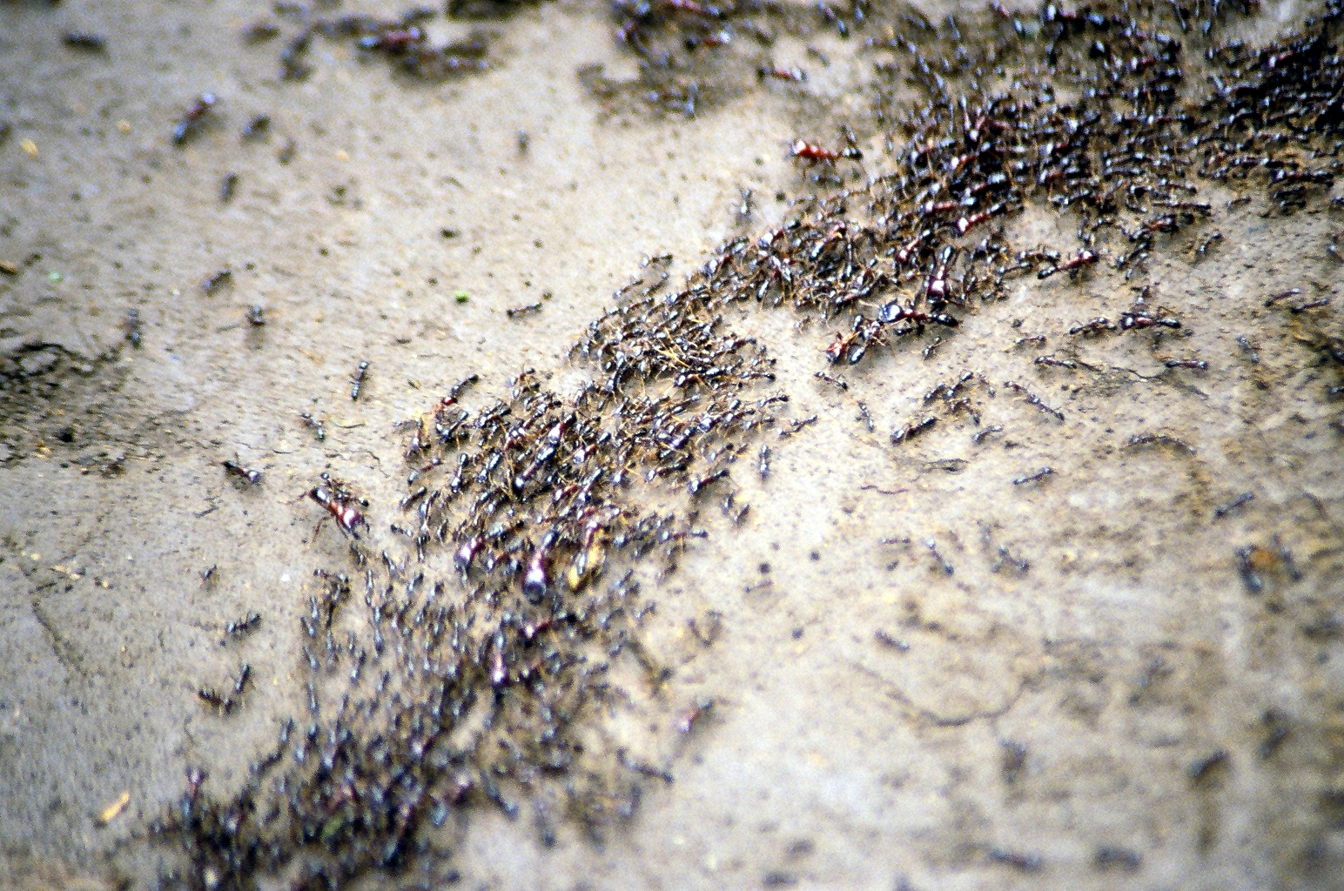
ANTS
Ant System Optimization

Slide 2
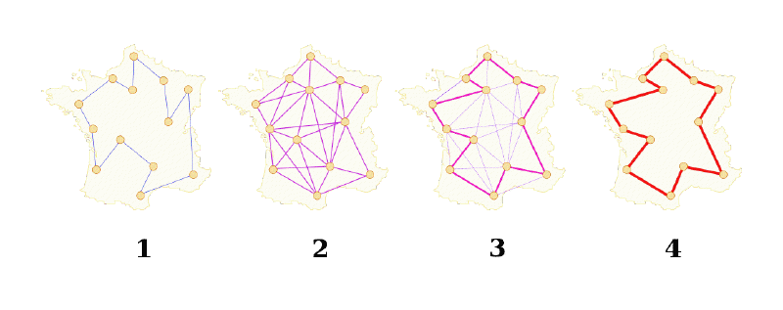
Introduction
Ant algorithms were first proposed as an approach to difficult combinatorial problems.
Such as the traveling salesman problem (TSP) and the quadratic assignment problem (QAP)
Notes:
An ant colony optimization approach to flexible
protein–ligand docking
there is currently
much ongoing activity in the scientific community to extend and apply ant-based algorithms
to many different discrete optimization problems. Recent applications
cover problems such as vehicle routing, sequential ordering, graph coloring, routing in
communications networks, and so on.

Slide 3
Inspiration
Ant algorithms are influenced by the observation of real ant colonies!
Ants are social insects, that is, insects that live in colonies and whose behaviour is directed more to the survival of the colony as a whole than to that of a single individual component of the colony.
Social insects have captured the attention of many scientists
Notes:
Social insects have captured the attention of many scientists because of the
high structuration level their colonies can achieve, especially when compared to the
relative simplicity of the colony’s individuals. An important and interesting behavior of
ant colonies is their foraging behavior, and, in particular, how ants can .nd the shortest
paths between food sources and their nest.

Slide 4
Pheromone
When walking from a food source to the nest, the ant will leave a pheromone trail.
The other ants will smell this pheromone and will be influenced to follow where it leads.
Notes:
While walking from food sources to the nest and vice versa, ants deposit on the
ground a substance called pheromone, forming in this way a pheromone trail. Ants can
smell pheromone, and when choosing their way, they tend to choose, in probability,
paths marked by strong pheromone concentrations. The pheromone trail allows the
ants to find their way back to the food source (or to the nest). Also, it can be used by
other ants to find the location of the food sources found by their nestmates.

Slide 5
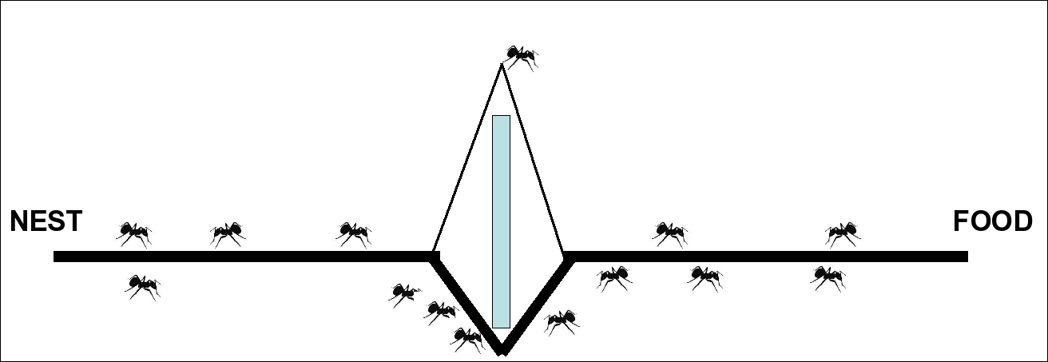
Emergent Behavoir
Deneubourg, J.-L., Aron, S., Goss, S., & Pasteels, J.-M. (1990). The self-organizing exploratory pattern of the argentine ant. Journal of Insect Behavior, 3, 159–168.
In controlled studies ants will tend to converge to one path.
This path tends to be the shortest path.
Notes:
To study in controlled conditions the ants’ foraging behavior, the binary bridge experiment
has been set up by Deneubourg et all. The nest of a colony
of ants of the species Linepithema humile and a food source have been separated by
a double bridge in which each branch has the same length. Ants are then left free to
move between the nest and the food source and the percentage of ants that choose
one or the other of the two branches is observed over time. The result is that after an initial transitory phase in which some oscillations can appear, ants tend
to converge on a same path.

Slide 6
Stigmergy
Thought one ant can find a solution. It is only the colony of ants that present the “shortest path-finding” behaviour.
This is the result of the indirect communication of the pheromone
"Stimulation of workers by the performance they have achieved.“French biologist Pierre-Paul Grassé in 1959
Notes:
It is clear that what is going on in the above-described process is a kind of distributed
optimization mechanism to which each single ant gives only a very small contribution.
It is interesting that, although a single ant is in principle capable of building a solution
(i.e., of finding a path between nest and food reservoir), it is only the ensemble of ants,
that is, the ant colony, that presents the “shortest path-finding” behavior.1 In a sense,
this behavior is an emergent property of the ant colony. It is also interesting to note that
ants can perform this specific behavior using a simple form of indirect communication
mediated by pheromone laying, known as stigmergy.
1 The above-described experiments have been run in strongly constrained conditions. A formal proof of the pheromone-driven
shortest path-finding behavior in the general case is missing. Bruckstein et al. [9, 10] consider the shortest path-finding problem
in absence of obstacles for ants driven by visual clues and not by pheromones and prove the convergence of the ants’ path to the
straight line.

Slide 7
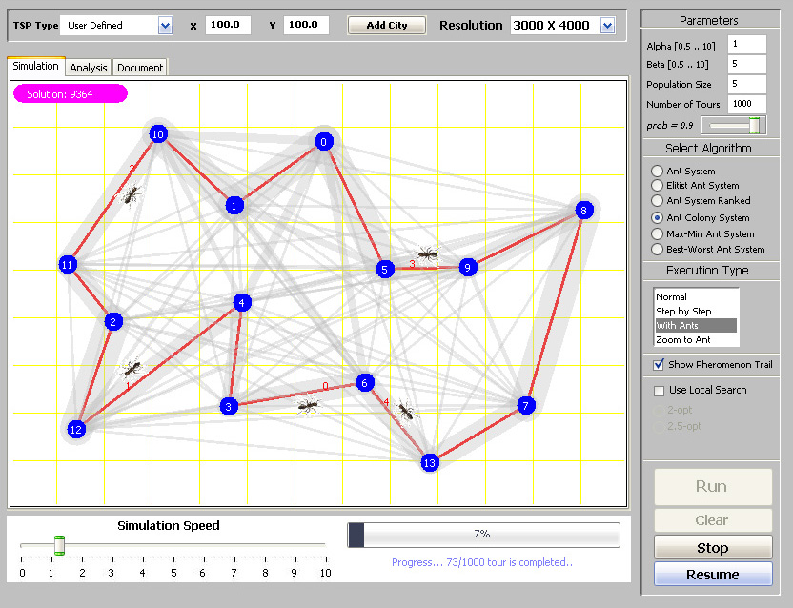
The Ant Colony Optimization Approach
Quick Walk-Through
http://yzgrafik.ege.edu.tr/projects/TSPAntSim/
Notes:
In the ant colony optimization (ACO) metaheuristic a colony of artificial ants cooperates
in finding good solutions to difficult discrete optimization problems. Cooperation is a
key design component of ACO algorithms: The choice is to allocate the computational
resources to a set of relatively simple agents (artifocial ants) that communicate indirectly
by stigmergy. Good solutions are an emergent property of the agents’ cooperative
interaction.
Link :
Interactive Simulation and Analysis Tool for Solving TSP using Ant Colony Optimization Algorithms

Slide 8
Similarities and Differences with Real Ants
Similarities
Differences
a colony of cooperating individuals
an (artificial) pheromone trail for local stigmergetic communication
a sequence of local moves to find shortest paths
a random decision policy using local information and no look-ahead
Artificial ants live in a discrete world and their moves consist of transitions from discrete states to discrete states.
Artificial ants deposit an amount of pheromone that is a function of the quality of the solution found.
Artificial ants’ timing in pheromone laying is problem dependent and often does not reflect real ants’ behaviour.
Notes:
In reality, some real ants have a similar behavior: They deposit more pheromone in case of richer food sources.
For example, in many cases artificial ants update
pheromone trails only after having generated a solution.

Slide 9
ACO Metaheuristic
Each ant makes a solution incrementally.
A solution is expressed as a minimum cost through a path of states stated in the problem
Each ant will (however poor it may be) find a solution.
High-quality solutions are only found as the result of the emergent behaviour.
Sometimes there can be a daemon that will observe the ants actions and deposit additional pheromone using the information collected.
Notes:
In computer science, metaheuristic designates a computational method that optimizes a problem by iteratively trying to improve a candidate solution with regard to a given measure of quality. Metaheuristics make few or no assumptions about the problem being optimized and can search very large spaces of candidate solutions. However, metaheuristics do not guarantee an optimal solution is ever found. Many metaheuristics implement some form of stochastic optimization.
An incremental constructive approach is used by the ants to search for a feasible
solution. A solution is expressed as a minimum cost (shortest) path through
the states of the problem in accordance with the problem’s constraints. The complexity
of each ant is such that even a single ant is able to find a (probably poor
quality) solution. High-quality solutions are only found as the emergent result of the
global cooperation among all the agents of the colony concurrently building different
solutions.
The overall ACO metaheuristic, besides the two above-described components acting
from a local perspective (i.e., ants’ generation and activity, and pheromone evaporation),
can also comprise some extra components that use global information and that
go under the name of daemon actions in the algorithm reported in Figure 3. For
example, a daemon can be allowed to observe the ants’ behavior and to collect useful
global information to deposit additional pheromone information, biasing, in this way,
the ant search process from a nonlocal perspective. Or, it could, on the basis of the
observation of all the solutions generated by the ants, apply problem-speci.c local optimization
procedures and deposit additional pheromone “ofine” with respect to the
pheromone the ants deposited online.

Slide 10

Psudo Code
function ACO
while (termination_criterion_not_satidfied)
scheduel_activities
ants_generation_and_activity();
pheromone_evaporation();
% optional
daemon_actions();
%refers to centralized actions
%executed by a daemon possessing global knowledge
end while
end function
Notes:
The procedure daemon actions() is optional and refers to centralized actions executed by a daemon possessing global knowledge

Slide 11
Psudo Code
function ants_generation_and_activity();
while (available_resources)
scheduel_the_creation_of_a_new_ant();
new_active_ant() ;
end
end

Slide 12
Psudo Code
function new_active_ant() % ant life cycle
initialize_ant();
M = update_ant_memory();
while ( current_state ~= target_state)
A = read_local_ant_routing_table();
P = compute_transition_probabilities(A,M,problem_constraints) ;
next_state = apply_ant_desicion_policy(P,problem_constraints);
move_to_next_state(next_state) ;
if (online_step-by-step_pheromone_update)
deposit_pheromone_on_the_visited_arc();
update_ant-routing_table();
end if
%Continues
Notes:
The target state refers to a complete solution, or to a component of a complete solution, built by the ant.
The step-by-step and delayed pheromone updating procedures at often mutually exclusive. When both of them are absent the pheromone is deposited by the daemon.

Slide 13
Psudo Code
M = update_internal_state();
end while
if (online_delay_pheromone_update)
evaluate_solution();
deposit_pheromone_on_all_visited_arcs();
update_ant_routing_table();
end % if
die();
end % function new_active_ant()
Notes:
The step-by-step and delayed pheromone updating procedures at often mutually exclusive. When both of them are absent the pheromone is deposited by the daemon.

Slide 14

Psudo Code
function ACO
while (termination_criterion_not_satidfied)
scheduel_activities
ants_generation_and_activity();
pheromone_evaporation();
% optional
daemon_actions();
%refers to centralized actions
%executed by a daemon possessing global knowledge
end while
end function
Notes:
The procedure daemon actions() is optional and refers to centralized actions executed by a daemon possessing global knowledge

Slide 15
Applications of ACO Algorithms
to Static Combinatorial Optimization
Problems

Slide 16
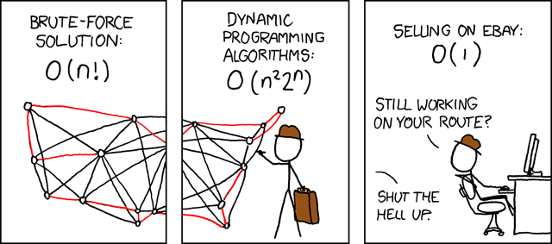
Travelling Salesman Problem
Notes:
What's the complexity class of the best linear programming cutting-plane techniques? I couldn't find it anywhere. Man, the Garfield guy doesn't have these problems ...

Slide 17
Travelling Salesman Problem
Given a list of cities and their pairwise distances, the task is to find a shortest possible tour that visits each city exactly once.
Notes:
A general de.nition of the traveling salesman problem is the following. Consider a
set N of nodes, representing cities, and a set E of arcs fully connecting the nodes N .
Let dij be the length of the arc .i; j / 2 E, that is, the distance between cities i and j ,
with i; j 2 N . The TSP is the problem of .nding a minimal length Hamiltonian circuit
on the graph G D .N ; E/, where a Hamiltonian circuit of graph G is a closed tour
visiting once and only once all the n D |N | nodes of G, and its length is given by the
sum of the lengths of all the arcs of which it is composed.7

Slide 18
Travelling Salesman Problem
Consider N node, representing cities
A set E of paths connecting Nodes
Let d_{i,j} be the length of path(i,j)
Notes:
A general de.nition of the traveling salesman problem is the following. Consider a
set N of nodes, representing cities, and a set E of arcs fully connecting the nodes N .
Let dij be the length of the arc .i; j / 2 E, that is, the distance between cities i and j ,
with i; j 2 N . The TSP is the problem of .nding a minimal length Hamiltonian circuit
on the graph G D .N ; E/, where a Hamiltonian circuit of graph G is a closed tour
visiting once and only once all the n D |N | nodes of G, and its length is given by the
sum of the lengths of all the arcs of which it is composed.7

Slide 19
Ant System Optimization
Ants build solutions be moving from one city to another.
m-many Ants build a tour in n-steps with a probabilistic decision rule.
So when at node i , the ant will move to node j, and path(i,j) is added to the tour.
Repeat until tour is completed
Notes:
In AS, artificial ants build solutions (tours) of the TSP by moving on the problem
graph from one city to another. The algorithm executes tmax iterations, in the following
indexed by t . During each iteration m ants build a tour executing n steps in which
a probabilistic decision (state transition) rule is applied. In practice, when in node i
the ant chooses the node j to move to, and the arc .i; j / is added to the tour under
construction. This step is repeated until the ant has completed its tour.

Slide 20

Ant System Optimization
After tours are built, each ant deposits pheromone on the paths that it’s tour is constructed of.
No daemon activities are preformed
function ACO
while (termination_criterion_not_satidfied)
scheduel_activities
ants_generation_and_activity();
pheromone_evaporation();
% optional
daemon_actions();
Notes:
As we said, in AS after ants have built their tours, each ant deposits pheromone on
pheromone trail variables associated to the visited arcs to make the visited arcs become
more desirable for future ants (i.e., online delayed pheromone update is at work).
Then the ants die. In AS no daemon activities are performed, while the pheromone
evaporation procedure, which happens just before ants start to deposit pheromone, is
interleaved with the ants’ activity.

Slide 21

Ant System Optimization
The amount of pheromone added to path(i,j) will represent desirability of picking city j from city i.
This reflects the experience acquired by the ants during problem solving.
τ_{i,j} =pheromone
ρ = evaporation
Δτ_{i,j} ^{k}=pheromone added this iteration by ant k
Notes:
The amount of pheromone trail ¿ij .t / associated to arc .i; j / is intended to represent
the learned desirability of choosing city j when in city i (which also corresponds to the
desirability that the arc .i; j / belongs to the tour built by an ant). The pheromone trail
information is changed during problem solution to reflect the experience acquired by
ants during problem solving. Ants deposit an amount of pheromone proportional to
the quality of the solutions they produced: The shorter the tour generated by an ant,
the greater the amount of pheromone it deposits on the arcs that it used to generate
the tour. This choice helps to direct search toward good solutions. The main role of
pheromone evaporation is to avoid stagnation, that is, the situation in which all ants
end up doing the same tour.

Slide 22
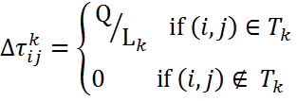
Ant System Optimization
τ_{i,j} =pheromone
ρ = evaporation
Δτ_{i,j} ^{k}=pheromone added by ant k
Q= parameter
L_{k} = Length of the tour of ant k
T_{k} = paths that make up the tour for ant k
m= number of ants
Notes:
So the shorter the tour the more pheromone added

Slide 23
Ant System Optimization
Ant System compared to other methods are good for lower dimension problems. It can out do most things including a genetic algorithm
For higher dimension it is know for quick convergence to good solutions but never reached best known solutions within a reasonable time
Whitley, D., Starkweather, T., & Fuquay, D. (1989). Scheduling problems and travelling
salesman: The genetic edge recombination operator. In J. D. Schaffer (Ed.), Proceedings
of the Third International Conference on Genetic Algorithms (pp. 133–140). Palo Alto, CA:
Morgan Kaufmann
Notes:
Ant System was compared with other general purpose heuristics on some relatively
small TSP problems (these were problems ranging from 30 to 75 cities). The results
were very interesting and disappointing at the same time. AS was able to .nd
and improve the best solution found by a genetic algorithm for Oliver30 ,a 30-city
problem, and it had a performance similar or better than that of some general-purpose
heuristics with which it was compared. Unfortunately, for problems of growing dimensions
AS never reached the best-known solutions within the allowed 3,000 iterations,
although it exhibited quick convergence to good solutions. These encouraging, although
not exceptional, results stimulated a number of researchers to study further the
ACO approach to optimization. These efforts have resulted in numerous successful
applications, listed in the following sections.

Slide 24
Max-Min Ant System Optimization
Same as AS but:
The best ant only receives extra pheromones for his tours.
Pheromones are restricted to be within the interval of [τ_{min},τ_{max}]
All pheromone trail are initialized to τ_{max}
Notes:
which is the same as AS, but (a) pheromone trails are only updated ofine
by the daemon (the arcs that were used by the best ant in the current iteration receive
additional pheromone), (b) pheromone trail values are restricted to an interval
[¿min; ¿max], and (c) trails are initialized to their maximum value ¿max.

Slide 25

Max-Min Ant System Optimization
The restriction helps prevent stagnation, which is why AS preformed so poorly
To avoid Stagnation, which may occur when pheromone levels are close to max, one can implement a smoothing mechanism
It is found that when applied to TSP it performs significantly better than AS but comparable to ACS (this will be discussed later)
Notes:
stag·nate
[stag-neyt] Show IPAverb, -nat·ed, -nat·ing.
–verb (used without object)1.to cease to run or flow, as water, air, etc.
2.to be or become stale or foul from standing, as a pool ofwater.
3.to stop developing, growing, progressing, or advancing: Mymind is stagnating from too much TV.
4.to be or become sluggish and dull:
Putting explicit limits on the trail strength restricts the range of possible values for
the probability of choosing a speci.c arc according to Equation 3. This helps avoid
stagnation, which was one of the reasons why AS performed poorly when an elitist
strategy, such as allowing only the best ant to update pheromone trails, was used.
To avoid stagnation, which may occur when some pheromone trails are close to ¿max
while most others are close to ¿min, St¨utzle and Hoos have added what they call a “trail
smoothing mechanism”; that is, pheromone trails are updated using a proportional
mechanism: 1¿ij / .¿max ¡ ¿ij .t //. In this way the relative difference between the
trail strengths gets smaller, which obviously favors the exploration of new paths. They
found that, when applied to the TSP, MMAS .nds signi.cantly better tours than AS,
although comparable to those obtained with ACS. (ACS is an extension of AS discussed
in the next subsection.)

Slide 26

AS_{Rank} Optimization
Same as regular AS but:
Pick the top σ-many ants and only the get extra pheromones on the tours proportional to rank
The paths used by the best tour get extra pheromones as well.
τ_{i,j} =pheromone
ρ = evaporation
L₊ = Length of the tour of the best ant
Lμ = Length of the tour of ant with rank μ
Notes:
This will also produce significantly better results than AS
Sigma < m where m=number of ants

Slide 27
Ant Colony System
Based off AS but with key differences:
After constructing solutions, only the best ant gets pheromones added to its tour.
Adds a local search to improve solutions generated by ants before applying pheromones.
Psudo-Random-Proportion rule is added in place of the old probability rule.
During the creation of a solution, it reduces the pheromones for the paths used. So that is decreases the chance of other ants from using it.
I have yet to build the code for this adaptation.
Notes:
The Ant Colony System (ACS)
algorithm has been introduced by Dorigo and Gambardella to improve the
performance of AS, which was able to .nd good solutions within a reasonable time
only for small problems. ACS is based on AS but presents some important differences.
First, the daemon updates pheromone trails ofine: At the end of an iteration of the
algorithm, once all the ants have built a solution, pheromone trail is added to the arcs
used by the ant that found the best tour from the beginning of the trial. In ACS-3-opt
the daemon .rst activates a local search procedure based on a variant of the 3-opt local
search procedure to improve the solutions generated by the ants and then performs
ofine pheromone trail update. The ofine pheromone trail update rule is
¿

Slide 28




Quadratic Assignment Problem

Slide 29
Quadratic Assignment Problem
You have n-facilities and n-locations to place them.
Each pair (facility i at location j) has an associated cost
Find a combination with the smallest cost.
Generalization of the TSP
Notes:
The quadratic assignment problem is the problem of assigning n facilities to n locations
so that the cost of the assignment, which is a function of the way facilities have been
assigned to locations, is minimized . The QAP was, after the TSP, the .rst problem
to be attacked by an AS-like algorithm. This was a reasonable choice, since the QAP
is a generalization of the TSP.10 Maniezzo, Colorni, and Dorigo applied exactly
the same algorithm as AS using the QAP-speci.c min-max heuristic to compute the
´ values used in Equation 3. The resulting algorithm, AS-QAP, was tested on a set of
standard problems and turned out to be of the same quality as metaheuristic approaches
such as simulated annealing and evolutionary computation. More recently, Maniezzo
and Colorni and Maniezzo developed two variants of AS-QAP and added to
them a local optimizer. The resulting algorithms were compared with some of the best
heuristics available for the QAP with very good results: Their versions of AS-QAP gave
the best results on all the tested problems.
Similar results were obtained by St¨utzle and Hoos with theirMMAS-QAP algorithm (MMAS-QAP is a straightforward application of MMAS, see Section 3.1.1, to the
QAP), and by Gambardella, Taillard, and Dorigo with their HAS-QAP.11 MMASQAP
and HAS-QAP were compared with some of the best heuristics available for the
QAP on two classes of QAP problems: random and structured QAPs, where structured
QAPs are instances of problems taken from real-world applications. These ant algorithms
were found to be the best performing on structured problems. A detailed

Slide 30
Quadratic Assignment Problem
The paths that the ants take doesn't correspond to distance.
The index of each step is a facility and the node you go will be the location that facility will be placed at.
Construction Step | Node
1 | 3
2 | 6
3 | 2
4 | 7
5 | 1
6 | 5
7 | 4

Slide 31
Quadratic Assignment Problem
Both AS and MMAS perform well with this problem
AS and MMAS seems to perform exceptionally well when the problem is taken from real-world application.
Gambardella, L. M., Taillard, E. D., & Dorigo, M. (1997). Ant colonies for the QAP. (Tech.
Rep. 4-97). Lugano, Switzerland: IDSIA.
Gambardella, L. M., Taillard, E. D., & Dorigo, M. (1999). Ant colonies for the quadratic
assignment problem. Journal of the Operational Research Society, 50(2), 167–176.
Notes:
The quadratic assignment problem is the problem of assigning n facilities to n locations
so that the cost of the assignment, which is a function of the way facilities have been
assigned to locations, is minimized. The QAP was, after the TSP, the .rst problem
to be attacked by an AS-like algorithm. This was a reasonable choice, since the QAP
is a generalization of the TSP.10 Maniezzo, Colorni, and Dorigoapplied exactly
the same algorithm as AS using the QAP-speci.c min-max heuristic to compute the
´ values used in Equation 3. The resulting algorithm, AS-QAP, was tested on a set of
standard problems and turned out to be of the same quality as metaheuristic approaches
such as simulated annealing and evolutionary computation. More recently, Maniezzo
and Colorni and Maniezzo developed two variants of AS-QAP and added to
them a local optimizer. The resulting algorithms were compared with some of the best
heuristics available for the QAP with very good results: Their versions of AS-QAP gave
the best results on all the tested problems.
Similar results were obtained by St¨utzle and Hoos with theirMMAS-QAP algorithm
(MMAS-QAP is a straightforward application of MMAS, see Section 3.1.1, to the
QAP), and by Gambardella, Taillard, and Dorigo with their HAS-QAP.11 MMASQAP
and HAS-QAP were compared with some of the best heuristics available for the
QAP on two classes of QAP problems: random and structured QAPs, where structured
QAPs are instances of problems taken from real-world applications. These ant algorithms
were found to be the best performing on structured problems .A detailed

Slide 32
Demos

Slide 33
Goals
Add Ant Colony System
Only have AS,MMAS, and AS_{Rank}
Generalize the code to be more apply to more problems.
Hybridize with GA
Continuous Ant Colony Version
Ant colony optimization for continuous domains
European journal of operational research [0377-2217] yr: 2008 vol: 185 iss: 3 pg: 1155 - 1173
Ant colony optimization in continuous problem
Frontiers of Mechanical Engineering in China [1673-3479]
yr: 2007 vol: 2 iss: 4 pg: 459 - 462

Slide 34
Feedback

Slide 35
References
Ant algorithms for discrete optimization Artificial life [1064-5462] yr: 1999 vol: 5 iss: 2 pg: 137 - 172
Ant Colony Optimization Genetic programming and evolvable machines [1389-2576] yr: 2005 vol: 6 iss: 4 pg: 459 - 460

