Slide 1
CS 6476 Project 6
Joshua Ng
jng45@gatech.edu
jng45
903392755

Slide 2
Parts 4 & 5: mIoU of different models
Add each of the following (keeping the changes as you move to the next row):
 | Training mIoU | Validation mIoU
Simple Segmentation Net (no pretrained weights)
ImageNet-Pretrained backbone
Data augmentation
ImageNet-Pretrained PSPNet w/ Data Aug. without PPM
PSPNet with PPM
PSPNet with auxiliary loss

Slide 3
Parts 4 & 5: Per class IoUs
Report your model’s IoU for the 11 Camvid classes (you can find the order they are listed in at dataset_lists/camvid-11/camvid-11_names.txt):
Class Index | Class name | Simple Segmentation Net Class IoU | PSPNet Class IoU
0 | Building |  | 0.8761
1 | Tree |  | 0.8983
2 | Sky |  | 0.8755
3 | Car |  | 0.7424
4 | SignSymbol |  | 0.0000
5 | Road |  | 0.9372
6 | Pedestrian |  | 0.3930
7 | Fence |  | 0.7968
8 | Column_Pole |  | 0.0471
9 | Sidewalk |  | 0.7968
10 | Bicyclist |  | 0.6201

Slide 4
Parts 4 & 5: Most difficult classes
[Which classes have the lowest mIoU? Why might they be the most difficult? Provide an example RGB image from Camvid that illustrates your point]
The pedistrian and column_pole have the lowest mloU.

Slide 5
Part 4: Simple segmentation net qualitative results
[Paste a figure of the generated semantic segmentation from Colab. It should be a 2x3 grid, with ground truth on the top row, and your predictions on the bottom row.]

Slide 6
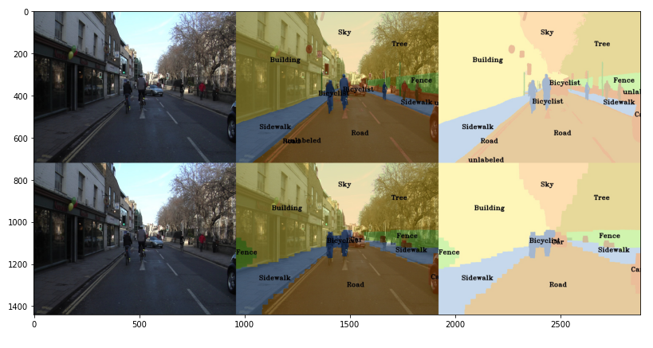
Part 5: PSPNet qualitative results
[Paste a figure of the generated semantic segmentation from Colab. It should be a 2x3 grid, with ground truth on the top row, and your predictions on the bottom row.]

