Slide 1
CS 6476 Project 6
Joshua Ng
jng45@gatech.edu
jng45
903392755

Slide 2
Parts 4 & 5: mIoU of different models
Add each of the following (keeping the changes as you move to the next row):
 | Training mIoU | Validation mIoU
Simple Segmentation Net (no pretrained weights) | 0.4359 | 0.4521
ImageNet-Pretrained backbone | 0.4659 | 0.4651
Data augmentation | 0.4479 | 0.4767
ImageNet-Pretrained PSPNet w/ Data Aug. without PPM | 0.5734 | 0.5931
PSPNet with PPM | 0.6001 | 0.6069
PSPNet with auxiliary loss | 0.6426 | 0.6291

Slide 3
Parts 4 & 5: Per class IoUs
Report your model’s IoU for the 11 Camvid classes (you can find the order they are listed in at dataset_lists/camvid-11/camvid-11_names.txt):
Class Index | Class name | Simple Segmentation Net Class IoU | PSPNet Class IoU
0 | Building | 0.7711 | 0.8761
1 | Tree | 0.8208 | 0.8983
2 | Sky | 0.7225 | 0.8755
3 | Car | 0.4265 | 0.7424
4 | SignSymbol | 0.0000 | 0.0000
5 | Road | 0.8544 | 0.9372
6 | Pedestrian | 0.1263 | 0.3930
7 | Fence | 0.6193 | 0.7968
8 | Column_Pole | 0.0000 | 0.0471
9 | Sidewalk | 0.5569 | 0.7968
10 | Bicyclist | 0.3459 | 0.6201

Slide 4
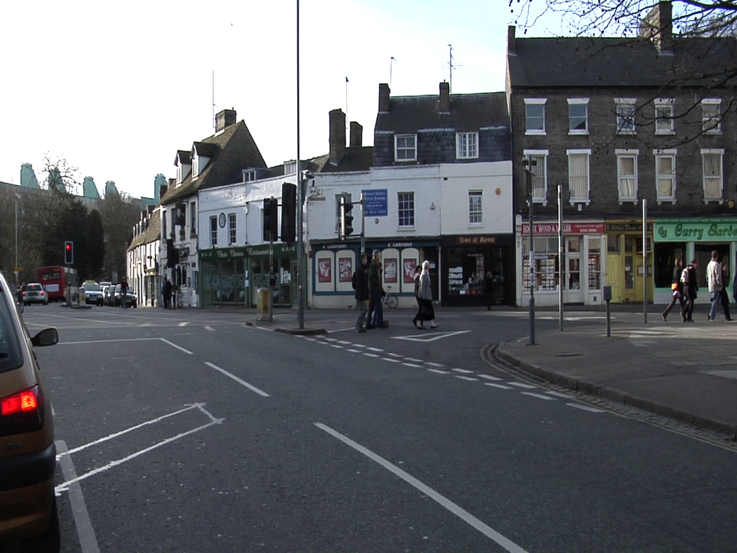
Parts 4 & 5: Most difficult classes
[Which classes have the lowest mIoU? Why might they be the most difficult? Provide an example RGB image from Camvid that illustrates your point]
The sky symbol and column_pole have the lowest mloU.
This is because the symbol most images have different exposure values, thus making the sky a different color. This confuses the model and the symbol blends in with the overexposed sky. Also, in simplesegmentation, the sky blends in with the road at times, thus confusing the model further. The column is very thin and is mistaken as a building, rather than a pole. The pole does not have enough distinctive features to differentiate it.

Slide 5
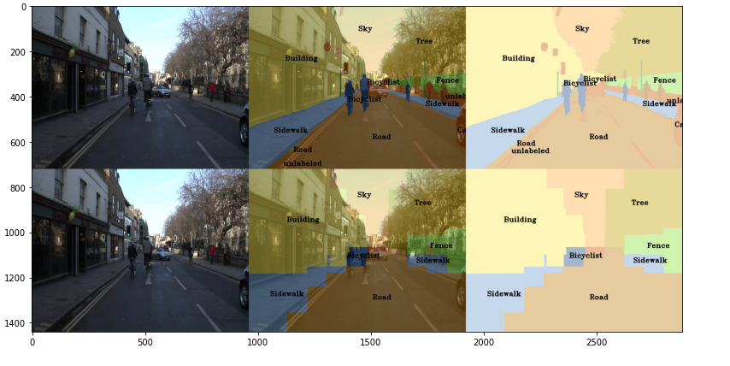
Part 4: Simple segmentation net qualitative results
[Paste a figure of the generated semantic segmentation from Colab. It should be a 2x3 grid, with ground truth on the top row, and your predictions on the bottom row.]

Slide 6
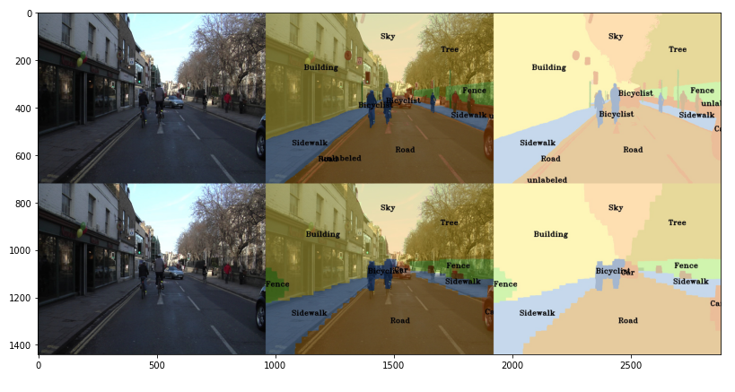
Part 5: PSPNet qualitative results
[Paste a figure of the generated semantic segmentation from Colab. It should be a 2x3 grid, with ground truth on the top row, and your predictions on the bottom row.]

