Slide 1
December 2024 ISACA North Texas: How to Get Started with Cyber Risk Quantification (for FREE!)
Josh Marker

Slide 2
Disclaimer:
All opinions expressed herein are mine and do not represent my employer.
Any perceived recommendations are my opinion and do not constitute professional or consulting services nor do they represent my employer.

Slide 3
AGENDA
Goals of this talk
Basics of FAIR
Data Sources—Cyentia
Data Gathering
Simulate with Data
Summary
What next?
Resources

Slide 4
Goals of this talk:
Get you started with Cyber Risk Quantification
No cost
No special software
High Quality, freely available data

Slide 5
Basics of FAIR
Scenario-based (scoping)
Threat
Asset
Effect

Slide 6
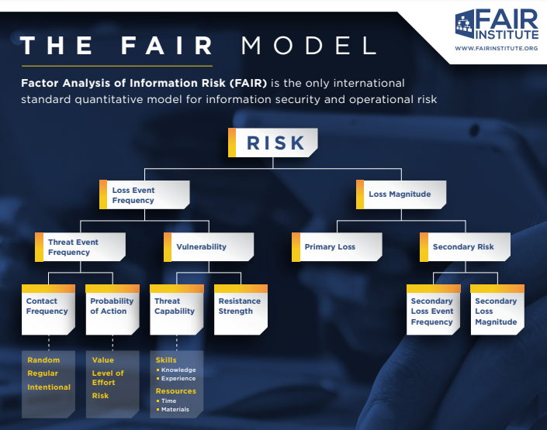
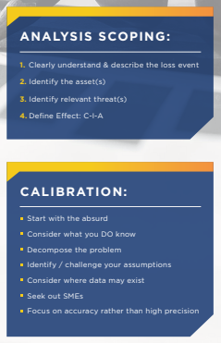
Basics of FAIR

Slide 7
FAIR Scenarios
Σ
[THREAT ACTOR] targets [ASSET] causing [EFFECT]
Cyber criminals target web application 1 causing confidentiality event.
Cyber criminals target web application 2 causing confidentiality event.
State-affiliated hackers (APT) target web application 3 causing confidentiality event.
State-affiliated hackers (APT) target our organization causing confidentiality event.
.
.
.
= LEF (breach)

Slide 8
FAIR Scenarios
[THREAT ACTOR] targets [ASSET] causing [EFFECT]
Which scenarios should we analyze?

Slide 9
Data Sources

Slide 10
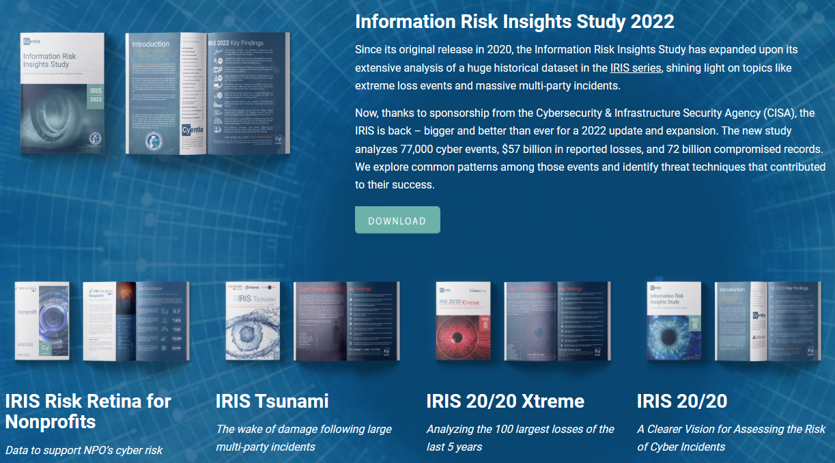
Data Sources
Cyentia Information Risk Insights Study (“IRIS”)
https://www.cyentia.com/iris/

Slide 11
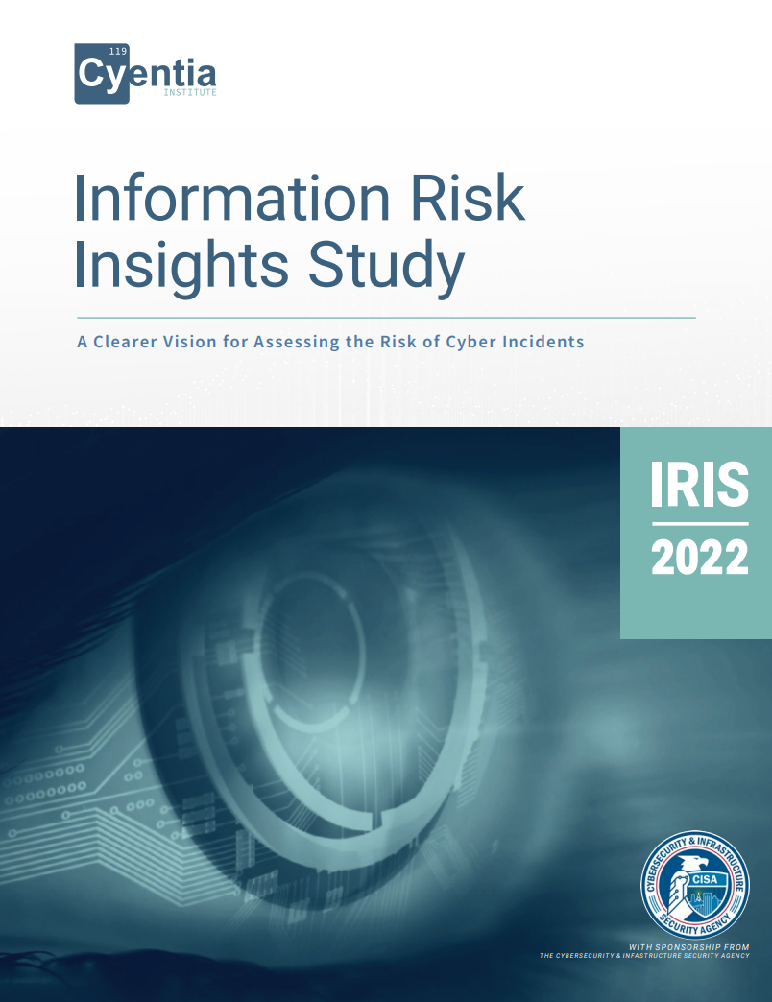
Data Sources
Cyentia Information Risk Insights Study (“IRIS”)
https://www.cyentia.com/wp-content/uploads/IRIS-2022_Cyentia.pdf
IRIS-2022

Slide 12
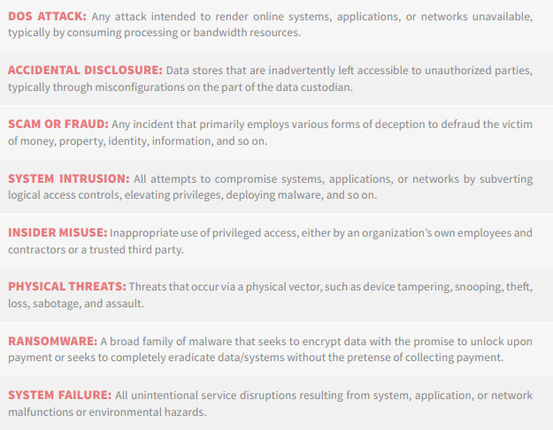
Data Sources
IRIS-2022
Which scenarios should we analyze?
IRIS Incident Patterns

Slide 13
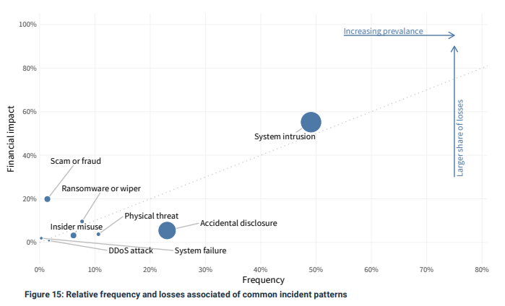
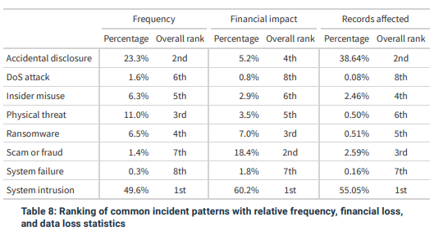
Data Sources
Which scenarios should we analyze?
IRIS Incident Patterns
IRIS-2022

Slide 14
Data Gathering
Loss Event Frequency or Probability
Loss Magnitude
Adjustments by pattern

Slide 15
Now that we’ve selected our scenarios, what LEF values should we use? How do we account for the scenario (incident pattern)? What LM values should we use? How do we account for the scenario (incident pattern)?
Data Gathering (data extraction)

Slide 16
2) Simulate with Data

Slide 17
Why do we simulate? What are we looking at? What does it mean? How do we know it is correct or applicable?
Simulations and results

Slide 18
Summary
We’ve created multiple scenarios for an organization in a reference class.
We’ve used these to create an aggregated risk profile (1 loss exceedance curve).
Our example reference class is the set of nonprofits.
The results of this analysis pertain to any organization in this reference class.
If your organization is a member of this reference class, this does not mean that this
is the risk for your organization; it means this is the risk for any randomly selected
organization in this reference class.

Slide 19
What Next?
A Few IDeas
Extend data tables (use more than 1,000 simulations per scenario, recommend at least 10,000)
Analyze all the incident patterns (the 8 from Cyentia’s IRIS)
Compare to other approaches
FREE
SIPmath (https://publications.opengroup.org/i181)
HTMA (http://www.howtomeasureanything.com/cybersecurity/)
Cyentia
Use different distributions (PERT, Triangle, Poisson/Lognormal)
Non-Free (vendors)
Get additional data
From outside your organization (Cyentia, Verizon DBIR, Advisen, NetDiligence, etc.)
From inside your organization
Determine how your organization is different from your reference class
How is the threat environment compared to your reference class?
How is your control environment compared to your reference class?
How to Use this:
What control additions or improvements are needed and make most economic sense?
We can express risk quantitatively → how does that compare to what our company wants?
Risk Appetite / Tolerance / Capacity
Remember: this is a starting place
Shows you how to structure and what is reasonable starting data
Now improve iteratively

Slide 20
Resources
1) FAIR Institute (www.fairinstitute.org)
2) FAIR on a page (link)
3) Verizon DBIR (https://www.verizon.com/business/resources/reports/dbir/2023/introduction/) Free, but behind registration wall
4) Cyentia IRIS Reports (https://www.cyentia.com/iris/)
5) How To Measure Anything (http://www.howtomeasureanything.com/cybersecurity/)
6) Ellerhold et al 2023 (Enterprise Cyber Threat Modeling and Simulation of Loss Events for Cyber Risk Quantification)
7) SIPmath (https://publications.opengroup.org/i181)
8) Modified PERT distribution (https://riskwiki.vosesoftware.com/ModifiedPERTdistribution.php)
9) OpenFAIR OR-A (https://pubs.opengroup.org/security/o-ra)
10) OpenFAIR OR-T (https://pubs.opengroup.org/security/o-rt/)
11) OpenFAIR Mathematics (https://publications.opengroup.org/security-library/g224)
12) HDR PRNG Paper (https://hubbardresearch.com/wp-content/uploads/2020/07/Final-Hubbard-WSC-PRNG-version-dwh-8-21-2019.pdf)
13) Society of Actuaries (Quantification of Cyber Risk for Actuaries | SOA)
14) Github (https://github.com/josh-marker/risk-quant)
15) Tony Martin-Vegue (https://www.tonym-v.com/blog/easing-your-company-into-a-quantitative-cyber-risk-program-33es5)

Slide 21
THANK YOU
Josh Marker
Josh.L.Marker@gmail.com
https://www.linkedin.com/in/joshm314/

