Slide 1

Programming for Mortals

Slide 2

How smart is a computer, really?

Slide 3
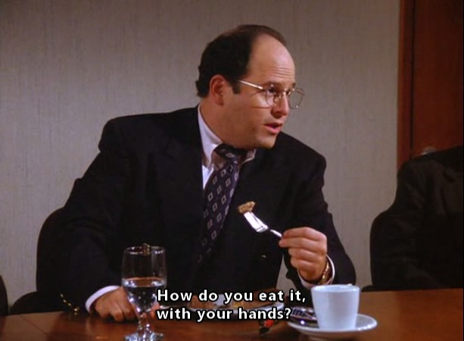
How many ways are there to solve a problem?

Slide 4
There is more than one RIGHT way..
But...
There are MANY wrong ways..

Slide 5

Silent fail

Slide 6
Loops
for number in [1, 2, 3]:
print number
print “and..”
1
and..
2
and..
3
and..

Slide 7
Iterables
List – ['H', 'E', 'L', 'L', 'O']
Dictionary – {'one' : 'H', 'two' : 'E', 'three' : 'L' }
String - “hello world!”

Slide 8
Iteration with a for-loop
List = ['H', 'E', 'L', 'L', 'O' ]
for letter in List:
print letter
H
E
L
L
O

Slide 9
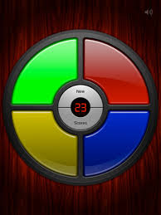
Simon says...
For each button that blinks:
press the button

Slide 10
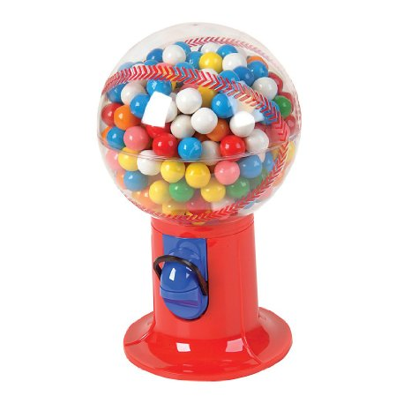
Iterators
Iterable = xrange(1, 99999999999)
for number in iterable:
print number

Slide 11
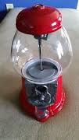
Generators
Fill me up with whatever you want!!

Slide 12
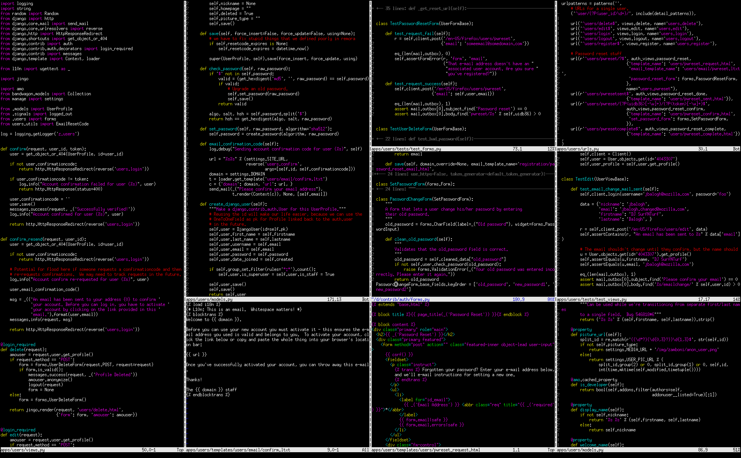
Code Evaluator

Slide 13
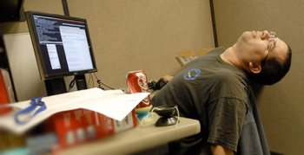
Conclusion

