Slide 1
Team 4 CIS 330
Members:
Joshua Powell
Jessica Brown
Arthur Oliveira
Joseph Powell IV

Slide 2
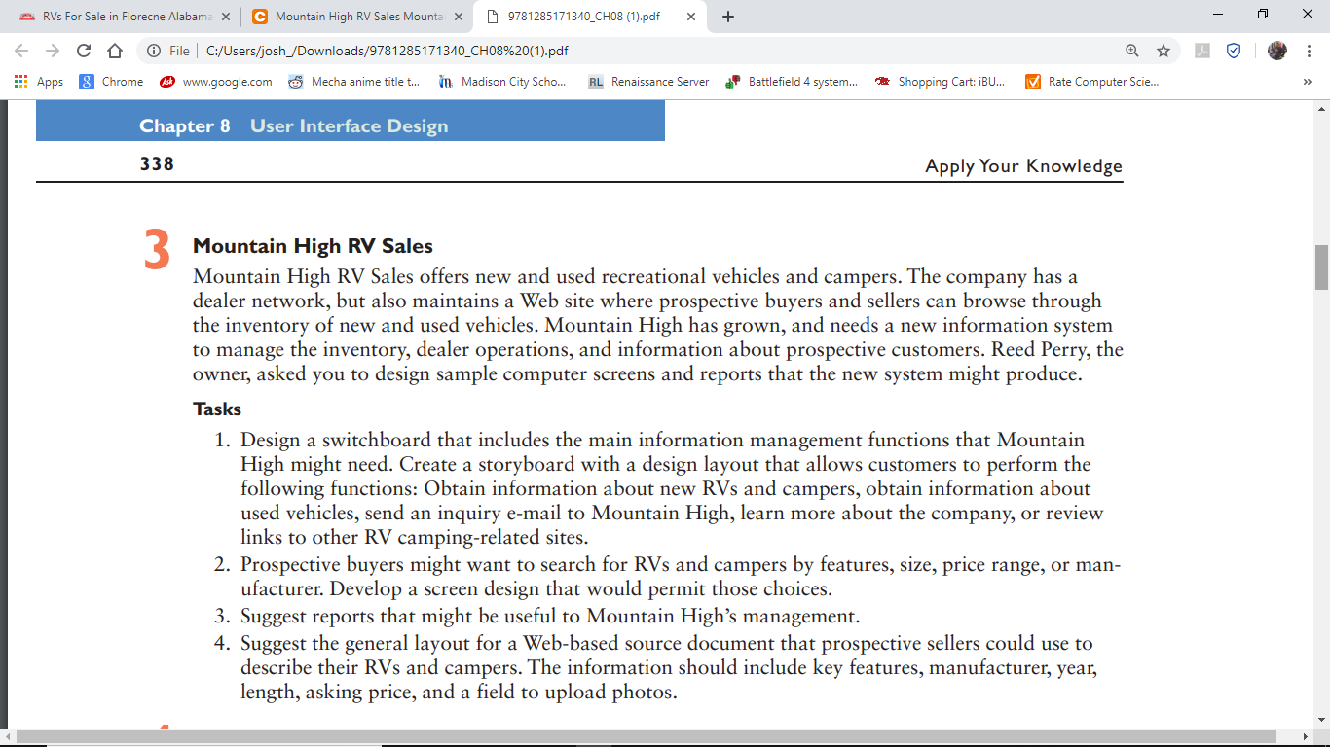
Ch. 8 AYK 3

Slide 3
Switch Board
The use of command buttons in a user interface to enable users to navigate a system and select from groups of related tasks.
Inventory
Inventory
New
Used
Dealer Operations
Company Informatiom

Slide 4
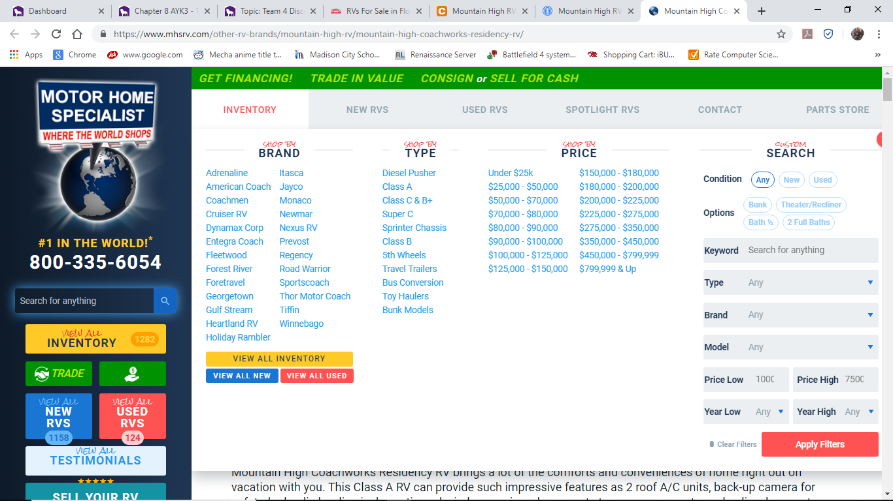
Screen Design: Motor Home Specialists
Story Board: Sketches used during prototyping to show the general screen layout and design.
Inventory
Brand
Type
Price
Used or New
Spotlight RVs
Contact
Trades
Parts Store
Sell Your RV
More about the Company

Slide 5
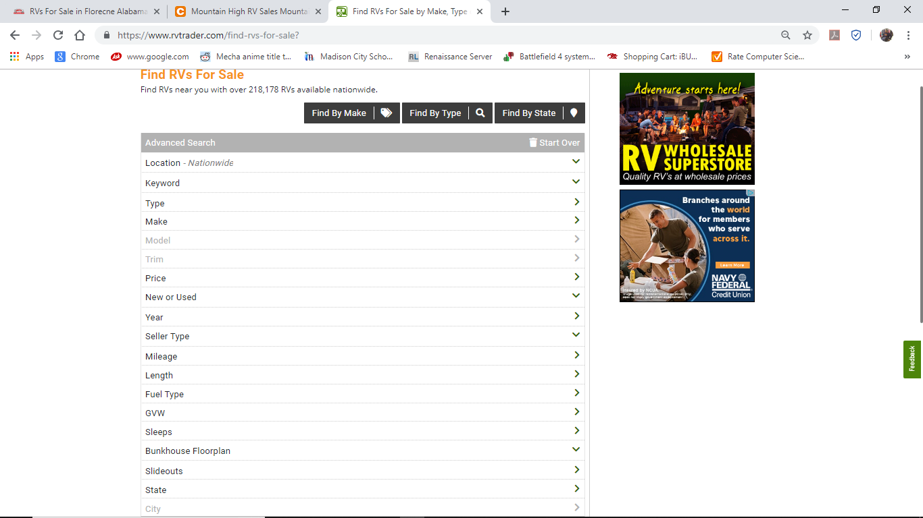
Screen Design: RV Trader

