Slide 1
Chapter 9
AYK 2
Joseph E. Powell IV
Arthur Oliveira
Jessica Brown
Joshua Powell
Team 4
CIS 330
2019/04/01

Slide 2
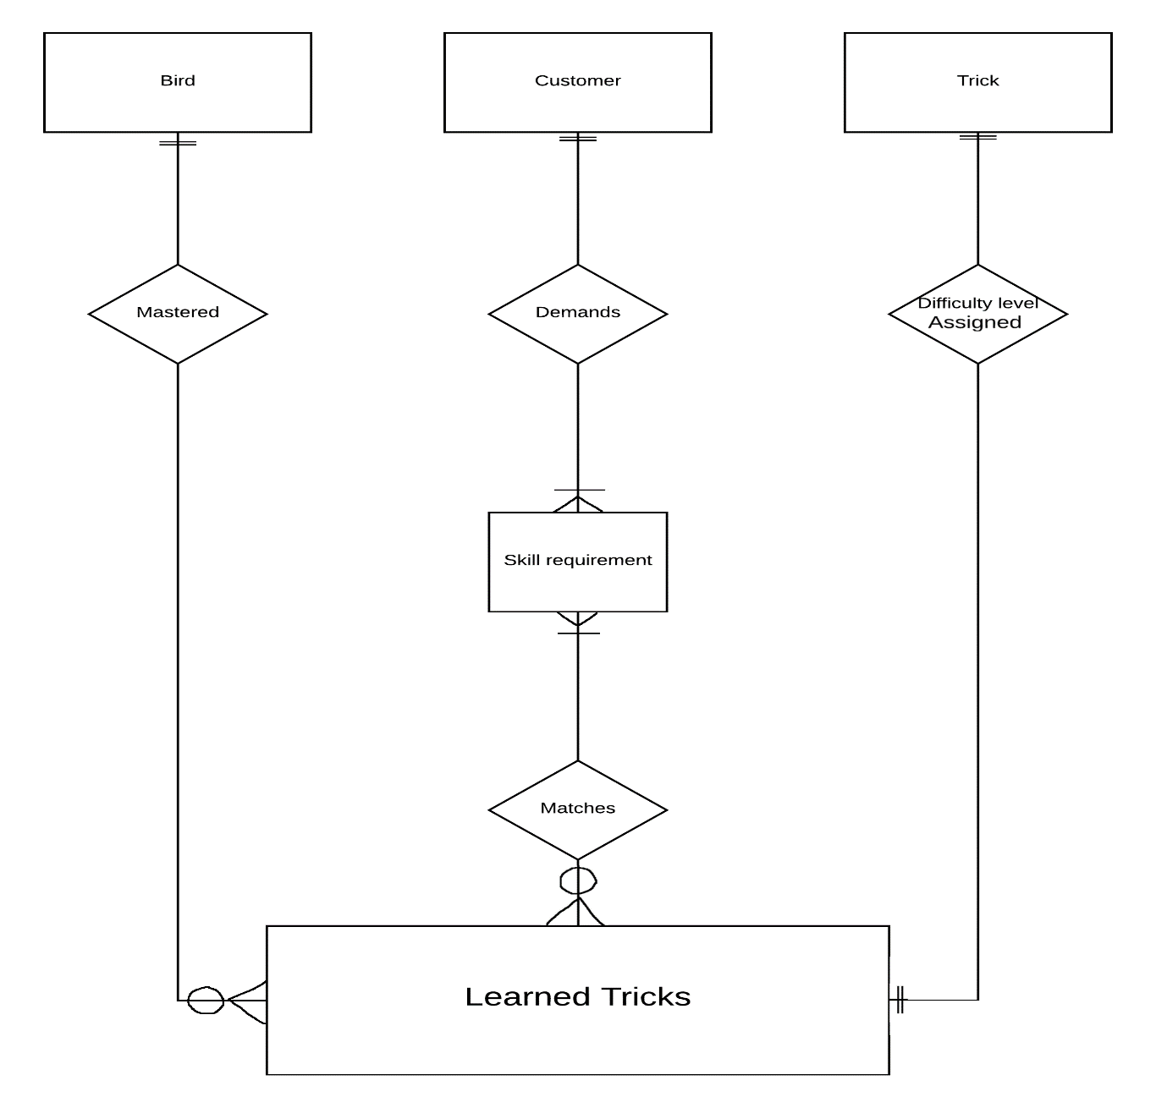
ERD and Cardinality

Slide 3
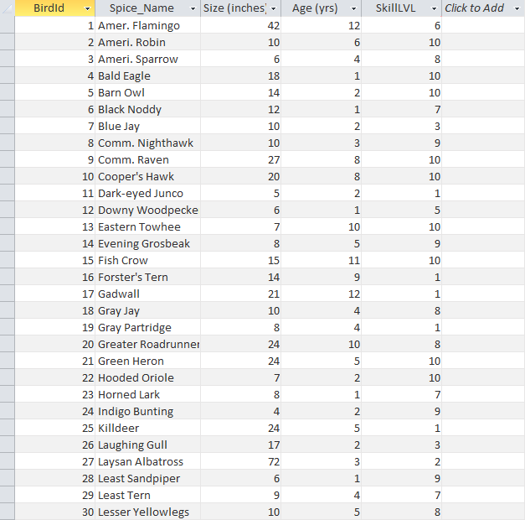
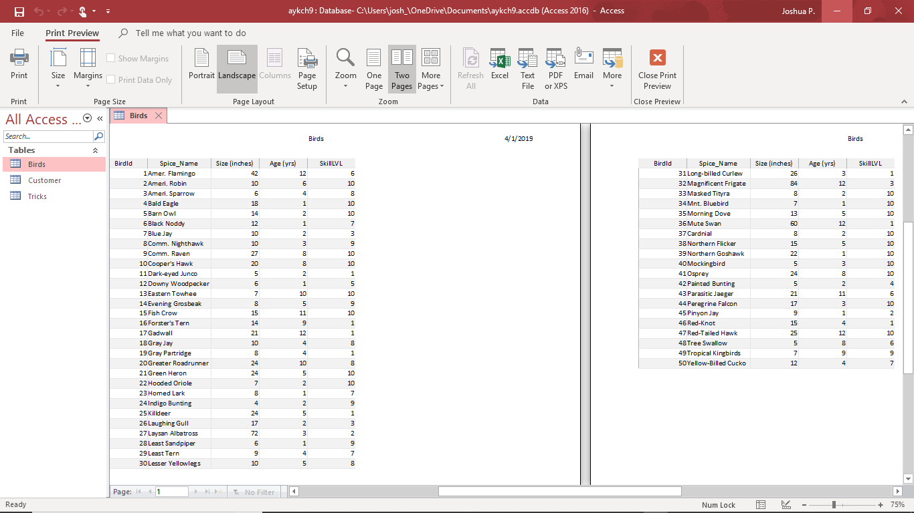
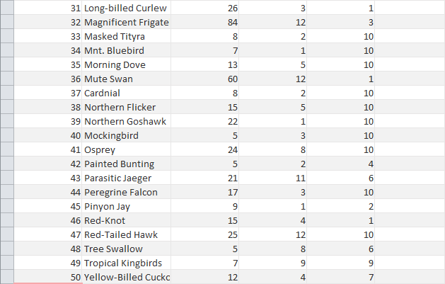
Birds Table
BirdId, Spec_Name (species name),Size, Age, SkillLVL

Slide 4
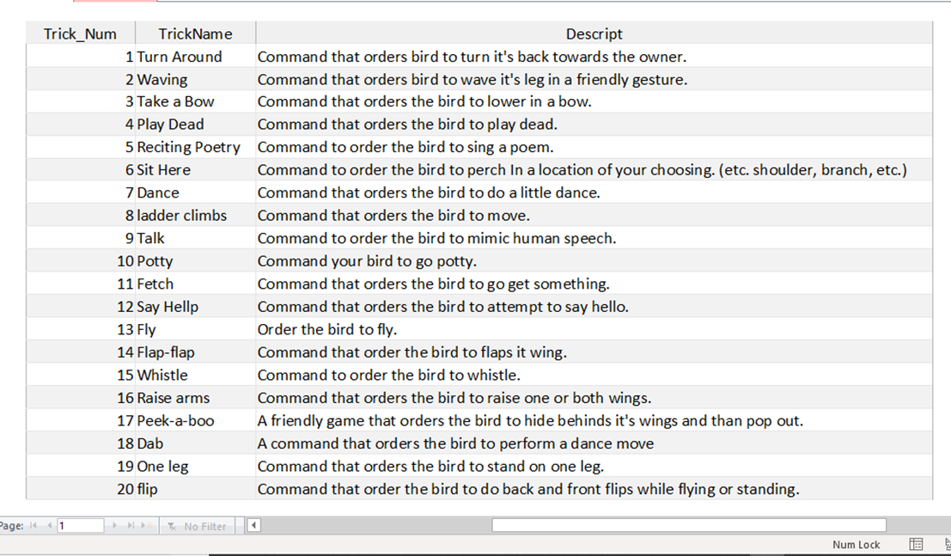
Tricks Table
Trick_Num (primary-key), Trick_Name, Description

Slide 5
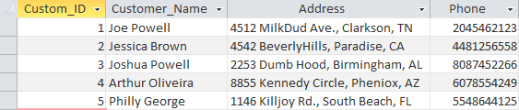
Customer Table
Custom_ID(primary-key), Customer_Name, Address,Phone

