Slide 1
Practicing Data Analysis of Krypton Event: events_177_222_236_248.h5

Slide 2
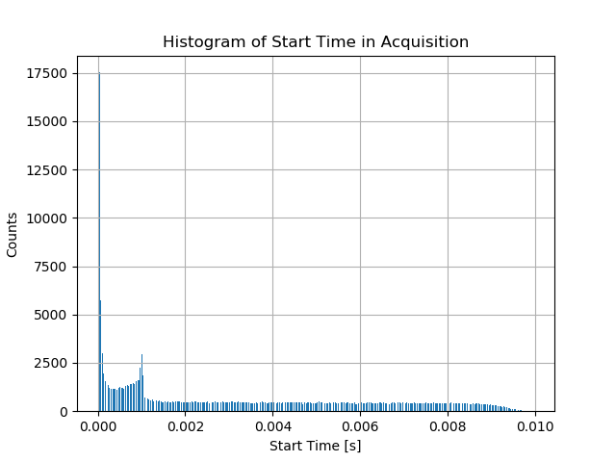
Acquisition begins at 1 ms

Slide 3
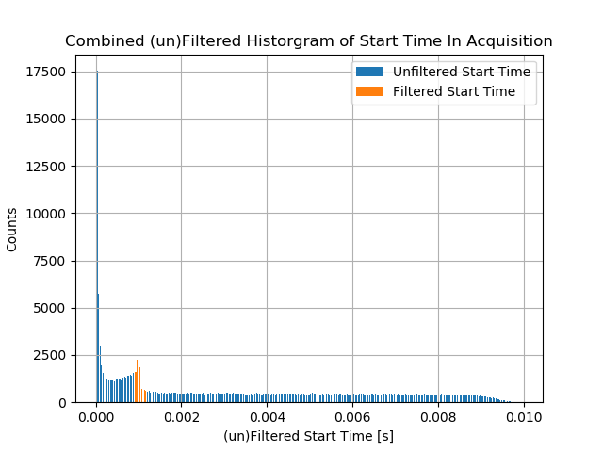
Filtered Histogram for 0.9 – 1.2 ms

Slide 4
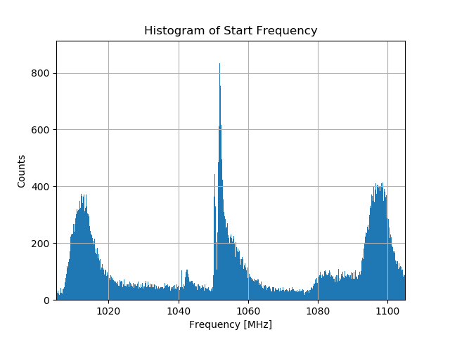
Histogram of Freq with 32KeV center

Slide 5
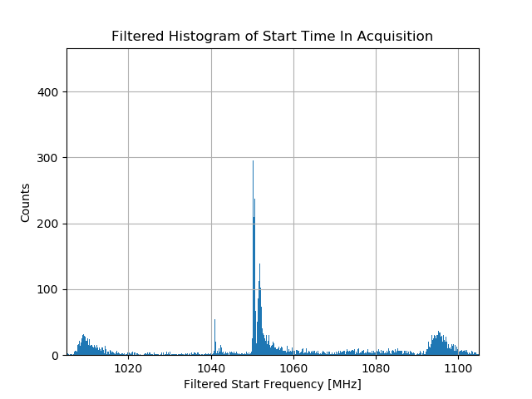
Filtered 32 keV peak for 0.9-1.2 ms

Slide 6
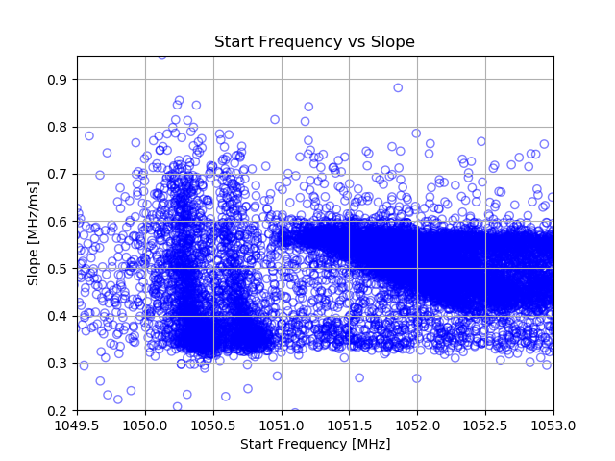

Slide 7
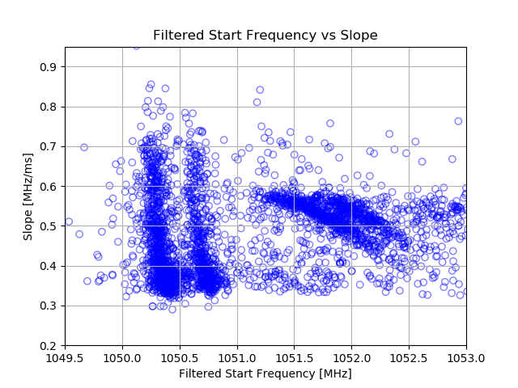
Filtered for 0.9-1.2 ms

Slide 8
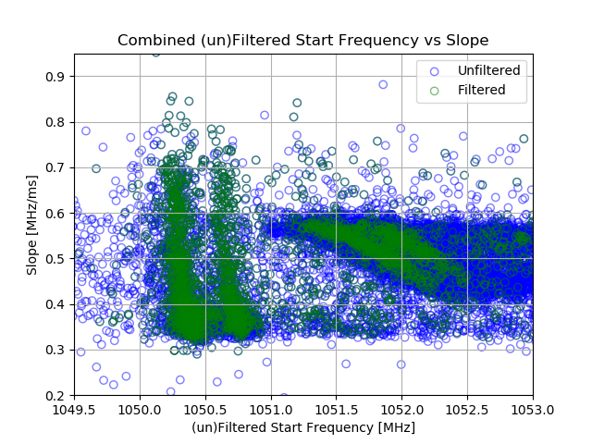
Combined filtered and unfiltered

Slide 9
End Remarks
Objective: To complete some basic data analysis and gain comprehension of the labs experiment
Conclusion:
Made sufficient progress to understand the h5py library
Connected through wright server to perform analysis
Gained insight into slide presentation format

