Slide 1

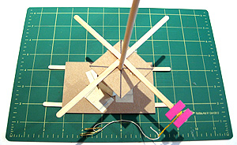
Pinwheel
Build-It-blocks Creative Robotics

Slide 2
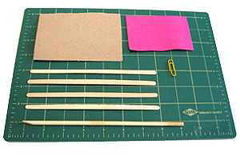
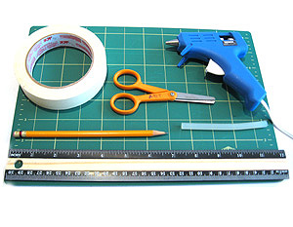
Materials
1. Materials
- 1 piece of cardboard
- 1 piece of foam
- 1 paper clip
- 1 chop stick
- 4 coffee stirrer sticks
2. Tools
- tape
- scissors
- pencil
- hot glue gun
- glue stick
- ruler
-cutting matt

Slide 3
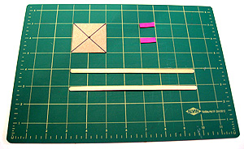
Cut Pieces
1. Collect pieces
- Cut 2”x2” inch square out of cardboard.
- Cut two 1”x 0.5” rectangle out of foam.
2. Mark the center of the cardboard by drawing 2 diagonal lines from the corners.

Slide 4
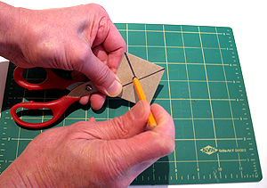
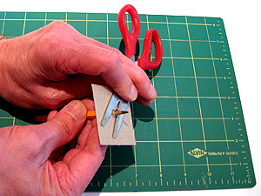
Glue Coffee Stirrer Sticks
3. Poke a hole
- Use your pencil to poke a hole in the middle of the cardboard square
- Position the scissors so your pencil pokes through the cardboard between the scissor blade. (Not into your finger.)
The more fingers you have the easier it is to build!

Slide 5
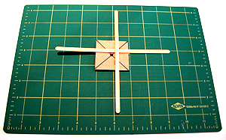
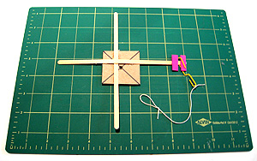
Glue and Assemble final pieces
4. Glue coffee stirrer sticks to the cardboard.

Slide 6
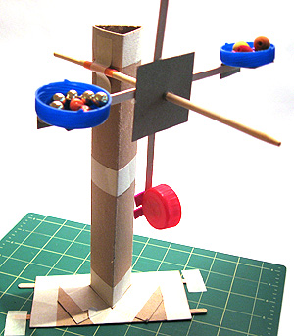
Final Pinwheel
Take your chopstick put it though the hole of your base
Put pinwheel on your chopstick
Done!

