Slide 1

LEGO Robo-Olympics

Slide 2

Overview
The Fay School will be hosting its first Robo-Olympics Competition and we need teams to super smart engineers to build the ULTIMATE competitors

Slide 3
The Events

Slide 4

1 ½ Meter Sprint

Slide 5

Weightlifting

Slide 6

Shotput

Slide 7
Day 1
1 ½ Meter Sprint
Agenda:
Build Chassis
Customize!
Modularize!

Slide 8
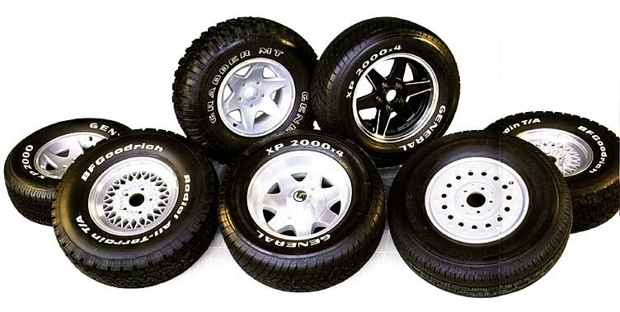
Big Wheels Small Wheels

Slide 9
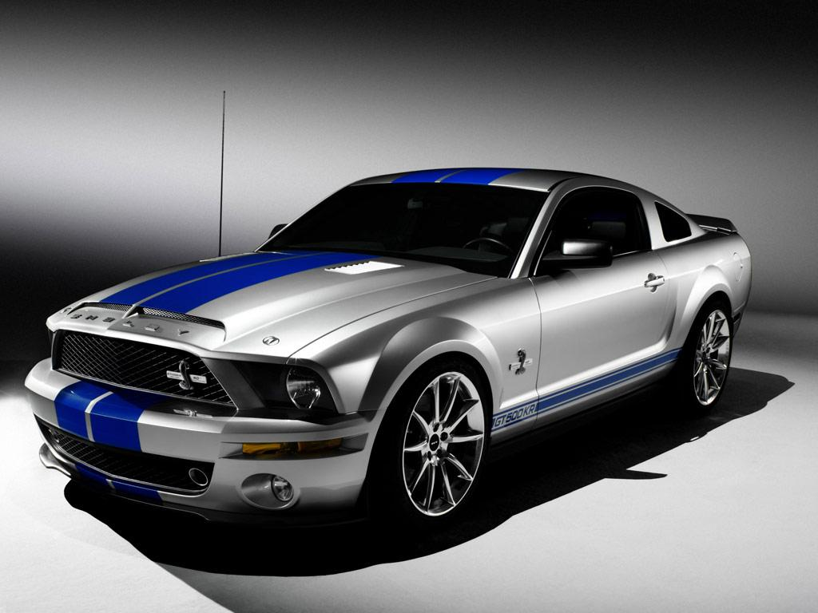
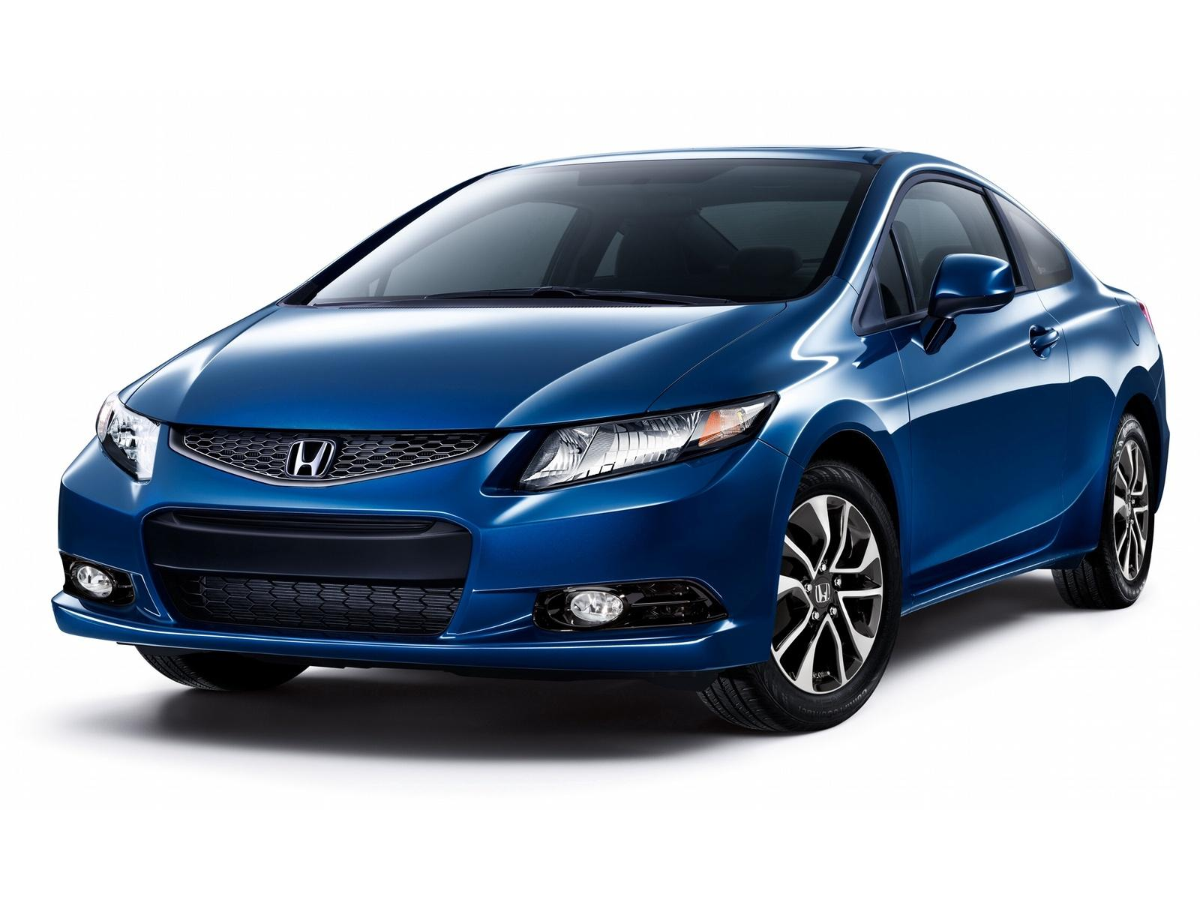
Front Wheel Drive
Rear Wheel Drive
Thoughts to take home: Ask your parents what kind of car they drive. Front wheel or rear wheel

Slide 10

Gear Ratio

Slide 11
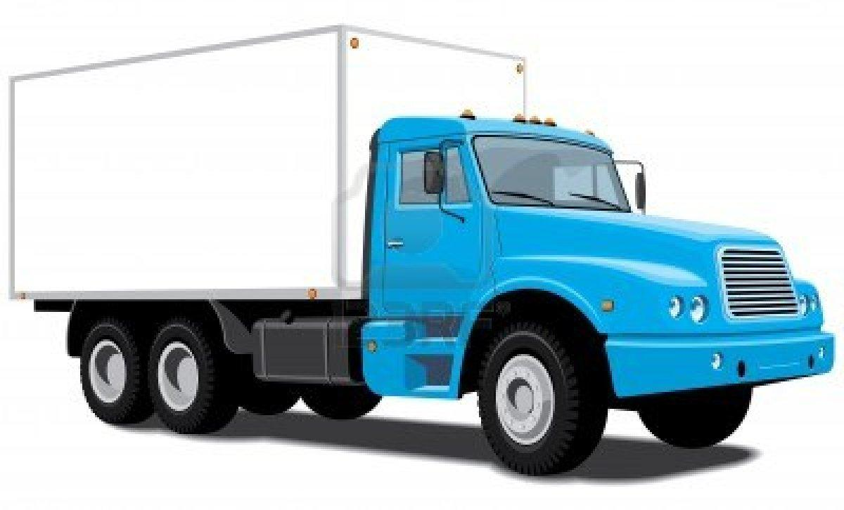
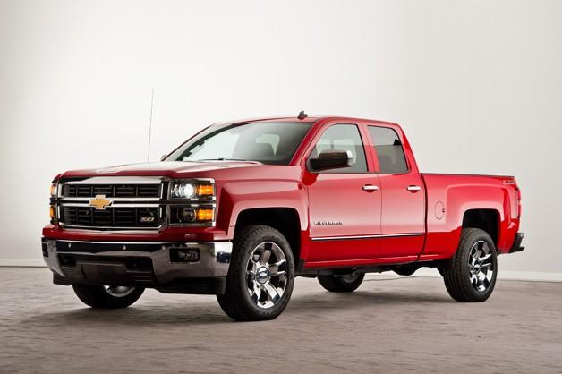
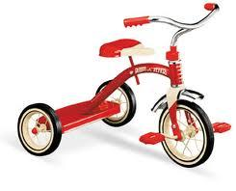
4 Wheels? 6? 3?

Slide 12
Day 2
Finishing Design Touches
Competition

