Slide 1

90s Net
Chad Lape and Joshua Hale

Slide 2
Contact Info
Group Members
Chad Lape: lapech@mail.uc.edu
Joshua Hale: haleju@mail.uc.edu
Advisor
Will Hawkins: hawkinwh@ucmail.uc.edu

Slide 3
Abstract
This senior design project, called "90s Net" aims to recreate the network and systems of the University of Cincinnati West main campus in the 1990s in a completely virtual environment. Users should be able to connect to this network and interact with it as if it were a true network. Admins should be able to control and view aspects of the network using common network tools. An interface should be able to create network views and run automation's triggered by user actions all from an external perspective. In total, this network should be an effective training ground for basic cyber exercises in a (hopefully) non-derived and familiar environment for students.

Slide 4
User Stories – Organizer
As a 90s net host, I want the network to be resiliant to denial of service and other attacks which may down the network, that way the network can automate recovery and I do not have to manage the resources.
As a 90s net scorer, I want the network to keep track of competitors access of machines so that the scoring system will keep track of the scores without human intervention.
As a 90s net challenge developer, I want a simple interface which allows me to build new machines easily, that way the creation of new configurations of 90s net is simple.

Slide 5
User Stories – Competitor
As a naive competitor, I want to have traffic which comes from 90s net appear to be normal traffic for a university, that way I can capture traffic and view it.
As an attacker, I want machines to be vulnerable to cyber attacks which are somewhat common, my skill will then be tested as I move through the network
As a competitor, I want my own access of 90s net to remain secure, that way my own system does not become compromised from traffic on the network.

Slide 6
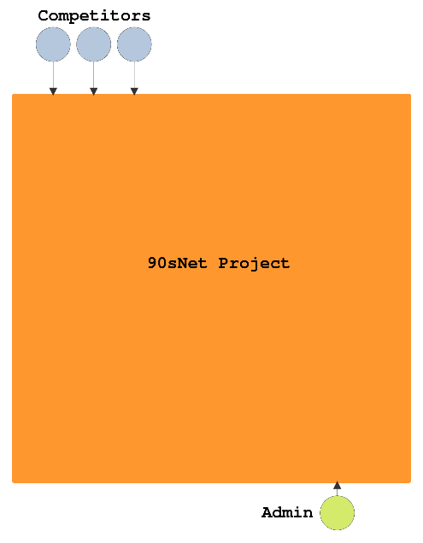
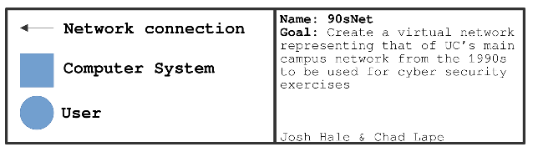
Design Diagram #1
Competitors and Admins connect over network connection to the 90s net project.

Slide 7
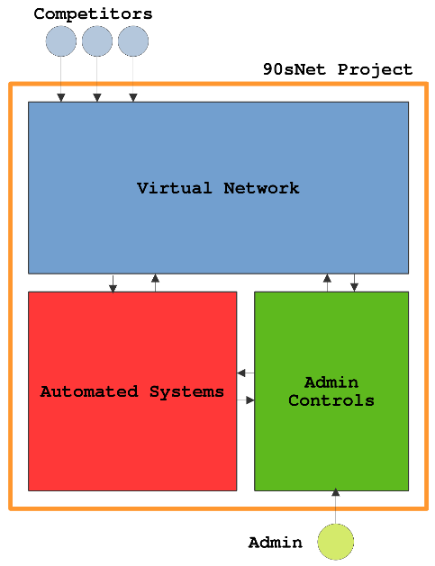
Design Diagram #2
Competitors connect to virtual network
Admins connect to Admin controls
Automated Systems, Virtual Network, and Admin Controls are all connected

Slide 8
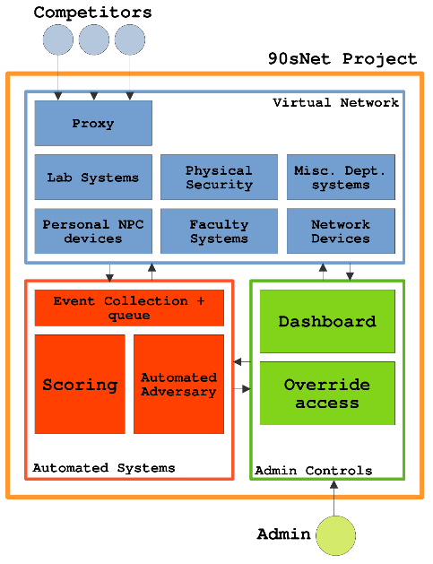
Design Diagram #3
Virtualized systems on the network are interconnected
Event collection system watches virtual network traffic and systems for changes
Scoring interprets events and adds scores to players accordingly
Automated adversaries interact with competitors on the network

Slide 9
Constraints
Economic: Our current solution would rely on large amounts of computing power. We have a dedicated server for this project, however individuals wanting to recreate our work may not be able to.
Ethics: Our current solution allows users to test real malware in a realistic environment. By "turning back the clock" to the 90s, the hope is that it is not comparable to real university hardware in an effort to not put it in any danger.
Maintenace: Our current solution must be relatively easy to know given a basic knowledge of cloud computing and such so that maintainers would not be burdened with months of learning just this tool alone
Security: Implementation of proxies and networking rules can help mitigate the threat to contestants.

Slide 10
State of Project
Talked with University employees about historical systems and network
Developed scheme and patterns of network structure and systems
Investigating methods for containerizing network
Investigating and developing methods for external network inspection

Slide 11
Expectations for Term
Lock down network design (complete 10/31): Have a formal design written for the network structure within 90s net set.
Small scale network demonstration (10/31): Have one network spoke along with around a dozen devices virtualized and communicating. A user should be able to proxy into this network as well.
Network interaction demonstration (11/30): Have an automated system and admin abilities to interact with the network.

Slide 12
Division of Labor
Research Phase
Research university network structure in 1990s [Josh Hale]
Research university network systems in the 1990s [Josh Hale]
Research general university information (buildings etc) in the 1990s to fill knowledge gaps [Josh Hale]
Research general campus networking practices (common systems and structure) in the 1990s to fill knowledge gaps [Josh Hale]
Research viable hardware to run project on {Likely nomad with lab hardware} [Chad Lape]
Research viable medium to run project on (Docker etc) [Chad Lape]
Research Daemons which can give an overview of the state of the network [Chad Lape]
Research methods to access hardware remotely [Chad Lape]

Slide 13
Division of Labor
Design Phase
Specify systems to include on network [Josh Hale]
Develop a small scale test network on the hardware [Chad Lape]
Design admin control system and a way to interact with the virtual network [Chad Lape]
Develop methods for event collection+queueing and scoring in the automated systems [Josh Hale]
Develop Admin Dashboard for tracking container failures and logging [Chad Lape]

Slide 14
Division of Labor
Development of Virtual Network Environment
Develop proxies which competitors will connect into the environment [Josh Hale]
Develop images for containers of the Lab Systems [Josh Hale]
Develop images for containers of the Physical Security Systems [Josh Hale]
Develop images for containers of the Network Devices [Chad Lape]
Develop images for containers of the Personal NPC Devices [Chad Lape]
Develop images for containers of the Department Systems [Chad Lape]

Slide 15
Expo Demo
Show Admin Controls
Allow expo attendees to join virtual network and explore
Show demo scenarios

