Slide 1
Eulerian Video Magnification for Revealing Subtle Changes in the World
Student: 邱煥榮
Advisor: Tzuu-Hseng S. Li
aiRobots Laboratory, Department of Electrical Engineering,
National Cheng Kung University, Tainan, Taiwan, R.O.C.

Slide 2
Abstract
Our goal is to reveal temporal variations in videos that are difficult or impossible to see with the naked eye and display them in an indicative manner.
Our method, which we call Eulerian Video Magnification, takes a standard video sequence as input, and applies spatial decomposition, followed by temporal filtering to the frames.
The resulting signal is then amplified to reveal hidden information. Using our method, we are able to visualize the flow of blood as it fills the face and also to amplify and reveal small motions.
Our technique can run in real time to show phenomena occurring at temporal frequencies selected by the user.
Notes:
1,我們提出了一種新的基於模型的步態識別技術，稱為基於姿勢的步態識別。
它由兩個元素組成：基於姿勢的特徵和基於姿勢的分類
2,基於姿態的特徵由當前幀和相鄰幀之間的所有關節的位移以及所有關節的中心（CoB）相對坐標組成，其中每個關節的坐標來自其相對位置
到四個關節：髖關節中心，髖關節，髖關節和脊柱關節，從前鋒向前。
3, CoB 相對坐標係是處理不同觀測角度問題的關鍵部分>
4, 基於姿勢的步態識別技術在固定方向和自由式步行場景中均優於現有技術，其中涉及到轉向和改變方向。
5,這表明一套姿勢和快速動作足以識別一個人

Slide 3
Content
Introduction
Space-time video processing
Eulerian motion magnification
First-order motion
Bounds
Multiscale analysis
Results
Discussion
Conclusion

Slide 4
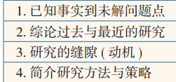
1. Introduction
The experimental results
Notes:
1,

Slide 5
2. Space-time video processing
PROPOSED METHOD
Center-of-Body Relative Coordinates
Posture-Based Features
C. Posture-Based Classification

Slide 6
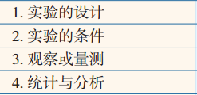
3. Eulerian motion magnification
In this section, we show how temporal processing produces motion magnification using an analysis that relies on the first-order Taylor series expansions common in optical flow analyses [Lucas and Kanade 1981; Horn and Schunck 1981]
First-order motion
Bounds
Multiscale analysis

Slide 7



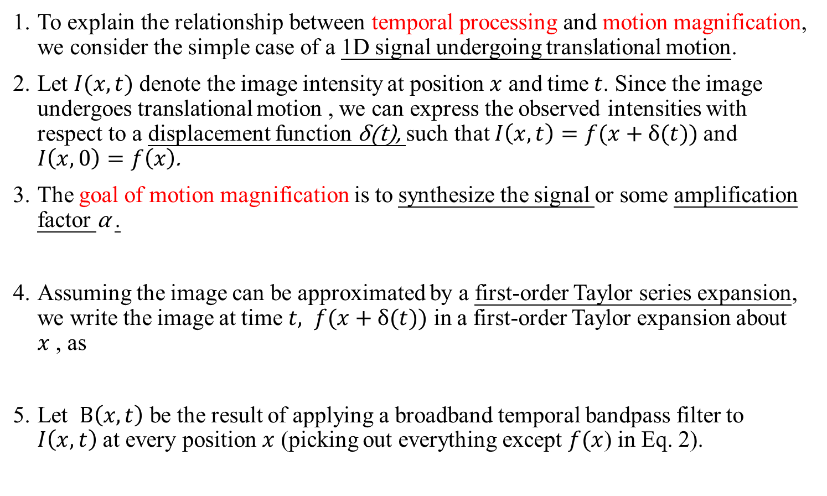
3.1 First-order motion
To explain the relationship between temporal processing and motion magnification, we consider the simple case of a 1D signal undergoing translational motion.
Let $I(x,t)$ denote the image intensity at position $x$ and time $t$. Since the image undergoes translational motion , we can express the observed intensities with respect to a displacement function δ(t), such that $I\left(x,t\right)=f(x+δ(t))$ and $I\left(x,0\right)=f\left(x\right)$.
The goal of motion magnification is to synthesize the signal or some amplification factor α .
Assuming the image can be approximated by a first-order Taylor series expansion, we write the image at time $t, f(x+δ(t))$ in a first-order Taylor expansion about $x$ , as
Let $B\left(x,t\right)$ be the result of applying a broadband temporal bandpass filter to $I\left(x,t\right)$ at every position $x$ (picking out everything except $f(x$) in Eq. 2).
Notes:
4,根據該技術，數據集被隨機分成m個不相交的子集。 然後，我們執行m次模型構建。 在第i次迭代中，
使用第i個子集作為測試集。
5,其他子集合併到訓練集中。 m模型的測試精度取平均值並作為交叉驗證報告準確性。

Slide 8


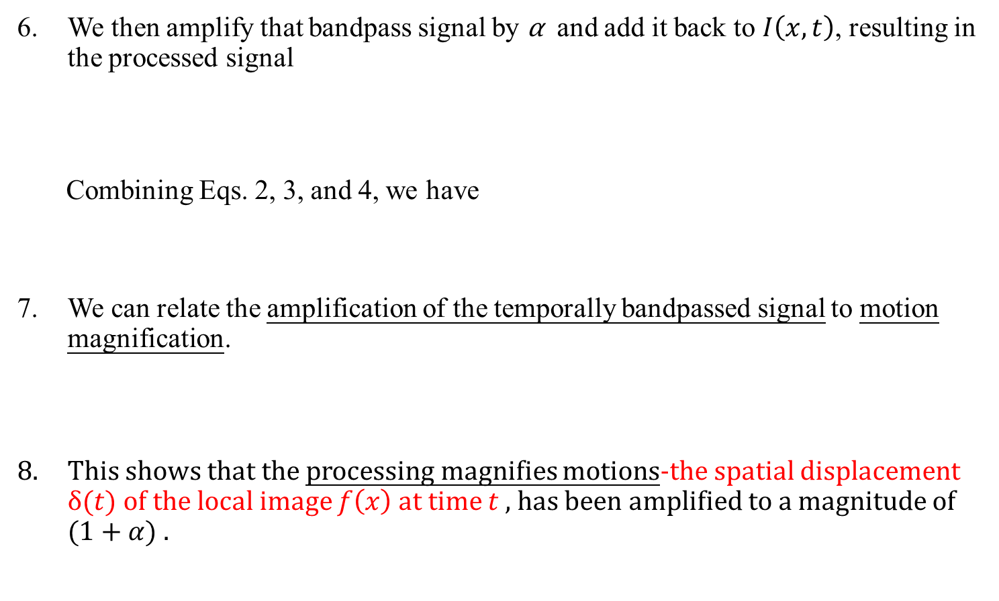
3.1 First-order motion
We then amplify that bandpass signal by α and add it back to $I\left(x,t\right)$, resulting in the processed signal
Combining Eqs. 2, 3, and 4, we have
We can relate the amplification of the temporally bandpassed signal to motion magnification.
This shows that the processing magnifies motions-the spatial displacement $δ(t)$ of the local image $f\left(x\right)$ at time $t$ , has been amplified to a magnitude of $(1+α)$ .
Notes:
4,根據該技術，數據集被隨機分成m個不相交的子集。 然後，我們執行m次模型構建。 在第i次迭代中，
使用第i個子集作為測試集。
5,其他子集合併到訓練集中。 m模型的測試精度取平均值並作為交叉驗證報告準確性。

Slide 9


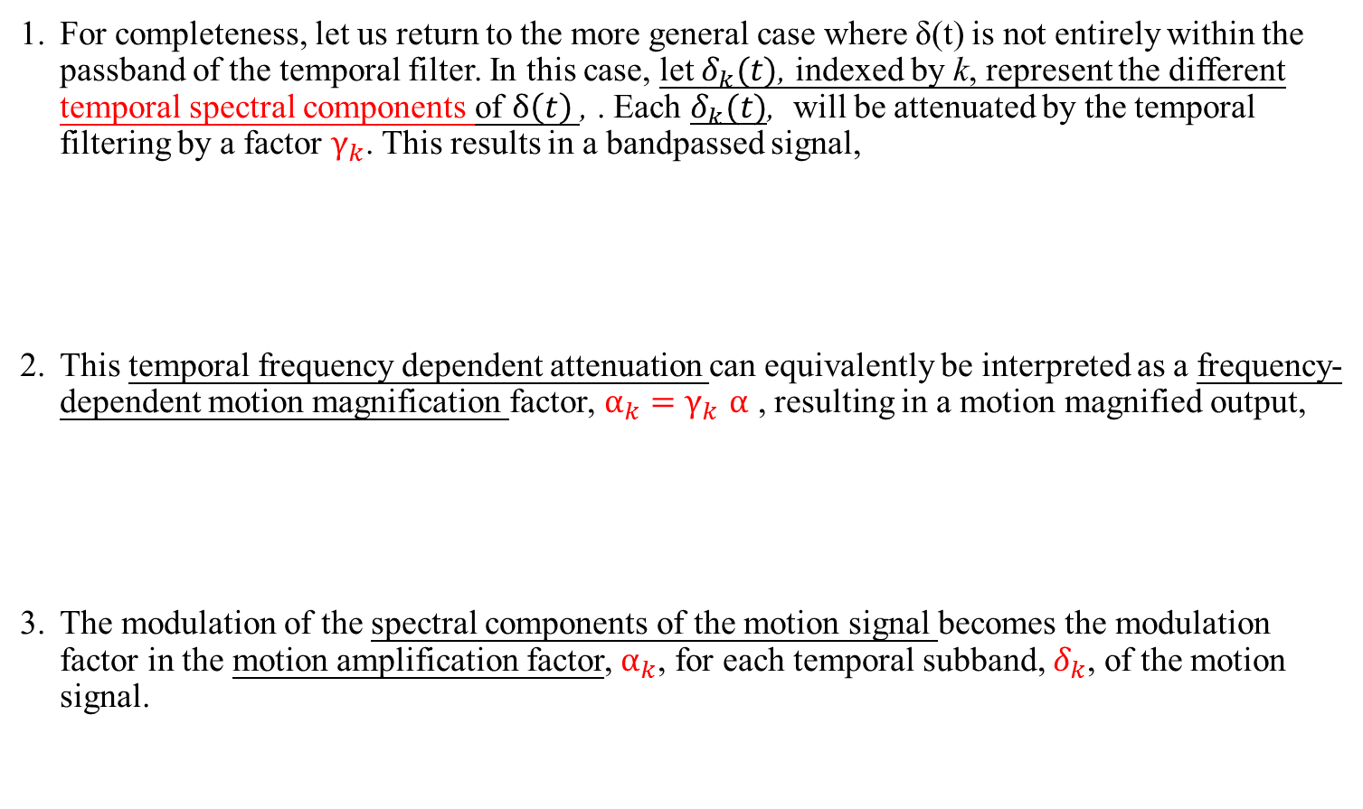
3.1 First-order motion
For completeness, let us return to the more general case where δ(t) is not entirely within the passband of the temporal filter. In this case, let $δ_{k}(t)$, indexed by k, represent the different temporal spectral components of $δ\left(t\right)$, . Each $δ_{k}(t)$, will be attenuated by the temporal filtering by a factor $γ_{k}$. This results in a bandpassed signal,
This temporal frequency dependent attenuation can equivalently be interpreted as a frequency-dependent motion magnification factor, $α_{k}{=γ}_{k}α$ , resulting in a motion magnified output,
The modulation of the spectral components of the motion signal becomes the modulation factor in the motion amplification factor, $α_{k}$, for each temporal subband, $δ_{k}$, of the motion signal.
Notes:
4,根據該技術，數據集被隨機分成m個不相交的子集。 然後，我們執行m次模型構建。 在第i次迭代中，
使用第i個子集作為測試集。
5,其他子集合併到訓練集中。 m模型的測試精度取平均值並作為交叉驗證報告準確性。

Slide 10
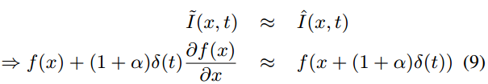




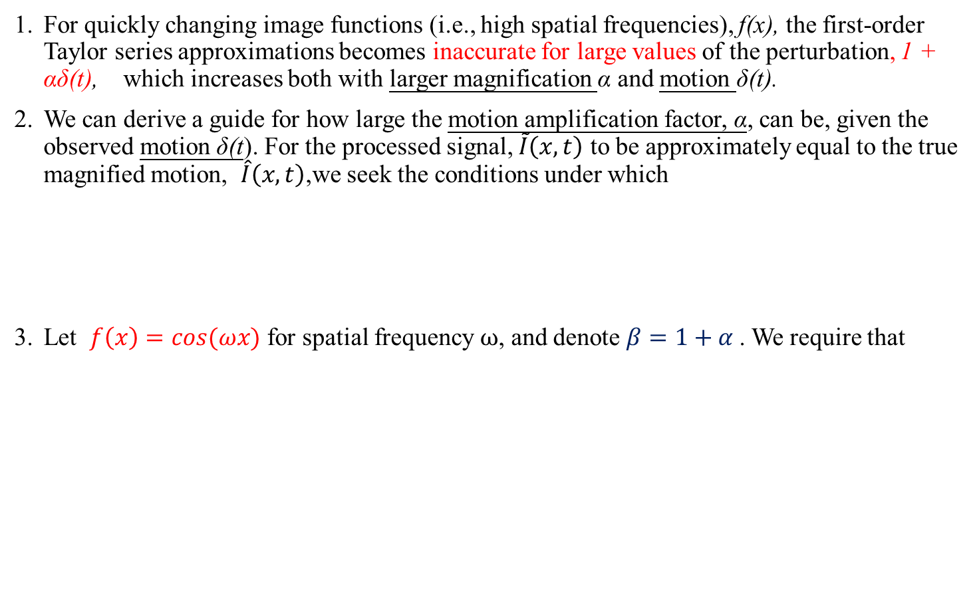

3.2 Bounds
For quickly changing image functions (i.e., high spatial frequencies), f(x), the first-order Taylor series approximations becomes inaccurate for large values of the perturbation, 1 + αδ(t), which increases both with larger magnification α and motion δ(t).
We can derive a guide for how large the motion amplification factor, α, can be, given the observed motion δ(t). For the processed signal, $\tilde{I}\left(x,t\right)$ to be approximately equal to the true magnified motion, $\hat{I}\left(x,t\right)$,we seek the conditions under which
Let $f\left(x\right)=cos⁡(ωx)$ for spatial frequency $ω$, and denote $β=1+α$. We require that
$$\cos\left(\left(ωx\right)+βωδ\left(t\right)\right)=$$
Fig. 5. Components of a DVD-pickup head.
Notes:
1 ,我們研究各種特徵和關節組合的貢獻。

Slide 11


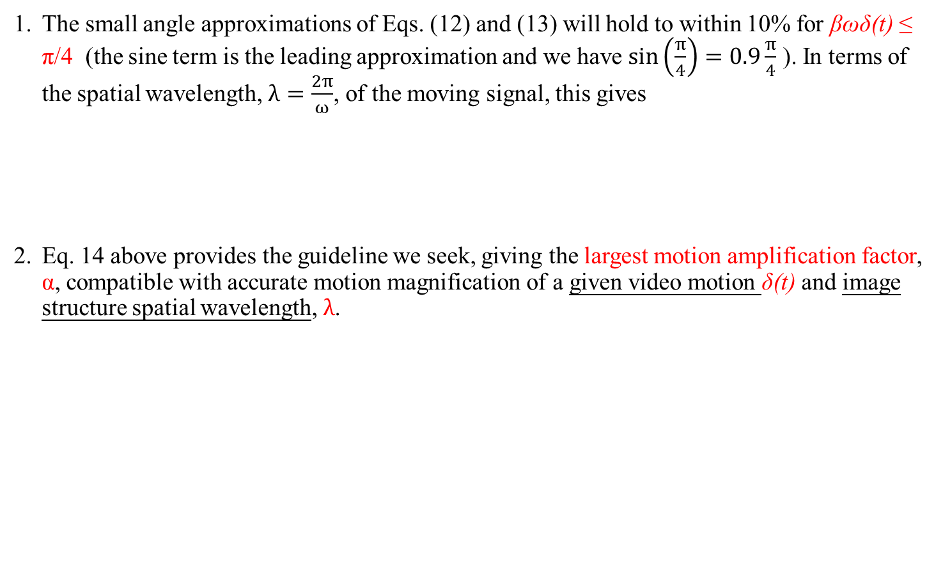

3.2 Bounds
The small angle approximations of Eqs. (12) and (13) will hold to within 10% for βωδ(t) ≤ π/4 (the sine term is the leading approximation and we have $\sin\left(\frac{π}{4}\right)=0.9\frac{π}{4}$ ). In terms of the spatial wavelength, $λ=\frac{2π}{ω}$, of the moving signal, this gives
Eq. 14 above provides the guideline we seek, giving the largest motion amplification factor, α, compatible with accurate motion magnification of a given video motion δ(t) and image structure spatial wavelength, $λ$.
$$βωδ\left(t\right)<\frac{π}{4} ⇒ β\frac{2π}{λ}δ\left(t\right)<\frac{π}{4}$$
$$⇒ βδ\left(t\right)<\frac{π}{4}∗\frac{λ}{2π}$$
Notes:
1 ,我們研究各種特徵和關節組合的貢獻。

Slide 12
3.3 Multiscale analysis
One of the assessments of human identification techniques is how they perform with different gallery sizes.
Poor performance techniques may achieve high accuracy rates with a small gallery size.
Fig. 6 and Fig. 7 show accuracy rates of the proposed technique with different gallery sizes, in comparison to techniques from [11], [12], and [27], on dataset A and dataset B, respectively.
For each gallery size, q subjects are randomly chosen from each dataset. The number q starts from 10 and increases by 10 until it matches the size of each dataset.
Fig. 5. Components of a DVD-pickup head.
Notes:
4,對於每個圖庫大小，從每個數據集中隨機選擇q個主題。數字q從10開始並增加10，直到它匹配每個數據集的大小。

Slide 13
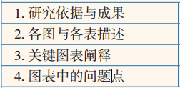
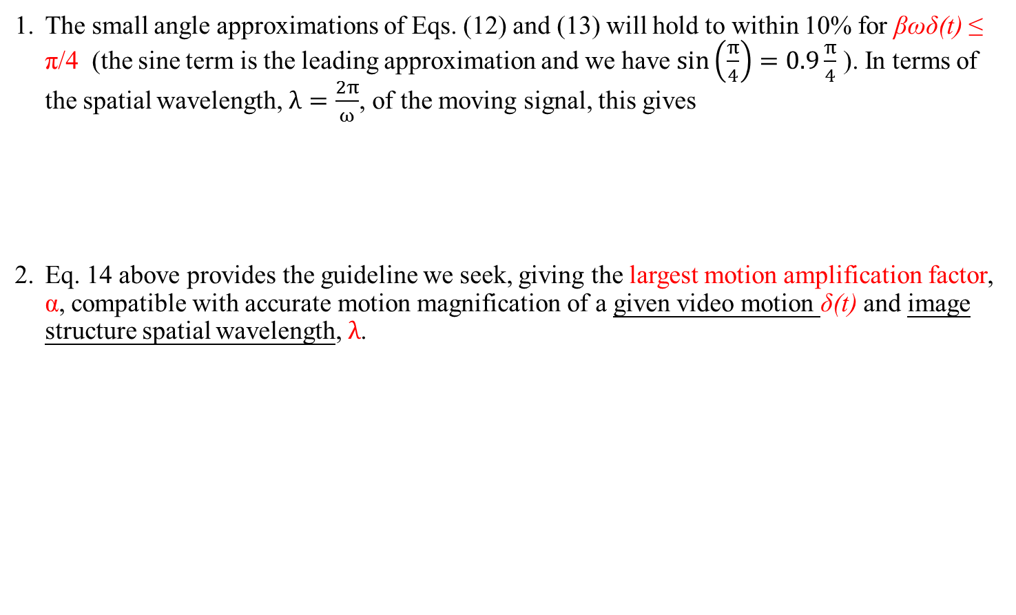
4. Results
The small angle approximations of Eqs. (12) and (13) will hold to within 10% for βωδ(t) ≤ π/4 (the sine term is the leading approximation and we have $\sin\left(\frac{π}{4}\right)=0.9\frac{π}{4}$ ). In terms of the spatial wavelength, $λ=\frac{2π}{ω}$, of the moving signal, this gives
Eq. 14 above provides the guideline we seek, giving the largest motion amplification factor, α, compatible with accurate motion magnification of a given video motion δ(t) and image structure spatial wavelength, $λ$.
Notes:
1; 對於這兩個數據集，兩個數據集的第二高度組合是使用CoB所有關節基於姿勢的，沒有關節運動。
基於姿勢的特徵僅使用所有關節運動，對兩個數據集的表現都很差。
這表明，一個人的獨特特徵可以被最好地識別出來考慮身體的某些部分。
此外，添加快速關節運動時識別準確性得到改善。
然而，聯合運動本身並沒有顯示足夠的行走順序的獨特特徵。在數據集A中，使用CoB下身關節比以身體關節的上，中和中心按降序執行效果更好。

Slide 14
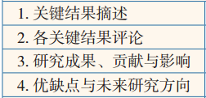
5. Discussion
From Table I,
This implies that observing only the lower part of the body works better in a fixed direction scenario, but not in a freestyle walk.
Unique characteristics of a person are revealed through upper and middle parts of the body more consistently with or without changing directions.
In other words, the unique posture of a person shows more through the upper part or middle part of the body than through lower parts of the body, when turning around or changing directions are involved.
Using only four center of body joints as posture-based features performs second to worst on both datasets.
This illustrates that only four center of body joints are not enough to identify a person. From the study of joint contributions in Table I, the entire body (all joints) must be considered as a whole (not just parts of a body) along with their quick movements, in order to optimize gait recognition.
Notes:
1 這意味著僅觀察身體的下半部分在固定方向的情況下效果更好，但不是在自由式步行中。
這可能部分是因為在自由式散步場景中，受試者可以轉彎並改變方向，而固定方向散步沒有轉彎。
一個人的獨特特徵通過身體的上部和中部顯示，不管方向是否改變，都會更加一致。
換句話說，當轉向或改變方向時，人體的獨特姿勢通過身體的上部或中部比通過身體的下部顯示更多。
僅使用四個身體關節的中心作為基於姿勢的特徵在兩個數據集上執行從第二到最差。
這說明只有四個身體關節中心不足以識別一個人。從表I的聯合貢獻研究中，整個身體（所有關節）必須是 作為一個整體（不只是身體的一部分）和快速運動，以優化步態識別。

Slide 15
6. Conclusion
We propose a new model-based human gait identification technique called the posture-based recognition technique, which consists of two main components: posture-based features and posture-based classification.
Notes:
1可以得出結論，一個人可以從一組姿勢和快速動作中被最好地識別出來。
所提出的技術消除了不同的觀察視點問題並且工作良好，即使在轉向和改變方向時也是如此。
基於姿勢的識別系統對尺寸不敏感。
它的精確度仍然很高，各種畫廊尺寸都有小幅下降。
所提出的技術在累積數學特徵測試下也表現良好，這將使該技術成為法醫和監視領域的合適工具。

Slide 16
Thanks for your attention

