Slide 1
Eulerian Video Magnification for Revealing Subtle Changes in the World
Student: 邱煥榮
Advisor: Tzuu-Hseng S. Li
aiRobots Laboratory, Department of Electrical Engineering,
National Cheng Kung University, Tainan, Taiwan, R.O.C.

Slide 2
Abstract
Our goal is to reveal temporal variations in videos that are difficult or impossible to see with the naked eye and display them in an indicative manner.
Our method, which we call Eulerian Video Magnification, takes a standard video sequence as input, and applies spatial decomposition, followed by temporal filtering to the frames.
The resulting signal is then amplified to reveal hidden information. Using our method, we are able to visualize the flow of blood as it fills the face and also to amplify and reveal small motions.
Our technique can run in real time to show phenomena occurring at temporal frequencies selected by the user.

Slide 3
Content
Introduction
Space-time video processing
Eulerian motion magnification
First-order motion
Bounds
Multiscale analysis
Results
Discussion
Conclusion

Slide 4

1. Introduction
The experimental results
Notes:
1,

Slide 5
2. Space-time video processing
We first decompose the video sequence into different spatial frequency bands. These bands might be magnified differently because
(a) they might exhibit different signal-to-noise ratios or
(b) they might contain spatial frequencies for which the linear approximation used in our motion magnification does not hold (Sect. 3).
In the latter case, we reduce the amplification for these bands to suppress artifacts.
When the goal of spatial processing is simply to increase temporal signal-to-noise ratio by pooling multiple pixels, we spatially low-pass filter the frames of the video and downsample them for computational efficiency.
In the general case, however, we compute a full Laplacian pyramid

Slide 6
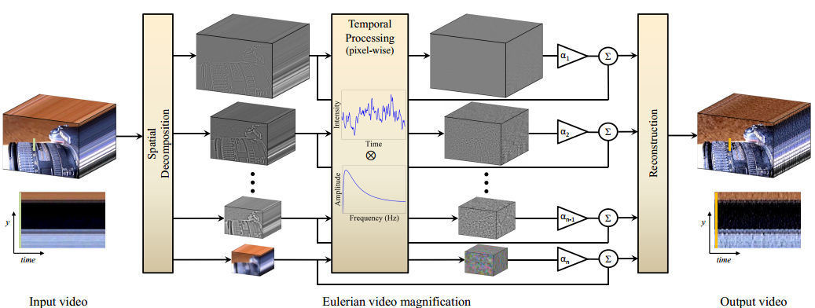
2. Space-time video processing
We first decompose the video sequence into different spatial frequency bands. These bands might be magnified differently because

Slide 7
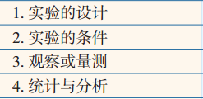
3. Eulerian motion magnification
In this section, we show how temporal processing produces motion magnification using an analysis that relies on the first-order Taylor series expansions common in optical flow analyses [Lucas and Kanade 1981; Horn and Schunck 1981]
First-order motion
Bounds
Multiscale analysis

Slide 8







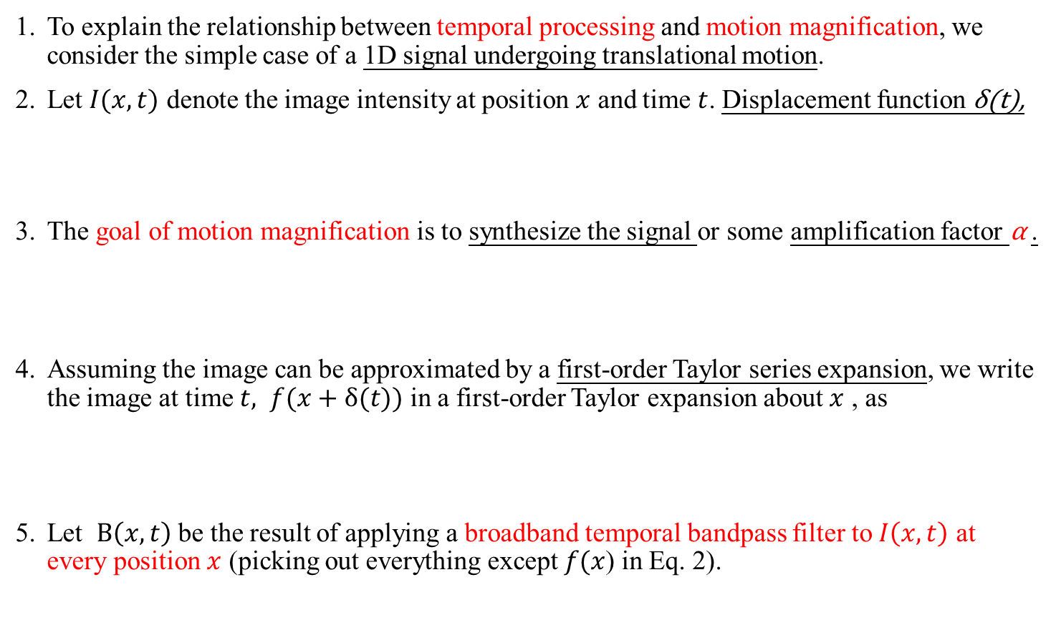
3.1 First-order motion
To explain the relationship between temporal processing and motion magnification, we consider the simple case of a 1D signal undergoing translational motion.
Let $I(x,t)$ denote the image intensity at position $x$ and time $t$. Displacement function δ(t),
The goal of motion magnification is to synthesize the signal or some amplification factor α .
Assuming the image can be approximated by a first-order Taylor series expansion, we write the image at time $t, f(x+δ(t))$ in a first-order Taylor expansion about $x$ , as
Let $B\left(x,t\right)$ be the result of applying a broadband temporal bandpass filter to $I\left(x,t\right)$ at every position $x$ (picking out everything except $f(x$) in Eq. 2).
Notes:
5. 假如所有的变化信号 δ(t) 的频率范围恰好是我们进行带通滤波时所选的频带范围

Slide 9




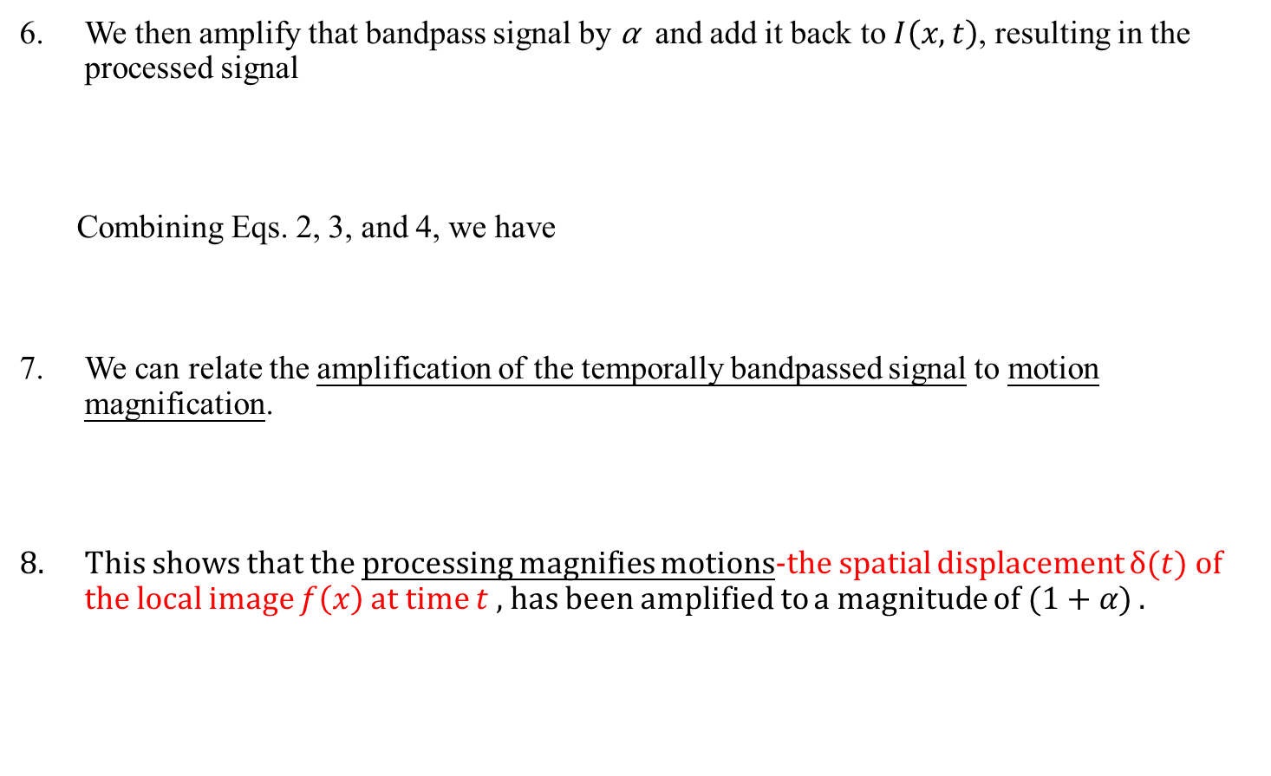
3.1 First-order motion
We then amplify that bandpass signal by α and add it back to $I\left(x,t\right)$, resulting in the processed signal
Combining Eqs. 2, 3, and 4, we have
We can relate the amplification of the temporally bandpassed signal to motion magnification.
This shows that the processing magnifies motions-the spatial displacement $δ(t)$ of the local image $f\left(x\right)$ at time $t$ , has been amplified to a magnitude of $(1+α)$ .

Slide 10
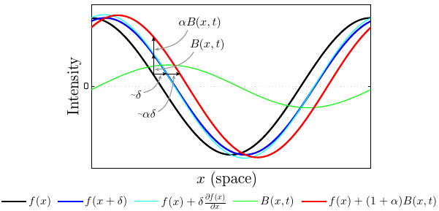

3.1 First-order motion
We then amplify that bandpass signal by α and add it back to $I\left(x,t\right)$, resulting in the processed signal
Fig. 3. Temporal filtering can approximate spatial translation

Slide 11


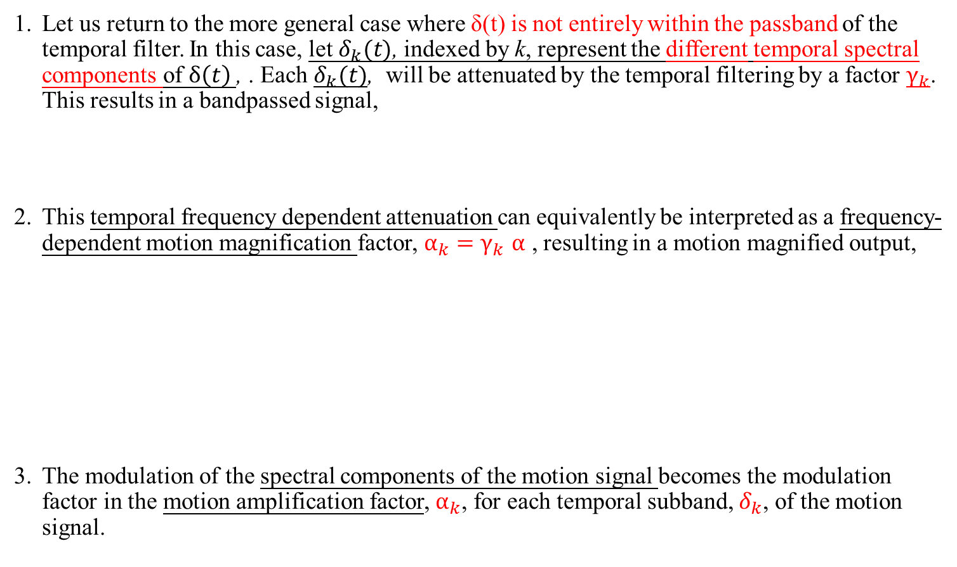

3.1 First-order motion
Let us return to the more general case where δ(t) is not entirely within the passband of the temporal filter. In this case, let $δ_{k}(t)$, indexed by k, represent the different temporal spectral components of $δ\left(t\right)$, . Each $δ_{k}(t)$, will be attenuated by the temporal filtering by a factor $γ_{k}$. This results in a bandpassed signal,
This temporal frequency dependent attenuation can equivalently be interpreted as a frequency-dependent motion magnification factor, $α_{k}{=γ}_{k}α$ , resulting in a motion magnified output,
The modulation of the spectral components of the motion signal becomes the modulation factor in the motion amplification factor, $α_{k}$, for each temporal subband, $δ_{k}$, of the motion signal.
$$\tilde{I}\left(x,t\right)=I\left(x,t\right)+αB\left(x,t\right)…..\left(4\right)$$
$$\tilde{I}\left(x,t\right)≈I(x,t)+α\sum_{k}{γ_{k}}δ\left(t\right)\frac{∂f\left(x\right)}{∂x}$$
$$\tilde{I}\left(x,t\right)≈f\left(x\right)+\left(1+α\right)\sum_{k}{γ_{k}}δ\left(t\right)\frac{∂f\left(x\right)}{∂x}….⇒$$
Notes:
1, 变化信号 δ(t)δ(t) 的频率范围超出了我们所选的频段范围。这种情况下，
应用带通滤波意味着只是保留了一部分的变化信号，而其他频率超出范围的信号将会被减弱。
2,我们用 γk(t) 来表示在 t 时刻变化第 k 个变化信号减弱的倍数（0≤γk≤1）³

Slide 12
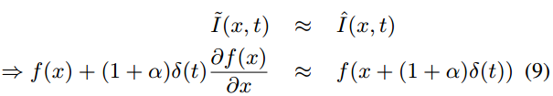




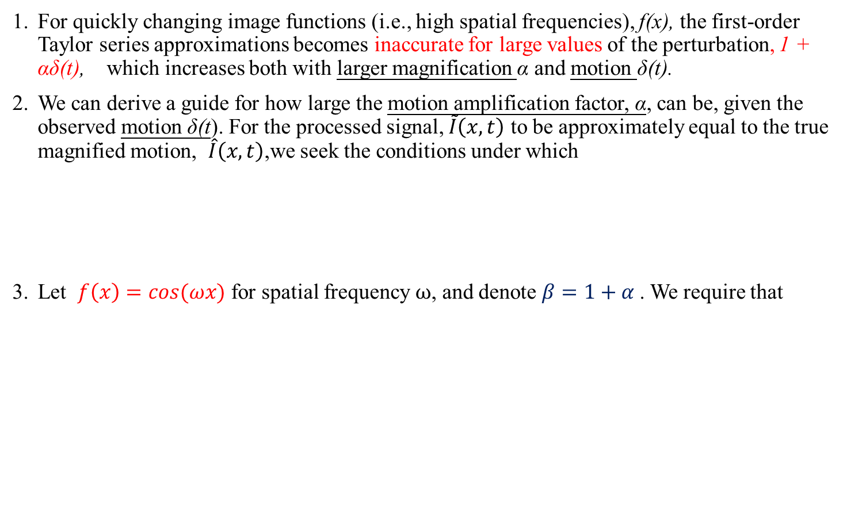

3.2 Bounds
For quickly changing image functions (i.e., high spatial frequencies), f(x), the first-order Taylor series approximations becomes inaccurate for large values of the perturbation, 1 + αδ(t), which increases both with larger magnification α and motion δ(t).
We can derive a guide for how large the motion amplification factor, α, can be, given the observed motion δ(t). For the processed signal, $\tilde{I}\left(x,t\right)$ to be approximately equal to the true magnified motion, $\hat{I}\left(x,t\right)$,we seek the conditions under which
Let $f\left(x\right)=cos⁡(ωx)$ for spatial frequency $ω$, and denote $β=1+α$. We require that
$$\cos\left(\left(ωx\right)+βωδ\left(t\right)\right)=$$
Fig. 5. Components of a DVD-pickup head.

Slide 13


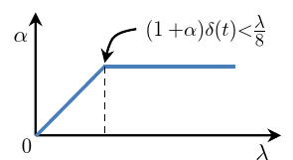
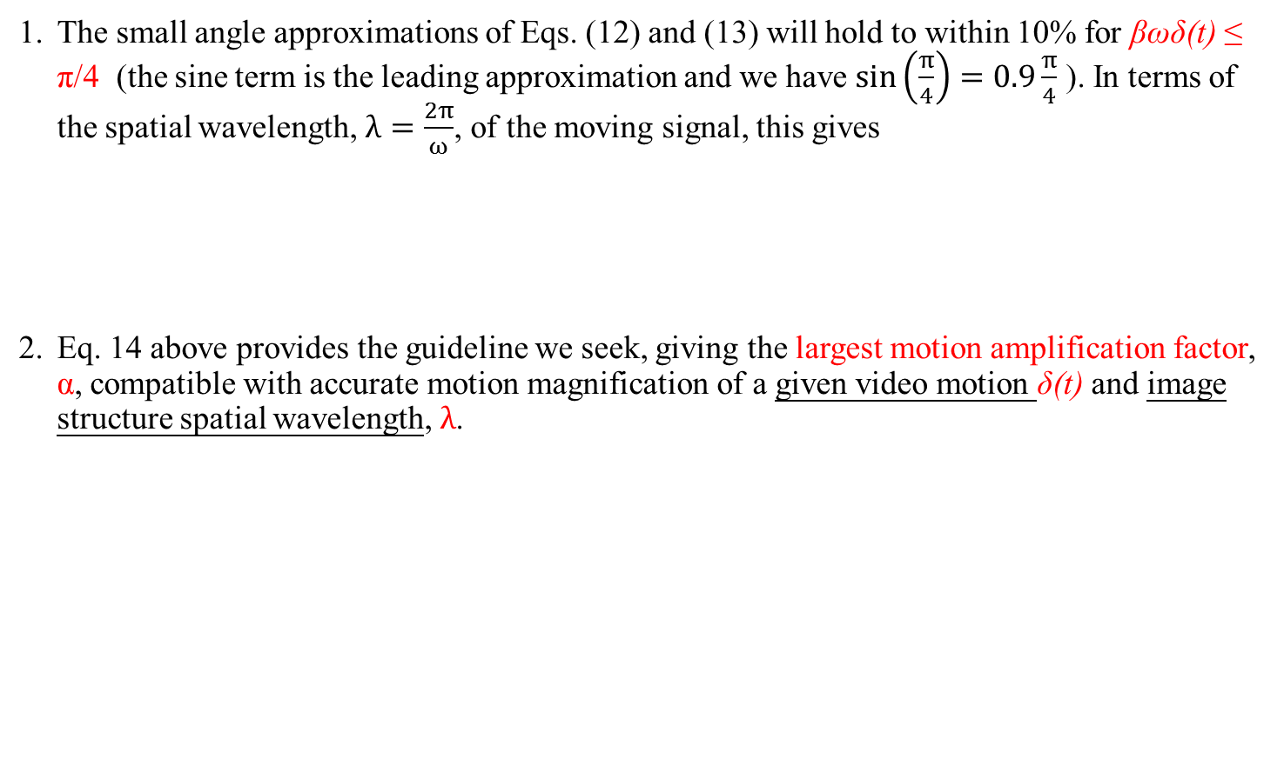

3.2 Bounds
The small angle approximations of Eqs. (12) and (13) will hold to within 10% for βωδ(t) ≤ π/4 (the sine term is the leading approximation and we have $\sin\left(\frac{π}{4}\right)=0.9\frac{π}{4}$ ). In terms of the spatial wavelength, $λ=\frac{2π}{ω}$, of the moving signal, this gives
Eq. 14 above provides the guideline we seek, giving the largest motion amplification factor, α, compatible with accurate motion magnification of a given video motion δ(t) and image structure spatial wavelength, $λ$.
$$βωδ\left(t\right)<\frac{π}{4} ⇒ β\frac{2π}{λ}δ\left(t\right)<\frac{π}{4}$$
$$⇒ βδ\left(t\right)<\frac{π}{4}∗\frac{λ}{2π}$$
Fig. 6. Amplification factor, α, as function of spatial wavelength
λ, for amplifying motion. The amplification factor is fixed to α for
spatial bands that are within our derived bound (Eq. 14), and is
attenuated linearly for higher spatial frequencies

Slide 14
3.3 Multiscale analysis X
One of the assessments of human identification techniques is how they perform with different gallery sizes.
Fig. 5. Components of a DVD-pickup head.

Slide 15
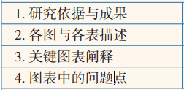
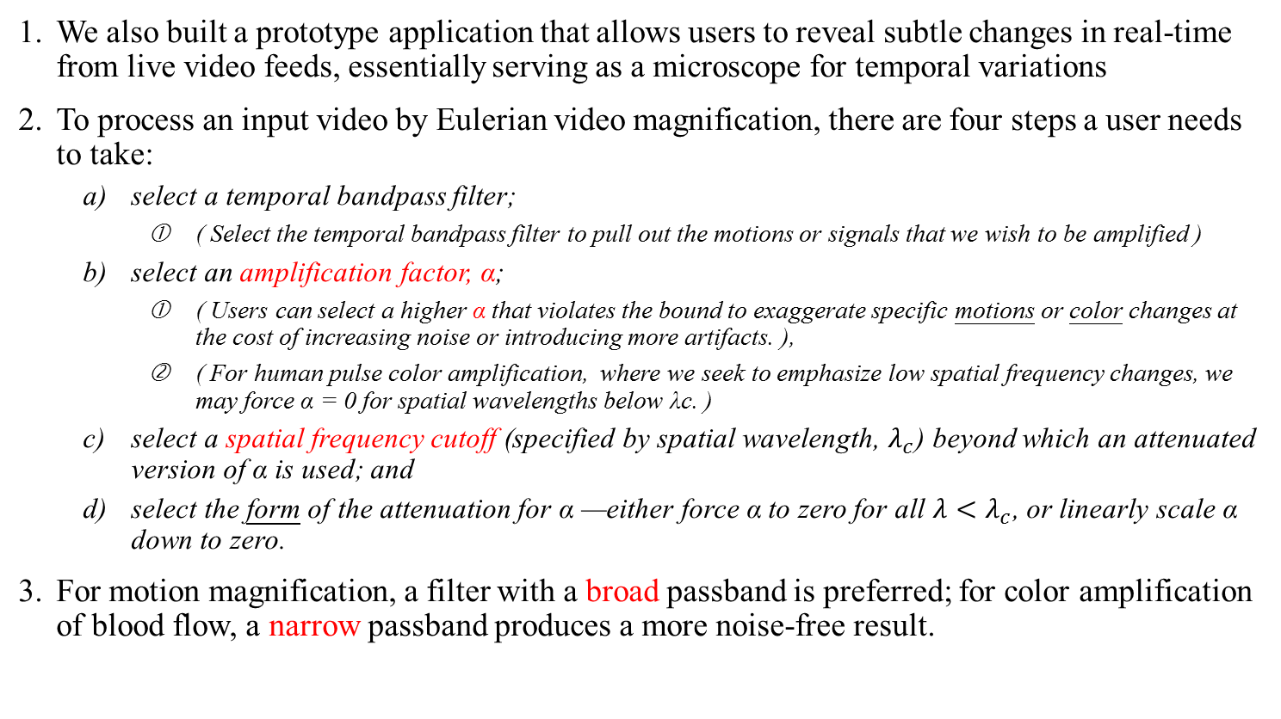
4. Results
We also built a prototype application that allows users to reveal subtle changes in real-time from live video feeds, essentially serving as a microscope for temporal variations
To process an input video by Eulerian video magnification, there are four steps a user needs to take:
select a temporal bandpass filter;
( Select the temporal bandpass filter to pull out the motions or signals that we wish to be amplified )
select an amplification factor, α;
( Users can select a higher α that violates the bound to exaggerate specific motions or color changes at the cost of increasing noise or introducing more artifacts. ),
( For human pulse color amplification, where we seek to emphasize low spatial frequency changes, we may force α = 0 for spatial wavelengths below λc. )
select a spatial frequency cutoff (specified by spatial wavelength, $λ_{c}$) beyond which an attenuated version of α is used; and
select the form of the attenuation for α —either force α to zero for all ${λ<λ}_{c}$, or linearly scale α down to zero.
For motion magnification, a filter with a broad passband is preferred; for color amplification of blood flow, a narrow passband produces a more noise-free result.

Slide 16
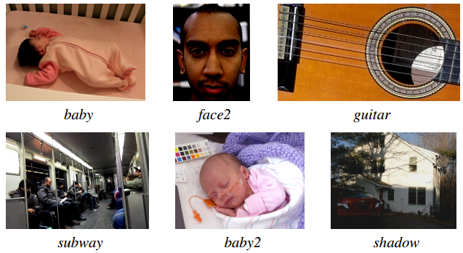
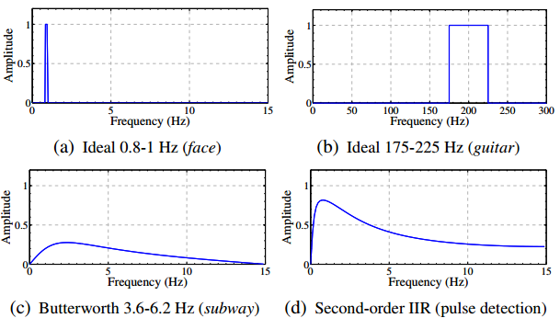

4. Results
We also built a prototype application that allows users to reveal subtle changes in real-time from live video feeds, essentially serving as a microscope for temporal variations
Low-order IIR filters can be useful for both color amplification and motion magnification and are convenient for a real-time implementation. In general, we used two first-order lowpass IIR filters with cutoff frequencies $ω_{l}$ and $ω_{h}$ to construct an IIR bandpass filter.
Fig. 8. Representative frames from additional videos demonstrating our technique..
Fig. 9. Temporal filters used in the paper. The ideal filters (a)
and (b) are implemented using DCT.
The Butterworth filter (c) & second-order IIR filter (d).
These second-order filters have a broader passband than an ideal filter.

Slide 17
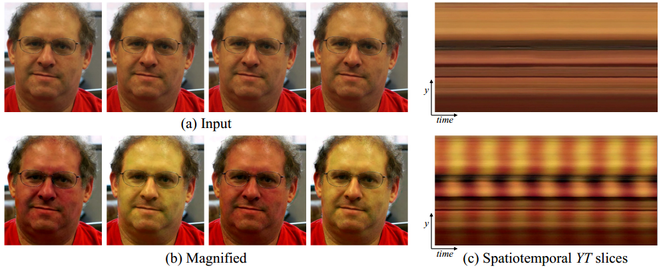
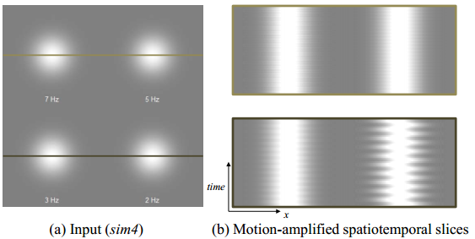
4. Results
We evaluated our method for color amplification using a few videos:
two videos of adults with different skin colors
and one of a newborn baby.
Our objective was to amplify the color change as the blood flows through the face.
We downsampled and applied a spatial lowpass filter to each frame to reduce both quantization and noise and to boost the subtle pulse signal that we are interested in. For each video, we then passed each sequence of frames through an ideal bandpass filter with a passband of 0.83 Hz to 1 Hz (50 bpm to 60 bpm). Finally, a large value of α ≈ 100 and λc ≈ 1000 was applied to the resulting spatially lowpass signal to emphasize the color change as much as possible.
Fig. 10. Selective motion amplification on a synthetic sequence (sim4 on left)
Fig. 8. Representative frames from additional videos demonstrating our technique..

Slide 18
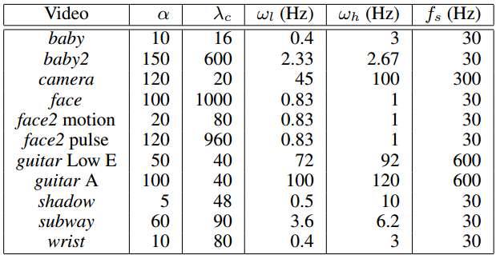
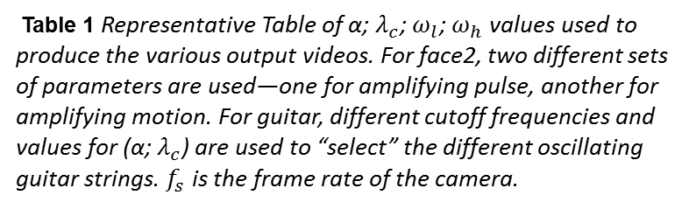
4. Results
(baby2 is a video )We obtained ground truth vital signs from a hospitalgrade monitor. We used this information to confirm the accuracy of our heart rate estimate and to verify that the color amplification signal extracted from our method matches the photoplethysmogram, an optically obtained measurement of the perfusion of blood to the skin, as measured by the monitor.
To evaluate our method for motion magnification, we used several different videos: face (Figure 1), sim4 (Figure 10), wrist (Figure 7), camera (Figure 2), face2, guitar, baby, subway, shadow, and baby2 (Figure 8).
In sim4 and guitar, we were able to selectively amplify the motion of a specific blob or guitar string by using a bandpass filter tuned to the oscillation frequency of the object of interest.
Table 1 Representative Table of α; $λ_{c}$; $ω_{l}$; $ω_{h}$ values used to produce the various output videos. For face2, two different sets of parameters are used—one for amplifying pulse, another for amplifying motion. For guitar, different cutoff frequencies and values for (α; $λ_{c}$) are used to “select” the different oscillating guitar strings. $f_{s}$ is the frame rate of the camera.

Slide 19
4. Results
We note that most of the examples in our paper contain oscillatory movements because such motion generally has longer duration and smaller amplitudes.
However, our method can be used to amplify non-periodic motions as well, as long as they are within the passband of the temporal bandpass filter.
In shadow, for example, we process a video of the sun’s shadow moving linearly yet imperceptibly over 15 seconds. The magnified version makes it possible to see the change even within this short time period.
Finally, some videos may contain regions of temporal signals that do not need amplification, or that, when amplified, are perceptually unappealing.
Due to our Eulerian processing, we can easly allow the user to manually restrict magnification to particular areas by marking them on the video (this was used for face and wrist).

Slide 20

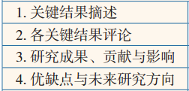
5. Discussion
Sensitivity to Noise.
The amplitude variation of the signal of interest is often much smaller than the noise inherent in the video. In such cases direct enhancement of the pixel values will not reveal the desired signal. Spatial filtering can be used to enhance these subtle signals. However, if the spatial filter applied is not large enough, the signal of interest will not be revealed (Figure 11).
In order to boost the power of a specific signal, e.g., the pulse signal in the face, we can use the spatial characteristics of the signal to estimate the spatial filter size.
The noise power σ2 can be estimated by examining pixel values in a stable region of the scene, from a gray card, or by using a technique as in [Liu et al. 2006].
This equation gives an estimate for the size of the spatial filter needed to reveal the signal at a certain noise power level.

Slide 21
5. Discussion
Eulerian vs. Lagrangian Processing
Because the two methods take different approaches to motion—Lagrangian approaches explicitly track motions, while our Eulerian approach does not-they can be used for complementary motion domains.
Lagrangian approaches, e.g. [Liu et al. 2005], work better to enhance motions of fine point features and support larger amplification factors, while our Eulerian method is better suited to smoother structures and small amplifications.
We note that our technique does not assume particular types of motions. The first-order Taylor series analysis can hold for general small 2D motions along general paths.
This equation gives an estimate for the size of the spatial filter needed to reveal the signal at a certain noise power level.

Slide 22
6. Conclusion
We described a straightforward method that takes a video as input and exaggerates subtle color changes and imperceptible motions.
To amplify motion, our method does not perform feature tracking or optical flow computation, but merely magnifies temporal color changes using spatio-temporal processing.
This Eulerian-based method, which temporally processes pixels in a fixed spatial region, successfully reveals informative signals and amplifies small motions in real-world videos.

Slide 23
Thanks for your attention

Slide 24
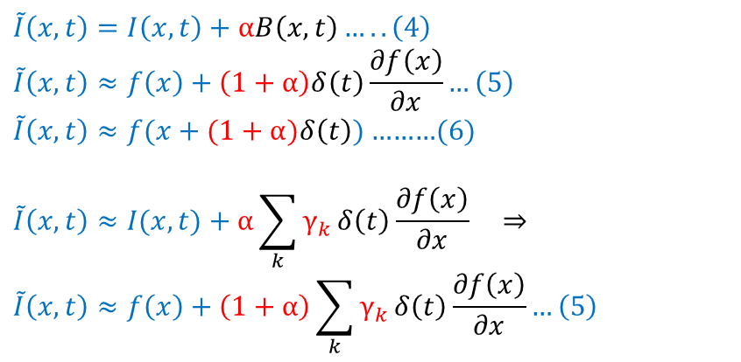
$$\tilde{I}\left(x,t\right)=I\left(x,t\right)+αB\left(x,t\right)…..\left(4\right)$$
$$\tilde{I}\left(x,t\right)≈f\left(x\right)+\left(1+α\right)δ\left(t\right)\frac{∂f\left(x\right)}{∂x}…\left(5\right)$$
$\tilde{I}\left(x,t\right)≈f(x+(1+α)δ\left(t\right))$………(6)
$$\tilde{I}\left(x,t\right)≈I(x,t)+α\sum_{k}{γ_{k}}δ\left(t\right)\frac{∂f\left(x\right)}{∂x} ⇒$$
$$\tilde{I}\left(x,t\right)≈f\left(x\right)+\left(1+α\right)\sum_{k}{γ_{k}}δ\left(t\right)\frac{∂f\left(x\right)}{∂x}…\left(5\right)$$

